Slide 1
Insurance in Super – Public Policy Statement Insurance in Superannuation Sub-Committee Presented by: Jeff Humphreys Amy McDonald Karen Lau

Slide 2
Important notice for all participants
2
This meeting is being conducted in accordance with Institute’s Code of Conduct and attended by members in their professional capacity.
It is acknowledged that professional members in their employed capacity, may be active market participants in their respective industries who may compete with each other as defined by competition law.
Participants are, therefore, reminded that in accordance with their competition law compliance obligations they should not:
discuss any matter that may be perceived as being cooperation by competitors in a market to influence that market;
discuss any matters that could be regarded as fixing, maintaining or controlling prices, allocation of customers or territories, coordinating bids and/or restricting output or acquisitions in any circumstances;
share commercially sensitive information relating to their employer; or
share information for an anti-competitive purpose.

Slide 3

Public Policy Statement
3
Purpose
Join at slido.com #1162820
First Public Policy Statement (PPS) on Insurance is Super
Public Policy Statements present the Institute’s current standing on important public policy issues:
‘Living documents’ – refined and updated as required by the changing policy environment
Useful for –
Media and public policy makers to know the Institute’s position on a topic
Spokespeople to use as needed
Volunteers to draw upon when drafting Institute submissions to consultations

Slide 4
Public Policy Statement
4
Jeff
Purpose
Key public policy positions of the Institute relating to group insurance in superannuation:
Aspects we support that are happening
Aspects we support that are not always happening
Suggesting/advocating areas for improvement

Slide 5
Public Policy Statement
5
Jeff
Process
Originated within a Superannuation and Investments Practice Committee (SIPC) discussion on retirement income policy and the gap in the Institute’s ability to respond to insurance in super issues that may arise
Actuaries Institute decided a public policy statement was required
Insurance in Super Sub-Committee (ISSC) took carriage for drafting the document and steering the PPS through the Institute review and approval process

Slide 6
Public Policy Statement
6
Jeff
Process
ISSC subgroup - draft and steer
Iterative review and approval process:
ISSC, SIPC and Life Insurance Practice Committee (LIPC)
ISSC, SIPC and LIPC subgroup
Public Policy Council Committee (PPCC) review and approval
Actuaries Institute review and approval

Slide 7
Public Policy Statement
7
Jeff
Structure
10 policy positions summarising a wide range of issues within 5 areas:
Support for Group Insurance in Superannuation
Strong Governance Standards
Simplify the System
Improve System Efficiency and Innovation
Effective Communication and Advice

Slide 8
Public Policy Statement
8
Jeff
Context
Risk – During their working life, around 30% of Australians will be financially impacted by disablement or the death of their partner
Efficient Risk Mitigation – Group insured death and disability benefits can be a very efficient and effective means of mitigating the financial loss impacting these individuals
Super Objective Legislation

Slide 9
Public Policy Statement
9
Amy
Context - Utilisation
Actuaries Digital Article¹ – The Value of Group Insurance in Superannuation: Utilisation
Total Risk – 30% of Australians experience financial impact from disability/death during working life
Disability Risk – 24% of members experience either early retirement or interrupted work patterns
Validation – Survival techniques were employed to analyse the probability of claim over the working life (age 18-66 inclusive). The results were validated using published premium rate data.
1. https://www.actuaries.asn.au/research-analysis/the-value-of-group-insurance-in-superannuation-utilisation

Slide 10
Support for Group Insurance in Super
Amy
The Actuaries Institute supports:
how the legislated Objective of Superannuation recognises the role of group insurance in providing members with a dignified retirement.
1

Slide 11
Objective of Super
11
Amy
Insurance as Cornerstone of Dignified Retirement
Legislative Recognition – Explanatory Memorandum² of the Superannuation (Objective) Act 2024 recognises the role of group insurance, providing a "safety net"
Broad Reach – Provides broad reach with affordable access
Valuable Protection – Delivers "valuable protection to community and meets member’ needs at reasonable cost“
Dignified Retirement – Supports a dignified retirement under all lifetime scenarios
2. https://classic.austlii.edu.au/au/legis/cth/bill_em/sb2023287/memo_0.html

Slide 12
Provision of Automatic Default Cover
12
Amy
Efficient Protection for all Members
Automatic Access – Automatic default cover provides access to insurance for all members, as deemed appropriate by the trustee.
No Underwriting – No health evidence or underwriting required
Adaptive Coverage Controls – Cover available on eligibility and (as a default) switches off during long periods of unemployment when considered with PYS legislation

Slide 13
Support for Group Insurance in Super
Karen
The Actuaries Institute supports:
2
the trustee structure as the best structure for insurance in superannuation to achieve the Objective of Superannuation; and
the role of trustees to assess the value of default death and disability cover to the member and to balance a dignified retirement under various lifetime health scenarios, in conjunction with the impact of premiums on member retirement income.
4

Slide 14
Benefits of the Trustee System
14
Karen
Trustee System – Value Add
Market Power – Trustee is better able to negotiate on risk pooling, premiums, terms and service levels in the best financial interest of members.
Advocacy – Trustee can advocate for claimants
Monitoring & Oversight – Trustees can actively monitor insurance arrangements for sustainability; assess the appropriateness of design, terms and conditions for all covers; cover represents value for money
Minimise Cross-Subsidisation – Ensure premiums reflect the estimated member cohort risks and manage risks of voluntary cover on default premiums
Market Discipline – Review Insurance market through a market tender and benefit structures on a regular basis.

Slide 15
Benefit Designs Set by the Trustee
15
Karen
Trustee-Led, Member-Focused Insurance Design
Trustee-led Design –
Set by trustee to recognise fund members’ profile
Regulation & Legislation Solutions imposed only if product design concerns and unsatisfactory industry response
Benchmarking Design – Unlikely optimal for members; does not inform trustee on best financial interests

Slide 16
Support for Group Insurance in Super
Jeff
The Actuaries Institute advocates:
for improvements as to how trustees strike an appropriate balance between the costs and benefits of providing insurance cover to members.
3

Slide 17
Costs and Benefits
17
Jeff
Striking the Right Balance
SIS Act – SIS legislation currently has a design, a cost and an erode covenant (and insurer selection and claims covenant).
“(a) …… insurance strategy for the benefit of beneficiaries …..
(iii) the basis for the decision to offer or acquire insurance of those kinds, with cover at that level or levels, having regard to the demographic composition of the beneficiaries of the entity
(b) to consider the cost to all beneficiaries of offering or acquiring insurance of a particular kind, or at a particular level;
(c) to only offer or acquire insurance of a particular kind, or at a particular level, if the cost of the insurance does not inappropriately erode the retirement income of beneficiaries;

Slide 18
Costs and Benefits
18
Jeff
Striking the Right Balance
Erode is negative and may be given undue weight by trustees. Has resulted in benefit reductions in real terms and in absolute terms.
Reflection of Benefit – Better reflect the nature of the premium as ‘removing part or all of the financial risk of the member’, not an erosion of their retirement benefit.
30% - need to better reflect the risk of the membership
Cost – Support ‘cost’ expressed as a ‘reduction in retirement income’

Slide 19
Costs and Benefits
19
Jeff
Striking the Right Balance
Institute suggests:
Replacing the cost and erode covenant with a covenant focused on the trustee requirement to determine an appropriate balance between cost and benefit

Slide 20
20
Jeff
SIS Insurance Covenants – Proposed Change
Sections 52(7) of the Superannuation Industry (Supervision) Act
“(b) to consider the cost to all beneficiaries of offering or acquiring insurance of a particular kind, or at a particular level;
(c) to only offer or acquire insurance of a particular kind, or at a particular level, if the cost of the insurance does not inappropriately erode the retirement income of beneficiaries”
RED TO GREEN
“(b) to consider and determine an appropriate balance between the cost and the benefit, to all beneficiaries, of offering or acquiring insurance of a particular kind and at a particular level under various lifetime health scenarios, such as working to normal retirement age, becoming disabled or dying before normal retirement age. The cost of insurance is to be measured as the reduction in retirement income.”

Slide 21
21
Q&A
Join at slido.com #1162820

Slide 22
Strong Governance Standards
Karen
The Actuaries Institute supports:
5
Board competency in the governance of insurance in superannuation, including where relevant strong operational risk management practices in the use of third-party providers.

Slide 23
Improve Governance
23
Karen
Elevate Board Governance
Board competency – Recognise insurance in superannuation as a core and separate board competency to seek, monitor and report
Oversight and reporting – Monitor and report board insurance competency to members
Management expertise – Ensure trustee’s management and their advisers have insurance in superannuation expertise

Slide 24
Managing Third Parties
24
Karen
Uplift Trustee Responsibilities on Third Party Agreements
Operational risk – The Institute supports strong operational risk management practices as set out in CPS 230
Accountability – Ensure third-party rectification clauses are appropriate and enforced; responsible parties should meet full cost of errors
Data integrity – Include compulsory data integrity checks or audits in insurance service agreements

Slide 25
Amy
Simplify the System
The Actuaries Institute supports:
a simpler more integrated system to assist in making death and disability designs easier to understand, engage with, administer and communicate to members, including advocating for a review of start of cover rules, more accurate insurance product names and descriptions, and stamp duty rationalisation.
6

Slide 26
Simplification and Streamlining
Amy
26
SIS, Tax & Superannuation Guarantee for Disability Benefits and Stamp Duty
Simplify:
SIS, Tax & Superannuation Guarantee alignment for disability benefits
Stamp duty rationalisation across states/territories
Benefits:
Reduced administrative burden and RISK!
Improved member understanding and engagement

Slide 27
Integration – “No Gaps, No Overlaps”
27
Amy
Creating Seamless Protection Across All Benefits
Inefficiency - There could be various disability benefits supporting members, such as government disability schemes (e.g. Newstart, DSP), workers compensation, NDIS, CTP and other insurance policies
Integrate and Simplify - The Institute sees opportunity for:
Alignment of payment periods,
Industry standards on who pays when,
Consideration of offsets.

Slide 28
Start of Automatic Insurance Cover Rules
28
Jeff
PMIF
PMIF and Member Outcomes – PMIF has produced unintended consequences:
Members working in a Dangerous Occupation are covered in some funds but not others
Additional and substantive pre-existing condition exclusions
Start of cover
Also impacting claim assessment duration
Complexity reduces member understanding

Slide 29
Start of Automatic Insurance Cover Rules
29
Jeff
PMIF Funds – Can a member understand start of cover?
Complexity - reduces member understanding, delays claim payments
“You’re eligible to receive basic cover automatically if you’re 25 or older; and your super balance reaches $6,000; and you’ve received an employer super contribution after you meet both age and balance requirements (other conditions apply).”
“Once you’re eligible………….., your basic cover will start on the latest of these dates:
the date you turn 25, or
the date your balance first reaches $6,000, or
the date you started working for your employer, or
the start date of the payment period that applies to your first employer super contribution (after you meet both age and balance requirements), or
120 days before we receive your first employer super contribution (after you meet both age and balance requirements).“

Slide 30
Start of Automatic Insurance Cover Rules
30
Jeff
PMIF Funds – how is a member to understand exclusions?
PEC’s exclusions reduce member understanding, delay claim payments
And the member pays the full premium for Limited Cover
“Your basic cover is limited cover if:
You haven’t been in active employment for 60 consecutive days ending on the date that your basic cover starts or restarts.
You’ve been unable to work because you’re ill or injured, for 10 or more consecutive days in the 12 months immediately prior to when your basic cover starts or restarts.
Your basic cover …….will be limited cover until you’ve been in active employment for 60 consecutive days. “

Slide 31
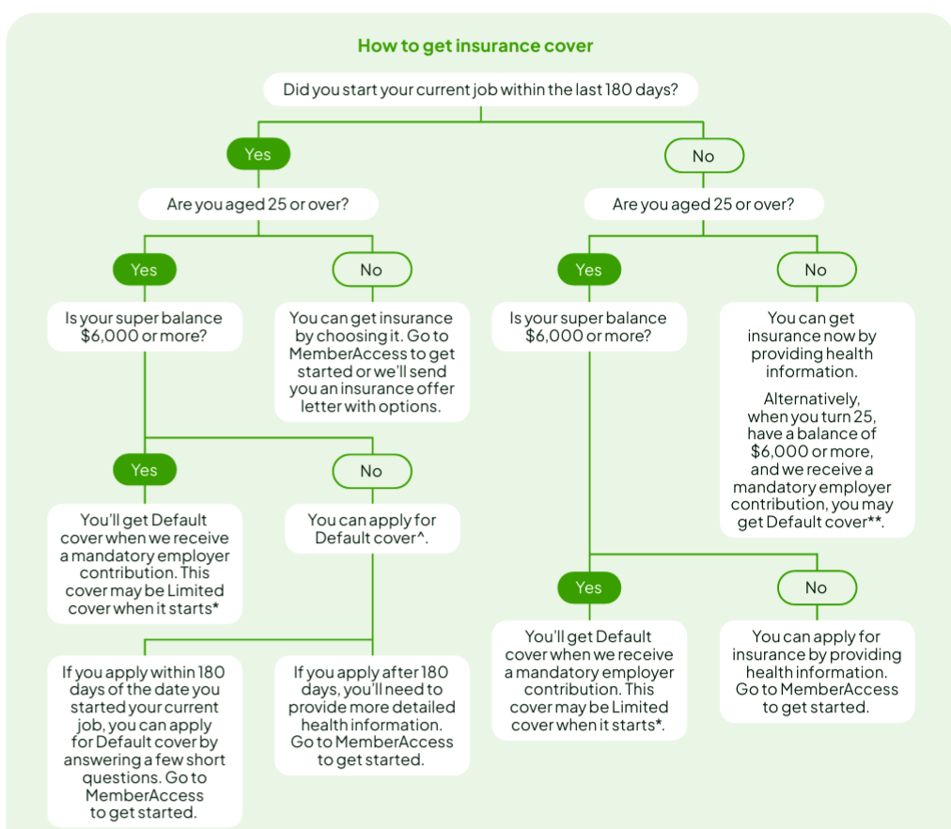
Start of Automatic Cover Rules
31
Jeff
Start of Cover Rules – PMIF Funds

Slide 32
Start of Automatic Cover Rules
32
Jeff
Review Start of Cover Rules
Review the need for a legislated start of cover rule:
Optimise trustee design reflecting their membership eg Cbus
PMIF possibly outdated with YFYS (staple member,“fund for life”)
Consider Low-level Death/TPD cover for all low balance members when joining workforce:
Similar to admin fee cap (3% until account balance reaches $6,000)
Could be fully or partially subsidised at very low cost at around $2 per member p.a. for $10,000 cover (until account balance reaches $6,000)

Slide 33
Product Names and Descriptions
33
Jeff
Member understanding – description fits the benefit
IP – Through its offset provisions is often a supplement to other disability support benefits
TPD – is a probability estimate, and does not mean “never work again” or “total and permanent disablement”
TPD definitions vary widely - between funds and within funds as does the associated premium
Institute suggests standardise to the legislated definition

Slide 34
34
Q&A
Join at slido.com #1162820

Slide 35
Improve System Efficiency & Innovation
The Actuaries Institute supports and advocates for:
7
efficient use of superannuation savings to provide death and disability benefits, including the appropriate design and use of indemnity cover, service structures and effective standards, terminal illness benefits, risk pooling and insurance reserve arrangements, health and wellbeing initiatives, exclusions and restrictions and insurer selection practices.

Slide 36
Indemnity Cover and Efficient Use of Premiums
36
Jeff
IP as the Primary Disability Benefit
Indemnity cover
Meets financial needs or part thereof
Optimises the limited premium dollars available
Key sustainability requirement
Income stream to replace lost income stream - IP
Claim cause

Slide 37
Service Structures – Best of Breed
37
Amy
Enhancing Member Experience and Outcomes
Service – Provision of structures to provide best member outcomes
Continuous Review & Improvement of Services – efficient, honest and fair
Institute Supports FSC Standard 28 (Claims handling standard for Superannuation Funds); Opportunity for similar compulsory standards to extend to other services

Slide 38
Terminal Illness Benefits
38
Jeff
Purpose
2 components - account balance and insured benefit, if any
Origins in early release
Is Terminal Illness insurance indemnity cover?
Key question Is the Terminal Illness benefit the bringing forward of the death benefit?
Who receives the benefit?
Is the sum insured the same?
What proportion die within 24 months?
Default death sum insured set with financial dependents in mind?
20%+ of death insurance claims

Slide 39
Terminal Illness Benefit
39
Jeff
Purpose
What other ways does the terminally ill member receive fund support?
IP benefits, many funds
Early release - financial hardship and disability
Insured Death Benefit for Financial Dependents – Institute proposes a middle position - the insured component be retained for the financial dependents while the member receives account balance

Slide 40
Leveraging the Benefits of Pooling Risk
40
Jeff
Alternatives
Risk Sharing – Pooling involves sharing a financial risk (by paying premiums) that all members in the pool face but only a few will experience (claimants).
Pooling Arrangements – Many pooling arrangements are possible and used as determined by the trustee
Alternatives – should be able to be considered

Slide 41
Cross Subsidy
41
Karen
Addressing Cross-Subsidy Misconceptions
Clarity – The Institute supports initiatives that provide clearer understanding of cross subsidy in group insurance; often misused and misunderstood
Definition – Premiums not reflecting cohort risk cause cross-subsidy; e.g. young versus old members
Protection – ‘No benefit received’ ≠ Cross-Subsidising; all receive protection for premiums paid
Trustees Responsibility – Play a key role in pricing and design to reduce material cross subsidies that harm value or price stability
Limitation – Cross-subsidies cannot be fully eliminated, but must be justified, fair and preserve value for all cohorts.

Slide 42
Insurance Reserve
42
Karen
Maintain Value, Governance and Equity
Trustee Use – Supported under actuarial advice to lower long-term premiums and stabilise premiums
SPG 515 Compliance – Use only for insured benefit provision and administration, not general fund expenses
Excess Reserves – Release promptly to minimise generational cross-subsidy
Reserving Policy – Consider fairness and equity across cohorts and over time using actuarial principles

Slide 43
Health and Wellbeing Initiatives
43
Amy
Enhancing Member Outcomes
Institute supports:
Appropriate initiatives where trustees believe they promote the best financial interests of members
Flow on impacts to fund membership, claim rates and premiums.
Return to work (gainful employment) claims management initiatives including rehabilitation strategies
Faster disability claim reporting for earlier intervention

Slide 44
Exclusions, Restrictions & Premium Rating Factors
44
Karen
Fair Pricing for Default Cover
Exclusions & Restrictions – Supported only if, with the premium, justifiable, fair and reasonable for affected members
Occupational Exclusions & Restrictive Disability Definitions – Supported removal in default cover, subject to FSC Standard No. 27 exceptions
Rating Factors – Support use only where justifiable, fair, reasonable, based on adequate data and demonstrated direct causal link to expected claims cost

Slide 45
Insurer Selection
45
Karen
Strengthening Policy and APRA Guidance
Insurer Selection Policy – Trustee’s policy should include max period between tenders and reason for period
APRA Guidance (SPG 250) – Supports identifying practices when beneficiaries’ best financial interests aren’t prioritised – including a lack of market tender
Tender Frequency – APRA guidance should set fixed tender period; current “industry average” is hard to calculate; no public data

Slide 46
Improve System Efficiency & Innovation
Karen
The Actuaries Institute supports:
improvements to insurance data collection, retention and reporting with appropriate safeguards to enable trustees to better tailor cover, and to charge more accurate and fairer premiums.
8

Slide 47
Improve Data
47
Karen
Collection, Retention and Reporting
Extend SPS 250 P15 – The Institute suggests extension to require insurance data from 2012; five years is too short for TPD to understand claims experience and pricing
ASIC Report 806 – the Institute supports the suggested trustee actions: ‘Taking ownership of death benefits: How trustees can deliver outcomes Australians deserve, to improve insurance data collection, retention and reporting.’

Slide 48
Additional Data
48
Karen
Elevate Data, Drive Better Member Outcomes
Occupation Data – Trustees should be permitted, with safeguards, to use government-held member occupation data to tailor cover and improve premium accuracy
Industry Studies – The Institute supports regular industry studies of group insurance claims experience, facilitated by regulators if required
Regulatory Role – Regulators should ensure studies capture claim loss ratios, claims reporting patterns, causes of claim (TPD and IP) and IP claim duration.

Slide 49
Effective Communication and Advice
Karen
The Actuaries Institute supports:
9
the role of trustees to deliver and improve the standard of communication to members and the broader community about insurance in superannuation.

Slide 50
Communication
50
Karen
Improve Communication to Members
Explain Purpose & Provide Info – Trustees should explain the purpose of insurance in super and provide additional information to members including:
Estimate of full needs cover and proportion provided by default cover
Reasoning of design and cover levels;
Trustee’s design objectives and limitations; and factors for members to assess suitability
To help members review and adjust their coverage, as appropriate

Slide 51
Communication
51
Karen
Elevate Communication Standards
SIS Act – Inclusion of communication requirements covenants to inform and improve member awareness
Insurance Communication Strategy – Required and set out in the Insurance Management Framework; Should be effective and fit for purpose for various cohorts
Member Documentation – Set out clear purpose for benefits: why provided and why set at the level provided
Plain English – Support plain English descriptors and consistent terminology across funds

Slide 52
Communication
52
Karen
Elevate Communication Standards
Benefit Naming – Review names to reflect benefits provided; restrict "TPD" to legislated definition
Standardised Disclosures – supports standardisation of death and disability benefits communication and disclosures
Other Benefits – Trustees should disclose any other possible entitlements to claimants

Slide 53
PYS
53
Jeff
Legislated communication
Legislated requirements – May be inadequate in some cases
Communication of end of cover –
Multiple communication channels
Additional frequencies
Alternative communication wording

Slide 54
54
Q&A
Join at slido.com #1162820

Slide 55
Effective Communication and Advice
Jeff
The Actuaries Institute supports:
10
policies and innovations that allow members to receive appropriate guidance and financial advice on death and disability cover, including the use of calculators to assist members in determining their cover needs.

Slide 56
Financial Advice
56
Jeff
Guidance on Cover Levels
Accessibility to guidance – More accessible and affordable
Including capability of financial advice and guidance tools
Disclosure
The extent of coverage provided by the default design relative to the member’s needs; and
Methods and assumptions used by the trustee.
Member Empowerment – Helps to empower members and their advisers to make informed decisions on cover levels

Slide 57
Insurance Cover Level Calculators
57
Jeff
Institute Supports Improved Guidance
Funds Comparison – Wide variation of results, for the same member profile, between funds
Cover Basis – Institute suggest indemnity cover (salary) rather than estimated expenses
Full Disclosure for cover levels and types:
Algorithms
Methods
Assumptions
Responsible party

Slide 58
58
Feedback Poll
Join at slido.com #1162820

Slide 59
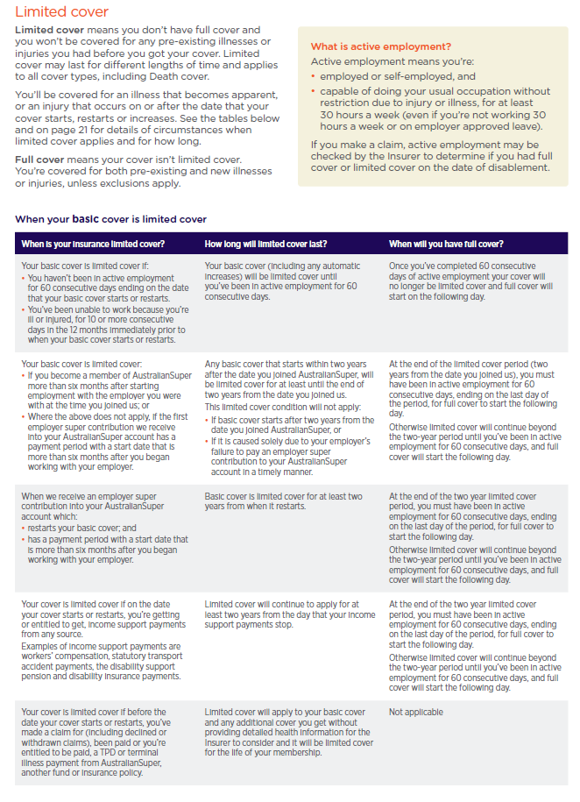

Start of Automatic Insurance Cover Rules
59
Jeff
PMIF – added complexity and PEC’s

