Slide 1
Client Zero for AI: our journey and experience
Bartosz Piwcewicz
11 June 2025

Slide 2
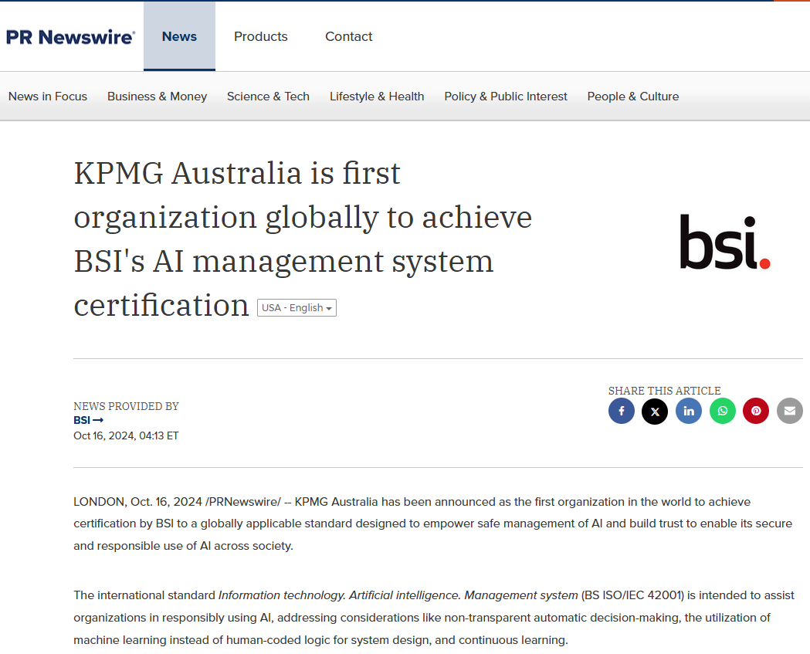
"We will be the first company in the world to achieve ISO 42001 certification."
That was our ambitious goal in February 2024.
By October 2024, we made it reality.

Slide 3
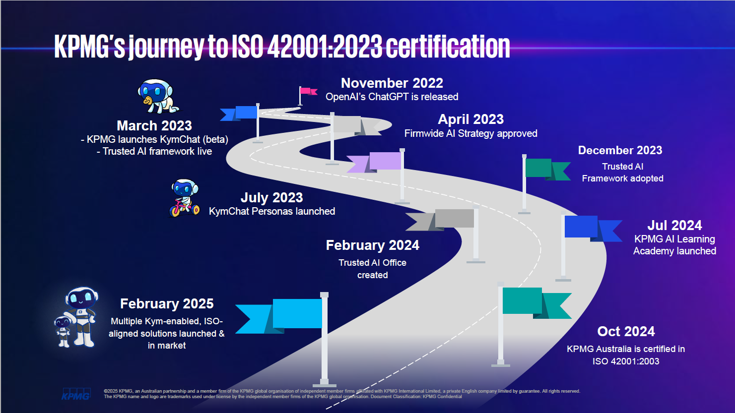
Page heading

Slide 4
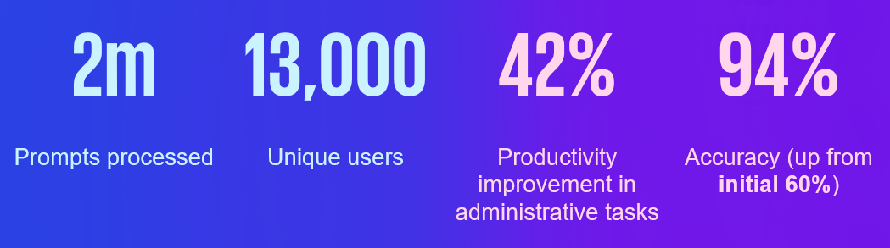
The journey: three distinct phases
Phase 1 - Phase 1: Emergency Response (March 2023)
The Challenge: ChatGPT launched, security blocked access, media attention
Our Response:
Leveraged Microsoft partnership for secure version
Launched KymChat internally in weeks, not months
Moved from denial to deployment in record time
Lesson Learned: Speed matters, but security can't be compromised
Phase 2: Strategic Scaling (July 2023 - June 2024)
The Evolution:
Extended KymChat to clients (July 2023)
Developed KymTax for tax specialists (June 2024)
Built Trusted AI framework and governance
Achieved near 100% employee participation
Key Metrics:
Phase 3: Certification Excellence (February - October 2024)
The Commitment:
Formed dedicated team for ISO 42001 certification
Comprehensive audit of AI governance
Integration of Trusted AI principles into daily operations
World-first achievement in October 2024

Slide 5
Our "Client Zero" philosophy
Why "Client Zero"?
We use ourselves as the testing ground for AI solutions
Every tool we deploy internally becomes a case study for clients
We "walk the talk" before advising others
Our lessons learned become client value propositions
The Human-Centric Approach
Core Principle: AI augments, never replaces human capabilities
Evidence in Action:
76% of CEOs believe AI won't impact staff levels
Focus on freeing people for higher-value work
Emphasis on creativity and strategic thinking
Continuous upskilling and adaptation
* Statistics for Australian CEOs from the KPMG Global CEO Outlook 2024

Slide 6

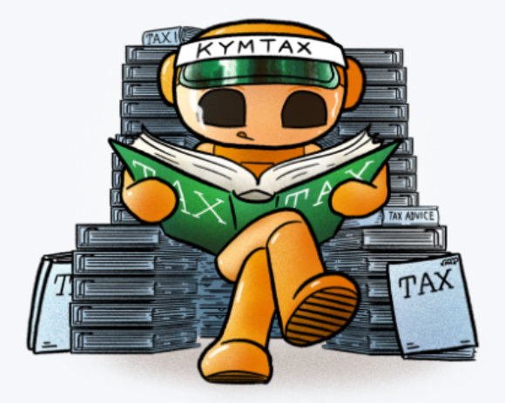
Breakthrough use cases
KymChat:
Our Foundation AI Agent
Business Impact:
Rapid document analysis and summarisation
Client communication drafting
Research acceleration
Knowledge management enhancement
Security Features:
Data never leaves KPMG environment
Full audit trail
Role-based access controls
Compliance with privacy regulations
KymTax:
Specialised AI for Tax Services
Innovation: One of the first generative AI applications globally for tax services
Capabilities:
Research tool combining internal knowledge base
Content generation for client advice
Real-time regulatory updates integration
Precedent and training guide analysis
Value Proposition:
Reduced research time by 60%
Enhanced advice quality
Always current with latest developments
Personal research assistant for each tax professional
Microsoft Copilot Integration
42% improvement in administrative efficiency
Automated meeting summaries
Document consolidation
Enhanced collaboration workflows

Slide 7
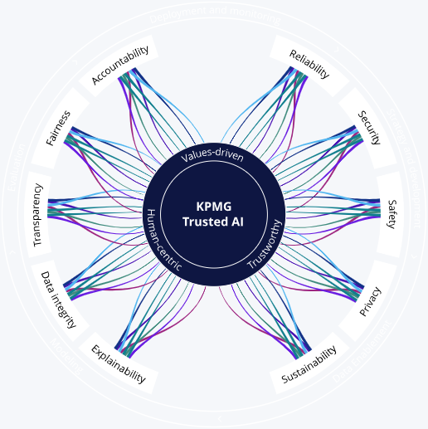
The Trusted AI framework: our foundation
Three Core Principles:
Ten Ethical Pillars:
1.
Values-Led
Guided by KPMG's ethical standards
2.
Human-Centric
Prioritising human impact
3.
Trustworthy
Ethical standards compliance
Open, inclusive culture
Purpose-driven approach
Community-focused outcomes
Empowering and augmenting capabilities
Unleashing creativity
Improving productivity meaningfully
Privacy and data protection
Confidentiality arrangements
Transparent operations

Slide 8
Governance: the secret to success
Eight-Element Governance Framework
1. Leadership & Accountability
Board Level: Risk appetite, strategic alignment, oversight responsibilities
C-Suite: Strategy development, cross-organisational collaboration, culture modelling
Management: Implementation, capability building, integrated risk management
2. Policies & Standards
Ethical use principles
Data lifecycle management
Existing policy alignment with AI considerations
Transparency and explainability requirements
3. Risk Management
Privacy impact assessments
Security risk evaluations
Vendor management protocols
Escalation and challenge processes
4. Data Governance
Quality assurance throughout AI lifecycle
Security protocols
Ethical data use compliance
Regulatory alignment
5. Cross-Functional Collaboration
Diverse expertise integration
Regular interdisciplinary meetings
Shared ownership and accountability
External independent expert engagement
6. Supporting Infrastructure
AI system inventories
Robust data governance platforms
Cyber security policy evaluation
Legacy system modernisation
7. Culture, Training & Awareness
Ethics-committed culture
Comprehensive training programs
Role-specific AI education
Continuous improvement mindset
8. Continuous Evaluation
Regular effectiveness assessments
Stakeholder engagement
Performance monitoring against metrics
Regulatory alignment reviews

Slide 9
Lessons learned: the hard-won insights
Lesson
Challenge
Solution
Outcome
1. Start with Security, Scale with Confidence
Balancing innovation speed with security requirements
Leverage existing partnerships and infrastructure
Secure deployment in weeks, not months
2. Accuracy Requires Investment
Initial 60% accuracy rate was insufficient
Develop curated datasets and custom libraries
Achieved 94% accuracy through dedicated effort
3. Culture Change is Everything
Employee resistance and job security concerns
Transparent communication, hands-on experimentation, leadership modelling
Near 100% participation rates
4. Governance Must Evolve
Traditional risk frameworks inadequate for AI
Develop AI-specific governance structures
World-first ISO 42001 certification
5. Specialisation Drives Value
Generic AI tools provide limited business value
Develop purpose-built applications like KymTax
Significant productivity gains and service enhancement

Slide 10
Next steps: where we’re heading
Continue transforming our business and how we deliver our services and products
Add more specialised AI applications for specific domains and industries
Expand our autonomous AI systems (i.e. agentic AI) with human oversight
Create fully integrated AI-augmented workforce

Slide 11
A potential approach if your organisation is starting the journey
Getting Started: The First 90 Days
Assess Current State: Conduct AI readiness evaluation
Building Momentum: Months 4-12
Scale Successful Pilots: Expand proven use cases
Achieving Excellence: Year 2+
Pursue Certification: Consider ISO 42001 or equivalent standards
Establish Governance: Form AI oversight committee
Start Small: Pilot with low-risk, high-value use cases
Engage Stakeholders: Transparent communication about AI strategy
Invest in Training: Build organisational AI literacy
Develop Policies: Create AI-specific governance frameworks
Enhance Security: Implement robust data protection measures
Measure Impact: Establish metrics and monitoring systems
Prepare for Regulation: Align with emerging standards
Innovate Continuously: Develop custom AI solutions
Share Learnings: Contribute to industry best practices
Transform Culture: Embed AI thinking across organisation
Lead Market: Become recognised AI implementation leader

Slide 12
Key success factors
Technical Excellence
Secure Infrastructure: Protection without hindering innovation
Quality Data: Clean, representative, well-governed datasets
Scalable Architecture: Systems that grow with demand
Integration Capability: Seamless workflow incorporation
Organisational Readiness
Leadership Commitment: Visible, consistent executive support
Change Management: Structured approach to cultural transformation
Skills Development: Comprehensive training and upskilling programs
Performance Metrics: Clear measurement and accountability systems
Risk Management
Proactive Governance: Anticipate and address challenges early
Regulatory Compliance: Stay ahead of evolving requirements
Ethical Considerations: Embed responsible AI principles
Continuous Monitoring: Regular assessment and improvement

Slide 13
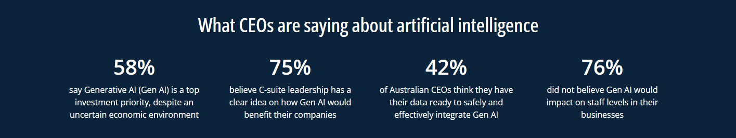
Parting thought…
The future belongs to organisations that can harness AI responsibly and effectively.
Let’s be involved in this conversation and shape it.
* Statistics for Australian CEOs from the KPMG Global CEO Outlook 2024
13

Slide 14
Thank you
Actuaries Institute
actuaries.asn.au

