Slide 1
CHANGING DEMOGRAPHICS OF DISABILITY & AUTISM
Maathu Ranjan
Australian National University
June 2025

Slide 2
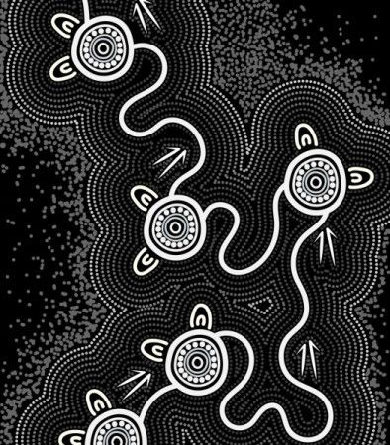
I acknowledge the traditional custodians of the lands and waters where we live and work, travel, and trade.
We pay our respect to the members of those communities, Elders past and present, and recognise and celebrate their continuing custodianship and culture.

Slide 3
OUTLINE
Background
Prevalence
Compositional Analysis
Australian Population
New diagnoses
Projection of Future Demand
Undiagnosed population
Projected prevalence
Implications for a New Age Actuary
Social policy
Insurance industry
Actuarial profession

Slide 4
DISABILITY IN AUSTRALIA

Slide 5
Global Shift in Disability Policy
Disability
“Long-term physical, mental, intellectual or sensory impairments which when interacting with various barriers, may hinder their full and effective participation in society on an equal basis with others.”
United Nations Convention on the Rights of People with Disability (UNCRPD)
Adopted in 2006 and entered into force in 2008, marked a fundamental shift in the global understanding of disability, moving away from the medical and welfare models to a human rights-based model.

Slide 6
Models of Disability
Charity Model
Medical Model
Social Model
Rights Based Model
Charity/Welfare/Medical Model (Pre 2008)
Social/Rights Based Model (Post 2008)
Focus on diagnosis and treatment of disability
Institutional and segregated care with limited access to mainstream services
Financial assistance and benefits through welfare system
Charity organisations are funded to provide services in the community
Focus on the rights and dignity of people with disabilities, advocating for full participation and inclusion in society.
System transformation to remove societal barriers that prevent people with disabilities from fully engaging in life

Slide 7
Prevalence of Disability in Australia
Source: ABS Survey of Disability. Ageing and Carers (2003-2022)

Slide 8
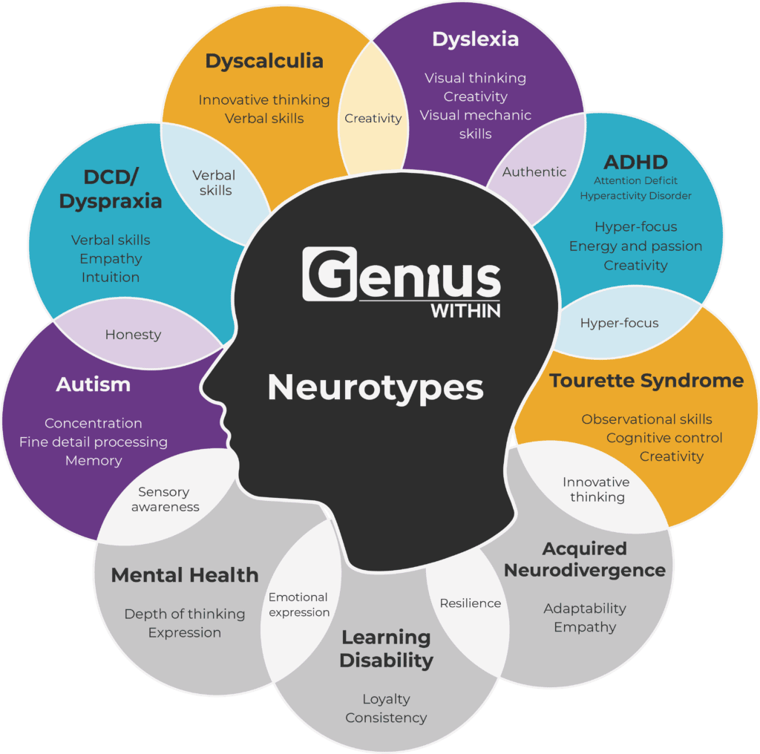
Neurodiversity in Australia
Neurodiversity is a broader concept recognising natural variations in brain function and cognition, including conditions like autism, ADHD, dyslexia, and more. Many who are neurodiverse, identify as such without a formal diagnosis of a condition.
Globally, it is estimated that 1 in 7 people are neurodivergent.
Other studies estimate that 15 - 20% of children show signs of neurodiversity at school.
When looking at the workplace, 8% of the Australian Public Service identify as neurodivergent. It is higher at 12% in the Australian Bureau of Statistics.
Neurodiversity
Source: https://geniuswithin.org/what-is-neurodiversity/

Slide 9
Support for Neurodiversity in Australia
NDIS & Disability support
Diagnosed
Undiagnosed
Education support
No additional support
Health support
Employment support
Neurodiversity
Diagnosed
Some conditions are mostly managed medically or pharmacologically (e.g. ADHD, Tourette syndrome) with support through Australia’s healthcare system.
People with disabilities that stem from neurological conditions (e.g. autism, intellectual disability) can minimise social barriers associated with having a disability through non-pharmacological supports (e.g. therapy, assistive devices, education) through Australia’s NDIS and disability support system. A disability diagnosis is needed to access these supports.
Other children who are developmentally delayed (i.e. have not reached expected developmental milestones) may also benefit from early access to disability supports. Developmental delay is clinical descriptor not a diagnosis and can be an early sign of a neurodiverse condition, but can also be temporary or an early diagnosis that may evolve over time.

Slide 10
NDIS Participation
Source: National Disability Insurance Agency (2025)

Slide 11
Autism prevalence in Australia
Source: ABS Survey of Disability. Ageing and Carers (2009-2022)

Slide 12
COMPOSITIONAL ANALYSIS

Slide 13
Australian Population by Age
All Disabilities
Autism

Slide 14
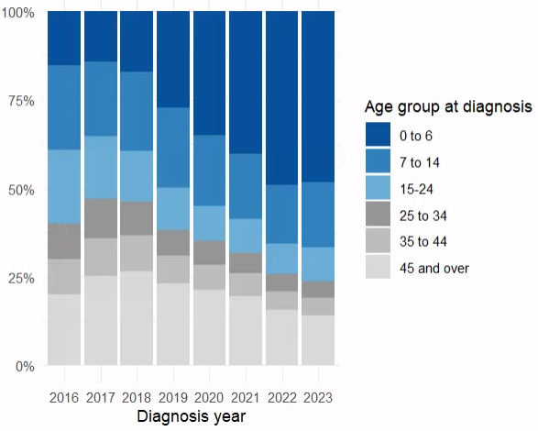
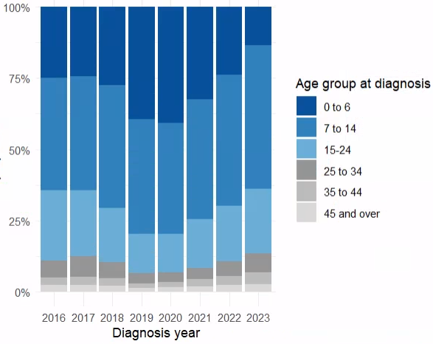
New Diagnoses by Age
All Disabilities
Autism

Slide 15
Australian Population by Gender
All Disabilities
Autism

Slide 16
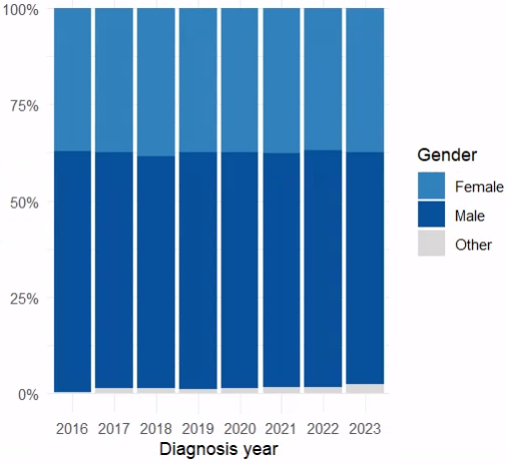
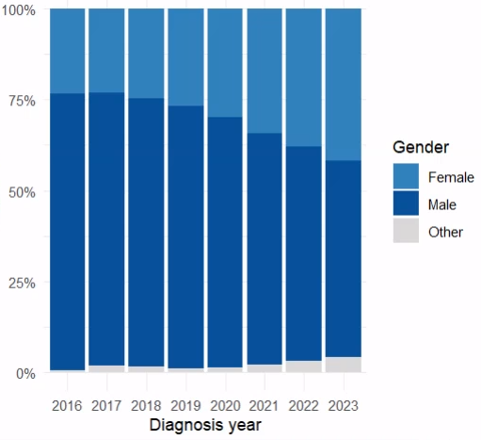
New Diagnoses by Gender
All Disabilities
Autism

Slide 17
Australian Population by Functional Capacity
All Disabilities
Autism

Slide 18
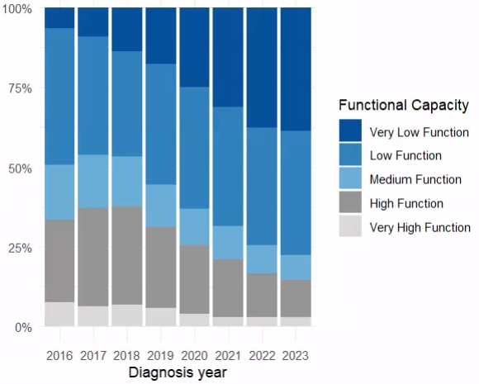
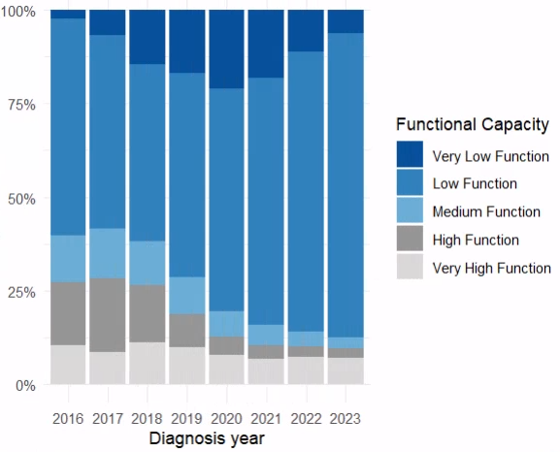
New Diagnoses by Functional Capacity
All Disabilities
Autism

Slide 19
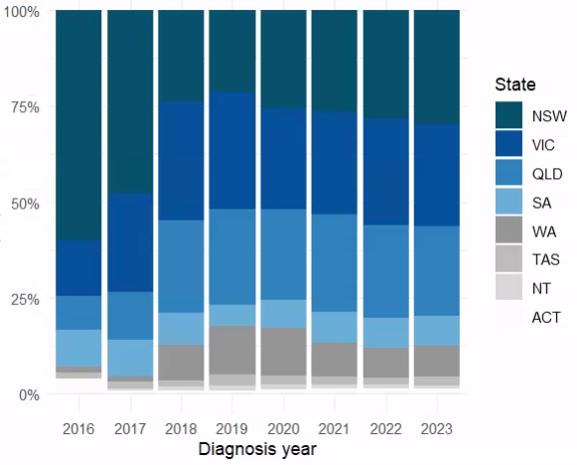
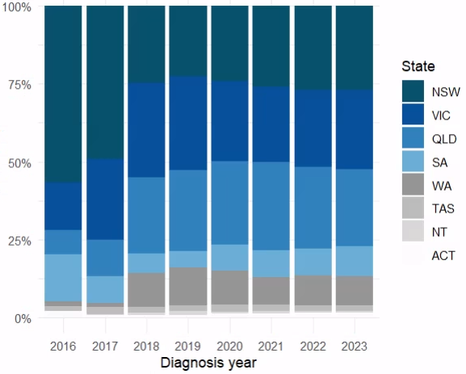
New Diagnoses by State
All Disabilities
Autism

Slide 20
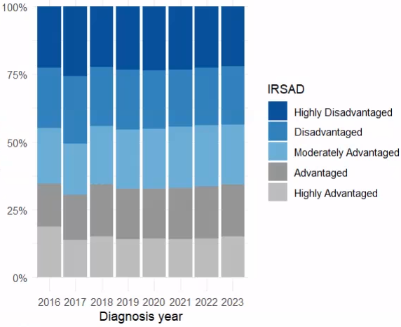
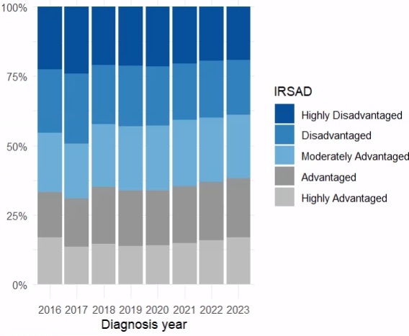
New Diagnoses by Socio Economic Index For Areas (SEIFA)
All Disabilities
Autism

Slide 21
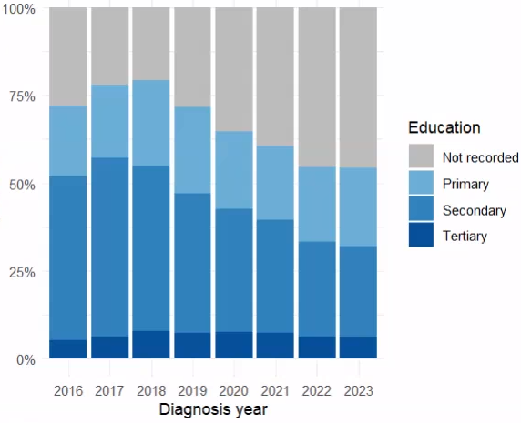
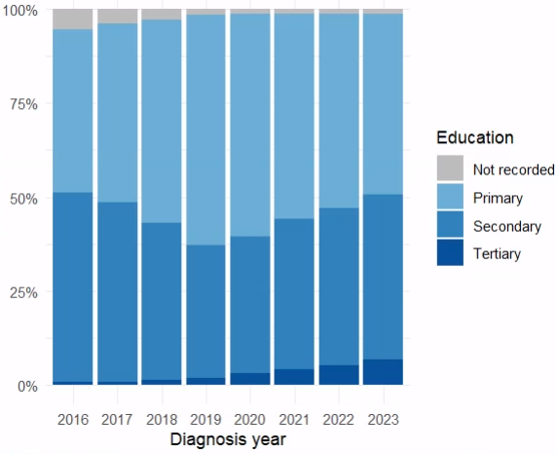
New Diagnoses by Highest Education Level
All Disabilities
Autism

Slide 22
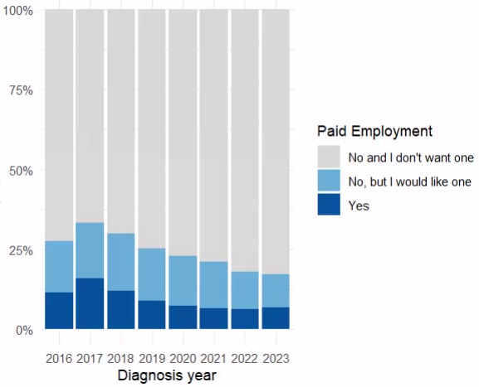
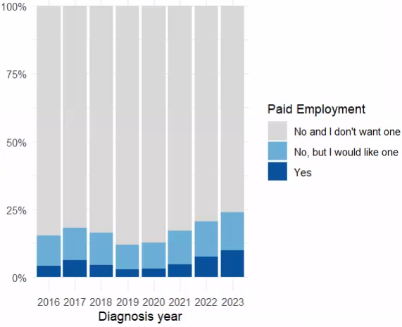
New Diagnoses by Employment
All Disabilities
Autism

Slide 23
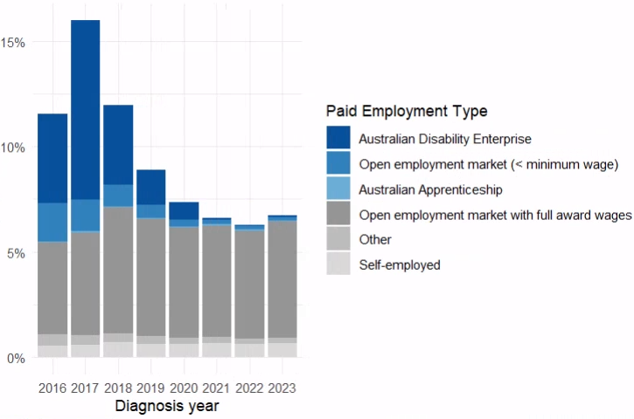
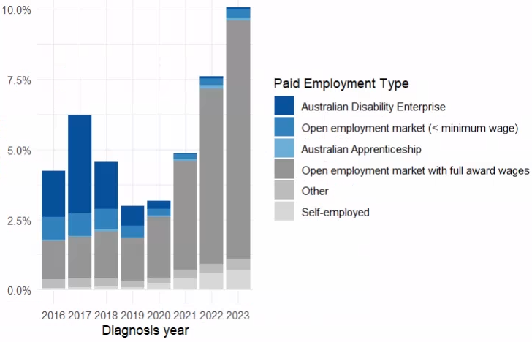
New Diagnoses by Employment Type
All Disabilities
Autism

Slide 24
Summary of Findings
All Disabilities
Autism
Increasing recognition of disability among young children
Gender ratio remains stable
Significant increase in low-functioning individuals, with a corresponding decrease in high-functioning
Diagnoses are evenly distributed across both advantaged and disadvantaged socioeconomic areas
Rising number of individuals with no recorded education level likely due to being under school age (<6 years)
Falling proportion in or seeking paid employment, reflecting the younger age profile as levels in open, self and other employment remains stable
Increasing number of diagnoses among older individuals
Growing proportion of females being diagnosed
Shift from predominantly low-functioning to more medium and high-functioning presentations
More diagnoses coming from socioeconomically advantaged areas
Rising levels of tertiary education among newly diagnosed (though primary education still most common overall)
More people in paid employment, especially in the open labour market

Slide 25
PROJECTED DEMAND FOR DISABILITY SUPPORT

Slide 26
Estimating Undiagnosed Autism
We use cohort-based methodology from O’Nions et al. (2023) to estimate undiagnosed prevalence of autism in the community.
An estimated 60-70% of the autistic community in the UK were undiagnosed. Australia is similar with 75% at 2022, reflecting increases in diagnoses at younger ages.
Prevalence continues to increase, with an implied annual growth rate of 9% (SDAC) and 15% (NDIS participants with autism).

Slide 27
Projected Autism Rates by Functional Capacity
SDAC Growth Rate of 9% Applied

Slide 28
Projected Autism Rates by Functional Capacity
NDIS Growth Rate of 15% Applied
    Currently, 1% of the population are autistic and diagnosed, where 80% have high or very high support needs.
    We estimate that prevalence could be 4% if you account for the autistic population that is undiagnosed, in line with recent findings from UK studies.
    If the policy and support landscape remains unchanged, we expect growth to continue.
    If growth is in line with population estimates of autism prevalence, we expect 21% of the population will be autistic in ten years, including 4.0% (1.2 million) with high and very high support needs.
    If growth is in line with autistic participation in the NDIS, we expect an autistic population that accounts for 23% of Australians in ten years, including 4.3% (1.3 million) with high and very high support needs.

Slide 29
IMPLICATIONS

Slide 30
Australian Social Policy
NDIS and disability sector reform:
  Expand early intervention programs that reduce long-term support needs
  Address eligibility for individualised support to ensure that the scheme remains equitable, needs-based, and sustainable
Expand supported and inclusive education pathways and employment initiatives
Embed neurodiversity-informed training into mainstream health and community services
Improved social inclusion and public awareness through universal design in mainstream infrastructure

Slide 31
Insurance Industry
Life
Historic assumptions of autism as a high-risk condition
General
Higher risk of psychological injury claims (e.g. burn out from masking, workplace exclusion, sensory stressors)
Investment in inclusive workplace design
Health
Autistic individuals can experience worse overall health outcomes (e.g. mental health, sleep disorders, sensory-related challenges)
Certain groups with co-occurring conditions (i.e. intellectual disability, anxiety, epilepsy) have poorer health and mortality outcomes
Higher claim rates and pressure on extras cover
Policy development around reasonable adjustments and early intervention supports
Gaps in access due to standard exclusions or lack of coverage for non-hospital-based developmental support

Slide 32
A New Age Actuarial Profession
Actuarial Education
Increasing numbers of autistic and neurodiverse students are entering university and the profession.
Consider how traditional teaching and assessment styles (e.g., time-pressured exams, verbal participation) affect learning and performance.
Actuarial Workplaces
The actuarial profession naturally attracts neurodivergent thinkers due to the nature of the work: structured, logic-based, quantitative.
Consider how social dynamics, sensory environments, or traditional "soft skills“ expectations may affect employee performance.
Consider evolving population demographics in the expanding role actuaries play in insurance and broader fields
Actuaries in Broader Fields

Slide 33


Maathumai Ranjan
Sir Roland Wilson PhD Scholar
maathumai.ranjan@anu.edu.au

