Slide 1
In Gold we trust?
How do we approach fixing gold hospital products?
June 2025

Slide 2
The Actuaries Institute acknowledges the traditional custodians of the lands and waters where we live and work, travel, and trade.
We pay our respect to the members of those communities, Elders past and present, and recognise and celebrate their continuing custodianship and culture.

Slide 3


How do we approach fixing gold hospital products?
Presenters and preparers
What is happening?
Key Issue?
Rating solutions
Levers of change
Taskforce next steps
Q&A
Nathaniel Leonard
(nib)
Antony Claughton
Thanks to the Gold Hospital Working Group, Greg Morris, and the contributors to the Insights session “Is the Gold Private Health Insurance Hospital Tier Sustainable?”
Notes:
Raise: we are assuming knowledge of PHI, such as hospital tiers, media coverage, minister proposals. Going through what is happening quickly.
Are focussing on gold standalone

Slide 4
What is happening?
01

Slide 5
The Crisis in Numbers
Gold tier membership has collapsed from 40% to 34% in just three years
Multiple funds "hiding" Gold products, closing them to new members, or closing them entirely
Only 32 Gold products available from unrestricted funds at July 2024
Average Gold premiums increased ~40% over four years
Widening premium gap between open and closed Gold products
The fundamental promise of community rating – that all coverage types and comprehensive coverage remains accessible – is potentially failing.
Source: Department of Health and Aged Care Private Health Insurance Reform Data released 15 April 2024
Notes:
Explain going through background quickly
Explain did investigations, reported back at the September 2024 Insight Session.

Slide 6
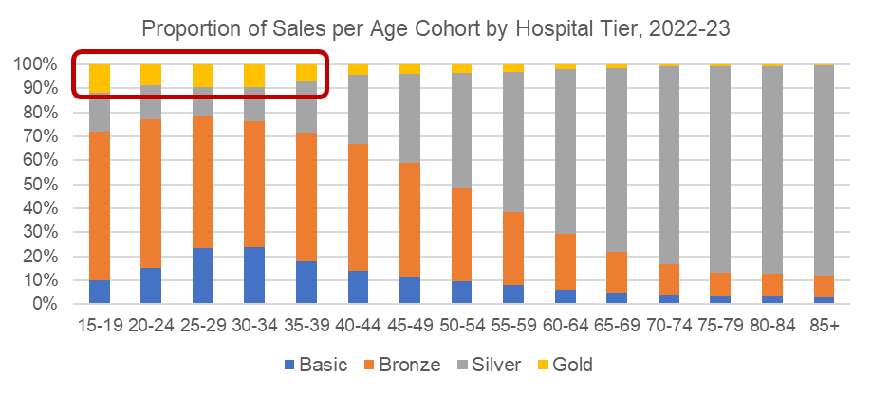
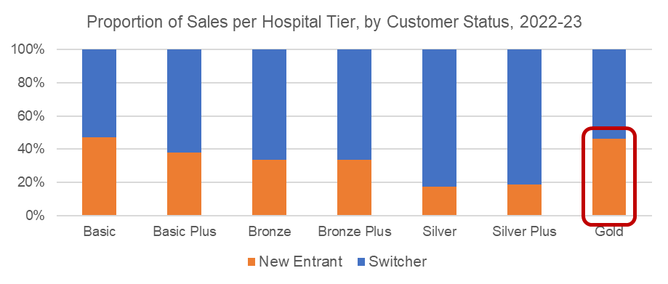
Gold purchasers
2023 survey data shows:
    The majority of Gold tier products were sold to people under the age of 39
    The proportion of sales to new entrants is much higher for Gold products compared to all other tiers except Basic
  This data won’t capture members utilising the mental health waiver to switch to gold (80% under age 55)
  Young claimers have limited risk equalisation involvement
Source: PHIIA State of the Sector Survey 2023
The survey data only accounts for around a quarter of total industry sales. Many funds do not offer Gold tier products through major intermediaries. Hence, the data may not be reflective of overall industry trends.

Slide 7
The Risk Equalisation Fund gap
Current REF structure creates perverse incentives:
What REF covers well:
  >60% reinsurance for members over age 65
  82% reinsurance for claims above $50,000
What REF covers poorly:
  Psychiatric treatment (high cost but mostly under $50k threshold)
  Obstetrics (high frequency, costs typically under $50k)
  Weight Loss surgery and IVF which are planned activities
  Younger members (<55 yrs) often claim in these categories but spend proportionality less time in the gold hospital category
The mental health waiver compounds this problem
Source: APRA DCL Data Collection

Slide 8
The resulting adverse selection ‘spiral’
Members planning to use Obstetrics, Psychiatric Hospital, weight loss surgery and IVF purchase gold and make claims that are high cost for funds
Funds have responded by closing gold products to protect existing members, reducing access and raising premiums
This incentivises good risks to choose other options
High claimers are incentivised to purchase gold, utilise it, then move to a cheaper product (or drop health insurance)
As a result open gold hospital only products’ performs worse, requiring further premium increases
Gold has become a niche product and is being priced for the members who buy and use that niche product
Notes:
Drink!

Slide 9
Key issue?
02

Slide 10
Community rating principles are under threat
If comprehensive clinical coverage is only available at unaffordable prices, the system has failed
Adverse selection is creating unsustainable risk pools
Market distortions are undermining actuarial pricing principles
However, community rating already isn’t applied unilaterally:
    Hospital tiers
    Discounts for new customers
    Closed and corporate products
    Restricted funds
Is it a problem that new members expecting to shortly make high cost claims pay more?
Was this known and accepted when hospital tiers were introduced?

Slide 11
Key issue
In our view the key issue is accessibility
If some clinical coverage is only available to consumers on the gold tier and that tier is unaffordable or unavailable then this is a failure of community rating principles
Similarly, if consumers want a product that gives them cover for all clinical categories and if that product is unaffordable or unavailable then that is a failure of the system
We note that for many (most?) policyholders the coverage they want is likely still available at affordable rates on non-gold products
and may be cheaper due to what is happening on gold!

Slide 12
Rating solutions
03

Slide 13
The requirement for principles to define a solution
Solutions can be varied, and when comparing them there must be some basis against which they are measured for their plausibility
The principles should reflect the core goal
The principles should attempt to mitigate the most egregious secondary impacts that could occur
There is no silver bullet
No solution proposed (or considered) won’t have secondary impacts on other stakeholders

Slide 14
Proposed goal for a solution
Assuming current behaviour is not a good outcome and is leading to an issue of accessibility, we would propose the following principles should be applied when assessing solutions:
    Key goal:
      Reduce the cost of access for clinical categories currently only available on gold and the cost of a full coverage insurance product
    Secondary goals (to reduce undesirable impacts)
      Maintain the financial viability of PHI Funds and the system
      Avoid creating further incentives for funds and/or consumers to act in ways that would cause further ‘problems’ for the industry
Notes:
we want to limit the secondary effects:
A solution would not work if it led to funds becoming financially vulnerable
If it leads to consumers o acting in ways that distort their choices or outcomes
If it leads to insurer actions that would create distortions (i.e. to access and availability) in the market

Slide 15
Levers of change
04

Slide 16
Approach to finding levers to enact change
We identified broad areas of similar levers/changes that could be made to potentially solve the problem
Unfortunately all will have secondary impacts on other stakeholders
The problem is balancing impacts on stakeholders
The levers discussed below are ones which do potentially solve the problem; however, they all have material drawbacks.
Other levers aren’t shown as we don’t believe they’d match the solution requirements on their own
We do not expect our set of levers are all possible, and will be performing further investigation and consultation to seek further possibilities
Notes:
Only these ones do possibly fix, but they’ve got problems themselves.

Slide 17

Changing waiting periods

Slide 18
Proposed change | Allow funds to apply increased waiting periods (up to 5 years) by clinical category, and remove the mental health waiver
Pros | Requiring members to opt-in before using certain surgeries will increase member contribution and should reduce gold costs Should reduce ‘hit-and-run’ type behaviour, reducing premiums Encourage members to take up gold earlier to remove waiting periods Funds should be more willing to offer gold products at cheaper premiums
Cons | Reduces the ‘insurance’ nature of PHI for new entrants Will members understand the waiting periods on their products? Could lead to more disputes Reverses government policy on mental health and slows access to hospital psychiatric services May make comparison of products more difficult for customers
Practical Issues | Would require legislative change Operational changes required: Would need to be able to track time members had spent in the system with access to each clinical category Unknown how funds would change waiting periods; would funds increase other clinical categories’ waiting periods or waiting periods on other hospital tiers? Can funds waive or reduce waiting periods for clinical categories as a marketing incentive? Question of what happens to waiting periods of members leaving and returning to the system?

Slide 19
Stakeholder impacts
At least initially, may be less private and more public patients.
And more complaints
Longer waiting periods, but likely lower premiums
Private Hospitals
Public Hospitals
Gold Customers
(new, no claiming plans)
Regulators
Gold Customers
(existing members)
Government
Non-gold Customers
(new members)
PHI Funds
Non-gold Customers
(existing members)
Gold Customers
(new, planning to claim)
Tilt is just a visual example and is not representative of any views of the taskforce
These are high-level views by the taskforce members without rigorous analysis. They are meant to be indicative only. Some outcomes may depend on individual entities or view points.
Notes:
Tilt doesn’t signify anything!
Many are a balance; probably have cheaper access but higher costs

Slide 20

Risk Equalisation

Slide 21
Proposed change | Add obstetrics and mental health to the risk equalisation system. Foreseeable costs would be shared across the industry
Pros | A sufficiently high level of risk equalisation should lead to reduced cost of gold products Probably be welcomed by media and public as lowering access costs to obstetrics and hospital psychiatric services
Cons | Will lead to higher costs on other products, with extent depending on REF changes. This may lead to reduced PHI participation, possibly of good risks. May lead to increased number of bad risks purchasing PHI due to reduced Gold price These two combined may lead to higher costs for the entire PHI industry and more coverage of bad risks Poor media when other products’ premiums increase, and possibly higher future annual increases
Issues | Would require legislative change Determining the level of REF sharing, and what/if other changes to REF need to be made Various governments have investigated making changes to risk equalisation yet it has remained predominantly unchanged Any change in risk equalisation likely to lead to winners and losers in the PHI industry

Slide 22
Stakeholder impacts
RE changes expected to reduce premiums for open gold
But increase premiums for everyone else, to some degree
Customers
(open gold, full cover)
PHI Funds
Customers
(open gold, claimers)
Government
Non-gold customers
(>60 years old)
Regulators
Private Hospitals
Non-gold customers
(<60 years old)
Public Hospitals
Customers
(closed gold)
Tilt is just a visual example and is not representative of any views of the taskforce
These are high-level views by the taskforce members without rigorous analysis. They are meant to be indicative only. Some outcomes may depend on individual entities or view points.
Notes:
Results do vary depending on if RE is balanced elsewhere, or just increases amount shared.

Slide 23
What is an optimal level of equalisation?
Need to establish criteria on which to measure the current system and rate potential changes
Notes:
Should broader changes be made at the same time?
Are considering this as a future HPC goal/focus.

Slide 24

Higher Government Support

Slide 25
Proposed change | Government rebates for obstetrics and psychiatric hospital services
Pros | Would reduce cost of obstetrics and psychiatric hospital services. This is likely to lead to reduction in gold hospital premiums and improved availability Improves viability of the PHI system and likely increases private hospital use (as key cost of bad risks covered/mitigated by government)
Cons | Would cost government (and hence tax payers) money Would face opposition from some media parties and some political groups Does not address adverse selection or ‘hit-and-run’ behaviour
Issues | Would require legislative change Would require political buy-in, which may not be practical
Alternatives | Alternative is to make change via adjusting existing regulatory ‘sticks’ and ‘carrots’ such as: higher product tier = higher rebate % Higher MLS income tiers requires higher tier cover LHC loading exemption for maintaining Gold cover?

Slide 26
Stakeholder impacts
Government in both as it depends on their point of view.
Depends on re-calibration of any policy settings
Public hospital views will depend on where the money is coming from, but may reduce patient load
Government
Private Hospitals
Tax payers
PHI Customers
Public Hospitals
Government
PHI Funds
Regulators
Tilt is just a visual example and is not representative of any views of the taskforce
These are high-level views by the taskforce members without rigorous analysis. They are meant to be indicative only. Some outcomes may depend on individual entities or view points.
Notes:
Tilt doesn’t signify anything!
Showing for unfiltered support. If other changes (such as having to buy the gold to access tax exemption, boxes will shift). Also depend on what else money could have been spent on.

Slide 27

Other areas considered

Slide 28
Other areas considered?
Changing the tiering system
    Restrict ‘+’ products
    Add gold categories as riders or on lower product tiers
Forcing funds to have an open gold product
Forcing funds to have a single gold product
Non-insurance levers
    Review of the costs around pregnancy and how those are charged and funded
    E.g. issue of falling admissions
On their own, these possible levers had distinct issues but combining with other levers may contribute to a sensible outcome
Notes:
These options were not considered to be viable without causing significant market distortions. Such as funds offering products at exorbitant levels.

Slide 29

A hybrid approach

Slide 30
A hybrid approach
There could be many approaches which blend some or all of the preceding levers of possible change.
An approach which combines levers may balance improvements and secondary impacts better.
We present one example here of how a hybrid set of levers may be a better fix.
An example combination:
  Change risk equalisation to cover obstetrics, hospital psychiatric services and (possibly) weight loss surgery and IVF
  Allow funds to increase waiting periods, with a maximum of five years allowed
  Require all hospital tiers to include obstetrics and hospital psychiatric services
  No mental health waiver
Notes:
These options were not considered to be viable without causing significant market distortions. Such as funds offering products at exorbitant levels.
For this discussion, assume no other impacts on RE.

Slide 31
Proposed change | Hybrid: longer waiting periods, no mental health waiver, risk equalisation on key clinical categories and all hospital tiers include coverage of obstetrics and psychiatric hospital services
Pros | All hospital products have obstetrics and mental health coverage Lower tiers acting as more ‘true’ insurance offering for younger Australians Would encourage participation to start waiting periods Should reduce gold premiums and reduce/remove reduction in product offerings Bad risks forced to spend more time in the system (albeit possibly on a lower tier level)
Cons | Same as for waiting periods and risk equalisation Non-gold product premiums will increase due to REF changes and increased coverage provided May encourage participation by bad risks by reduced gold costs (but offset by higher waiting periods)
Issues | Would require legislative change Unknown the balance of impact on PHI participation and mix of good/bad risks Knock-on impacts of greater coverage on Basic and Bronze products are uncertain Unknown how funds would change waiting periods Operational: Much more complicated for funds to implement Operational: Need to track time limits more closely

Slide 32
Stakeholder impacts
Likely lower premiums but longer waiting periods
Likely higher premiums, but also higher coverage
Lower premiums but longer waiting periods apply
Non-gold customers
(<60 years old)
Gold Customers
(existing)
Private
(longer term)
Hospitals
(short term)
Customers
(new, claiming plans)
Public
(longer term)
Hospitals
(short term)
Gold Customers
(new, no claiming plans)
Non-gold customers
(>60 years old)
Government
PHI Funds
Regulators
Customers
(closed gold)
Likely higher premiums and waiting periods
Tilt is just a visual example and is not representative of any views of the taskforce
These are high-level views by the taskforce members without rigorous analysis. They are meant to be indicative only. Some outcomes may depend on individual entities or view points.
Notes:
Tilt still means nothing! ☺

Slide 33
Taskforce next steps
05

Slide 34
Next Steps
Request for data to try and determine if our root causes theories are correct and calibrate impacts of any proposed changes
Publish more in-depth articles on the levers that may solve the problem
Liaise with a wide variety of industry stakeholders on the view of the root cause and key issue, the solution principles, and possible levers and solutions (both those currently considered and any other possibilities)
Write a paper on our findings
Can the audience suggestions on areas of investigation or publication?

Slide 35
Q&A session
06

Slide 36
Question 1: What do you think is/are the best lever(s) to use?
Can choose multiple options
  A1: Waiting Periods
  A2: Risk Equalisation
  A3: Government rebates for obstetrics & mental health
  A4: Remove “+” tiering
  A5: Add these coverages to other tiers or as riders
  A6: Funds must have an open gold product
  A7: Funds can only have a single gold product that is open
  A8: Policies can be longer than 1 year
  A9: Remove mental health waiver
  A10: Link MLS by income tier to hospital tier
  A11: Link PHI rebate level to coverage of the policy

Slide 37
Question 2: Do you agree accessibility is the key issue?
  A1: Yes, it is the key issue
  A2: It is the major issue
  A3: It is part of the issue
  A4: It is not the main issue
  A5: It is not an issue at all

Slide 38
About the Actuaries Institute
The Actuaries Institute is the peak professional body for Actuaries in Australia. The Institute provides expert comment on public policy issues where there is uncertainty of future financial outcomes.
Actuaries have a reputation for a high level of technical financial expertise and integrity. They apply their analytical and risk management expertise to allocate resources efficiently, identify and mitigate emerging risks and to help maintain system integrity across multiple segments of the financial and other sectors. This unrivalled expertise enables the profession to comment on a wide range of issues including life, general and health insurance, climate change, superannuation and retirement income policy, enterprise risk management and prudential regulation, the digital economy, finance and investment and wider health issues.
© Institute of Actuaries of Australia 2025.​ All rights reserved.

Slide 39
Thank you
Actuaries Institute
actuaries.asn.au

