Slide 1
Quantum Computing
Anthony Lowe and Michael Walker
June 2025

Slide 2
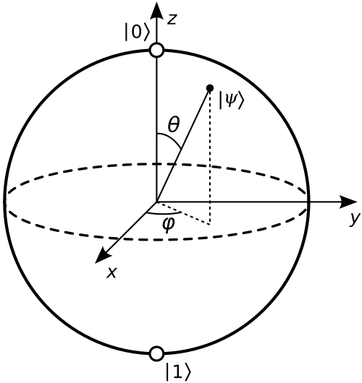
Key Concepts of Quantum Computing
Classical
  Information (e.g., a number or letter) is represented by bits.
  Bit values: 0, 1
Quantum
  Information is represented by qubits, quantum states of a system that can have two values. Common examples are electrons which have a quantum property called spin that is either -1/2 (↓) or +1/2 (↑), and photons, which have either vertical (V) or horizontal (H) polarisation.
  Qubit values: |ψ> = α |0> + β |1> where α and β are complex numbers and |α|² + |β|² = 1, known as a superposition of states. When we measure the state, we will either get the answer 0 with probability |α|² or 1 with probability |β|². State can be visualised as a sphere, known as the Bloch Sphere

Slide 3
Key Concepts of Quantum Computing
Classical
  Gates and circuits: Boolean operators e.g. AND, OR, NOT …
  Many Boolean operators e.g. AND and OR are irreversible whereas quantum operators are reversible.
Quantum
  Gates and circuits: Unitary operators e.g. CNOT, H, CCNOT …
  |0 > H 1/√ 2 (|0 > + |1 >)
  |1 > H 1/√ 2 (|0 > – |1 >)

Slide 4
Key Concepts of Quantum Computing
Entanglement
  e⁻ π⁰ e⁺
  |ψ> = α |↓↑> + β |↑↓>
  Einstein didn’t like this at all – he called it “spooky action at a distance”.
  Unfortunately for Einstein experiments have shown entanglement is real.
  Entanglement is important because it allows qubits to control operations on other qubits, permitting fine control over which components are included in qubits’ states.
No Cloning
  It is impossible to make an independent and identical copy of a qubit unless its state is already known. This puts limitations on quantum circuit design.
  No cloning has important implications for error correction in quantum computing.
No Deletion
  Information cannot be deleted or overridden in a quantum calculation and is only ever lost at measurement.
  This conservation of information is called unitarity.

Slide 5
How Do Quantum Computers Provide an Advantage Over Classical Computers?
Quantum computers do not run faster than classical computers, in fact they are typically slower measured by operations per second.
Classical bits are 0 or 1 whereas qubits are represented by the superposition α |0> + β |1> where α and β are complex numbers. Hence the state space of a qubit as represented by the Bloch Sphere is much larger than that of a classical bit.
This allows quantum computers to follow algorithmic paths unavailable to classical computers. Some of these can be interpreted as quantum parallelism.

Slide 6
Computational Complexity
  The difficulty of calculations – irrespective of hardware – can be classified by the number of steps required to complete the calculation.
  If the calculation can be completed in ≤ kn^{p} steps, where n measures the input size, then it is said to be polynomial and regarded as tractable.
  Calculations that require more steps than this are said to be intractable. Quantum computing has the potential to provide tractable calculations where classical ones are intractable.
  N qubits can hold 2^{n} values simultaneously, the number of values growing exponentially with the number of qubits.
  Applied to a calculation, each component can represent a solution to our problem, i.e. quantum superpositions (and entanglement) enable quantum parallel processing.
  Actuarial calculations most likely to benefit from quantum parallelism are those involving sparse matrices and combinatoric calculations.

Slide 7
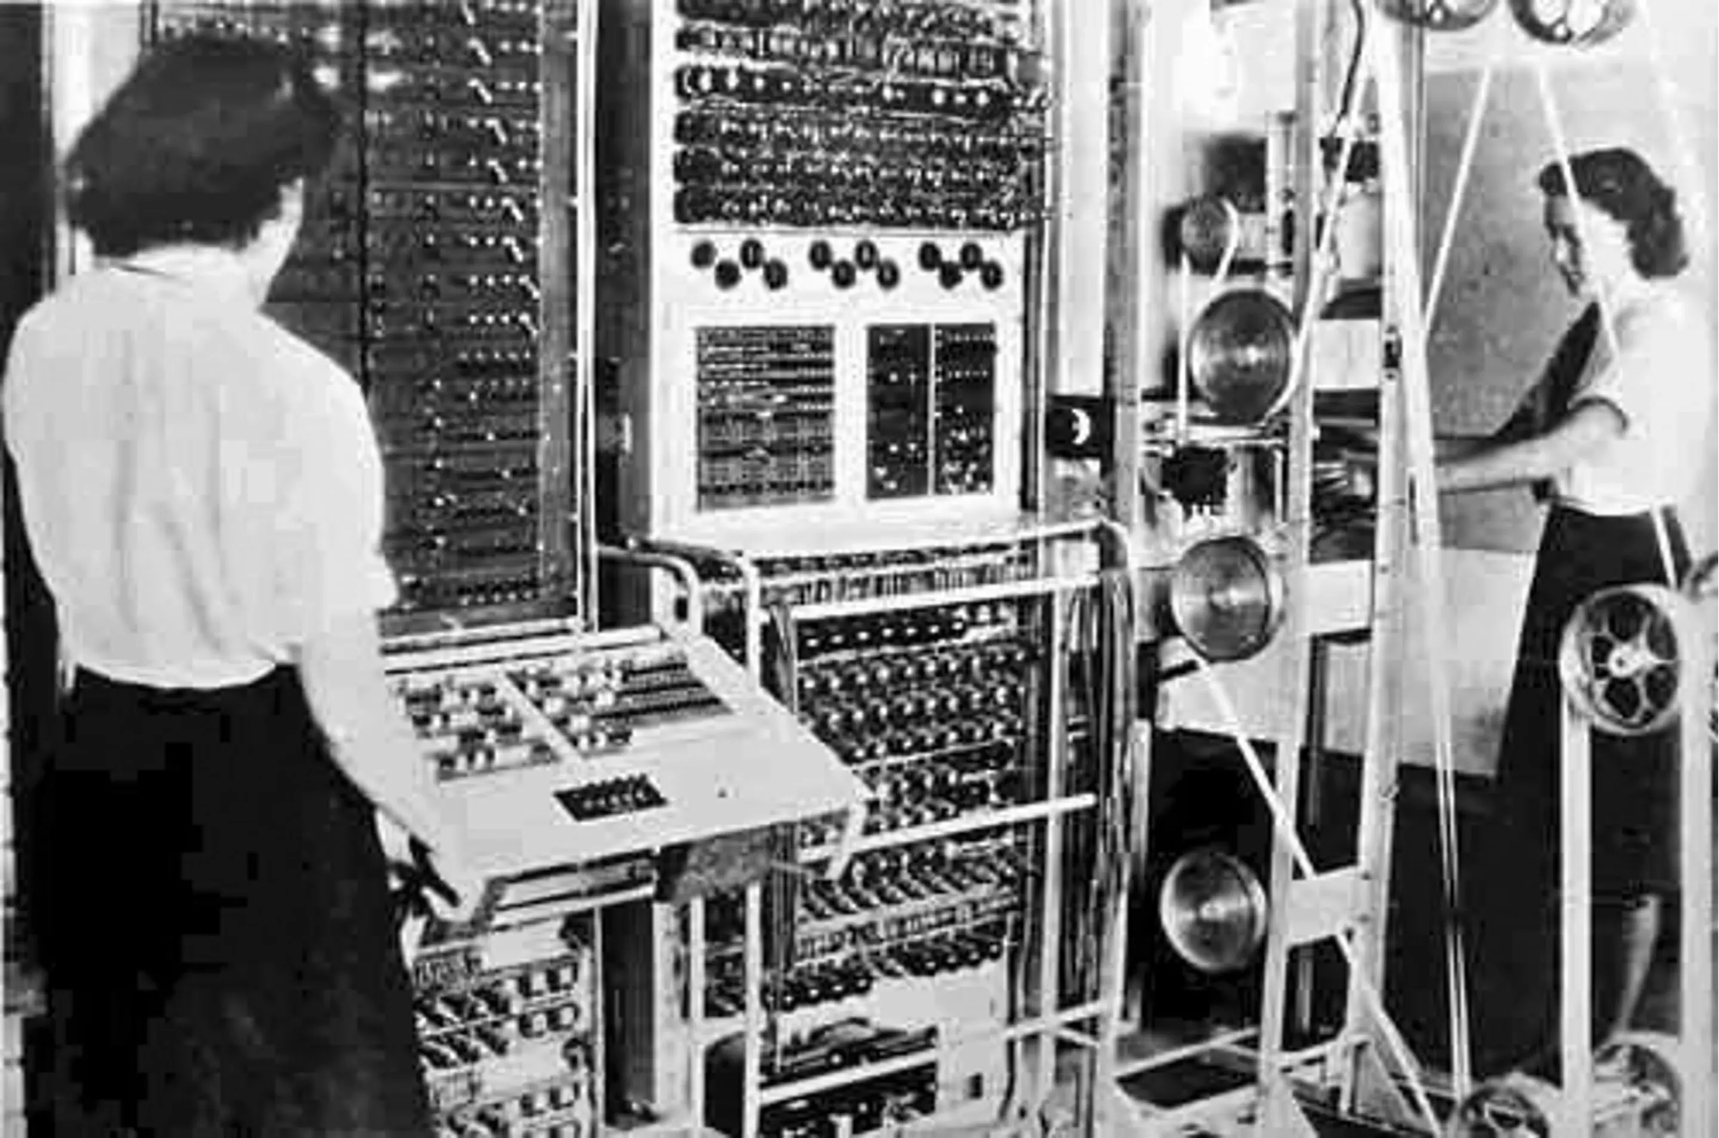
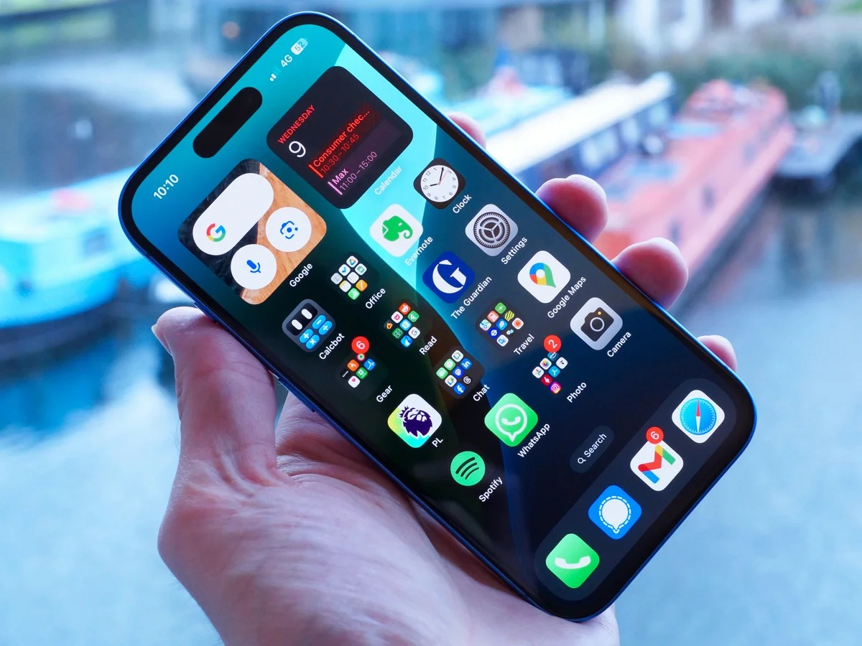
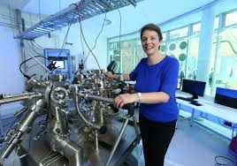
Historical Context
?

Slide 8
Approaches and Challenges to Building a Working Quantum Computer
  Decoherence
  Qubits don’t just interact with each other, they interact with the wider environment, degrading the quantum states and introducing errors in a process known as decoherence.
  Decoherence increases with temperature and time. Most current quantum computers operate at a temperature close to absolute zero (-273 Celsius) to reduce thermal noise and maintain the coherence of the qubits. The practical implication is that whilst qubits themselves may be small, the equipment currently needed to set up and manipulate them is large and expensive.
  Error Correction
  Another implication of decoherence is that error correction will be important for quantum computers. Error correction allows clusters of qubits to correct errors and reduce the impacts of decoherence. In practice this means that every logical or effective qubit, requires many, perhaps hundreds or even a thousand physical qubits.
  Currently, the most advanced quantum computers have 10s of physical qubits and are large and expensive. To be of practical use, they would need many times this number, perhaps millions of physical qubits, equating to thousands of logical qubits.

Slide 9
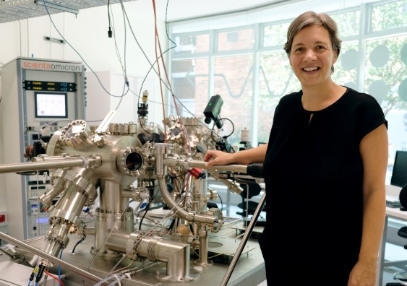

Approaches and Challenges to Building a Working Quantum Computer
  Hardware Approaches
  Building quantum hardware is experimental. There are currently 8 broad approaches:
  Spin/ quantum dot
  Photonic
  Trapped ions
  Superconducting
  Adiabatic/ annealing
  Topological
  NV diamond/ NVR
  Cold/ neutral/ helium atom.
UNSW
(Quantum dot)
PsiQuantum
(Photonic)

Slide 10
The Data Loading Bottleneck
One of the most practical challenges for actuarial applications of quantum computing is efficiently loading classical data into quantum systems.
Actuarial work often involves very large datasets that would need to be encoded into quantum states.
Current approaches like Quantum Random Access Memory (QRAM) remain theoretical.
Existing data loading methods require time proportional to dataset size, resulting in decoherence of the qubits and potentially negating quantum speedups.
Promising strategies to address this include:
Hybrid classical-quantum systems where data preparation occurs classically
Quantum feature maps that efficiently encode only the most relevant features
Compression techniques optimised for actuarial datasets.

Slide 11
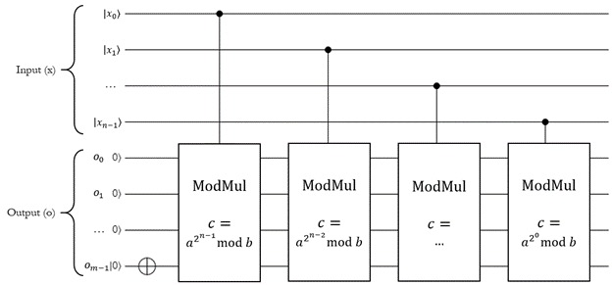
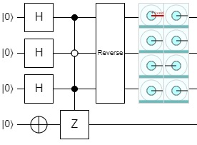
Quantum Algorithms
Shor’s Algorithm
  Exponentially speeds up factorisation of large semiprime numbers.
Grover’s Algorithm
  Quadratically speeds up searching unsorted databases.

Slide 12
Quantum Algorithms
Quadratic Unconstrained Binary Optimisation (QUBO) Algorithm
  Efficiently solves quadratic optimisation problems, of great importance in portfolio optimisation.
  Quantum Annealing
  A general method for solving functions in which the register starts in a |0> state and is subjected to a Hamiltonian whose final solution is the optimal input for the function of interest.
  HHL
  Named for its discoverers, will solve sparse linear equations with exponential speedup over classical methods.
Quantum Approximate Optimisation Algorithm (QAOA)
  Offers faster runtimes compared to conventional methods.
Partial Differential Equations
  An efficient quantum algorithm for solving PDEs has been published with a one-hundred-fold improvement in accuracy over classical methods.
  Quantum Machine Learning
  Current conventional machine learning algorithms all have their quantum computing equivalents, early work in quantum machine learning being driven by the hope of faster performance.

Slide 13
Energy Efficiency
Landauer’s Principle and Classical Computing
  Most classical computation involves irreversible operations like AND and OR. Each irreversible operation increases entropy and according to the second law of thermodynamics the increase in entropy must be dissipated as heat.
  Landauer's principle establishes a fundamental thermodynamic limit on computation, erasing one bit of information must dissipate at least kT ln(2) of energy as heat, where:
  k = Boltzmann's constant
  T = absolute temperature.

Slide 14
Energy Efficiency
Quantum Computing
  Unitary operators are reversible and therefore quantum computers are not subject to the Landauer limit (except for the final readout). This was initially thought to offer an energy advantage. However, most current quantum computers use significant energy for cooling.
  Quantum computers could still lead to significant improvements in energy efficiency for certain types of calculations through:
Algorithmic efficiency
Reduced infrastructure needs
Better optimisation.

Slide 15
Cybersecurity Danger
Whilst commercially useful quantum computers are still a decade away by most expert estimates, that does not mean organisations can afford to wait to act.
Almost all the transactions routinely taking place over the internet rely on encryption to protect privacy and sensitive data. Modern encryption relies on mathematical problems which are difficult to solve but easy to verify.
The chief danger is to asymmetric encryption from Shor’s algorithm (coprime factorisation).
Hackers, typically supported by rogue states and similar, are already running harvest-now-decrypt-later attacks.

Slide 16
Cybersecurity Solutions
  Post-quantum encryption algorithms have already been developed based on different mathematical problems which neither conventional nor quantum computers can solve efficiently.
  The US National Institute of Standards and Technology has recommended four standards (Federal Information Processing Standards 203, 204, 205 and 206) based on new post-quantum encryption methods believed to be secure against quantum computers to be implemented by 2035. These methods are:
  ML-KEM : Module Lattice – Key Encapsulation Mechanism
  ML-DSA : Module Lattice – Digital Signature Algorithm
  SPHINCS+ : An implementation of stateless hash-based digital signature algorithm
  FaLCON : Fast Fourier Lattice-based compact signatures over NTRU.
  Similar recommendations have been made by the Australian Signals Directorate to be implemented by 2030, and the European Commission has encouraged Member States to develop coordinated standards.

Slide 17
Conclusion
  Commercially useful quantum computers are still a decade away by most expert estimates but will offer significant computational advantages to those who are ready when they arrive.
  Quantum algorithms relevant to optimisation offer improved performance with large calculations while quantum machine learning methods offer improved accuracy with less data.
  Organisations seeking to take advantage of this technology will need to consider the pros and cons of different approaches.
  .
  Most quantum computing technologies require cryogenic cooling down to temperatures approaching absolute zero, requiring bulky and sophisticated cooling equipment. They are therefore kept in specially adapted facilities and made available over the cloud.
  Field deployable approaches are under development, such as the diamond-based technology of Quantum Brilliance or the neutral atom technology of Pasqal or QuEra.
  Each organisation has its own needs and priorities, both now and going forward, but rewards exist for those who prepare for the arrival of quantum computers ahead of time.

Slide 18
Thank you
Actuaries Institute
actuaries.asn.au

