Slide 1
Contemporary issues in PHI
Nicholas Stolk
June 2025

Slide 2
The Actuaries Institute acknowledges the traditional custodians of the lands and waters where we live and work, travel, and trade.
We pay our respect to the members of those communities, Elders past and present, and recognise and celebrate their continuing custodianship and culture.

Slide 3

Contents
A very brief intro to Australia’s PHI system
My survey of stakeholder views and issues with Australia’s PHI system
  Consumers
  Providers (especially hospitals)
  Government
  Insurers
3. Q&A & audience discussion

Slide 4
New to Australian Private Health Insurance?
What do you need to know?
01

Slide 5
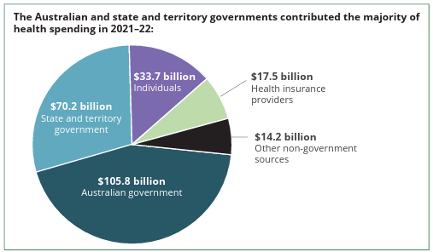
The Australian health system is complex with many funders and providers…

Slide 6
Health insurers have hit a purple patch…

Slide 7
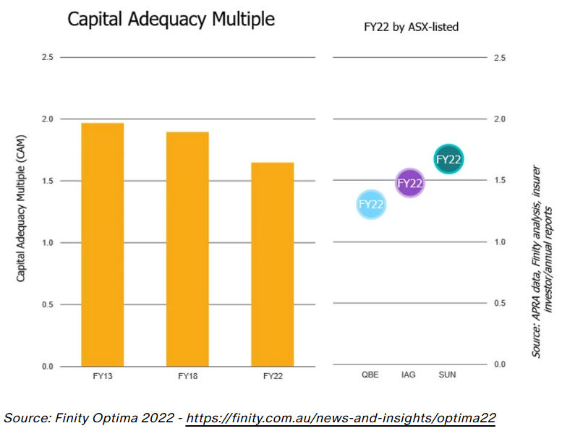
…and the industry is well capitalised
GI

Slide 8
Where are we now?
A view from
Consumers
Providers
Government
Insurers
02

Slide 9
Consumers

Slide 10
Membership
Inputs
Current challenges are often front of mind
Community rated PHI is poor value for healthy people
Price increase will generally exceed CPI
Free public alternative
Scope of cover (not all costs, not everywhere)
Perennial issues
Government incentives (rebate, MLS, LHC)
Recent price increases less than CPI
Economy: low unemployment, wages rising
Supports access to private health care
Supporting factors
Incentives are not optimised
Next price increase likely higher than CPI
Economy: cost of living crisis
Negative media (‘phoenixing’, hospitals)
Current challenges

Slide 11
Membership
Outputs
Industry membership continues to grow
Record number of people insured
  Since the start of the pandemic, an additional 1.2m people have hospital cover
  PHI participation rate similar to June 2018, undoing some of the previous slide despite high population growth
  Consistent system-wide growth for 5 years
Where PHI growth happens matters…
  Age profile
  Coverage profile (product mix)
  State profile (geographic mix)
  New to sector profile

Slide 12
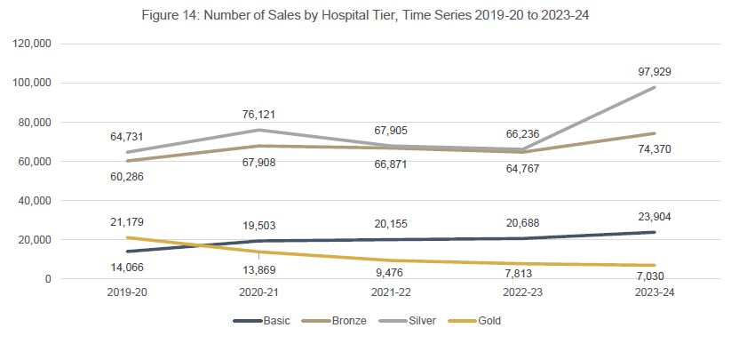
Sales mix & coverage mix
Source: PHIIA State of the Sector Report 2024
This data only represents sales made by intermediaries who are members of PHIIA. It comprises only ~25% of industry sales

Slide 13
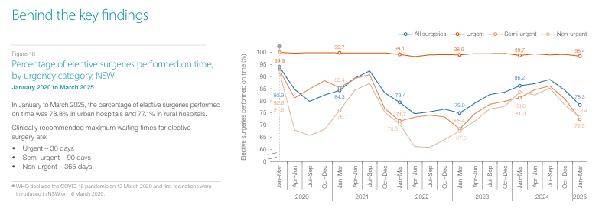
State of the public health system (using NSW as an example)

Slide 14
Sidebar: reform that works?
Extended dependants reforms

Slide 15
Sidebar: reform that works?
Extended dependants reforms – what did I expect? The story of one early adopting insurer

Slide 16
Does this represent success? Or do we need more time?
Extended dependants reforms – what happened?

Slide 17
Providers

Slide 18



Claims
Inputs
Multiple current cost pressures
Picture 1
Picture 2
Long term average
Service cost inflation: 2 - 3% per annum
Technology/acuity mix: 0.5 - 1% per annum
Utilisation growth due to ageing and other trends: 2 - 3% per annum
Additional current pressures
Claims
Higher hospital input costs, including nurses wages (>40% of hospital costs)
Hospital viability / Healthscope issues: push for additional insurer funding
DoHAC consultations on short term reform options (inflationary)
Public health system flow-on: Including NSW Health Insurance levy
Delays to prosthesis savings
Consequences if industry growth reduces
Other costs
Management expense ratios have increased
Ever increasing regulatory expectations
Text here
Text here
Text here

Slide 19
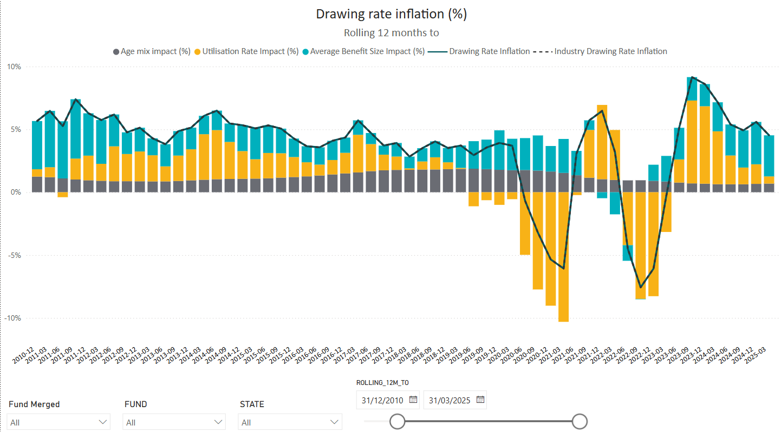
Recapping 2024: Average claims returned to pre COVID levels

Slide 20
PHI Hospital utilisation – permanently changed from pre-COVID levels
Average annual hospital benefit per person (utilisation rate)
Three clinical categories of special interest to the sector:
+ Pregnancy related services
+ Hospital Psychiatric services
+ Weight Loss Surgery

Slide 21
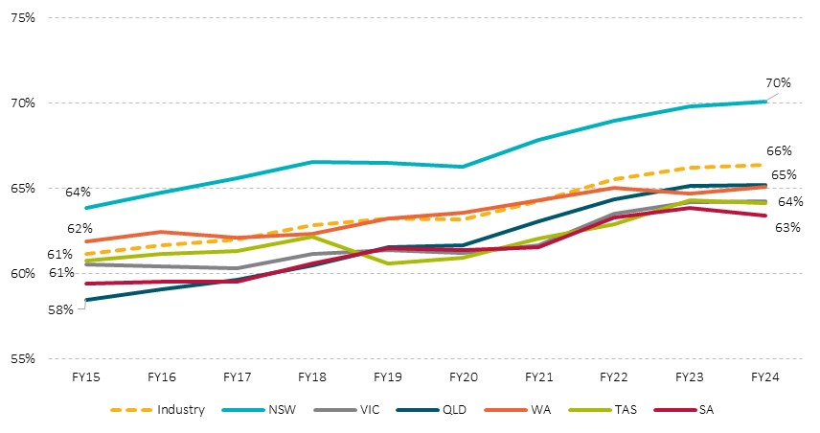
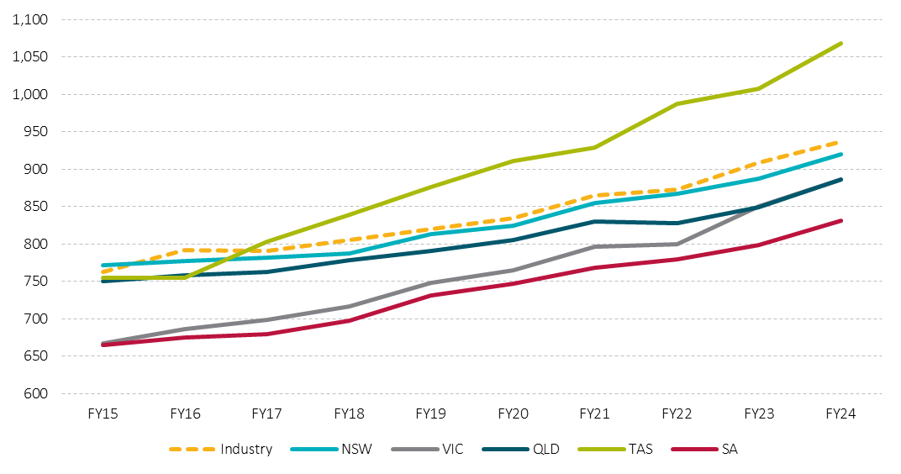
Slow but inexorable shifts to same day procedures continue
Episode mix: proportion of same day episodes (FY15 to FY24)
Annualised cost per same day episode

Slide 22

Private hospital responses

Slide 23
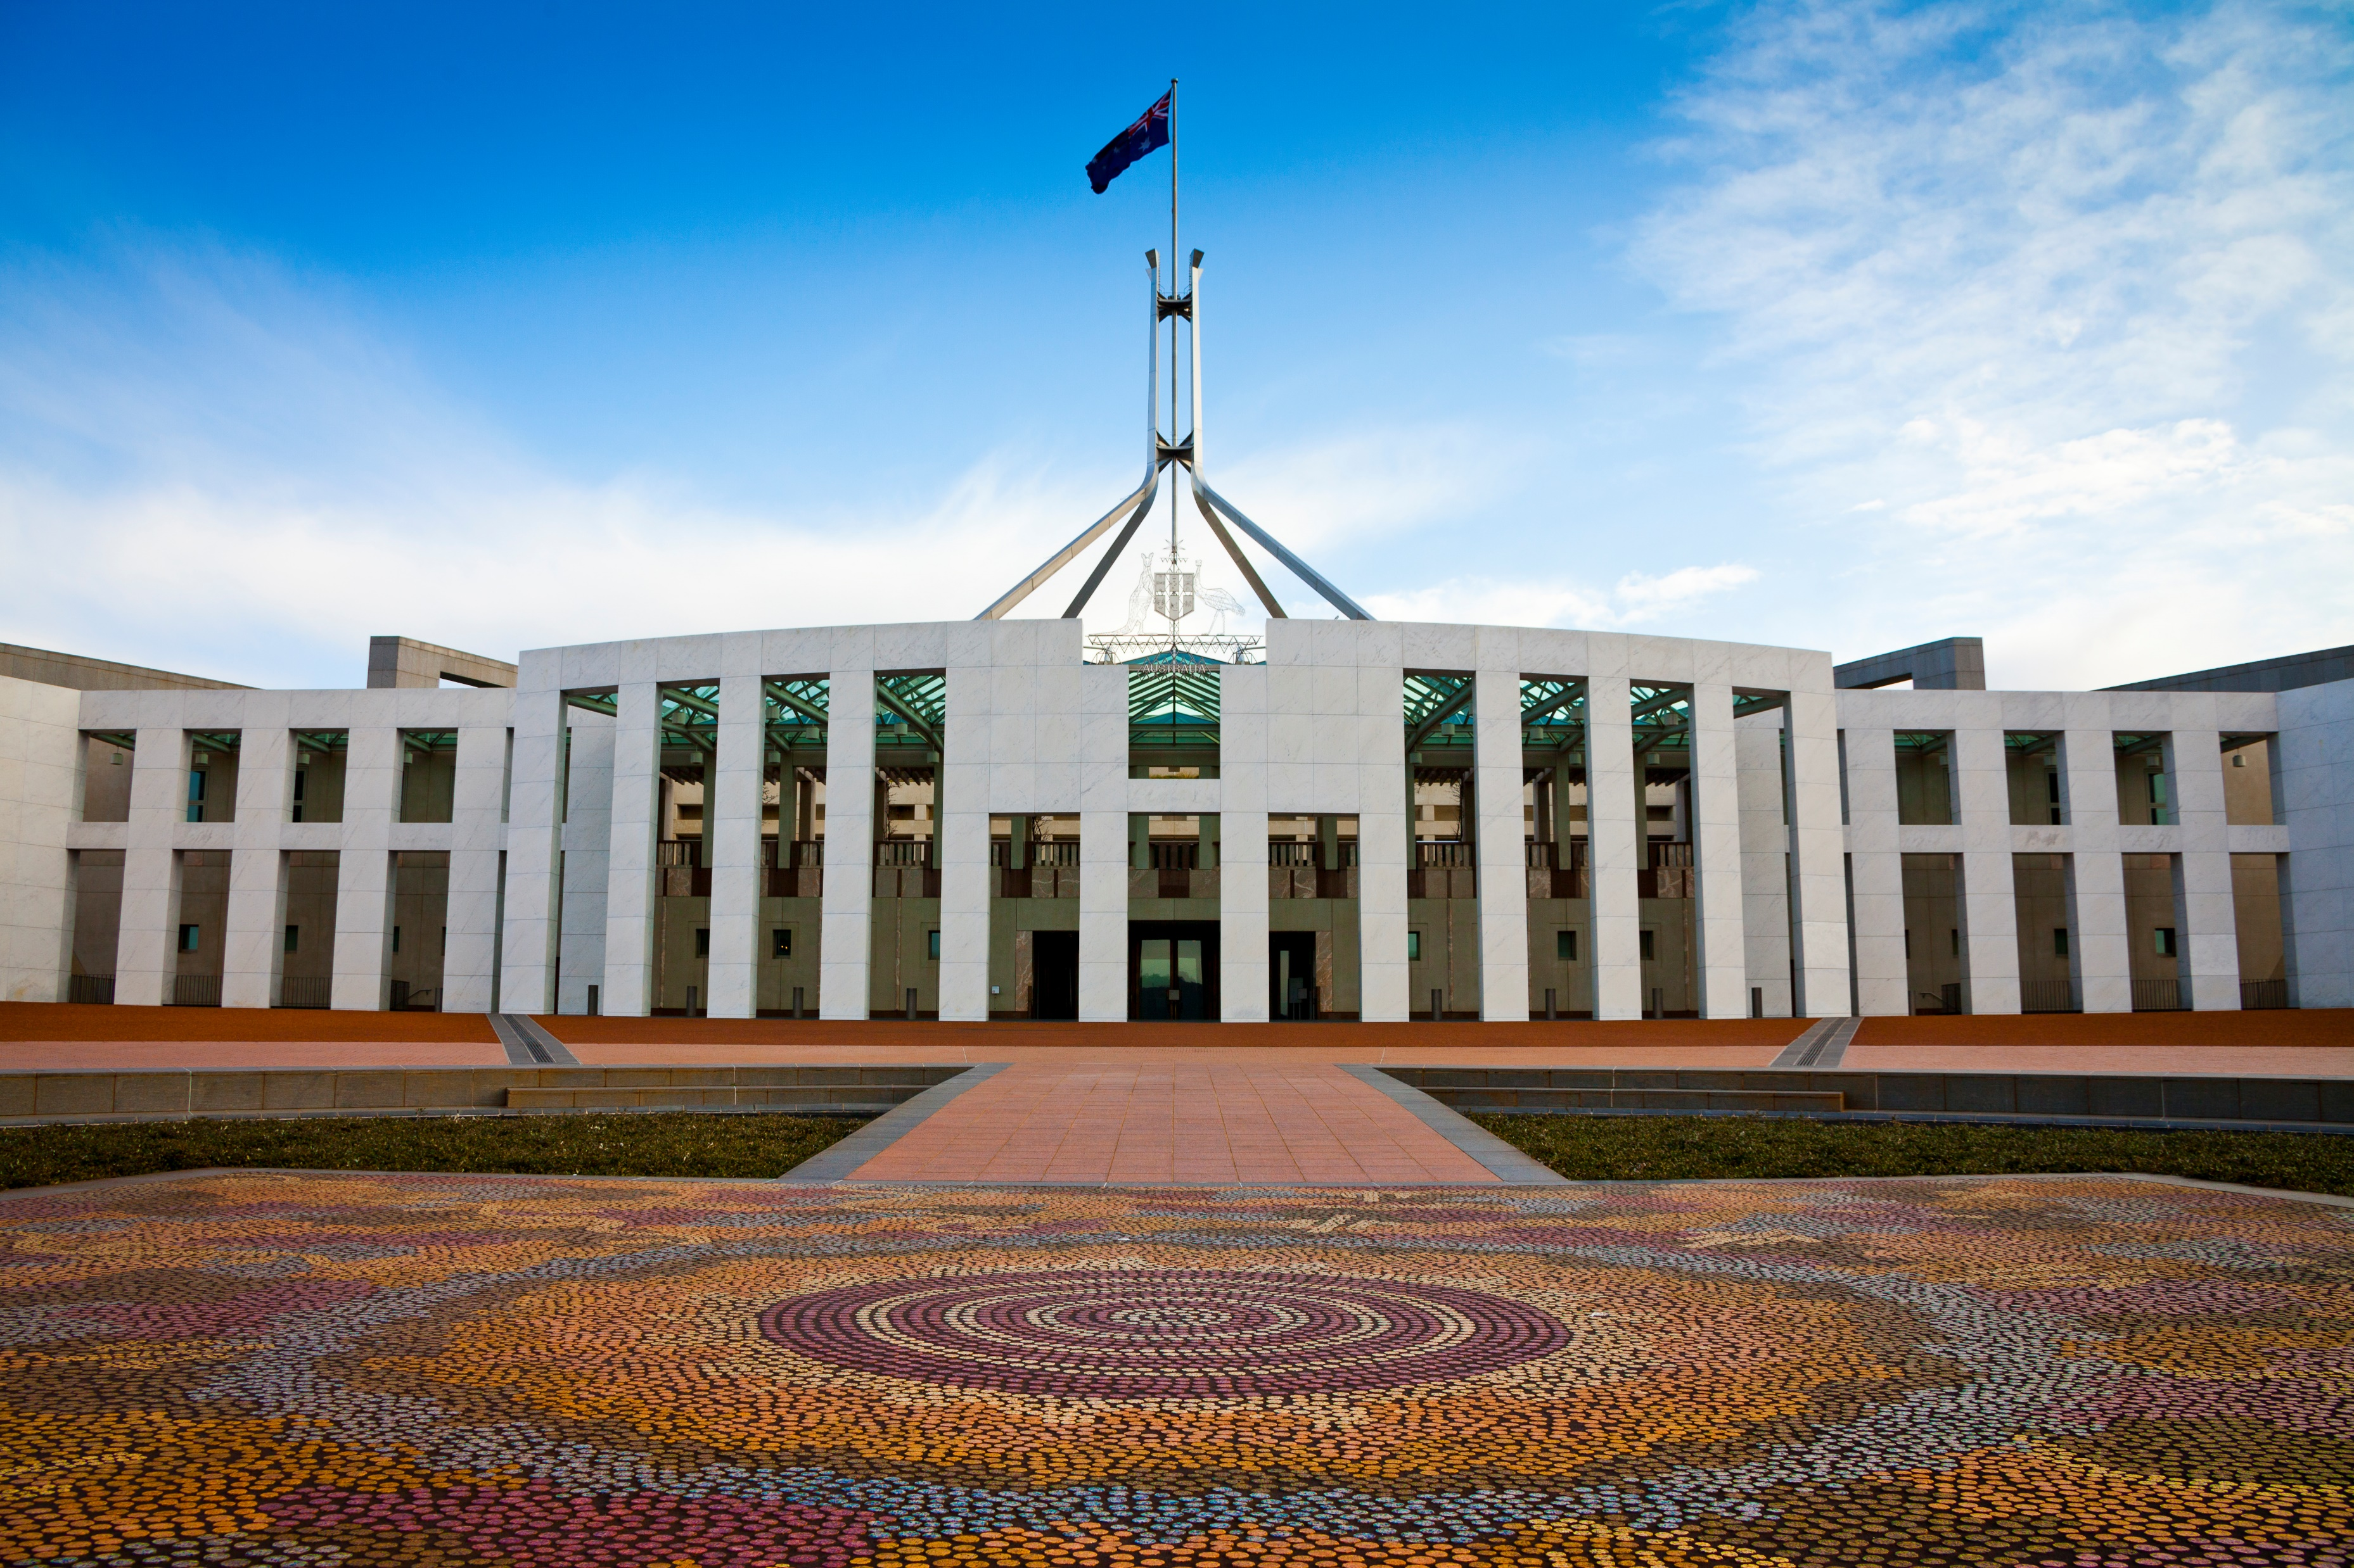
Government

Slide 24
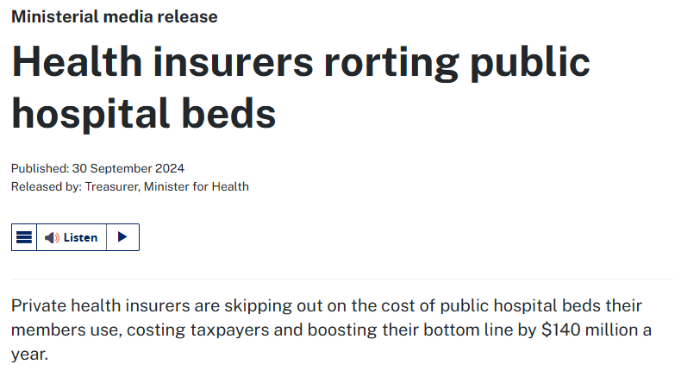
Sovereign risk or ‘stroke of a pen’ risk – raising new levies on PHI

Slide 25
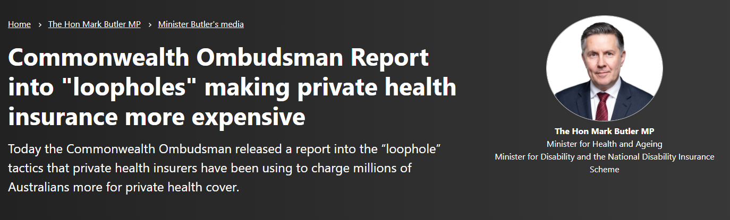
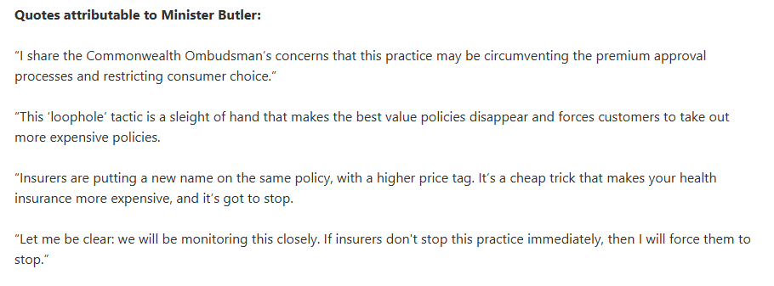
Sovereign risk – what is product phoenixing?

Slide 26
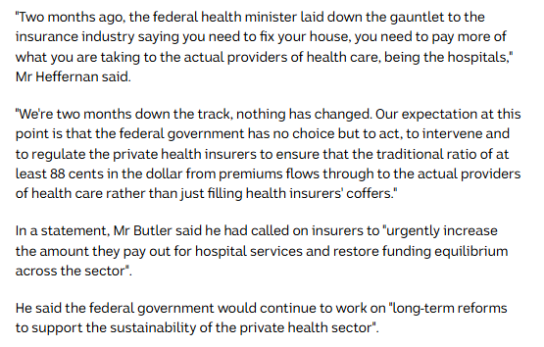
Private Hospital Viability Review & Ministerial approach to private health system – stakeholder management

Slide 27























Slide 28


Insurer responses
Source: Finity State of the Market Report 2025
NSW hospital products, open, $750 excess, excluding corporate products

Slide 29


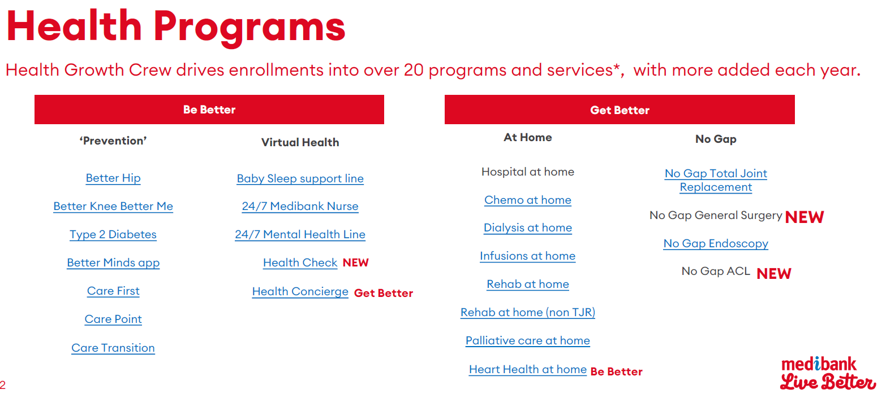
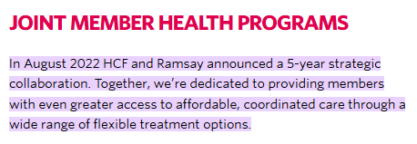

Insurer responses

Slide 30
Insurer responses
Forays into primary care by some of the larger insurers…

Slide 31
Opportunities for actuaries
There are many paths and I would love to hear your story…
+ More sophisticated & predictive claims modelling
+ Building clinical familiarity to support greater collaboration
+ Next generation financial projections and scenario analysis
+ Policy development and assessment
+ Developing a National Efficient Price
03

Slide 32
Q&A Discussion
What would you like to talk more about?
04

Slide 33
About the Actuaries Institute
The Actuaries Institute is the peak professional body for Actuaries in Australia. The Institute provides expert comment on public policy issues where there is uncertainty of future financial outcomes.
Actuaries have a reputation for a high level of technical financial expertise and integrity. They apply their analytical and risk management expertise to allocate resources efficiently, identify and mitigate emerging risks and to help maintain system integrity across multiple segments of the financial and other sectors. This unrivalled expertise enables the profession to comment on a wide range of issues including life, general and health insurance, climate change, superannuation and retirement income policy, enterprise risk management and prudential regulation, the digital economy, finance and investment and wider health issues.
© Institute of Actuaries of Australia 2025.​ All rights reserved.

Slide 34
Thank you
Actuaries Institute
actuaries.asn.au

