Slide 1
Actuarial Adaptability
Unlocking New Paths Mid-Career
Discussion with:
Aidan Nguyen, Actuaries Institute
Theresa Shiels, Suncorp Group
Mike Fowlds, Avant Mutual
Chaired by Kirsten Flynn, RGAA

Slide 2
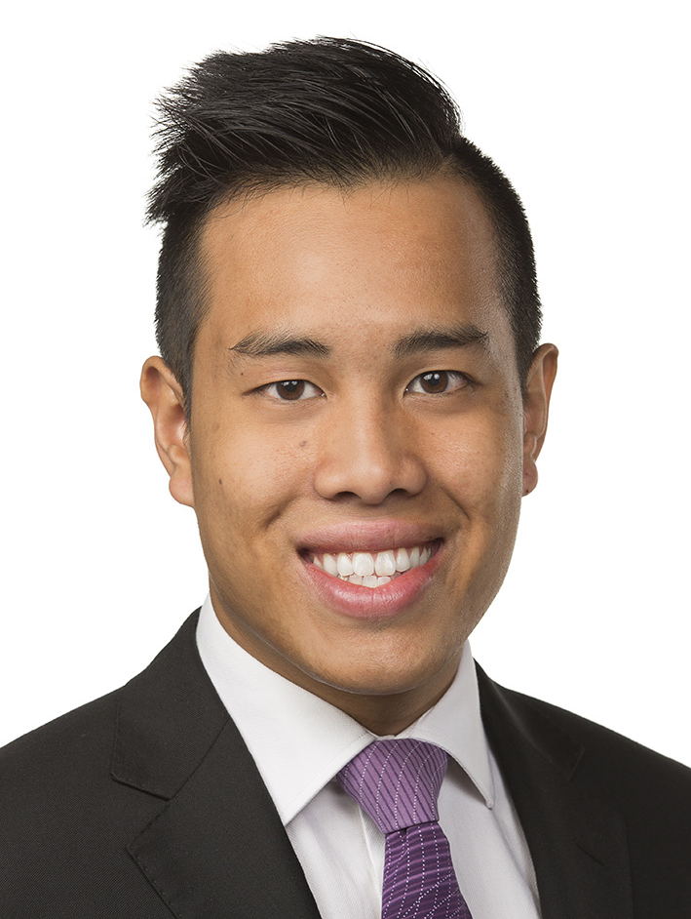





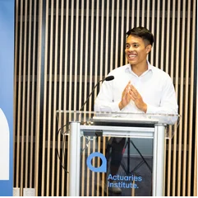

2018 – Completed FIAA
Actuarial Consultant – EY
Life Insurance and Wealth
2019 H1 – Career Break
Solo Backpacker
India, Vietnam, Laos, Cambodia, Thailand
2019 H2 – Back but Where to?
Consultant at EY still… Volunteering + Conversations
2022-23 – into Super
Policy Manager/Director – FSC
Superannuation
2021-22 – Back to the Books
Masters of Business Law
1/3rd of a Law Degree
2020-22 H1 – a Big Jump
Policy Manager – FSC
Life Insurance
2023 September
Public Policy Lead
Actuaries Institute
Life Insurance, Superannuation, Investments, Financial Advice
Today
Once an Actuary
Policy Wonk
Lifelong Learner
Podcast Producer

Slide 3







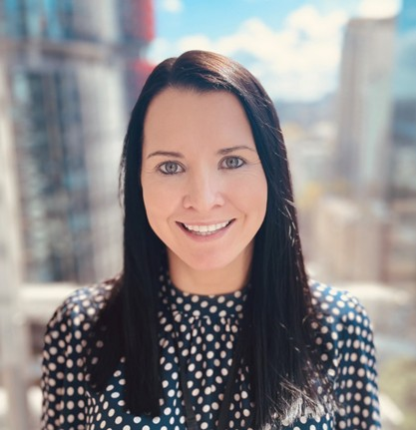

UCD Dublin, Ireland
First Class Honours in Actuarial and Financial Studies (2004-2008)
Life Pricing Analyst
Irish Life and Permanent
(2008-2011)
Qualified Actuary
(2011)
Pricing Actuary
Retail and Group Life
Suncorp Life (2012 - 2015)
Head of Group Finance
(Australia & NZ Insurance,
Bank)
(2020-2022)
Head of Finance – General Ins.
(Home, Motor, Commercial, CTP, Workers Compensation)
(2018-2020)
Exec Manager – Personal Injury Finance
(Life, CTP, Workers Compensation) (2015-2018)
Head of Risk & Operational Excellence
Commercial Insurance
Suncorp
(2022-2023)
Theresa Shiels
CFO Insurance Australia & EGM Transformation
Suncorp
Notes:
*** REPLACE photo with an image of yourself ***
Add any highlights/key points – moves, positions, skills/type of work (whatever works to tell your story)

Slide 4






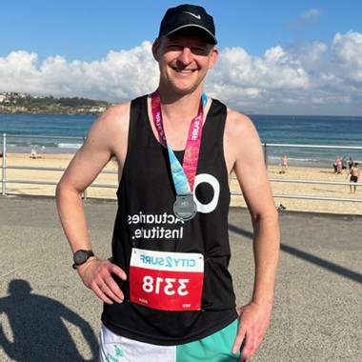
1996 – Qualified (IFoA)
Life Insurance Company
Defined Benefit Superannuation
1998 -2003
Consultancy
Financial Services Consulting
2003 to 2009
Reinsurance
GI pricing and Appointed Actuary
2012 to 2017
Reinsurance
Life Appointed Actuary
2009 to 2012
Reinsurance
Life and GI
Risk and Actuarial Management
2017 to 2023
Reinsurance
Life Appointed Actuary
2018 to 2023
Actuaries Institute volunteering
Data Science and AI practice committee
Assignment / Exam marker
Today
Mutual Insurer
GI Chief Actuary
Actuaries Institute Council Member

Slide 5
Actuarial Adaptability
Unlocking New Paths Mid-Career
Discussion with:
Aidan Nguyen, Actuaries Institute
Theresa Shiels, Suncorp Group
Mike Fowlds, Avant Mutual
Chaired by Kirsten Flynn, RGAA

