Slide 1
The Future of Health Care and the Impact on Insurance
Alan Merten and Dr Sean Chung
12 June 2025

Slide 2
The Actuaries Institute acknowledges the traditional custodians of the lands and waters where we live and work, travel, and trade.
We pay our respect to the members of those communities, Elders past and present, and recognise and celebrate their continuing custodianship and culture.

Slide 3


Speakers
Sean Chung
Partner, Healthcare Advisory
Deloitte Australia
seanchung@deloitte.com.au
+61 408 106 129
Alan Merten
Partner, Insurance Advisory
Deloitte Australia
almerten@deloitte.com.au
+61 439 564 657
Notes:
Dr Sean Chung
Partner, Healthcare Advisory
Sean specialises in large-scale multi-year, multi-initiative program and service evaluations, digital health/health innovation strategic planning, benefits frameworks and business cases. Sean has a particular interest in the use of innovative technology and data to facilitate better understanding and management of health and human services clients and system performance.
Prior to entering consulting, Sean spent almost five years’ as a molecular virologist within the
Department of Microbiology and Immunology at the University of Melbourne. He leveraged this experience in directly supporting the Victorian COVID-19 response and strategic planning for the establishment of a statewide ecosystem for production of RNA therapeutics and vaccines.
Sean’s project work has included engagements across public, private and not-for-profit clients in Australia and Canada.

Slide 4
Contents
Health at a glance
What’s the need for the change?
What are the future models?
Role of Insurers
Impacts on value chain in insurance
Value Chain – Underwriting, Product Development, Claims Management
What role can insurers and actuaries play?
Notes:
Executive summary/Story
1. Future of health vs now at a glance
2. What’s the need for changes in the Care model? Outdated models.
(include Barriers)
3. What are the new Care models? How should they change?
4. As the Future focus will be Long Term Well-Being, how should the role of insurers change? From funding providers (payers of claims) to service providers, providing incentive/mechanism for new form of care.
5. Traditional Value Chain in Insurance (talk about Health, Life, WC …)
6. Where in chain can insurers contribute to the new focus - underwriting
7. Where in chain can insurers contribute to the new focus – product development
8. Where in chain can insurers contribute to the new focus – claims management
9. Thoughts for audience to consider/discuss

Slide 5
Future of health – what does it look like?
Healthcare in 2040 will be vastly different from what it has been for 150+ years of formal medicine with a shift in focus towards the creation of health rather than the treatment of illnesses, enabled by digital tools & data
Today
Facility
Job-to-be-Done: Receive Care
Monitor
Advise
Support
Assess
Treat
Funnel to facility-based medical services
Focus on Illness
Home/Community
Digital
Care Channels Today
Future
Job-to-be-Done: Sustain Well-being
Facility
Monitor
Advise
Support
Assess
Treat
Sources: Report on Government Services 2020 Section 18A and plus ABS population statistics
Home/ Community
Increasing Care Complexity and Acuity
Digital/home first, facilities last
Remote monitoring
Navigation
Virtual primary care
Hospitals
Digital
Source: DI_Forces-of-change_Future-of-health-g.pdf (deloitte.com)
Care Channels of the Future
13
Notes:
Sean’s Slide
The future of health is coming, transforming. Perhaps a slide that showcases present versus future state. And some examples of how things are changing
Insurers: pay when problem (treatment or rehab) versus supporting/preventation → investing in care sector. Claims management to health management.
Notes:
To add to slide?
Insurers: pay when problem (treatment or rehab) versus supporting/prevention → investing in care sector. Claims management to health management.

Slide 6



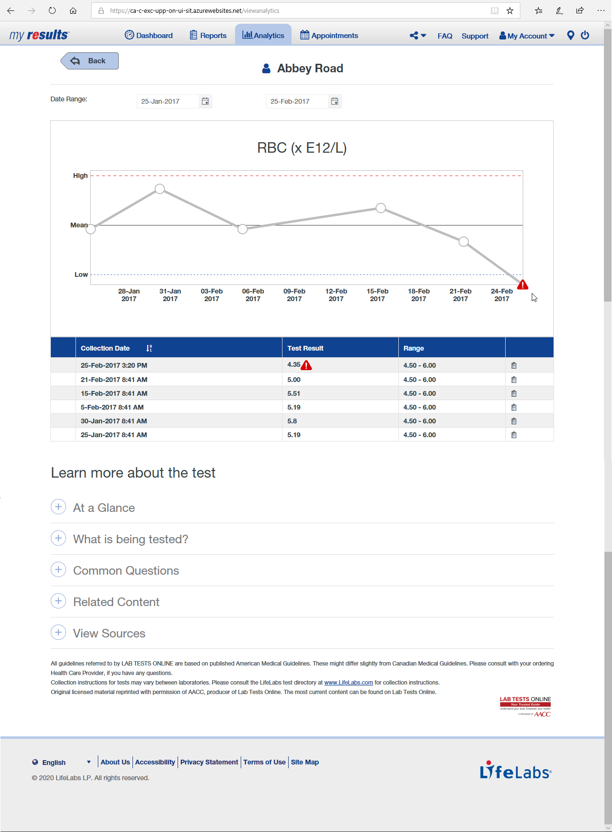

Outdated models of care not fit for today let alone the future
There are clear and persistent shortcomings in current patient care, and despite the recognition of these issues, the path to meaningful improvement is hindered by systemic barriers
Roadblocks to an effective, centralised healthcare system in Australia
We go to a place to get help when symptoms escalate
Clinic experience has not changed in 45+ years
Ingrained mindsets
Providers and the public needs to shift their mindset from diagnosis to early prevention and wellness.
Funding Models
Current model rewards interventions for illnesses rather than proactive prevention or cross-sectoral collaboration for better health outcomes. It also does not support personalised diagnostics.
Get one shot at a test, often a questionable test
Siloed Systems
Hard to engage across the key players in the health value chain and integrate data.
Less than 3% of available clinically relevant data is accessed or used
Regulation and governmental relations
As key providers of funds, centralising health services will involve renegotiating government roles, which can create tension in Australia’s federated system.
Get a treatment course based on what worked for the average
Legacy infrastructure
Upgrading outdated physical infrastructure and technological systems requires large capital investment.
Notes:
Sean’s Slide
Pathway on the left has not really changed in 50 years
Health organizations will need to be bold in defining their future roles in the health system, accounting for lasting COVID-19 implications, the evolution of hospital and community roles, exponential growth of healthcare technology, and new patient behaviours, among other considerations

Slide 7
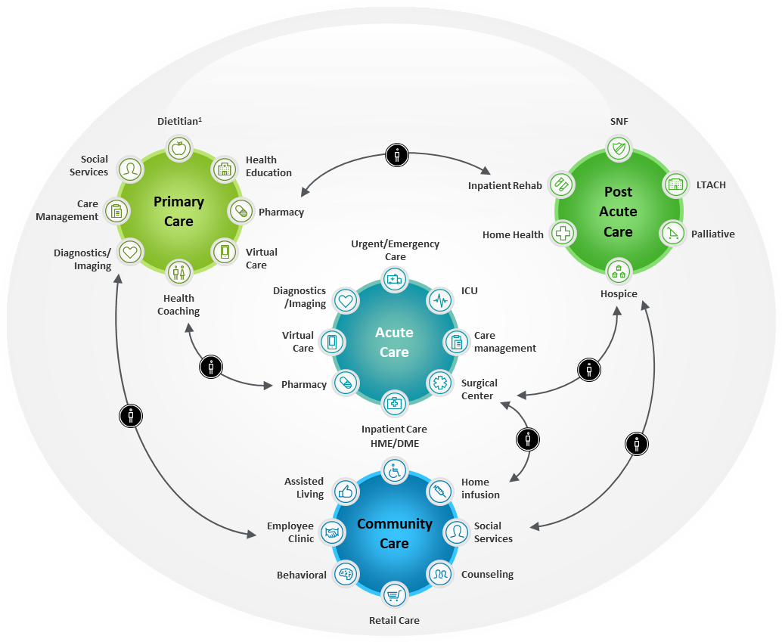
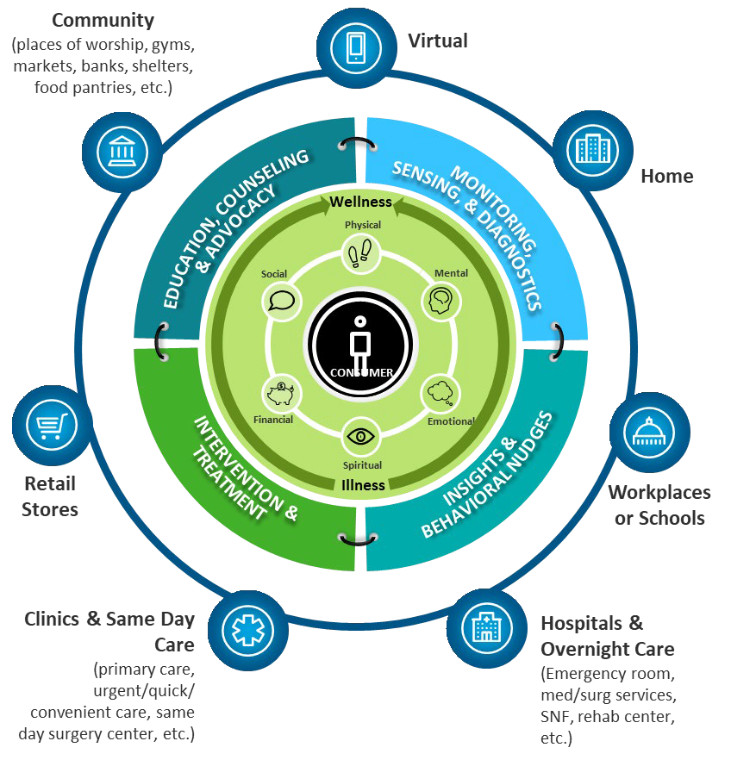
New & next care delivery models will adapt to be consumer-centric
To remain financially viable, our hospitals and health system must pivot towards integrated consumer-centric models that are designed to address consumers’ unique needs and preferences
TODAY: Models centre around providers. Primary focus is on physical health. Experiences are fragmented, transactional, analog … with redundancies, misalignment, disconnected interactions between settings.
FUTURE: models are oriented around meeting the individual’s holistic needs, goals & expectations. Experiences and info are seamlessly integrated between touch points.
Notes:
Sean’s Slide
Care models of the future will focus on wellness, and providing care holistic care that is not linked to discreet episodes
This will drastically impact the role of hospitals today – which will transition into care hubs that are one of several “nodes” within the health system the patient will experience
Mental health: summit presentation for mental, pre-incident, generic incident. Care journey versus funding journey.

Slide 8
Insurers will need to consider key themes driving the future of health
With the future of health being focused on promoting long term wellbeing, insurers will need to consider key themes in strategic plans to navigate the future
Future focus is on promoting long term wellbeing
Current focus: Insuring Treatment & Care
Facility
Home/ Community
Increasing Care Complexity and Acuity
Proactive management
Seeking medical advice
Treatment & care
Recovery & Rehabilitation
Long-Term Wellbeing
Digital/home first, facilities last
Future focus: Promoting Long-term Well-being
Digital
Key thematics and changes allowing insurers to change the way they operate
Care Channels of the Future
Better community health outcomes
Personalised medicine and improved understanding of health risks
Availability of data on individual and community health
Funding for better health outcomes
With the objective of creating better health outcomes, insurers can play a role in:
Facilitating access to preventative care and acute treatment
Reducing financial barriers
Alleviating pressure from the public health system
Health insurers are presented with challenges of adverse selection and erosion of risk pooling, but also opportunities in proactive health management and enhanced customer engagements for more accurate underwriting
While the availability of data poses challenges to risk pooling, there are also opportunities for innovative use through personalising the customer experience and enabling a shift from risk prediction to risk management
To support the creation of better community outcomes, health insurers should consider a shift from fee-for-service to value-based care and outcomes-based funding
13
Notes:
Sean’s Slide
The future of health is coming, transforming. Perhaps a slide that showcases present versus future state. And some examples of how things are changing
Insurers: pay when problem (treatment or rehab) versus supporting/preventation → investing in care sector. Claims management to health management.
https://www2.deloitte.com/us/en/insights/industry/financial-services/financial-services-industry-outlooks/insurance-industry-outlook.html

Slide 9
Healthcare in future requires changed roles for incumbents, adjacent and new players
Currently insurers play a smaller role than the Australian government and Households in funding health care - there are clear opportunities for insurers across different sectors to help create an integrated health ecosystem
Flow of funds in the Australian health system
Health insurers to support integrated care models
- Offer value-based care with proactive prevention programs.
- Expanding care to the underserved and integrating care platforms.
Workers’ compensation insurers to reshape the workforce
- Invest in technology-enabled recovery such as VR physical therapy.
- Partner with employers and other insurers on workplace health & safety.
Life insurers advocating for consumers to increase perceived value
- Encourage healthier lifestyles through product design.
- Partner with health companies and mental health platforms.
Building a collaborative ecosystem
- Break down data silos between insurers, providers, patients.
- Support health infrastructure especially in underserved communities.
Federal, State & Territory Government
Taxes
Medical services
Public hospitals
Medicines
Payments
Healthcare providers
Out of pocket
General practitioners (GPs)
Medical specialists
Allied health workers
Nurses
Households
Premiums
Private health insurers
Payments
Hospital cover
General treatment cover
Proportion of total health spending by source of funds, 2022–23
6.2%
7.7%
Government (Federal, State & Territory)
15.4%
Households
Health Insurers
70.8%
Other Non-Government
Notes:
Sean speak to the left; Al speak to the right
Why does it need to change? And how quickly does it need to change? Add some numbers.
Ella: health insurance landscape, market consolidation will happen but costs are high to consolidate.
Private hospital landscape > how that might impact things would change
Regulator led?
Private equity link into private hospital.
Health insurers struggling to negotiation with many hospitals >> benefits.
Headline slide
https://insuranceasia.com/insurance/news/australians-out-pocket-medical-expenses-rise-1b-in-2024
https://www.aihw.gov.au/reports/health-welfare-expenditure/health-expenditure-australia-2022-23/contents/spending-trends-by-source

Slide 10
















Evolving the insurance value chain: adapting for healthcare dynamics
The provision of healthcare is evolving from a traditional model to a more modern, patient centered approach – driven by advanced technologies, improved healthcare services and more proactive roles for health insurers
Product (“Proposition”) Development
Migration of clinical applications to AWS Cloud to provide efficient telehealth services since COVID
Wearable devices connected to the NBN network to allow for remote monitoring
Accidental injury cover with fast activation, no lock-in contracts and high affordability
Customer Engagement & Experience
Independence at home with proactive insights ​from in-home sensors
At-home medical grade genetic counselling
Wellness platform to understand how lifestyle choices affect glucose levels in real-time
Pricing
Analysis of health data using AI to dynamically adjust premiums
Reward healthier customers, ensuring precise risk pricing for high-risk individuals
Marketing and distribution
`Value Ads’ campaign to put members first by turning advertising spaces into platforms for member stories and messages
Claims Management
Leveraging AI tools to expedite insurance application process
Analysing vast quantities of data from past applications to reduce processing times for mental-health claims
Risk Assessment and Underwriting
Enhancing underwriting process using medEbridge platform to improve healthcare screenings and rehab services
Improving Underwriting Rules Engines to help automate assessments and reduce manual touchpoints in applications processing
Notes:
Al’s slide (Sean speak to the NSW eHealth example)
Product Development: Enhancement of clinical services that include acquisition of medical technologies and implementation of innovative care models, that
Pricing: Setting fair and sustainable prices by balancing affordability and financial viability. Value based approaches that reward positive health outcomes rather than service volume
Marketing and Distribution: Expanding access to underserved communities using digital distribution channels. Health insurers can promote access by using data to identify gaps in coverage.
Risk Assurance and Underwriting: Evaluating risks associated with potential policies and assessing population health risks to inform tailored policies and benefits. Data driven underwriting to manage risk pools for long term affordability.
Claims Management: Assessing claims, verifying policy coverage and processing payments. Leveraging AI technologies to streamline claims handling, reduce errors and improve decision making.
Customer Engagement & Experience: Personalising communications and healthcare services throughout the patient journey. Insurers assist by improving health literacy through wellness and coaching programs. Through targeted services such as rewards and gym reimbursements as well as transparency around benefits and pricing.
Notes
eHealth – migrated 10 clinical applications from on premises infrastructure to AWS Cloud, providing telehealth services and eHealth NSW uses AWS Security Hub and Amazon GuardDuty to automate security checks, implement continuous monitoring, and conduct early threat detection to minimise security risks.
(https://www.ehealth.nsw.gov.au/about/cs-digital-transformation?utm_source)
Observa care – wearable devices connected to the nbn network to allow remote monitoring. Aiming to enhance healthcare for people in rural, regional, and remote areas of Australia.
(https://observacare.com.au/)
Flip (HCF) - Australia’s first provider of on-demand accidental injury cover.
(https://www.hcf.com.au/health-agenda/health-care/private-health-insurance/flip-australias-first-on-demand-injury-insurance)
PingAn – Ping An Life’s “111 Fast Claim” service offers “one-sentence reporting, one-click uploading and one-minute validation”, AI-powered health data analyses dynamically adjust premiums, rewarding healthier customers with lower rates while ensuring precise risk pricing for high-risk individuals.
(https://group.pingan.com/media/perspectives/2025/driving-innovation-with-generative-ai.html)
HCF – Value Ads campaign, showcasing real member stories. The initiative invites HCF members to take over 60 percent of the brand’s advertising airtime and Out of Home (OOH) advertising, including bus stops and shopping centres, to share their personal stories.
(https://www.hcf.com.au/about-us/media-centre/media-releases/2024/HCF-unveils-value-ads-campaign-showcasing-real-member-stories)
AIA/UHG – mEdbridge platform to streamline claims and underwriting process. UHG is also currently exploring ways to improve Underwriting Rules Engines to help automate assessments and reduce the number of manual touchpoints in application processing.
(https://www.aia.com.au/content/dam/au/en/docs/press-releases/2020/aia-x-uhg-partnership.pdf)
Zurich – Partnership with UTS for an AI solution for underwriting of mental health claims. the AI models will allow Zurich to make an immediate underwriting decision on applications with mental health disclosures without the need for a doctor’s report, which previously would take as long as 22 days.
(https://www.zurich.com.au/latest-news/media-releases/2024/2024-05-27)
Bupa – investments of $2.2m for Umps, Vively Health and Eugene
Umps - supports independence and wellbeing at home with proactive insights ​from in-home sensors
Vively Health –developed a wellness platform that helps people understand how lifestyle choices affect glucose levels in real-time.
Eugene - Eugene offers at-home medical-grade genetic testing and genetic counselling
(https://media.bupa.com.au/bupa-ventures-announces-first-investments/)

Slide 11



Underwriting: more precision with data and technology and making it valuable to customers
Insurers have the opportunity to improve underwriting accuracy through the data collected from proactive health management; and if not allowed to underwrite (price or select risks), to assist policyholders in managing their own health risks from “post-issue underwriting” processes
Value-based care technology to improve risk profiles
Proactive health management in an integrated health system
Personalised & proactive treatment of chronic illnesses
Partnering with data providers
Sun Life is a Canadian financial services company with life and health insurance offerings. It has partnered with:
Dialogue Health Technologies – platform to support physical health, mental health, employee assistance, wellness and fitness resources.
Qardio – smart body analyzers, wireless blood pressure monitors, and wearables that sync with mobile apps to track health over time.
Ping An is a financial services company in China that aims to build a health maintenance organization (HMO). Ping An’s Zhenxiang RUN plan for 20m+ policyholders of critical illness utilizes data for continuous engagements in proactive health management including:
Individualised checkups, blood sugar control, online consultations, outpatient appointment assistance and critical illness management.
Medibank has been increasing investment in Myhealth Medical Group to promote a proactive and coordinated care system, with a more connected healthcare experience.
Through Amplar Health, Medicare is also working alongside Myhealth GPs to develop new GP-led programs in Western Sydney clinics with particular focuses on chronic conditions such as Type 2 Diabetes, mental health.
LexisNexis Health Intelligence formed alliances and partnerships with data and service providers to produce a comprehensive health database. Privacy is ensured through tokenization and de-identification.
Through LexisNexis solutions, insurers can more accurately classify risk and accelerate underwriting with greater confidence, without requiring traditional medical exams.
Notes:
Al’s slide (Sean speak to the Medibank example)
Another example: Sompo Himawari Life’s Insurhealth in Japan offers at-home cancer risk testing through SalivaTech Co., to promote early detection and prevention of cancer.
Another example: Star Health & Allied Insurance Co. Ltd is a health insurer in India, with roles across thesupply chain: maintaining hospital networks, promoting, preventative care and being financial intermediaries in the health system.

Slide 12







Product development: from product to “proposition” and pooling more personalised
While personalised medicine challenges insurance pooling concepts, insurers can personalise their offerings and potentially serve those we haven’t been able to in the past
Preventative Healthcare
Leveraging data to invest in preventative care programs
Preventing illness early to lower long-term claims cost
Personalised Approach
Based on pooled rather individual risk factors
1
Contributors
2
Incentivises treatment over prevention
Insurance Pooling
Health insurers
Workers Compensation
Non-Traditional Players
Life Insurers
Fundamentally based on uncertainty of individual risk
Increasingly misaligned with what technology can now reveal e.g. genetic testing
Shift in insurance from reactive payment to holistic proactive support for maintaining health.
Support mental health
by offering counselling rather than simply
reimbursing costs.
Wearable devices for data collection to enable early detection and intervention of health complications.
Partnering with wellness/fitness players to take proactive steps to maintain health and nutrition.
4
Does not consider real time data to adjust coverage or pricing
3
Limitations
High costs of advanced diagnostics and gene testing (ethical concerns)
Personalised interventions are still experimenting or emerging
Additional data required for data driven decisions
Notes:
Al’s Slide
We see health insurers investing more into preventative care and becoming a more holistic health care offering
Medibank Private: Live Better rewards programs, my health primary care practices, no gap private hospital
Bupa: preventative health assessments, weight management, bupa dental
Nib Health funds: personalized health coaching and risk assessments
What else can be done? Telehealth presentation,
Non traditional players being more prominent
- Amazon/ Apple – wearable devices which help in tracking vital signs, for early detection and prevention rather than a reactive approach
Could more be done in life insurance space?
- AIA Vitality program - a health and wellbeing program that helps clients improve their health, and rewards them for it
- MetLife – 360Health offer expert guidance to help build healthy habits
Personalization of products? Noninsurance?
With the advent of exponential growth in medical improvements, what do insurers need to consider such that conditions covered remain relevant?
E.g. diabetes is a more manageable condition.
Responding to what’s known.
Should insurers help you plan if something comes out of underwriting for examples.
Are there areas insurers too scared to get into. Long term care, what it might be?
Insurers creating incentives, financial incentives?
Private health insurers and brick and mortar:
Can insurers motivate change to move away from brick and mortar
Health insurers are trying to move up the value chain.
Could workers compensation insurance provide the services directly, versus paying a claim to contract for services, e.g. mental health counselling
Simplified products – customer trends

Slide 13








Claims management: alignment across providers and funders for better consumer outcomes
Disconnected claims processes in injury recovery can lead to inconsistent care outcomes (health, financial and lived experience), which can be significantly improved by streamlining processes and creating stronger links between insurers in different sectors, healthcare providers and recovery partners
Single access point and one ID
Single Digital
Entry Point
Unified Data Platform
Workers Compensation
Income Protection
Delayed submission of claims due to lack of coordination between key providers
Private Health Insurance
The claims process is lengthy and intrusive, involving income checks, medical reviews and financial guidance
Patients must navigate insurer-specific claim forms leading to reimbursement delays
Shared Evidence Repository
Electronically sharing payment data
Care and rehab funding spread across systems, creating complexity and financial burden for injured workers
Lack of central coordination
Medical Providers & Employers
Notes:
Al’s Slide
Innovations around more dynamic claims management process, to streamline this process. There can be a link back to the insurers as a health partner, so they are tracking things
Potentially link into the robots/ co- robots thing?
Injury at work: workers comp, health insurer, maybe life.. But these systems are disconnected. Is there opportunity for these systems to connected. Some parties might have more developed ways to manage the condition.
Claims management: someone who gets injured at work will claim health insurance and life insurance and all disconnected and no sharing of information or treatment pathway so reenforcing about certain injuries and diagnoses where need for insurers to coordinate better on high value vs diagnoses

Slide 14
What role can insurers and actuaries play?
Actuaries and Insurers are expected to play a more proactive role in enhancing healthcare initiatives with an emphasis on patient-centered outcomes.
 | Insurers | Actuaries
 | Shift to value-based care models Alternative payment methods: bundled payments, shared savings Transition away from traditional fee-for-service models Partnerships for more integrated and coordinated care provision | Shift to value-based care models Work on cross-functional teams for better consumer-focused design and quality innovation Using data and evidence based insights with credibility and objectivity to advocate for sustainable patient-first ideas Translating technical insights into strategic recommendations for insurers
 | Integrate digital tools into strategic initiatives Using AI powered virtual assistants to provide assistance 24/7 Adopting PROMs and PREMs measures to assess patient care quality Digital operating models, including chat robots as first point of sale and point of contact Investing in more automative elements – eg da Vinci Surgical system | Data driven transformations Incorporating non-traditional data into models to identify equity gaps Using machine learning models to accurately assess hospital readmissions, chronic disease progressions Analysing vast amounts of data to identify high risk cohorts, gaps in care, increasing types of claims and gaps in funding mechanisms Simulate how bundled payments can perform under different patient scenarios
 | Meaningful healthcare initiatives Removing regulatory constraints that lead to unintended health / financing outcomes Reimbursement models that reward outcomes, not volume Investing in software vendors to develop systems complying with national health standards Supporting policy changes that expand coverage – using telehealth services for rural communities Coverage for non-traditional services – social care, nutrition | Evidence based equity and funding Using data to identify disparities and quantify the impact of closing equity gaps Showing long-term cost-benefit projections to support preventive interventions Quantifying mental health needs, risks, and value in population models to support parity in funding
Mindset
Tools
Advocacy
Notes:
Closing slide
Sean to speak on health insurers, Al to speak on Actuaries

Slide 15
Closing Remarks

Slide 16
Thank you
Actuaries Institute
actuaries.asn.au

