Slide 1
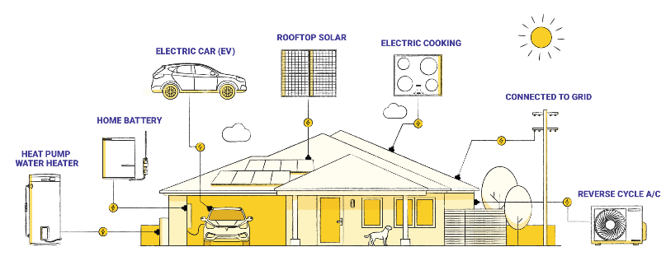
Insuring the home energy revolution
Graphic from Rewiring Australia
Vicki Mullen, Sharanjit Paddam and Dominic Thorn
June 2025

Slide 2
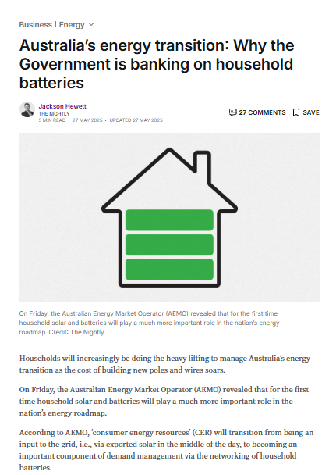
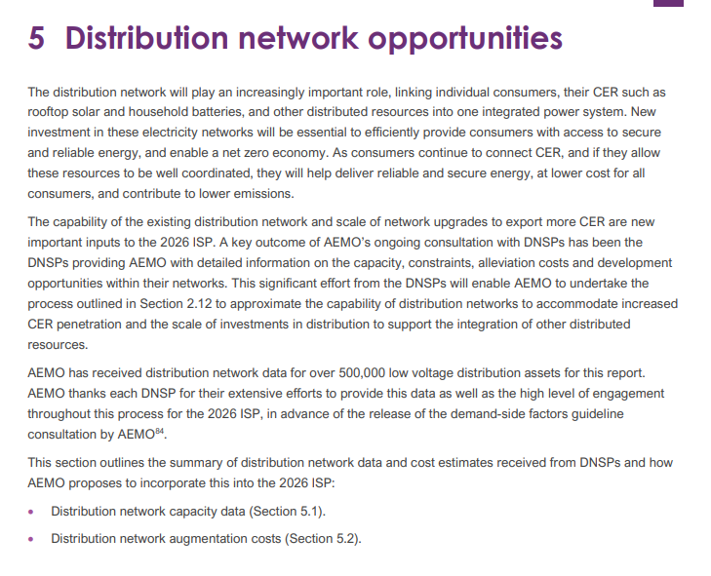


The home energy revolution is here
Source: The Nightly
Source: AEMO

Slide 3


Slide 4
Australia is well on the way to Net-Zero.
This means free, abundant renewable energy for homeowners and families, and zero-emissions homes, cars and personal transport.
What role will insurers play in the energy revolution?

Slide 5
The home electrification revolution is underway
80% of freestanding homes will have rooftop solar by 2050, up from around 30% today.
60% of homes with solar will also have home batteries by 2050 and virtually all vehicles are projected to be electric by 2050.
Australian Energy Market Operator (AEMO) Step Change scenario
Stylised projections of adoption of CER in Australia. Curves are roughly fitted to the AEMO and CSIRO projections but may not exactly match
CSIRO projection

Slide 6
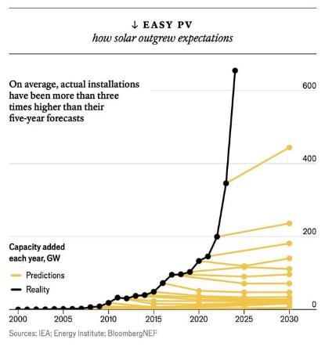

Solar power continues to exceed expectations
However, models have consistently underestimated the speed of uptake of consumer energy resources because they typically
underestimate the downward trajectory of panel production costs, and/or
underappreciate the savings associated with installing solar.
Chart from The Economist with data from IEA, Energy Institute and BloombergNEF. June 2024

Slide 7
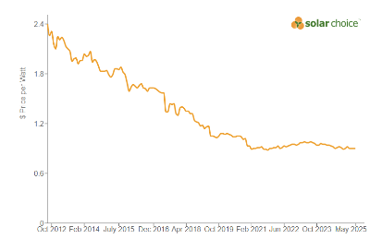
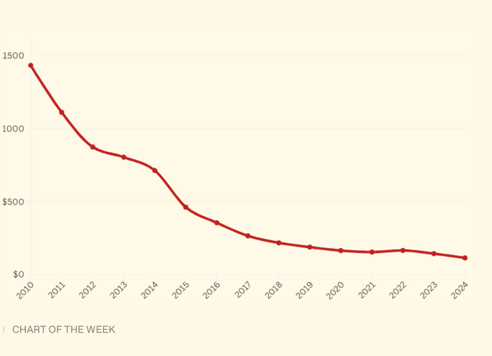

Solar panels, electric vehicles (EVs) and home batteries are becoming more affordable
Solar panels, batteries and EVs (which are closely related to the cost of batteries) are rapidly reducing in price.
More affordable
Better quality
Top: Decreasing costs of installing solar in Australia. Graph from Solar Choice
Bottom: Decreasing costs of battery packs. Graph from Canary Media (in USD/kwh)

Slide 8
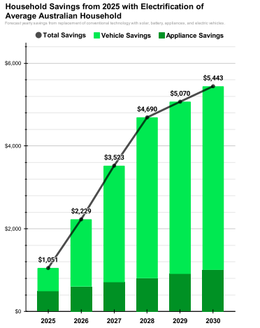


It’s economically and environmentally smart for homes to electrify and generate their own electricity from rooftop solar
Uptake of consumer energy resources will
bring down costs for households, and
reduce the need for expensive, new large-scale generation, transmission and distribution.
Rewiring Australia Castles and Cars

Slide 9
The cost savings provided by home electrification mean we could exceed AEMO projections.
By 2050 virtually every home, apartment block and small business could have solar panels and batteries.

Slide 10
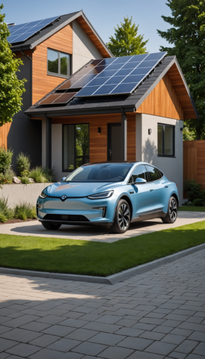

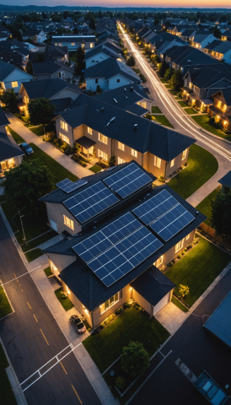
The future of energy in Australia looks very different to today
Home energy will be generated and stored in an integrated system.
Home energy costs will drop.
Cost-of-living pressures will be alleviated.
Home living and personal transport are decarbonised.
The need for expensive, new large-scale generation, transmission and distribution is reduced.
Home energy will be generated by the sun and wind. It will be abundant and low cost.
Homes will be power stations - generating and storing their own electricity.
With battery storage, homes will supply energy for other users – potentially supporting secure energy supply across the national grid.

Slide 11
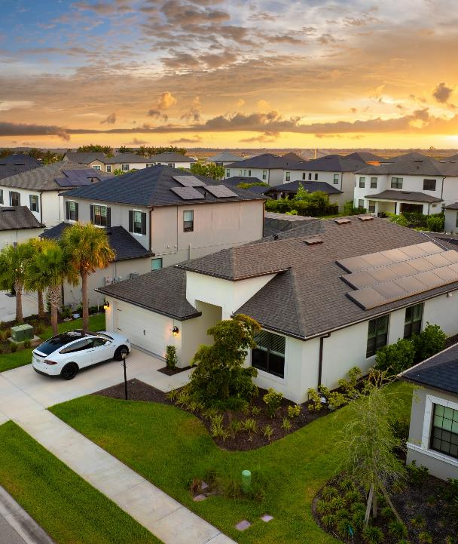
However, the role and cost of electricity from the grid will change…
Households may no longer rely on grid electricity day-to-day. Therefore, the retail electricity market may play a fundamentally different role.
If a household’s solar panels or battery are damaged, they will require
fast backup from the grid.
Grid power may become vastly more expensive because the costs are not shared between many customers.
So, while self-sufficiency may reduce costs for consumers, a battery outage at home could come with a very large bill.

Slide 12



What does this mean for home insurance over the next 10, 15, 25 years – to 2050?
Electric insurance product
Any repairs or replacements of damaged machines would be electric.
A damaged gas water heater would be replaced with an electric one, and a damaged vehicle could be replaced by an electric one (instead of a cash payout).
This would be a meaningful use of insurance companies’ “sphere of influence” - using their influence over household decisions to incentivise uptake of zero emissions technologies.
Home insurance – covering a home energy system
Product Disclosure Statement
2035
Electric insurance product
Could provide a hedge against the retail market which may be significantly more expensive and/or volatile as residential demand decreases.
For example, if damage to solar panels leaves them out of action for a month, this could lead to a very large electricity bill for the household.
An electric insurance product could cover this additional cost to ensure residents aren’t excessively burdened.
This is another way insurers can provide support for the energy transition. By providing cover for some of the cost, insurers are de-risking the investment.
Electric insurance product
Explicitly recognises that the home and vehicle are part of the same energy system
Each contributes to the other, either by the home providing power to the vehicle or the vehicle providing power to the home (or both).
An electric insurance policy would cover both the home and vehicle and any other electric products (e.g. e-bikes)
The Future Insurance Company Pty Ltd.

Slide 13
Scope of cover
Some things need to remain the same
Personal assets insurance policy
Fact sheet
2035
Home insurance
Key Fact sheet – insured events and benefits
2035
Insurance still required for cost to repair physical damage to the home – including the home energy system
Key insured events such as storm (including hail), lightning, bushfire, flood, impact, malicious damage
Accidental damage available as optional cover
Further benefits such as temporary accommodation if home is uninhabitable due to damage caused by insured risk – including damage to the home energy system
The Future Insurance Company Pty Ltd.
The Future Insurance Company Pty Ltd.

Slide 14
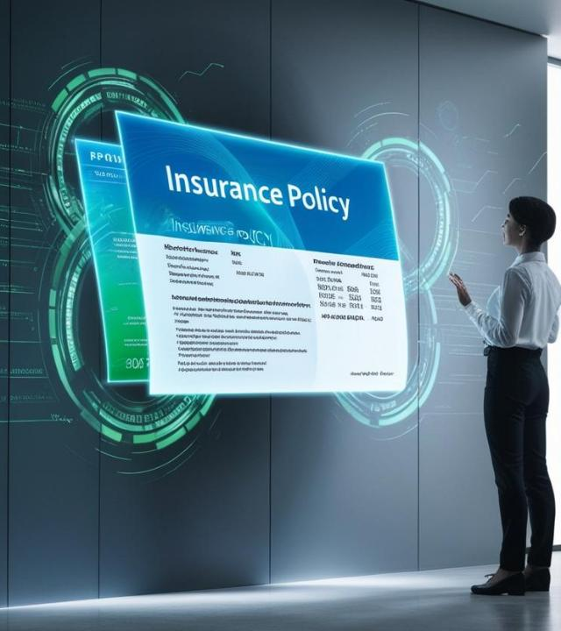
Scope of cover
Some things may need to change
Should a home energy system be clearly defined and covered by the home building policy?
On policy inception/renewal, should homeowners be required to disclose relevant details about their home energy system?
What impact will this have on calculating sums insured?
Should the sum insured include a specific sum for total replacement of the home energy system?
Should sum insured for the cost of replacing a home energy system cover the latest technology/most efficient system?

Slide 15

Scope of cover
What are the new and material risks associated with home energy systems?
Insurance policy
    Economic loss due to energy system damage and cost of sourcing alternative energy supply
    High cost of accessing expert and qualified energy system technicians/repairers
    Third party risks?
    Others?

Slide 16
Handling a claim for home energy system damage
Claims assessment and decision: expert assessment required
Damage assessment and make-safe – should this only be done by a qualified electrician?
How do current standard policy exclusions apply? How does wear and tear exclusion apply if solar panels have pre-existing but minor hail damage?
Should the policy provide a clear definition of ‘maintenance’ required for a home energy system?
If home energy system damage claim is cash settled, how is the cash amount determined?
Cash settle or repair?

Slide 17
Repairing home energy systems
Qualified technicians – noting occupational standards and regulatory requirements
Interaction between and co-ordination of energy system technicians,
and other home repairers (tilers, builders, plumbers)
Developing energy system repair networks
Industry support for training and education of home energy system technicians
Preparing for a scaled response – for example, if 1999 Sydney hailstorm were to occur in 2035
Development of accessible and efficient supply chains for solar panels, inverters, home batteries, chargers, smart meters

Slide 18

Let’s imagine a Sydney hailstorm in 2035…
Solar panels are damaged
  The power supply to the house is disrupted
  All appliances are not working
  Homeowner can’t charge the car (e-scooter, e-bike, work phone…etc.)
  The whole neighbourhood is impacted – thousands of homes have damaged panels and are without power
  Homeowner urgently needs access to the energy grid
  Grid electricity is expensive – possibly hundreds of dollars/day
  Solar panels (and other system elements) need to be repaired
  Specialist repairers are in high demand and expensive.
  Homeowner and family may urgently need temporary accommodation.

Slide 19
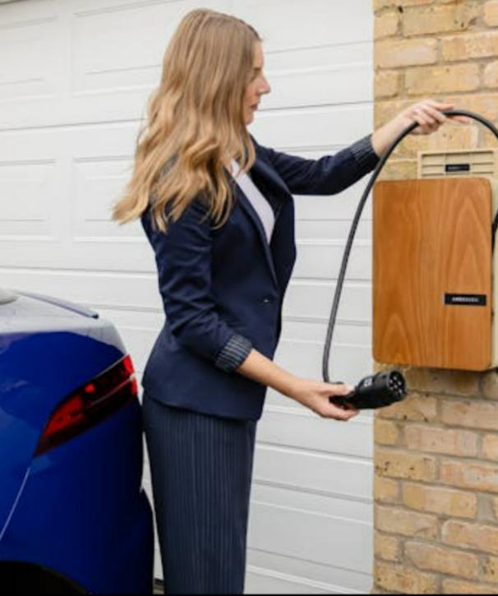
Why it matters to insurers: A blurring of lines
A 2035 scenario: An EV battery fire
The EV battery catches fire in the garage while plugged in at home
The car is damaged
The home electricity system is damaged
The home itself is damaged
  The house needs access to the grid…
  In this future grid electricity is expensive
  …or maybe the house is so damaged it’s unfit to live in
  Alternative accommodation is required
The car is undrivable
Alternative transport is required
Specialist electric mechanics are necessary to repair
Specialist parts must be replaced
The home needs to be repaired, including its electricity system
Home electricity systems require specialist repair resources
What insurance is claimed on? How do you price this?

Slide 20

‘Take note’
AFCA Determination 1069992 – claim for solar inverter system damage
Claim for damage to solar inverter and the associated system
Determination was that damage was accidental and covered by the policy
Cited exclusions did not apply
Insurer must cover the cost to repair the damage, with the exception of the generator main control fuse
Insurer could complete repairs, subject to lifetime guarantee on repair quality
Or cash settle with contingency uplift of 15% to compensate for loss of guarantee and transfer of risk
While amount to settle the claim was not determined, the insured’s quote for work required was ~ $80,000
This matter has raised important issues for insurers to consider in relation to policy cover for home energy systems

Slide 21
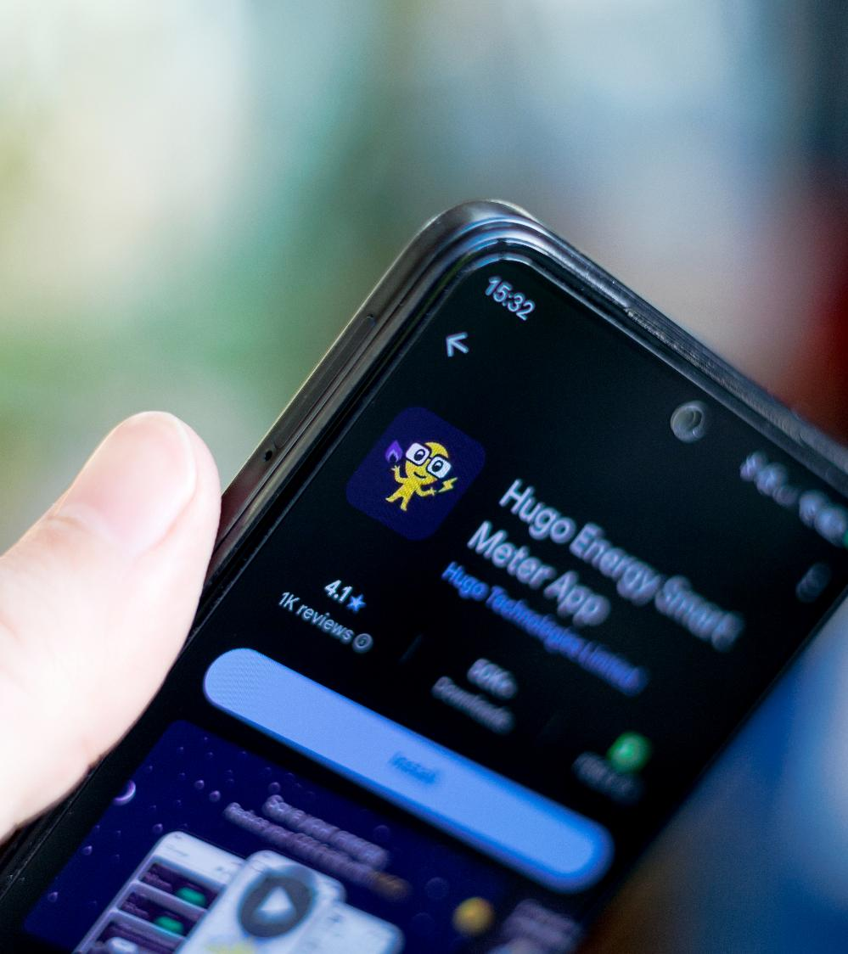
Pricing personal assets insurance
For actuaries, pricing these types of cover will be a challenge
Absence of historical loss information on which to price
Interaction of risks will need to be carefully modelled, e.g. damage to car, resulting in no battery for the home, leading to energy claim
Reinsurers have priced warranties for batteries based on battery testing and thresholds for failure
Potential for smart meters to provide historical data on household energy use to use for pricing
A lot of risks, but a huge opportunity

Slide 22
About the Actuaries Institute
The Actuaries Institute is the peak professional body for Actuaries in Australia. The Institute provides expert comment on public policy issues where there is uncertainty of future financial outcomes.
Actuaries have a reputation for a high level of technical financial expertise and integrity. They apply their analytical and risk management expertise to allocate resources efficiently, identify and mitigate emerging risks and to help maintain system integrity across multiple segments of the financial and other sectors. This unrivalled expertise enables the profession to comment on a wide range of issues including life, general and health insurance, climate change, superannuation and retirement income policy, enterprise risk management and prudential regulation, the digital economy, finance and investment and wider health issues.
© Institute of Actuaries of Australia 2023.​ All rights reserved.

Slide 23
Thank you
Actuaries Institute
actuaries.asn.au

