Slide 1
AI, Actuaries, and Education
Colin Priest
June 2025

Slide 2
AI, Actuaries, and Education
Colin Priest
June 2025

Slide 3
AI, Actuaries, and Education
Colin Priest
June 2025

Slide 4
Contents
The Challenge 05
Should We Ban AI in Education? 11
What is an Actuary? 15
AI Use Cases for Actuaries 22
AI Use Cases in Education 29
What About Assessments and Cheating? 41
AI Usage Guidelines 50
Conclusion 54

Slide 5
The Challenge
01

Slide 6
Bloom’s Taxonomy
Bloom's Taxonomy is a classification system that categorises cognitive learning into six levels. These levels range from basic knowledge acquisition to higher-order thinking skills like synthesis and evaluation.
Remembering
Understanding
Applying
Analysing
Evaluating
Creating

Slide 7
Bloom’s Taxonomy (Simplified)
Bloom's taxonomy can be simplified into 3 levels:
Knowledge
Comprehension
Application
Solve problems or analyse situations
Understand and explain in your own words
Acquire, retain and recall information

Slide 8

Challenges to “Knowledge”
Knowledge
Comprehension
Application
Google it
Knowledge
Notes:
AI's Challenge in Acquiring Basic Information and Facts
AI challenges the acquisition of basic information and facts by potentially providing instant access to vast amounts of data, leading to a reliance on external sources rather than internal knowledge.
This reliance on AI for information may hinder the development of critical thinking skills and the ability to retain and recall information without technological assistance.
Furthermore, AI's algorithms may prioritize certain types of information over others, potentially skewing the understanding and interpretation of basic facts and concepts.

Slide 9
Challenges to “Comprehension”
Knowledge
Comprehension
Application
ChatGPT summarised this document
Comprehension
Notes:
Challenges of AI in Comprehension Development
Complexity: AI poses a challenge in comprehension development due to its ability to process vast amounts of data and generate complex outputs that may be difficult for individuals to fully understand.
Speed: The rapid processing speed of AI systems can overwhelm human comprehension capabilities, making it challenging to keep up with the pace of information analysis and interpretation.
Bias: AI algorithms may introduce biases into the comprehension process, leading to skewed interpretations and hindering the development of unbiased understanding.
Interpretation: Understanding the outputs and decisions made by AI systems requires a high level of technical knowledge and expertise, which can be a barrier to comprehensive comprehension for the general population.

Slide 10
Challenges to “Application”
ChatGPT solved this problem
Knowledge
Comprehension
Application
Application
Notes:
AI Challenges in Application
AI challenges the application of knowledge and comprehension by introducing the need for adaptability and continuous learning. As AI evolves, it requires humans to stay updated with the latest advancements and techniques to effectively apply their knowledge.
Furthermore, AI challenges traditional problem-solving methods by offering new tools and algorithms that can sometimes outperform human capabilities. This necessitates individuals to enhance their problem-solving skills and think creatively to leverage AI effectively in various situations.

Slide 11
Should We Ban AI in Education?
02

Slide 12


A Precedent

Slide 13
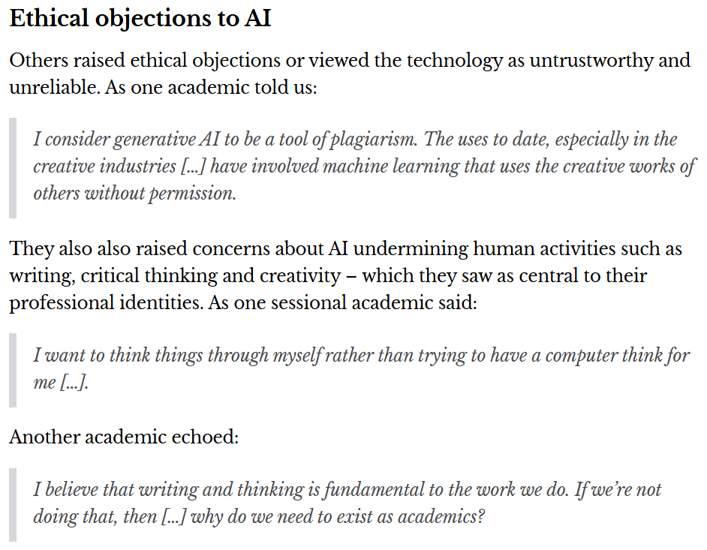
Doublethink?
    “71% of Australian uni staff are using AI.”
    https://theconversation.com/71-of-australian-uni-staff-are-using-ai-what-are-they-using-it-for-what-about-those-who-arent-240337

Slide 14



A Potential Disconnection
Education: Using AI is cheating
Employment: You must use AI to be productive

Slide 15
What is an Actuary?
03

Slide 16
What is an Actuary?

Slide 17
Actuarial Skills
Domain Knowledge
Technical
People

Slide 18
Actuarial Skills
Domain Knowledge
Insurance
Investment
Superannuation
Banking
Regulation
Professional standards
Technical
People

Slide 19
Actuarial Skills
Domain Knowledge
Technical
People
Maths + Statistics
Economics
Finance
Risk Management
Coding + Software
Data Management

Slide 20
Actuarial Skills
Domain Knowledge
Technical
People
Communication
Stakeholder Management
Ethics
Leadership
Teamwork
Negotiation and Persuasion

Slide 21




What is an Actuary?

Slide 22
AI Use Cases for Actuaries
04

Slide 23

Insurance AI Use Cases
    Insurance application processing and triage
    Claims handling
    Customer service chatbot
    Customer communication
    Personalised insurance policy recommendations
    Fraud detection
    Pricing
    Reinsurance contract administration
    Natural language risk profiling
    Customer sentiment analysis
    Policy document review
    Competitor analysis
    Model documentation
    Explaining complex topics
    Identify emerging risks
    Risk scenario generation
    Knowledge management
Notes:
1. Risk Assessment and Underwriting
Automated Policy Underwriting: LLMs can analyze structured and unstructured data, such as medical reports, social media posts (where permitted), and past claims, to enhance underwriting decisions.
Natural Language Risk Profiling: Extract insights from customer-provided descriptions of their property, health, or lifestyle to refine risk categorization.
2. Claims Management
Claims Triage and Processing: Automate the categorization and prioritization of claims by analyzing claim descriptions and attached documents.
Fraud Detection: Identify patterns in claim narratives that are indicative of fraudulent behavior.
Customer Communication: Generate personalized responses for claim status inquiries or assistance requests.
3. Customer Engagement
Personalized Policy Recommendations: Analyze customer queries and suggest appropriate coverage options tailored to their needs.
Chatbots and Virtual Assistants: Provide 24/7 support for policyholders, answering questions about coverage, premium payments, or claims.
Customer Sentiment Analysis: Analyze customer emails or chats to assess satisfaction and identify areas for improvement.
4. Regulatory Compliance
Policy Document Review: Summarize and highlight non-compliance risks in policy wordings or marketing materials.
Regulatory Reporting: Automate the preparation of reports for regulatory filings by extracting required data from company records.
5. Product Development
Market Sentiment Analysis: Extract trends from social media or customer feedback to design new insurance products.
Competitor Analysis: Summarize competitor offerings by analyzing public data like websites, brochures, or news articles.
6. Actuarial Modelling
Data Enrichment: Incorporate unstructured data, such as customer reviews or external reports, to supplement traditional actuarial models.
Trend Identification: Analyze text-heavy data sources to identify emerging risks or changes in customer behavior (e.g., climate change impacts).
Model Documentation: Generate clear and comprehensive documentation for actuarial models and assumptions.
7. Training and Development
Explaining Complex Topics: Use LLMs to explain actuarial concepts to non-technical stakeholders.
Interactive Learning Tools: Build chatbot-based training modules for new hires or ongoing professional education.
8. Portfolio Management
Reinsurance Insights: Analyze reinsurance contracts and treaties to identify opportunities for optimization.
Loss Forecasting: Extract insights from historical claim reports and qualitative data to refine loss forecasts.
9. Scenario Analysis
Risk Scenario Generation: Generate plausible risk scenarios for stress testing or capital modeling, based on market or environmental changes.
Qualitative Insights for ERM: Support Enterprise Risk Management by identifying emerging risks from unstructured data sources like news articles or research papers.
10. Operational Efficiency
Process Optimization: Analyze operational data to identify inefficiencies in workflows or customer interactions.
Knowledge Management: Create and maintain FAQs or knowledge bases by summarizing internal documents and historical queries.

Slide 24

Banking AI Use Cases
    Customer service chatbot
    Loan application processing
    Fraud detection
    Operational risk insights
    Generate stress test scenarios
    Compliance policy review and summarisation
    AML/KYC Support
    Regulatory Reporting
    Customer Sentiment Analysis
    Personalised Financial Advice
    Customer Retention
    Product development
    Product documentation
    Early warning systems
    Generate economic scenarios
    Customer behavioural models
    Incident report summarisation
    Investment insights
    Sustainability and ESG analysis
    Knowledge management
    Due diligence summarisation
24
Notes:
1. Risk Management
Credit Risk Assessment: Analyze customer financial histories, transaction data, and external credit data to improve credit risk modeling.
Fraud Detection: Identify anomalous patterns in transaction narratives or customer communications indicative of fraudulent activity.
Operational Risk Insights: Extract trends from incident reports and internal documents to mitigate operational risks.
Regulatory Stress Testing: Generate stress test scenarios and analyze the potential impacts on loan portfolios or capital reserves.
2. Regulatory Compliance
Policy Review and Summarization: Summarize complex regulatory changes and their impact on banking operations or capital requirements.
AML/KYC Support: Automate Anti-Money Laundering (AML) and Know Your Customer (KYC) processes by analyzing customer documentation for inconsistencies or risks.
Regulatory Reporting: Extract data from unstructured sources to populate regulatory reports or ensure compliance with reporting standards.
3. Customer Insights and Engagement
Sentiment Analysis: Analyze customer feedback and communications to identify satisfaction levels or emerging concerns.
Personalized Financial Advice: Provide tailored suggestions for savings, investments, or loan products based on customer profiles and goals.
Customer Retention: Predict potential churn by analyzing transactional patterns, feedback, and demographic data.
4. Product Development
New Product Insights: Analyze market trends, competitor offerings, and customer feedback to identify gaps and opportunities in product portfolios.
Dynamic Pricing Models: Leverage unstructured data, such as customer behavior and market conditions, to refine pricing strategies for loans or deposits.
Product Documentation: Draft clear and compliant product disclosures, terms, and conditions for new financial products.
5. Credit Portfolio Management
Loan Portfolio Analysis: Summarize and extract insights from reports on credit performance, borrower demographics, and default trends.
Early Warning Systems: Identify signals of portfolio deterioration by analyzing economic data, customer narratives, and repayment histories.
Scenario Analysis: Generate economic scenarios (e.g., interest rate hikes) and assess their impact on loan portfolios.
6. Actuarial Modeling and Forecasting
Loan Loss Provisions: Enhance Expected Credit Loss (ECL) models by incorporating unstructured data like borrower reviews or external economic forecasts.
Behavioral Models: Refine assumptions on customer behavior (e.g., prepayments or defaults) using insights from qualitative data.
Capital Adequacy Projections: Use LLMs to synthesize scenarios for capital planning and stress testing.
7. Fraud and Cybersecurity
Transaction Analysis: Automate the analysis of transaction narratives and supporting documentation to identify suspicious patterns.
Incident Report Summarization: Summarize and categorize internal cybersecurity or fraud incident reports for rapid response.
Phishing Prevention: Analyze email patterns and flag potentially fraudulent or malicious communications.
8. Portfolio Optimization
Investment Insights: Analyze market news, reports, and data to identify opportunities or risks for portfolio adjustments.
Sustainability and ESG Analysis: Summarize ESG risks and opportunities from unstructured sources for inclusion in investment decisions.
9. Operational Efficiency
Process Automation: Automate tasks like summarizing meeting minutes, internal memos, or financial statements.
Knowledge Management: Extract and categorize information from internal documents to create accessible knowledge bases for staff.
10. Training and Development
Interactive Learning: Develop chatbot-based training tools for staff on regulatory updates, financial products, or risk management.
Onboarding Support: Create tailored onboarding plans for new employees using internal policies and industry standards.
11. Market Risk and Economic Analysis
Interest Rate Risk Analysis: Summarize trends and forecasts from central bank publications or economic reports.
Economic Risk Scenarios: Generate plausible risk scenarios for macroeconomic changes (e.g., inflation spikes, recessions) and assess their impact on banking operations.
12. Customer Support and Service
Automated Query Handling: Use chatbots to answer FAQs about banking products, services, and transaction queries.
Document Assistance: Generate summaries or explanations for complex documents, such as loan agreements or account statements, for customer understanding.
13. Mergers and Acquisitions
Due Diligence Summarization: Extract key insights from due diligence reports to evaluate the risks and opportunities of potential deals.
Portfolio Integration: Summarize and analyze the credit and investment portfolios of acquired entities.

Slide 25

Superannuation AI Use Cases
    Personalised member communication
    Customer service chatbots
    Financial literacy tools
    Analyse new regulations
    Identify inconsistencies or non-compliance in fund disclosures or member statements
    Automated responses to member queries
    Summarise and organise internal policies
    Emerging risk detection
    Market sentiment analysis
    ESG summaries from sustainability reports
    Generate economic scenarios
    Automatically draft detailed and clear documentation for actuarial models and their assumptions.
    Summarize key trends or anomalies in projection results for better decision-making
    Customer sentiment and churn analysis
    Trustee and Board Support report summarisation
    Generate customer behavior scenarios
25
Notes:
Member Engagement
Personalized Member Communication: Generate tailored messages to members about their superannuation balances, retirement projections, and contribution strategies.
Chatbots and Virtual Assistants: Provide 24/7 support for inquiries about retirement savings plans, contribution rules, or withdrawal options.
Financial Literacy Tools: Explain complex pension concepts, such as investment options, fees, and taxation, in simplified and personalized terms.
2. Benefit Projections and Planning
Retirement Income Forecasting: Create personalized projections of retirement income, considering contribution rates, investment performance, and inflation assumptions.
What-If Scenarios: Enable members to explore scenarios (e.g., increasing contributions, delaying retirement) with natural language queries.
3. Regulatory Compliance
Legislative Summarization: Analyze new regulations and provide concise summaries of their impact on superannuation funds or pension schemes.
Compliance Document Review: Identify inconsistencies or non-compliance in fund disclosures or member statements.
Policy Communication: Draft compliant and clear communications to inform members about regulatory changes affecting their benefits.
4. Fund Operations
Automated Member Queries: Respond to queries about fund rules, contribution caps, or benefit payment options.
Internal Knowledge Management: Summarize and organize internal policies, investment strategies, and regulatory guidelines for quick access by staff.
5. Risk Management
Longevity Risk Analysis: Analyze demographic data and external sources (e.g., medical advancements) to refine assumptions on life expectancy.
Economic Risk Monitoring: Extract insights from market reports and news articles to assess risks affecting fund performance.
Emerging Risk Detection: Identify new risks, such as cyber threats or inflation shocks, from unstructured external data.
6. Investment Strategy Support
Market Sentiment Analysis: Analyze economic reports, social media, and news to assess market sentiment for portfolio decisions.
ESG Insights: Evaluate environmental, social, and governance (ESG) risks by summarizing data from sustainability reports or news.
Scenario Testing: Generate narratives for economic scenarios (e.g., inflation surges, recessions) and assess their impact on fund portfolios.
7. Actuarial Modeling and Valuation
Data Enrichment: Extract insights from unstructured sources, such as member surveys or industry reports, to enhance actuarial assumptions.
Model Documentation: Automatically draft detailed and clear documentation for actuarial models and their assumptions.
Projection Analysis: Summarize key trends or anomalies in projection results for better decision-making.
8. Member Retention and Insights
Churn Prediction: Analyze member communication patterns and survey responses to identify those likely to leave the fund.
Survey Analysis: Summarize open-ended feedback from members to identify key drivers of satisfaction or dissatisfaction.
9. Trustee and Board Support
Report Summarization: Prepare concise summaries of lengthy board papers, investment reports, or regulatory updates.
Policy Drafting: Generate drafts of policies or position statements based on fund strategies or regulatory needs.
10. Education and Training
Interactive Learning: Develop chatbot-based tools for educating fund staff on superannuation rules or actuarial concepts.
Custom Knowledge Base: Automatically curate FAQs or training materials from internal documents and industry updates.
11. Scenario Analysis and Stress Testing
Member Behavior Scenarios: Simulate potential behaviors (e.g., increased early withdrawals) based on economic trends or policy changes.
Market Stress Scenarios: Create stress test narratives combining economic and demographic data to assess fund resilience.
12. Operational Efficiency
Process Automation: Streamline manual tasks, such as summarizing investment manager reports or member surveys.
Knowledge Discovery: Extract and organize critical insights from internal documents for use in decision-making.

Slide 26

Investment AI Use Cases
    Extracting information from company annual reports
    Investment strategy insights
    Generate economic scenarios
    ESG Integration
    Automate portfolio reviews
    Identify trends and risks by analysing economic reports, central bank updates, and other financial publications
    Stress test scenarios
    Regulatory compliance policy summarisation
    Automated compliance documentation
    Market sentiment analysis
    Competitor benchmarking
    Projection documentation
    Investor reporting
    Stakeholder communication
    Knowledge management
    Sustainability risk assessment
    Climate scenario modeling
    Due diligence and M&A pre-investment analysis
26
Notes:
1. Portfolio Management
Investment Strategy Insights: Analyze market reports, economic publications, and news to identify emerging investment opportunities or risks.
Scenario Analysis: Generate and evaluate economic scenarios (e.g., interest rate changes, geopolitical events) to assess their impact on portfolio performance.
ESG Integration: Summarize environmental, social, and governance (ESG) data from unstructured sources to guide sustainable investment decisions.
Dynamic Rebalancing: Automate portfolio reviews by synthesizing insights from performance reports and market conditions.
2. Risk Management
Market Risk Analysis: Identify trends and risks by analyzing economic reports, central bank updates, and other financial publications.
Liquidity Risk Monitoring: Summarize cash flow trends and transaction data to predict and manage liquidity needs.
Stress Testing: Create plausible stress test scenarios for portfolios, incorporating insights from macroeconomic and geopolitical data.
3. Regulatory Compliance
Policy Summarization: Extract and summarize key insights from evolving regulatory frameworks and guidance.
Compliance Documentation: Automate the drafting and updating of compliance reports, including investment mandates and disclosures.
Risk Governance: Analyze board meeting minutes and regulatory reports to ensure alignment with governance standards.
4. Investment Research
Market Sentiment Analysis: Extract sentiment from market commentary, analyst reports, and news to guide investment decisions.
Thematic Research: Identify long-term investment themes (e.g., renewable energy, AI) by analyzing reports, publications, and online content.
Competitor Benchmarking: Summarize competitor strategies and performance using publicly available data.
5. Actuarial Valuation and Forecasting
Asset Liability Management (ALM): Enhance ALM models by incorporating unstructured data, such as economic forecasts and policy changes.
Longevity and Demographic Risk: Analyze demographic reports and external research to refine actuarial assumptions for long-term liabilities.
Projection Documentation: Automate the generation of clear and comprehensive documentation for actuarial projections.
6. Communication and Reporting
Investor Reporting: Generate detailed yet clear investment performance summaries for institutional clients.
Stakeholder Communication: Automate tailored responses to queries from investors, regulators, or internal stakeholders.
Risk Reporting: Summarize and communicate key risks in investment portfolios using natural language explanations.
7. Operational Efficiency
Process Automation: Streamline repetitive tasks such as summarizing investment committee minutes, fund performance reports, or policy documents.
Knowledge Management: Create searchable knowledge bases from internal documents, research reports, and meeting notes.
8. ESG and Sustainability
Sustainability Risk Assessment: Summarize and analyze sustainability risks using ESG ratings, reports, and public data.
Climate Scenario Modeling: Generate narratives and insights on climate-related risks to guide investment strategy adjustments.
Regulatory Alignment: Extract key points from ESG regulations to ensure compliance and adapt investment policies.
9. Due Diligence and M&A
Pre-Investment Analysis: Summarize investment opportunities, including market position, risks, and growth potential, from due diligence reports.
Post-Acquisition Integration: Extract and analyze key data from acquired entities to guide integration into institutional portfolios.
10. Training and Development
Team Education: Use LLMs to create training materials or conduct interactive sessions on complex investment concepts.
Onboarding Support: Automate the creation of tailored onboarding documents for new analysts or actuaries.
11. Strategic Asset Allocation
Macro Trends Analysis: Analyze global economic trends and forecast their impact on strategic asset allocation.
Horizon Scenarios: Generate long-term scenarios to evaluate different strategic allocations for various time horizons.
Policy Alignment: Summarize how proposed allocations align with an institution’s risk appetite and investment mandates.
12. Client Engagement
Custom Queries: Provide clients with tailored responses to questions about investment strategy, performance, or risk exposure.
Interactive Tools: Build client-facing tools for real-time portfolio insights and projections.
Feedback Analysis: Extract insights from client feedback to refine reporting or investment approaches.
13. Innovation and Product Development
New Asset Classes: Research emerging asset classes (e.g., digital assets, private equity) by summarizing insights from industry reports.
Alternative Investments: Identify opportunities in alternative investment spaces using trends extracted from unstructured data.
Custom Product Design: Generate bespoke investment strategies or products tailored to specific institutional needs.

Slide 27

Data Science AI Use Cases
    Automated data cleaning
    Feature engineering
    Natural language to code
    Model documentation
    Model interpretability
    Scenario generation
    Trend detection of unstructured data
    Code automation
    Pipeline documentation
    Data cataloging
    Stakeholder reports
    Dashboard narratives + insight summarisation
    Model validation
    Text data analysis
    Customer behaviour analysis
    Anomaly detection
    Code explanations
    Code review assistance
    Integration assistance
    Fairness audits
27
Notes:
1. Data Preprocessing and Management
Automated Data Cleaning: Generate code or instructions to handle missing values, outliers, or inconsistencies in datasets.
Feature Engineering: Suggest or create new features based on existing data and problem context.
Natural Language to Code: Translate plain-text data manipulation requests into SQL, Python, or R scripts.
2. Model Development and Validation
Model Documentation: Automatically generate clear documentation for machine learning models, including descriptions of assumptions, input variables, and limitations.
Hyperparameter Optimization: Assist with selecting and fine-tuning hyperparameters for predictive models.
Model Interpretability: Generate natural language explanations of model predictions for use in stakeholder communications.
3. Forecasting and Trend Analysis
Time Series Analysis: Automate the generation of scripts for time series modeling (e.g., ARIMA, exponential smoothing) and forecast visualizations.
Scenario Generation: Create plausible economic or behavioral scenarios for actuarial forecasting.
Trend Detection: Analyze unstructured data (e.g., news, research papers) to identify trends affecting actuarial forecasts.
4. Risk Assessment and Management
Emerging Risk Identification: Analyze external sources, such as news or social media, to identify potential risks for inclusion in models.
Stress Testing: Generate stress test scenarios and evaluate their potential impacts on portfolios or reserves.
Operational Risk Insights: Extract patterns and trends from internal incident reports to refine risk models.
5. Automation and Workflow Efficiency
Code Automation: Automate repetitive data science tasks like EDA, model training, or evaluation using LLM-generated scripts.
Pipeline Documentation: Generate end-to-end documentation for data workflows and processes.
Data Cataloging: Extract metadata and create structured summaries of datasets for better management and accessibility.
6. Communication and Reporting
Stakeholder Reports: Translate technical analyses into accessible reports for non-technical stakeholders.
Dashboard Narratives: Generate automated narratives to accompany visualizations in dashboards (e.g., Tableau, Power BI).
Insight Summarization: Summarize key findings from large datasets or complex models.
7. Actuarial Model Development
Assumption Testing: Generate tests for actuarial assumptions by analyzing data trends or distributions.
Experience Studies: Assist in automating the analysis of experience data, such as mortality, morbidity, or lapse studies.
Model Validation: Provide automated checks for consistency and accuracy in actuarial models.
8. Advanced Analytics
Text Data Analysis: Extract insights from unstructured text (e.g., policy documents, claims narratives) to enhance actuarial models.
Customer Behavior Analysis: Predict customer behaviors (e.g., lapses, renewals) using machine learning models informed by structured and unstructured data.
Anomaly Detection: Identify unusual patterns in claims, transactions, or operational data for fraud detection or process improvement.
9. Education and Training
Learning Tools: Provide interactive tutorials on data science techniques or actuarial concepts using conversational prompts.
Code Explanations: Explain complex code snippets or algorithms to junior team members.
Skill Assessment: Create quizzes or exercises to evaluate team members’ proficiency in data science or statistical techniques.
10. Regulatory Compliance and Governance
Model Audit Trail: Document model development processes for regulatory review or internal governance.
Regulatory Reporting: Summarize and automate compliance reports using structured and unstructured data.
Bias Detection: Identify and explain potential biases in datasets or predictive models.
11. Knowledge Discovery and Insights
Literature Summarization: Summarize industry papers or reports to identify new methodologies or benchmarks.
Competitor Analysis: Extract insights from publicly available data on competitor strategies and products.
Historical Insights: Analyze historical data trends to uncover insights relevant to current actuarial projects.
12. Collaboration and Workflow Integration
Code Review Assistance: Automatically review and suggest improvements for Python, R, or SQL scripts.
Collaborative Documentation: Summarize team discussions or meetings into actionable tasks for data science projects.
Integration Assistance: Help with connecting disparate systems or datasets into a cohesive analytics pipeline.
13. Data Ethics and Governance
Fairness Audits: Assess data and models for biases that may lead to unfair outcomes.
Privacy Risk Analysis: Summarize and enforce compliance with data privacy regulations (e.g., GDPR, CCPA) in workflows.
Transparency Reporting: Generate plain-language explanations of model usage and limitations for ethical AI governance.
14. Innovation and Strategy
New Methodology Discovery: Propose innovative techniques for analyzing data or enhancing actuarial models.
Scenario Planning: Generate future scenarios based on macroeconomic trends to guide long-term planning.
Cross-Industry Insights: Apply insights from other industries (e.g., healthcare, retail) to innovate within the actuarial domain.

Slide 28

Regulatory AI Use Cases
    Regulatory reporting
    Compliance documentation
    Regulatory stress tests
    Emerging risks identification
    Model governance
    Board reporting
    Data quality assessments
    Model documentation
    Fairness and transparency audits
    Market conduct monitoring
    Climate scenario reporting
    Sustainability metrics
    Policy impact analysis
    Public consultation responses
    Transparency tools
    Operational risk quantification
    KYC (Know Your Customer)
    Regulatory updates
    Cross-jurisdiction analysis
    Legislation summarisation
28
Notes:
1. Regulatory Compliance
Solvency Requirements: Assist in calculating and validating solvency capital requirements (e.g., Solvency II, Risk-Based Capital).
Regulatory Reporting: Automate the preparation of reports for regulators, including quantitative and qualitative sections.
Policy Wordings Review: Analyze and summarize policy documents to ensure alignment with regulatory standards.
Compliance Documentation: Generate clear documentation of methodologies, assumptions, and processes for regulatory audits.
2. Stress Testing and Scenario Analysis
Regulatory Stress Tests: Automate the generation of scenarios and evaluation of their impact on reserves and capital adequacy.
Reverse Stress Testing: Identify conditions that could cause financial failure, meeting regulatory requirements for risk management.
Emerging Risks Identification: Use external data to analyze and report on emerging risks (e.g., climate change, pandemics) as required by regulators.
3. Governance and Risk Management
Enterprise Risk Management (ERM): Enhance risk identification, measurement, and reporting frameworks in line with regulatory guidelines.
Model Governance: Document and audit actuarial models for compliance with governance standards.
Board Reporting: Create concise summaries of regulatory findings or requirements for board members.
4. Data Management and Transparency
Data Quality Assessments: Ensure data used in regulatory models meets accuracy, completeness, and consistency standards.
Model Documentation: Generate transparent documentation of assumptions, inputs, and outputs for use in regulatory reviews.
Privacy Compliance: Assess and document compliance with data protection regulations (e.g., GDPR, CCPA).
5. Risk-Based Pricing
Fairness and Transparency Audits: Ensure pricing models comply with anti-discrimination regulations and fairness guidelines.
Market Conduct Monitoring: Analyze pricing data to confirm alignment with regulatory standards for consumer protection.
6. Climate Risk and Sustainability
Climate Scenario Reporting: Support regulatory reporting on climate risks, such as those required by the Task Force on Climate-Related Financial Disclosures (TCFD).
Sustainability Metrics: Calculate and report on sustainability or ESG metrics to meet new regulatory frameworks.
Impact Analysis: Model and report the financial impact of climate-related risks on reserves and capital.
7. Regulatory Innovation and Consultation
Policy Impact Analysis: Simulate the effects of proposed regulations on actuarial models, reserves, and solvency.
Regulatory Benchmarking: Compare compliance practices against regulatory peers or industry standards.
Public Consultation Responses: Summarize and provide technical input for responding to regulatory consultations or proposals.
8. Consumer Protection
Claims Processing Oversight: Ensure claims handling processes comply with fair treatment regulations.
Benefit Adequacy Analysis: Analyze product designs to ensure benefits align with regulatory requirements for consumer protection.
Transparency Tools: Provide clear and accessible explanations of policies, pricing, or benefits for customers.
9. Actuarial Risk Quantification
Capital Allocation Models: Develop and validate models to allocate capital in line with regulatory expectations.
Operational Risk Quantification: Measure and report on operational risks as part of regulatory frameworks.
Liquidity Risk Monitoring: Model and report liquidity risk exposures to ensure regulatory compliance.
10. Financial Crime Prevention
Anti-Money Laundering (AML): Analyze transactional data to identify patterns indicative of money laundering.
Fraud Detection: Monitor claim or policyholder data to identify and mitigate potential fraudulent activities.
KYC (Know Your Customer): Automate KYC processes to align with regulatory expectations on customer due diligence.
11. Training and Awareness
Regulatory Updates: Summarize regulatory changes and their impacts for actuarial teams.
Interactive Training Tools: Develop tools to train teams on regulatory requirements and their practical applications.
12. International Compliance
Cross-Jurisdiction Analysis: Assist multinational firms in understanding and complying with regulations across different countries.
Global Regulatory Reporting: Consolidate and automate reporting processes for various regulatory regimes.
13. Audit and Review Support
Internal Audit Assistance: Provide detailed summaries and validations of actuarial assumptions and methods for internal reviews.
Regulator Inquiries: Automate responses to specific regulatory requests, ensuring clarity and compliance.
14. Monitoring Emerging Regulatory Trends
Legislation Summarization: Summarize proposed or enacted legislation to determine its impact on actuarial practices.
Risk Implications: Analyze unstructured data to identify regulatory trends that may pose risks or opportunities.
15. Pillar Reporting (e.g., Solvency II)
Pillar 1 (Quantitative Requirements): Support capital requirement calculations and model validation.
Pillar 2 (Governance and Risk Management): Develop and document ORSA (Own Risk and Solvency Assessment) reports.
Pillar 3 (Supervisory Reporting and Disclosure): Automate disclosures and ensure compliance with transparency requirements.

Slide 29
AI Use Cases in Education
05

Slide 30
Bloom’s Taxonomy (Simplified)
Knowledge
Comprehension
Application
Solve problems or analyse situations
Understand and explain in your own words
Acquire, retain and recall information

Slide 31


Knowledge
Teachers
Students
    Simplifying explanations in course materials
    Redesigning presentations to be more engaging and intuitive
    Designing learning activities
    Summarising the course details
    Generating multiple-choice quiz questions
    Chatting with an interactive textbook to clarify ideas and check understanding
    Quizzing themselves using AI-powered adaptive questions
    Generating mnemonics and images or diagrams, to enhance memory retention
    Create flashcards based on the course content
    Personalised study plans tailored to individual learning styles and pace

Slide 32
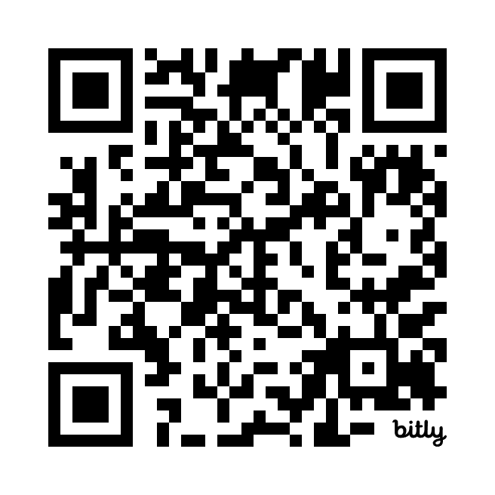
Knowledge: Mnemonics
https://bit.ly/40UaKWk

Slide 33
Bloom’s Taxonomy (Simplified)
Knowledge
Comprehension
Application
Solve problems or analyse situations
Understand and explain in your own words
Acquire, retain and recall information

Slide 34
Comprehension
Teachers
Students
    Brainstorming new questions, structures, and entry points for classroom discussions
    Creating innovative assignments, activities, and learning outcomes
    Designing better rubrics that objectively measure understanding
    Ask students to explain their conclusions to an AI stakeholder simulation
    Chatting with an interactive textbook to clarify doubts
    Generating summaries of complex course material
    Generating simpler explanations of complex concepts
    AI-powered quizzes that provide live feedback and suggestions for improvement
    Personalised study plans tailored to individual learning styles and pace
Presented at the 2025 All Actuaries Summit
34

Slide 35
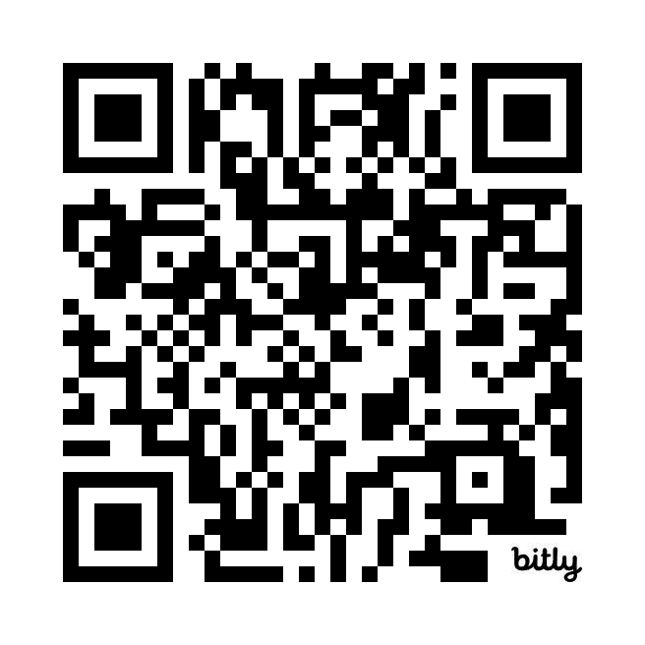
Comprehension: ELI5
https://bit.ly/3CzFkez

Slide 36
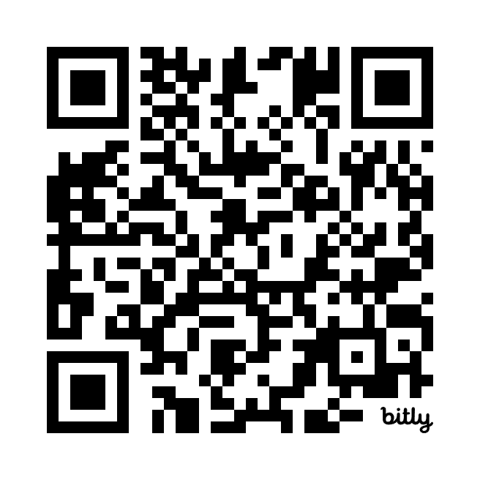
Comprehension: “Own Words” Quiz
https://bit.ly/3WCRydf

Slide 37
Bloom’s Taxonomy (Simplified)
Knowledge
Comprehension
Application
Solve problems or analyse situations
Understand and explain in your own words
Acquire, retain and recall information

Slide 38
Application
Teachers
Students
    Creating realistic scenarios and practical problems for students to solve
    Ask students to explain a recommendation to an AI stakeholder simulation
    Generating discussion prompts for classroom discussions
    Generating convincing AI hallucinations that require critical thinking
    Comparing student work with AI-generated examples, showing how to produce work better than AI in the future
    AI feedback on writing style
    AI feedback on spoken communication
    AI copilot for writing and debugging data science scripts and code
    Test five AI-generated ideas for solving a case study, to determine which is best
    Generate practice exams and provide feedback on practice answers
    Discussions with an AI tutor
    Discussions with AI chatbots simulating stakeholders
Presented at the 2025 All Actuaries Summit
38

Slide 39
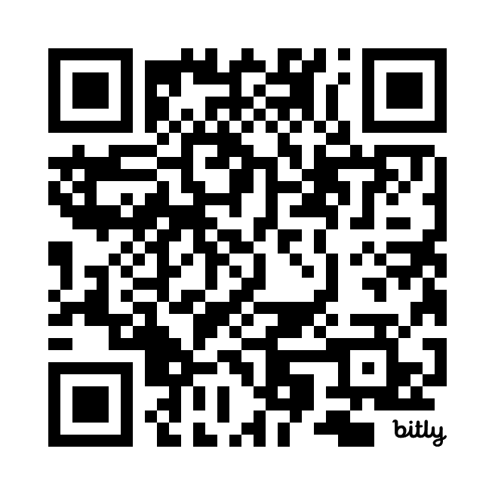
Application: Question Writing
https://bit.ly/40ypUPP

Slide 40
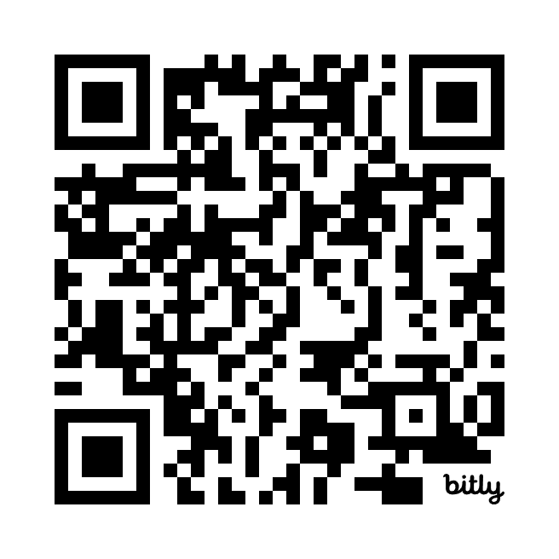
Application: Stakeholder Communication
https://bit.ly/40F9B3t

Slide 41
But What About Assessments & Cheating?
06

Slide 42

AI is the new…
    “AI is the new C work.”
    Bowen, José Antonio, and C. Edward Watson. Teaching with AI. Ascent Audio, 2024.
42
Notes:
One result of the way LLMs use probability to mimic human thinking is that AIs typically produce a predictable or average result. An infinite number of AIs with an infinite number of attempts could eventually reproduce Hamlet, but LLMs have
learned that we mostly just want a clear and efficient but also boring summary. AI is the new C work. Unique but mostly average.

Slide 43

Higher Standards Required
    ChatGPT received a 3.34 GPA at Harvard.
    Bodnick, M. ChatGPT goes to Harvard. Slow Boring. 2023.
43
Notes:
A rising sophomore at Harvard wanted to know whether ChatGPT could have passed her freshman year at Harvard, so she took real assignments from her eight classes and then asked her professors to (re)grade them, telling them they might be
hers or might be ChatGPT. They were all written by ChatGPT (Bodnick, 2023).
ChatGPT received a 3.34 GPA. In general, professors were more effusive about the writing style than the content: “The writer’s voice comes through very clearly.” The worst grade was a C for an essay in Freshman Expository Writing because “this
essay’s claims are consistently large and unclear, in part because key terms are not clearly defined.” A C is the right grade, or at least, it was.

Slide 44

AI Detection Tools
    “OpenAI, the parent company of ChatGPT, initially proposed an accuracy rate of 98% for its classifier, but its own research found that it discovered true positives (of actual AI-written text) only 26% of the time and misidentified (sometimes with high confidence) human-text as AI 9% of the time .”
    Bowen, José Antonio, and C. Edward Watson. Teaching with AI. Ascent Audio, 2024.
44
Notes:
The inability to reliably flag AI plagiarism makes it an unfair approach.
AI plagiarism detection tools are not a practical solution because they have varying accuracy levels and can make mistakes in identifying AI writing, leading to false positives. These tools do not directly accuse students of cheating but provide probability scores, raising concerns about the ethical implications of using them. Additionally, strategies exist to decrease the accuracy of AI detectors, making it challenging to rely solely on these tools for academic integrity.

Slide 45
“Dead” Assessment Styles
    Knowledge and comprehension questions are obsolete.
45
Notes:
No more assessments that require only recall in the student’s own words.

Slide 46

“New” Assessment Styles
    A return to closed-book hand-written exams?
46
Notes:
A return to the good old days?
Biased against ESL students
Further disconnected from real-life skills demanded by employers.

Slide 47

“New” Assessment Styles
    Live interview-style quizzes.
47
Notes:
Biased against ESL students but an in-demand and valuable skill.
However, doesn’t scale and will be expensive and time-consuming.

Slide 48

AI-Specific Assessment Styles
    Student Assignment Question Structure:
    Here is the question
    Paste the AI’s answer
    Write your answer
    Explain the process you went through to write your answer to be better than the AI
48
Notes:
Part 4 is the key. It forces students to develop comprehension.

Slide 49

AI-Aware Assessment Styles
    Keep the old assignment structure:
    Here is the question
    Write your answer
    However:
    The assessment task is designed to be more difficult, primarily requiring complex application.
    The marking guide is scaled to give a failing grade to an AI answer.
    Most marks are earned for documenting the student’s process of obtaining the result, including revisions/corrections to draft answers.
49
Notes:
Just as actuarial exams set higher standards once students began to use spreadsheets, we can recalibrate the assessments for students using AI.

Slide 50
AI Usage Guidelines
07

Slide 51
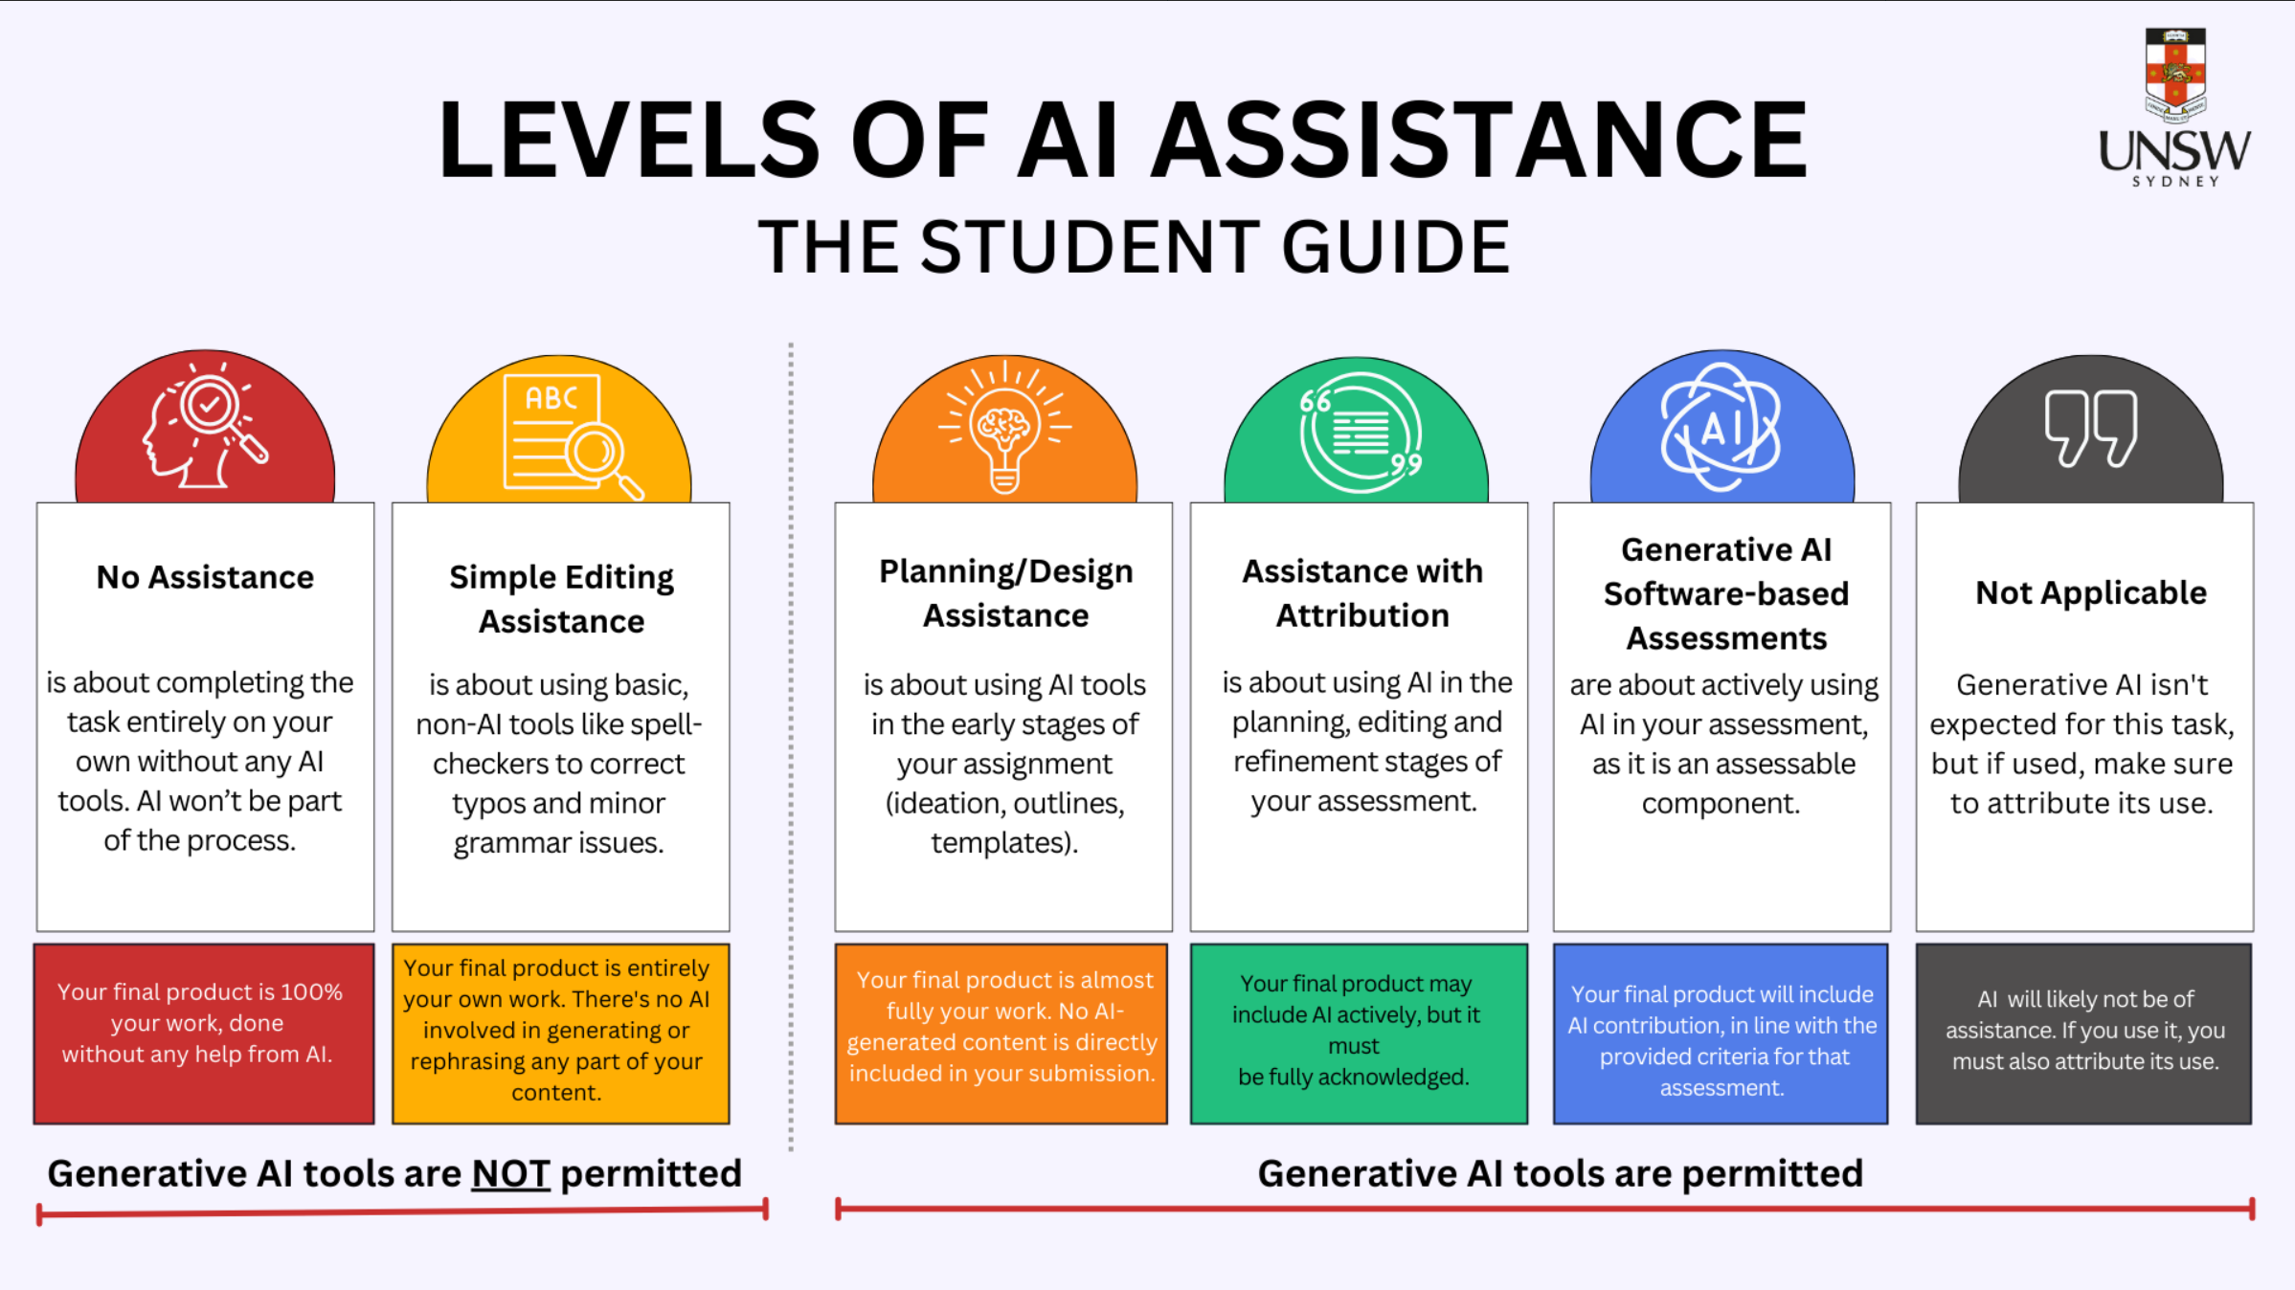
Case Study: UNSW AI Assessment Categorisation

Slide 52
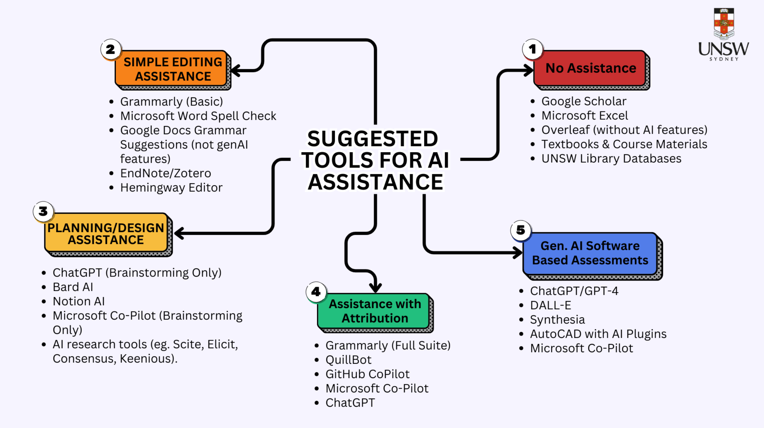
Case Study: UNSW AI Assessment Categorisation

Slide 53
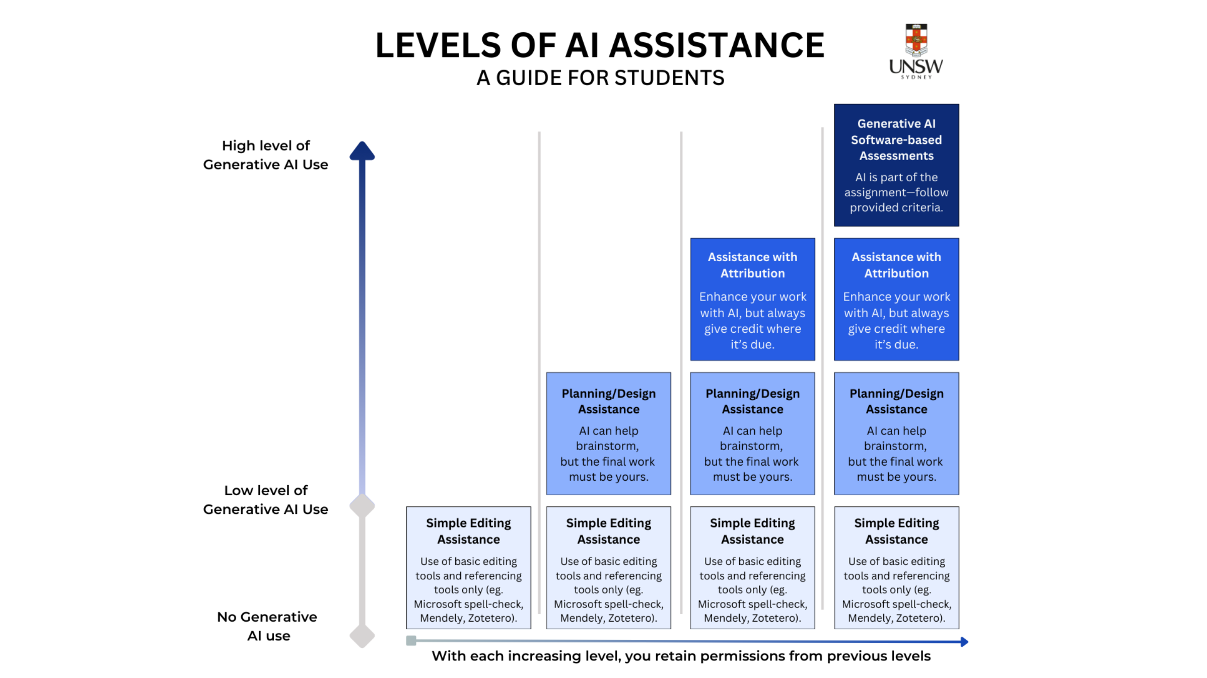
Case Study: UNSW AI Assessment Categorisation

Slide 54
Conclusion
08

Slide 55
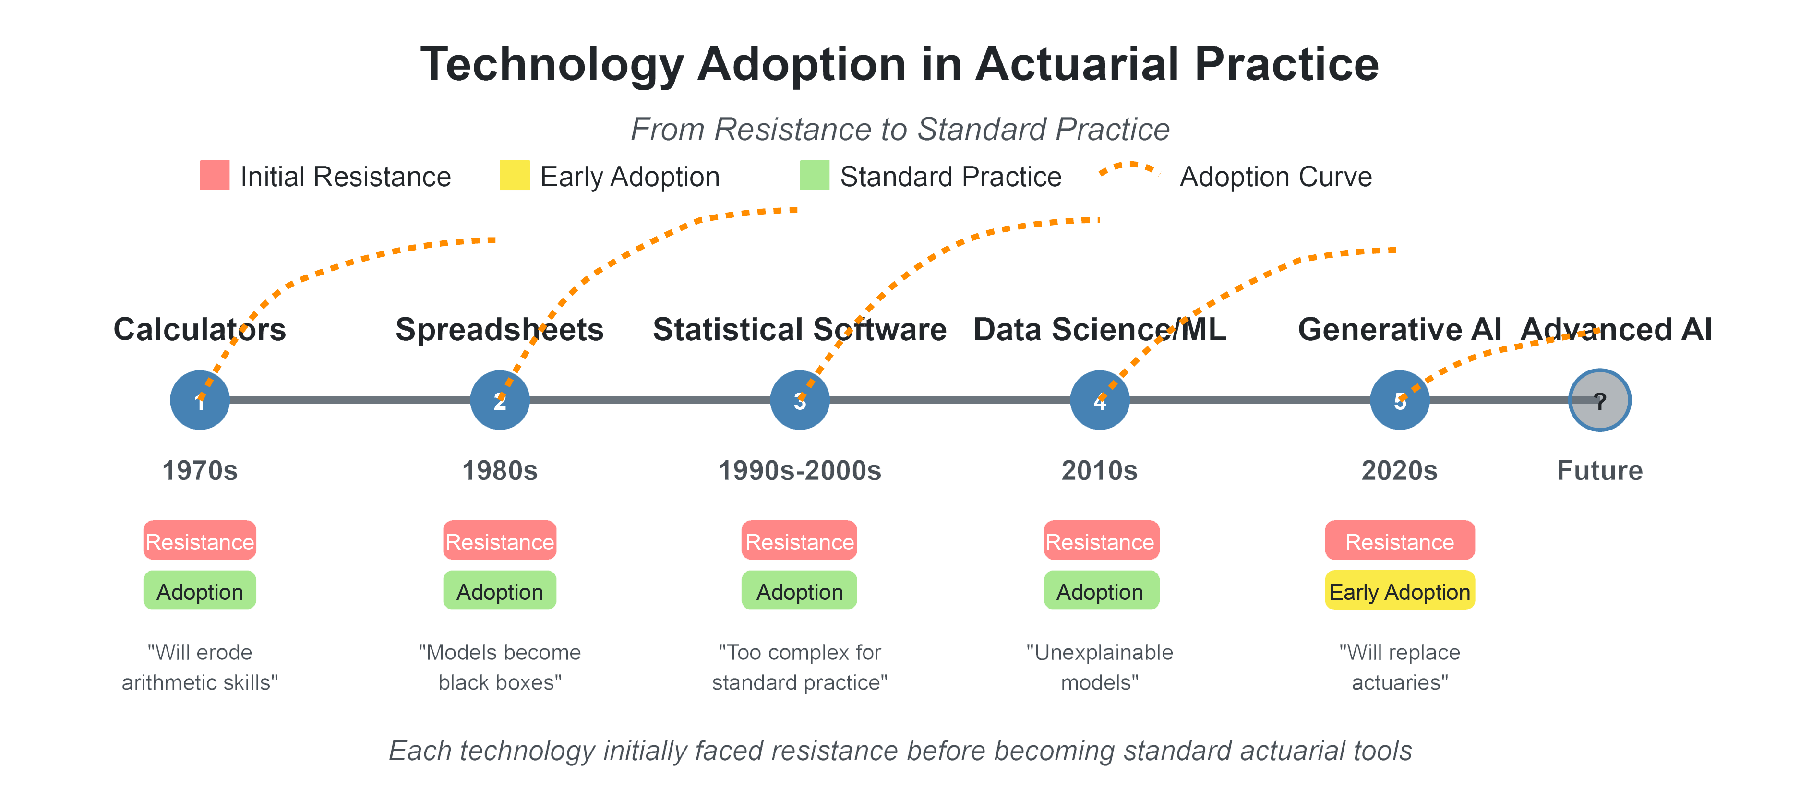
Conclusion
Actuaries have evolved with historical technological advances, and we will continue to do so.
Our education process will ensure it.

Slide 56
About the Actuaries Institute
The Actuaries Institute is the peak professional body for Actuaries in Australia. The Institute provides expert comment on public policy issues where there is uncertainty of future financial outcomes.
Actuaries have a reputation for a high level of technical financial expertise and integrity. They apply their analytical and risk management expertise to allocate resources efficiently, identify and mitigate emerging risks and to help maintain system integrity across multiple segments of the financial and other sectors. This unrivalled expertise enables the profession to comment on a wide range of issues including life, general and health insurance, climate change, superannuation and retirement income policy, enterprise risk management and prudential regulation, the digital economy, finance and investment and wider health issues.
© Institute of Actuaries of Australia 2023.​ All rights reserved.

Slide 57
Thank you
Actuaries Institute
actuaries.asn.au

