Slide 1
HOOT
Mitigating the risk of errors you can’t afford to make
Simone Leas
12 June 2025
01

Slide 2


Slide 3


Slide 4
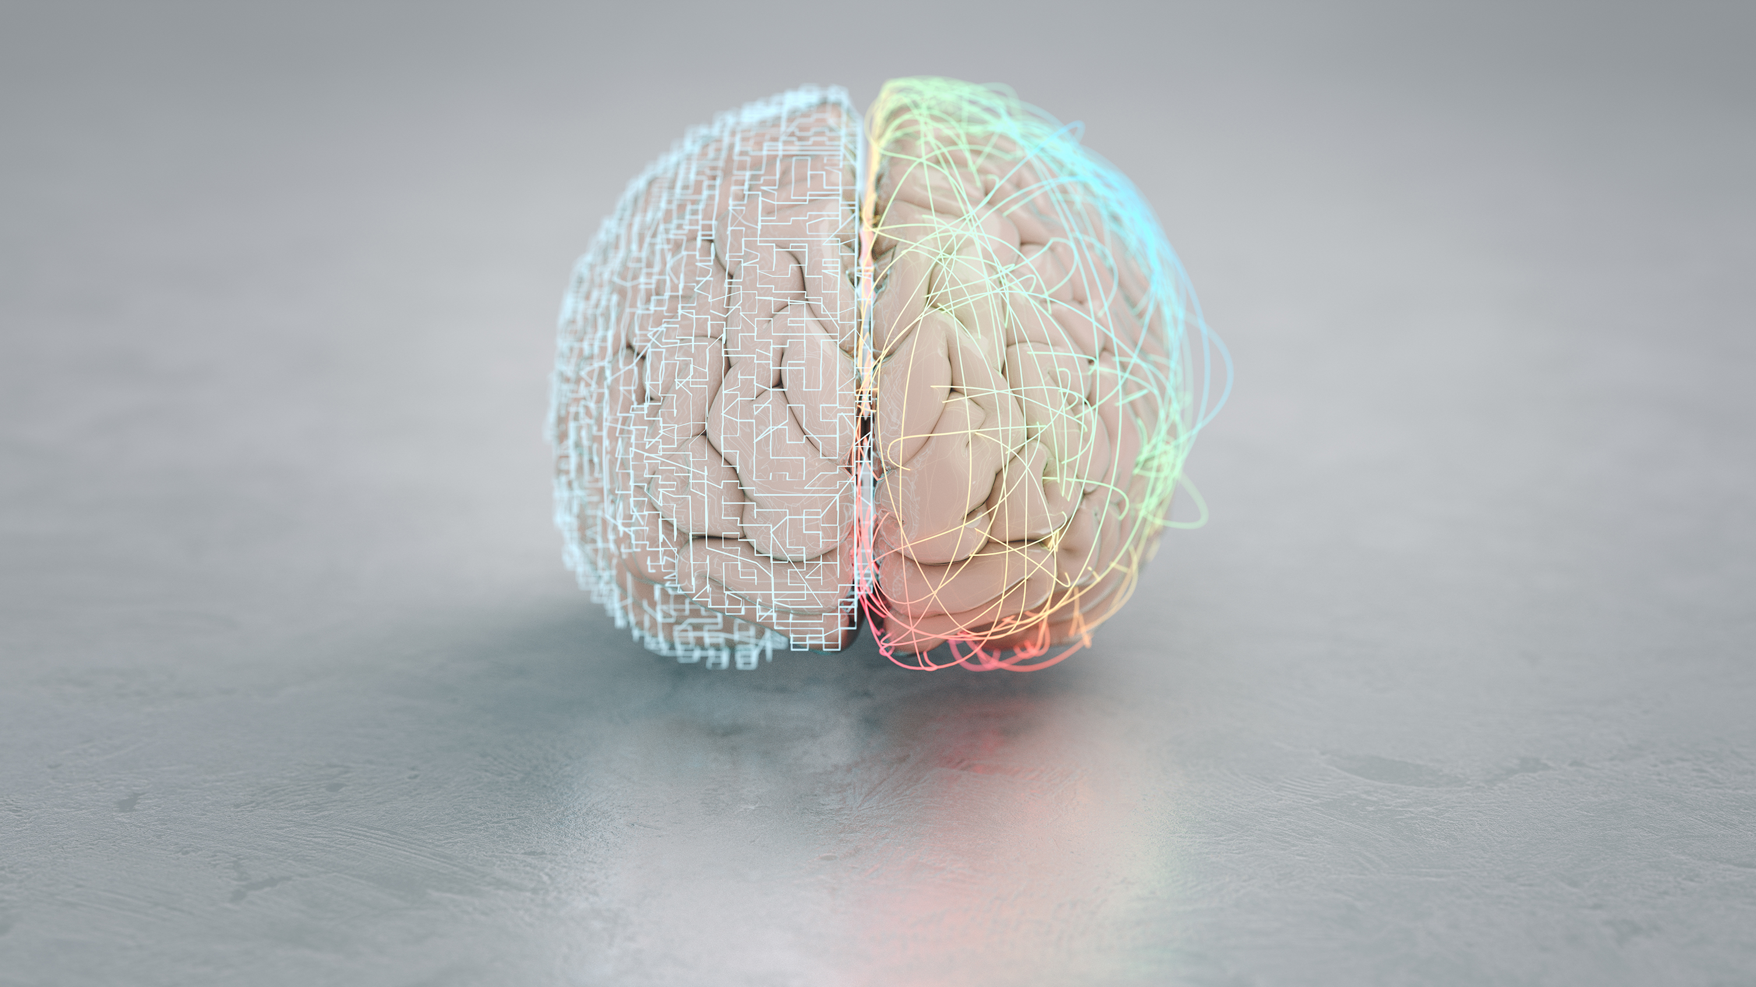

Slide 5
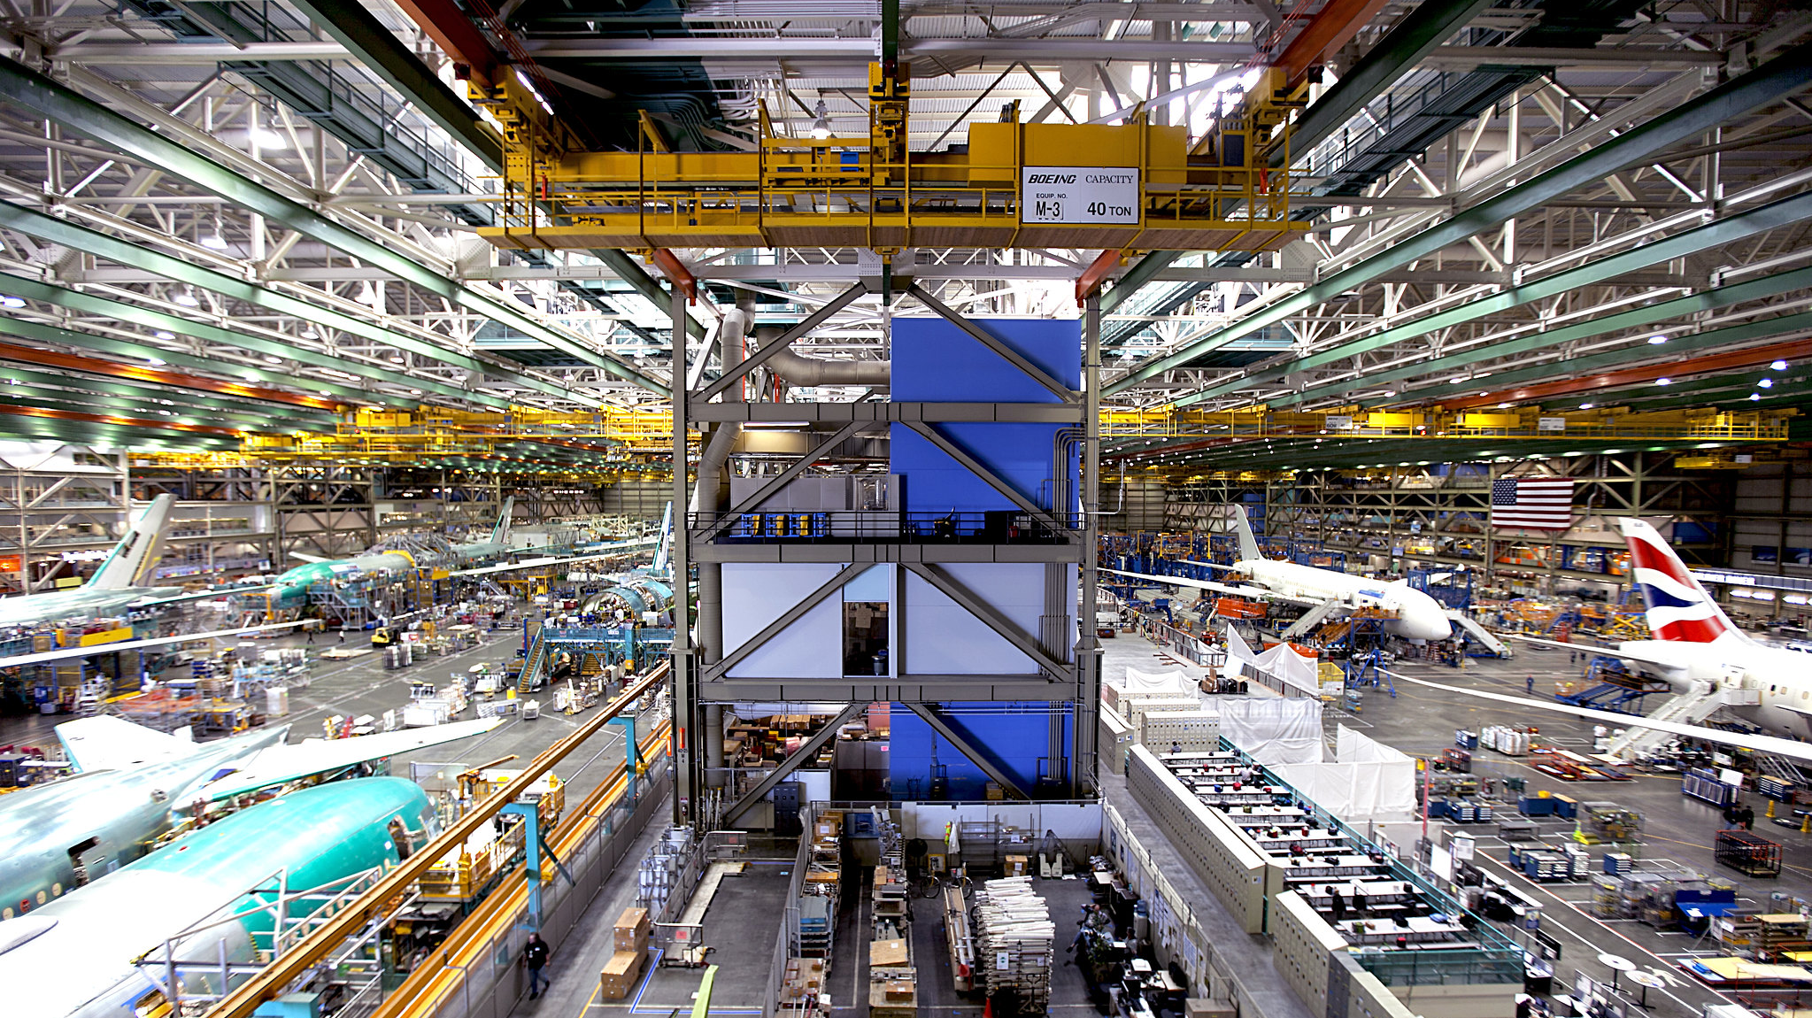

Slide 6
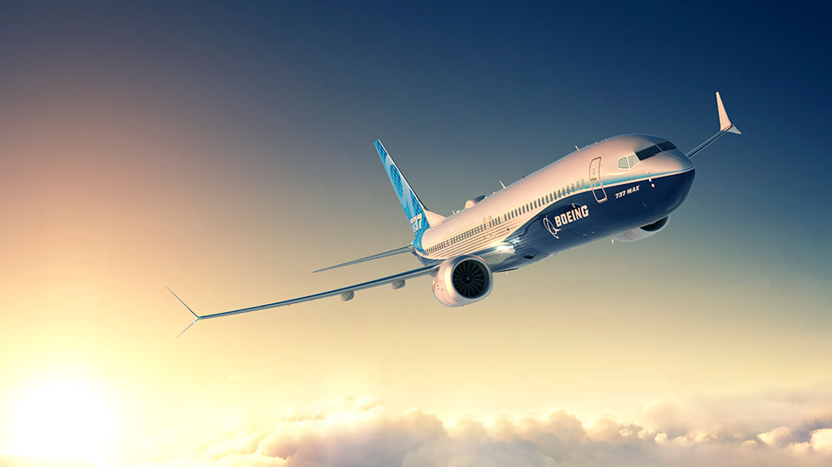

Slide 7
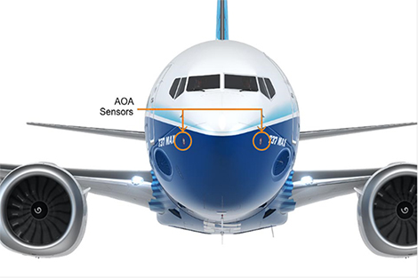
AoA sensors

Slide 8
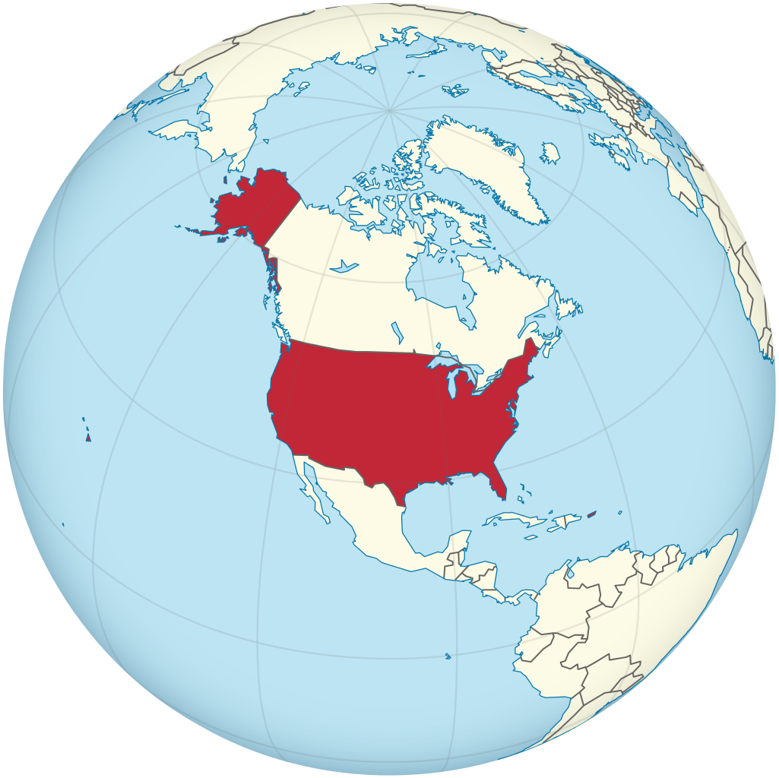
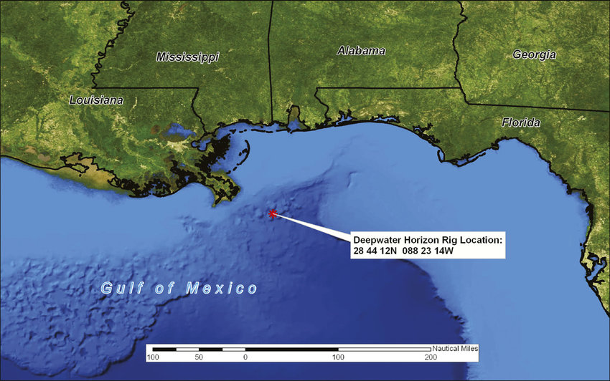

Slide 9
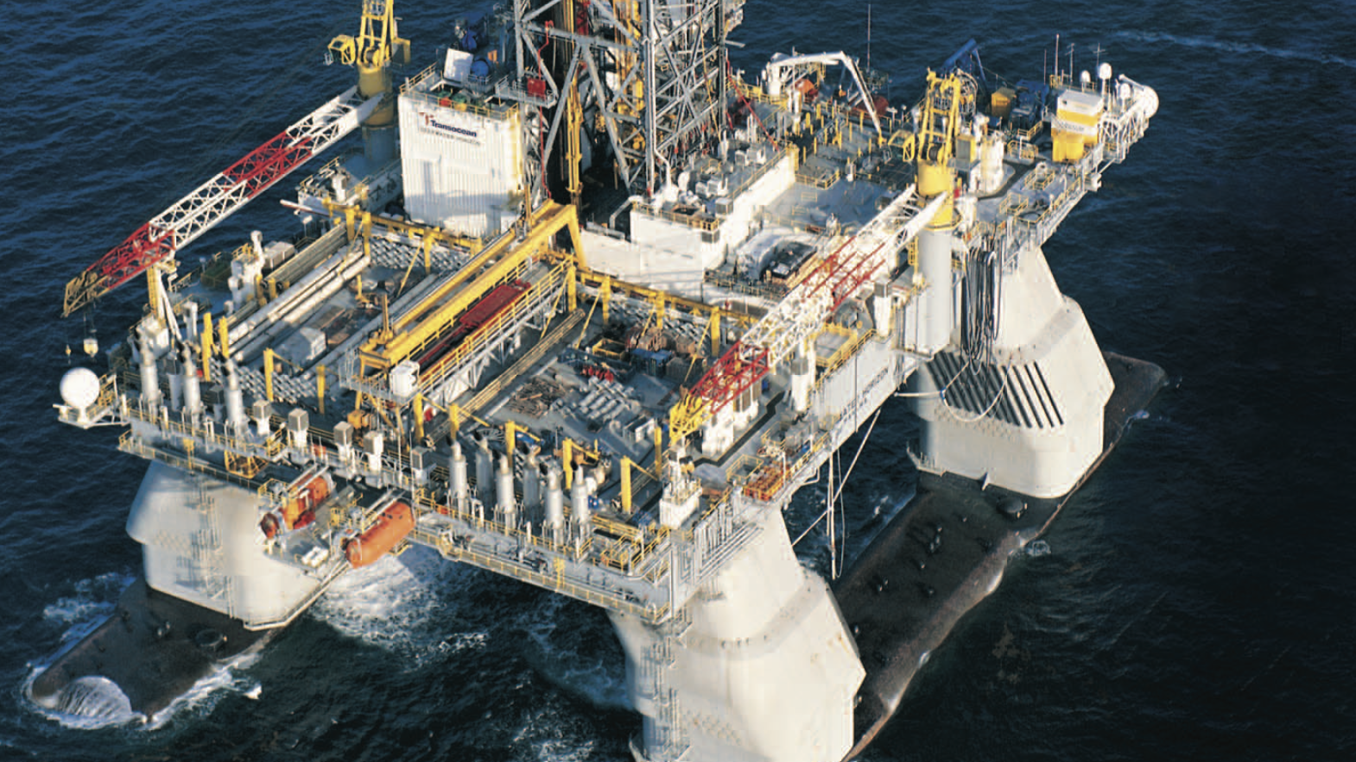

Slide 10
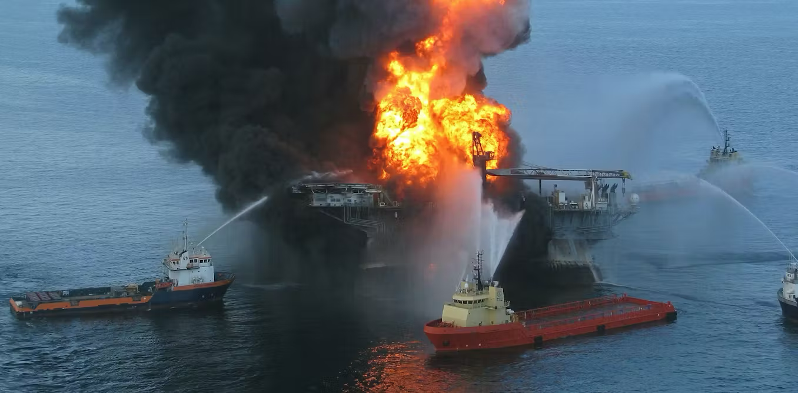

Slide 11
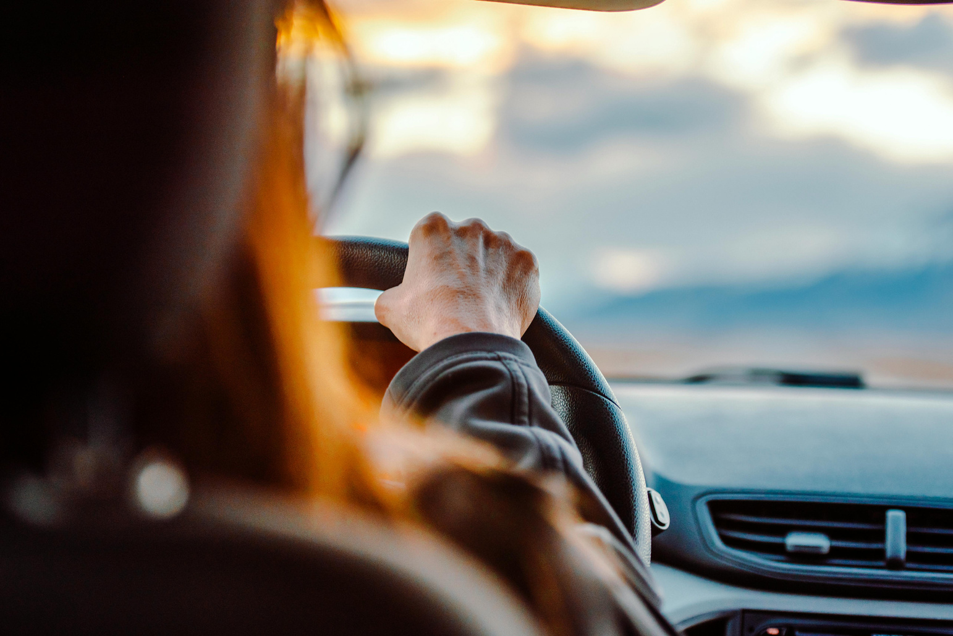


Slide 12

Side Mirrors
Rear Mirrors
Break lights
Windscreen
Tyres
Speed

Slide 13
Premortems
Devil’s Advocate
Outside View
Simplest
Diagnostics
Anonymous Views

Slide 14
Premortems
Devil’s Advocate
Outside View
Simplest
Diagnostics
Anonymous Views

Slide 15
Premortems
Devil’s Advocate
Outside View
Simplest
Diagnostics
Anonymous Views

Slide 16
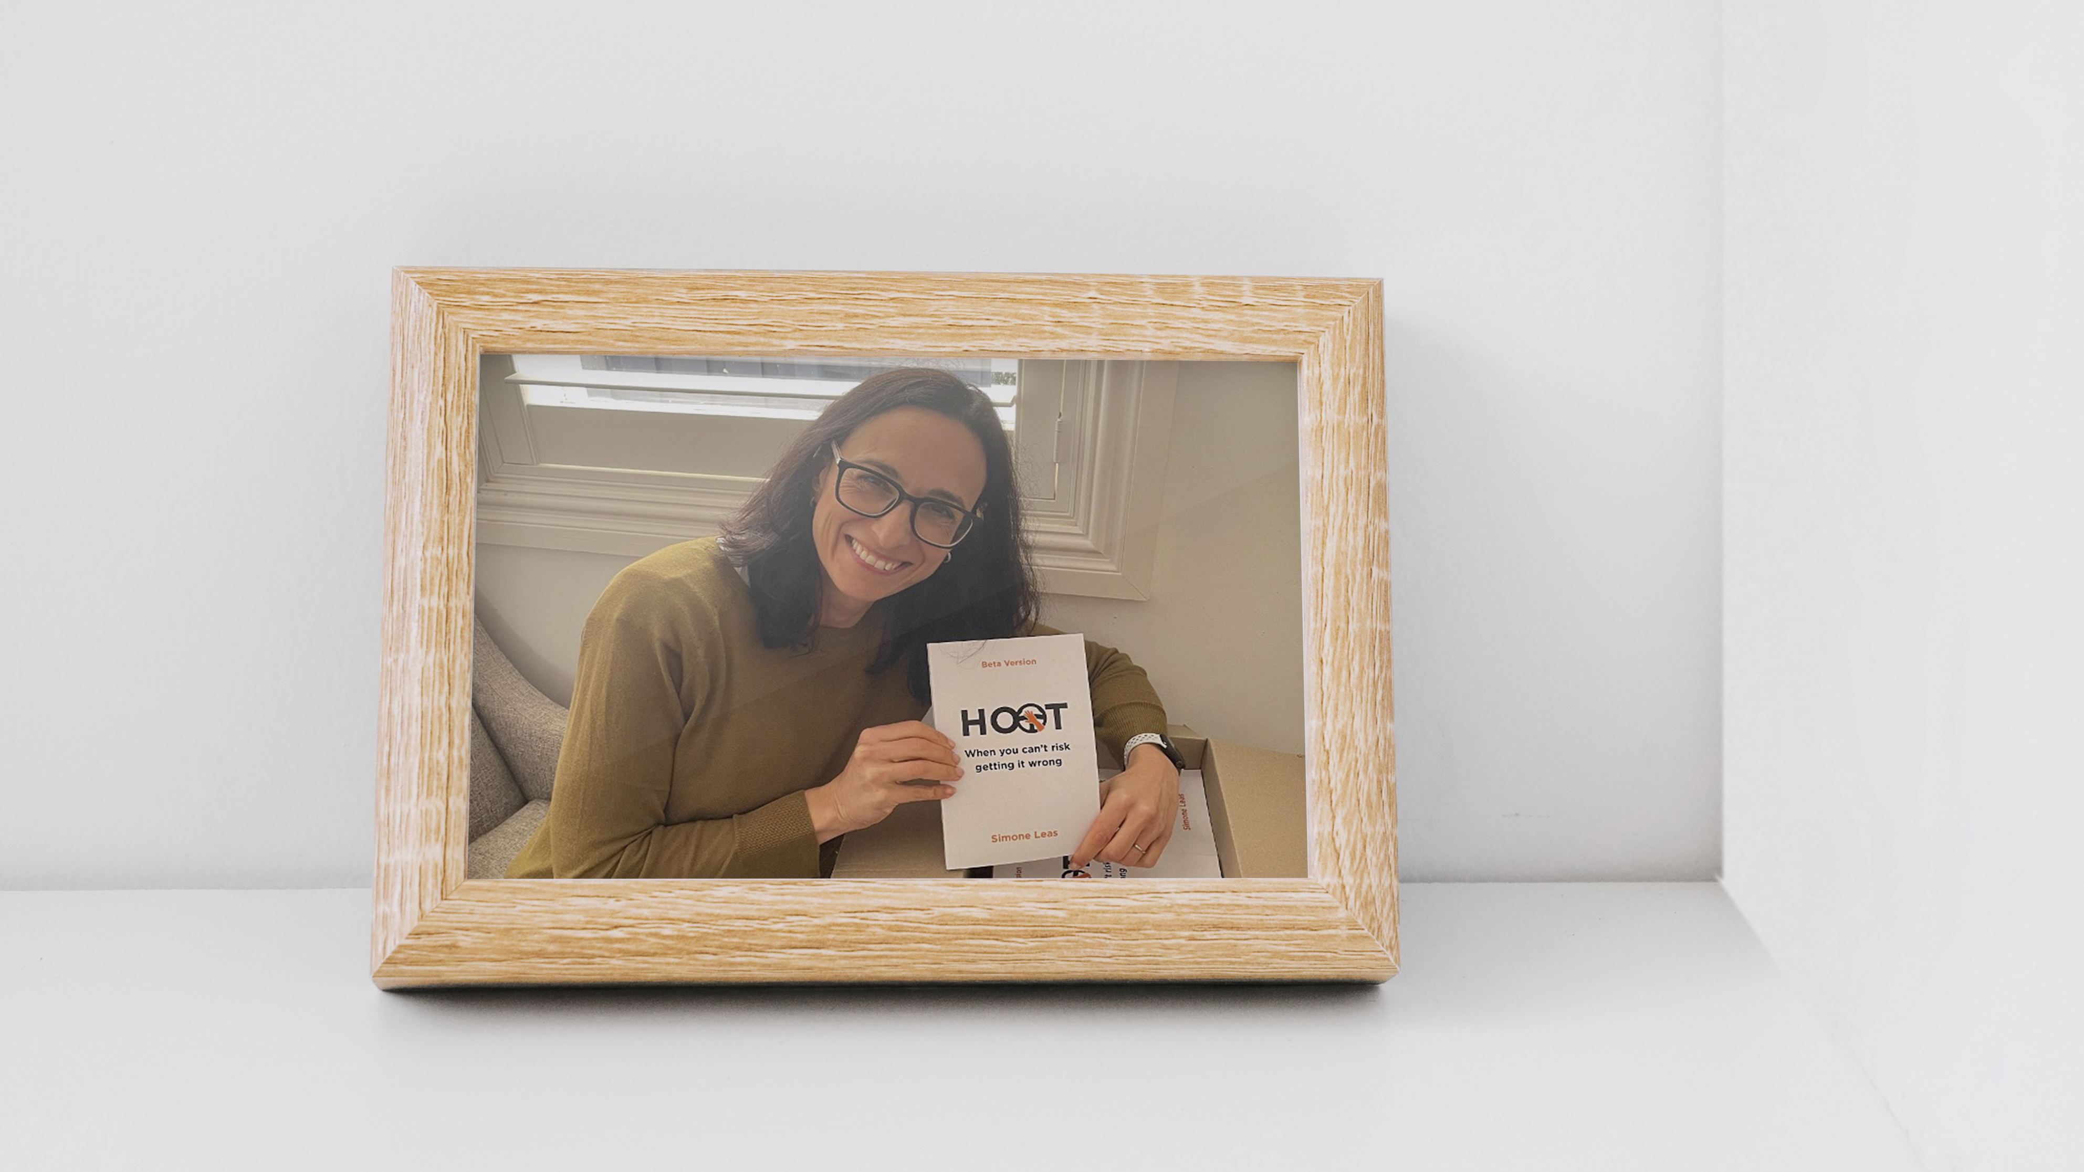

Slide 17
Simone Leas
hootbook2025@gmail.com
Thank you
Actuaries Institute
actuaries.asn.au
01

Slide 18
Source of images
Slide 7: www.flickr.com
Slide 8 - 13: www.boeing.com
Slide 11: https://www.researchgate.net/figure/Location-of-the-Macondo-well-Deepwater-Horizon-spill-in-the-Gulf-of-Mexico-50-miles-80_fig4_51904223
Slide 12:Deep Water: The Gulf Oil Disaster and the Future of Oil Drilling, Report to the President, 2011
Slide 13: https://en.wikipedia.org/wiki/Deepwater_Horizon_explosion

