Slide 1
Managing retirement risks in the personal financial lifecycle
Anthony Asher
June 2025

Slide 2
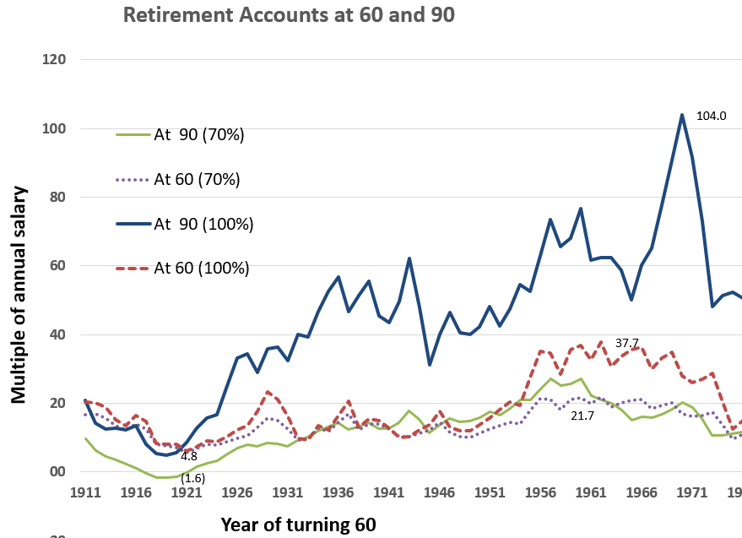
Contents
Moneysmart as a guide
Impossibilities in the context
Financial literacy
There are not enough equities
Returns cannot continue indefinitely
A control system
    Optimization
    Heuristics
    Stabilization

Slide 3
Moneysmart as a guide to the financial lifecycle
Moneysmart a template for industry

Slide 4

Financial Lifecycle - support from Moneysmart
House
Insurance
Payments
Credit cards
Saving
Low-income support
Debt management
Budget
Free financial counselling
Retirement planning
Investing
Mortgages
Financial advice
Emergency fund
Breaks
Car
Retirement products
Retire

Slide 5
Impossibilities in the context
Financial literacy is low
There are not enough assets
Returns will be lower

Slide 6
Financial literacy is low
The Big 3 multiple choice questions (cited >7500 times):
1. Suppose you had $100 in a savings account and the interest rate was 2% per year. After 5 years, how much do you think you would have in the account if you left the money to grow?
2. Imagine that the interest rate on your savings account was 1% per year and inflation was 2% per year. After 1 year, would you be able to buy more than, exactly the same as, or less than today with the money in this account?
3. Do you think the following statement is true or false?
"Buying a single company's stock usually provides a safer return than a stock mutual fund.“
35–55% of Australian adults answer all the Big 3 questions correctly, and no evidence of improvement.

Slide 7
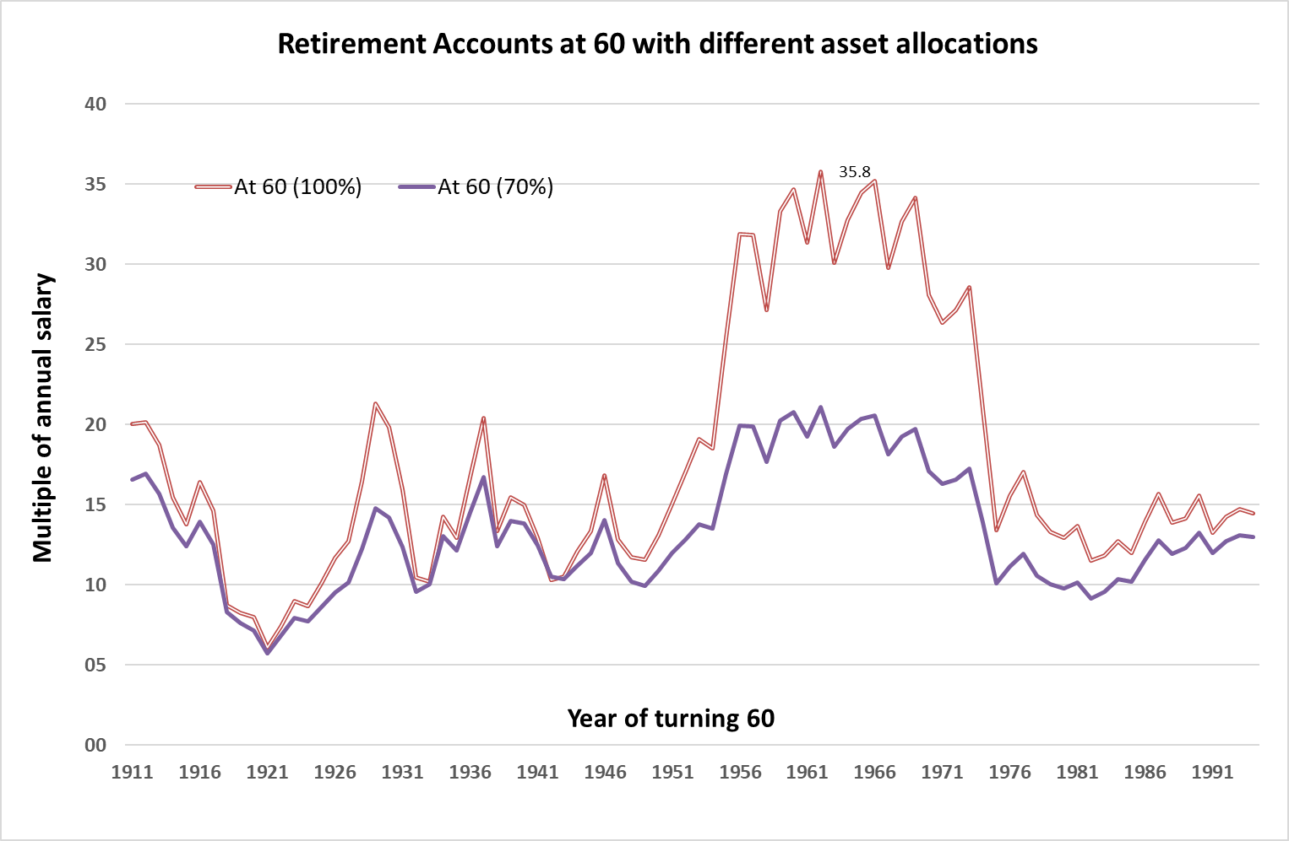
Accumulation of equities
Contribute 12% of income from age 20 to 60.
Actual US experience Robert Shiller. Equities invested in the S&P500 and incur a charge of 1% p.a.
The rest of the assets are invested in short deposits earning the long-term government interest rate. All numbers adjusted for price inflation.
Equities have significantly outperformed.

Slide 8
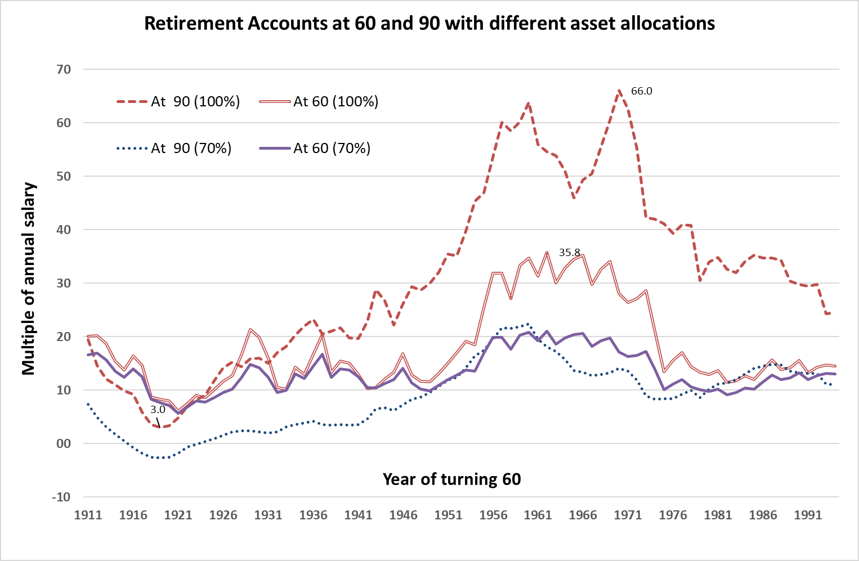
Not enough assets
Contribute 12% of income from age 20 to 60 and then drawing down 60% of income until age 90.
100% equity portfolio grows after retirement 80% of the time. Drops to 24% of the time for 70:30 portfolio.
Average balance over a lifetime with a 70:30 portfolio is 10 times annual wages, twice as much as the market value of total non-residential assets in Australia.

Slide 9
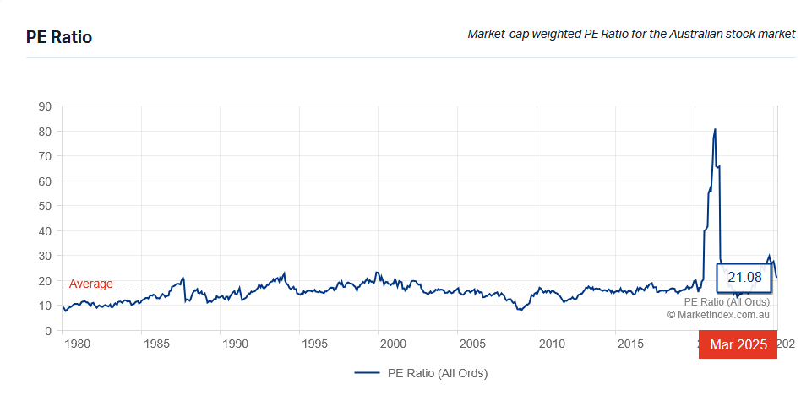
Consequences of too much saving
Inflated asset prices
Average market:book value ratio of shares
in the ASX20 is 2.5
PE ratios high
Land prices, gold, bitcoin at all time highs
Lower future returns
Shiller CAPE good predictor of future returns
Total profits in GDP / total produced assets at MV ≈ 3% without down-rating?
Industry needs to manage investment risk more actively and find other assets

Slide 10
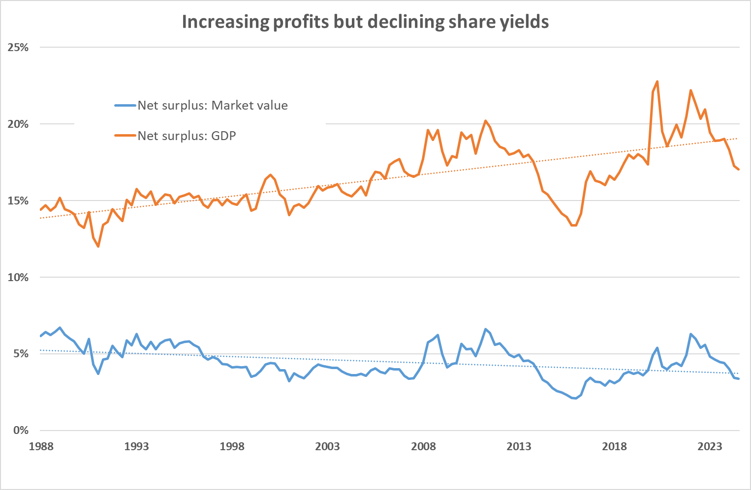
Longer term, returns will be lower
Total profits have been rising relative to GDP – partly due to higher margins, but have been declining as a percentage of the market value of all shares (listed and unlisted).
There is no where for returns to come from unless a significant pickup in productivity.

Slide 11
A control system
Optimisation
Stabilisation
Heuristics

Slide 12


Long term lifecycle control system
Optimisation
Long term expectations:
Income
Returns
Expenses
Margin
Lifecycle plan
Stochastic model
Retirement Calculator
Changes to circumstances
Earnings
Savings/spending
Investments
Measurement system
Stabilization
Controlled process: Earning,
Saving and investing
Adjusts:
Income
Returns
Expenses

Slide 13
Heuristics
“Complexity:
practically uncountable possible variants of control
the interconnection of subsystems and system variables.
real control processes, cannot be described by the … language of linear analysis.“
Therefore, simple rules

Slide 14
Stabilization heuristics 1
Contributions
Adjust size or retirement date depending on balance
May also have to work longer or earn more
Drawdown
Lower risk and adjust down depending on balance
Other sources
Age Pension, Home equity, Family

Slide 15
Stabilization heuristics 2
Expenditure
Insurances where possible
Adjust less essential spending
    Housing
    Medical insurance
Investment
Default lifecycle asset allocation
CAPE timing
Average disinvestment over time (smoothing)
More bond / cash flow generation
Liquidity / emergency buffer of 3 to 24 months expenditure that can be topped up

Slide 16
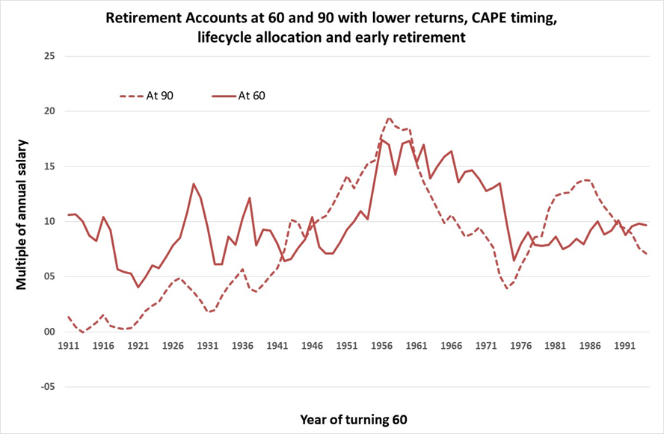
Lower returns & stabilization
Actual US experience – reduced by 2%. Contribute 12% of income from age 20 to 60 and then drawing down 36% of income until age 90.
Stabilization used:
Lifecycle derisking
Retire early if balances adequate
Use CAPE for timing market
Illustrates the need for lower risk investments after retirement. Past would have seen assets accumulating in retirement for 30 years, and almost wipe out in another 15.
Still need to find more assets that can provide lower risk: borrowing for infrastructure, corporate debt, housing repayments.

Slide 17
Summary
Moneysmart as a guide
Impossibilities in the context
Financial literacy
There are not enough equities
Rerating cannot continue indefinitely
A control system
    Optimization
    Heuristics
    Stabilization

Slide 18
Thank you
Actuaries Institute
actuaries.asn.au

