Slide 1
Decoding Annuities: Unveiling Global Trends and Solutions
Helena Hayes & Hamish Wilson
June 2025

Slide 2
Contents
Introduction 03
Market context 08
Research framework 14
Key Results 17
Conclusion 26
Agenda
2

Slide 3
Introduction
01

Slide 4


Introduction
Helena Hayes
Hamish Wilson
Director, Global Individual Retirement Income
Global Head of Individual and Flow
4

Slide 5
Introduction
Helena Hayes
Hamish Wilson
Millennial Rep
Gen X Rep
Director, Global Individual Retirement Income
Global Head of Individual and Flow
5

Slide 6

Investigation Purpose
What were we trying to achieve?
1. Understanding the Disconnect: Perception vs. Value
2. Mapping Sentiment Across Markets
3. Tailoring Solutions by Region
  Our research aimed to explore why guaranteed lifetime income products remain unpopular among consumers, despite their evident long-term financial benefits. This includes exploring the psychological and emotional barriers that limit uptake.
Our aim was to explore consumer sentiment and understanding of lifetime retirement products in the UK, US, and Australia. This was done by identifying awareness levels, investigating misconceptions, and analysing informational gaps that impact interest and trust.
We sought to determine whether key drivers of GLI demand vary by country, and to uncover how cultural, economic, and generational differences should influence our regional strategies and product communication.
Introduction
6
6

Slide 7



Key takeaways
What were our key findings?
Focus group key messages
Across all three markets, the most common trends were as follows:
I want to spend absolutely zero time worrying about maximizing my retirement
- US Gen X Participant
The biggest hurdle for me [in retirement savings] is currently the cost of living: I have nothing leftover to save.
- Australian Millennial Participant
Failing to prioritise
People are simply unaware they should be preparing for retirement, or
Aware but suffering from cost-of-living anxiety
I haven’t really forecasted my retirement. It’s always on my to-do list but it never gets done.
- Australian Gen X Participant
Introduction
Lack of trust
Caution towards insurance in general, unknown brands and government support
Reluctance to rely on digital tools
I’m betting on the fact that I'll live longer than they expect...they might try to find reasons to deny paying me what I'm owed.
- UK Millennial Participant
Financial security underpins everything in my life related to retirement. I want to support my children as well.
- UK Boomer Participant
Don’t know where to start
Analysis paralysis, too many options
Fear of facing reality
7

Slide 8
Market Context
02

Slide 9



Focus Markets
Which markets did we select for our analysis and why?
Market |  | Market headline |  | How did we determine our focus markets?
 |  | World leading in terms of saving for retirement. Lacking in terms of guaranteed income retirement provisions. |  | Diverse Retirement Systems: These markets represent three distinct accumulation models — the US (401(k)-led, largely individual responsibility), UK (auto-enrolment with employer contributions), and Australia (mandatory superannuation) — allowing for comparative insights across systems. Mature Financial Markets: All three countries have developed retirement product landscapes and engaged regulatory environments, providing a rich base for analysing consumer sentiment and awareness. Demographic Pressure: Each market faces similar aging population trends, increasing the urgency and relevance of retirement planning across diverse policy contexts. English-Speaking & Data-Rich: Shared language and strong availability of market data, consumer research, and financial behaviour studies facilitating consistent analysis across the three regions.
 |  | Long history of DB pensions schemes and historic compulsory annuitisation of DC savings prior to the introduction of the Pensions Freedoms in 2015.
 |  | Complex system with rules varying by state. Generally benefiting from a tax advantaged system.
Australia
UK
Market Context
US
9
Notes:
We could also mention Netherlands here as another market

Slide 10
Market Background
Understanding the broader context of the market environment is key
General Commentary | Population | ~27million | ~70 million | ~350 million
 | Size | ~$4tn AUD in DC system | ~$1.3tn AUD in DC system | ~$35tn AUD in DC system
 | Lifetime income take-up | ~3% of ret assets | ~15% of DC savers | ~2% of DC savers
State Benefits | State pension age | 67 | 66-67 | 66-67
 |  | Means tested system | Not means tested
 | State Pension system
Personal savings | Saving for retirement | Compulsory (‘ER 11.5% & 12.0% from 1 July 25) | Auto enrolment – opt-out permitted (min ‘EE 5%,‘ER 3%) | Rules on a state-by state basis, some mandatory others no rules
 | Preservation age | 60 | 55 (increasing to 57) | 60
 | Tax treatment | Taxed on way in, taxed on investments, no tax on way out | No tax on way in, no tax on investments, taxed on way out (25% tax free) | Usually, invest with post tax income, but no tax on earnings. No tax on way out.
 |  | No | No | Yes – annuities defer taxes, allow you to accrue investment income based on pre-tax benefits
 | Tax incentive for annuity purchase
Market Context
10
Notes:
https://www.thinkingaheadinstitute.org/research-papers/global-pension-assets-study-2025/
Aus stats: https://treasury.gov.au/sites/default/files/2023-12/c2023-441613-dp.pdf
UK stats: Mintel paper
US stats: https://crr.bc.edu/how-much-do-people-value-annuities-and-their-added-features-2/?utm_source=chatgpt.com
US annuity # does not include proportion of annuities that that are invested in accumulation lifetime annuities, that may or may not annuities once they get to retirement
UK
Total minimum contribution: 8% of qualifying earnings
Employer must contribute at least: 3%
Employee contributes: 5% (which may include tax relief)
Qualifying Earnings
These are earnings between £6,240 and £50,270 per year before tax. They include:
As of the 2025/26 financial year in Australia, the minimum superannuation contribution (known as the Superannuation Guarantee or SG) is:
11.5% of an employee’s ordinary time earnings (OTE) from 1 July 2024
Scheduled to increase to 12% from 1 July 2025 1

Slide 11
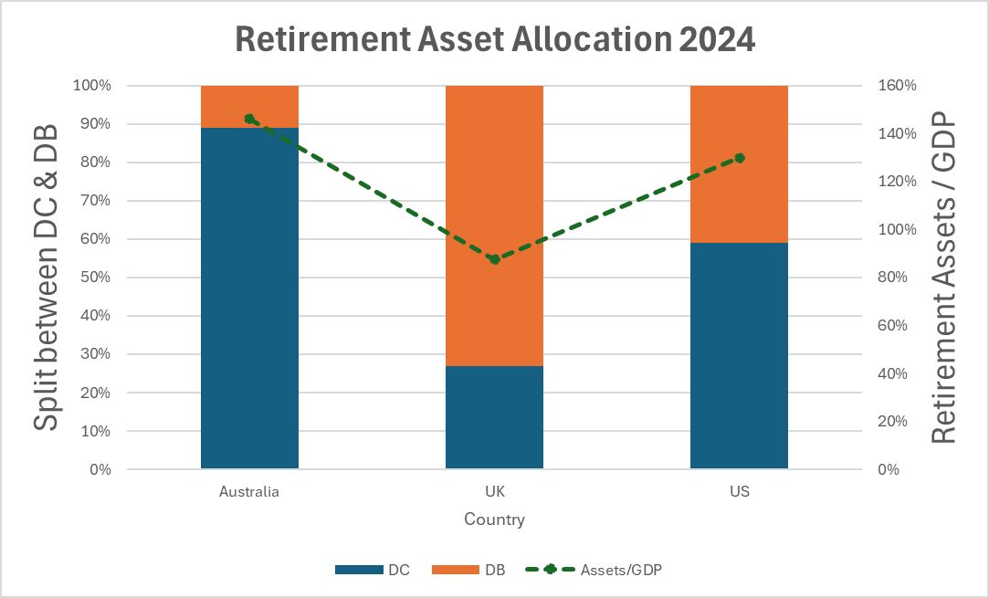
Market Background
Understanding the broader context of the market environment is key
General Commentary | Population | ~27million | ~70 million | ~350 million
 | Size | ~$4tn AUD in DC system | ~$1.3tn AUD in DC system | ~$35tn AUD in DC system
 | Lifetime income take-up | ~3% of ret assets | ~15% of DC savers | ~2% of DC savers
Market Context
This chart demonstrates:
The split between DC and DB assets across all three markets and
The overall retirement market savings coverage by market (expressed as retirement assets / GDP)
11
Notes:
https://www.thinkingaheadinstitute.org/research-papers/global-pension-assets-study-2025/
Aus stats: https://treasury.gov.au/sites/default/files/2023-12/c2023-441613-dp.pdf
UK stats: Mintel paper
US stats: https://crr.bc.edu/how-much-do-people-value-annuities-and-their-added-features-2/?utm_source=chatgpt.com
US annuity # does not include proportion of annuities that that are invested in accumulation lifetime annuities, that may or may not annuities once they get to retirement

Slide 12
Market Background
Understanding the broader context of the market environment is key
State Benefits | State pension age | 67 | 66-67 | 66-67
 |  | Means tested system | Not means tested
 | State Pension system
What’s the difference?
Means-Tested: Benefits are reduced or denied if a person has income or assets above certain thresholds.
Non-Means-Tested: Everyone receives the benefit regardless of their income or assets.
Why it matters?
Means-tested systems can:
  Discourage saving, because higher savings may reduce eligibility for government support.
  Allow governments to focus resources on those who need it most — improving equity and cost-efficiency.
  Be complex and create uncertainty about how much support people will receive.
  Result in sub-optimal decision making e.g. concentrating wealth in assets exempt from the means test.
Market Context
12
Notes:
https://www.thinkingaheadinstitute.org/research-papers/global-pension-assets-study-2025/
Aus stats: https://treasury.gov.au/sites/default/files/2023-12/c2023-441613-dp.pdf
UK stats: Mintel paper
US stats: https://crr.bc.edu/how-much-do-people-value-annuities-and-their-added-features-2/?utm_source=chatgpt.com
US annuity # does not include proportion of annuities that that are invested in accumulation lifetime annuities, that may or may not annuities once they get to retirement

Slide 13
Market Background
Understanding the broader context of the market environment is key
Personal savings | Saving for retirement | Compulsory | Auto enrolment – opt-out permitted | Rules on a state-by state basis, some mandatory others no rules
 | Preservation age | 60 | 55 (increasing to 57) | 60
 | Tax treatment | Taxed on way in, taxed on investments, no tax on way out | No tax on way in, no tax on investments, taxed on way out (25% tax free) | Usually, invest with post tax income, but no tax on earnings. No tax on way out.
 | Tax incentive for annuity purchase | No | No | Yes – annuities defer taxes, allow you to accrue investment income based on pre-tax benefits
Market Context
Australia is an outlier because of compulsory nature of saving for retirement
Tax incentives (or lack thereof), can impact the relative attractiveness of annuities
13
Notes:
https://www.thinkingaheadinstitute.org/research-papers/global-pension-assets-study-2025/
Aus stats: https://treasury.gov.au/sites/default/files/2023-12/c2023-441613-dp.pdf
UK stats: Mintel paper
US stats: https://crr.bc.edu/how-much-do-people-value-annuities-and-their-added-features-2/?utm_source=chatgpt.com
US annuity # does not include proportion of annuities that that are invested in accumulation lifetime annuities, that may or may not annuities once they get to retirement
UK opt –out rate:
As of the most recent data, the opt-out rate for automatic enrolment into workplace pensions in the UK is relatively low. According to the Department for Work and Pensions (DWP), the opt-out rate has remained stable at around 9% to 10% since the introduction of auto-enrolment in 2012
1
.This means that approximately 90% of eligible employees stay enrolled in their workplace pension scheme once automatically enrolled.

Slide 14
Research Framework
03

Slide 15



Research Framework
What was the overall approach?
Research approach
Market Deep Dive | Focus groups
Industry trends Quantitative insights Public policy context Regulation review Product analysis | Multi-generational view Qualitative insights Emotional drivers and attitudes Product and provider perceptions
Research Framework
15

Slide 16












Research Framework
What was the methodology for setting up the focus groups?
Through focus groups conducted in conjunction with Harvard Undergraduate Consulting Group (‘HCCG’), we explored customer sentiment and understanding of lifetime retirement products across the UK, US and Australia and aimed to uncover the key factors that influence demand. We sought to determine if these factors varied by country.
HCCG Led Focus Groups
Sample selection
Age Range
Geography
Country
Question prep
Income
Household
Focus groups were separated by country: US, UK, Australia
Focus groups for each country were tailored to include country-specific questions
Met multiple times with industry experts for each country to review questions
Questions workshopped to focus on guaranteed income solutions
Career Stages
Gender
Pre-Focus group briefing
Research Framework
  All information stated would be anonymized and kept confidential
  No “wrong answers,” but simply different opinions
  Only one person permitted to speak at a time
  Not needed to answer every question, but all should share equally
  Participants were encouraged to voice their opinions even if it differed from the general group
Methods
Privacy
Participants met virtually in small groups with at least two HCCG members present
Moderators ensured all participants shared speaking time equally
All participants were informed their information would be kept confidential and anonymous
No focus groups were recorded, only notetaking was used
16

Slide 17
Key Results
04

Slide 18



Generational Profiles of Australians
Where do Australians fit on the retirement continuum?
Not a priority
People are simply unaware they should be preparing for retirement, or
Aware but suffering from cost-of-living anxiety
Generation Y & Z
< age 44
Greater concern around day-to-day expenses, cost of living, buying a home, etc. Superannuation is often viewed as a set-and-forget system, reducing perceived need for active engagement.
Lack of trust
Caution towards insurance in general, unknown brands and government support
Reluctance to rely on digital tools
Generation X
Age 45 – 60
Wants to plan for retirement but does not trust financial advice, especially digital tools. Often stretched between supporting children and aging parents, can be behind on savings.
Key Results
Don’t know where to start
Analysis paralysis, too many options
Fear of facing reality
Boomers
Age 61 - 80
Terminological complexity, fear of facing reality, and present-day financial stress prevent this group from taking action.
18

Slide 19



Generational Profiles of Australians
Where do Australians fit on the retirement continuum?
Not a priority
People are simply unaware they should be preparing for retirement, or
Aware but suffering from cost-of-living anxiety
Generation Y & Z
< age 44
Greater concern around day-to-day expenses, cost of living, buying a home, etc. Superannuation is often viewed as a set-and-forget system, reducing perceived need for active engagement.
Lack of trust
Caution towards insurance in general, unknown brands and government support
Reluctance to rely on digital tools
Generation X
Age 45 – 60
Wants to plan for retirement but does not trust financial advice, especially digital tools. Often stretched between supporting children and aging parents, can be behind on savings
Key Results
Don’t know where to start
Analysis paralysis, too many options
Fear of facing reality
Boomers
Age 61 - 80
Terminological complexity, fear of facing reality, and present-day financial stress prevent this group from taking action.
19

Slide 20


Generational Profiles of Australians
What are the observable effects?
Not a priority
Generation Y & Z
< age 44
This group expresses a lack of confidence in government pensions
Generally, this group feels as though their superannuation savings will be adequate for them
Lack of trust
Generation X
45 – 60
Almost all participants were worried that they would outlive their superannuation savings
Consumers seem to want guaranteed lifetime income, but they feel that it may be too good to be true.
Participants reported wanting real life stories of guaranteed lifetime income plans working for others, some citing suspicion “of these guaranteed policies”
Key Results
Don’t know where to start
Boomers
61 - 80
Boomers display general distrust of free advice due to concerns about qualifications and hidden intentions.
Boomers are interested but remain cautious of guaranteed lifetime income due to a lack of information and knowledge many stating a need for greater financial and retirement literacy.
20

Slide 21

Generational Profiles of Australians
How do we tailor our solutions?
Early engagement is critical to guiding individuals through the retirement journey and introducing lifetime income concepts before key decision points. A psychological study by the Wharton School showed that cognitive discounting due to temporal distance leads to younger ages delaying retirement savings.
Trust is a consistent barrier across generations and countries. Guaranteed income interest exists across all generations but requires investment in education, engagement and trust-building.
Digital tools and online information is vital for earlier stages of process, however later on face to face is vital. Older generations need human interaction and real life stories to overcome scepticism.
Not a priority
Generation Y & Z
< age 44
Lack of trust
Generation X
45 – 60
Australians value neutral, unbiased information and are often cautious of sales-driven approaches. Australia's trust index stands at 52, indicating a neutral stance on trust in financial institutions, slightly below the global average of 56
There is a general lack of trust in financial advice—especially when it is offered for free—driven by concerns around credibility and hidden motives.
Key Results
Don’t know where to start
Boomers
61 - 80
Consumers want custom options, but not an overwhelming user interface. Studies have shown tools with fewer options improve decision-making efficiency by 32%
Real-life stories play a crucial role — Australians seek tangible evidence that guaranteed retirement income products work
Sources: Brax, Chimney, Charles Schwabb, Northwestern
: Bipartisan Policy Center, NBER, Pension Research Council, Principal Mutual
21
Notes:
Because retirement feels distant, younger people don’t prioritize saving for it — even if they logically know it’s important.
Trust: https://www.edelman.com/sites/g/files/aatuss191/files/2024-02/2024%20Edelman%20Trust%20Barometer%20Global%20Report_FINAL.pdf?utm_source=chatgpt.com

Slide 22
Solutions that can increase customer demand
One size does not fit all in Retirement Solutions
Digital Tools
Brand Perception
Advice
Default Options
Australians show a strong preference for digital tools to support retirement decision-making, but uniquely value personal, real-life stories to enhance those tools.
This contrasts with the UK and US, where emotional storytelling plays a less central role.
Brand recognition plays a more significant role for UK workers choosing a retirement plan, primarily due to the structure of the UK pension system and historical market dynamics.
In contrast, it holds less weight in Australia and the US.
In Australia, financial advice, particularly around retirement, is viewed with caution. Australians tend to be sceptical of "free" advice and place a high value on qualifications and independence.
This contrasts with the UK and US, where advice is more widely accepted and less scrutinised.
Default decumulation options could provide valuable support across Australia, the UK, and the US by helping retirees convert savings into sustainable income, but each market has distinct needs.
In Australia, they offer structure for disengaged retirees; in the UK, they can guide choices post-Pension Freedoms; and in the US, they are helping to guide individuals to lifetime income during the accumulation phase.
Key Results
22
Notes:
Digital tools
Australia: Low trust, high self-direction.
Australians operate in a highly individualised Superannuation system, where responsibility for retirement outcomes largely falls on the individual. This drives demand for digital tools that offer control and clarity. However, low levels of trust in institutions and financial products mean Australians often seek reassurance through peer experiences and relatable personal stories to validate their choices.
UK: Preference for expert-led guidance.
UK savers are generally more institution-trusting and deferential to expert advice or employer guidance. The growing prevalence of default schemes and regulated advice services means personal anecdotes are less critical to engagement.
US: Transactional mindset and familiarity with financial products.
In the US, the retirement system is long-established, and many workers are accustomed to employer-sponsored 401(k) plans and financial apps. Engagement tends to be more data- and feature-driven, with less emphasis on narrative or emotional validation.
Brand perception:
UK: Trust and familiarity drive choice in a fragmented market.
UK workers are automatically enrolled in workplace pensions but often face multiple provider options when switching jobs or consolidating pots. In this context, well-known brands signal trust, stability, and perceived performance, especially as many savers lack deep financial literacy or engagement.
Australia: Default system reduces brand influence.
The Australian Superannuation system relies heavily on default funds selected by employers, meaning most individuals stay in a chosen fund unless they opt out. Brand plays a secondary role because engagement levels are low and switching is rare. Regulatory focus on performance benchmarking also shifts attention away from branding.
US: Employer-led plan selection limits consumer choice.
In the US, retirement plans (e.g., 401(k)s) are typically selected by employers, not individuals. Workers usually choose from a set of investment options within a plan rather than picking a provider. As a result, brand matters less to the end user, who is often more focused on fees, fund options, and employer matching.
Advice
Australia: Legacy of scandals and regulatory change.
A series of high-profile misconduct cases in the financial advice industry (e.g., the Royal Commission into Banking and Financial Services) has significantly eroded public trust. As a result, Australians are wary of conflicted or free advice, especially where retirement savings are at stake. There’s a strong cultural expectation that advisors should be well-credentialed, transparent, and independent.
UK: More established advice infrastructure.
The UK has long had structured, regulated financial advice systems (especially post-RDR reforms), and the rise of workplace pension default options and guidance services means many workers engage without needing full advice. Trust is placed more in systems and employers than in individual advisors.
US: Advice often embedded in employer plans.
In the US, financial advice is often bundled into 401(k) plans or accessed via workplace-provided tools and robo-advisors. It is typically seen as part of the service, rather than a standalone offering, and is less scrutinised because individuals are more used to self-managing or choosing from pre-vetted options.

Slide 23

Overseas case studies
What can we learn from our US colleagues?
Due to the largely self-directed nature of the U.S. retirement system, many providers are placing increased focus on early engagement to support long-term outcomes. In the U.S., some providers now consider retirement planning to begin on the first day of employment.
TOOLS
Innovative tools help participants plan a successful retirement.
RESOURCES
Guidance and advice provide direction and confidence.
EDUCATION
Informed decisions lead to better retirement outcomes.
AWARENESS
Knowing what options, tools, and resources are available.
Key Results
MEMBER RETIREMENT JOURNEY
RETIREMENT BEGINS
23
23

Slide 24


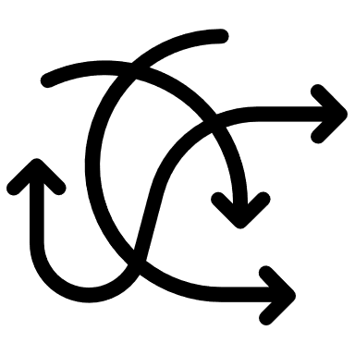
Overseas case studies
Recent US regulation changes
The power of the default option
New regulation (Secure Act 2.0) introduced in the US allows lifetime income products as default options in 401(k) plans, making it easier to include guaranteed income solutions automatically.
Protects employers by reducing legal risks when choosing these default income products.
Requires clear annual income estimates to help savers understand how their savings translate into retirement income.
Makes it simpler for workers to convert savings into guaranteed income without extra steps or withdrawals.
Key Results
24
24
Notes:
SECURE Act 2.0, signed into law in late 2022

Slide 25



Overseas Case Studies
What can we learn from our UK colleagues?
Key Results
Money Helper
Pension Wise
Wakeup Packs
Shopping around
Assessment tools
Free and impartial guidance to help individuals understand their pension options.
Government-backed initiative offering free guidance to individuals over 50 with defined contribution pension pots.
These are designed to provide individuals with timely and relevant information about their pensions. Previously sent only six months before retirement, they have been revamped to be issued earlier.
The FCA mandates that pension providers must inform customers about their right to shop around for annuities rather than simply vesting internally.
Advisers are using more sophisticated and engageable cashflow modelling tools to help customers understand the risks associated with drawdown and retirement income strategies.
25
Notes:
Wake up packs:
First wake-up pack: Must be sent when the member turns 50.
Subsequent wake-up packs: Sent at age 55 (when pension access typically begins) and then:
Every 5 years after that, until the pension is fully accessed.
Additional wake-up pack: Must also be sent when the member asks to access their pension or requests a retirement quote.

Slide 26
Conclusion
05

Slide 27
Global Trends and Solutions “unveiled”
GLOBAL TRENDS
POTENTIAL SOLUTIONS
Failing to prioritise
People are simply unaware they should be preparing for retirement, or
Aware but suffering from cost-of-living anxiety
Early engagement
Normalise engaging with younger members. Planning for retirement starts on day one of employment.
Conclusion
Lack of trust
Caution towards insurance in general, unknown brands and government support
Reluctance to rely on digital tools
Relatable real-life stories
Gradually build confidence and trust in GLI.
Normalise GLI so it's discussed by Australians in the same manner that they currently discuss account-based pensions.
Don’t know where to start
Analysis paralysis, too many options
Fear of facing reality
Improve access to financial advice
Encourage insurers/funds to act on the QAR reforms.
Digital tools have a significant role to play in education and instilling confidence in future generations.
27

Slide 28
Thank you

