Slide 1
Practical Learnings in Applying GBM, GLM and Traditional Analysis in Modelling Life Insurance Claims and Lapses
Jin Cui and Timothy Lam
June 2025

Slide 2
The Actuaries Institute acknowledges the traditional custodians of the lands and waters where we live and work, travel, and trade.
We pay our respect to the members of those communities, Elders past and present, and recognise and celebrate their continuing custodianship and culture.

Slide 3
Contents
Introduction and Context 01
Morbidity Analysis 02
Lapse Analysis 03
Summary 04
Questions and Comments 05

Slide 4
Introduction and Context
01

Slide 5

Motivation
  GLM applications in Life Insurance Experience Analysis increasingly common
  AI, in particular Generative AI front of mind for everyone… BUT…!!!
  Exploration beyond GLM – any practicalities?

Slide 6
This Presentation…
  Is the following:
  Sharing our learnings from applying three different methods in two distinct analyses
  Encourage discussions on the value of analytics in the life insurance industry beyond traditional analysis and GLMs
  Is not the following:
  Insight generation on the modelled data
  Dive into a deep technical discussion on methodologies
  Claiming that GBM is the best analysis method of the three

Slide 7

Classes of Models Explored
  Traditional Analysis
  GLM
  GBM

Slide 8
Considerations
Accuracy
Interpretability
Efficiency

Slide 9
Morbidity Analysis
02

Slide 10
Context and Data
  New Zealand Disability Income Accident Incidence Data
  Regression Analysis

Slide 11

Models Fitted
Traditional
$$\log\left(y_{i}\right)=β_{0}+log⁡({expected}_{i})$$

Slide 12
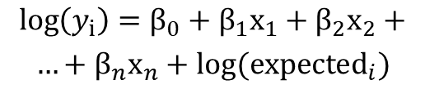
Models Fitted
Traditional
GLM
$$\log\left(y_{i}\right)=β_{0}+log⁡({expected}_{i})$$
$$\log\left(y_{i}\right)=β_{0}+β_{1}x_{1}+β_{2}x_{2}+$$
$$…+β_{n}x_{n}+log⁡({expected}_{i})$$

Slide 13
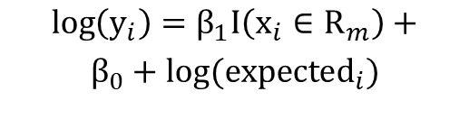
Models Fitted
Traditional
GLM
Regression Tree – 1 Split
$$\log\left(y_{i}\right)=β_{0}+log⁡({expected}_{i})$$
$$\log\left(y_{i}\right)=β_{0}+β_{1}x_{1}+β_{2}x_{2}+$$
$$…+β_{n}x_{n}+log⁡({expected}_{i})$$
$$\log\left(y_{i}\right)=β_{1}I\left(x_{i}∈R_{m}\right)+$$
$$β_{0}+log({expected}_{i})$$

Slide 14

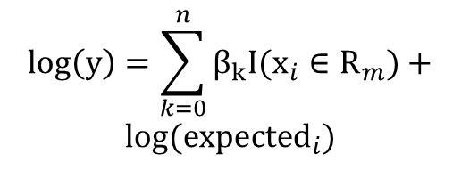
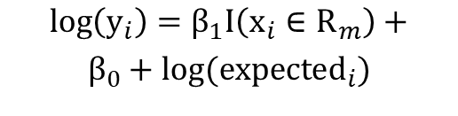
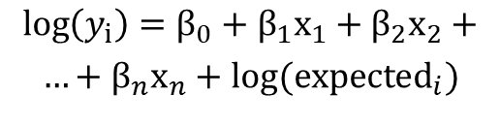
Models Fitted
Traditional
GLM
Regression Tree – 1 Split
$$\log\left(y_{i}\right)=β_{0}+log⁡({expected}_{i})$$
$$\log\left(y_{i}\right)=β_{0}+β_{1}x_{1}+β_{2}x_{2}+$$
$$…+β_{n}x_{n}+log⁡({expected}_{i})$$
$$\log\left(y_{i}\right)=β_{1}I\left(x_{i}∈R_{m}\right)+$$
$$β_{0}+log({expected}_{i})$$
Regression Tree – Many Splits
$$\log\left(y\right)=\sum_{k=0}^{n}{β_{k}I(x_{i}∈R_{m})}+$$
$$log({expected}_{i})$$

Slide 15
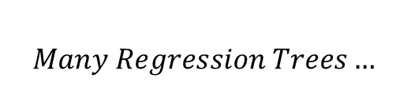
Models Fitted
Traditional
GLM
Regression Tree – 1 Split
$$\log\left(y_{i}\right)=β_{0}+log⁡({expected}_{i})$$
$$\log\left(y_{i}\right)=β_{0}+β_{1}x_{1}+β_{2}x_{2}+$$
$$…+β_{n}x_{n}+log⁡({expected}_{i})$$
$$\log\left(y_{i}\right)=β_{1}I\left(x_{i}∈R_{m}\right)+$$
$$β_{0}+log({expected}_{i})$$
GBM
Regression Tree – Many Splits
$$Many Regression Trees…$$
$$\log\left(y\right)=\sum_{k=0}^{n}{β_{k}I(x_{i}∈R_{m})}+$$
$$log({expected}_{i})$$

Slide 16
Models Fitted
Traditional
GLM
Regression Tree – 1 Split
$$\log\left(y_{i}\right)=β_{0}+log⁡({expected}_{i})$$
$$\log\left(y_{i}\right)=β_{0}+β_{1}x_{1}+β_{2}x_{2}+$$
$$…+β_{n}x_{n}+log⁡({expected}_{i})$$
$$\log\left(y_{i}\right)=β_{1}I\left(x_{i}∈R_{m}\right)+$$
$$β_{0}+log({expected}_{i})$$
GBM
Regression Tree – Many Splits
$$Many Regression Trees…$$
$$\log\left(y\right)=\sum_{k=0}^{n}{β_{k}I(x_{i}∈R_{m})}+$$
$$log({expected}_{i})$$

Slide 17
Accuracy

Slide 18
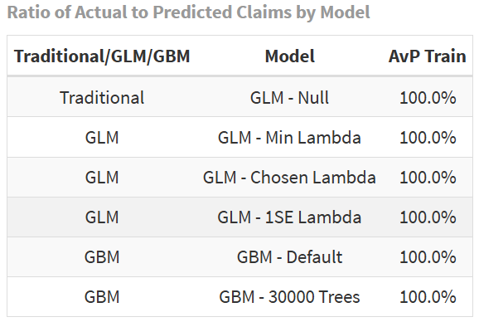
Accuracy – Actual vs Predicted

Slide 19
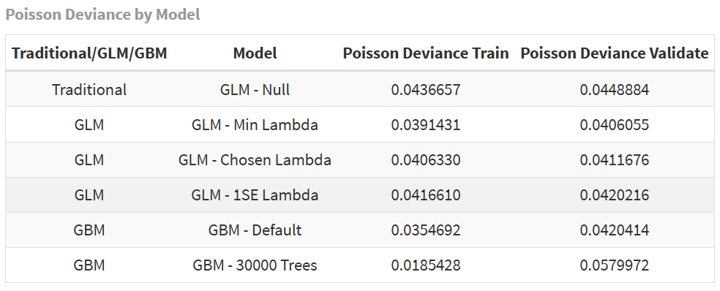
Accuracy – Poisson Deviance

Slide 20
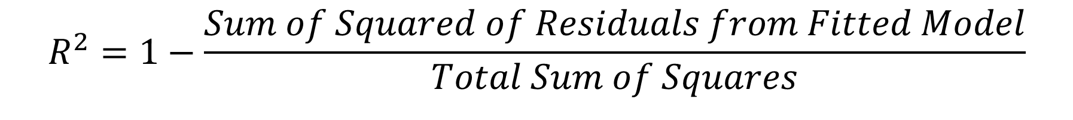
Accuracy – Pseudo R-Squared
$$R^{2}=1−\frac{Sum of Squared of Residuals from Fitted Model}{Total Sum of Squares}$$

Slide 21
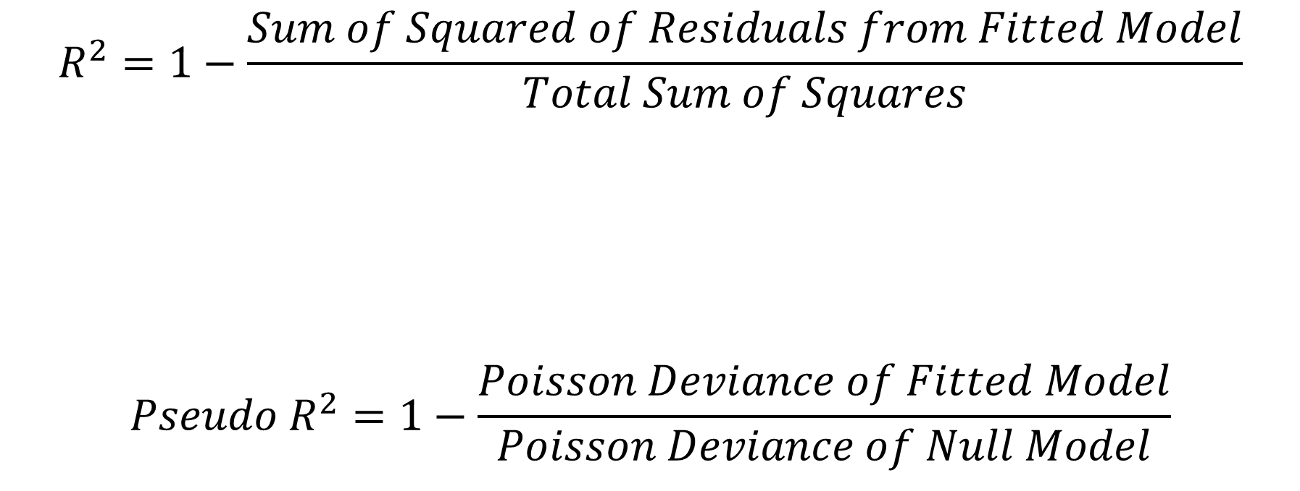
Accuracy – Pseudo R-Squared
$$R^{2}=1−\frac{Sum of Squared of Residuals from Fitted Model}{Total Sum of Squares}$$
$$Pseudo R^{2}=1−\frac{Poisson Deviance of Fitted Model}{Poisson Deviance of Null Model}$$

Slide 22
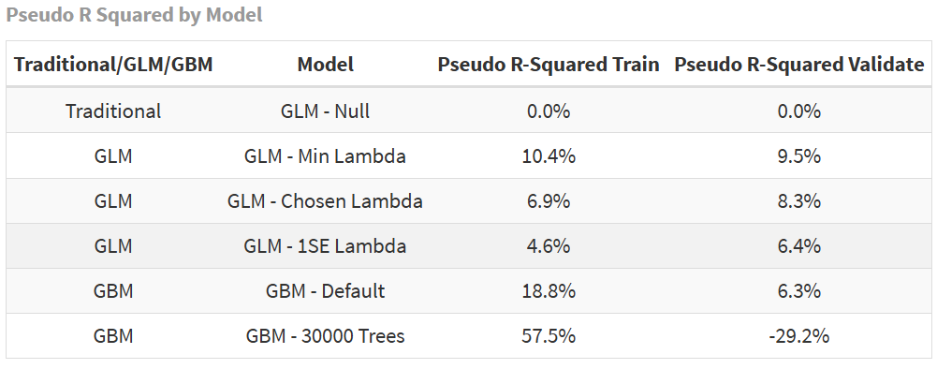
Accuracy – Pseudo R-Squared

Slide 23
Interpretability

Slide 24
Interpretability – If We Need to Know Exact Relativities…

Slide 25
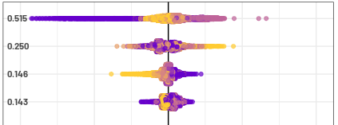

Interpretability – If We Do Not Need to Know Exact Relativities…
  Feature Importance
  Partial Dependency Plots
  Shapley Values

Slide 26
Efficiency

Slide 27
Efficiency
Model | Model Run/Train Time | Explanation Time | Upstream Efficiency | Downstream Efficiency
Traditional Analysis | 1 min | Least | Similar | Discussed Next Slide
GLM | 20 min | More
GBM | 7 hours | Most

Slide 28
Downstream Efficiency
  Assumption structure for projection software
  Business understanding
  Smoothness

Slide 29
Downstream Efficiency
  Assumption structure for projection software
  Business understanding
  Smoothness

Slide 30
Downstream Efficiency
  Assumption structure for projection software
  Business understanding
  Smoothness

Slide 31
Downstream Efficiency
  Assumption structure for projection software
  Business understanding
  Smoothness

Slide 32
Downstream Efficiency
  Assumption structure for projection software
  Business understanding
  Smoothness

Slide 33
Learnings and Considerations

Slide 34
Lapse Analysis
03

Slide 35

Now… What about lapses
Data and Modelling
  Lapse is a key driver of profitability for Life Insurance companies, especially in an environment where new business sales have been constrained.
  This analysis examines the use of non-traditional Machine Learning modelling techniques such as Gradient Boosting Machines (GBM) in modelling lapses, comparing their performance to the more traditional linear modelling techniques such as Generalised Linear Model (GLM), using a publicly available dataset. Our analysis aims to discuss properties of the tested models. In particular:
  Evaluate whether non-traditional modelling techniques offer better performance for predicting lapse outcomes;
  Interpretability of model results and how this impacts actuaries;
  Identify use cases suitable for the different modelling approaches.
  The following three models were fitted to a dataset created by IBM - originally designed to model customer lapses in a Telecommunications context but generally considered to be a close representation to a lapse dataset in a Life Insurance context:
    A Baseline GLM with (only) the intercept term
    A GLM with LASSO regularisation
    A GBM
  70% of the data were chosen at random to train the models, which were then evaluated against the remaining 30% of the data for performance
  Predicts a (binary) lapse class rather than lapse rate
Presented at the 2025 All Actuaries Summit

Slide 36
1. Model Performance – Relative Performance
GBM appears to deliver the best performance across all three evaluation metrics. Why (?)
Evaluation Metric
Accuracy
Precision
Area under Curve (AUC)
Measures
Proportion of correct predictions for both classes
Proportion of correct predictions within the lapse class
Model’s ability to distinguish between “Lapse” and “Non-Lapse” classes relative to a random guess (which would score a 50% AUC)
Baseline GLM
73%
0%
50%
LASSO GLM
78%
79%
85%
GBM
86%
87%
94%

Slide 37
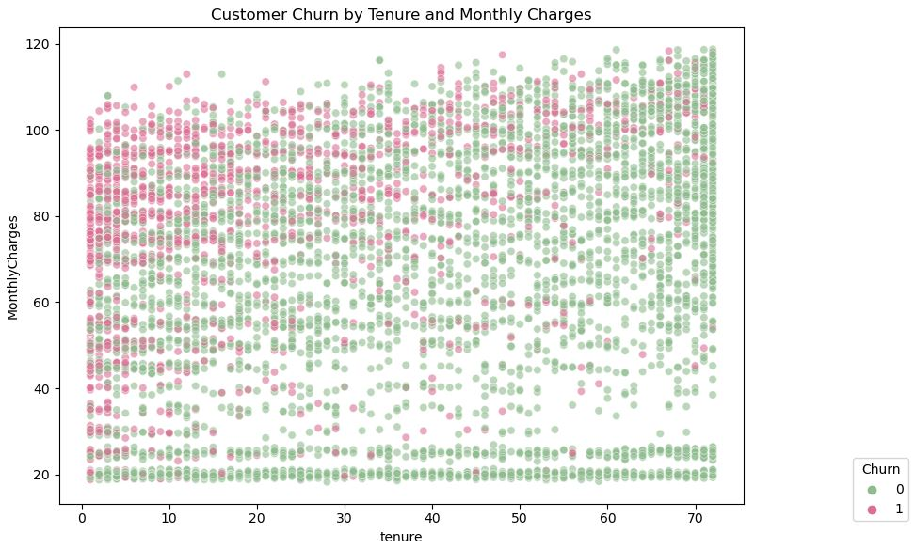
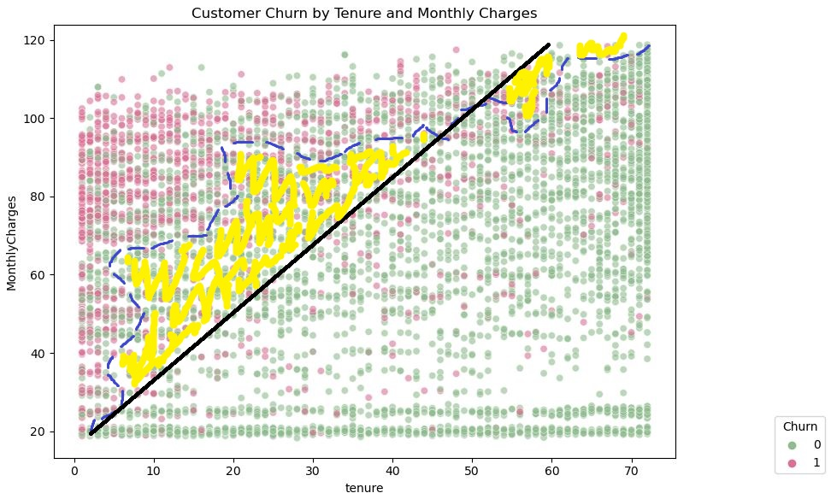
1. Model Performance – GLM
Even though GLM (in this instance, Logistic Regression) applies non-linear transformation to the data, it may not always provide the best fit, potentially resulting in material prediction errors.
This is illustrated below using two features from the dataset, Monthly Charges and Tenure.
  Figure 1 – Raw data
  Figure 2 – GLM vs. best fit
Best fit (benchmark)
GLM fit
Error

Slide 38
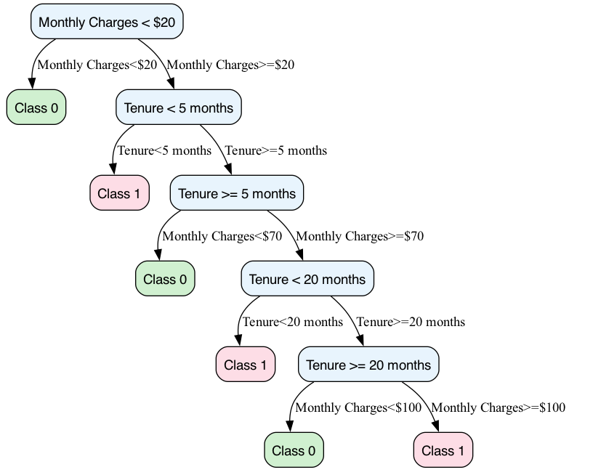
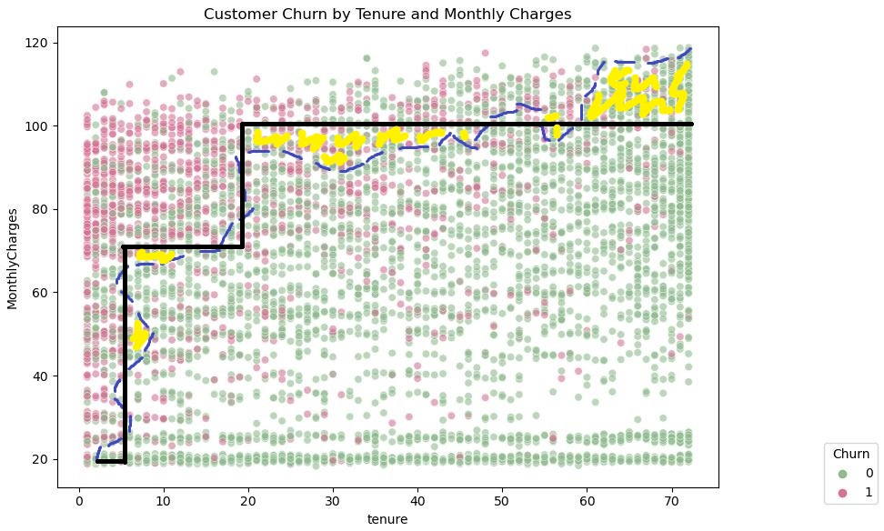
1. Model Performance – GBM
With decision rules learned, GBM is able to capture a more non-linear decision boundary.
As illustrated below, this results in reduced prediction errors.
  Figure 3 – Rules learned by GBM
  Figure 4 – GBM vs. best fit
Best fit (benchmark)
GBM fit
Error

Slide 39
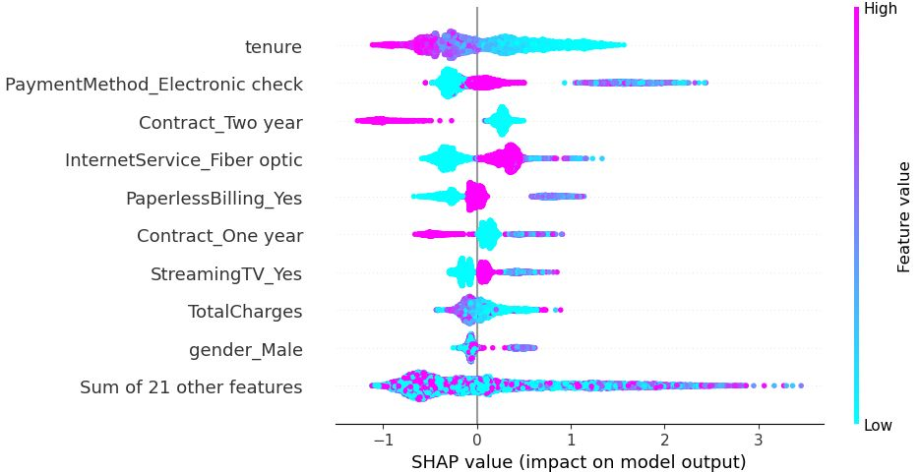
2. Model Interpretability – GLM vs. GBM
  Where interpretations align
  It is generally expected that the same features demonstrate broadly similar influence with respect to lapse outcomes between models. For example:
  The Tenure feature was identified as an important feature by both models, and similar interpretation of the feature was offered by both models (i.e. lapses on average reduced as tenure increased, as indicated by the negative sign of the β coefficient under the GLM and dependency plot below under the GBM).
  Where interpretations may NOT align
  Interpreting results from a GBM can be more challenging than from a GLM, especially when assessing influence of specific features. For example:
  GBM might not provide the right signal for assessing Pricing Elasticity.
  GLM, being a parametric model, offers more transparent and interpretable outcomes based on a function of the GLM coefficient for Monthly Charge.
  GLM allows users to explicitly specify interactions (e.g. via one-way or two-way interaction terms), providing transparent control over model structure.
Presented at the 2025 All Actuaries Summit

Slide 40
3. Model Selection – Example Use Cases

Slide 41
Summary
04

Slide 42

Summary
  Whilst Life Insurance Actuaries should start considering non-traditional modelling techniques, there is no single “best” model.
  When selecting a modelling approach, consider:
    The trade-off between Accuracy, Interpretability and Efficiency
    Investing time to understand business context and align choice of model with intended use cases
    Hybrid modelling approaches where traditional and non-traditional models complement each other

Slide 43
Questions and Comments
05

Slide 44
About the Actuaries Institute
The Actuaries Institute is the peak professional body for Actuaries in Australia. The Institute provides expert comment on public policy issues where there is uncertainty of future financial outcomes.
Actuaries have a reputation for a high level of technical financial expertise and integrity. They apply their analytical and risk management expertise to allocate resources efficiently, identify and mitigate emerging risks and to help maintain system integrity across multiple segments of the financial and other sectors. This unrivalled expertise enables the profession to comment on a wide range of issues including life, general and health insurance, climate change, superannuation and retirement income policy, enterprise risk management and prudential regulation, the digital economy, finance and investment and wider health issues.
© Institute of Actuaries of Australia 2023.​ All rights reserved.

Slide 45
Thank you
Actuaries Institute
actuaries.asn.au

