Slide 1
Can Improving Longevity Literacy Motivate Interest In Life Annuities?
Professor Hazel Bateman
Risk & Actuarial Studies, UNSW Sydney
June 2025

Slide 2








Co-authors:
Professor Hazel Bateman
Associate Professor Katia Hanewald
Dr Hanlin Lou
PhD candidate Jamie Yan

Slide 3
Contents
1. Annuity Puzzles in Australia
2. Longevity Literacy
3. Experimental Design
4. Preliminary Results
5. Discussion

Slide 4
Annuity Puzzles in Australia
01

Slide 5
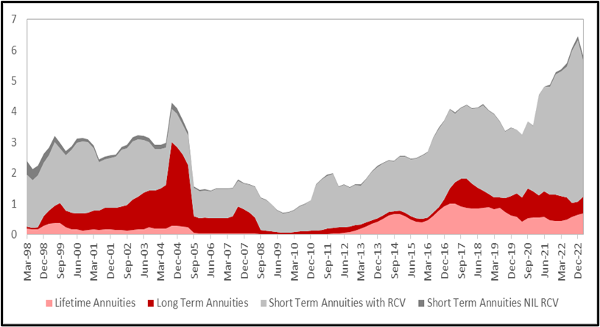
The lifetime annuity market in Australia has always been small
Annuity sales, by type (1998-2023) $billion
Mandatory super still maturing
Age Pension provides full or partial annuitization: 2/3 Australian retirees on full/part pension
Lifecycle models predict partial annuitisation, but do not explain such low levels of annuity take-up
Behavioural impediments to annuity demand addressed by providers and product regulation – consumption framing, reversible, death benefits, indexation, market-linked
Source: Plan for Life

Slide 6

The Decision States Model provides a framework to consider ‘barriers’ to the purchase of annuities (lifetime income products)
Unaware
Aware
Aware
not interested
Aware
and Interested
Interested
not capable
Aware, Interested and Capable
Already chosen
Choose now
Choose later
Choose never

Slide 7
Around 2/3 of a representative sample of Australians aged 50-75 are unaware or not interested in annuities (lifetime income products)*
Unaware
Aware
57.4%
42.6%
Aware
not interested
Aware
and Interested
8.3%
34.3%
Interested
not capable
Aware, Interested and Capable
7.1%
27.2%
Already chosen
Choose now
Choose later
Choose never
*(Bateman et al., 2025)

Slide 8
Around 2/3 of a representative sample of Australians aged 50-75 are unaware or not interested in annuities (lifetime income products)*
Unaware
Aware
57.4%
42.6%
Aware
not interested
Aware
and Interested
8.3%
34.3%
Interested
not capable
Aware, Interested and Capable
7.1%
27.2%
Already chosen
Choose now
Choose later
Choose never
*(Bateman et al., 2025)

Slide 9
Longevity Literacy
02

Slide 10
We explore the role of longevity literacy in building INTEREST in annuities (lifetime income products)
For people to have good longevity literacy, they need to:
    Understand how long they might live: e.g., awareness of average life expectancy; survival probabilities
    Understand the financial implications of living long: e.g., outlive savings
  People tend to underestimate their longevity – yet higher survival expectations are associated with higher saving and interest in/demand for retirement insurance products (Heimer et al., 2019; Hurwitz et al., 2022; Teppa & Lafourade, 2013; Wu et al., 2015)

Slide 11
Key research questions
Can we motivate INTEREST in annuities (lifetime income products) though:
Eliciting individuals’ longevity beliefs – subjective life expectancy, subjective survival probabilities?
Providing individuals with ‘objective’ longevity information → feedback?
Presentation of financial consequence information that describes a scenario in which savings can be exhausted?
Combinations of the above?

Slide 12
Experimental Design
03

Slide 13
We conducted an online experimental survey to elicit INTEREST in annuities (lifetime income products)
May 2025 via Pureprofile
1,716 participants aged 50-75, have/had a superannuation account
Paid $8 for completion
7 longevity literacy treatments
Participants randomly assigned to 17 experimental groups, each receiving a different combination of the longevity literacy treatments

Slide 14
Experiment design
Screening
(Age 50-75
superannuation account)
Personal
Information collection
(health, lifestyle)
Random assignment to 17 experimental groups
Introduce lifetime income product and elicit INTEREST
Collect data on finances, preferences, knowledge etc..
Communication formats aimed to improve longevity literacy

Slide 15
Treatments 1 & 2: Longevity Elicitation
Treatment 1: Longevity Elicitation (subjective life expectancy - SLE)
        “To what age do you think you will live?”
Treatment 2: Longevity Elicitation (subjective survival probabilities - SSP)
        “How likely do you think it is that you will live to age 85/90/95?”

Slide 16
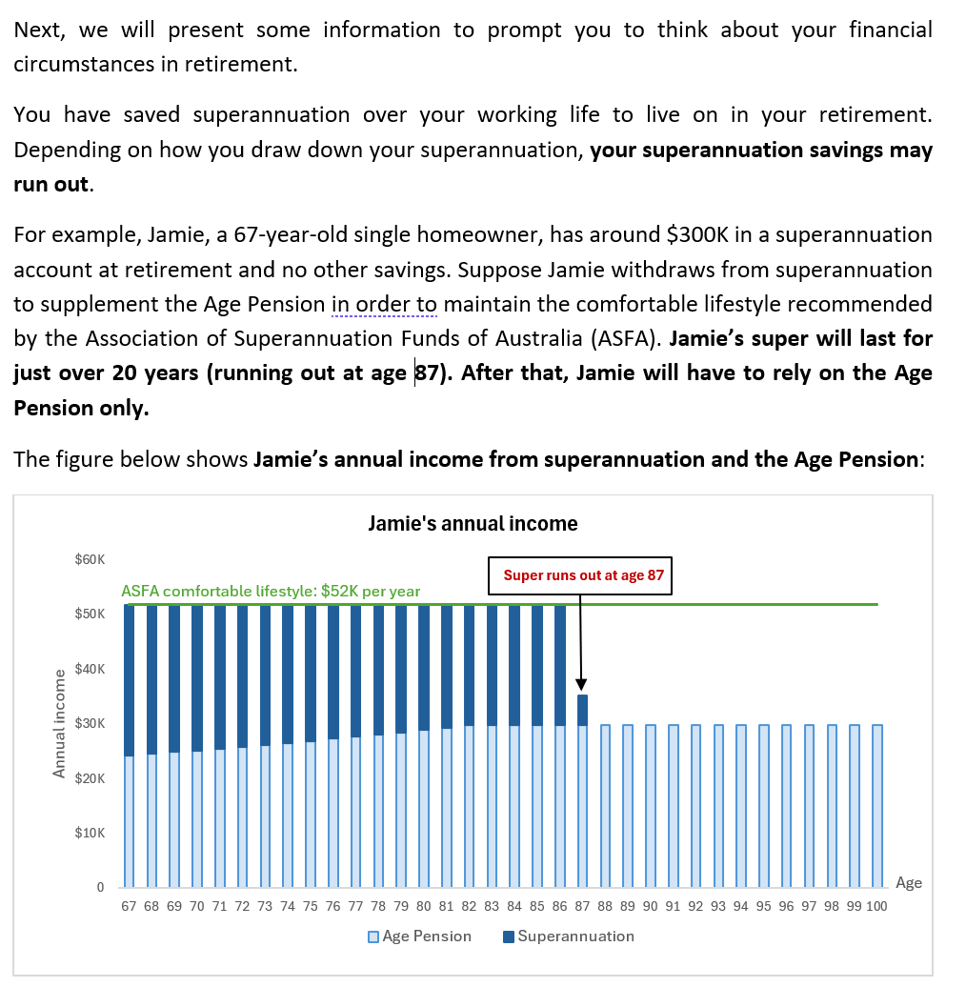
Treatment 3: Financial Consequences Information

Slide 17
Treatments 4,5,6 & 7: Feedback – Provision of Longevity Information
Treatment 4: Objective life expectancy information (OLE)
        “According to data from the Australian Government Actuary, Australians of the same age and gender as you will live to be at least X years old on average, which is Y years more/less/the same as your estimate of how long you will live”
Treatment 5: Objective survival probabilities information (OSP)
Treatment 6: Personalised life expectancy information (PLE)
Treatment 7: Personalised survival probabilities information (PSP)
    After provision of longevity information, participants were prompted to update their SLE/SSP - to higher, lower or the same
    [Data for Treatments 4/5 derived from Australian Life Tables 2020-22; data for Treatments 6/7 derived from Optimum Pensions Lifespan Calculator]

Slide 18
We created 17 groups from combinations of the 7 treatments – each participant sees a different combination of the longevity literacy treatments
 | Control | 1 | 2 | 3 | 4 | 5 | 6 | 7 | 8 | 9 | 10 | 11 | 12 | 13 | 14 | 15 | 16
T1: Elicit Subjective LE
T2: Elicit Subjective SP
T3: Financial consequence
T4: Provide Objective LE
T5: Provide Objective SP
T6: Provide Personal LE
T7: Provide Personal SP

Slide 19
Participants were introduced to the Lifetime Income Product
All participants were told that the Lifetime Income Product will pay you a regular income for as long as you live, and shown a FACT SHEET describing the key features of the product: Lifetime income, inflation protection, guaranteed income, capital access option, death benefits, and reversion
And asked about their INTEREST in the Lifetime Income Product
How do you see yourself: are you interested in the lifetime income product?
I am NOT interested in the lifetime income product AT ALL
I am SOMEWHAT interested in the lifetime income product
I am MODERATELY interested in the lifetime income product
I am VERY interested in the lifetime income product
I am EXTREMELY interested in the lifetime income product

Slide 20
Preliminary Results
04

Slide 21
On average participants were pessimistic about their life expectancy
Subjective life expectancy below objective life expectancy* in years
*AGA (2024)

Slide 22
However, a large minority of participants updated their subjective life expectancy (and SSP) – mostly upward - following provision of ‘objective/personal ’ longevity information
Life Expectancy | Upward | No Change | Downward
Subjective LE <= Objective LE (Pessimistic) | 33.8% | 61.2% | 5.0%
Subjective LE > Objective LE (Optimistic) | 4.5% | 83.3% | 12.1%
Subjective LE <= Personal LE (Pessimistic) | 37.0% | 56.2% | 6.9%
Subjective LE > Personal LE (Optimistic) | 9.5% | 71.4% | 19.0%

Slide 23
However, a large minority of participants updated their subjective life expectancy (and SSP) – mostly upward - following provision of ‘objective/personal ’ longevity information
Life Expectancy | Upward | No Change | Downward
Subjective LE <= Objective LE (Pessimistic) | 33.8% | 61.2% | 5.0%
Subjective LE > Objective LE (Optimistic) | 4.5% | 83.3% | 12.1%
Subjective LE <= Personal LE (Pessimistic) | 37.0% | 56.2% | 6.9%
Subjective LE > Personal LE (Optimistic) | 9.5% | 71.4% | 19.0%

Slide 24
INTEREST in the lifetime income product higher where participants receive longevity information
 | Control | 1 | 2 | 3 | 4 | 5 | 6 | 7 | 8 | 9 | 10 | 11 | 12 | 13 | 14 | 15 | 16
T1: Elicit Subjective LE
T2: Elicit Subjective SP
T3: Financial consequence
T4: Provide Objective LE
T5: Provide Objective SP
T6: Provide Personal LE
T7: Provide Personal SP
% INTEREST in lifetime income product compared to Control |  | 1.4 | -1.0 | 3.2 | 1.8 | 11.8 | 15.9 | -4.2 | 5.6 | 7.7 | 2.8 | 6.3 | 5.6 | 19.4 | 15.5 | -4.2 | -1.0
[**]
[*]
[**] and [*] refer to significantly different from the Control at 5% (**) and 10% (*)

Slide 25
INTEREST in the lifetime income product higher where participants receive longevity information
 | Control | 1 | 2 | 3 | 4 | 5 | 6 | 7 | 8 | 9 | 10 | 11 | 12 | 13 | 14 | 15 | 16
T1: Elicit Subjective LE
T2: Elicit Subjective SP
T3: Financial consequence
T4: Provide Objective LE
T5: Provide Objective SP
T6: Provide Personal LE
T7: Provide Personal SP
% INTEREST in lifetime income product compared to Control |  | 1.4 | -1.0 | 3.2 | 1.8 | 11.8 | 15.9 | -4.2 | 5.6 | 7.7 | 2.8 | 6.3 | 5.6 | 19.4 | 15.5 | -4.2 | -1.0
[**]
[*]
For example – elicitation of Subjective LE and Subjective SP and provision of Objective LE and Objective SSP → 19.4% higher INTEREST in lifetime income product compared to control

Slide 26
INTEREST in the lifetime income product higher where participants receive longevity information
 | Control | 1 | 2 | 3 | 4 | 5 | 6 | 7 | 8 | 9 | 10 | 11 | 12 | 13 | 14 | 15 | 16
T1: Elicit Subjective LE
T2: Elicit Subjective SP
T3: Financial consequence
T4: Provide Objective LE
T5: Provide Objective SP
T6: Provide Personal LE
T7: Provide Personal SP
% INTEREST in lifetime income product compared to Control |  | 1.4 | -1.0 | 3.2 | 1.8 | 11.8 | 15.9 | -4.2 | 5.6 | 7.7 | 2.8 | 6.3 | 5.6 | 19.4 | 15.5 | -4.2 | -1.0
[**]
[*]
For example – elicitation of Subjective LE and Subjective SP and provision of Objective LE and Objective SSP → 19.4% higher INTEREST in lifetime income product compared to control

Slide 27
That provision of longevity information enhances INTEREST in lifetime income products is confirmed by regression analysis
Dep Var: INTEREST in lifetime income productª | All SLE | Pessimistic SLE revised up | Optimistic SLE, revised down/ no change
Constant | 0.726** | 0.726** | 0.726**
Provide longevity information (Objective LE) | 0.095** | 0.149** | 0.099
Provide longevity information (Personal LE) | -0.046 | 0.040 | -0.025
Objective LE x Financial consequence | -0.090 | 0.027 | -0.057
Personal LE x Financial consequence | 0.046 | 0.012 | 0.161*
a. Estimated using a linear probability model

Slide 28
That provision of longevity information enhances INTEREST in lifetime income products is confirmed by regression analysis
Dep Var: INTEREST in lifetime income product | All SLE | Pessimistic SLE revised up | Optimistic SLE, revised down/ no change
Constant | 0.726** | 0.726** | 0.726**
Provide longevity information (Objective LE) | 0.095** | 0.149** | 0.099
Provide longevity information (Personal LE) | -0.046 | 0.040 | -0.025
Objective LE x Financial consequence | -0.090 | 0.027 | -0.057
Personal LE x Financial consequence | 0.046 | 0.012 | 0.161*
Provision of longevity information → INCREASE interest in lifetime income product by 9.5% on average, and by 14.9% for those with pessimistic SLE who revise up
Longevity information and financial consequence information → INCREASE interest in lifetime income product by 16.1% for those with optimistic SLE who revise down/no change

Slide 29
Similar results for SSP regressions
Dep Var: INTEREST in lifetime income product | All SSP | Pessimistic SSP revised up | Optimistic SSP revised down/ no change
Constant | 0.718*** | 0.718*** | 0.718***
Provide longevity information (Objective LE) | 0.089** | 0.157 | 0.117***
Provide longevity information (Personal LE) | 0.000 | -0.012 | 0.041
Objective LE x Financial consequence | -0.032 | -0.042 | -0.030
Personal LE x Financial consequence | 0.009 | 0.072 | 0.037

Slide 30
Discussion
05

Slide 31
Key takeaways
On average, participants under-estimated their life expectancy at all ages
Improving longevity literacy through provision of objective longevity information motivated higher INTEREST in lifetime income product
    Via update of pessimistic survival expectations
Provision of personalised longevity information and financial consequence information is less effective
Our results suggest that improving longevity literacy is key to higher interest in lifetime income products

Slide 32
Key takeaways
To plan for retirement, people need help to understand their planning horizon and be aware of and understand the features of available products (and the impact of living long)
Our findings provide guidance for communication strategies which could be used by super funds, product providers and financial advisors to ‘help’ members/customers improve their longevity literacy

Slide 33
References
Australian Government Actuary (2024), Australian Government Actuary. (2024). Australian Life Tables 2020-22. https://aga.gov.au/publications/life-tables/australian-life-tables-2020-22.
Bateman, H., Hanewald, K., Lou, H., and J Yan. (2025), Exploring Consumers’ Progress Through Annuity Decision States, working paper.
Heimer, R. Z., Myrseth, K. O. R., & Schoenle, R. S. (2019). Yolo: Mortality beliefs and household finance puzzles. The Journal of Finance, 74 (6), 2957–2996.
Hurwitz, A., Mitchell, O. S., & Sade, O. (2022). Testing methods to enhance longevity awareness. Journal of Economic Behavior & Organization, 204 , 466–475.
Lot, A. (2023). Longevity pessimism, misinformation, and pension choice (Working Paper No.4901164). SSRN Institute.
Lusardi, A., Oggero, N., & Yakoboski, P. (2022). Financial Literacy, Longevity Literacy, and Retirement Readiness. TIAA Institute-GFLEC Report.
Teppa, F., & Lafourcade, P. (2013). Can longevity risk alleviate the annuitization puzzle? Empirical evidence from survey data (De Nederlandsche Bank Working Paper No. 302). De Nederlandsche Bank (DNB). https://archivo.alde.es/encuentros.alde.es/anteriores/xviieea/trabajos/t/pdf/85.pdf.
Wu, S., Stevens, R., & Thorp, S. (2015). Cohort and target age effects on subjective survival probabilities: Implications for models of the retirement phase. Journal of Economic Dynamics and Control , 55 , 39–56.

Slide 34
Can Improving Longevity Literacy Motivate Interest In Life Annuities?
Professor Hazel Bateman
Associate Professor Katia Hanewald
Dr Hanlin Lou
PhD candidate Jamie Yan
This research is funded by:

Slide 35
Extra slides

Slide 36
Seven (7) Longevity Literacy Treatments
Treatment 1: Longevity Elicitation (life expectancy)
Treatment 2: Longevity Elicitation (survival probabilities)
Treatment 3: Financial Consequence Information
Treatment 4: Objective Life Expectancy Information
Treatment 5: Objective Survival Probabilities Information
Treatment 6: Personalized Life Expectancy Information
Treatment 7: Personalized Survival Probabilities Information

Slide 37
Treatments 4 & 5: Objective Longevity Information
Treatment 4: Objective life expectancy information (OLE)
        “According to data from the Australian Government Actuary, Australians of the same age and gender as you will live to be at least X years old on average, which is Y years more/less/the same as your estimate of how long you will live”
Treatment 5: Objective survival probabilities information (OSP)
        “According to data from the Australian Government Actuary, Australians of the same age and gender as you will have a x% chance of living to age 85, a y% chance of living to age 90, and a z% chance of living to age 95”
        [a figure compares these with the subjective survival probabilities]
    For both Treatment 4 and 5, participants are prompted to update their SLE/SSP - to higher, lower or the same

Slide 38
Treatments 6 & 7: Personalised Longevity Information
Treatment 6: Personalised life expectancy information (PLE)
        “According to your responses to the earlier personal information questions we used a lifespan calculator to predict your life expectancy considering your age, gender, marital status, work status, health status, and lifestyle. The result shows that your personalized expected lifespan is at least X years old on average, which is Y years more/less/the same as your estimate of how long you will live”
Treatment 7: Personalised survival probabilities information (PSP)
        “According to your responses to the earlier personal information questions we used a lifespan calculator to predict your life expectancy considering your age, gender, marital status, work status, health status, and lifestyle. The result shows that you will have a x% chance of living to age 85, a y% chance of living to age 90, and a z% chance of living to age 95”
        [a figure compares these with the subjective survival probabilities]
    For both Treatment 6 and 7, participants are prompted to update their SLE/SSP - to higher, lower or the same.

