Slide 1
A new age retirement advice workflow
Melanie Dunn, Accurium
June 2025
Notes:
1.40pm – 2.25pm = 45min including chair intro and qns

Slide 2


Slide 3


Slide 4
Retirement advice & lifetime income products
Retirement planning is the top reason
for seeking financial advice
- Ensuring money lasts in retirement
- Developing an investment strategy
(Investment Trends, Australian Financial Advice Report 2024)
4.8% of pension member accounts /
1.6% of pension member benefits
were in an ‘annuity’
Vast majority = account-based type pensions
(APRA, Annual superannuation bulletin June 2015 to June 2024 – Superannuation entities, Table 8, June 2024 data,
data in respect of entities with more than 6 members)
Annuity Puzzle: research consistently shows that including a
lifetime income stream in a retirement portfolio can improve retirement income outcomes.

Slide 5

Contents
Advice challenge 06
Planning horizon 10
Product selection 15
Portfolio construction 26
Modelling 39

Slide 6

Advice challenge

Slide 7
Challenges to advising on lifetime income streams
?
Knowledge
Technology
Product
    Clients, advisers, licensees
    Products and strategies
    Longevity risk
    Modelling tools
    Portfolio construction
    Compliance and SoA generation
    Lack of integration and work arounds
    Allianz, AMP, Australian Retirement Trust, Challenger, Generation Life…
    All differentiated, features and options vary across products

Slide 8
Technology challenges to advising on lifetime income streams
Current lifetime income advice process
Product website / PDS
Product selection
Strategy formulation
External tools
Modelling
Product selection
Advice technology
Strategy formulation
Modelling
Product selection
Client discovery
Advice production
Advice implementation

Slide 9
Technology challenges to advising on lifetime income streams
Efficient and integrated lifetime income advice process
Product website / PDS
Goal: meaningful improvement vs perfection
Product information
Quotes
External tools
Advice technology
Client discovery
Strategy formulation
Product selection
Modelling
Advice production
Advice implementation

Slide 10

Planning horizon

Slide 11

Why focus on the retirement planning horizon?
  Outcomes of modelling a retirement strategy highly dependent on timeframe over which is tested!
    Will my client’s income last to age 85 / to ‘life expectancy’?
  What ‘life expectancy’ is right?
    Most ‘Google search’ references are life expectancy at birth
    AGA: “any realistic measure of longevity needs to consider the possible
    improvements in mortality that may occur in the future”
    SMSF retiree life expectancy is 2-3 years higher than population average¹
Advice technology can aid in selecting a planning horizon
    Encourage a ‘long term’ focus, defaults important
    Identify the ‘longevity risk’ of a timeframe
    Educate adviser so can explain to a client
Meet Ken Weeks, Australia’s oldest living person!
Celebrated his 111th birthday on 5 Oct 2024.
Born and lives in Grafton, NSW.
Retired at age 65… 46 years and counting!
Source: https://www.grg-supercentenarians.org/2024/10/05/ken-weeks-australias-oldest-living-person-celebrated-his-111th-birthday/
1 – Accurium, SMSF Retirement Insights paper, SMSF Trustees - healthier, wealthier and living longer, 2015.

Slide 12

Use of life expectancies for retirement planning
More than half of people are expected to live beyond ‘life expectancy’
Very few people live exactly to life expectancy, how long a client will live
is uncertain
June is a female aged 65 seeking retirement advice.
The chance she lives exactly to age 90 is 5%.
Life expectancy: age 90
About the same chance of
living exactly to age 76 as 102
Basis: ALT 2020-22 with 25-year improvement factors

Slide 13


Case study: Jane and June
Risk-based retirement planning horizon
Basis | Life expectancy | Life expectancy w improvements | Age 25% will live to | 10% chance will live to
Jake age 69 | 18.9 years (to age 86) | 18.9 years (to age 88) | 25 years (to age 94) | 29 years (to age 99)
June age 65 | 23 years (to age 88) | 24.7 years (to age 90) | 31 years (to age 96) | 35 years (to age 100)
As a couple (last survivor) | 26 years Jake 93, June 91 | 27.0 years Jake 96, June 92 | 32 years Jake 101, June 97 | 35 years Jake 104, June 100
Suggested starting point for safe retirement planning for a
couple with no material health issues.
Provides 75% confidence are planning for life.
Basis: ALT 2020-22 with 25-year improvement factors

Slide 14
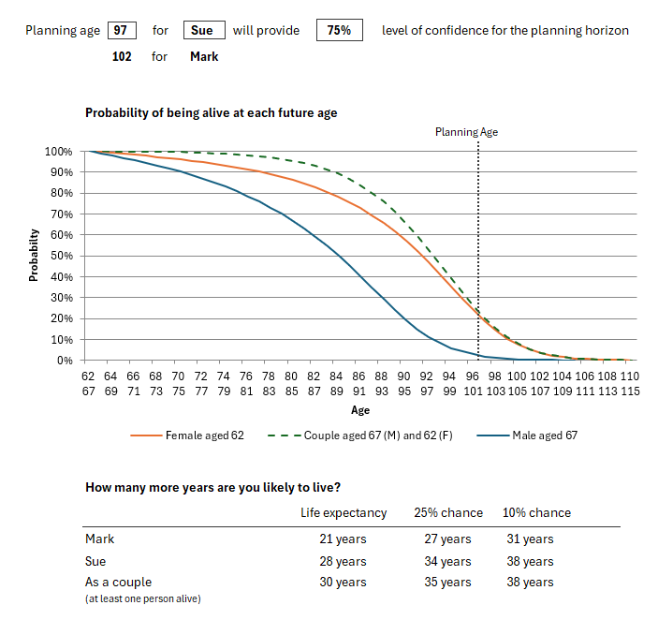
Retirement planning age
    Case Study: Mark and Sue
    A 67-year-old male and a 62-year-old female client
Ideas for advice technology to aid advisers select a timeframe for retirement
Default to age which provides 75% confidence it will last for life (25% age)
    Couple: age at which last person passes away
    Target age vs number of years
    Allow adviser to modify
  Outputs on screen to assist adviser
    Risk-based lifespan table to educate on longevity risk accepted over different timeframes
    Survival probability chart

Slide 15

Product selection

Slide 16

Selecting a lifetime income product
Products offer range of features and options to navigate
    Deferred or immediate payments
    Purchase from super or non-super monies
    Purchase pre-retirement or at/after retirement
    Payment indexation type: nil, inflation, partial inflation, investment linked, investment linked with protection…
    Payment boosts – trade off higher initial start payment for lower future indexation
    Reversionary or not
    Concessional Age Pension assessment (subject to CAS) or not
    Access to capital – voluntarily / on death – no access, CAS, an investment balance
    Within a super account/platform e.g. an investment option within an ABP, or as a separate income stream
    Insured or pooled longevity risk protection
    Fee structures
PROBLEM:
product feature overload
Advisers must understand a product and why it meets a client’s needs
AND need to feel comfortable explaining this to their client!
Help advisers navigate all this choice.

Slide 17

Aligning product options with client needs and objectives
  In concept all lifetime income products provide a client with an income for life how they do it can be very different
Advice technology could aid advisers select product options which align with a client’s objectives
    Set initial product selections
    Identify if any product may not be appropriate for a client
    Adviser can change and customise
Risk exposure
Starting payment and pattern of future payments
Impact on social security entitlements
Estate planning implications
Voluntary access to capital

Slide 18


Selecting lifetime income products for an advice strategy
To manage the complexity of options available for a client’s strategy:
    Offer adviser a questionnaire which aims to align client objectives to product options
        Provide a meaningful starting point for navigating the range of product options
    Integrate with product providers to provide key information based on product selections
        PDS
        Starting payments
        Fee information
        Estimates of future payments, withdrawal benefits, and death benefits

Slide 19
Case study: Mark lifetime product assessment
Lifetime income questionnaire
Would your client consider deferring commencement of lifetime income in exchange for a higher initial payment? | Not sure
If income was deferred, how long might be preferred (in years)?
Would your client consider higher lifetime income in exchange for no access to capital or death benefit? | No
Is Age Pension planning a focus for this client? | Not sure
What is your clients target superannuation risk profile? (% growth) | 60%
Would your client prefer for lifetime income to keep pace with the cost of living over time? | Not sure
What level of inflation protection is desired?
Would your client be comfortable with lifetime income which could fluctuate based on market outcomes? | Not sure
Would your client prefer lifetime income to continue to their spouse after their death? | Not sure
Product A | Product B
No option - Immediate payments | Immediate payments
Max of CAS | No option - Account balance
No option – concessional treatment | Max of CAS – concessional treatment
 | Balanced investment
CPI | Balanced
No reversion | No reversion
67-yrs-old, reasonable health, $650k in super invested 60% growth
  Product A
      Option for reversionary or not
      Voluntary and death benefit is max CAS, choice of no capital access for higher start payment
      Income is immediate
      Income indexes with CPI, or no indexation
  Product B
      Option for reversionary or not
    Voluntary and death benefit is an account balance, option to be subject to CAS
    Account balance can be in a balanced or conservative investment mix
    Income is immediate or deferred
    Income indexes with investment returns or nil

Slide 20
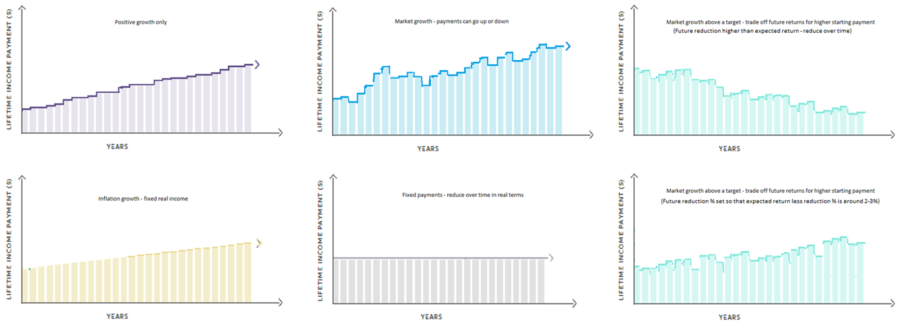
Lifetime income payment profiles
Lifetime income questionnaire | Option for response
Preference for lifetime income to keep pace with the cost of living over time? | Yes | No | Not sure
What level of inflation protection is desired? | Guaranteed | Targeted | Exceed | Not sure
Would your client be comfortable with lifetime income which could fluctuate based on market outcomes? | Yes | No | Not sure
Key flexibility / complexity is variety of indexation options:
    Nil, inflation, partial inflation, investment linked, investment linked
    with protection…
    Payment boosts – trade off higher initial start payment for lower
    future indexation
  Much flexibility to create different payment profiles:

Slide 21
Lifetime income payment profiles
Lifetime income questionnaire | Option for response
Preference for lifetime income to keep pace with the cost of living over time? | Yes | No | Not sure
What level of inflation protection is desired? | Guaranteed | Targeted | Exceed | Not sure
Would your client be comfortable with lifetime income which could fluctuate based on market outcomes? | Yes | No | Not sure
Key flexibility / complexity is variety of indexation options:
    Nil, inflation, partial inflation, investment linked, investment linked
    with protection…
    Payment boosts – trade off higher initial start payment for lower
    future indexation
  Much flexibility to create different payment profiles:

Slide 22
Case study: Mark lifetime product assessment
Lifetime income questionnaire |  | Product A | Product B
Would your client consider deferring commencement of lifetime income in exchange for a higher initial payment? | Yes | No option - Immediate payments | Deferred payments
If income was deferred, how long might be preferred (in years)? | 5 |  | 5 years
Would your client consider higher lifetime income in exchange for no access to capital or death benefit? | No | Max of CAS | No option - Account balance
Is Age Pension planning a focus for this client? | Yes | No option – concessional treatment | Max of CAS - concessional treatment
What is your clients target superannuation risk profile? (% growth) | 60% |  | Balanced investment
Would your client prefer for lifetime income to keep pace with the cost of living over time? | Yes | CPI | Not Available
What level of inflation protection is desired? | Guaranteed
Would your client be comfortable with lifetime income which could fluctuate based on market outcomes? | Yes
Would your client prefer lifetime income to continue to their spouse after their death? | No | No Reversion | No Reversion
  Product A
      Option for reversionary or not
      Voluntary and death benefit is max CAS, choice of no capital access for higher start payment
      Income is immediate
      Income indexes with CPI, or no indexation
  Product B
      Option for reversionary or not
    Voluntary and death benefit is an account balance, option to be subject to CAS
    Account balance can be in a balanced or conservative investment mix
    Income is immediate or deferred
    Income indexes with investment returns or nil

Slide 23
Lifetime income payment profiles
Lifetime income questionnaire | Option for response
Preference for lifetime income to keep pace with the cost of living over time? | Yes | No | Not sure
What level of inflation protection is desired? | Guaranteed | Targeted | Exceed | Not sure
Would your client be comfortable with lifetime income which could fluctuate based on market outcomes? | Yes | No | Not sure
Key flexibility / complexity is variety of indexation options:
    Nil, inflation, partial inflation, investment linked, investment linked
    with protection…
    Payment boosts – trade off higher initial start payment for lower
    future indexation
  Much flexibility to create different payment profiles:

Slide 24
Case study: Mark lifetime product assessment
Lifetime income questionnaire |  | Product A | Product B
Would your client consider deferring commencement of lifetime income in exchange for a higher initial payment? | Yes | No option - Immediate payments | Deferred payments
If income was deferred, how long might be preferred (in years)? | 5 |  | 5 years
Would your client consider higher lifetime income in exchange for no access to capital or death benefit? | No | Max of CAS | No option - Account balance
Is Age Pension planning a focus for this client? | Yes | No option – concessional treatment | Max of CAS - concessional treatment
What is your clients target superannuation risk profile? (% growth) | 60% |  | Balanced investment
Would your client prefer for lifetime income to keep pace with the cost of living over time? | Yes | CPI | Balanced
What level of inflation protection is desired? | Target
Would your client be comfortable with lifetime income which could fluctuate based on market outcomes? | Yes
Would your client prefer lifetime income to continue to their spouse after their death? | No | No Reversion | No Reversion
  Product A
      Option for reversionary or not
      Voluntary and death benefit is max CAS, choice of no capital access for higher start payment
      Income is immediate
      Income indexes with CPI, or no indexation
  Product B
      Option for reversionary or not
    Voluntary and death benefit is an account balance, option to be subject to CAS
    Account balance can be in a balanced or conservative investment mix
    Income is immediate or deferred
    Income indexes with investment returns or nil

Slide 25
Case study: Mark lifetime product assessment
Lifetime income questionnaire |  | Product A | Product B
Would your client consider deferring commencement of lifetime income in exchange for a higher initial payment? | Yes | No option - Immediate payments | Deferred payments
If income was deferred, how long might be preferred (in years)? | 5 |  | 5 years
Would your client consider higher lifetime income in exchange for no access to capital or death benefit? | No | Max of CAS | No option - Account balance
Is Age Pension planning a focus for this client? | Yes | No option – concessional treatment | Max of CAS - concessional treatment
What is your clients target superannuation risk profile? (% growth) | 60% |  | Balanced investment
Would your client prefer for lifetime income to keep pace with the cost of living over time? | Yes | CPI | Balanced + 2% boost
What level of inflation protection is desired? | Target
Would your client be comfortable with lifetime income which could fluctuate based on market outcomes? | Yes
Would your client prefer lifetime income to continue to their spouse after their death? | No | No Reversion | No Reversion
  Product A
      Option for reversionary or not
      Voluntary and death benefit is max CAS, choice of no capital access for higher start payment
      Income is immediate
      Income indexes with CPI, or no indexation
  Product B
      Option for reversionary or not
    Voluntary and death benefit is an account balance, option to be subject to CAS
    Account balance can be in a balanced or conservative investment mix
    Income is immediate or deferred
    Income indexes with investment returns or nil
    + option for 2% payment boost

Slide 26

Portfolio construction

Slide 27
Portfolio construction of a strategy including a lifetime income product
Allocating a portion of a client’s portfolio to a lifetime income product can be complex in practice…
Advice technology can aid adviser in rebalancing
    Implement a default rebalancing approach using existing investments
    Allow adviser to manually adjust the investment selections and view impact on risk profile
    Warn adviser about strategies which are not aligned with target risk profile
How much to invest in the lifetime income product?
What investments to sell to fund the investment in the lifetime product?
What is the adviser’s view of the risk profile of the lifetime product?
Can we maintain the target risk profile?

Slide 28
Risk profile of a lifetime income product
Working within existing advice processes assessment within context of a risk profile = a growth/defensive allocation
What are the characteristics of the lifetime income product?
    A growth investment
    A defensive investment
    A mix of growth / defensive
  Traditional lifetime income products - inflation linked or fixed payment
    General consensus: defensive investment
  New lifetime income products are ‘investment linked’
    Many advisers view as having a growth component
    Some advisers see product as providing a guaranteed (albeit variable) income and so ‘defensive’
    Advisers may view risk profile as that of investment option driving payment indexation or growth of underlying account balance e.g. payments index with balanced return (60% growth) then product is viewed as 60% growth
Advice technology solution needs to accommodate different views

Slide 29


Case study: Mark portfolio construction
Lifetime income products selected for consideration:
  Product A selection
      Voluntary and death benefit is max CAS
      Immediate income
      Payments index with CPI
      Reversionary to Sue
      Assess as 0% growth investment
  Product B selection
    Voluntary and death benefit is account balance up to max CAS
    Account balance invested in a balanced investment
    Income is deferred 5 years
    Income indexes with returns on balanced investment
    Assess as 60% growth investment (PDS identified balanced investment as 60% growth)

Slide 30

Case study: Mark portfolio construction
The adviser manages the client portfolio on XYZ Platform
Consider the Lifetime income investments as follows:
    Product A purchased by Mark from a life insurer
    Product B in respect to Mark as investment in XYZ platform ABP
  The adviser is considering three strategies:
    100% ABP in XYZ Platform
    20% investment Product A + 80% investment in ABP in XYZ Platform
    100% ABP in XYZ Platform which includes 20% investment in Product B

Slide 31

Case study: Mark portfolio construction
ABP only strategy
$650,000 in accumulation phase on XYZ platform to be moved to retirement phase
A superannuation target risk profile of 60% growth
  ABP only strategy: 100% ABP in XYZ Platform
Total | Growth | Defensive
$130,000 | $0 | $130,000
$130,000 | $0 | $130,000
$195,000 | $95,000 | $0
$65,000 | $65,000 | $0
$130,000 | $130,000 | $0
$650,000 | $390,000 | $260,000
60% 40%

Slide 32

Rebalancing to maintain the risk profile
Without adviser input won’t know preference for which assets to sell down and by how much
Easy approach for advisers will be to adjust allocation to currently chosen investments
        Initial default approach within advice technology might assume investment is taken proportionately from existing investments
  Will not achieve the target risk profile if:
        Using initial default approach and lifetime income product risk profile does not match the target risk profile
        Allocation to lifetime income product requires higher investment in growth or defensive assets than is available
    If risk profile of lifetime income product is different to target risk profile, will need to rebalance other investments

Slide 33
Case study: Mark portfolio construction
  100% ABP in XYZ Platform which includes 20% investment in Product B
  Investments after initial default allocation to Product B within XYZ platform
Total | Growth | Defensive
$104,000 | $0 | $104,000
$104,000 | $0 | $104,000
$156,000 | $156,000 | $0
$52,000 | $52,000 | $0
$104,000 | $104,000 | $0
$130,000 | $78,000 | $52,000
$650,000 | $390,000 | $260,000
Product B is assessed as a 60% growth investment
Risk profile is maintained for this strategy
Adviser could choose to manually adjust how investments are rebalanced if desired
60% 40%

Slide 34
Case study: Mark portfolio construction
    20% investment Product A + 80% investment in ABP in XYZ Platform
  Investments after initial default allocation to Product A
Total | Growth | Defensive
$104,000 | $0 | $104,000
$104,000 | $0 | $104,000
$156,000 | $156,000 | $0
$52,000 | $52,000 | $0
$104,000 | $104,000 | $0
$130,000 | $0 | $130,000
$650,000 | $390,000 | $260,000
Product B is assessed as a 0% growth investment
Target risk profile of 60% growth is NOT maintained for this strategy
Adviser will be warned of risk profile mis-match
Will need to manually adjust investments
48% 52%

Slide 35
Case study: Mark portfolio construction
    20% investment Product A + 80% investment in ABP in XYZ Platform
  Investments after initial default allocation to Product A
Proposed | % | Growth | Defensive
$65,000 | 10% | $0 | $65,000
$65,000 | 10% | $0 | $65,000
$195,000 | 30% | $195,000 | $0
$65,000 | 10% | $65,000 | $0
$130,000 | 20% | $130,000 | $0
$130,000 | 20% | $0 | $130,000
$650,000 | 100% | $390,000 | $260,000
Adviser takes from defensive assets
Target risk profile of 60% growth is now maintained for this strategy
60% 40%

Slide 36
Case study: Mark portfolio construction
    20% investment Product A + 80% investment in ABP in XYZ Platform
  Investments after initial default allocation to Product A
Total | Growth | Defensive
$65,000 | $0 | $65,000
$65,000 | $0 | $65,000
$195,000 | $195,000 | $0
$65,000 | $65,000 | $0
$130,000 | $130,000 | $0
$130,000 | $0 | $130,000
$650,000 | $390,000 | $260,000
ABP in XYZ Platform
75% growth / 25% defensive
60% 40%

Slide 37

Case study: Jennifer portfolio construction
$650,000 in accumulation phase to be moved to retirement phase
A superannuation target risk profile of 50% growth
  ABP only strategy 20% invested in Product A
Risk profile is NOT maintained for this strategy
Adjusting existing investments will not rebalance the risk profile
Asset | Total | Growth | Defensive
Balanced portfolio | $650,000 | $325,000 | $325,000
Asset | Total | Growth | Defensive
Balanced portfolio | $520,000 | $260,000 | $260,000
Product A | $130,000 | $0 | $130,000
50% 50%
40% 60%

Slide 38
Case study: Jennifer portfolio construction
$650,000 in accumulation phase to be moved to retirement phase
A superannuation target risk profile of 50% growth
  ABP only strategy 20% invested in Product A
Adviser has option of a Balanced growth portfolio which is 65% growth
Risk profile is approximately maintained for the strategy
Where within adviser’s tolerance for matching risk profile could proceed
Asset | Total | Growth | Defensive
Balanced portfolio | $650,000 | $325,000 | $325,000
Asset | Total | Growth | Defensive
Balanced Growth portfolio | $520,000 | $338,000 | $182,000
Product A | $130,000 | $0 | $130,000
50% 50%
52% 48%

Slide 39

Modelling

Slide 40
Retirement income modelling
Understand strategy trade-offs
Actuaries provide guidance on retirement modelling principles
To effectively test and compare retirement strategies
    Stochastic modelling to allow for risk
    Age Pension entitlements
    Accurately model lifetime income streams
  Deterministic outputs useful for explaining a strategy to a client
  Advice Technology could aid advisers through integrated modelling
    Feed strategies into modelling to remove double entry of data
    Informative and engaging outputs for informed decision making
    Option for adviser to select results to include in the SoA
Sustainability of retirement income
Manage risks
Access to capital

Slide 41


Importance of stochastic modelling for retirement
  Future outcomes are not ‘risky’ if know about them and can plan with
  certainty, even if they are bad
    Most future outcomes are uncertain and difficult to plan for
    Market risk, inflation risk, longevity risk
  Deterministic models assume a fixed return - only certainty is won’t
  achieve ‘8% return’ every year in retirement
Educating advisers about sequencing risk identifies benefit of stochastic modelling for retirement advice
Key measure of success of a retirement income strategy = sustainability of income for life
    ‘What can I afford to spend?’ ‘Will my income last for life?’ ‘Do I have enough?’
    Focus on ‘likelihood’ of achieving goals for retirement
Stochastic assumptions key to avoid rubbish in / rubbish out
      Don’t rely on licensees or individual advisers to have knowledge to set and maintain assumptions
      A ‘real world’ model considers current economic environment and moves to equilibrium over time

Slide 42

Case study: Tim and Shelly modelling
Male aged 67 $350k in ABP and Female aged 69 $250k in ABP
Two strategies being considered:
    Keep existing ABP strategy
    Invest 30% each from super monies into Product C, an investment linked
    lifetime income product
  Using the retirement advice workflow adviser has established:
    Target retirement planning horizon of 29 years
    Selected lifetime product options (immediate pmts, index pmts with 50% growth returns, max CAS, no reversion)
    Strategy B portfolio constructed by investing 30% in Product C and 70% in ABP invested 50% growth
Scenario assumptions: 50% growth super portfolios, $100k shares and cash outside super not being consumed, $30k personal assets, spending of $73,340 p.a. keeping pace with inflation

Slide 43
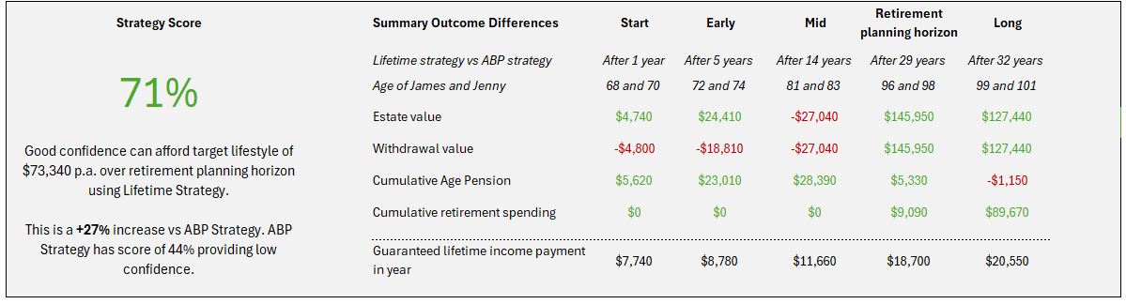
Case study: Tim and Shelly modelling
Adviser could be provided with overview of Strategy B vs Strategy A to
understand key trade-offs over retirement
Strategy Score an overall indication of success by answering
‘Can we afford to spend at our target lifestyle over retirement?’
Summary table gives comparison of outcomes at different ages

Slide 44
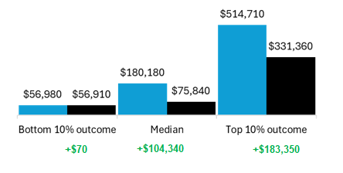
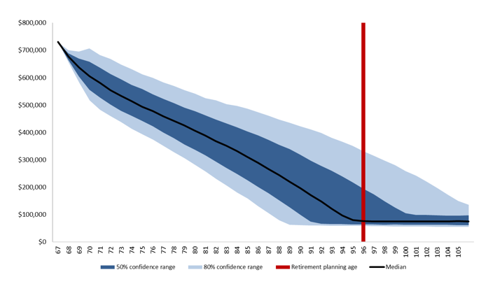
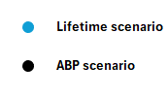
Case study: Tim and Shelly modelling
Ideas for risk-based outputs from stochastic modelling
Range of estate value outcomes after 29 years
Estate value funnel of doubt
ABP Only strategy

Slide 45
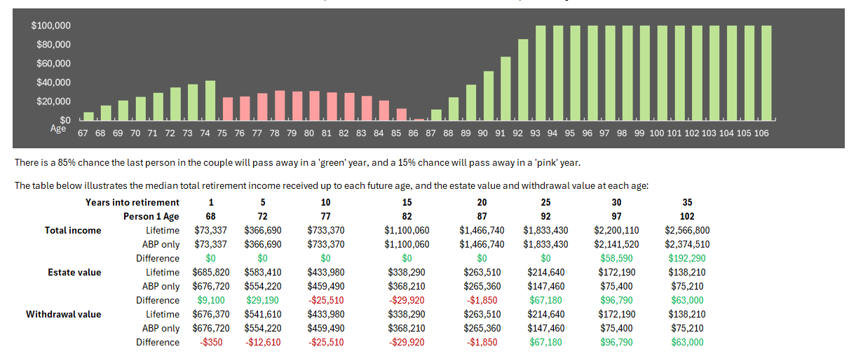
Case study: Tim and Shelly modelling
Ideas for risk-based outputs from the stochastic modelling

Slide 46

A new retirement advice workflow
Advice technology has a key role to play in removing barriers to advising on lifetime income products
Integration and usability within current processes
is important
Assist advisers select:
    A retirement planning horizon that considers longevity risk
    Lifetime product options which align with
    a client’s objectives
    Investment allocations to maintain the target risk profile
    Strategies based on an informed decision
    using modelling which takes account of risk

Slide 47
About the Actuaries Institute
The Actuaries Institute is the peak professional body for Actuaries in Australia. The Institute provides expert comment on public policy issues where there is uncertainty of future financial outcomes.
Actuaries have a reputation for a high level of technical financial expertise and integrity. They apply their analytical and risk management expertise to allocate resources efficiently, identify and mitigate emerging risks and to help maintain system integrity across multiple segments of the financial and other sectors. This unrivalled expertise enables the profession to comment on a wide range of issues including life, general and health insurance, climate change, superannuation and retirement income policy, enterprise risk management and prudential regulation, the digital economy, finance and investment and wider health issues.
© Institute of Actuaries of Australia 2023.​ All rights reserved.

Slide 48
Thank you
Actuaries Institute
actuaries.asn.au

