Slide 1


Are Actuarial Group Pricing Methods still fit for purpose
Authors Mary Liao
Damian Thornley
Acknowledging assistance from
Daniel Stone
Ethan Field
Chair: Kirsty Hogan
June 2025

Slide 2
The Actuaries Institute acknowledges the traditional custodians of the lands and waters where we live and work, travel, and trade.
We pay our respect to the members of those communities, Elders past and present, and recognise and celebrate their continuing custodianship and culture.

Slide 3
Contents
Introduction
Biometric Method
Experience Sharing Mechanisms

Slide 4
Introduction
Biometric Method – Biometric approach may better meet stakeholders' requirements under current landscape
Discuss two approaches
Landscape changed/changing
Biometric approach might deal with changing landscape well
What are the challenges for biometric approach
Key takeaway
Profit Share Mechanism - Are current designs and communication achieving the original intention?
History of the modem PAM/Buffer/PSM
Design intention/Goals
Disclosure
Achieving original goals?

Slide 5
Biometric Method
01

Slide 6

Two approaches: Loss Ratio approach relies rescaling
Biometric approach looks directly at claim incidence
Loss Ratio Approach
"Traditional" LR = with trend allowance
Rescaling required to bring past experience to reflect current product design and premium rates
Forward looking view based on "rescaled" experience normally derived at a relatively aggregate level
Biometric Approach
"Biometric" LR =
"Raw" claim experience is used to understand historical experience, compared to an expected basis
Projected view would be purely based on "forward looking" assumptions
Notes:
Why LR?
1. LR approach arose during the 1990’s due to the difficulty of the exposure measurement for Industry Funds. Because the premium payment method was ‘contribution based’, there was not a good connection between the InForce membership listing vs the Amount of Revenue collected. And membership listing might also not complete and not frequent enough.
2.Premium information was more reliable than membership exposure measurement in the early days.
3.Easy and direct way to measure, understand and present the experience and pricing decision
4.Premium revenue used as exposure measurement became the norm and the least risky way for the Life Insurers to proceed.
A key concept in LR is "rescaling", which is to bring the historical experience to be representative to current. It includes rescaling on both claims and premium side. LR approach uses "premium" to "standardise" claims. The historical rescaled LRs are used to understand claim experience and form "forward looking view", normally derived at a relatively aggregate level.
Biometric
Biometric is not a new concept, similar to LR approach, projected incidence rates & projected membership exposures are also based on study of historical experience. The difference is that it tackles the problem from first principle – the incidence rates look at the likelihood of making a claim. We can project membership based on observed historical movements as well. It is at the very end stage, when we are going to estimate the future claim cost, we combine the forward looking incidence rates and membership exposure. Forward looking incidence rates can be defined by "biometrics" - in other words, claim differentiating factors such as age, gender, SI band etc. Historical membership movements can be assessed by "biometrics" as well, and movement assumptions can be used to derive projected membership. "Biometric approach" separates premium out from the historical "claim analysis", and use only "forward looking "assumptions in estimating future claims.
A key concept here is a "basing analysis", in other words, an "AvE" analysis – where E is the expected claims from a basis table, and A is the fund specific claim experience. This helps actuaries making informed decision on expected claims when certain cohorts have lower credibility. We will explore this concept a bit more in later slides.
^ For Group Salary Continuous (GSC) policies, termination and partial assumptions should also be derived by various pricing factors. Estimated future claim cost is a combination of incidence, termination, partial and projected membership exposure assumptions.

Slide 7

Landscape has changed significantly (and will continue to change)
Where,
- Membership data could be more accurate making Biometric approach possible
- Funds demanding more granular insights (claims and membership)
Notes:
Given APRA's oversight to Trustee governance, Trustees have increased needs to understand insurance to test if their insurance offerings meet members' best financial interest. We observed more insurance design changes in the last decade. We anticipate there will be more to come. We also note there is an increasing interest from funds to have a better understanding of it membership movements (both insured and not insured).
Regulatory changes and other components of external environment, such as workers comp, retail insurance take up/retention rate, lawyer involvement, economic cycle etc, all of these are less stable now and are likely to have an impact to group insurance claim experience. We have also observed quite a few funds M&A activities in the past few years. This means funds history become more complicated, estimate into future could be more challenging and funds need more insights to ensure member equity.
On the positive side, with APRA's minimum data quality requirement, and funds intention to understand its membership movement better, funds are more likely to invest into its admin system, which means accurate membership information with biometric data are likely to be available now, and can closely align to premium revenue.

Slide 8
Biometric approach potentially deals with landscape change well with less operational risk and offering more granular insights
Biometric approach (vs LR approach) | Description
Pros | No rescaling: efficiency + lower operational risk
 | Provide insights to claim drivers and membership exposure separately, at a granular level
 | Provide insights into volatility – at both portfolio and cohort level
 | Flexible for stress testing, back-testing and benchmarking
Cons | Potential initial system/development investment + change management
Common challenges | Reserving challenges remains
Muncih Re
Notes:
Pros
1.For LR approach, rescaling is normally required if there is historical benefit scale change, premium change, grandfathering, funds offering change, or economic change (such as indexation). It requires high effort and normally associated with operational risk.
The operational risk can be mechanical rescaling risk (i.e. complex grandfathering rules), or it can be on the more technical side. For example, if we observed there is a termination improvement trend, and decided to allow that trend to the forward looking assumption, then not only the DLR should use the forward looking termination assumption, the “paid” component of historical claims should also be “rescaled” to reflect the forward looking view. Another example would be reporting pattern. If we truly believe there is a change to the claim “reporting pattern”, then not only the IBNR should reflect the reporting pattern, the “paid” claims theoretically should be “rescaled” to reflect the reporting pattern as the PV claim could be different especially under a high yield environment. The IBNR example is less “apparent” compared to the termination example. There are other examples less “apparent” and can be missed in a tight tender environment, or can be time consuming to implement. For example, GSC indexation. If a GSC benefit has claim indexation, and the forward looking view is different to historical view, the “paid” component of GSC claims should be “rescaled”. Biometric approach does not require rescaling, not only saving time during tight tender timeline, but also avoid associated operational risk.
2. For biometric approach, we can conduct cohort analysis at a level as granular as underlying data sets allow in an efficient way. We do not need to "throw away data" to make it representative for future (such as PYS/PMIF), as future representation will naturally be realized via "biometric" assumption setting for claims and projected membership exposure. We can also examine and make explicit judgement calls regarding credibility, trend etc at a granular level. In later slides, we will provide examples demonstrate this point in more detail.
3. By using incidence rates, we can conduct simulation to understand volatility. It can be done by count, amount and by various guarantee periods.
4. With the right tool to support, in theory, we can calculate estimated claim cost and premium for whatever combination of underlying assumption set and exposure. This would be very useful for 1) stress testing (on both membership/claims) 2) Back-testing . It also provides great insight for benchmarking between various funds – LR is not a like for like comparison given different funds would have different pricing strategy, biometic level incidence rates are more like for like.
Overall biometric approaches provide more insight and reduce operational risk, especially when environment is not stable and fund history is complicated.
Cons
1.Hard to develop system using BAU resource with busy BAU activities. A holistic revamp of system and approach might require initial investment.
2.New approach and system require good change management to ensure smooth implementation – this include but not limited to upskilling, talent acquisition and retention, and extensive stakeholder management.
Common challenges
1.Both traditional LR and biometric approach use historical experience as a base to estimate for future. Thus the unknown part of the historical experience is the common challenge for these two approaches, which is the "reserving" part for long tail liabilities. Biometric approach can look at the assumptions at a granular level without "premium noise", but the fundamental challenge such as TPD acceleration vs deterioration are still remain for biometric approach.
2.This also applies to uncertainty due to external environment, such as the link between GSC incidence/termination to inflation.

Slide 9
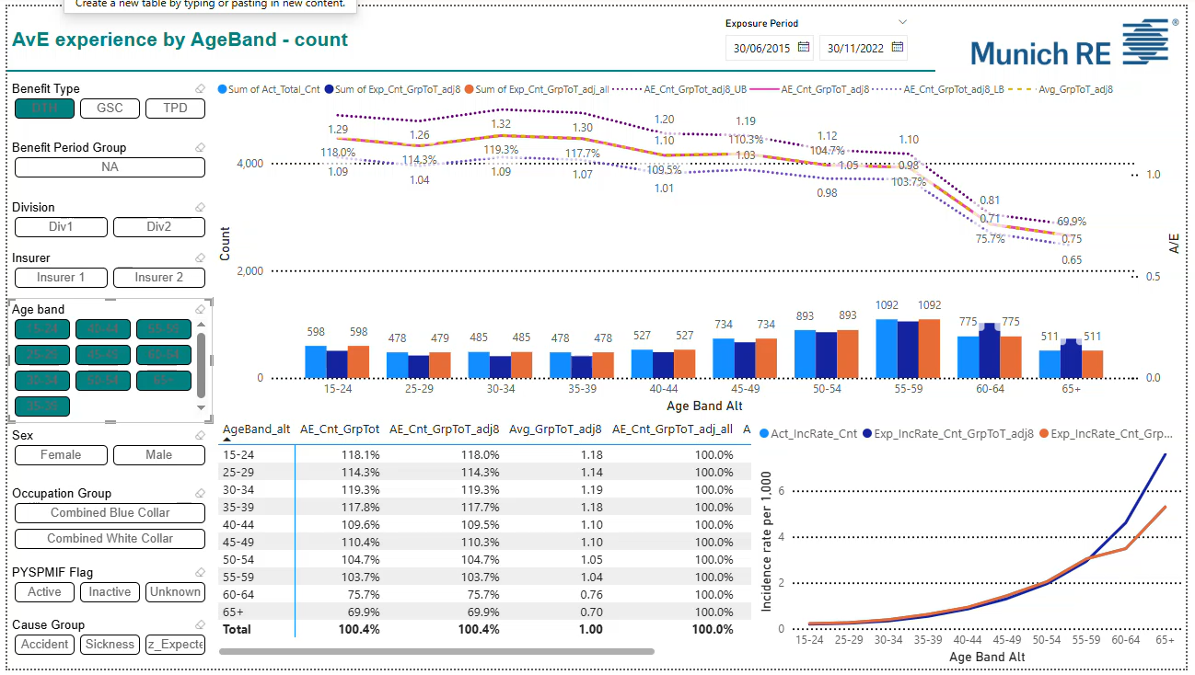
Biometric approach provides more granular insights
Notes:
Disclaimer – dummy data used.
This example looks at claim experience for a historical period (2015-2022). It look at the experience and can slice and dice into granular cohorts – flexible for deep dive, easy to use and understand. We can explore all potential drivers (biometric factors) as long as they exist in membership/claim data.
AvE analysis, can make informed judgement call around credibility.
Easy to understand "explanatory power" from various pricing factors, by analysing fitting "residuals", and it can be done in an interative process.
Easy to benchmark and Compare to other Funds – removing premium in the formula, incidence rates are more like for like comparisons
At the end of this analysis – we should form a view around the "shape" of the incidence rates

Slide 10
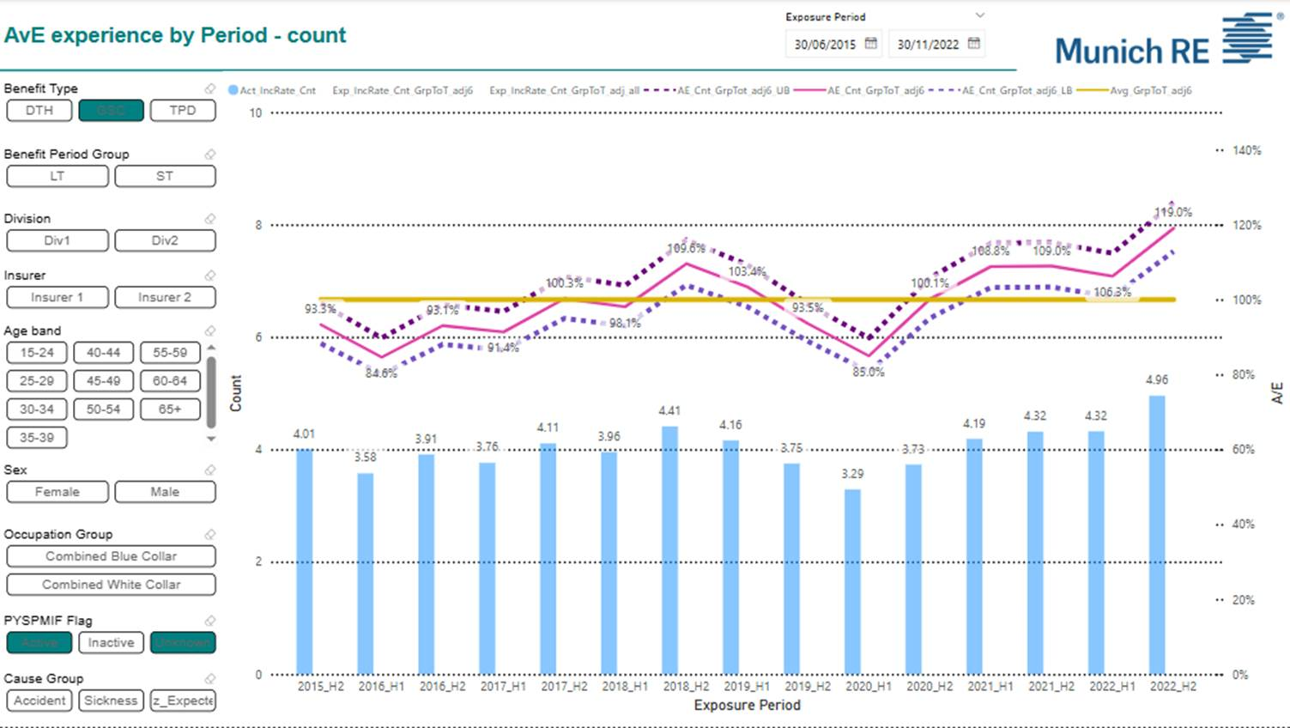
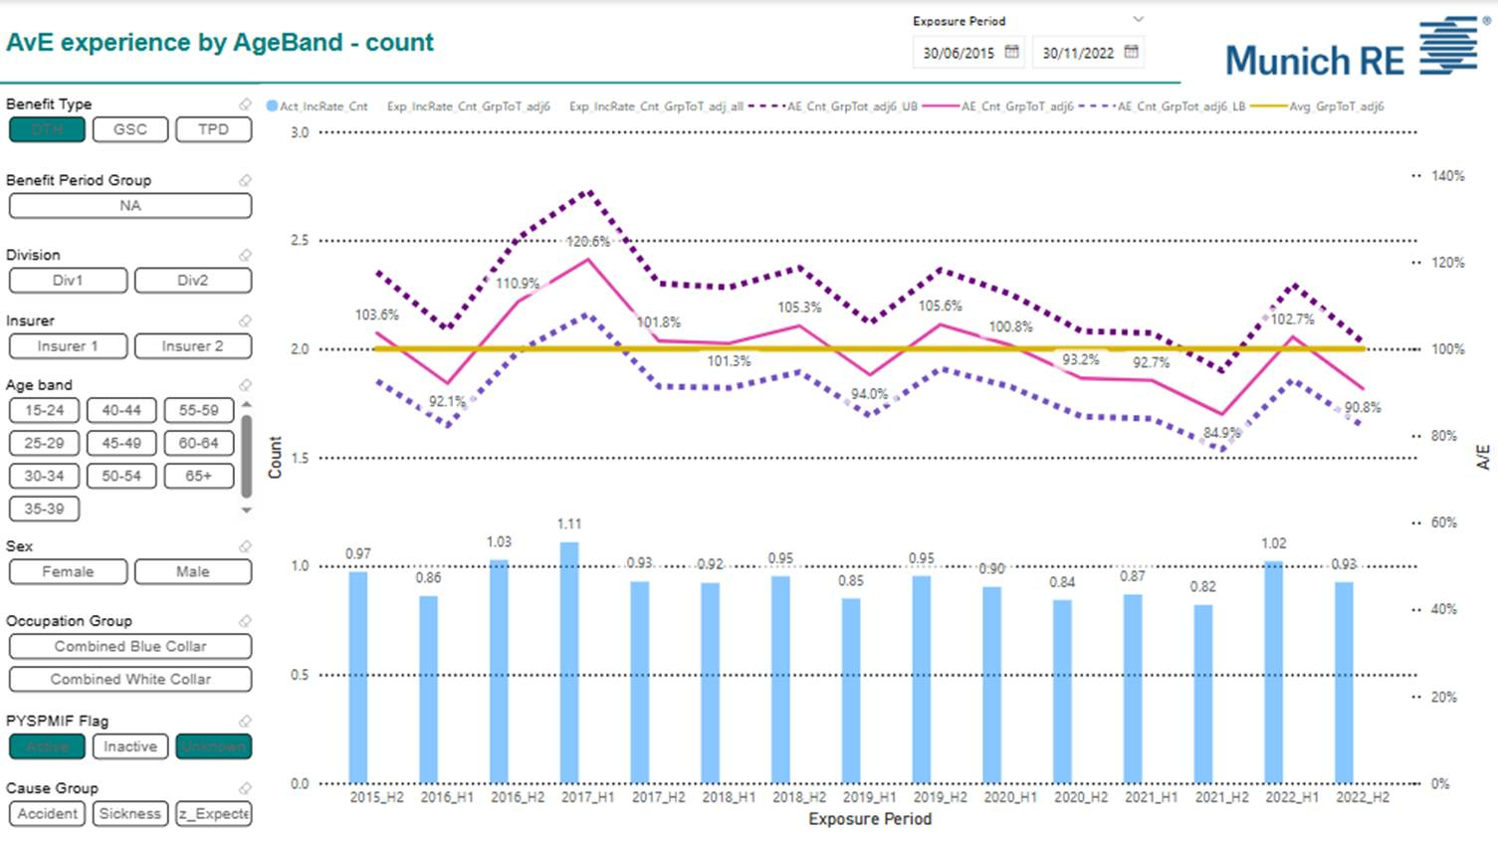
Biometric approach provides more granular insights
Notes:
Disclaimer – dummy data used.
This example looks at claim experience for a historical period (2015-2022). It look at the experience and can slice and dice into granular cohorts – flexible for deep dive, easy to use and understand. We can explore all potential drivers (biometric factors) as long as they exist in membership/claim data.
AvE analysis, can make informed judgement call around credibility.
Easy to understand "explanatory power" from various pricing factors, by analysing fitting "residuals", and it can be done in an interative process.
Easy to benchmark and Compare to other Funds – removing premium in the formula, incidence rates are more like for like comparisons
At the end of this analysis – we should form a view around the "shape" of the incidence rates

Slide 11
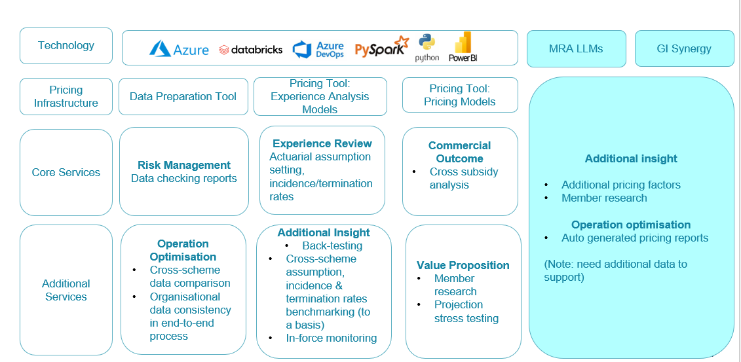
Biometric Method – Framework
Notes:
It oulines the supporitng technolog and tools, and various "stages" of pricing exercise.

Slide 12
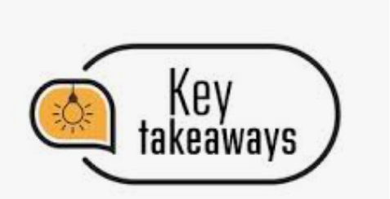
The biometric approach meets evolving Trustee needs by offering more granular insights, and presents less operational risk in dealing with change, but an initial investment might be required.

Slide 13
Experience Sharing Mechanisms
02

Slide 14
History of Experience Sharing contract structures
Born out of the Group Insurance TPD crisis in 2013
Around this time there was capital constraint / restricted capacity in the Insurance market. One way to address that was to provide contract structures that de-risked the P&L outcome for the Life Insurer, hence the creation of experience sharing mechanisms (ESM).
Preliminary discussion:
Do ESM structures compliment a competitive market, where Life Insurers and Reinsurers are willing to deploy large amounts of capital to insure benefits for funds members.
Why is it in the members best interest to bear some of the risk when non-participating contracts are priced so competitively?
Trustees / Funds are able to compare Policies more freely with no ESM
We will review - are these contract structures still appropriate in today’s environment? What benefits do such structures bring to Members?

Slide 15
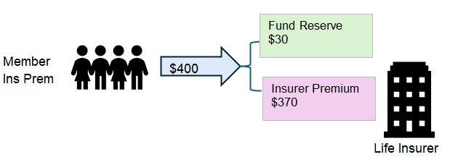
How are they disclosed to Members?
We will show the Disclosed Statements of five large Superannuation Funds (AUST SUPER, CBUS, ART, HOSTPLUS, REST) and we will analyse their disclosure to Members.
Leads to buildup on Insurance Reserves within the Super Fund which increases complexity of understanding true cost of cover
Does it make it easier or harder for Fund to go to tender and review their Insurance?
Experience share mechanisms are marketed to members as a simple trade off; lower premiums in return for taking on some of the claims volatility risk or the group life policy.

Slide 16
Not all ESMs are Created Equal
 | ($ million)
Superfund | Net Member Benefits (FUM) | Annual Insurance Premium | Total reserves | Insurance reserve | Insurance reserve as % of Annual Premium
Australian Super | 343,207 | 806 | 1,662 | 509 | 63%
CBUS | 92,429 | 417 | 468 | 127 | 27%
ART | 301,614 | 1,121 | 3,097 | 1 | n/a
HOSTPLUS | 114,752 | 351 | 981 | 108 | 31%
REST | 85,997 | 444 | 526 | 223 | 50%
All information is sourced from 2024 Annual Reports
Total Reserves are all reserves held by the fund, including operational, investment, insurance, etc.
Different types of PAM arrangements can result in different reserving behavior
This is driven by the contract itself, the claims experience, and the super funds risk standards
Notes:
Explain total reserves: operational reserves + other reserves
Add comment about information being from annual reports

Slide 17
Other considerations for ESM structures
Market Timing Risk – moving funds between growth investments and defensive reserves exposes fund (and members) to market timing risk
Lower Equity Between Members – future distributions based on historical experience, fund membership likely to have changed. Complexity of transfers between groups of members
Decrease In Competition – ESM may make it more difficult to conduct “like for like” comparisons in a market tender situation.
Consolidation and M&A Activity Creates Additional Complexity – How should historical adjustments be distributed to new merged fund?
Long tail-risk PAM true ups and recalculations – does the Fund understand what they’re exposed to?
Opaque structure in Fund Pricing, because the Fund insurance price is different to the insurer premium
+ On a positive note, the structure of high profit sharing can make it fairer for Life Insurer & Fund to enable agreement of best-estimate assumptions where there is high volatility / risk in the underlying assumption. In this type of situation traditionally, assumption setting may otherwise mean that contingency margins are included so that Members are paying a high price for certainty of insurance.
Notes:
Key message: Do funds truly understand the risks they are exposed to

Slide 18
Key messages for ESM structures
Think Twice about whether it’s the best structure in current market environment
Entails a lot of “overhead” complexity in the required contractual structure
Requires that the Fund can understand, and accept, the insurance risk transferred to the Members – and agree that it is a risk for which their Members are being adequately compensated
Arguably in a competitive market you can achieve good outcomes for Members by keeping the structure most simply as a Non-Participating structure thus achieving a full risk transfer and enabling an easier pricing comparison across Life Insurer A, Life Insurer B.
Upside of ESM structure is that uncertain product changes can be accommodated within the partnership & experience sharing benefits conferred by the structure
Notes:
Key message: Do funds truly understand the risks they are exposed to

Slide 19



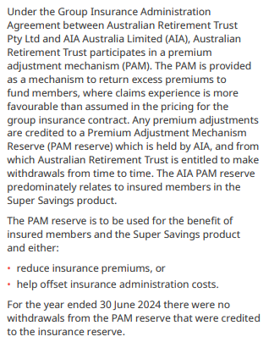
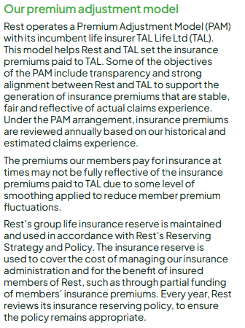
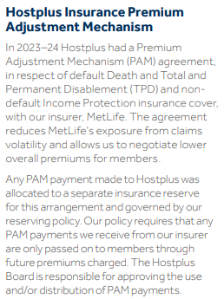

Slide 20


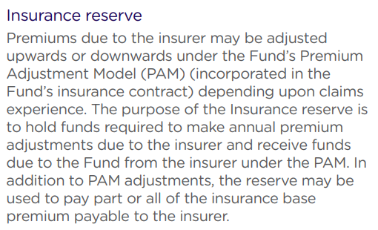
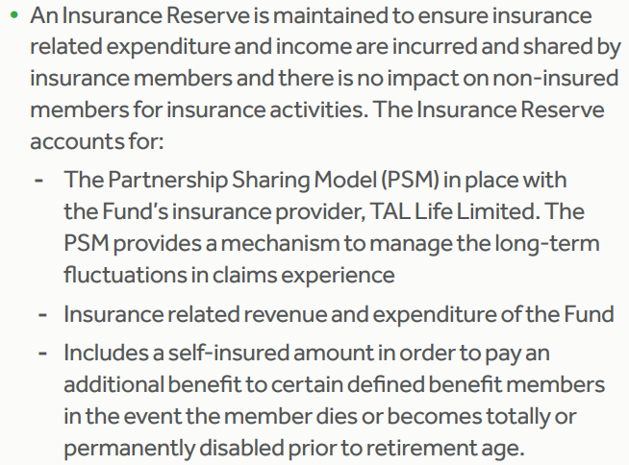
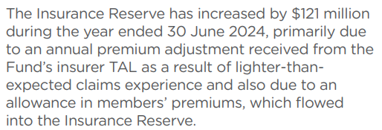

Slide 21


Thank you!
Mary Liao
Damian Thornley
Daniel Stone
Ethan Field
Kirsty Hogan

