Slide 1
Women-Centric Insurance Products:
Good Business Proposition?
Rummana Choudhury
Friday, 13 June 2025

Slide 2
Contents
Introduction 03
Women at Risk 05
Women as Risk 13
Women in Risk 15
Audience Discussion 17

Slide 3
Introduction
01

Slide 4
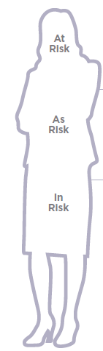
A framework for insuring women’s futures
Women at Risk:
Women’s risks in life: Understanding the personal and professional risks women face across society and their experience of life insurance
Women as Risk:
Risk solutions for women: Identifying new and improved valuable insurance solutions for women’s risks. This includes approaches to engagement, information and guidance as well as financial planning and advice, together with their needs and preferences as buyers of insurance.
Women in Risk:
Careers in risk for women: Improving the profile of women in the life insurance industry, in particular increasing the number of women at senior levels and making the industry more attractive to new female talent.
Source: Insuring Women's Futures, The Chartered Insurance Institute (CII), https://media.umbraco.io/ciigroup-dxp/zbxhqlq2/iwf-manifesto-full-report-web-parts-1-2.pdf
Notes:
This framework is from a report from the Insuring Women’s Futures group in the UK. This group was founded in 2016 by a group of women in the insurance profession in collaboration with the CII as part of its public trust remit. Three years later, following detailed research and analysis and with the support of over 150 leading experts giving their personal time, they published a c.230 page report, titled ‘Living a financially resilient life in the UK’.

Slide 5
Women at Risk:
Understanding the personal and professional risks women face across society and their experience of life insurance
02

Slide 6
Labour participation rates – 1978 to 2024
Increasing female participation in the working age population
Female participation rates were 50.2% in February 1978 and have increased to 77.3% in December 2024.
Gap between male and female participation rates have narrowed from around 37 percentage points in February 1978, to around 7 percentage points in December 2024.
Source: Australian Bureau of Statistics, Spotlight: Changes in participation for men and women in Australia 20/03/2025
Notes:
The change in the participation rate for people aged between 15-64, the population labour economists and demographers sometimes describe as the ‘working age population’, has been significant.

Slide 7
Women in the workforce – a snapshot
The graph on the right shows the number of employed women as a proportion of all women by age at different time periods, 1966, 1980, 2000 and 2020.
Observations:
  High levels of employment for women in their early 20s.
  Drop in employment for women between around 25 and 40.
    This decrease was earlier, and more pronounced in 1966, but has steadily declined over the years.
    In 2020, there was only a slight dip in female employment at around 30 years of age. The timing of this dip roughly coincides with when women are becoming mothers.
  In 2022¹:
  c.57% of all employed women in Australia were reported to be in full-time employment and the remaining c.43% in part-time or casual employment.
  In comparison, c.80% of employed men were in full-time employment and the remaining c.20% are in part-time or casual employment.
Source: Australian Bureau of Statistics, Changing female employment over time 18/03/2021
1 Gender equality workplace statistics at a glance 2022, Workplace Gender Equality Agency (WGEA), https://www.wgea.gov.au/publications/gender-equality-workplace-statistics-at-a-glance-2022

Slide 8
Burden of disease
The Australian Institute of Health and Welfare’s (AIHW) measures the burden of disease for the Australian population.
Burden of disease is measured using the summary metric of disability-adjusted life years (DALY, also known as the total burden). One DALY is one year of healthy life lost to disease or injury.
Study reported that males and females experience disease burden differently.
For those aged 15–44, anxiety disorders was the leading specific cause of burden in females, while for males it was suicide & self-inflicted injuries.
For women aged 45–64, back pain & problems, osteoarthritis, anxiety disorders, breast cancer and rheumatoid arthritis were the leading 5 specific causes of burden. For men it was coronary heart disease, back pain & problems, suicide & self-inflicted injuries, lung cancer and chronic liver disease.
  Source: https://www.aihw.gov.au/reports/burden-of-disease/australian-burden-of-disease-study-2024/contents/key-findings#which-risk
Notes:
Burden of disease
measures the impact of diseases and injuries on a population. It combines the years of healthy life lost due to living with ill health (non-fatal burden) with the years of life lost due to dying prematurely (fatal burden). A portion of this burden is preventable, being due to modifiable risk factors. The Australian Burden of Disease Study (ABDS) 2024 includes estimates of disease burden due to 220 diseases and injuries in Australia in 2024, as well as the disease burden attributed to 20 individual risk factors.
DALY caused by living in poor health (non-fatal burden) are the ‘years lived with disability’. DALY caused by premature death (fatal burden) are the ‘years of life lost’ (YLL) and are measured against an ideal life expectancy.

Slide 9
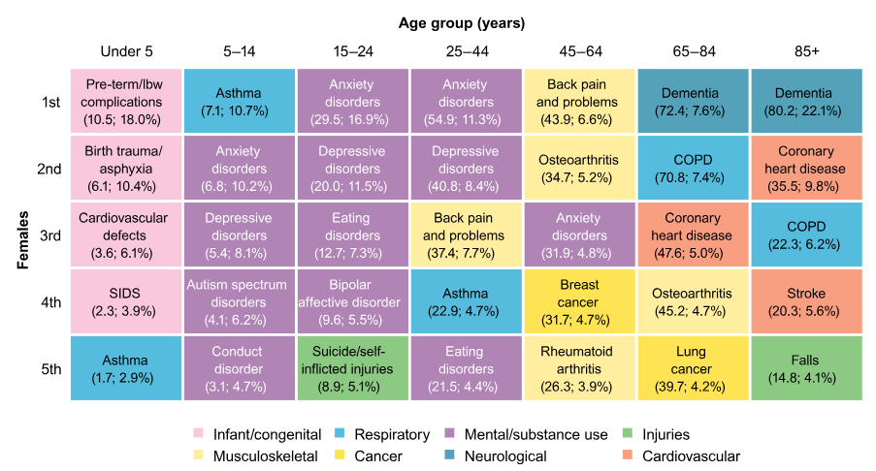
Burden of disease - DALY ‘000; proportion % by sex and age group in 2024 – Females
  Source: https://www.aihw.gov.au/reports/burden-of-disease/australian-burden-of-disease-study-2024/contents/key-findings#which-risk

Slide 10
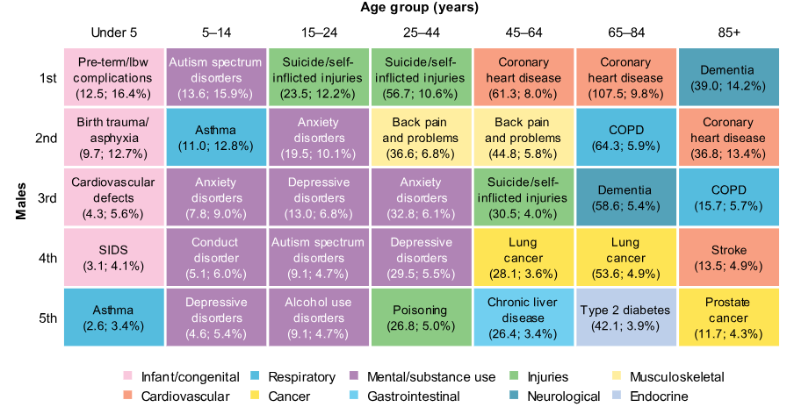
Burden of disease - DALY ‘000; proportion % by sex and age group in 2024 - Male
  Source: https://www.aihw.gov.au/reports/burden-of-disease/australian-burden-of-disease-study-2024/contents/key-findings#which-risk

Slide 11
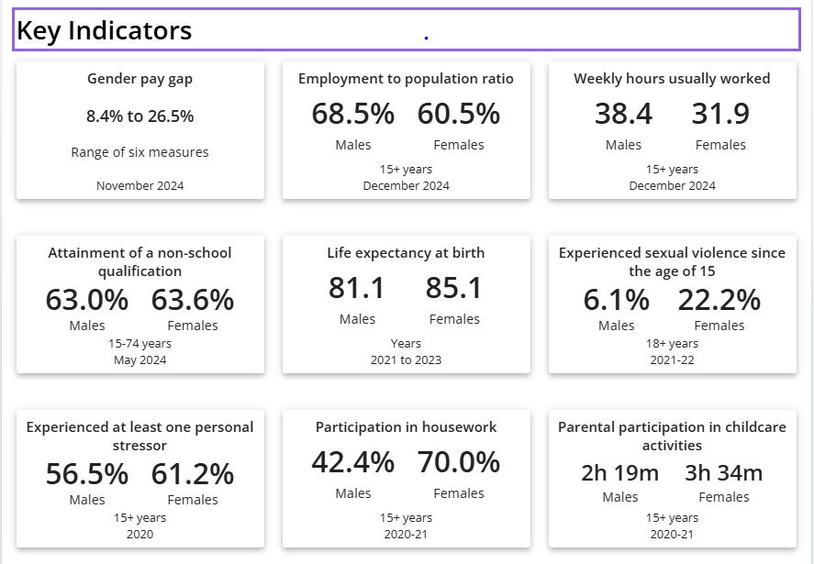
ABS: Gender indicators
Source: ABS: Gender indicators: https://www.abs.gov.au/statistics/people/people-and-communities/gender-indicators#key-indicators

Slide 12
Women’s interaction with life insurance
Women’s working lives are made up of many phases – many women moving between full-time, part-time or casual work, or even transition into unpaid work and a return to work later in life.
In addition, women take on a large proportion of care responsibilities, e.g. young children, ageing parents.
This results in women’s financial situations being less predictable which can influence their ability to secure and maintain insurance cover.
CALI’s research found¹:
  3 in 5 working women who don’t have life insurance say the reason is because it is too expensive or they can’t afford it
  2 in 5 women surveyed said “more accessible information to understand what they’re protected for” would improve the value of life insurance to them personally
  Majority of women (c.60%) obtained life insurance cover through their super fund. This is the same story for men.
1 The Gender Gap in Life Insurance: Exploring women’s awareness, perceptions and uptake of life insurance, Council of Australian Life Insurers (CALI), March 2025

Slide 13
Women as Risk
Risk solutions for women: Identifying new and improved valuable insurance solutions for women’s risks. This includes approaches to engagement, information and guidance as well as financial planning and advice, together with their needs and preferences as buyers of insurance.
03

Slide 14
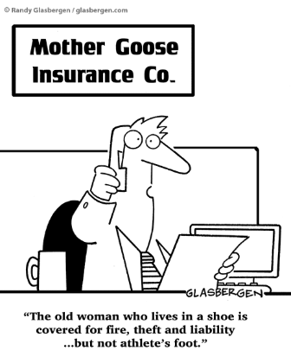
Current landscape
  Most insurers already offer products with features that may benefit women:
    income protection that considers pre-maternity leave earnings
    premium waivers during parental leave
    TPD cover based on domestic duties.
  Some insurers have recently started to offer insurance products or services tailored to women’s health and well-being including coverage for menopause, endometriosis, and pregnancy complications.
  Opportunity for product innovation across the industry.
  Challenges include:
    Availability of data
    Sustainable product design
    Distribution
    Retail vs Super
    Non-financial benefits
To be covered in the audience discussion

Slide 15
Women in Risk
Careers in risk for women: Improving the profile of women in the life insurance industry, in particular increasing the number of women at senior levels and making the industry more attractive to new female talent.
04

Slide 16
Women in life insurance industry
Actuaries – product development & pricing
In 2024, 34% of the members of the Actuaries Institute were female¹:
    Fellows: 29%
    Associates: 40%
    Students: 38%
Similar to levels to 2015.²
Financial planners and advisers
22 per cent of all financial advisers on the ASIC Financial Advisers Register are female (Oct 2024).³
CALI interviewed 50 financial planners and advisers (20 women and 30 men) to reflect on product gaps in life insurance. Those relating to women were raised by 4 of the female advisers – potential for increasing awareness of women’s experience within the industry.⁴
Other professions: Underwriting, Claims, Product Managers, BDMs – representation? Generally, feels like there is good female representation in the industry in these professions.
1 2024 Actuaries Institute Annual Report: https://content.actuaries.asn.au/resources/resource-ce6yyqn64sx3-2093352434-60107
2 2015 Actuaries Institute Annual Report: https://content.actuaries.asn.au/resources/resource-ce6yyqn64sx3-2093352434-31366
3 Female Financial adviser numbers hit stagnation, Money Management, https://www.moneymanagement.com.au/news/financial-planning/female-financial-adviser-numbers-hit-stagnation
4 The Gender Gap in Life Insurance: Exploring women’s awareness, perceptions and uptake of life insurance, Council of Australian Life Insurers (CALI), March 2025

Slide 17
Audience Discussion
05

Slide 18
Challenges & solutions: discussion
  Availability of data
  Sustainable product design
  Product design - Retail vs Super
  Distribution
  Non-financial benefits

Slide 19
About the Actuaries Institute
The Actuaries Institute is the peak professional body for Actuaries in Australia. The Institute provides expert comment on public policy issues where there is uncertainty of future financial outcomes.
Actuaries have a reputation for a high level of technical financial expertise and integrity. They apply their analytical and risk management expertise to allocate resources efficiently, identify and mitigate emerging risks and to help maintain system integrity across multiple segments of the financial and other sectors. This unrivalled expertise enables the profession to comment on a wide range of issues including life, general and health insurance, climate change, superannuation and retirement income policy, enterprise risk management and prudential regulation, the digital economy, finance and investment and wider health issues.
© Institute of Actuaries of Australia 2023.​ All rights reserved.

Slide 20
Thank you
Actuaries Institute
actuaries.asn.au

