Slide 1
Insurance in Super
Optimising a Dignified Retirement for All Members
Jeff Humphreys – CHR Consulting
Karen Lau – Rest Super
June 2025

Slide 2

Insurance in Super
  What is the risk
  Background
  Issues for members
  How much insurance is needed
  How much default cover is provided
  How much does insurance cost
  Optimising a dignified retirement for all members

Slide 3
Insurance in Super
What is the risk

Slide 4
What is the risk of death and disability facing Australians over their working lifetime?
~30%¹
will experience at least one insurance event for death or disability
Over an Australian’s working lifetime, it is estimated¹ that…
  ~ 23 out of 100
  will experience disability
  ~ 7 out of 100
  will die

Slide 5
Insurance in Super
Background

Slide 6
What does the legislation say - Tradeoff
SIS Act Section 52, Subsection 7 Insurance Covenants
(a) to formulate, review regularly and give effect to an insurance strategy for the benefit of beneficiaries of the entity that includes provisions addressing each of the following matters:
(i) the kinds of insurance that are to be offered to, or acquired for the benefit of, beneficiaries;
(ii) the level, or levels, of insurance cover to be offered to, or acquired for the benefit of, beneficiaries;
(iii) the basis for the decision to offer or acquire insurance of those kinds, with cover at that level or levels, having regard to the demographic composition of the beneficiaries of the entity;
.....
(c) to only offer or acquire insurance of a particular kind, or at a particular level, if the cost of the insurance does not inappropriately erode the retirement income of beneficiaries;
XXXXXXXXXXXXX

Slide 7

What is the issue for the trustee?
  Striking a Balance Between
  70%
  30%
  Members don’t claim
  How may the trustee solve this?
  Members claim
  ~By optimising a dignified retirement of both the 30% and the 70%~

Slide 8





Insurance in Super – Why is it important?
8
Financial protection
Affordable
Peace of mind
Provide financial protection to members efficiently (low distribution costs, super fund negotiating power, tax benefit) at an affordable cost, with payments made from the super account, not take-home pay being a contributing factor.
Without insurance, fund members and their financial dependents are left with little or no financial protection.
Reduces the uncertainty around what would happen in the event of death or disability.
Community safety net
Accessible
Provides a safety net that protects the community, where there is limited government support.
Improves accessibility automatic insurance provides cover to almost all occupations and generally without underwriting.

Slide 9

Buy now pay later
Buy Now Pay Later
  SG is fixed – 12% from 1 July 2025
  No salary – no SG
  Insurance of today’s salary is paid for tomorrow via retirement income reduction

Slide 10
Insurance in Super
Issues for Members

Slide 11

What are the issues for members?
Emphasis on the Erosion Covenant
Benefits Losing
Their Value
Inadequate Education and Member Tools
  An industry with an unhealthy emphasis on the ‘erosion’ covenant
  Trustees and some management
  Regulators
An industry that as a whole has cut member’s default benefits and/or let the real value of benefits slide
Large uptake in voluntary cover to fill the gap (for those who get through underwriting)
Lack of member awareness and understanding with little education by trustees
Poor Insurance Need Calculators

Slide 12

What are the issues for members
Insurance Calculators / Guidance Tools
  Issues with Calculators
  Do they provide useful guidance?
    Some calculators require the member to nominate a loss period. Therefore, the answer is whatever the member thinks it should be!
  Insufficient?
    No Income Protection
  Inappropriate?
    Death cover for singles
    Disability cover = Death cover
  Inconsistent

Slide 13
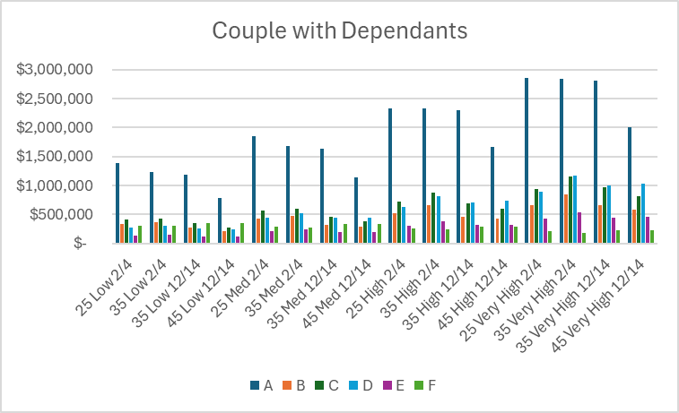
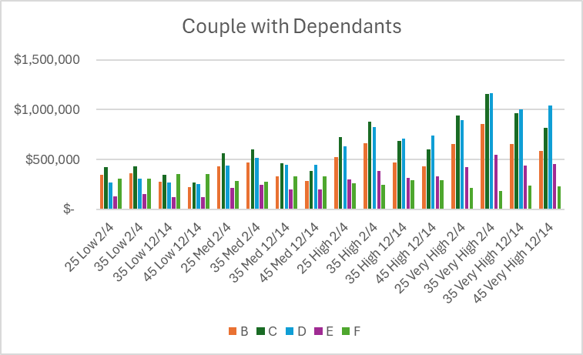
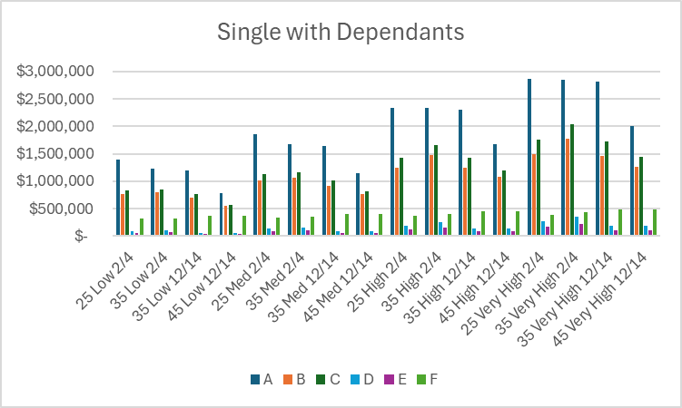
What are the issues for members
Calculators / Guidance Tools - Super Funds – Death

Slide 14
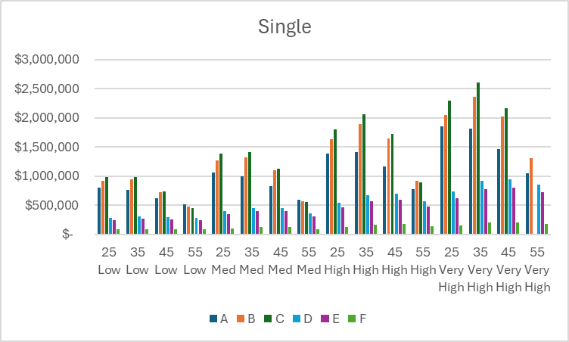
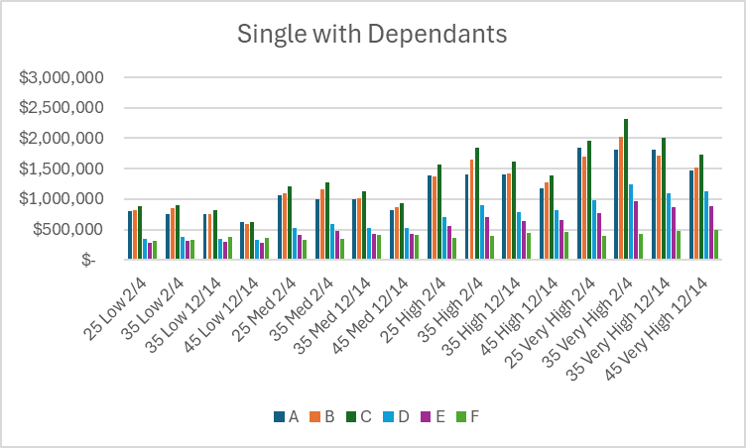
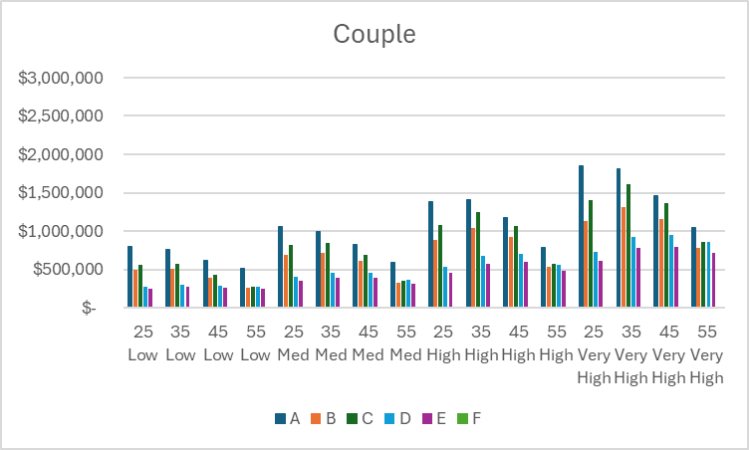
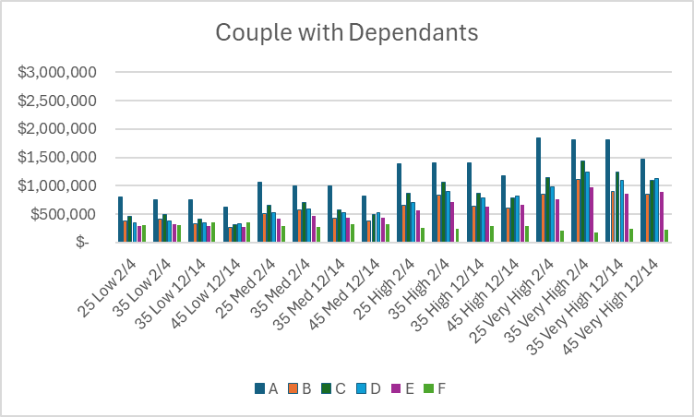
What are the issues for members
Calculators / Guidance Tools - Super Funds - Disability
  Good
  Down with age
  Up with salary
  Bad
  Inconsistent between funds
  Intuitively wrong
  Of little value to the member

Slide 15
What are the issues for members
ASIC Insurance Calculator - MoneySmart
What are the deficiencies?
  Only Death cover, no Disability cover
  More calculator than guidance tool
  Very dependent on member input

Slide 16
Common Industry Misconceptions
Members who don’t claim are subsidising members who do
  The Facts…
It is not possible to predict which members will claim or will not claim.
All insured members are protected by the insurance cover, regardless of whether they make claims – this is not cross-subsidisation.
  Pooling involves…
  Sharing a financial risk by paying premiums that all members in the pool face, but only a few will experience – the claimants.
  Super funds provide members with access to this pool.

Slide 17
Common Industry Misconceptions continued
The percentage of members claiming is very small
Premium is a ‘cost’
  The Facts…
30% members will claim over their working life.
23% will claim disability benefit.
7% will claim death benefit.
The actual cost of premium is the ‘insurer margin’, which is only a fraction of the premium
Most of the premium is paid out as member benefits

Slide 18
Insurance in Super
How much insurance is needed

Slide 19

What is indemnity-based insurance design?
Indemnity-based insurance design is fundamental to many insurance contracts. It is based on the following key principles:
Restore
Financial Position
No “Profit”
From A Claim
  Indemnity-based insurance is based on the concept of restoring the insured to the same financial position they were in before an insured event occurred by compensating ‘actual financial losses’ occurred.
  Indemnity-based insurance ensures that the insured doesn't gain financially from their claim, which could otherwise encourage moral hazard or fraudulent behavior.
These principles allow insurers to offer financial protection to the insured against unforeseen events that could otherwise lead to substantial financial hardship, in a fair and sustainable way.

Slide 20
What should we be indemnifying?
Lost Salary /
Income
Expenditure / Living Costs
Pay off the Mortgage? No, this is a capital item, not a cash flow.
Mortgage repayments account for 12% of household income for households with a mortgage ¹. The remaining 88% of the income still needs to be funded.

Slide 21
Indemnity Cover - Salary v Expenditure?
Income based cover: Replace lost income (salary) PLUS adjustment expenses
Expenditure-based cover: Replace estimated expenditure PLUS adjustment expenses
Income
Expenditure
Focuses on income replacement
Income = Salary
Focuses on replacing living expenses –Discretionary as well as non-discretionary?
Tax adjusted?
Lower risk of moral hazard as insurance payout is limited to a % of lost salary
Higher risk of moral hazard as the insurance payout can exceed the actual financial loss.
Ensures continuation of standard of living pre-insured event.
Higher chance of over and under-insurance.
Have to gross up for tax impacts
Cover amount is determined based on a percentage of member’s salary plus other financial losses, that is simple and easy to understand, with little guess work
Easy to estimate for trustee
No tax adjustment estimate required
Cover amount is determined based on the estimated living expenses and financial obligations that are hard to estimate as members’ living expenses under diverse lifestyles are often unknown to the trustees.

Slide 22
Indemnity-based insurance design for super funds – How does it work?
Indemnity-based insurance design for a super fund means the cover levels reflect the financial losses members experience in the event of death or disability.
These financial losses for death and disability for a super fund member are salary-based plus other financial losses as follows:
Death
  Disability
    Financial losses
      Lost Salary and Super until retirement age / repartner¹
    Financial Losses
      Loss Salary and Super until retirement age +
        Excess Medical Expenses +
        Retraining Cost +
        Adjustment costs

Slide 23
Applying a practical example…
Defining members’ insurance needs using indemnity-based insurance design…
Death
  Disability
      5¹ times Lost Salary and Super Contributions²
      (75%³ times Lost Salary⁴) and Super Contributions⁴ +
      $100k⁵ Excess Medical Cost and Adjustment Cost +
      $35k⁶ Retraining Cost

Slide 24
Question slide

Slide 25
Death: What does an indemnity-based default design look like for the Australian working population?
Under the indemnity-needs-based insurance design, the Australian working population earning a median salary:
The insurance needs peak between the ages of 34 and 46 years at approximately $360,000.
This is primarily due to peak salary levels during these ages.
Needs increase from age 18², following the tapering up of the 'needs' formula from 18 to 25 years, and decrease from age 50 due to reduced salary and financial commitments, as superannuation account balances grow and children are likely to have become independent.

Slide 26
Disability: What does an indemnity-based default design look like for Australian working population?
Under the indemnity-needs-based insurance design, the Australian working population earning a median salary:
Will need approximately $1.7 million in disability cover to compensate for future lost salary and super, excess medical costs, and retraining costs for ages between 26 and 38 years.
These needs decrease with age as the time exposure to financial risk reduces until retirement age.

Slide 27
Insurance in Super
How much default cover is provided

Slide 28
Death: How does an indemnity default design for Australian working population compared to the default cover offered by large industry funds?
On average, most large industry funds provide materially lower default cover compared to the indemnity-needs-based design.
The current average default death cover provided by Australia’s seven largest industry funds covers 57%, 62%, 48% and 31% of the Australian’s working population needs¹, in the event of death at ages 25, 35, 45 and 55 respectively.
Lower quartile is not a permanent category for a member.
Using bottom quartile salary, the coverage levels are 79%, 105%, 81% and 50% at ages 25, 35, 45 and 55 respectively.

Slide 29
Disability: How does an indemnity default design for Australian working population compared to the default cover offered by large industry funds?
The current default disability cover (TPD and IP combined) provided by Australia’s seven largest industry funds covers 9%, 9%, 9% and 10% of the Australian’s working population needs¹, in the event of disability at ages 25, 35, 45 and 55 respectively.
Using bottom quartile salary, the coverage levels are 13%, 16%, 15% and 14% at ages at ages 25, 35, 45 and 55 respectively.
The poverty line design is roughly the same as the bottom quartile design. The illustrates a significant level of underinsurance for disability cover for working Australians across all ages, even when using bottom quartile salary and poverty⁶ line salary.
This leaves many working Australians financially exposed to disability and at risk of severe financial hardship⁵ and poverty.

Slide 30
Death: How much cover do members seek when applying for additional cover?
The voluntary death cover applications has similar age shape to the indemnity-needs-based design as well as the average default design where middle ages have higher cover needs.
Members applying for voluntary death cover apply for significantly higher cover than what they are provided under default and also higher compared to the indemnity-needs-based design.

Slide 31
Disability: How much cover do members seek when applying for additional cover?
The voluntary disability cover applications on average has similar age shape to the indemnity-needs-based design where younger ages have higher cover needs.
The average voluntary cover application is lower than that of the indemnity-needs-based design, but significantly higher than the default cover offered by the seven large industry funds.

Slide 32
Insurance in Super
How much does insurance cost

Slide 33
What are the possible measures of insurance cost?
Possible measures of Insurance Cost | Simple for members to understand | Long term measure? | Alignment with Retirement Goals? | Can be tailored to member demographics? | Alignment with Legislation
Percentage of Salary^{1, 2} | a | r | r | a | r
Percentage of Account Balance¹ | a | r | r | a | r
Percentage of Dollar Premiums versus the Fund’s Competitors’³ | r | r | r | r | r
Percentage of Retirement Balance⁴ | a | a | a | a | r
Percentage of Retirement Income^{4, 5} | a | a | a | a | a

Slide 34
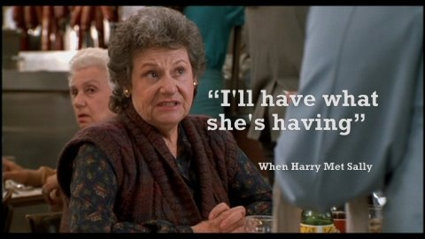
Why not benchmarking?
Benchmarking is a suboptimal method of determining:
Design – cover levels
Total premium cost
Premium rates
Inconsistent with the SIS Act
and yet is used by most funds to “position” their design
A function of the herd mentality that dominates the decisions of trustees and management

Slide 35

How should we measure insurance cost?
    1
    2
    3
    Alignment with Legislation
    The Three Pillars of Retirement Funding
    Time Period
    Age pension
    Compulsory Super
    Other
    Cost measured over members’ working lifetime
    Impact on retirement income measured from retirement to death
    Inappropriate Erosion Covenant
    Objective of Super legislation
    The ‘Three Pillars of Retirement Income’
  Cost of insurance =
  Total Premiums¹ as a Percentage of Retirement Income
1. Over a member’s working lifetime.

Slide 36
What is the retirement income erosion?
Indemnity-needs-based design versus default designs by seven large industry funds versus 1% of Salary
Based on the Australian working population earning a median salary and with median account balance:
Under the indemnity-needs-based insurance design, member is estimated to experience 11% retirement income erosion if they are insured throughout their working lifetime from 18 to 67 years old.
This 11% translates to approximately $5,500 annual post tax income loss at retirement.
Using 1% of Salary design, the expected erosion is 4.1%.
Based on the default cover offered by the seven large industry funds, the average retirement income erosion is 2.1%, which translates to $1,000 annual income loss at retirement.

Slide 37
What is the retirement income of the Member under various Insurance Scenarios – Healthy Member?
Healthy members refer to members who do not claim insurance – the 70%.
Based on the Australian working population earning a median salary and with median account balance:
Having full insurance (indemnity-based design) throughout a members’ working lifetime does not reduce their living standards below the ASFA Comfortable threshold.

Slide 38
Insurance in Super
Optimising a dignified retirement for all members
Balancing needs and cost

Slide 39

How should a trustee work out an optimal balance between benefits and cost of insurance?
  Do you know or did you guess?
  Fund history inertia
  Herd methodology: Benchmarking
  1% of salary (ceased 1 July 2021) methodology, no longer used
  What is the appropriate/inappropriate boundary for erosion
    Calculate the retirement income reduction under various designs
    Use of utility theory

Slide 40

Utility Theory
  Utility theory hypothesises that where there is a trade off, a person will maximise their utility or satisfaction.
  Not the expected value
  There is limited total income or budget.
  Utility curve is concave – marginal utility decreases e.g. ice creams
  Marginal Utility may go negative
1
2
3
4

Slide 41
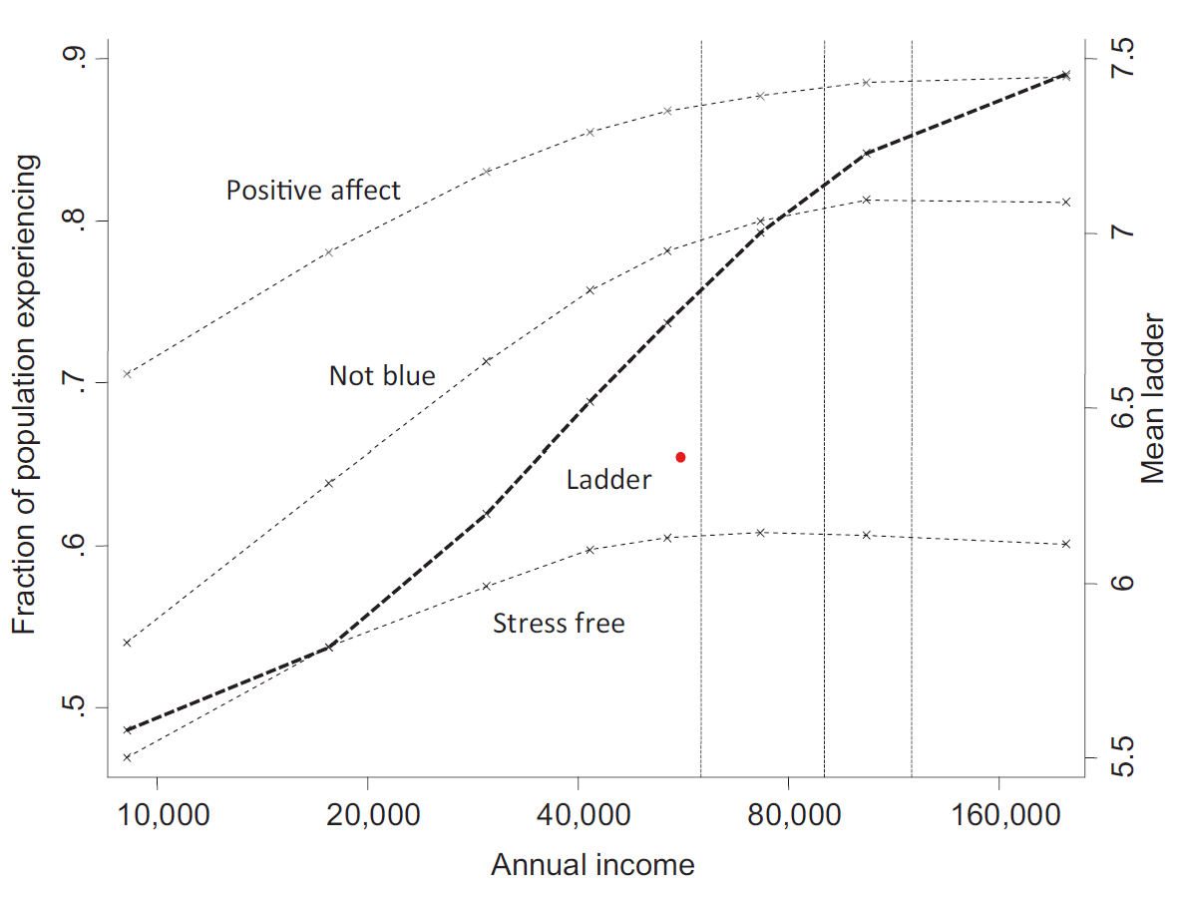
Utility Theory: Diminishing marginal utility applies to income
Diminishing marginal utility applies to income
The marginal dollar of income provides less satisfaction or utility than the prior dollars
For example: Log income versus Life Satisfaction on a scale of 0 to 10¹

Slide 42
Utility Theory: Diminishing marginal utility – why insurance works
Kahneman converted to today’s Aus$
Power function fits nicely

Slide 43
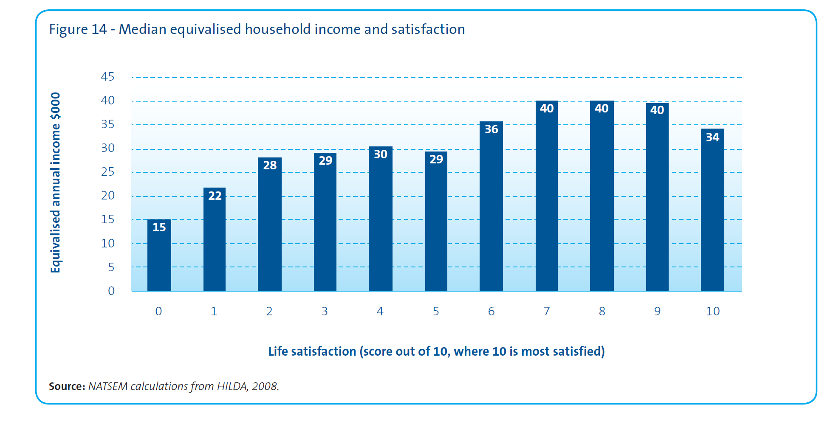
Utility Theory: Diminishing and Negative marginal utility
Annual Income and Life Satisfaction – Australia
Diminishing marginal utility
Negative marginal utility

Slide 44
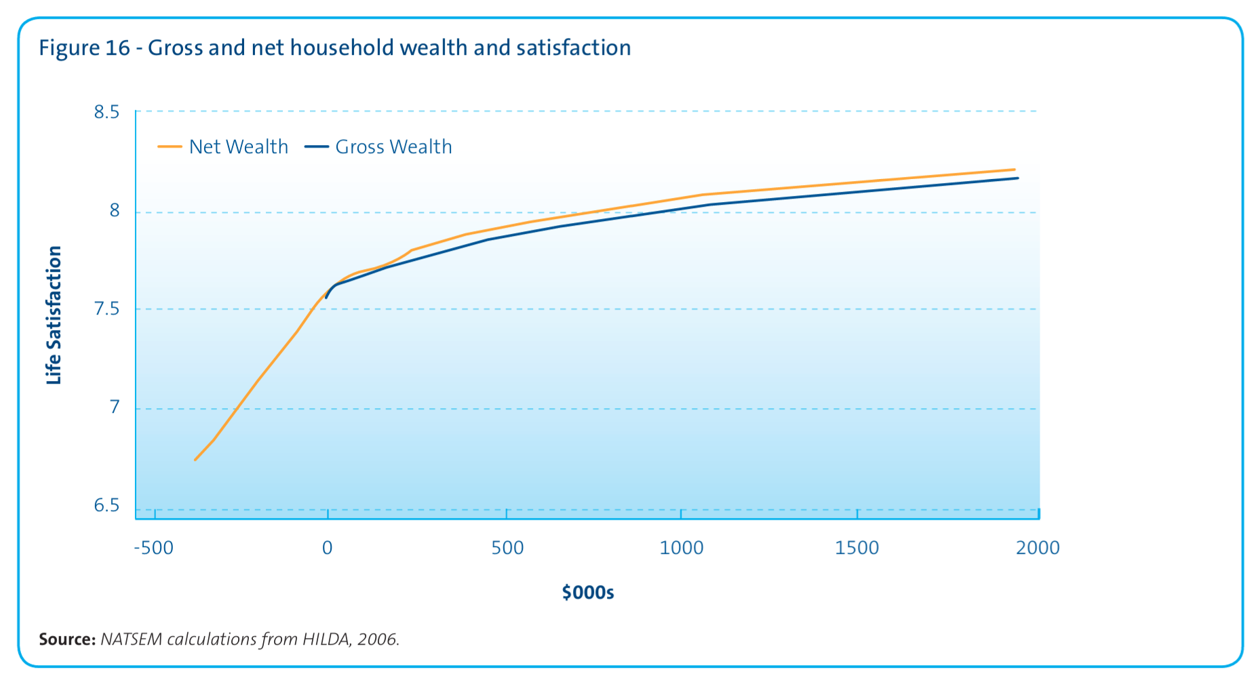
Utility Theory: Diminishing utility – wealth

Slide 45
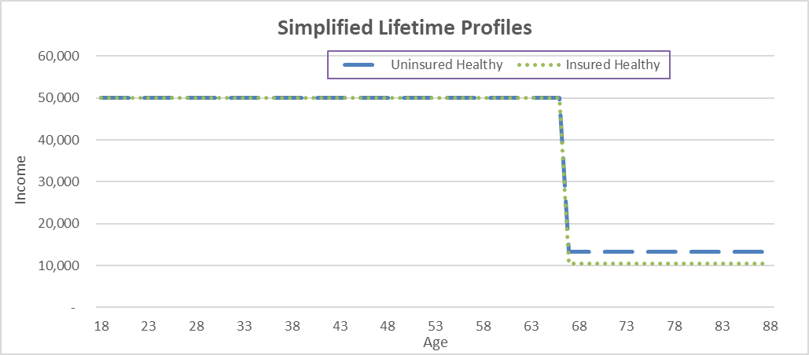
Utility Theory: Healthy Life – Insured v Uninsured
Member earns Salary to age 67 exact then retirement income from the SG
Assumes constant $50,000 salary;
  Premium = 3% of Salary;
  Investment return = Salary inflation
Result
  No difference in salary
  Small difference in retirement income

Slide 46
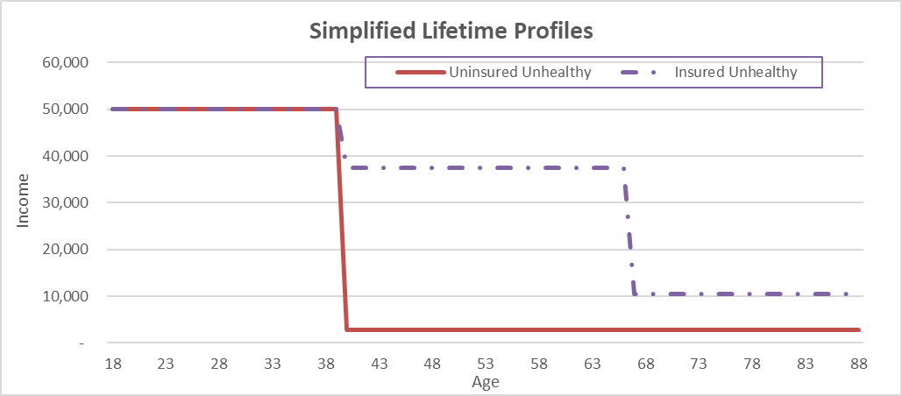
Utility Theory: Unhealthy Life – Insured v Uninsured
Disabled at age 40
Uninsured income falls dramatically for the rest of their life
Insured salary falls 25% gross
Insured Retirement Income unchanged

Slide 47
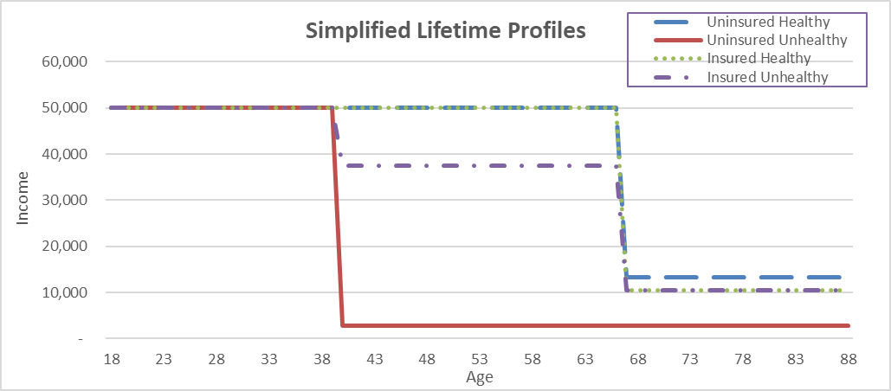
Utility Theory: Unhealthy Life – Insured v Uninsured

Slide 48
Utility Theory: Maths
Astin Bulletin (2024), pp. 1–23
doi:10.1017/asb.2024.22
RESEARCH ARTICLE
Optimal defined-contribution pension management with
financial and mortality risks
“…..pension management problem as a random horizon utility maximization problem and derive its explicit solution under the assumption of constant relative risk aversion utility.”
Considers the impact of investment volatility as well as death cover - could be extended to disability cover

Slide 49
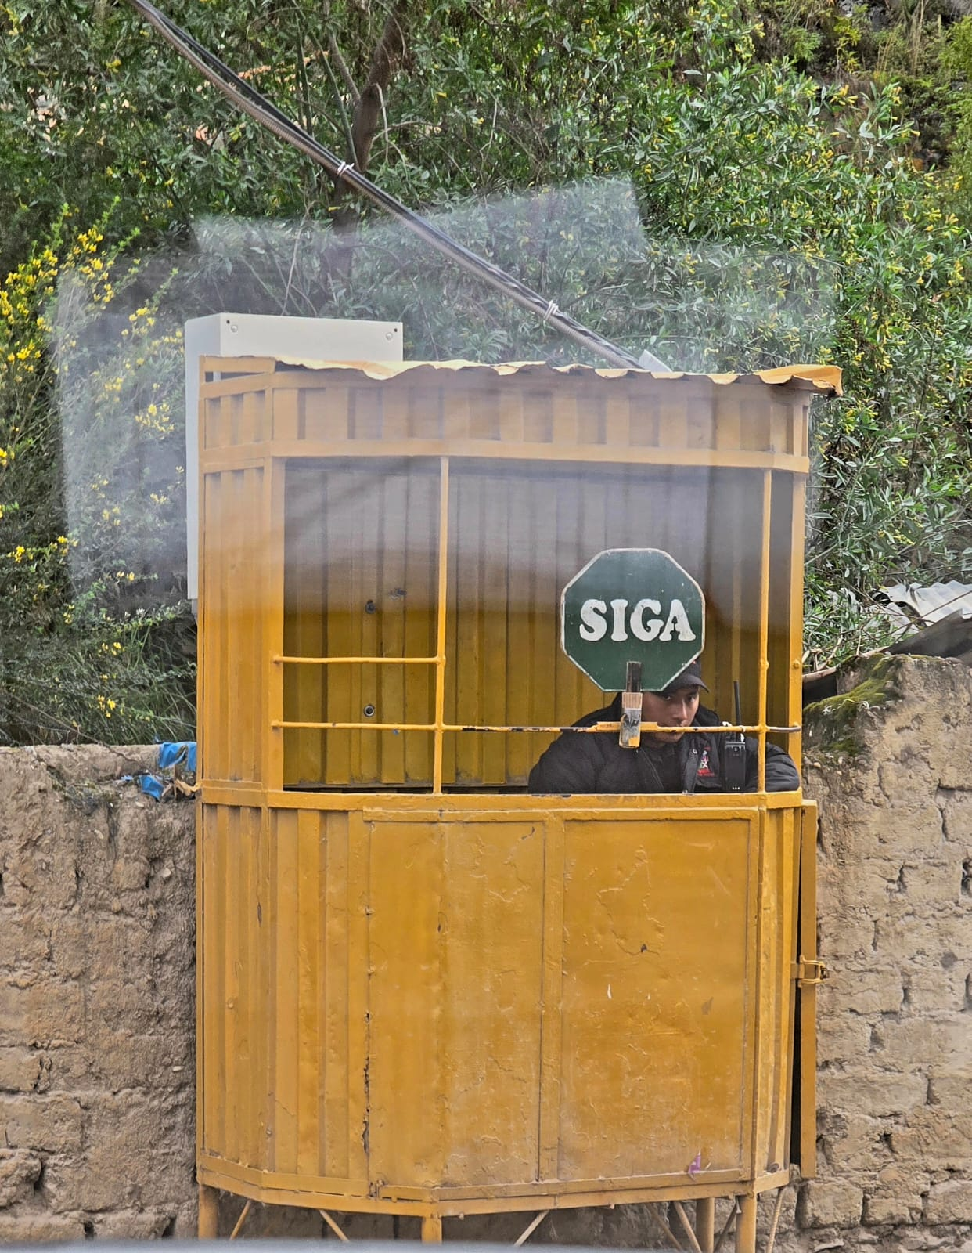
Insurance in Super
Questions

Slide 50
Insurance in Super
Appendices

Slide 51
A Very Big Thank You to:
        George Yang from Rest Super
        George Fountotos from CHR Consulting
        John Carroll from CHR Consulting
for their invaluable contributions to our presentation.

Slide 52





What do fund trustees say?
Provides most members with basic insurance cover with their super account. “This cover provides a basic level of protection if you die or become ill or injured… Age-based cover is designed to provide a minimum amount of cover for changing needs as you get older.”
52
“ Insurance cover is essential in providing financial protection and security to you and your family. Cbus is proud to offer our members insurance options that can be tailored to meet the needs of people working in the building, construction and allied industries.”
“Plan for the unexpected. If the unthinkable should happen, Death and Total & Permanent Disablement (TPD) insurance aims to ensure you’ve taken care of your loved ones ….. It helps to ease financial stress by giving you and your family some security.”
“Life doesn’t always go as planned. Insurance helps you protect yourself and your loved ones from the unexpected….. We've got you covered.”
“Feel safe with insurance in super that will keep you and your family secure if life doesn't go to plan…. Insurance gives you peace of mind knowing you and your family will have financial support if you pass away or can’t work because of sickness or injury”
https://hostplus.com.au/members/our-products-and-services/insurance/death-and-total-and-permanent-disability
https://www.australiansuper.com/insurance
https://www.cbussuper.com.au/super/my-insurance-options
https://www.australianretirementtrust.com.au/insurance
https://rest.com.au/insurance

Slide 53


What do regulators say?
“A financial safety net through your super”¹
“Life and disability insurance are important benefits offered by superannuation funds to Australians”²
https://moneysmart.gov.au/how-life-insurance-works/insurance-through-super
https://www.apra.gov.au/life-insurance-superannuation-improving-outcomes-for-members

Slide 54
Appendix: Inputs and Assumptions
Category | Item | Assumption | Comment
Projection | Projection Start Date | Start 1 January 2025
Economic | Inflation Rate | 0% p.a. | No inflation is assumed such that the benefit scale is applicable for current day.
 | Real Investment Return (net of tax and investment fees) Also: Discount Rate | Accumulation phase (prior to age 67): 2.00% p.a. Pension phase (from age 67): 2.39% p.a. | Based on the expected investment return of a “moderate” investment option, less 2.50% p.a. inflation to convert from nominal to real returns
 | Administration Fee (Population) | Administration fixed fee: $62.07 p.a. Administration % fee: 0.10%, capped at $600 p.a. | Weighted Average fee based on top seven largest funds by number of member accounts.
 | Administration Fee (By Fund) | Administration fixed fee: Fund Actual Administration % fee: Fund Actual
Super | Account Balance | Varied by age | Based on MySuper median account balance from APRA data as at 31 Dec 2024
 | Super Contribution | 12% of median Fund 1 member salary by age | Compulsory employer super contribution rate effective from 1 July 2025
 | Super Contribution Tax Rate | 15% of contribution | Legislated
Insurance | Premium Rates (Population) | Default Fund 1 member rates effective 31 May 24
 | Premium Rates (By Fund) | Default member rates, varied by fund | Default member premium rates as at March 2025, varied by fund
Employment Income | Median Salary | Varied by age | Based on ABS 2021 Census data projected to 2024.
 | Income Tax Rate | Varied by age | 24-25 Australian Income Tax Rates applicable to the median salary of each age
Retirement Income | Retirement Age | Age 67 | Legislated
 | Life Expectancy (following retirement) | Age 88 | Average 2020-2022 life expectancy for a female after reaching age 65 is 87.8 years. Source: Deaths in Australia, AIHW.
 | Age Pension | Age pension payments accounting for; minimum drawdown, deeming, and age pension payment rates. Income and asset tests are applied. | Legislated

Slide 55
Thank you
We would like to extend our sincere gratitude to George Yang from Rest Super and George
Fountotos from CHR Consulting for their invaluable contributions to our presentation.
Actuaries Institute
actuaries.asn.au

