Slide 1
From Fixed to Flexible, Rethinking Life Insurance Premium Structures to Rebuild Trust and Consumer Affordability
Adrian Kerins, Ludi Han
13 June 2025

Slide 2
"Trust is the glue of life. It's the most essential ingredient in effective communication. It's the foundational principle that holds all relationships.“
Stephen R. Covey, Author “The 7 habits of Highly Effective People”
Notes:
Speaker Notes:
Adrian:
Morning everyone and thank you Juilia for chairing our session and your introduction.
So we are here to talk about trust in life insurance, how certain industry practices impact on trust and what alternative approaches might exist. Before we jump into the detail though, why are we talking about trust. Well, for a long-term contract like life insurance, when you look past all the complexity, all the legal contacts, all the regulations, we are fundamentally offering a promise. That promise is to look after our customers or their loved ones if something catastrophic happens. We typically look after them by paying a sum of money when events occur, and those events re unlikely to occur for most customers in the short term.
Consumers having trust in the industry is absolutely critical to our longer term success.

Slide 3
Contents
Measuring Trust
International Learnings
Australian Opportunities
Recap
Q&A
Notes:
SO, we are going to think through this as firstly how do we measure trust and a qualitative assessment of how life insurance is doing in Australia.
I’ll then hand over to Ludi who will cover off some learnings from across the world and how that might be applied in Australia.
And we will then have a quick wrap up and questions.

Slide 4
Measuring Trust
01

Slide 5
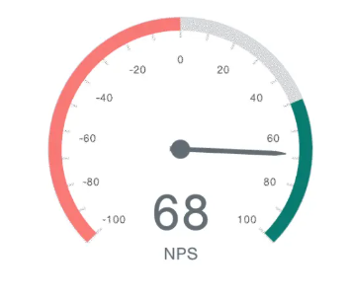


1. How to Measure Trust in Organisations
Net Promoter Score
Edelmans Trust Barometer
Five Dimensions of Trust
Competence
Ethical Behaviour
Transparency
Integrity
Reliability
Benevolence
Notes:
So leets start off with measuring trust in organisations. Unsurprisingly, there is a lot of science behind this, there are organisations that specialise in measuring this and they have built commercial models around it.
Examples include the Net Promoter Score. This is a very common measure and essentially measures whether customers would recommend an organisation to their friends and family or look to use the organisation further. It’s a very common measure in operational environments and I have seen how tracking it can have a realy positive impact on the experience consumers have on the phone.
The Trust Index, or edelmans Trust Barometer, is one of the most recognised frameworksf or measuring trust across industries. It asseses in institutions across competetence, ethical behviour, transparency and reliability. There is lots of ability to tailor to different business models, eg B2B2C…, vs B2B vs B2C…
Another model is Gartners Five Dimensions of Trust. This also builds on accountability, competency, consistency, integrity and transparency.
With all of these models and other ones out there, there is common themes…..,

Slide 6
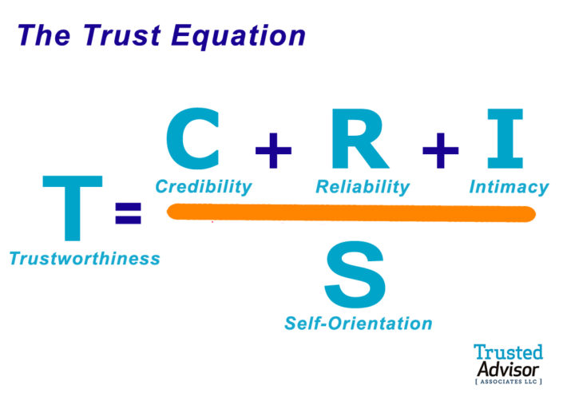
1. The Trust Equation
    Credibility
    Perception of expertise and honesty
    Reliability
    Consistency in fulfilling promises
    Intimacy
    How comfortable customers feel interacting with the organization (e.g., customer service)
    Self-Orientation
    Whether the company is perceived to put its interests above customers’ needs (lower self-orientation = higher trust)
Notes:
For the purposes of our work, we have chosen the Trust Equation.
This one is a simple model that measrues trust as the sum fo credibility(are you able to do what you say), reliability(do you consistently fulfill promises), and intimacy(how comfortable are customers interacting with your organization) divided by self-oreientation, ie is the orgnasiation perceived as putting its interests over the consumers.
This is a great model, that I personally use all the time, I have seen others in the industry using it and some organisations have adapted their own versions….,

Slide 7
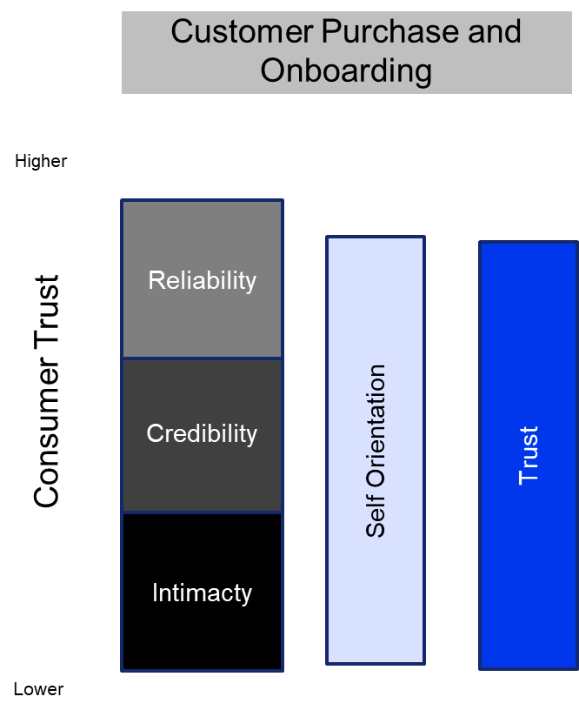
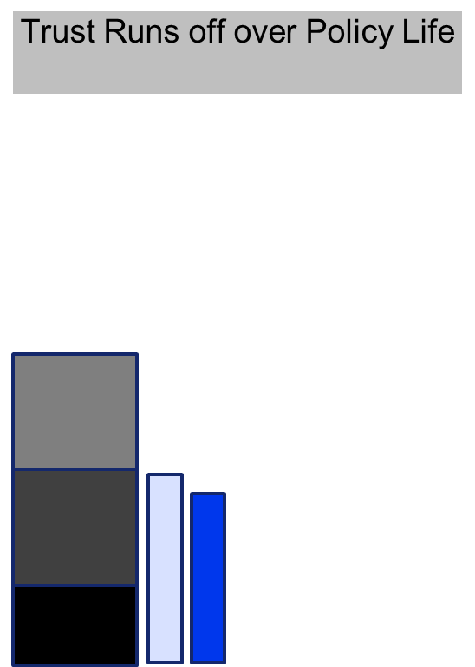
1. The Trust Equation in Practice
Consumer Trust over time
Trust is High immediately after Purchase
Trust in Insurer will decrease over time
Notes:
So, what might this look like in practice for the life insurance industry.
Well, at point of sale, where a sale happens, trust will need to be very high. Why is this? The Purchase process is highly involved, involves insruers and customers getting to know each other, a customer has to believe that we will be able to fulfill the long term promise and they also have to believe that at the point of claim we will put their interests above ours.
Achieving this level of trust is one of the reasons why life insurance sales processes are so complicated and largely involve an individual(phone or face to face) vs digital.
Thinking about this over the life of the contract, we think that trust will fall. Even if a company does a great job on all fronts, the intimacy will fall as the interactions are so limited. Layer on top any bad coverage of the industry, potentially poor customer service, royal commisisons….., the view of self-orientation will probably erode.
So, we have our work cut out for us longer term.

Slide 8
1. Trust in Australian Life Insurance
Industry Shrinking in Real Terms
Customers exiting at increasing rates!
Mixed Customer Feedback!
“…is untrustworthy. I have had insurance for over 10 years, and the premiums have been going up with monotonous regularity ever since I bought the policy.”
Direct
Have consumers lost trust in the industry?????
Notes:
Just very quickly thinking about the industry, we can’t easily measure trust, but we can make a qualitative assessment.
I’m not sure that things look great:
How many customers opt to use our products and services is failing, particaurlly in the individual space.
The customers we do have aren’t hanging around. Lapse rates are high. Its actually quite an interesting observation that direct life has lower lapse rates than retail advice.
If you search the web for customer feedback, you will get some interesting comments.
So, have consuemrs lost trust in the industry??

Slide 9


1. Qualitative Assessment of Life Industry Trust
Service
Claims
Premiums
Notes:
Well, we thought about this across 3 dimensions:
We think that the industry is doing a good job on service. The life code, investment in process and systems is paying off and its evidenced through industry stats such as complaints.
Claims, we also think we are doing a good job. Despite this being such a challenging space, where inevitably some consuemrs will see claims declined, the industry is paying most claims and there is actually a lot of positive reviews online.
Premiums…, well we aren’t so sure on this one. Some of the stats I just showed indicate a problem. If you talk to advisors, they struggle with rerates, they struggle with being confident about the future direction. And they don’t like some of the features in market today such as large upfront selection discounts…., despite most recommendations driving towards the cheapest initial price.
So, I’ll hand over to Ludi no and she will explore this in more detail.

Slide 10
International Learnings
02
Notes:
Transition:
Trust – a measure of trust, why important, lacking in AU, reflected by shrinking market with high lapse
International market – look at practices, overall trust level by lapse rates

Slide 11
2. International Learnings – Overview
5 Countries: Canada, US, UK, South Africa & China
Premium structures
Market initiatives to manage lapse
Products and Distribution
Lapse Rate (Trust)
Notes:
Overview
Actuaries in 5 countries and 3 focus areas
Premium structures
Other initiatives to manage lapse
Product and distribution
Actual lapse rates => indication of trust

Slide 12
2. International Learnings
What are the premium structures?
Notes:
In terms of premium structures

Slide 13

2. International Learnings
What are the premium structures?
Level as Market Dominance
Level premium structures prevail in Canada, UK, US and China with various term designs.
South Africa (stepped for short-term focus) and other 4 markets (stepped as an option)
Various level structures
Notes:
In terms of premium structure
Across all 5 markets, level premium is the dominant structure:
South Africa, stepped has a market, but for short term focus
Other 4 markets, stepped is only offered as an option to complex product
There are also different types of level structures

Slide 14
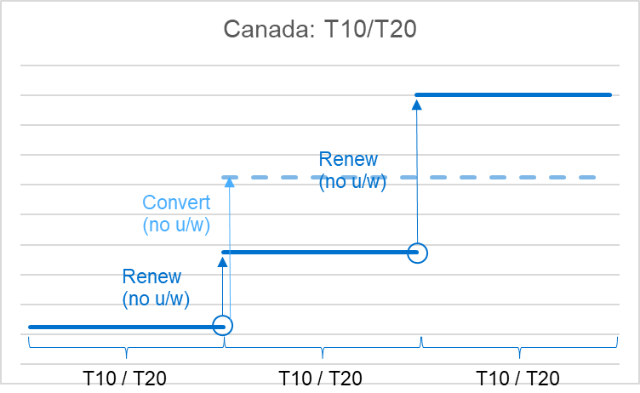
2. International Learnings
What are the premium structures?
Level as Market Dominance
Level premium structures prevail in Canada, UK, US and China with various term designs.
South Africa (stepped for short-term focus) and other 4 markets (stepped as an option)
Various level structures
Notes:
In Canada, level premiums guaranteed for a fixed term, 10 or 20 years, referred to as T10 or T20
At the end of the term:
Renewal (automatic): to another level term with high premium
Conversion: to a WoL policy
Both don’t require underwriting

Slide 15
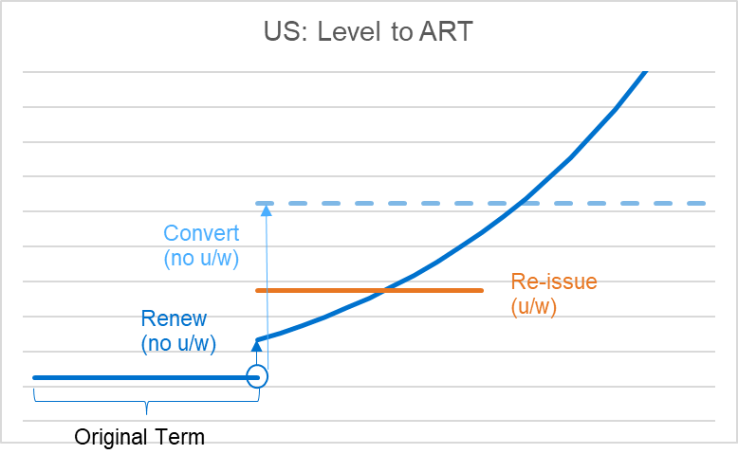
2. International Learnings
What are the premium structures?
Level as Market Dominance
Level premium structures prevail in Canada, UK, US and China with various term designs.
South Africa (stepped for short-term focus) and other 4 markets (stepped as an option)
Various level structures
Notes:
US has a similar structure.
Renew to stepped: instead of renewing to another level term, renews to stepped premium structure.
Take up rate low: despite the jump in premium being much smaller at renewal, the take up rate is low, due to expected exponential increase in premium
Level re-issue: US customer wants level premium, need a new policy re-issued, and requires u/w

Slide 16
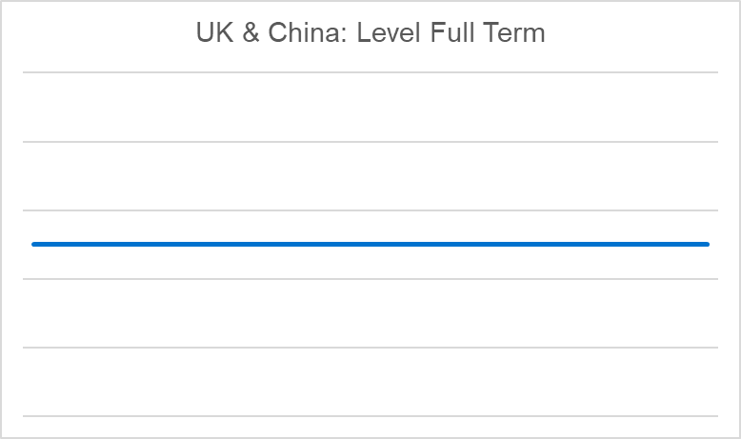
2. International Learnings
What are the premium structures?
Level as Market Dominance
Level premium structures prevail in Canada, UK, US and China with various term designs.
South Africa (stepped for short-term focus) and other 4 markets (stepped as an option)
Various level structures
Notes:
In UK and China, guaranteed level full term more common

Slide 17

2. International Learnings
What are the premium structures?
Level as Market Dominance
Level premium structures prevail in Canada, UK, US and China with various term designs.
South Africa (stepped for short-term focus) and other 4 markets (stepped as an option)
Various level structures
Guaranteed
Guaranteed Premium is the Norm
Premium guarantees are standard in all markets. Guarantee terms exceed 10 years.
Guaranteed: South Africa stepped premium, Canada & US renewed premiums
Guaranteed
Notes:
Guaranteed features:
All 5 markets, guaranteed premium as standard offering
SA: stepped premium also the case
Canada & US: renewed premium guaranteed, disclosed upfront, customers expectation

Slide 18

2. International Learnings
What are the premium structures?
Level as Market Dominance
Level premium structures prevail in Canada, UK, US and China with various term designs.
South Africa (stepped for short-term focus) and other 4 markets (stepped as an option)
Various level structures
Guaranteed
Guaranteed Premium is the Norm
Premium guarantees are standard in all markets. Guarantee terms exceed 10 years.
Guaranteed: South Africa stepped premium, Canada & US renewed premiums
Limited Payments are Popular
Guaranteed
Limited payment terms are popular for savings products across multiple markets.
(e.g. 1, 3, 5, 7, 10 premium payments)
Notes:
Saving type products, limited payments (1, 3, 5) are popular in China and Canada, it gives greater certainties to customers

Slide 19

2. International Learnings
What are the premium structures?
Level as Market Dominance
Level premium structures prevail in Canada, UK, US and China with various term designs.
South Africa (stepped for short-term focus) and other 4 markets (stepped as an option)
Various level structures
Guaranteed
Guaranteed Premium is the Norm
Premium guarantees are standard in all markets. Guarantee terms exceed 10 years.
Guaranteed: South Africa stepped premium, Canada & US renewed premiums
Limited Payments are Popular
Guaranteed
Limited payment terms are popular for savings products across multiple markets.
(e.g. 1, 3, 5, 7, 10 premium payments)
No Large Discounts
No large upfront discounts, wellness-linked discounts are more common.
Notes:
For discounts, none of the 5 rely on large upfront discounts as what we do in AU
Wellness linked pricing more common
Links premium incentives to long term engagement and behaviour

Slide 20
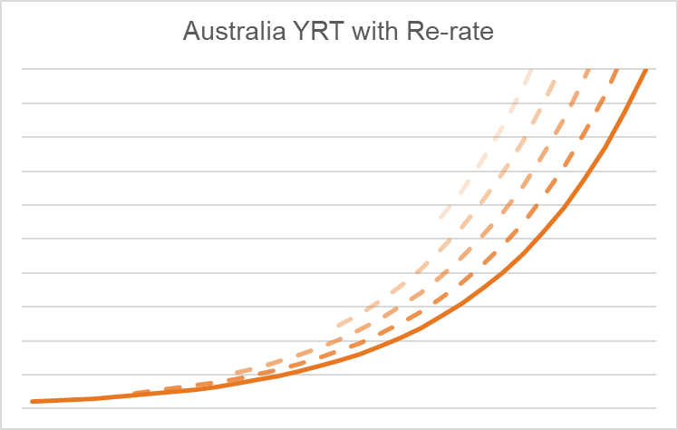
2. International Learnings
What are the premium structures?
Level as Market Dominance
Level premium structures prevail in Canada, UK, US and China with various term designs.
South Africa (stepped for short-term focus) and other 4 markets (stepped as an option)
Various level structures
Guaranteed
Guaranteed Premium is the Norm
Premium guarantees are standard in all markets. Guarantee terms exceed 10 years.
Guaranteed: South Africa stepped premium, Canada & US renewed premiums
Limited Payments are Popular
Guaranteed
Limited payment terms are popular for savings products across multiple markets.
(e.g. 1, 3, 5, 7, 10 premium payments)
Australia:
Non-guaranteed Stepped
Frequent Reprice
Unwind of Upfront Discount
No Large Discounts
VS
No large upfront discounts, wellness-linked discounts are more common.
Not
Guaranteed

Slide 21
2. International Learnings
What are the premium structures?
Certain & Stable Premium
Lapse Trust
Level as Market Dominance
Level premium structures prevail in Canada, UK, US and China with various term designs.
South Africa (stepped for short-term focus) and other 4 markets (stepped as an option)
Various level structures
Guaranteed
Guaranteed Premium is the Norm
Premium guarantees are standard in all markets. Guarantee terms exceed 10 years.
Guaranteed: South Africa stepped premium, Canada & US renewed premiums
Limited Payments are Popular
Guaranteed
Limited payment terms are popular for savings products across multiple markets.
(e.g. 1, 3, 5, 7, 10 premium payments)
Australia:
Non-guaranteed Stepped
Frequent Reprice
Unwind of Upfront Discount
No Large Discounts
VS
No large upfront discounts, wellness-linked discounts are more common.
Not
Guaranteed
Notes:
Overall comparing international vs AU
International market has more certain, stable and sustainable premium structure
=>support low lapse rates, and reflect higher trust from customers

Slide 22
2. International Learnings
What about any initiatives to manage lapse?
Notes:
Market initiative to successfully manage lapse

Slide 23
2. International Learnings
What about any initiatives to manage lapse?
South Africa: Wellness Programs
Shared-value ecosystem benefiting healthy lives.
Encourages positive selection
Improves long-term lapse & claim experience
Positive cycle
AU: 1) upfront discount -> vicious cycle
2) wellness program needs refinements
Notes:
In SA, wellness program is popular and successful
Benefit healthy lives -> discounts and benefits
Helps long term retention of healthy lives, improves claim experience
Positive cycle
In AU
Upfront discounts more commonly used, by all major life insurers nowadays, as large as 30% first year
Discount stops, triggers lapses from healthy lives, leaving remaining pool having worse claim experience, pushing up price => vicious cycle
Wellness program exists, but need refinements, separate topic

Slide 24
2. International Learnings
What about any initiatives to manage lapse?
South Africa: Wellness Programs
Shared-value ecosystem benefiting healthy lives.
Encourages positive selection
Improves long-term lapse & claim experience
Positive cycle
UK: Distribution Quality Management
Systematic approach to improve advisor behavior.
Initiated by a large life insurer in UK
Monitors lapse rates, early claims and non-disclosures by advisor groups
Restricts high-lapse IFAs
AU: 1) upfront discount -> vicious cycle
2) wellness program needs refinements
AU: similar analysis exists, but needs formalization and rewarding mechanism
Notes:
In UK, large insurer DQM
Monitor lapse, early claim, non-disclosure by adviser groups
Restrict groups with poor outcome
In AU, some insurers conduct similar analysis, but a formal DQM framework needs to be widely adopted, with rewarding mechanism given heavy reliance on IFA

Slide 25
2. International Learnings
What about any initiatives to manage lapse?
South Africa: Wellness Programs
Shared-value ecosystem benefiting healthy lives.
Encourages positive selection
Improves long-term lapse & claim experience
Positive cycle
UK: Distribution Quality Management
Systematic approach to improve advisor behavior.
Initiated by a large life insurer in UK
Monitors lapse rates, early claims and non-disclosures by advisor groups
Restricts high-lapse IFAs
Canada & US: Surrender Charges
Features provided with permanent life insurance to manage early lapse.
Reduced cash value for early lapsed policies
Discourages early lapse
AU: 1) upfront discount -> vicious cycle
2) wellness program needs refinements
AU: similar analysis exists, but needs formalization and rewarding mechanism
AU: surrender value not a financially viable feature due to strict regulatory requirements
Notes:
In Canada and US, surrender charges are used effectively to discourage early lapse for investment product
In AU, no commonly used feature, due to strict regulatory requirement, making the feature expensive and financially unviable

Slide 26
2. International Learnings
What are the products and distribution channels?
Notes:
Important to understand different product and distribution channels used in all markets

Slide 27
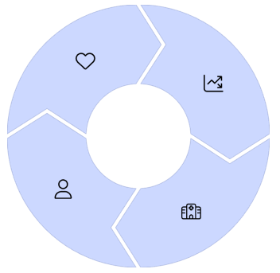
2. International Learnings
What are the products and distribution channels?
Whole Life Insurance
Strong in all markets (apart from AU)
Saving + protection
Features: 1) guarantee acceptance (UK, SA); 2) limited pay options and 3) surrender values (US, Canada, China).
Notes:
WoL:
Strong in all market not AU
Protection and saving: death benefit early on, or cash value withdrawal if protection is no longer needed

Slide 28
2. International Learnings
What are the products and distribution channels?
Whole Life Insurance
Investment Products
Strong in all markets (apart from AU)
Saving + protection
Features: 1) guarantee acceptance (UK, SA); 2) limited pay options and 3) surrender values (US, Canada, China).
Popular in Canada, US, and Asia (e.g. Indexed Universal Life, Par, Increasing SA)
Good profits
Promote growth
Notes:
Investment products popular in various countries
US and Canada: big market in UL, good profit. UL is another permanent product similar to WoL, but with greater flexibility in premium, SI and investment options
Nowadays, indexed UL where cash value tracks a certain market index like S&P500, booming in US and Asia
HK: mature par market
China: sees growth in products with SI increasing with investment returns

Slide 29
2. International Learnings
What are the products and distribution channels?
Whole Life Insurance
Investment Products
Strong in all markets (apart from AU)
Saving + protection
Features: 1) guarantee acceptance (UK, SA); 2) limited pay options and 3) surrender values (US, Canada, China).
Popular in Canada, US, and Asia (e.g. Indexed Universal Life, Par, Increasing SA)
Good profits
Promote growth
Living Benefits
Simplified trauma is popular (SA, China)
LTC rider for WoL as main living benefit in US
TPD only common as an acceleration of Death.
DI remain small.
Notes:
In terms of living benefits, it’s smaller in scope internationally
In SA and China, simplified trauma gaining tractions online
In US, LTC is the primary living benefit, only offered as a rider to WoL nowadays
Standalone TPD is rare, it’s more commonly offered as an acceleration of death
DI is small, but it’s seeing growth in UK, and only mature in SA

Slide 30
2. International Learnings
What are the products and distribution channels?
Whole Life Insurance
Investment Products
Strong in all markets (apart from AU)
Saving + protection
Features: 1) guarantee acceptance (UK, SA); 2) limited pay options and 3) surrender values (US, Canada, China).
Popular in Canada, US, and Asia (e.g. Indexed Universal Life, Par, Increasing SA)
Good profits
Promote growth
Distribution Models
Living Benefits
Mix of direct and IFA models, with tied agents in China. No out-of-pocket fee from p/h (apart from AU).
Sees demand and potential growth in direct (Canada, UK, SA).
Simplified trauma is popular (SA, China)
LTC rider for WoL as main living benefit in US
TPD only common as an acceleration of Death.
DI remain small.
Notes:
For distribution
All markets use a mix of direct and adviser model
One key difference is in other countries, customers don’t pay explicit adviser fees, the costs are implicitly in premium instead
Whereas in AU, customers need to pay thousands of out-of-pocket fees

Slide 31
2. International Learnings
Lapse Rates Comparison: A Reflection of Trust Level
Notes:
So what does this mean for the actual lapse rates

Slide 32
2. International Learnings
Lapse Rates Comparison: A Reflection of Trust Level
(Source: Canadian Institute of Actuaries)
Notes:
Canada publish lapse rates by product and policy duration
T10 / T20, high shock lapse at the end of the term, but focus is the lapse within the term
T10, lapse is between 5%-7%
T20 has lower lapse, at around 3%
WoL has lowest lapse, with long term below 1%

Slide 33
2. International Learnings
Lapse Rates Comparison: A Reflection of Trust Level
Other markets
From Life Actuaries practicing in UK, US and China:
Long term lapse rates are generally at single digit level
From Life Actuaries practicing in South Africa:
Lapse rates are high and mainly due to economic volatility and its impacts on level business
(Source: Canadian Institute of Actuaries)
Notes:
Although data isn’t always available in other markets, actuaries working in UK, US and China all suggests long term lapses are at single digits.
The exception is SA, where lapse rates are high, but this is mainly due to economic volatility

Slide 34
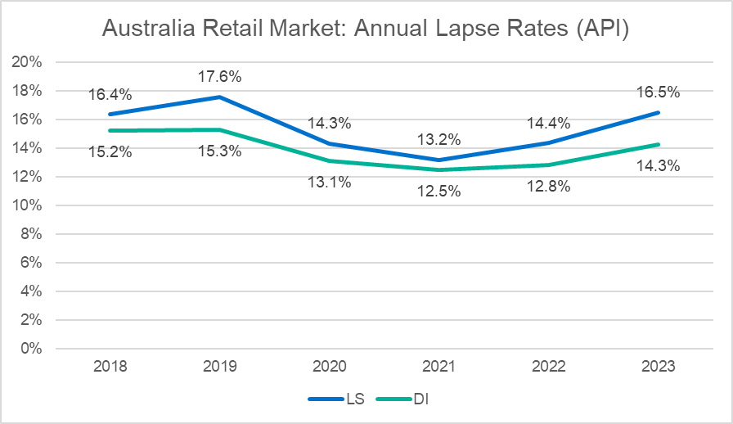
2. International Learnings
Lapse Rates Comparison: A Reflection of Trust Level
(Source: APRA stats)
Notes:
In AU, APRA publishes industry lapse rates over time. AU retail market has average lapse of 15%, significantly higher.

Slide 35
2. International Learnings
Lapse Rates Comparison: A Reflection of Trust Level
International (except SA):
single digit lapse
Higher Trust
Australia: ~15% lapse
Lower Trust
(Source: APRA stats)
Notes:
This suggested that customers in other countries are more likely to hold on to their policies, reflecting higher trust levels in those markets.

Slide 36
2. International Learnings
Key Lessons
International Markets have:
Certain and stable premium structure
  Guaranteed level, limited payments, wellness-linked pricing
  (Australia: non-guaranteed stepped, frequent reprice, unwind upfront discount)
Active lapse management strategies
Wellness program, DQM, surrender charges
(Australia: need refinements and wider adoptions)
Working products and distribution
Traditional WoL, investment products (e.g. Universal Life)
(Australia: complex living benefits)
Lapse
Trust
Notes:
In summary, we learnt that international markets have:
More certain and stable premium structure, reflected by the market offering of xxx; in contrast, AU has unsustainable premium structure, where we have xxx
Other markets also have effective lapse management strategies such as xxx; in AU, some of the initiative exist, but they need refinements and wider adoption for them to be truly effective
In terms of products, internation markets offer more traditional WoL and investment products, which are popular, profitable and sustainable, whereas AU provide more complex living benefits.
All of these contribute to lower lapse in the international market, reflecting higher trust levels in those markets

Slide 37
Australian Opportunities
03
Notes:
Transition
So far we’ve looked at practices in international market, and how they are used to build trust
Now shift focus back to AU, consider its uniqueness and challenges, and ask what can we do here

Slide 38
3. Australian Opportunities: Roadmap
Premium Structure Reforms
(Immediate Priority)
1
2
Distribution Enhancement
(Mid-Term Focus)
Product Innovation
(Mid-Term Focus)
3
Trust Building
(Long-Term Aim)
Notes:
We think there are three areas of opportunities, with the long-term aim to rebuild trust.
The immediate priority is a premium structure reform. The current model doesn’t work and undermines customers’ trust. Important to fix the foundation first before focusing on growth
In the mid-term, potential of rethinking product and distribution to better meet evolving needs
In the long-term, the aim is to rebuild trust
Trust is not nice to have for the market; it’s the foundation for our industry to grow
Not just for current product, but also future opportunities (e.g. annuities for retirement planning, requires strong trust; increasingly uncertain world, demand for certainty and insurance has a role to play) -> if trust not rebuilt, can’t be successful in seizing these opportunities

Slide 39
3. Australian Opportunities
Premium Structure Reform (Immediate Priority)
4 areas of improvements
Level Premium
Guaranteed Features
Limiting Upfront Discount
Improving Premium Transparency
Challenges?
Opportunities?
Outcomes?
Implications to
Life Insurers / Reinsurers
Notes:
For immediate priority, premium structure reform, we considered 4 areas of improvement:
Promoting level premium options
Introducing guaranteed premium features
Limiting upfront discounts, and
Improving premium transparency
For each of the 4 areas, we’ve considered:
Specific challenges if we make these changes in the current AU market
Any opportunities despite these changes, and
What are the outcomes in lapse rate and trust, if we make these changes
We also considered the overall implications to the industry, if we manage to reduce lapse

Slide 40
3. Australian Opportunities
Premium Structure Reform (Immediate Priority)
4 areas of improvements
Level Premium
Guaranteed Features
Limiting Upfront Discount
Improving Premium Transparency
Challenges?
Opportunities?
Outcomes?
Implications to
Life Insurers / Reinsurers
Notes:
For the purpose of today’s presentation, we will only look at level premium options, and overall implications, due to the limited time we have today

Slide 41
3. Australian Opportunities
Premium Structure Reform (Immediate Priority)
Level Premium
Challenges? Unpopular (customer & adviser)
Notes:
So what are the challenges for promoting level premium in AU market?
It’s currently seen as unpopular, both by customers and advisers

Slide 42
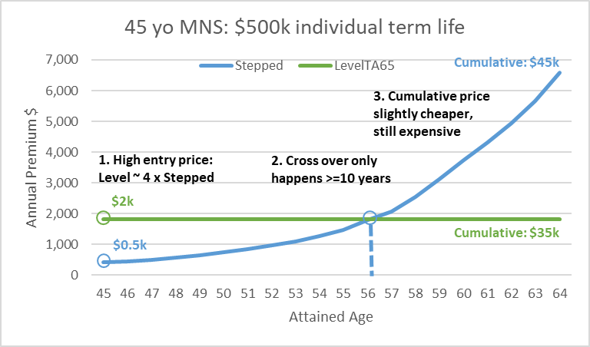
3. Australian Opportunities
Premium Structure Reform (Immediate Priority)
Level Premium
Challenges? Unpopular (customer & adviser)
Customer: expensive
Notes:
From the customer’s point of view, level premium is perceived as expensive
If we look at a 45yo MNS w 500k death benefit without indexation, we can do a comparison between stepped and levetTA65 premium
First observation: level has very high entry price, about 4 times that of stepped; stepped also comes with large upfront discount, which means the gap is even wider
Cross over only happens after 10 years, which means level is more expensive for more than 10 years, due to the exponential increasing nature of stepped rates
However, when looking at cumulative price up to age 65, level is overall cheaper, by 20% in this example. But this info is not disclosed to customer, so level is still perceived as expensive

Slide 43
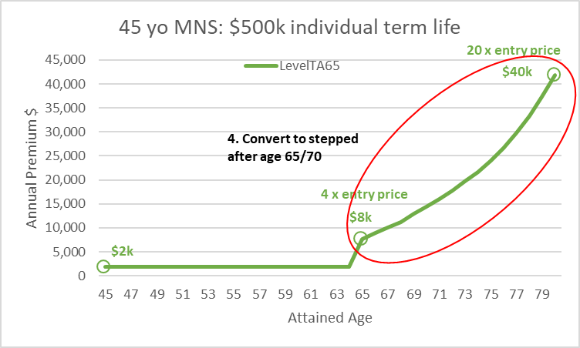
3. Australian Opportunities
Premium Structure Reform (Immediate Priority)
Level Premium
CPS001 & LPS360:
Minimum surrender value applies to Long-Term Risk Business
Level premium throughout the term
Term > 15 years and age at expiry > 70
SI > $15k
Challenges? Unpopular (customer & adviser)
Customer: expensive
Notes:
This is also a structural issue, revealed by extending the levelTA65 premium beyond age 65
In Australia, all life insurers converts level to stepped at age around 65 or 70, and this is because of regulation
LPS360 requires level policies with term greater than 15 years and expiry age greater than 70 to have surrender value features, which is expensive in this market
All insurers make the switch to stepped to avoid the provision of surrender value, making level not truly level

Slide 44
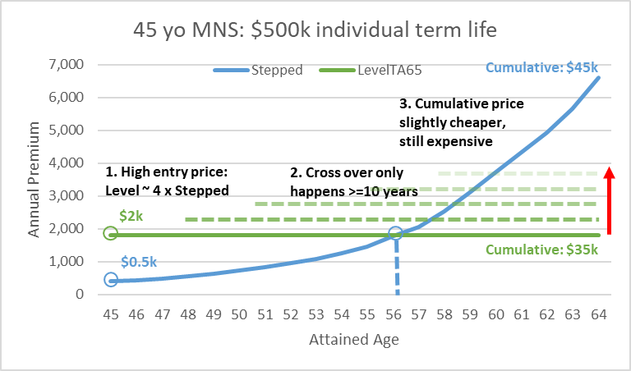
3. Australian Opportunities
Premium Structure Reform (Immediate Priority)
Level Premium
Challenges? Unpopular (customer & adviser)
Customer: expensive
Adviser: hard to justify Best Interest Obligation (non-guaranteed)
Notes:
From adviser perspective, because level premiums are not guaranteed, and are subject to increases over time
It is hard for advisers to promote level premium, and still justify BIO

Slide 45
3. Australian Opportunities
Premium Structure Reform (Immediate Priority)
Level Premium
Opportunities? Gradual Approach
Notes:
Despite these challenges, we still see opportunities
Australia has the history of driving down entry price: from unbundling of risk and investment products, to the introduction of stepped premium, and now the use of upfront discount
We think it’s more feasible to adopt a gradual approach in this market

Slide 46
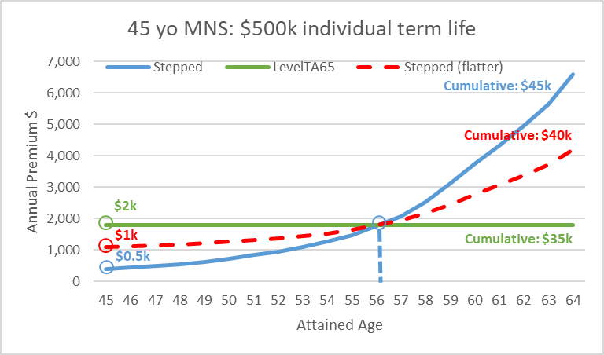
3. Australian Opportunities
Premium Structure Reform (Immediate Priority)
Level Premium
Opportunities? Gradual Approach
Flatter stepped premiums
Notes:
One option is to promote flatter stepped premium, which is already seen in the market. This means spreading increases more evenly towards level structure to reduce shocks.

Slide 47
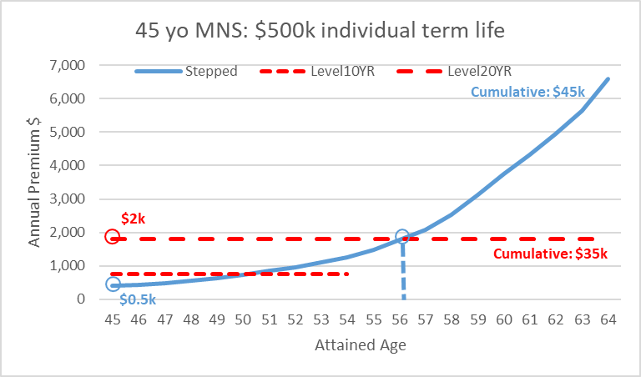
3. Australian Opportunities
Premium Structure Reform (Immediate Priority)
Level Premium
Opportunities? Gradual Approach
Flatter stepped premiums
UK-like guaranteed level term options (10, 20, 30 years)
        End of the term: expire instead of renewing
      Provide full projections to show cross-over
      Disclose cumulative price
Notes:
Another option is to adopt US-style guaranteed level premium, with different term options. The Australian market can start with a shorter term.
We think the premium should be guaranteed for a fixed term, and at the end of the term, the policy should expire instead of automatically renewed to another level term. This it to promote transparency and simplicity, and to avoid the shock lapse situation we’ve seen in the Canadian market.
It’s also important to provide the full projection so customers can see the cross over of the two premiums.
Also cumulative price needs to be disclosed.

Slide 48
3. Australian Opportunities
Premium Structure Reform (Immediate Priority)
Level Premium
Opportunities? Gradual Approach
Flatter stepped premiums
UK-like guaranteed level term options (10, 20, 30 years)
        End of the term: expire instead of renewing
      Provide full projections to show cross-over
      Disclose cumulative price
Review LPS360 for minimum surrender value calculation
Potential opportunity: introduce Universal Life with flexible premium structure to reduce cumulative price
Notes:
To truly offer level, LPS360 needs to be reviewed for min SV calculation
Once the market is ready to offer surrender value, opens up potential opportunity to introduce investment product, such as UL, popular and profitable in US and Canada
UL has flexible premium structure, and premium can be structure in a way that investment returns can be used to offset increasing incidence cost, as both are exponential increase. This can result in overall cheaper cumulative price.

Slide 49
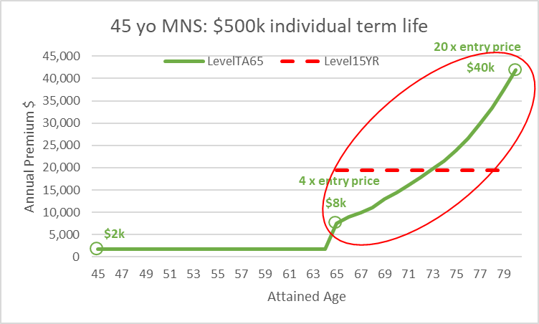
3. Australian Opportunities
Premium Structure Reform (Immediate Priority)
Level Premium
Opportunities? Gradual Approach
Flatter stepped premiums
UK-like guaranteed level term options (10, 20, 30 years)
        End of the term: expire instead of renewing
      Provide full projections to show cross-over
      Disclose cumulative price
Review LPS360 for minimum surrender value calculation
Potential opportunity: introduce Universal Life with flexible premium structure to reduce cumulative price
For post age 70, renew or re-issue another level with term < 15 years
Notes:
In the meantime, Canada’s approach, but only renewing to another 15 years, can be adopted, but this does come with shock lapse risks

Slide 50
3. Australian Opportunities
Premium Structure Reform (Immediate Priority)
Level Premium
Opportunities? Gradual Approach
Flatter stepped premiums
UK-like guaranteed level term options (10, 20, 30 years)
        End of the term: expire instead of renewing
      Provide full projections to show cross-over
      Disclose cumulative price
Review LPS360 for minimum surrender value calculation
Potential opportunity: introduce Universal Life with flexible premium structure to reduce cumulative price
For post age 70, renew or re-issue another level with term < 15 years
Outcomes
Trust (Credibility)
Lapse
    The Trust Formula:
    TRUST = Credibility + Reliability + Intimacy
    Self-Orientation
    Credibility – Perception of expertise and honesty
    Reliability – Consistency in fulfilling promises
    Intimacy – How comfortable customers feel interacting with the organization
    Self-Orientation – Whether the company is perceived to put its interests above customers’ needs
Notes:
If the AU market can adopt this gradual shift, with flatter stepped premium and more guaranteed level term options, it will build stronger credibility with customers. They will feel pricing more honest and predictable.
This will increase trust and ultimately drives down lapses.

Slide 51
3. Australian Opportunities
Premium Structure Reform (Immediate Priority)
→ What does it mean for Australian Life Insurers / Reinsurers?
Notes:
What does this mean for insurer/reinsurer?
If we look at recent APRA stat, # of lives insured reduced since 2018. In fact, there is a 20% drop in last 5 years, despite the need for life insurance remain unchanged, if not increasing over that period.

Slide 52
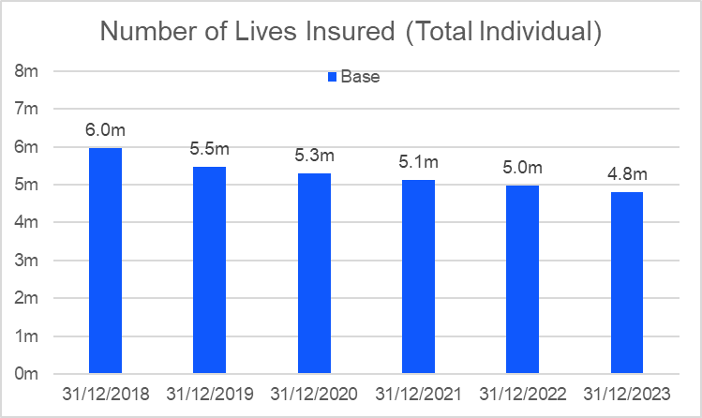
3. Australian Opportunities
Premium Structure Reform (Immediate Priority)
→ What does it mean for Australian Life Insurers / Reinsurers?
~20% drop in 5 years
Number of Insured Policies (Total Individual)
Source: APRA life insurance claims and disputes statistics
Notes:
What does this mean for insurer/reinsurer?
If we look at recent APRA stat, # of lives insured reduced since 2018. In fact, there is a 20% drop in last 5 years, despite the need for life insurance remain unchanged, if not increasing over that period.

Slide 53
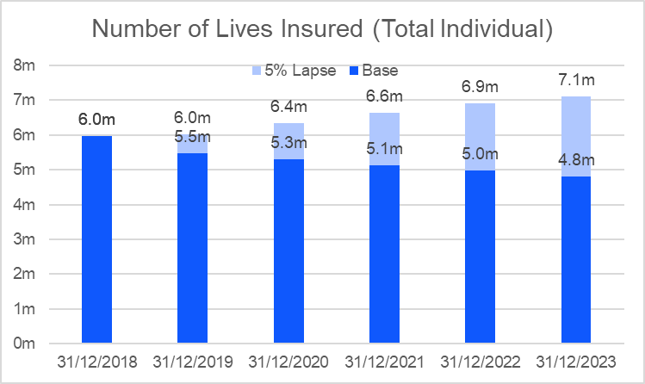
3. Australian Opportunities
Premium Structure Reform (Immediate Priority)
→ What does it mean for Australian Life Insurers / Reinsurers?
With 5% lapse rate:
~20% growth
Number of Insured Policies (Total Individual)
Level terms
Guaranteed premium
Limiting upfront discount
Improving premium transparency
Source: APRA life insurance claims and disputes statistics
Notes:
What if we can manage lapse to an internationally comparable level, for example 5%, as what we have seen in the Canadian market
Then instead of a 20% drop, we will see 20% increase over the last 5 years.
This is 40% swing, and a big shift. It really changes the market outlook.

Slide 54
Recap
04
Notes:
Transition
International market -> trust
Now shift focus back to AU, what to do here considering the challenges

Slide 55
4. Australian Opportunities
Trust Building (Long-Term Aim)
Supporting A Caring Society
Industry Collaboration
Meaningful Products
Unite insurers, reinsurers, regulators, and advisers to strengthen the industry.
Reinforce insurance's core purpose of providing security when needed most and seize future opportunities.
Fair & Sustainable Premiums
Develop solutions that address real customer needs and improve insurance accessibility.
Implement transparent, long-term premium structures that customers can trust.
Notes:
To rebuild trust in the long-term, we must first address the key issue, unsustainable premium structure
This means moving towards more certain, stable, and transparent pricing
So customers know what to expect, and feel confident in what they buy
Trust also depends on offering meaningful and clear products that meet modern needs, and making insurance more assessable
This isn’t something that one party fix, but requires discipline and collaborations across insurers, reinsurers, advisers and regulator
And if we succeed, it’s not just for restoring trust for the current products, but we are also layering the foundation for future opportunities such as retirement planning, and increasing demand for certainty.
Because without trust, this industry won’t be in the position of seizing these opportunities.

Slide 56
Q&A
05
Notes:
Transition
International market -> trust
Now shift focus back to AU, what to do here considering the challenges

Slide 57
Additional Contents
06
Notes:
Transition
International market -> trust
Now shift focus back to AU, what to do here considering the challenges

Slide 58
3. Australian Opportunities
Premium Structure Reform (Immediate Priority)
Guaranteed Premium
Challenges?
Mis-price risk (e.g. living benefits)
Higher capital
Notes:
See two main challenges:
Increase in mispricing risk, especially in AU where we have complex living benefits
This is because offering guaranteed features means limiting our ability to reprice, which is a cost to us
Because of increasing in mispricing risk, it also means we need to hold more capital
Higher capital means higher costs

Slide 59
3. Australian Opportunities
Premium Structure Reform (Immediate Priority)
Guaranteed Premium
Challenges?
Mis-price risk (e.g. living benefits)
Higher capital
Opportunities?
Full guarantees for simple products (death, simple trauma, short-term DI)
Semi guarantees for complex products (e.g. set limits for repricing amount and frequency)
Clearer product definitions + better understanding on claim experience / risk
Notes:
To manage mispricing risk -> we think the level of guarantees need to be tailored by different products
For simple products, like death benefits (clear product definition and good understanding of claim experience), full guarantees are reasonable
For complex living benefits, semi-guarantees are more feasible -> take the form of limiting repricing amounts and frequency
Mispricing risk can’t be fully addressed by tailoring guarantees, we really need to have better and clearer product designs, and a better understanding of claim experience

Slide 60
3. Australian Opportunities
Premium Structure Reform (Immediate Priority)
Guaranteed Premium
Challenges?
Mis-price risk (e.g. living benefits)
Higher capital
Opportunities?
Full guarantees for simple products (death, simple trauma, short-term DI)
Semi guarantees for complex products (e.g. set limits for repricing amount and frequency)
Clearer product definitions + better understanding on claim experience / risk
Limit the guarantees to a fixed term instead of to age X (i.e. Canada and US style) and start with shorter term (e.g. 10, 15 years)
Learning opportunity for insurers/reinsurers to understand the guaranteed costs; lower lapse will help
Notes:
For capital concerns, we think the Australian market should offer guarantees for a fixed term, instead of to certain age, and we can start with short term such as 10 years to gain experience first.
And given guaranteed feature is a critical feature to build trust, it is crucial for actuaries to understand cost of guarantee, so this is a learning opportunity.
Note that none of the actuaries working in the 5 global markets suggest guaranteed feature being a concern to their capital requirement. This is also the case for Canada which is believed to have very strong capital regime.
Guaranteed features also come with lower lapse, which actually reduces capital requirements. So the total impact of introducing guaranteed features on capital may not be as significant as it seems.

Slide 61
3. Australian Opportunities
Premium Structure Reform (Immediate Priority)
Guaranteed Premium
Challenges?
Mis-price risk (e.g. living benefits)
Higher capital
Opportunities?
Full guarantees for simple products (death, simple trauma, short-term DI)
Semi guarantees for complex products (e.g. set limits for repricing amount and frequency)
Clearer product definitions + better understanding on claim experience / risk
Limit the guarantees to a fixed term instead of to age X (i.e. Canada and US style) and start with shorter term (e.g. 10, 15 years)
Learning opportunity for insurers/reinsurers to understand the guaranteed costs; lower lapse will help
Outcomes
Trust (Credibility)
Trust (Reliability)
Trust (Self-Orientation)
Lapse
    Credibility – Perception of expertise and honesty
    Reliability – Consistency in fulfilling promises
    Intimacy – How comfortable customers feel interacting with the organization
    Self-Orientation – Whether the company is perceived to put its interests above customers’ needs
Notes:
If we can adopt some guaranteed features in the AU market and make it standard market offering -> send a strong message to customers:
Improves credibility by showing pricing deciplines
Improves reliability, by showing we stand by our promises
Reduce self-orientation, as we are putting customers’ interests first, and we are limiting our ability to reprice

Slide 62
3. Australian Opportunities
Premium Structure Reform (Immediate Priority)
Limiting Upfront Discount
Challenges?
Lower sales if other insurers all offer large discounts
Low product scores and not favoured by advisers
Notes:
To limit upfront discount, clear challenges:
It means lower sales, especially if all your competitors are offering large upfront discounts
It might result in lower product scores, which financial advisers rely on to recommend products

Slide 63
3. Australian Opportunities
Premium Structure Reform (Immediate Priority)
Limiting Upfront Discount
Challenges?
Lower sales if other insurers all offer large discounts
Low product scores and not favoured by advisers
Opportunities?
Limit the upfront discount => insurer and regulator
Find replacement (e.g. wellness-linked discount, better product designs)
Transparency with customer: unwinding discounts means large increases; paying more upfront is better for the long term
Notes:
To manage lower sales issues:
Really a joint effort between insurer and reinsurer – work together to limit, as we all know it has unintentional long-term hard
We also need to promote better alternatives, like wellness-linked discount, which requires long term engagement and creates a positive cycle
An alternative path, simply have better and smarter product design, to meet customer needs, not just rely on discounts
It’s also important to be transparent to customers, as unwinding discounts also mean sharp increases, also more frequent repricing in the long-term => trade-off needs to be clearly communicated

Slide 64
3. Australian Opportunities
Premium Structure Reform (Immediate Priority)
Limiting Upfront Discount
Challenges?
Lower sales if other insurers all offer large discounts
Low product scores and not favoured by advisers
Opportunities?
Limit the upfront discount => insurer and regulator
Find replacement (e.g. wellness-linked discount, better product designs)
Transparency with customer: unwinding discounts means large increases; paying more upfront is better for the long term
Include price sustainability as part of product scoring (customer centric for the long term)
Notes:
To address product score issues, we believe product ranking should take into consideration pricing sustainability.
For example, for upfront discount, only promotes short term growth, it actually has long term harm
Whereas more certain and stable premium should be recognised and rewarded => which is missing in the current scoring system

Slide 65
3. Australian Opportunities
Premium Structure Reform (Immediate Priority)
Limiting Upfront Discount
Challenges?
Lower sales if other insurers all offer large discounts
Low product scores and not favoured by advisers
Opportunities?
Limit the upfront discount => insurer and regulator
Find replacement (e.g. wellness-linked discount, better product designs)
Transparency with customer: unwinding discounts means large increases; paying more upfront is better for the long term
Include price sustainability as part of product scoring (customer centric for the long term)
Outcomes
Trust (Credibility)
Trust (Intimacy)
Lapse
    Credibility – Perception of expertise and honesty
    Reliability – Consistency in fulfilling promises
    Intimacy – How comfortable customers feel interacting with the organization
    Self-Orientation – Whether the company is perceived to put its interests above customers’ needs
Notes:
If we succeed in limiting upfront discount, it means we will achieve more stable premium, which improves insurers’ credibility.
Also replacing upfront discount with more sustainable wellness-linked pricing also improve intimacy, as it requires customers’ long-term engagement
Both elements will help improve trust

Slide 66
3. Australian Opportunities
Premium Structure Reform (Immediate Priority)
Improving Premium Transparency
Challenges?
Additional efforts upfront
Reduce sales for stepped premium due to exponential increase in price
Reduce sales for non-guaranteed premium
Notes:
It is also important to improve premium transparency, however, there are also some challenges:
first, it requires additional efforts from insurers at the point of sales
Second, it might reduce sales for stepped and non-guaranteed premium => because after the customers fully understand how price increases over time, some of them may not purchase life insurance

Slide 67
3. Australian Opportunities
Premium Structure Reform (Immediate Priority)
Improving Premium Transparency
Challenges?
Additional efforts upfront
Reduce sales for stepped premium due to exponential increase in price
Reduce sales for non-guaranteed premium
Opportunities?
Make it the market practice => insurer and regulator
Promote guaranteed level premium by disclosing:
Full term projection
Cumulative price
Guaranteed vs non-guaranteed features
Discounts
Recent repricing activities: magnitude and reason
Notes:
Despite these challenges, setting clear expectation is crucial for building trust, thus:
This is a joint responsibility between insurers and regulators, and we should really make this a standard market practice
Improving transparency also promote more sustainable premium structure: guaranteed level with wellness-linked discount
We think there are a few actions that insurers can take, for example:
To provide full premium projections and clearly show the cross over points between level and stepped premium
And also to disclose cumulative price, so customers know exactly the total price they are paying
It is also important to be clear whether premiums are guaranteed or non-guaranteed
And if it’s non-guaranteed, to disclose recent repricing activities, including repricing amounts and reasons
It’s also important to explain any discount mechanism, especially if discounts will be unwind over time

Slide 68
3. Australian Opportunities
Premium Structure Reform (Immediate Priority)
Improving Premium Transparency
Challenges?
Additional efforts upfront
Reduce sales for stepped premium due to exponential increase in price
Reduce sales for non-guaranteed premium
Opportunities?
Make it the market practice => insurer and regulator
Promote guaranteed level premium by disclosing:
Full term projection
Cumulative price
Guaranteed vs non-guaranteed features
Discounts
Recent repricing activities: magnitude and reason
Outcomes
Trust (Credibility)
Lapse
    Credibility – Perception of expertise and honesty
    Reliability – Consistency in fulfilling promises
    Intimacy – How comfortable customers feel interacting with the organization
    Self-Orientation – Whether the company is perceived to put its interests above customers’ needs
Notes:
By improving premium transparency, customers will view pricing as more open and honest, which is important to rebuild trust

Slide 69
3. Australian Opportunities
Distribution Enhancement & Product Innovation (Mid-Term)
DQM framework
w rewarding mechanism
Simplified Products
w clear definition addressing direct needs
(outcome-based trauma, short-term DI)
Lapse
Direct to Customer
w digital platform & streamlined U/W
Distribution Enhancements
Diversified Products
New Business
Investment Products
w limited payments & surrender value offering
(par WoL, UL)
Hybrid Advise Model
w combined AI & human guidance

