Slide 1
Serving the underserved younger generation
Alan Merten, Marc Mer
13 June 2025

Slide 2
The Actuaries Institute acknowledges the traditional custodians of the lands and waters where we live and work, travel, and trade.
We pay our respect to the members of those communities, Elders past and present, and recognise and celebrate their continuing custodianship and culture.

Slide 3


Speakers
Alan Merten
Partner, Insurance Advisory
almerten@deloitte.com.au
+61 439 564 657
Marc Mer
Director, Insurance Advisory
mmer@deloitte.com.au
+61 2 9322 5523

Slide 4
Contents
Understanding the younger generation 05
The current environment 07
How to reach younger generation 10
Innovate to attract and retain 14
Conclusions and next steps 17

Slide 5
Understanding the younger generation
01

Slide 6

Understanding the younger generation
The younger generation is underserved and presents a substantial opportunity for market penetration based on unmet needs.
Population distribution in Australia in 2024, by age²
Distribution of annual income levels among 20-34 years old³
Sizing the market
Based on 2024 data, we estimate:
Gen Z
(19.7%)
Australian Population: 27.2m
Age 20-24: 1.77m
Age 25-34: 4.00m
circa AU$ 323.9 billion
Total annual income 20-34 year olds
circa AU$ 69.6 billion
Annual income 20–24 year-olds
Millenials
(21.5%)
circa AU$ 254.3 billion
Annual income 25-34 year-olds
Alex (22)
Average life insurance needs¹
Per individual aged 30 earning $92k
Single
Single, with Children
Couple
Couple, with Children
Renting
Small savings
Basic Death
$0.12m
$0.36m
$0.45m
$0.75m
Basic TPD
$0.45m
$1.37m
$0.98m
$1.32m
Just entered the workforce
Income Protection Cover
$69k
$69k
$69k
$69k

Slide 7
The current environment
02

Slide 8
Environmental obstacles in the Australian market
Regulatory and structural barriers must inform strategy, with focus on distribution, product fit and perceived value
Regulatory Obstacles
Structural / Behavioural Barriers
Target Market Determination
Retail Advised
Low Engagement
Low Financial Literacy
Due to DDO, products must be designed for target market
Fewer advisers in the market due to compliance and advice reforms
Particularly due to insurance through superannuation
Resulting in confusion around products and low engagement
Direct Insurance
PYS/PMIF
Siloed Systems
Insurance Coverage Misconceptions
Impacted by Royal Commission and ASIC reviews – perceived risk for affinity groups / distributors
Constraints on automatic insurance disproportionality affecting the younger generation³
Hard to engage across the insurance sectors holistically
Young Australians believe they have sufficient cover
1
Distribution Channels to maximise engagement
Key Blockages to Address:
2
Product-Market Fit tailored to the younger generation
3
Perceived Value to increase understanding of product worth

Slide 9
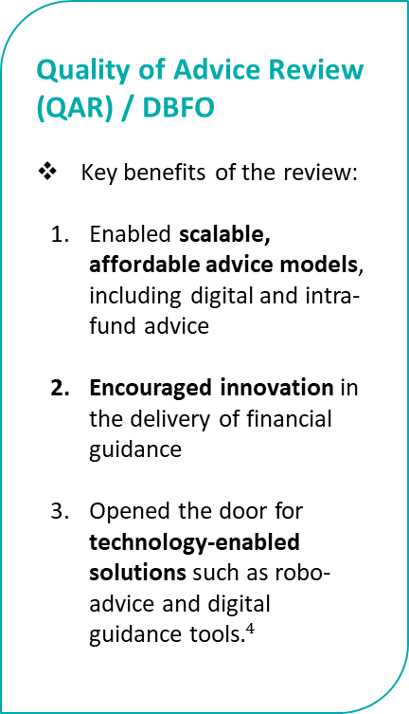
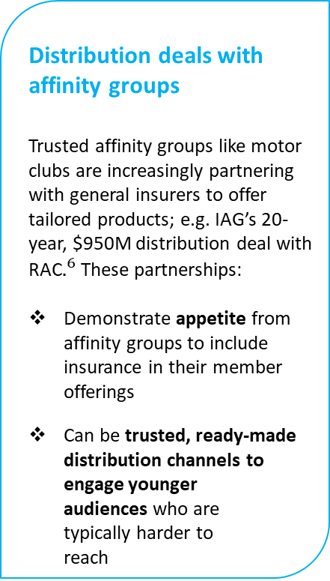
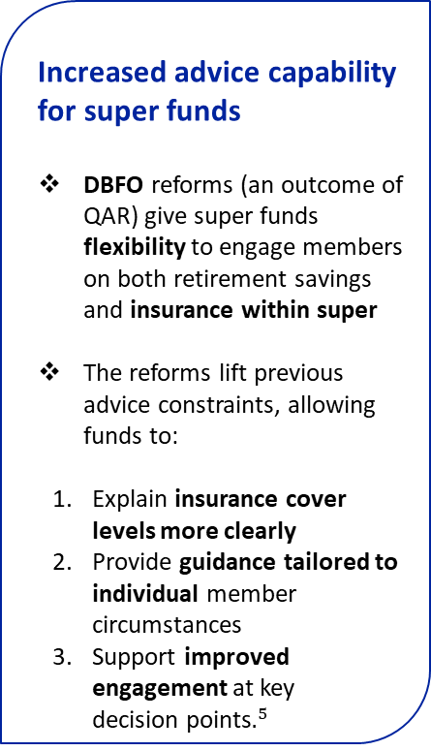
Emerging tailwinds
In recent years, positive regulatory and environmental changes have created a more favourable environment for life insurers to serve the underserved younger generation market
Quality of Advice Review (QAR) / DBFO
Key benefits of the review:
Enabled scalable, affordable advice models, including digital and intra-fund advice
Encouraged innovation in the delivery of financial guidance
Opened the door for technology-enabled solutions such as robo-advice and digital guidance tools$.^{4}$
Increased advice capability for super funds
DBFO reforms (an outcome of QAR) give super funds flexibility to engage members on both retirement savings and insurance within super
The reforms lift previous advice constraints, allowing funds to:
Explain insurance cover levels more clearly
Provide guidance tailored to individual member circumstances
Support improved engagement at key decision points$.^{5}$
Heightened risk awareness post-COVID
COVID-19 heightened awareness of health and financial risks, increasing public understanding of the need for life and income protection insurance
Led to renewed interest in protection insurance, with people more engaged in maintaining adequate cover
Distribution deals with affinity groups
Trusted affinity groups like motor clubs are increasingly partnering with general insurers to offer tailored products; e.g. IAG’s 20-year, $950M distribution deal with RAC$.^{6}$ These partnerships:
Demonstrate appetite from affinity groups to include insurance in their member offerings
Can be trusted, ready-made distribution channels to engage younger audiences who are typically harder to reach

Slide 10
How to reach the younger generation
03

Slide 11
Strategic distribution channels to tackle underinsurance
Different distribution models are available for insurers to consider in targeting the underserved younger demographic
No one-size-fits-all model — and young people know it: Each insurance distribution channel comes with trade-offs across Reach, Trust, Control, and Education — all factors that directly impact how younger customers discover, understand, and value coverage:
B2B2C: Maximises convenience and reach by integrating insurance leads into platforms young people already use and trust (eg. rideshare apps, digital banks).
  But it can feel invisible or transactional unless it’s clearly explained and offers opt-in choice.
White-label: Taps into trusted brands like super funds or buy-now-pay-later apps, which many young people already trust.
  However, limits transparency or control the insurer can offer, which may frustrate digital-native users who want more visibility.
Embedded: Works well for simple, one-off cover (e.g., travel, electronics) where price and ease matter most.
  But if not communicated well, risks low perceived value — especially for a generation that craves understanding before committing.
D2C: Offers maximum control, clarity, and education through digital journeys — appeals to young, research-driven customers.
  But it requires strong digital design and brand-awareness, and can be expensive to scale, potentially impacting pricing or accessibility.
Illustrative Framework

Slide 12







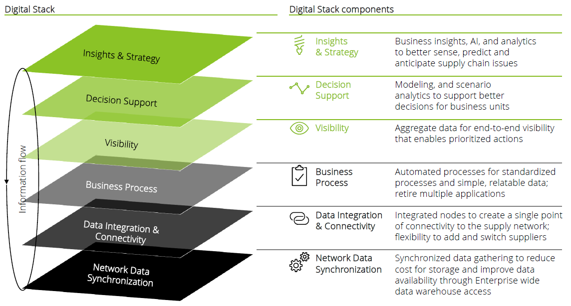



Targeted touchpoints: timing, channels, and partners matter
Insurers can shape perceived value by targeting the key moments when individuals are more likely to be considering life insurance
Overseas examples
 | Potential partners | Examples of potential touchpoints
 | Banks Credit unions | Banks or credit unions to consider life insurance in the loan origination process
 | Family planning centres Baby product suppliers Childcare | Family planning doctors promoting visibility of life insurance Childcares and baby product suppliers providing parents visibility on life insurance solutions
 | Banks Motor financing Buy now, pay later (BNPL) Credit card companies | Banks, motor financing companies or BNPL to provide life insurance options for protection against being unable to pay their loan off. Credit card companies communicating to customers when they identify changes in spending habits.
 | GP clinics | GPs to promote visibility of life insurance
 | Employers | Employers to nudge employees to assess insurance coverage; educate employees on income risk mitigation
 | Universities TAFE | Fairs at universities and TAFE to promote financial literacy and value of insurance Events and sponsorships to promote visibility of insurance and insurers
Taking out a mortgage
The Group Loan Protection Plan, offered by Bank of Baroda in partnership with IndiaFirst Life Insurance, provides life insurance coverage linked to loans
Early Parenthood
Millennials
Credit services
Banks like Standard Bank and Nedbank offer loan protection insurance that includes life cover
Health Check-ups
Private insurers like Bupa and Vitality partner with GPs to offer insurance or referrals during checkups
Entering the workforce
Gen Z
Higher education
Employers increasingly promote insurance awareness and financial wellness through insurer partnerships—e.g., Delta Airlines partners with an Insurance Trust to offer retiree coverage.

Slide 13
Perceived customer value improves insurer lifetime value
To reach and retain younger generation, insurers must not only highlight long-term value of insurance, but also view early engagement as a strategic investment — build trust, capture customers early, and create pathways to solve more complex protection needs over time
Since younger customers are less likely to claim, insurers should focus on delivering engaging experiences and value beyond claims to build early brand connection.
Lifetime Value for Insurers
Low Claims, High Engagement
Providing meaningful non-claim value (e.g. health tools, financial education) can foster brand attachment, increasing the likelihood that customers remain loyal when premiums rise later in life.
Long-Term Loyalty Strategy
Early Investment as Acquisition Cost
Insurers may need to treat early-stage (non-claim) benefits and lower pricing as a strategic investment in customer acquisition, helping ensure long-term retention and profitability. Consider cross-subsidy strategy.

Slide 14
Innovate to attract and retain
04

Slide 15


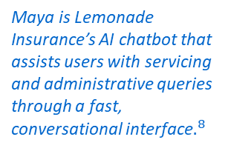
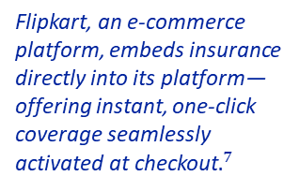
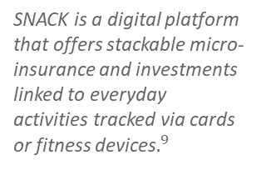
Innovation with technology
A seamless digital experience is key to customer acquisition & retention, with opportunities to innovate across every stage of value chain
        Automated, Criteria-Based Claims
          Adopt fully digital claims processes where smaller/simpler claims are settled directly and with straight-through automated processing between
          policyholder and insurer, reducing delays.
Buying a Policy
Ongoing Servicing
Staying Engaged
Making a Claim
    Digital-First Transaction
    Younger customers generally prefer low-touch experiences—buying a policy online and managing it without face-to-face interaction
    AI-Powered Support
    Use generative AI to answer questions, provide personalised advice, and streamline servicing via self-service applications
        Integration into Daily Activities
        Drive ongoing engagement by integrating other benefits into users’ daily routines, delivering value beyond claims through everyday digital touchpoints.
Flipkart, an e-commerce platform, embeds insurance directly into its platform—offering instant, one-click coverage seamlessly activated at checkout$.^{7}$
Maya is Lemonade Insurance’s AI chatbot that assists users with servicing and administrative queries through a fast, conversational interface$.^{8}$
SNACK is a digital platform that offers stackable micro-insurance and investments linked to everyday activities tracked via cards or fitness devices$.^{9}$
Allianz introduced a digital platform called ‘Defendant Hub’ that uses AI to handle Stage 3 injury claims$.^{10}$

Slide 16




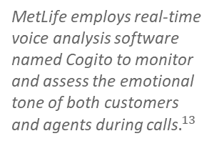
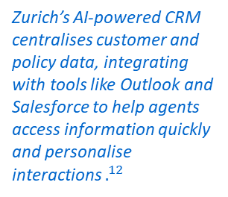
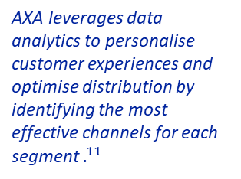
Innovation with data
With a need to continuously analyse, respond to and monitor customer experience, insurers should consider being at the forefront of innovating data usage along the value chain
    Policy & Payment Data
    Spot patterns like low coverage amounts, missed payments, policy
    lapses and reasons for cancellation
    that signal affordability challenges or
    that products are not evolving to
    meet their needs.
          Claims Data
    Automate collection of data for
    claim form filling and validation
    of form data and of claim validity.
    Monitor usage of claim and
    non-claim benefits by cohort.
Buying a Policy
Ongoing Servicing
Staying Engaged
Making a Claim
    Web Analytics
    See which pages or products visitors explore or ignore — ascertain interest, hesitation, or disengagement. Insights from common ChatGPT prompts can also highlight emerging trends, as younger users increasingly turn to AI over traditional search.
    Quote Drop-Offs
    Track where and why younger users abandon the quote process — often tied to price shock or confusion.
    App Usage
    Learn which features younger customers prefer using — e.g., digital self-service — and what keeps them engaged.
      Chat & CRM Data
    Analyse chat conversations to understand what young customers are asking, how they
    communicate and what
    reassures them.
    Call Centre Logs
      Identify the most common
      questions, objections, and trust
      issues raised by younger customers.
        Digital Drop-Off Analysis
      Identify points where existing policyholders disengage during key self-service actions (e.g., mid-claim process, policy renewal) to uncover moments of hesitation or UI/UX friction.
AXA leverages data analytics to personalise customer experiences and optimise distribution by identifying the most effective channels for each segment $.^{11}$
Zurich’s AI-powered CRM centralises customer and policy data, integrating with tools like Outlook and Salesforce to help agents access information quickly and personalise interactions $.^{12}$
MetLife employs real-time voice analysis software named Cogito to monitor and assess the emotional tone of both customers and agents during calls$.^{13}$
AIA uses optical character recognition technology to allow for uploaded claims documents instead of typewritten entry. AI models also verify entry against existing policy data.

Slide 17
Conclusions and next steps
05

Slide 18
Next steps for insurers
To capture underserved younger generations, insurers must be strategically positioned to innovate and navigate emerging challenges
Complexity
Perceived Regulatory Barriers
Customer needs first
More but simplified products fit for customer and channel
Testing with regulator
Consideration of processes/controls
Expanding Distribution Networks
Creating insurance ecosystem solutions
Leverage technology to appeal to the younger networks
System Challenges
Modernisation and harmonisation
Switch to low-touch, digital-first servicing

Slide 19
What can actuaries actually do?
Examples of actions that can be taken as steps to acquiring the underserved younger community
1
Be closer to younger customers to better understand their wants, needs and behaviours
2
Use evidence and data to garner support to influence regulatory change
3
Innovative design: “how can we do this?” instead of “can we do this?”
4
Leverage data to inform company decisions on optimising consumer engagement
5
Be leaders: Spearhead innovation projects from start to finish

Slide 20
Thank you
Actuaries Institute
actuaries.asn.au

Slide 21
Appendix
Deloitte Life Insurance Needs in Australia 2023
https://www.statista.com/statistics/608088/australia-age-distribution/
https://www.abs.gov.au/articles/new-census-insights-income-australia-using-administrative-data
https://www.apra.gov.au/putting-members-first
https://treasury.gov.au/sites/default/files/2023-01/p2023-358632.pdf
https://treasury.gov.au/sites/default/files/2023-12/p2023-471470.pdf
https://www.iag.com.au/newsroom/company/iag-enters-strategic-alliance-with-the-royal-automobile-club-of-western-australia
https://embedded-insurance-in-india/
https://www.lemonade.com/life
https://www.decerto.com/post/streamlining-insurance-claims-processes-with-ai-and-machine-learning
https://www.snackbyincome.sg/
https://webcast1.axa.com/files/Documents/file/167/65d732db2cf2b.pdf
https://www.businessinsider.com/zurich-insurance-ai-customer-relationship-management-crm-system-helps-agents-2025-5
https://www.wired.com/story/this-call-may-be-monitored-for-tone-and-emotion/

Slide 22
About the Actuaries Institute
The Actuaries Institute is the peak professional body for Actuaries in Australia. The Institute provides expert comment on public policy issues where there is uncertainty of future financial outcomes.
Actuaries have a reputation for a high level of technical financial expertise and integrity. They apply their analytical and risk management expertise to allocate resources efficiently, identify and mitigate emerging risks and to help maintain system integrity across multiple segments of the financial and other sectors. This unrivalled expertise enables the profession to comment on a wide range of issues including life, general and health insurance, climate change, superannuation and retirement income policy, enterprise risk management and prudential regulation, the digital economy, finance and investment and wider health issues.
© Institute of Actuaries of Australia 2025.​ All rights reserved.

