Slide 1
Default Pension Mechanism
Garvin Tso
13 June 2025

Slide 2
The Actuaries Institute acknowledges the traditional custodians of the lands and waters where we live and work, travel, and trade.
We pay our respect to the members of those communities, Elders past and present, and recognise and celebrate their continuing custodianship and culture.

Slide 3

“Our system is celebrated for being among the best in the world at securing and growing retirement savings through compulsory superannuation. A focus on retirement income is the most significant improvement we can make to our system and the lives of Australian retirees as they live longer.”
-David Knox on Australia slipping to 6th position in the 2024 Mercer CFA Institute Global Pension Index
Notes:
We have a celebrated superannuation system in Australia
Accumulation is built on compulsion and defaults – a great success
Retirement phase a different story. Retirement is built on action. We know we need to get better, but most of the improvements proposed are around improving retirement products, or product distribution, including through advice and education.
But I don’t think that’s enough. Why? Enter Bob.

Slide 4

  Meet Bob
  Bob is an 80-year-old retiree.
  Bob retired 20 years ago and currently has $570,000 in super.
  Bob has an accumulation account and never moved his super to pension phase.
Presented at the 2025 All Actuaries Summit
Notes:
Bob has never had to care about super while he was working
The underlying issue is that retirement planning remains too complicated and debilitating.
Bob is not unique. There are a lot of Bob’s out there.

Slide 5
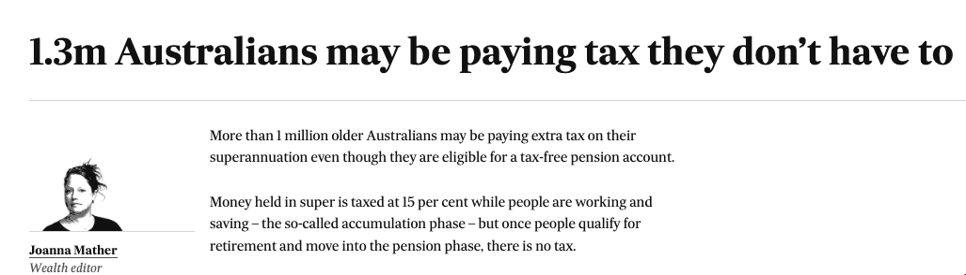
Australian Financial Review, 29 Aug 2023
Notes:
Challenger estimated 1.3 million superannuation accounts with $225 billion for members aged 65 years or more have not been moved to the pension phase.
Tax is only one issue

Slide 6

The Problem
  Retired members who remain in accumulation miss out on:
  Tax-free investment returns
  Cashing in on their retirement bonus
  An additional source of retirement income
  Can we create a mechanism to ensure that retired members do not miss out on a benefit for which they are eligible?
Presented at the 2025 All Actuaries Summit
Notes:
The retirement bonus is money set aside to pay for expected capital gains tax that is released to the member when they move their money from accumulation phase to the tax-free retirement phase via the transfer balance cap.
Members derive utility from income.
Assuming an average minimum drawdown rate of 5.2%15, it would represent up to $20.7 billion in value released to members, which they could then use to either pay down debt or spend in the wider economy.
This is increasingly important to Australia as we become increasingly dependent on consumption to drive economic growth.
Can we create a mechanism to ensure that retired members do not miss out on a benefit for which they are eligible?
Member guidance and member education will continue to play a role, but the sheer volume of affected members calls for escalated action.

Slide 7
Principles of Default
Best financial interest
We can clearly demonstrate that the default is in the member’s best interest;
For the vast majority of members
Do no harm
Consider and quantify any groups of members who may be worse off under the proposed mechanism
Develop mitigation strategies for members in niche scenarios
Members can opt out
Member choice is important
Mandatory policies are unlikely to be popular or politically feasible
Minimise the number of members who would be worse off
Notes:
Before I get into the details of what I am proposing, let’s keep in mind some principles that we should adhere to.
We can clearly show that members will be better off
We should be able to show that this statement applies to the vast majority of members
We have minimised the number of members who would be worse off
We have considered the needs of members in niche scenarios
Learning from past successes
Our current experience is comparable to the issue of account balance erosion by insurance premiums on inactive accounts prior to the Protecting Your Super (PYS) legislation coming into effect on 1 July 2019. The core underlying issue was disengagement. For a vast majority of these disengaged members, it would have been in their interest to cancel their insurance, but the onus was on the member to make such a choice - a choice that many do not make - even when nudged to do so.
The government addressed this issue by introducing the PYS legislation that soft defaults members into cancelling their insurance coverage if they are inactive for 16 months. The legislation requires superannuation funds to notify affected members with 9, 12, and 15-month notices in the lead-up to cancellation. During this time, they could opt-in to keep their insurance if it better suited their circumstances.
We should borrow from this successful experience and propose a similar default mechanism for retired members.

Slide 8



The Proposed Default Mechanism
  Members meeting a set of criteria are defaulted into an account-based pension.
  These criteria are:
  The account meets the minimum balance requirement for opening an account-based pension
  The member does not already have a pension account with the fund
  The member is at or beyond preservation age and has not received an SG contribution for 16 continuous months, or the member is 65 or older
Notes:
Account based pension is the one pension product all funds have
¹To meet the condition of release “ceasing an employment arrangement on or after 60”
²To meet the condition of release “is 65 years old or older (even if they haven’t retired”

Slide 9
Sizing the Opportunity
Affected members
Investment earnings
Retirement bonuses
Retirement income
$2 billion every year
$2 billion
$21 billion every year
1 million members, with $400 billion
Source: Laneway Analytics’ analysis of APRA fund level statistics and proprietary data
Notes:
Here’s the part where I try to hook you in. This is how many people would be affected by my proposal.
¹APRA-regulated funds only. Excludes exempt-Public Sector and SMSF
²Conservative estimate on minimum account balance requirement and retirement bonus rate
³Expected return (net of fees and taxes) of 6% in accumulation and 6.5% in pension
⁴Based on weighted average minimum drawdown rate, derived from the age distribution of members meeting the listed criteria

Slide 10
Additional Features
  Maintain existing investment options and insurance coverage
  Set drawdown amount to the legislated Minimum Drawdown Rate (MDR)
  Send members a series of communications in the lead-up to the soft default mechanism being triggered
  Recontribute drawdown amounts to the member if a bank account is not nominated
Notes:
Learning from past successes
Our current experience is comparable to the issue of account balance erosion by insurance premiums on inactive accounts prior to the Protecting Your Super (PYS) legislation coming into effect on 1 July 2019. The core underlying issue was disengagement. For a vast majority of these disengaged members, it would have been in their interest to cancel their insurance, but the onus was on the member to make such a choice - a choice that many do not make - even when nudged to do so.
The government addressed this issue by introducing the PYS legislation that soft defaults members into cancelling their insurance coverage if they are inactive for 16 months. The legislation requires superannuation funds to notify affected members with 9, 12, and 15-month notices in the lead-up to cancellation. During this time, they could opt-in to keep their insurance if it better suited their circumstances.
We should borrow from this successful experience and propose a similar default mechanism for retired members.
, where members’ bank details are requested, and they could opt out of the transfer.

Slide 11
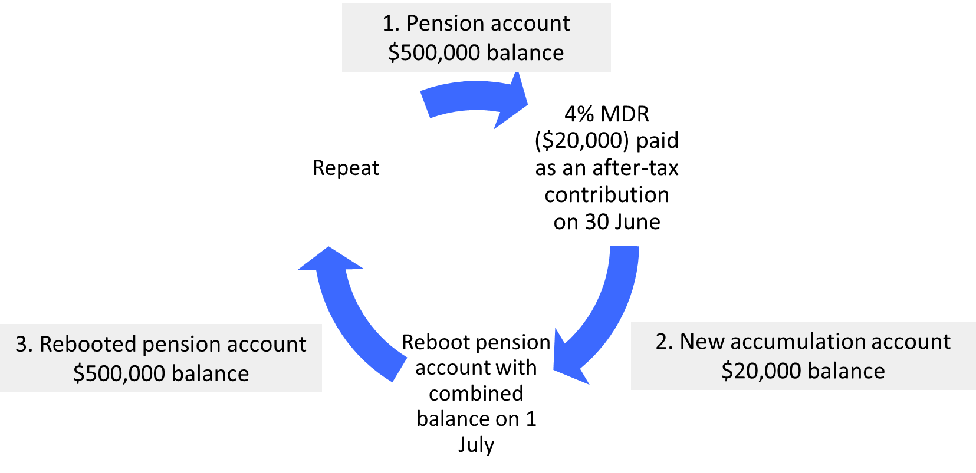
The Recontribution Strategy Example
Notes:
How and why?
Why?
This is the approach you would take if you goal was to maximise the financial outcome for the member.
This is what savvy high net worth individuals currently do manually to take advantage of the rules in our system.
I compare this to other options to prove it in my paper but I will not go through it today.
There are other benefits. Please refer to my paper.
The only people who would be worse off.
The strategy above will use some of the member’s non-concessional contribution cap (currently $120,000pa) and transfer balance cap (currently $1.9 million) without their explicit permission
Only members who had otherwise intended to fully utilise their caps would be worse off under the proposed mechanism
Given how high these thresholds are, we estimate that less than 0.1% of members would be affected

Slide 12



What if?
“I do not want an account-based pension”
“I never stopped working /
I would like to resume work”
“I do not want the additional income from my pension account”
Notes:
Considerations of unintended consequences
In designing any default system, it is crucial to anticipate and address potential unintended consequences. This proposal may have several unforeseen effects. Below, we outline some of these possible outcomes and propose corresponding mitigation strategies.
We also examine how our choice of selecting an account-based pension allows this proposed default mechanism to adhere to the principle of do no harm.
What if the member later realises that an account-based pension is not suitable for them?
The design of an account-based pension product allows members to commute part or all of their pension, including but not limited to:
Commute to an accumulation phase product
Purchase a lifetime pension product
Lump sum withdrawal as cash [Expand]
Complete rollback: Commute back into the accumulation phase and re-contribute any pension payments
If the member later decides that they want to take some of their retirement savings out of super as a lump sum or to purchase a retirement product at a different service provider, it is generally always in their best interest to first transfer to a pension product within their fund, receive their retirement bonus, wait out any claw back period where necessary, then make a redemption.
Members who directly make a redemption from their accumulation account miss out on this bonus, which can be very significant especially if they are very long-tenured members.
What if the member continues / later resumes work?
If the member receives an employer contribution, existing account stapling provisions would mean that they would automatically have a new accumulation account set up for them within the same fund.
The combined balance would be used to reboot the pension account via the recontribution mechanism once a year to maximise their investment potential.
What if the member does not want the additional income from their pension account?
This question would only be applicable if the member has provided their bank details and received the pension payments in their listed bank account.
The member has the choice to re-contribute the money back into their super fund at any point, provided they do not breach their contribution caps. This is default set by our recontribution mechanism.
Alternatively, if they can also leave it in their bank account to collect interest or invest it outside of superannuation.

Slide 13
Impact on Australian Population
 | Number of members | FUM | Lost earnings | Retirement bonus
FY2024 | 1,064,000 | $398 billion | $1.99 billion | $1.99 billion
FY2023 | 977,000 | $343 billion | $1.715 billion | $1.715 billion
FY2022 | 844,000 | $286 billion | $1.43 billion | $1.43 billion
FY2021 | 742,000 | $256 billion | $1.28 billion | $1.28 billion
Total |  |  | $6.415 billion
Source: Laneway Analytics’ analysis of APRA fund level statistics and proprietary data
Notes:
Understated numbers. The above figures only account for APRA-regulated funds. Total impact on Australian population would be even higher.
Growing numbers. Over the last four years, the number of qualifying members had increased 43%, whereas the total amount of affected FUM increased by 55%. We expect the figures to continue to increase as the baby boomer generation reaches retirement age.
Continued disengagement. In our analysis, over 90% of members who appeared on the list in one year appeared again in the following year, highlighting the prevalence of extended inaction and the need for such a default mechanism

Slide 14

What’s Stopping Us?
  Recontribution Mechanism
  Design Distribution Obligation
Notes:
Disclaimer
The following section highlights some of the legal issues that require attention.
We have not consulted with legal professionals to create an exhaustive list of all potential risk and compliance issues that may arise from our proposed mechanism.
We welcome input from the profession to create a more complete list and subsequent action plan.
The recontribution mechanism
It is unclear if it is legally possible to open an account-based pension without a listed bank account for processing payments. We have observed pension accounts with no listed bank accounts within administration systems17, but they may represent administrative errors rather than an intended feature.
It is also unclear if it is legally possible to make pension payments in the form of non-concessional contributions into an accumulation account. The common steps members currently undertake to manually recontribute money into super are:
1. Regular pension payments are paid to the listed bank account of the member’s pension account
2. An amount equal to the regular pension payments are paid to the member’s accumulation account as a non-concessional after-tax contribution
3. Reboot the pension account with the combined balance of the accumulation account and the existing pension account
Our proposal combines steps 1 and 2, which removes the requirement for the member to act from the process. Funds, with their risk-averse nature, are likely to require explicit guidance from the regulator to invest in the administrative upgrades needed to support this new recontribution process.
Design and Distribution Obligations (DDO)
There are currently TTR products that automatically become pension products on the member reaching age 65 as defined in the PDS. Can the same mechanism be embedded in the PDS’s of accumulation products?
Unfortunately, no. MySuper products are DDO exempt. There are no pension products which are DDO-exempt. We are currently unable to default members from a DDO-exempt product into a product that requires DDO checks.
We would require the account-based pension product to receive an exemption for the DDO regime similarly to how MySuper currently receives it.
This could be called MyPension – the other half of the default super system intended by Jeremy Cooper in the Super System Review of 2010.

Slide 15
Impact to Bob
 | Bob aged 60 | Bob today (aged 80)
Account balance (Actual) | $374,000 | $570,000
Account balance (Under current proposal) |  | $630,000
Difference | N/A | $60,000 / 11% more
Source: MoneySmart superannuation calculator
Notes:
Let’s try to do something to help the Bobs out there

Slide 16
Questions

Slide 17
Thank you
Actuaries Institute
actuaries.asn.au

Slide 18
About the Actuaries Institute
The Actuaries Institute is the peak professional body for Actuaries in Australia. The Institute provides expert comment on public policy issues where there is uncertainty of future financial outcomes.
Actuaries have a reputation for a high level of technical financial expertise and integrity. They apply their analytical and risk management expertise to allocate resources efficiently, identify and mitigate emerging risks and to help maintain system integrity across multiple segments of the financial and other sectors. This unrivalled expertise enables the profession to comment on a wide range of issues including life, general and health insurance, climate change, superannuation and retirement income policy, enterprise risk management and prudential regulation, the digital economy, finance and investment and wider health issues.
© Institute of Actuaries of Australia 2023.​ All rights reserved.

Slide 19
The Recontribution Strategy
1. Pension account
$500,000 balance
4% MDR ($20,000) paid as an after-tax contribution on 30 June
Reboot pension account with combined balance on 1 July
Repeat
The strategy above will use some of the member’s non-concessional contribution cap (currently $120,000pa) and transfer balance cap (currently $1.9 million) without their explicit permission.
Given how high these thresholds are, we estimate that less than 0.1% of affected members would be in this group.
3. Rebooted pension account
$500,000 balance
2. New accumulation account
$20,000 balance

Slide 20
Why Recontribution?
  Recontribution only applies when a bank account is not nominated by the member.
  Under such conditions, the recontribution strategy maximises the members’ financial interest while keeping the same functional outcome. Let’s compare the three scenarios below.
Current system
(Do nothing)
They leave their money in accumulation
They derive no utility from their super
With recontribution
(Pay out the minimum drawdown as a non-concessional contribution into a new accumulation account)
They cannot access their money until they take action
They derive no utility from their super, but now they have the additional benefit of…
Investment returns are now tax-free, and
Cash in on their retirement bonus, and
Reduce tax obligation on superannuation death benefit
Without recontribution
(Pay out the minimum drawdown to a bank account)
We do not have the authority make a contribution on their behalf from their bank account back into super
They derive no utility from their super, and the money is now sitting as cash instead of being invested
They cannot access their money until they complete proof of identity checks
They cannot access their money until they provide their bank account details
✓
Same functional outcome
Best financial outcome

Slide 21
Effect of recontribution strategy on tax obligation at death

Slide 22
Considerations of Unintended Consequences
“I do not want an account-based pension”
“I do not want the additional income from my pension account”
“I never stopped working /
I would like to resume work”
Alternatively, they can also bank it or invest it outside of superannuation
With an account-based pension, you can commute part or all of your pension to:
Commute to an accumulation phase product
Purchase a lifetime pension product
Lump sum withdrawal as cash
Complete rollback: Commute back into accumulation phase and re-contribute any pension payments
If the member receives an employer contribution, a new accumulation account being automatically set up for them within the same fund
The member can re-contribute the money back into their super fund at any point
The combined balance would be used to reboot the pension account via the recontribution mechanism once a year to maximise their investment potential
Notes:
In designing any default system, it is crucial to anticipate and address potential unintended consequences. This proposal may have several unforeseen effects. Below, we outline some of these possible outcomes and propose corresponding mitigation strategies.

Slide 23
The Retirement Income Covenant took effect from 1 July 2022.
“There is only incremental progress in measuring and tracking the success of retirement income strategies.”
-APRA ASIC joint thematic review follow-up pulse check
2 July 2024
Notes:
The Retirement Income Covenant which took effect from 1 July 2022 requires RSE licensees to formulate a retirement income strategy setting out how it will support its members approaching retirement and in retirement, supported by the monitoring of success metrics.

