Slide 1
Optimising Use of Account-based Pensions
Ian Laughlin
Cary Helenius
June 2025
Notes:
Thank Nicolette
Our topic is about ways super funds can optimize the use of account-based pensions
We’ll explain why we think that is important
- and we’ll show how super funds can help members do this.

Slide 2
The Issue for Super Funds
Accumulated balances are now substantial
Purpose of super – ‘… deliver income for a dignified retirement, alongside government support, in an equitable and sustainable way.’
Retirement covenant, mandated retirement income strategy
to maximise expected retirement income …
to manage expected risks to the sustainability and stability of retirement income
Responses by super funds so far are inadequate*
* APRA view: https://www.apra.gov.au/industry-update-pulse-check-on-retirement-income-covenant-implementation]
Notes:
Some context for our discussion
Run through the points on the slide.
Very strong focus on income
APRA says response by super funds are inadequate
Background only: SIS Act - Retirement Income Strategy:
(a) to maximise expected retirement income over the period of retirement;
(b) to manage expected risks to the sustainability and stability of retirement income over the period of retirement of the following kinds:
(i) longevity risks;
(ii) investment risks;
(iii) inflation risks;
(iv) any other risks to the sustainability and stability of the retirement income;
(c) to have flexible access to expected funds over the period of retirement.

Slide 3
Other Considerations for the Super Fund
Member’s needs
Regular cash flow
One-off cash
Anticipated
Unanticipated
Other Member assets?
“government support” and other contingent sources the member may receive over time
Age pension and other social services; health insurance
Ease for Member to understand
Member’s risk appetite
Advice and Support for Member
[Note: Every Retiring Member has an account – starting point]
Notes:
- When addressing this, there are other matters a fund must consider
- Run through the items on the slide

Slide 4
Today … Optimizing Use of Account-based Pensions
Possible Approaches for Super Funds
Propose Account-based CPI-linked Drawdown (“ABCD”) & Target-date Funds
Member Advice
Conclusions
Notes:
Today …
Run through items on slide

Slide 5
First … a Word about Risk
Volatility of underlying investments
VS
Risk to Target Outcomes (amount and timing)
Risk to Target Outcomes is a function of investment horizon and nature of investments
EG. If a Target Outcome is a positive real rate of return at time = T in the future:
Risk of falling short of Target Outcome | T = 2 years | T = 15 years
Cash | Low risk | Low risk
Shares | High risk | Low risk
Notes:
- Investment risk in a conventional sense: normally a focus on the volatility of the the value of and the income generated by the underlying investments.
- However, for a Member seeking a cashflow from super, the relevant risk is about the cashflow falling short of target in amount or for length of time. That is, the focus should be on risk to target cashflow to the Member rather than just the volatility of underlying investments. The risk is about outcomes rather than inputs.
- The risk to outcomes is a function of both investment horizon and the “riskiness” of underlying investments.
- Refer to table: For example, if the investment horizon is one year and the target outcome is a positive return, investment in shares (inherently volatile in value) would result in high risk to the target outcome. On the other hand, investment in cash would be low risk. Conversely, if the investment horizon is 15 years, and the target outcome is a real positive return on investment, both are likely to be low risk

Slide 6
… but …
Hand in hand:
Risk of falling short of Target Outcomes; and
Risk / opportunity of having “excess” residual funds after targeted drawdowns
Consider a target cashflow to the Member of $X (CPI-linked) each year up to year T :
OPPORTUNITY FOR HIGH RESIDUAL ~ RISK PRIOR DRAWDOWNS TOO LOW | T = 2 years | T = 15 years
Cash | low risk/low opp | low risk/low opp
Shares | high risk/high opp | low risk/ high opp
Notes:
BUT
- Hand-in hand with the risk of falling short of target cashflow, there is the possibility of exceeding the target outcomes – for example, having more funds than needed to meet the targeted cashflows.
- Conceptually, there is a tension between these two risks … the lower the risk of shortfall, the higher the risk of excess funds emerging.
- On the one hand, this might be seen as a blessing. On the other, it may be seen as a poor outcome, because prior cash flows may have been unnecessarily low.
- So, in some cases, excess funds may be seen as an opportunity; in others as a risk.
- Today, we will consider risks to target cash flows – both positive and negative.

Slide 7
Member Need
for
Regular Cash
… and mix and match
Account-based Drawdowns
“Product”
Fuzzy Horizon and Risk
Many Horizons
e.g.
Annuity – lifetime, fixed, deferred etc
Group self-annuity
Flexible Lifetime Pension
Target return fund
Other
*
e.g. investments:
Cash
Balanced
Shares
Conventional Lifecycle
e.g. investments:
Liability-driven
Multiple Target-date Funds
Dynamic Strategy
* see https://actuaries.asn.au/Library/Standards/MultiPractice/2024/Technical%20Paper%20Innovative%20Income%20Streams%20July%202024.pdf)
Notes:
We will use this simple representation to consider the various options for super funds
We’ll consider each in turn

Slide 8
Member Need
for
Regular Cash
Account-based Drawdowns
“Product”
Fuzzy Horizon and Risk
Many Horizons
e.g.
Annuity – lifetime, fixed, deferred etc
Group self-annuity
Flexible Lifetime Pension
Target return fund
Other
*
e.g. investments:
Cash
Balanced
Shares
Conventional Lifecycle
e.g. investments:
Liability-driven
Multiple Target-date Funds
Diverse Dynamic
* see https://actuaries.asn.au/Library/Standards/MultiPractice/2024/Technical%20Paper%20Innovative%20Income%20Streams%20July%202024.pdf)
Notes:
“Product”
- Product” : package with rules, features, fees, constraints.
- With this: marketing/competition/differentiation, understandability, PDSs, costs, possible capital, systems development, complexity of administration …
- On the other hand:
can meet needs closely eg a lifetime, indexed annuity for a secure, real income
some can complement account-based pensions well
- Important part of the system.
- Not our focus today.

Slide 9
Member Need
for
Regular Cash
Account-based Drawdowns
“Product”
Fuzzy Horizon and Risk
Many Horizons
e.g.
Annuity – lifetime, fixed, deferred etc
Group self-annuity
Flexible Lifetime Pension
Target return fund
Other
*
e.g. investments:
Cash
Balanced
Shares
Conventional Lifecycle
e.g. investments:
Liability-driven
Multiple Target-date Funds
Dynamic Strategy
* see https://actuaries.asn.au/Library/Standards/MultiPractice/2024/Technical%20Paper%20Innovative%20Income%20Streams%20July%202024.pdf)
Notes:
Consider account-based drawdowns

Slide 10
Using Drawdowns from Account-based Pensions
Pros
Every member already has an account at retirement
Familiar for member; Simple, easy to understand; Can be seen as just withdrawing from saving account
Fund has infrastructure to cope
Flexible; adaptable
Cons
Outcomes for member not certain
Member can run out of $
Member can be overly conservative
Member needs to make some investment decisions
Notes:
Some general points on ABPs
Run through points on slide

Slide 11
Member Need
for
Regular Cash
Account-based Drawdowns
“Product”
Fuzzy Horizon and Risk
Many Horizons
e.g.
Annuity – lifetime, fixed, deferred etc
Group self-annuity
Flexible Lifetime Pension
Target return fund
Other
*
e.g. investments:
Cash
Balanced
Shares
Conventional Lifecycle
e.g. investments:
Liability-driven
Multiple Target-date Funds
Dynamic Strategy
* see https://actuaries.asn.au/Library/Standards/MultiPractice/2024/Technical%20Paper%20Innovative%20Income%20Streams%20July%202024.pdf)
Notes:
- Let’s break it down a little
- Investments such as
balanced, cash, Aust shares or conventional lifecycle funds
have no defined investment horizon or identified risk to drawdown
These investments are not well-suited to meeting target cashflow for the Member, which for our purposes are drawdowns of defined amounts at defined times.
So, this is not a good approach

Slide 12
Member Need
for
Regular Cash
Account-based Drawdowns
“Product”
Fuzzy Horizon and Risk
Many Horizons
e.g.
Annuity – lifetime, fixed, deferred etc
Group self-annuity
Flexible Lifetime Pension
Target return fund
Other
*
e.g. investments:
Cash
Balanced
Shares
Conventional Lifecycle
e.g. investments:
Liability-driven
Multiple Target-date Funds
Dynamic Strategy
* see https://actuaries.asn.au/Library/Standards/MultiPractice/2024/Technical%20Paper%20Innovative%20Income%20Streams%20July%202024.pdf)
Notes:
Let’s consider what we have labelled “Many Horizons”

Slide 13

Multiple Single-horizon Pools
Many-horizons Thinking …
T = 0 | Start of Retirement
T = X | 0 < X < N
T = N | Nominated Period for Drawdowns
CY = CY₀ | Calendar Year of Retirement
CY = CY_{N} | Calendar year of last drawdown
T = 0
CY = CY₀
T = N
One payment at T = N
One pool for each CY₁ to CY_{N}
Member income for N years: invest in N pools
or …
One Multi-horizon Pool
T = 0
CY = CY₀
T = X
T = N
CY = CY_{N}
Member income for N years: invest in 1 pool
Payments at T = 1 to N
One pool for each CY₁ to CY_{N} , each pool with annual payments
Notes:
With many-horizons thinking …
- Multiple horizons are explicitly recognized in chosen investments
Conceptually …
- Investments are arranged systematically in investment pools so that they provide cash flow to meet target drawdowns.
With N drawdowns, this can be done through:
N Pools, each pool with its own horizon (1 to N)
OR
A single pool with multiple regular horizons (1 to N) within the pool.

Slide 14
Member Need
for
Regular Cash
Account-based Drawdowns
“Product”
Fuzzy Horizon and Risk
Many Horizons
e.g.
Annuity – lifetime, fixed, deferred etc
Group self-annuity
Flexible Lifetime Pension
Target return fund
Other
*
e.g. investments:
Cash
Balanced
Shares
Conventional Lifecycle
e.g. investments:
Liability-driven
Multiple Target-date Funds
Dynamic Strategy
* see https://actuaries.asn.au/Library/Standards/MultiPractice/2024/Technical%20Paper%20Innovative%20Income%20Streams%20July%202024.pdf)
Notes:
Let’s consider some of the approaches that might work with multiple horizons

Slide 15
LDI Concept
https://www.investopedia.com/terms/l/ldi.asp#toc-what-is-a-liability-driven-investment
Basic idea : investments are chosen to match duration and amount of liabilities
Useful where an institution is providing guaranteed payments eg annuity
For annuity payment number T of $X, assets chosen to match the payment – eg a zero-coupon government bond with a term of T years.
Minimizes investment risk, and hence the need for capital for the institution.
Notes:
Run through points on slide

Slide 16
Translation of LDI to a Member’s cashflow needs
Instead of hard liabilities, think in terms of member’s targeted cashflow needs
If we use multiple Single-horizon Pools to illustrate …
One Single-horizon Pool for each future year
Each pool is backed by assets closely matching the planned drawdown by amount and duration
Balance is drawn from the relevant pool each year.
Conservative investments, so likely sub-optimal except for short terms.
But may be an alternative to fixed term annuity for the super fund to offer
T = 0
CY = CY₀
T = X
One payment at T = X
One pool for each CY₁ to CY_{N}
Notes:
- What are the member’s “liabilities”?
- Instead of hard liabilities, think in terms of member’s defined cashflow needs
- If we use multiple Single-horizon Pools to illustrate …
One Single-horizon Pool for each future year
Each pool is backed by assets closely matching the planned drawdown by amount and duration
Drawdowns are made from the relevant pool each year.
- So likely sub-optimal except for short terms
- But may be an alternative to fixed term annuity for the super fund to offer

Slide 17
Member Need
for
Regular Cash
Account-based Drawdowns
“Product”
Fuzzy Horizon and Risk
Many Horizons
e.g.
Annuity – lifetime, fixed, deferred etc
Group self-annuity
Flexible Lifetime Pension
Target return fund
Other
*
e.g. investments:
Cash
Balanced
Shares
Conventional Lifecycle
e.g. investments:
Liability-driven
Multiple Target-date Funds
Dynamic Strategy
* see https://actuaries.asn.au/Library/Standards/MultiPractice/2024/Technical%20Paper%20Innovative%20Income%20Streams%20July%202024.pdf)

Slide 18
Multiple Target-date Funds
https://www.investopedia.com/terms/t/target-date_fund.asp
Basic idea: for each Target-date Fund, investments are chosen to broadly match duration, with investments in each pool becoming more conservative as the target date approaches
For example …
One Single-horizon Pool for each future year eg 2026, 2027 … 2054, 2055
Each pool is backed by assets which become more conservative over time, homing in on the target date
Balance paid from the relevant pool when the target date is reached.
Excess could be rolled over to later funds
Lifecycle thinking; easy to understand; super funds have capabilities
But underlying assets may not be optimized for risk
Notes:
- Explain basic Idea
Pros
Similar thinking to many lifecycle funds but not focused on NRA - better risk control
Easy to understand
The building blocks are already available in each super fund
Cons
Some risk that target outcomes will not be met
Member’s risk appetite may not align with the asset mix
Use of the various underlying funds is not optimised from a risk perspective
- Excess above target drawdown could be rolled into later funds – systematically if need be
15 minutes – IAN HANDS OVER TO CARY

Slide 19
Member Need
for
Regular Cash
Account-based Drawdowns
“Product”
Fuzzy Horizon and Risk
Many Horizons
e.g.
Annuity – lifetime, fixed, deferred etc
Group self-annuity
Flexible Lifetime Pension
Target return fund
Other
*
e.g. investments:
Cash
Balanced
Shares
Conventional Lifecycle
e.g. investments:
Liability-driven
Multiple Target-date Funds
Dynamic Strategy
Account-based CPI-linked
Drawdowns
(ABCD)
* see https://actuaries.asn.au/Library/Standards/MultiPractice/2024/Technical%20Paper%20Innovative%20Income%20Streams%20July%202024.pdf)
Notes:
Thanks Ian, to this point the investment strategies supporting the various alternatives have been static or pre-set, seeking to deliver targeted drawdowns at specified dates and times in the future. An alternative approach, is to vary the investment mix based on on past investment performance and future requirements to deliver the targeted future payments. It is possible to devise investment rules that can be applied to produce very high historical success rates. This proposed investment approach would enable the development of an account-based CPI indexed drawdowns (ABCD’s) as an alternative, innovative retirement solution.

Slide 20
Dynamic Investment Strategy & Account-based CPI-linked Drawdowns
Starts at retirement:
Objective is to maximise secure yearly drawdowns over 30 years, CPI indexed
Very high probability of full payment each year – say 99%
These needs can be met using a single Multi Horizon Pool
T = 0
CY = CY₀
T = X
T = N
CY = CY_{N}
Dynamic investment
Strategy
Payments at T = 1 to N
One pool for each CY₁ to CY_{N} , each pool with annual payments
Notes:
If we have an objective of delivering annual CPI indexed payments that commence at high initial drawdown rates of 5% or more, over (say) 30-year time frames, and we want to deliver a very high success rate (say 99% probability of success), then this can be met from a single pool of funds. However, rather than holding the investment mix constant it would need to change based on the past history and investment characteristics of the investment portfolios supporting the liabilities. I’ve tested this process using the Austmod data base which has over 65 years of quarterly unit price investment data across 15 investment and economic sectors. It was possible to produce an historical test that had 100% success rates across 144 30-year investment scenarios, which suggests a high level of success is possible in future scenarios.

Slide 21
As easy as ABCD for the Super Fund and the Member
A suite of CPI indexed income streams
One or more terms ranging from 1-30 years
A rules-based methodology resets the investment mix each year for each income stream
Easy for the Super Fund to manage and administer
Very attractive and flexible for the member
Supporting investments 100% redeemable at MV at all times
low cost to the member
simple management for the fund
Reliable, flexible, CPI-Indexed
Lump sum for aged care needs, major purchases
Notes:
Because it was possible to produce income streams for 30-year periods, that had 100% historical success rates when the launch dates were varied by a quarter, it is possible at any point of time to have a suite of income streams. For example, if we launch a new income stream today it has 30 years to run, an income stream launched a year ago has 29 years remaining, and one launched 29 years ago has 1 year remaining. This suite of income streams provides a range of drawdown yields and range of remaining durations and all operating on a basis that has proved to have a historical 100% success rates. This results in a flexible range of income streams that are CPI-indexed that allow the retiree to tailor their income needs and terms of payment. The supporting investments are all retained by the retiree and held at market value within the retirees superannuation account and so can be accessed/redeemed at any time by the retiree to provide an urgent lump sums (to fund aged care or other major purchases).
The investment process is rule-based – this means its low cost to the member and simple for the fund to administer.

Slide 22
ABCDs offer a low-risk, high-cashflow solution
Investors can switch at any time to increase or reduce payments or durations
All distributions are increased by CPI each year to provide predictable, reliable income streams, with a residual lump sum paid to the member at maturity
Each income stream has regular reporting and provides a star rating to indicate fund strength to deliver its CPI indexed income for the remaining term
A 100% success rate over 144 thirty-year investment scenarios
including the high inflation and weak investment markets of the 1970s, the GFC and COVID
Notes:
If these ABCD’s were made available, it would allow retirees to switch at any time between the income streams and so could reduce or increase their drawdown levels or remaining durations. The distributions are CPI indexed, which means the payment streams from each income stream is predictable and reliable. Because they have had 100% success rates in the past, that means there has been a residual lump sum at the end of each 30-year term. The suite of income streams would have regular reporting and provide a star rating to signify the risk of the income stream being able to reach maturity. As I’ve noted the income streams have been tested historically with a 100% success rate over the past 65 plus years, so provides confidence that a high success rate would continue.

Slide 23
Successfully managing sequencing risk in unitised funds is the key
Features
Pre-set, objective, rule-based dynamic process
30-year CPI-indexed drawdown
5% first year drawdown
A residual lump sum at full MV at maturity
Can be cashed in at any time at MV
Higher annual drawdown rates for shorter term drawdowns
Analysis - based on 65 years of historical returns:
100% success in managing sequencing risk
Initial drawdown rate can be sustained in all market conditions
The process strongly out-performed other investment strategies
Notes:
The dynamic process is a pre-set, objective, rule-based dynamic process produced 100% success in managing sequencing risk and so the initial drawdown rate (of 5%) can be sustained in all market conditions observed over the past 65 years. Because each historical run was able to complete 30 years of CPI indexed payments a residual lump sum occurred at completion each time, and is paid at its full market value at maturity. On average, these residual lump sums created value (except for cash) as they can be compared to a starting multiple of 20.
The process strongly out-performed other investment strategies in delivering 30-year CPI indexed income streams from ACCOUNT BASED PENSIONS
The 5% initial distribution for 30-year streams, regardless of market conditions is high, and a balanced fund would have only had a 60% success rate in delivering this successfully over the past 65 years.
The drawdowns increase annually with full CPI increases and assets increase with full market returns based on investment markets.
It is possible to increase drawdowns to higher levels, but this would imply shorter term income streams than 30 years

Slide 24
Example of the ABCDs that could be available today…
Member chooses how much to invest and in which streams.
Receives the drawdown yield as a payment in the first year
Increases with CPI until maturity
The income streams are labelled to show maturity date (eg i2054)
And show yield for the following 12 months
Member can switch at any time between streams to vary yields and durations – or cash-out completely
Distributions are based on the CPI indexed income commencing from launch date
The initial launch date of each security was 30 years prior to the shown maturity date
All the income streams can be recreated and offered to members at anytime
Notes:
The suite of income streams would look like this…. A simple table shows the range available which shows the remaining term (eg 30 years, 25 years, 10 years etc) It would also show the current year distribution – which will be increased by CPI in the remaining years. At the end of the term, any residual is returned as a lump sum (or can be re-invested in further income streams). The star-ratings indicate whether the income streams are on track, or whether they have an increased risk of failure. For example, and income steam launched around the time of the GFC is likely to have an increased risk of failure (shown here as a 3-star rating). If failures were to occur there is a lead time of (say) 5 years or more for retirees to take some actions to address the situation, Remember, at all times the member retains total freedom to switch between income streams or redeem their account balances.

Slide 25
Using ABCDs as a base, there is great flexibility in drawdown design …
The following designs tested with 100% success over past 65 years data:
ABCDs at 5% rate with CPI indexation and a lump sum of 40X (average) after 30 years
Initial flat drawdown rates (say 7% flat) with CPI protection in later periods and higher lump sums
Combining ABCDs with a targeted CPI indexed lump sum at a specified time
ABCD dynamic investment process to provide increased starting income and full CPI indexation to support Group Self Annuities with much higher success rates than a balanced fund, or other static investment strategies
PLUS
“Turbo” averaging 32% increase in total drawdowns above CPI offset by 29% decrease in lump sum after 30 years
… and combinations of above are possible
Notes:
Once you have established a suite of income streams that have had 100% historical success rates, these can form the building blocks for a range of innovative variations. For example, starting with higher drawdown rates that blend into CPI indexed income streams at later dates. Or combining a CPI indexed stream with a CPI indexed lump sum to be delivered at a specified future date. This process can also be used to support GSA’s and would enable higher initial pensions and higher security in delivering CPI indexation.
As an example of how the ABCD’s could be transformed – there is another example called the ‘turbo’ it also has 100% historical success rates but this optimises the ABCD’s to maximise the income payments. The turbo can produce more than 30% higher than CPI indexation over 30-year drawdown periods, offset by a lower expected lump sum after 30 years

Slide 26
Applying a switching rule to swap ABCDs improves the outcomes further …
“CPI Turbo” applies a further pre-set switching rule to the ABCDs and results in real rates of drawdown increase above CPI, whilst maintaining 100% historical success rates
30^{th-}year drawdowns averaged CPI+1.4% per annum (54% above CPI)
A minimum of CPI increases on prior year maintained at all times
>CPI in 94% of the historical 30-year runs, with 6% achieving CPI increases only
A residual 30th-year lump sum occurred in 100% of historical runs
“ABCDs” had a 40 X 30th-year drawdown as lump sum
“Turbo” had 22 X the 30th-year CPI adj income as a lump sum
Total “real” drawdowns were 32% higher than ABCD
“CPI adjusted” 30th-year account balances” for “turbo” were 29% lower (on average) than for ABCD’s
14% of CPI-turbo runs had both higher lump sums & drawdowns
Both ABCDs and CPI turbo drawdowns compare favourably to currently available GSAs, and the member retains full access to account balance at all times
based on 30-year terms for 144 quarterly commencements from June 1959 and ending March 2025
Notes:
Whilst retirees could individually decide on switches between the ABCD income streams to suit their circumstances, the turbo automates this process and uses an additional ‘pre-set switching rule’ to move between the ABCD’s.
Using this process the turbo produced a 30th year income that was 54% above CPI indexation (or around 1.4% per annum above CPI). The turbo maintained a minimum of CPI indexation at all times.
In 94% of the historical runs the turbo produced increases above CPI, and for 6% it still delivered CPI. Whereas the ABCD has an average income multiple of 40 X at maturity , the Turbo delivered a lower multiple but both approaches still created wealth (on average). The income streams provided by the ABCD’s and Turbos compare favourably to the income streams and GSA’s currently available to retirees.

Slide 27
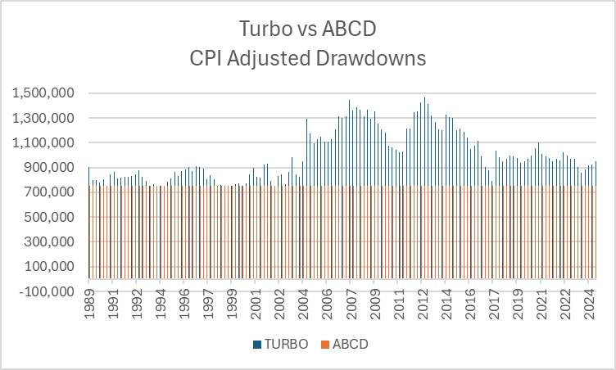
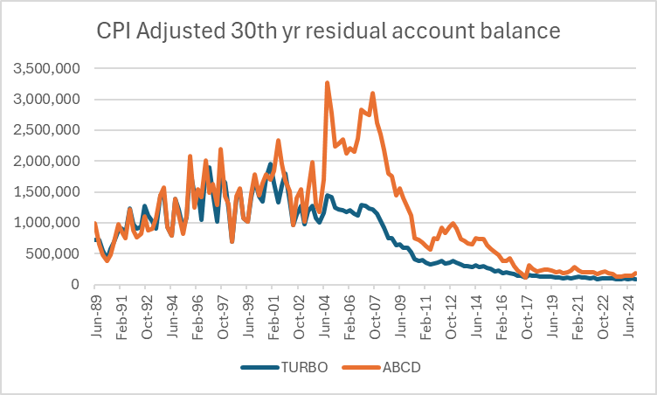
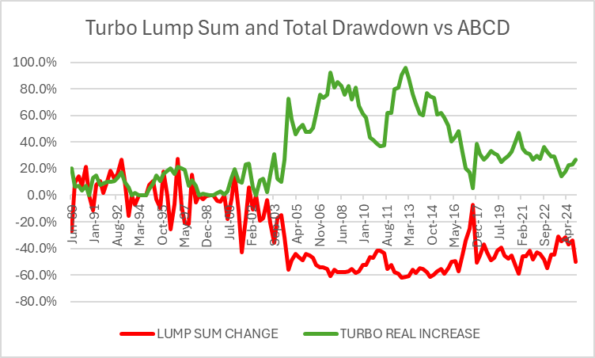
CPI Turbo vs ABCD: Drawdowns and Lump Sums
based on 30-year terms for 144 quarterly commencements from June 1959 and ending March 2025
Notes:
These charts provide some more insight into how ABCD’s and Turbo’s would have performed over the past 65 years. The top 2 charts have been adjusted for CPI and represent “real current dollar” comparisons.
The top left-hand side shows a comparison of the CPI adjusted total drawdowns paid over the 30 years. The ABCD was paying $25,000 per annum and so paid 30X $25,000 in real dollars or $750,000 over 30 years. The Turbo payments show how it would have paid higher total drawdowns in 94% of the trials. The top right hand side shows the residual lump sum in real dollars (and this compares to an initial $500,000 investment – highlighted by the black line). In most scenarios additional wealth was created in addition to the drawdowns being paid. Interesting to note that the trend has come down as inflation has fallen, but we have also had the GFC and COVID in the past 15 years.
The chart at the bottom shows the rates of increase above CPI for the total drawdowns for the turbo and the red line shows the percentage change in the final asset value relative to the ABCD’s. Clearly when the Turbo has paid higher drawdowns it coincides with lower residual lump sums.

Slide 28
Example: Applying a switching rule to the ABCDs …
Don’t worry about detail here
Each column shows available ABCD commencing on or after member’s drawdown start
The light blue shaded cells shows how switching to higher drawdown rates can be made under pre-set rule – with 100% historical success rate
Drawdown rates are based on the CPI indexed income commencing the top of each column at a 5% initial drawdown
The initial launch of a new ABCD varies by 1 year across each column
Each ABCD is indexed by CPI down the columns and the dynamic investment strategy
Table shows application of a pre-set rule.
Notes:
Don’t worry about the detail, but this chart shows how the turbo works. Each column represents the launch of a new ABCD. In year 1 there is only 1 ABCD available. In year 2 there is now an ABCD with 29 years to run, and a new one with 30 years to run. So Turbo decides whether it can increase its drawdown by moving to the new income stream. Each year new ABCD’s are added so there are more choices for Turbo. When the Turbo moves down a column it has decided the best option is to remain in the current income stream and receive CPI indexation and when it moves left or right it does so to increase the income payment above CPI. In this example the turbo made 6 switches initially, and then stayed in the single ABCD for a number of years before switching again, then eventually it switched back into the original ABCD – but in the process it had generated higher incomes than CPI indexation, and finishes with a lump sum that is higher than had it remained in the same ABCD throughout.

Slide 29
Higher Risk Appetite using ABCD
The ABCD Base Conditions produce low-risk outcomes for CPI indexed income streams
A Member can choose to lift risk in a number of ways. For example:
Divert some of their account balance to risky assets such as shares. This will increase the volatility of their total account value, with potentially higher (or lower) overall outcomes
OR
Increase their regular drawdown $ so that it exceeds the amount estimated to be supportable by their initial account balance.
Notes:
The ABCD is a low risk outcome – based on the historical 100% success rate. A member may choose to move to higher risk, higher return outcomes. For example, shares can deliver the best long-term returns, but they also have can also suffer from sequencing risk events and this can detrimentally impact plans if they occur shortly after retirement. Alternatively, a retiree may want to draw out higher levels of income than provided by the ABCD’s and in doing so this increases the risk that the assets will not be sufficient to last for the desired term. The ABCD’s provide a good baseline guide for budgeting income streams and/or likely durations of different drawdown strategies.

Slide 30
Irregular Cash Flow Needs

Slide 31
Irregular cash flow needs – ABCD and Target-date
Estimates can be made (at retirement and from time to time) for:
One-off anticipated expenses (eg. a new car every 7 years)
Lump sum at the age regular drawdowns finish
for aged care etc
for expenses after that date
Eg, using ABCD:
Choose appropriately long term for drawdown
Set aside amount outside ABCD at start and invest for long term eg shares, or if available a Target-date Fund
Note: Investments could also be made in a “product” at retirement – eg a deferred lifetime annuity to meet late cash flow needs.
Notes:
A retiree is likely to have irregular and regular income needs. A component of expenses for rates, power bills, water, internet, maintenance costs and food are indiscretionary and likely to move with CPI. However, there are also irregular expenses –a new car every 7 years. In addition, there is a need for lump sums at later ages to cover things such as aged care costs. It is also possible to invest in deferred income products which may provide more attractive future income streams by sacrificing some lump sum at retirement.
The ABCD could be used to cater for regular, and irregular CPI indexed expenses, and potentially combined with a targeted lump sum to cover additional large future expenses. With those thoughts I’ll pass back to Ian.
30 Minutes – HAND OVER TO IAN

Slide 32
Government Support

Slide 33
Government Support
Estimates can be made for anticipated age pension, as pension account balance declines
To accommodate receipt of age pension:
With ABCD, allowance could be made for age pension in later years, with higher drawdowns in earlier years
With Target-date Funds, investments could be reduced in relevant TDFs
Notes:
- Run through points on slide

Slide 34
Asset Test: Bites but Protects too
Wealth of $400,000 can sustain CPI indexed incomes of up to $20,000 pa with no age pension support
Wealth of $400,000 can sustain CPI indexed incomes of up to $64,200 pa with couple age pension support
Wealth of $1.2 million can sustain CPI indexed incomes of $91,800 pa with couple age pension support
Harsh on the way up
Strongly supportive
on the way down
Age pension acts like a put option
Even with starting wealth of circa $3 million, age pension supports higher drawdowns
Notes:
We are all familiar with the asset test for the age pension
The test produces quite savage reductions in age pension as assets rise (like a high marginal tax rate)
BUT …
Test also unwinds at a highly favourable rate as assets fall – eg with decumulation and/or poor returns
This provides considerable downside protection – acts like a put option

Slide 35
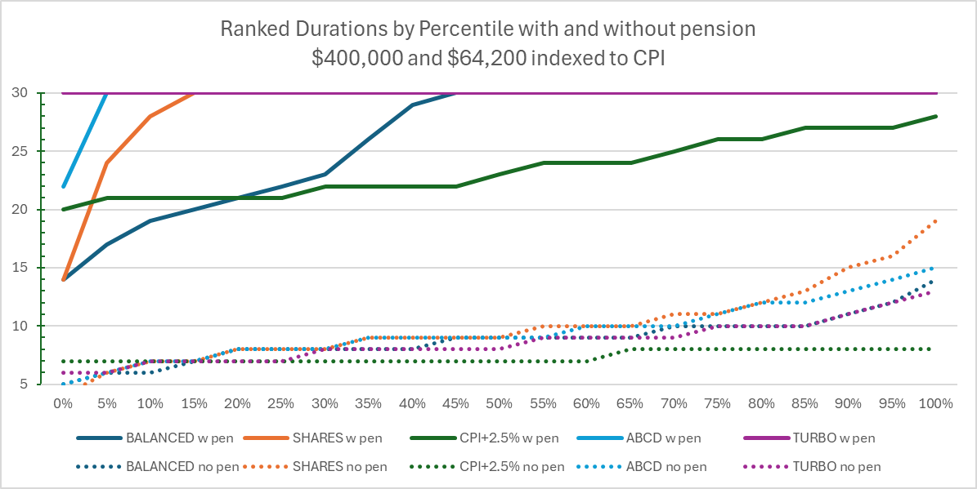
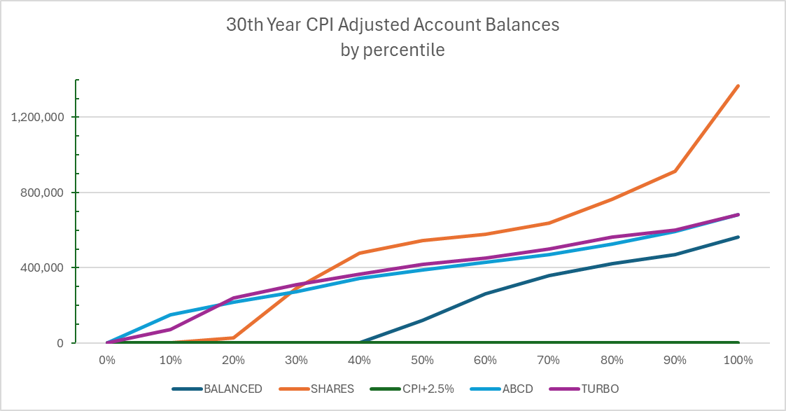
Age Pension Support
Duration (yrs)
$400,000 of wealth can sustain CPI indexed incomes of up to $64,200 pa (vs $20,000) with couple age pension support
Durations increase from 9-year to 28-year average
Turbo reached 30 years in every 30-year period
CPI+2.5% did not reach 30 years in any period
Aged pension assists with wealth retention:
Account balances equal or exceed the CPI adjusted initial wealth of $400,000 for:
shares by 35th percentile (65% exceed),
ABCD and Turbo at 50th percentile
Balanced fund by 75th percentile
CPI+2.5% didn’t reach 30 years historically
+ 19 years (average) extra duration from pension support
30 yr CPI Adj Acct Balance
$
30th year account balance exceeds
$400,000 CPI Adj
Notes:
Age pension support can make a large difference
The first graph shows that for an opening balance of $400,000 and a drawdown of $64,200 pa, the average duration across all investment arrangements would be 19 years longer
And Turbo delivered 100% of the time.
The second graph shows that a substantial number of outcomes provided a residual balance exceeding the original balance in real terms.

Slide 36
Member Support and Advice Needs

Slide 37
The Member’s Support and Advice needs
To help the Member make decisions* :
The Member could engage a financial planner
and/or
The Fund could provide on-line scenarios/simulations for the member to use
and/or
AI could be used to guide the Member through the decision-making process
* Regular and irregular cashflow needs, risk appetite, likely government support …
Notes:
Run through points on slide

Slide 38
AI : Outcomes-focused Retirement Income Advice
Consistent with Outcomes-focused Risk (see earlier), start with low-risk outcomes (eg ABCD): $X pa increasing by CPI
Adjust for one-off cash needs and for government support
Understand implied lifestyle (AI can provide)
Consider risk appetite and adjust investment or drawdown risk if needed
Loop back
Sample outcomes-focused AI question: I am a 65 year old male. My wife is 63. We own our own house. We are quite healthy. We live in Sydney Australia. I am about to retire. My wife is retired. Please describe my lifestyle if I have AUD $[X] to spend each year, indexed to CPI, and describe a typical month for us.
Notes:
- AI has much potential
For example, here is an outcomes-focused approach which could be very helpful
What is an outcomes-focused approach?
- Run through points on slide.

Slide 39
Conclusions
All members have an account
All super funds have the building blocks to offer drawdown facilities
Systematic drawdowns from Account-based Pensions:
Multiple Target-date Funds – potentially with dynamic investment strategy
ABCD – with dynamic investment strategy
AI – great potential to support members with focus on outcomes and lifestyle
good returns, secure outcomes
easy to understand
flexible – no long-term commitments
retirement covenant
retirement income strategy
purpose of super
Member
Fund
Notes:
- Run through points on slide
35 minutes - END

Slide 40
Discussion
Acknowledgements:
Austmod originated in Operations Research at National Mutual more than 30 years ago
Maintained and further developed by Colin Grenfell since that time and has been used extensively in the Actuarial and Superannuation industries since its origination.
Notes:
HANDS OVER TO IAN

