Slide 1
Medical advancement: challenges and opportunities
Dr Matthew Paul.
Chief Medical Officer, Munich Re Australasia.
June 2025

Slide 2

The rate of change is a challenge itself
Rate of advancement
  ~1.75m PubMed citations 2024
  4-6% annual growth
  Challenge: Volume, screening for relevance and quality issues
Notes:
Rate of advancement increasing
1.75 m articles published to pubme each year and a 4-6% annual growth rate in publications
Creates volume challenges, and also challenges sorting what is relevant and of reasonable quality to inform decisions
Rate at which scientific discovery is translated into clinical use increasing, with ongoing ethical and regulatory controls in place
Good example is COVID, arose in 2019, isolated early 2020, genome sequenced in weeks, mRNA vaccine candidate in months, testing for safety/efficacy and then global production and distribution in 9 months, following this repurposing of the technology into cancer vaccines and more recently to potentially treat HIV infection
Also: number of researchers, journals, and R&D spending also increasing

Slide 3
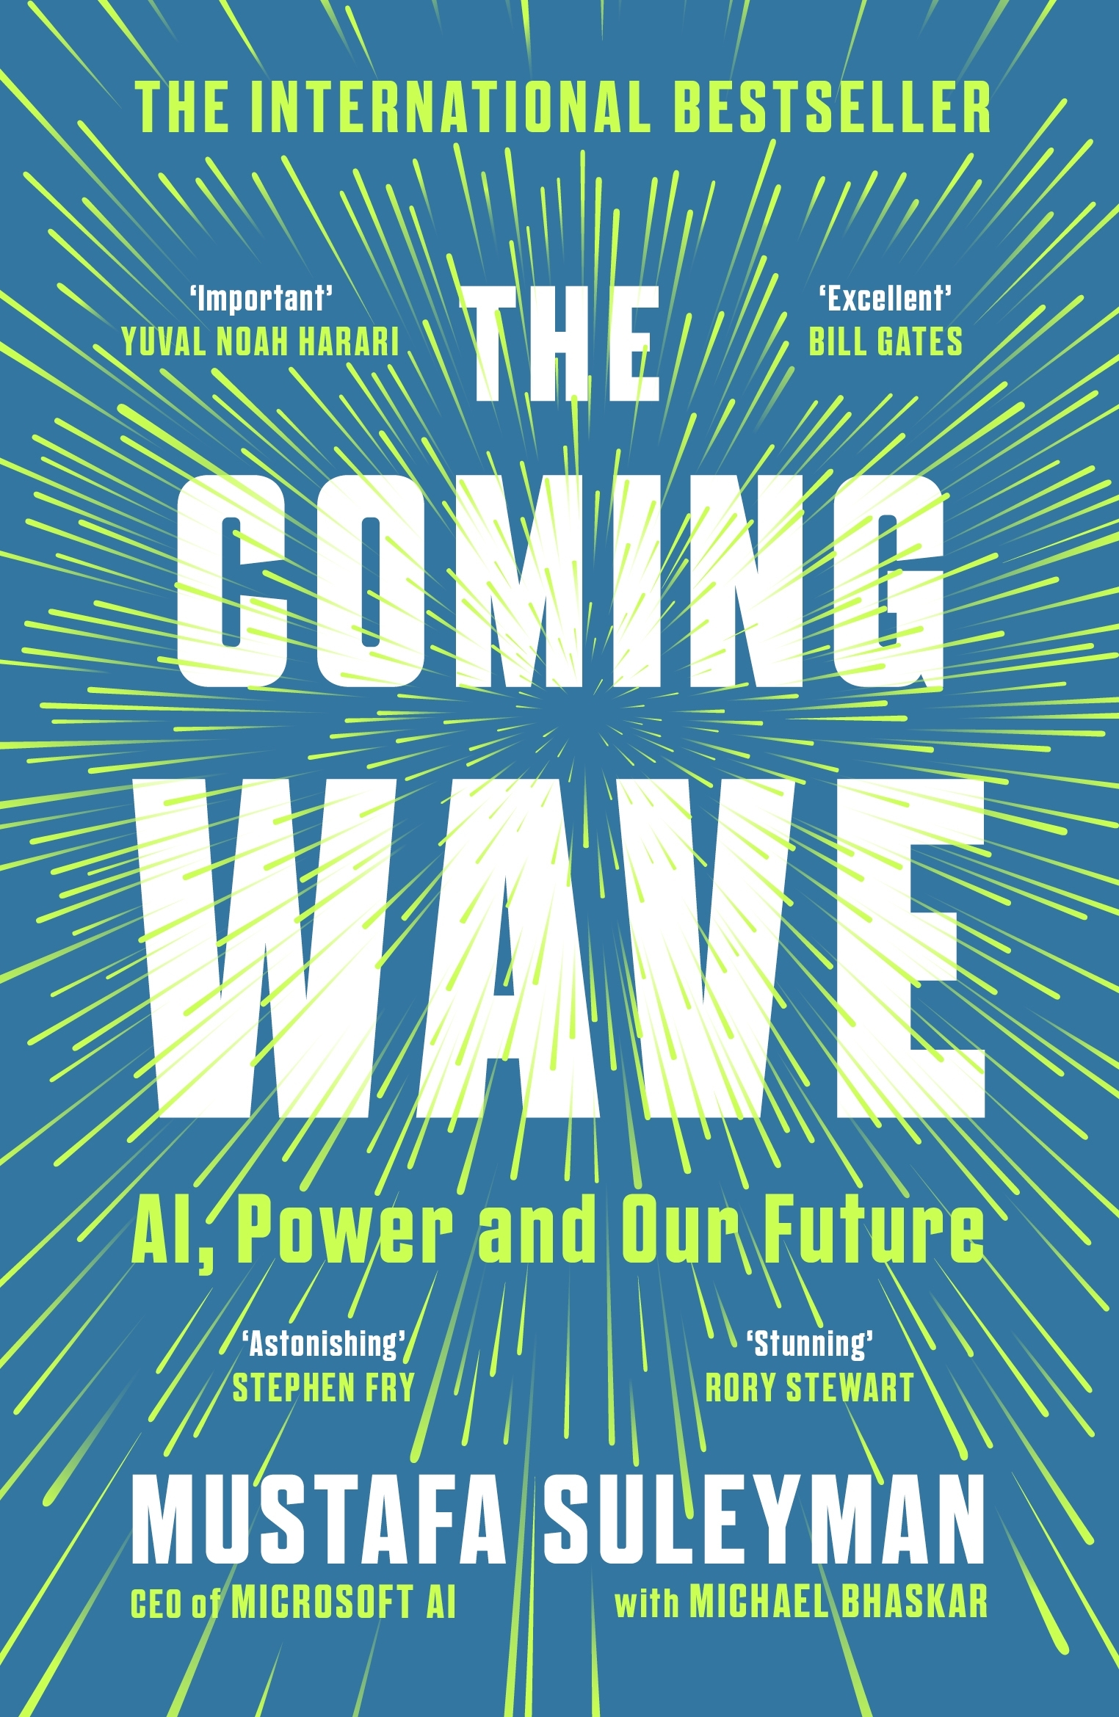
The acceleration of change is fuelled by foundational advances
Rate of advancement
  Advancement is cumulative, compounding and recombinant.
  General purpose or foundational advances:
  Artificial intelligence
  Omics and synthetic biology
Foundational advances
Notes:
The rate of advancement is expected to accelerate, this is driven by multiple factors, but best explained in the book ‘the coming wave’ by Mustafa suleyman, previous of googles deep mind, now working at Microsoft.
He explains there are foundational advancements, or general purpose advancements that accelerate advancements across many domains.
The two main foundational advances identified are:
Artificial intelligence especially in healthcare
Synthetic biology in combination with what medical people refer to omics
Lets talk through these two quickly, but I thoroughly recommend the book.

Slide 4

Artificial intelligence in healthcare: broad impacts
Rate of advancement
  Artificial intelligence + healthcare
  Epistemological advances: how we learn about and understand disease.
  Prevention advances: improved understanding of risk, more precise screening.
  Diagnostic advances: improving diagnostic reliability, opportunistic diagnostics.
  Treatment advances: treatment target and candidate identification.
  Healthcare efficiencies
Foundational advances
AI + healthcare
Notes:
AI is starting to make inroads and looks as if it will impact health care across the following domains:
How we learn about disease and disease knowledge, so called epistemological advances, by enabling things like genome wide association studies and linkage of genotypes, physiological data, behavioural data. The promise is the unlocking understanding of complex multifactorial chronic diseases
Prevention: by the improved understanding of disease, and new preventive technologies (especially screening tests), preventive advancements are expected. An example here is improved screening for cancers and disease via image analysis and even opportunistic screening.
Then there are diagnostics. How disease is accurately diagnosed will change, with diagnostic copilots integrated into clinical record systems and computer vision enhanced reading of radiology images
Then there are treatments: a stunning example of treatment advances are the expected efficiencies in identifying treatment targets by the use of technologies such as alphafold to identiy treatment targets and predict drug interactions, improving drug design
Finally, but quite importantly is improving healthcare efficiency. Some clinical practice software already integrates multi party voice transcription and generative AI to produce summarised clinical notes, freeing up clinicians. Much more is expected here.
The question for the audience is how will these advancements challenge life insurers?
If the understanding of cancer is changed, with new risk factors, preventive measures, diagnostics and treatments identified, how will this impact us. Are life insurers products future proof?
How will these changes impact claim incidence, and information asymmetry.

Slide 5
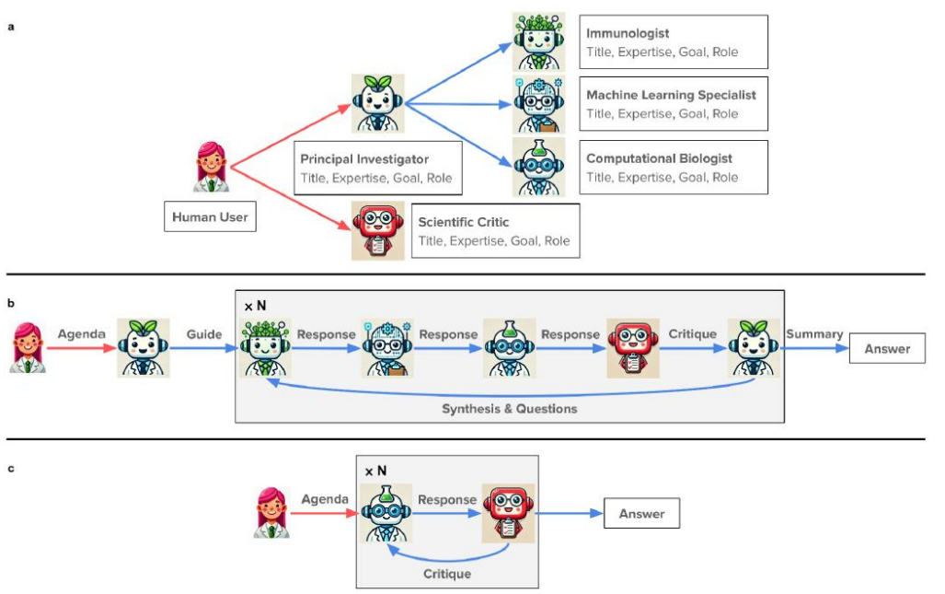
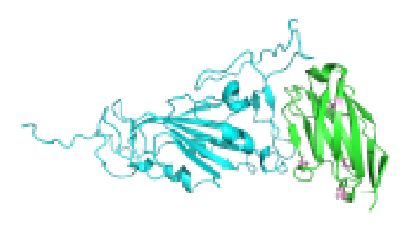
Omics and synthetic biology: just getting started
Rate of advancement
Omics: study, characterisation of biological molecules and how they translate to structure and function of organism.
Synthetic biology: identification, design, and construction of biological molecules or parts.
Examples:
mRNA from COVID19 vaccine, to cancer vaccine, to HIV cure?
CAR-T cell therapy
Combining AI + omics/synthetic biology
Insilico Medicine®
AI Agentic research
Foundational advances
AI + healthcare
Omics + synthetic biology
Notes:
Omics is the study, characterisation of biological molecules (proteins, DNA, RNA etc) and how they translate into structure and function of an organism. Synthetic biology is the field of science that involves the design and construction of new biological molecules, parts or even organisms.
This is a complex field, already impacting treatment. I have already mentioned the example of mRNA molecules being used as vaccines for COVID, and now being studied as cancer vaccines for melanoma, where a persons own tumour has its genome sequenced, then an mRNA vaccine produced to produce a personalised cancer vaccine with promising results showing a improvement in disease progression.
Another example is CAR-T (chimeric antigen receptors) cell therapy, where a persons own immune cells are harvested, T cell receptors are changed to give the T cell a new target specific cancers, again to improve disease progression by giving the T cell the ability to recognise a cancer and destroy it. This is already available in Australia and approved for use in some leukaemias, lymphomas and myeloma. With an expectation of expansion of use cases.
The question for the audience is how will these advancements challenge life insurers?
How do improved cancer treatments impact insurer, are the products future proofed. Think of how terminal illness claims are assessed?

Slide 6
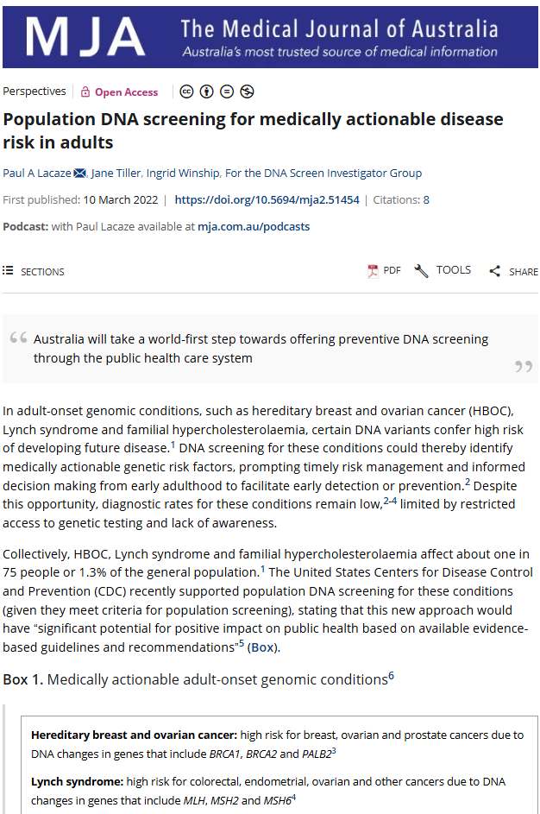
Precision medicine: the promise
Rate of advancement
  Precision medicine (4Ps):
  Personalised
  Precise
  Participatory
  Preventive
  Increasingly decentralised and digital.
  How do insurers adapt?
Reactive
Proactive
Foundational advances
AI + healthcare
Omics + synthetic biology
Precision medicine
Notes:
Lets talk about precision medicine.
This is a field, which combines multiple advancements, and is an attempt to shift medicine away from the historically reactive and very generalised and centralised approach (where people have to get sick, for the disease to be diagnosed and treated, with prevention and treatment advice being quite generic, and managed and controlled centrally via a GP
To an approach with is more proactive, personalised, precise, participatory, and preventive.
Where individuals will have precise information about health risk, personalised risk modification strategies, and participating in their health in a more digital and decentralised manner.
One example of an exciting move in this direction, which will empower more personalised risk assessment in the population being piloted in Australia as a world first is the

Slide 7
How will insurers respond to challenges and opportunities?
Rate of advancement
Staying informed of advances
Foundational advances
AI + healthcare
Product
Pricing
Underwriting
Portfolio Management
Claims
Omics + synthetic biology
Precision medicine
Challenges + opportunities
Notes:
Finally lets wrap up with a summary, and some considerations of actions, its important to note that advancement poses a challenge in itself, but there is a challenge posed by not being ready to take advantage of any opportunities?
Advancement is increasing: how are life insurers staying on top of this? Use of risk / opportunity radars?
How will products need to evolve, stay relevant, and be future proofed?
How will underwriting need to change, especially with the trend towards decentralised health services and information asymmetry.
How will claims management practices need to adapt?

