Slide 1
The Mental Health Safety Net Unifying Australia’s fragmented systems
Insights Session
5 November 2025

Slide 2
Important notice for all participants
This Insights Session is being conducted in accordance with Institute’s Code of Conduct and attended by members in their professional capacity.
It is acknowledged that professional members in their employed capacity, may be active market participants in their respective industries who may compete with each other as defined by competition law.
Participants are, therefore, reminded that in accordance with their competition law compliance obligations they should not:
discuss any matter that may be perceived as being cooperation by competitors in a market to influence that market;
discuss any matters that could be regarded as fixing, maintaining or controlling prices, allocation of customers or territories, coordinating bids and/or restricting output or acquisitions in any circumstances;
share commercially sensitive information relating to their employer; or
share information for an anti-competitive purpose.

Slide 3
Setting the Scene
Lucy Brogden

Slide 4
High-Level Australian Stats
20% of Australians experienced a mental disorder in 2020 to 2022
43% of Australians aged 16 to 85 experienced a mental disorder at some point through life – estimated 8.5 million people
46% of young women experienced a mental health condition in the last 12 months
45% of Australians with a mental disorder saw a health professional for their mental health in 2020 to 2022
25% of Australians delayed mental health care due to cost for psychologists, psychiatrists and other mental health professionals
40% of Australians who presented to hospital emergency with a mental health care were not seen within clinical recommended wait times
Burden of disease has been increasing for all age groups for the last 20 years
3,264 people died by suicide in 2023. Suicide is Australia’s16th leading cause of death
Suicide rate for First Nations people have increased in the last 10 years; and 3 times greater than rate for non-indigenous. Suicide is the leading cause of death amongst First Nations children

Slide 5






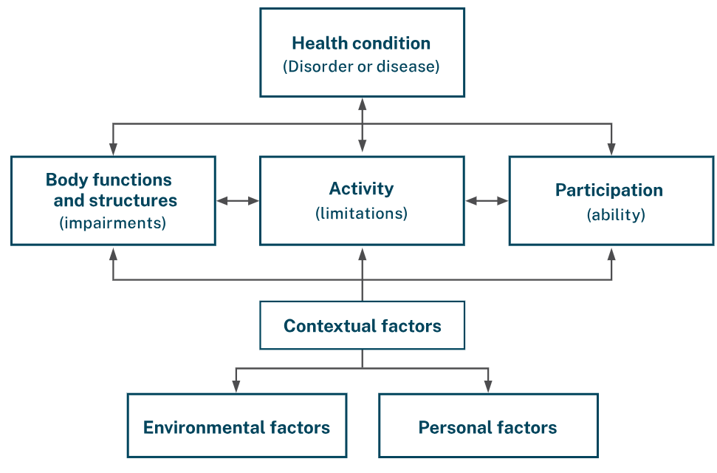






Financial Needs vs Safety Net
How someone’s mental health condition interact with their social environment will determine their ability to function.
Income
Support
Direct Health
Care Costs
Daily Living Supports
Diagnosis
Hospital
& EDs
GPs
Specialists
Meds
Hospital
& EDs
Carers
and Supervision
Support
to Families
Self-care
Daily living skills
Social and recreational activities
Education support
Employment support
Housing assistance
Travel
Respite
Income
Peer Support
Source: World Health Organisation International Classification of Functioning, Disability and Health Framework
slido.com #4689483

Slide 6

Mental Health Care Needs using Stepped Care Model
Engagement
Information
Education
Peer Support
Self-help resources
People are assigned to a level of intensity of care based on their symptoms, severity and functioning
Well population
Lower cost alternatives to face- to-face psychological therapy
Wellness Groups
Family Education
Digital mental health
Digital mental health
Psychological services for those who require them
Medication
Medication
Specialist service types (face to face clinical support)
Wrap-around coordinated care
Multi-agency services support
Medication
Mainly face-to-face clinical services, through primary care and backed by psychiatrist
60%
At risk group (early symptoms, prior illness)
23%
9%
Mild mental
illness
5%
3%
Moderate
Severe
Low intensity illness
High mental illness
slido.com #4689483

Slide 7
Key Safety Net Mechanisms
Immediate and universal access $355m
Universally accessible, often free, and accessible immediately without eligibility requirements.
• Digital mental health services
• Helplines
Low to no-cost clinical services
$3.4b
Low-cost or fully subsidised mental health care.
Accessible through referral processes but relatively easy to access for those in need.
• Headspace
• Kids Hubs
• Community mental health care services
• Medicare Mental Health Centres
• General Practitioners
Subsidised services and financial aids $11.0b
Financial aids (income support) and subsidies to help fund or reduce the cost of mental health care. Stricter eligibility and administrative requirements may apply.
• Pharmaceutical Benefits Scheme (PBS)
• Social Security Programs
• Better Access (a key Medicare initiative that funds clinical services under Mental Health Treatment Plans)
• Medicare services outside Better Access Program
• Commonwealth Psychosocial Support
Targeted and specific supports
$3.8b
Targeted financial aids (income support) and specific supports to help fund or reduce the cost of mental health care. Potentially higher barriers to access (potentially due to assessment or income requirements).
• Private health insurance
• Workers’ compensation insurance
• Life insurance
• Employer initiatives
slido.com #4689483

Slide 8
Key Challenges for Consumers Right Care – Right Time?
Navigation
“A skill many consumers and carers have to learn through trial and error” (Black Dog Institute)
Poor transitions across systems
Lack of interoperability between systems
Little data sharing
Individual’s health worsens
System reliance on high intensity services
Affordability
Access
Health system costs increase
Broader economic impacts
Geography
Cultural safety
CALD, Youth, LGBTQIA+
Workforce shortages
Administrative frictions and delays
Gaps in low to moderate intensity services
Sustainability issues for each funding mechanisms
Significant out-of-pocket costs
Limits and caps on subsidised care
Premium costs
slido.com #4689483

Slide 9
Recommendations
Whole of system priority investment approach
1. Embed a whole-of-system priority investment approach to improve affordability, focusing on:
• identifying duplication, funding gaps and cohorts at risk;
• evaluating equity and financial protection; and
• implementing reforms for integration and sustainability.
Consider as part of Government’s response to the PC’s Review of the National Mental Health agreement
Data Capability and Systems Intelligence
2. Implement a national mental health data strategy to address the immediate affordability challenges:
3. Develop a coverage and outcome framework that models and monitors the cost of failure points in the Mental Health Financial Safety Net - evidence of unmet needs, delayed treatment, underinsurance and preventable hospitalization. The framework would integrate funding streams and treatment pathways, and address socio-economic access barriers across public and private systems.
slido.com #4689483

Slide 10
Recommendations
Affordability relief for at risk groups
4. Provide more effective affordability relief for financially vulnerable groups in each component of the financial safety net, particularly individuals with chronic mental health conditions and frequent psychiatric service use.
4. Provide more effective affordability relief for financially vulnerable groups in each component of the financial safety net, particularly individuals with chronic mental health conditions and frequent psychiatric service use.
Private and public sector coordination
5. Develop a shared, evidence-based framework for assessing mental health conditions across both private and public sector contexts to improve consistency across products and sectors (e.g., DSP, Life Insurance).
5. Develop a shared, evidence-based framework for assessing mental health conditions across both private and public sector contexts to improve consistency across products and sectors (e.g., DSP, Life Insurance).
6. Review the coordination and integration of private and public funding mechanisms. E.g., gaps arising from the funding rules across Medicare, Private Health Insurance and Life Insurance.
6. Review the coordination and integration of private and public funding mechanisms. E.g., gaps arising from the funding rules across Medicare, Private Health Insurance and Life Insurance.
7. Identify opportunities for coordinated investment (e.g., pooled funding) to address gaps in prevention, continuity of care and recovery
7. Identify opportunities for coordinated investment (e.g., pooled funding) to address gaps in prevention, continuity of care and recovery
Product design reform
8. Redesign insurance products and pursue innovations that provide more appropriate and cohesive mental health support.
8. Redesign insurance products and pursue innovations that provide more appropriate and cohesive mental health support.
slido.com #4689483

Slide 11
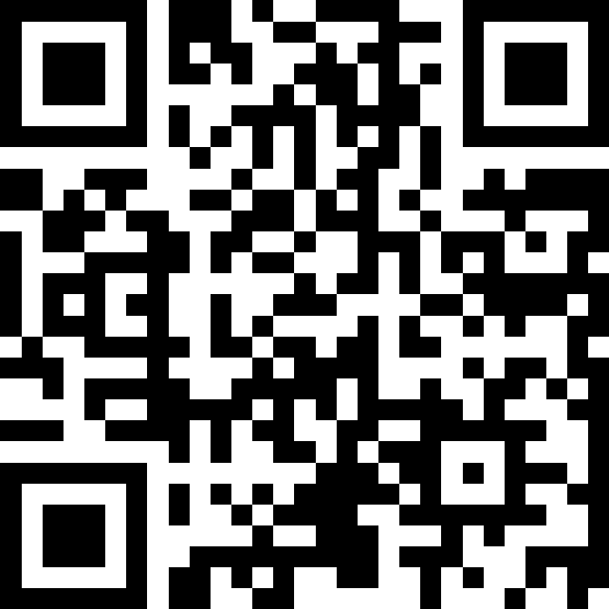
Q&A
Join at slido.com #4689483

Slide 12

The Mental Health Safety Net Unifying Australia’s fragmented systems
Q&A Panel Discussion Join at slido.com #4689483

Slide 13
Feedback Poll

Slide 14
Actuaries Institute
actuaries.asn.au

