Slide 1
Peering Into Peer Review
27 November 2025

Slide 2
Important notice for all participants
This meeting is being conducted in accordance with Institute’s Code of Conduct and attended by members in their professional capacity.
It is acknowledged that professional members in their employed capacity, may be active market participants in their respective industries who may compete with each other as defined by competition law.
Participants are, therefore, reminded that in accordance with their competition law compliance obligations they should not:
  discuss any matter that may be perceived as being cooperation by competitors in a market to influence that market;
  discuss any matters that could be regarded as fixing, maintaining or controlling prices, allocation of customers or territories, coordinating bids and/or restricting output or acquisitions in any circumstances;
  share commercially sensitive information relating to their employer; or
  share information for an anti-competitive purpose.

Slide 3
Agenda:
Welcome
Individual Perspectives
Collective Perspectives
Audience Q&A

Slide 4
Tracy Jiang
Head of Portfolio Pricing
TAL
The Corporate Actuary View

Slide 5
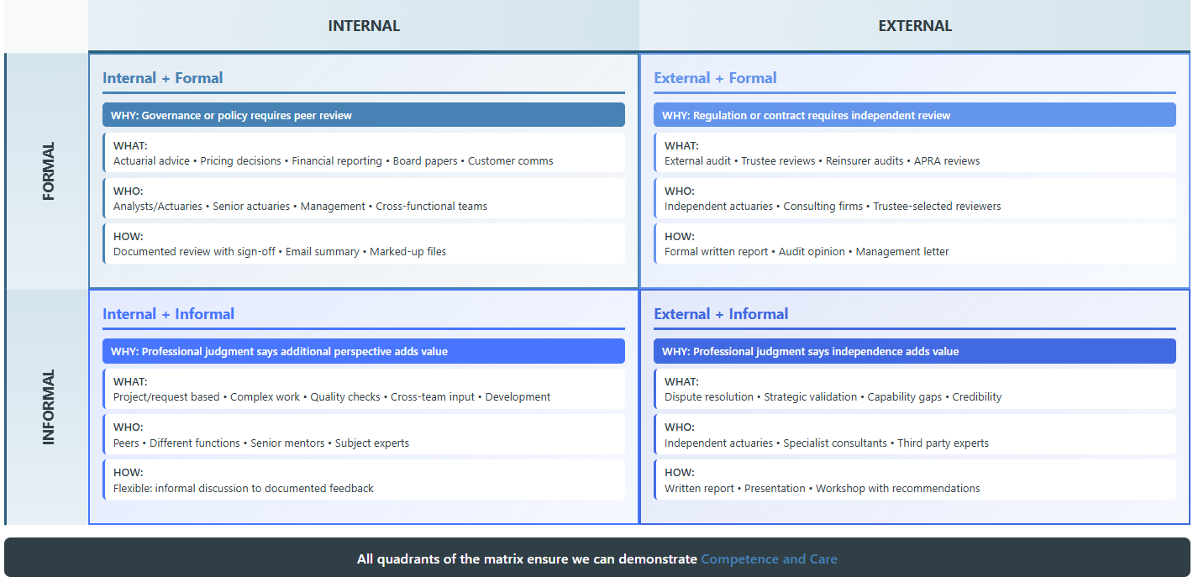
The Peer Review Landscape at a Life Insurer

Slide 6
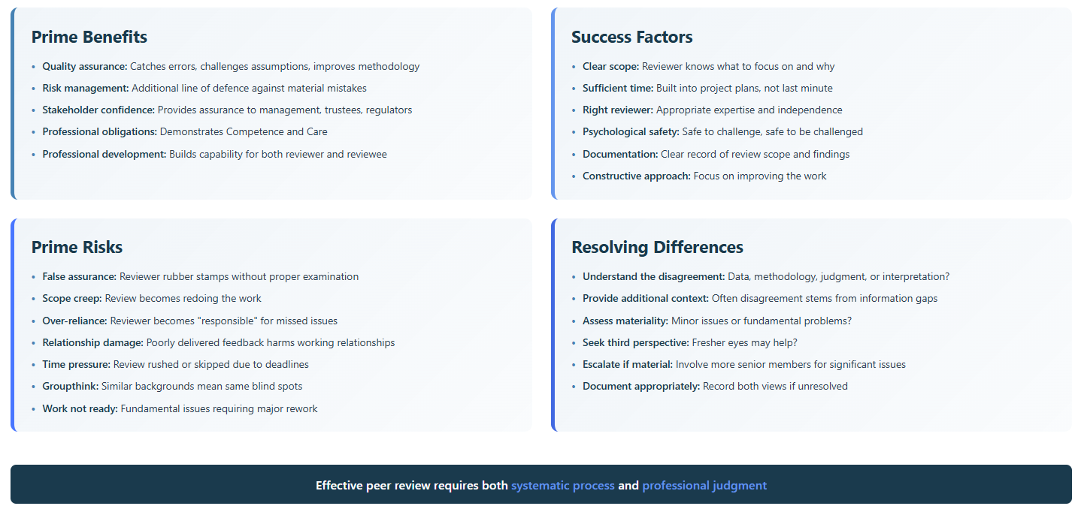
Making Peer Review Work – Benefits, Risks and Resolution

Slide 7
Saffron Sweeney
Chief Actuary
Aon Wealth Solutions
The Consulting Actuary View

Slide 8

A Superannuation Consulting Actuary’s Perspective
Peer review is central to consulting professionalism and client confidence

Slide 9
A Superannuation Consulting Actuary’s Perspective
Peer Review at Aon
Yes (advice) Yes (fresh perspective) No
Who – relevant experience/expertise Who relevant experience/insight Not Applicable
Internal External Generally Internal
Written sign-offs/formal correspondence Verbal feedback/annotated documents

Slide 10
Benefits, Success Factors and Risks of Peer Review
Benefits | Peer Review
Enhancing quality and accuracy | ✔
Supporting professional development and learning | ✔
Meeting community expectations | ✔
Provide reassurance to clients and stakeholders | ✔
Debate judgement calls and reduce bias | ✔
Strengthen resolve when advice is challenged | ✔
Success Factors | Peer Review
Clear understanding of review context and scope | ✔
Appropriate skills and independence of the peer reviewer | ✔
Open communication and willingness to debate differences | ✔
Documentation of assumptions, methods and decisions | ✔
Allowing sufficient time for thorough review | ✔
Risks | Peer Review
Potential conflicts of interest/lack of independence | ✖
Misunderstanding the scope, leading to gaps in review | ✖
Time constraints compromising thoroughness | ✖
Over-reliance on checklists without critical analysis | ✖

Slide 11











How we review at Aon
It is important to plan and allow time for unknowns to pop up
  Do-er starts the work and meet with other team members to check scope and deadlines
Other in between steps
Client Request
  Obtain information, check and ask clarifying questions
  Set assumptions, with Actuary/client etc.
  Checker reviews the work which may be calculations, report etc.
  Checker reviews changes
  Discuss results and potential recommendations with Actuary and possibly client
  Doer corrections/updates after feedback from checker
  Reviewer (Consultant/Actuary) does their review, adds their insights and confirms or otherwise recommendations
  Peer Review – if required can be comprehensive or on a focus area – judgement calls
  Consultant reviews peer review comments, may have a meeting with peer reviewer to discuss
  Deliver Report to Client

Slide 12
Simon Lim
Director
Implementation Actuaries Australia
The Individual Practitioner View

Slide 13
Simon Lim
Purpose
Peer review requirement assessed on a case-by-case
    Engagement complexity
    Expertise
    Consequence
    Contentiousness.
  Scope
    Focus on unknown unknowns
    Opinions and connotations
    Known unknowns are better managed upstream
    Specificity is key.
  Who
    Consulting actuaries (Formal)
    Other actuaries generally (Informal)
    Client
    Other external parties at the client.
Success factors
    Scope
    Reviewer selection
    Timing
    Response.
  Risks
    Reinforcement bias
    Reduced incentive mitigate technical risk
    Noise
    Feedback timing.

Slide 14
Panel Discussion
Collective Perspectives

Slide 15
Audience Discussion
Collective Enquiry

Slide 16

Q&A
Join at slido.com #5711904

Slide 17
Feedback Poll
Join at slido.com #5711904

Slide 18
About the Actuaries Institute
The Actuaries Institute is the peak professional body for Actuaries in Australia. The Institute provides expert comment on public policy issues where there is uncertainty of future financial outcomes.
Actuaries have a reputation for a high level of technical financial expertise and integrity. They apply their analytical and risk management expertise to allocate resources efficiently, identify and mitigate emerging risks and to help maintain system integrity across multiple segments of the financial and other sectors. This unrivalled expertise enables the profession to comment on a wide range of issues including life, general and health insurance, climate change, superannuation and retirement income policy, enterprise risk management and prudential regulation, the digital economy, finance and investment and wider health issues.
© Institute of Actuaries of Australia 2023.​ All rights reserved.

Slide 19
Thank you
Actuaries Institute
actuaries.asn.au

