Slide 1
Financial Advice Reform And Help Guidance And Advice
Actuaries Institute Insights Session
December 1, 2025
Notes:
Good afternoon and welcome.
Motivation behind and proposal for a Help, Guidance and Advice (HGA) Framework to help address the financial advice gap in Australia, where many consumers cannot access or afford full personal advice.
HGA WG was set up under the auspices of the SIPC in February 24, and following extensive research, including stakeholder research in the 2nd quarter of this year, we released our final Discussion Paper in late October.
Whilst Michel Rice and I are presenting today, I would like to also acknowledge the huge efforts of the other WG members – Stephen Huppert (who is attending today online from Melbourne). Melanie Dunn, Giacomo Tarantolo, and Peter Crump – diverse backgrounds which hopefully contributed to a well balanced paper and Aidan Nguyen from the Institute.
Also acknowledge great support from the Institute – especially SIPC, Institute HO, and also PPCC and life Insurance Practice Committee.
This Discussion Paper is just that – it is intended to stimulate debate, outlines thoughts for further pubic policy and regulatory reform to contribute to the financial wellbeing of Australians, and includes ‘call to action’ for different stakeholders, which we will cover later.
This Insights session is anticipated to be a valuable component of that process.

Slide 2
Important notice for all participants
This meeting is being conducted in accordance with Institute’s Code of Conduct and attended by members in their professional capacity.
It is acknowledged that professional members in their employed capacity, may be active market participants in their respective industries who may compete with each other as defined by competition law.
Participants are, therefore, reminded that in accordance with their competition law compliance obligations they should not:
discuss any matter that may be perceived as being cooperation by competitors in a market to influence that market;
discuss any matters that could be regarded as fixing, maintaining or controlling prices, allocation of customers or territories, coordinating bids and/or restricting output or acquisitions in any circumstances;
share commercially sensitive information relating to their employer; or
share information for an anti-competitive purpose.
Notes:
There is an imperative for more Australians to have access to and receive a broad range of support that is fit for their needs and contributes to enhanced financial wellbeing. We identify three broad categories of support: Help, Guidance and Advice, and propose a framework that brings them together.
Policy and regulatory objectives of a comprehensive HGA framework – see slide
We believe the target outcomes of the reform process should include – see Slide
An HGA framework should contribute to positive outcomes in the following areas:
To increase access and affordability to HGA through multiple channels, including financial advisers, superannuation funds, digital and accountants.
To have an HGA framework that increases the capability and capacity for superannuation funds and other entities to deliver HGA, including navigating the tension between superannuation trustee and financial advice obligations.
To support those who do not have a high degree of financial or retirement literacy–for example, through nudges, including targeted prompts, soft defaults, pathways for specific cohorts and choice menus (explained further in Section 4.3).
To have Help and Guidance components recognised in legislation in addition to Advice on a ‘principles’ rather than ‘prescription’ basis (refer to UK developments )
A key concept is the distinction between Advice and Guidance.
Out of scope:
Financial literacy and capability – refer The Big Lift (Iress/Deloitte Access Econ)
Non-financial aspects of Ret planning – important but ,,..refer Ret matters

Slide 3
The Challenge and Target Outcomes
Financial advice gap in Australia (access and affordability)
Imperative: more Australians have access to a broad range of support that fits their needs and contributes to enhanced financial wellbeing.
Policy and regulatory objectives of a comprehensive HGA framework:
Increase access to financial support.
Provide practical solutions to improve consumer financial wellbeing.
Define clear boundaries between Help, Guidance and Advice.
Target outcomes of the reform process should include:
Increased accessibility to financial support services.
Clearer regulatory framework for providing financial guidance.
Enhanced capacity for superannuation funds to support members.
Improved consumer financial wellbeing.
Notes:
There is an imperative for more Australians to have access to and receive a broad range of support that is fit for their needs and contributes to enhanced financial wellbeing. We identify three broad categories of support: Help, Guidance and Advice, and propose a framework that brings them together.
Policy and regulatory objectives of a comprehensive HGA framework – see slide
We believe the target outcomes of the reform process should include – see Slide
An HGA framework should contribute to positive outcomes in the following areas:
To increase access and affordability to HGA through multiple channels, including financial advisers, superannuation funds, digital and accountants.
To have an HGA framework that increases the capability and capacity for superannuation funds and other entities to deliver HGA, including navigating the tension between superannuation trustee and financial advice obligations.
To support those who do not have a high degree of financial or retirement literacy–for example, through nudges, including targeted prompts, soft defaults, pathways for specific cohorts and choice menus (explained further in Section 4.3).
To have Help and Guidance components recognised in legislation in addition to Advice on a ‘principles’ rather than ‘prescription’ basis (refer to UK developments )
A key concept is the distinction between Advice and Guidance.
Out of scope:
Financial literacy and capability – refer The Big Lift (Iress/Deloitte Access Econ)
Non-financial aspects of Ret planning – important but ,,..refer Ret matters

Slide 4



Addressing the gap
DBFO Reforms Critical
Financial advisers remain central
Super funds have pivotal role
Digital solutions enable scale
Essential for Middle Australia
Broader Framework Needed
Help → Guidance → Advice spectrum
Not everyone needs comprehensive advice
Regulation currently too blunt
Match complexity to risk
Guidance Fills Critical Gap
Between information and advice
Currently regulatory grey area
Requires legislative recognition
Resolves trustee dilemma, enables RIC compliance with regulatory certainty
Notes:
DBFO Reforms Critical:
DBFO reforms are potentially as significant as FSR (2004) and FOFA (2013).
They're critical for expanding access to affordable support.
Financial advisers remain at the centre, but super funds and digital tools have essential complementary roles, particularly for Middle Australia, who can't access or afford traditional comprehensive advice.
Broader Framework Needed:
Many consumers don't want or need full, comprehensive advice and its $5,000+ price tag.
They need support ranging from simple Help through to Guidance and various levels of Advice complexity.
Current regulations treat all advice as equally complex - they're a blunt instrument that doesn't recognize the differences in consumer risk between simple and complex situations.
Guidance Fills Critical Gap:
Guidance is the critical piece. It operates in a grey area between Help and Advice - providing direction and factors to consider without making specific recommendations.
The UK Financial Conduct Authority has done excellent work on this with their Advice Guidance Boundary Review, providing a useful pathway for Australia.
But Guidance needs proper legislative recognition and clarity.

Slide 5




Breaking down the challenges
The Advice Gap
The Affordability Problem
The Regulatory Complexity Problem
The Trustee Dilemma
Notes:
The Capacity Challenge
710,000 Australians retiring in next 5 years vs 15,500 advisers
Even if every adviser took 50 new clients, still couldn't serve everyone
Mathematics simply don't work
The Affordability Gap
Comprehensive advice costs $3,500-$7,000
61% of consumers have unmet advice needs
Only 16% saw an adviser in last 12 months
Middle Australia can't access or afford comprehensive advice
Regulatory Complexity
All advice treated as equally complex regardless of actual complexity
Simple interactions carry same burden as comprehensive planning
Guidance operates in regulatory grey zone
Advisers spend time on basic questions that don't need their expertise
The Trustee Dilemma
Regulated entities face a difficult situation - obliged to support members but navigating uncertain regulatory territory
APRA and ASIC's joint RIC oversight found trustees are reluctant to collect member data due to advice concerns
Many trustees taking overly cautious approach, limiting member support
This dilemma is constraining exactly what the RIC was designed to achieve

Slide 6
The Trustee Dilemma
RIC Obligations
Advice Regulations
Identify retirement needs
Build capacity to service
Support members
Monitor cohorts
Trustee
Caught
Between
Complex boundaries
Uncertain grey areas
Regulatory risk
Heavy compliance
RIC Implementation Barriers
Data Collection Barrier
Guidance Barrier
Cohort Strategy Barrier
Monitoring Barrier
Notes:
Superannuation fund trustees face a tension between their obligation to support members (including Retirement Income Covenant requirements to 'identify and recognise broad retirement income needs') and complex financial advice regulations."
Two Forms:
General: Trustees are often caught between the desire to provide comprehensive support to their members and the need to comply with strict advice regulatory requirements and navigate their associated complexities.
Retirement specific: The interaction between the Retirement Income Covenant (RIC) obligations, especially the need to 'identify and recognise the broad retirement income needs of the members of the fund' and an associated response plan, the changes in financial advice regulation arising from the DBFO reforms and the potential constraints of the Members' Best Financial Interests test.
Data Collection Barrier - Can't know retirement needs without data, but collecting data triggers advice concerns
Guidance Barrier - Can't assist members without guidance, but guidance operates in grey zone
Cohort Strategy Barrier - RIC requires cohort approaches, but applying them may be deemed advice
Monitoring Barrier - RIC requires monitoring, but reaching out may trigger advice obligations
Evidence: APRA/ASIC joint review found trustees reluctant to collect data due to advice concerns, taking overly cautious approach
What Remains Post-DBFO:
Guidance still not formally recognised (grey zone persists)
Data access limitations continue
Uncertainty about non-prescribed advice circumstances

Slide 7
Financial Advice Reforms – Evolution and Remaining Challenges
The Reform Journey
Remaining Challenges
2001-2004
FSR
Guidance Recognition
Licensing, disclosure, best interests duty introduced
Targeted prompts are a start, but broader Guidance framework not yet defined. Grey zone persists between Help and Advice.
2012-2013
FOFA
Banned conflicted remuneration, best interests duty for personal advice
Trustee Certainty
Non-prescribed advice circumstances unclear. Data collection for RIC triggers advice concerns. Cohort strategies uncertain.
2018-2019
Royal Commission
Exposed cultural and conduct failures
Regulatory Complexity
2022
Quality of Advice Review
Corporations Act remains "torturous" (ALRC 2023). One-size-fits-all approach regardless of complexity.
2024-2025
DBFO Reforms
Legislative Simplification
Tranche 1 complete, Tranche 2 in progress
ALRC recommendations largely unaddressed. Need for principles-based, risk-proportionate framework.
Notes:
Fifty years ago, financial services was simple. There was a narrow range of products, mainly sold by life companies and tied agents sold Whole of Life and Endowment products.
A decade later, we had many more products, including YRT life insurance, life savings plans and unit trusts. All institutions used dedicated salespeople for distribution.
In the last 30 years, the world became more complex, and some sales practices were poor. Some of you might remember the Trade Practices Commission’s review of life insurance in 1992. It was critical of sales practices and the lack of disclosure - and the start of a period of regulatory change which continues.
The outcome of the last 30 years has been a gradual transformation from an industry using salespeople to flog products to a professional industry working for consumers to develop strategies to meet their financial needs. The agreed strategies can be met through financial products.
FSR was a major step forward by grouping all financial products under a single law. However, it excluded banking products, so advice on buying an investment property is not covered.
You will all be aware of the reform packages since FSR. All are moving in the right direction but we have been bogged down in legalese and not much thought has been put into regulating strategic advice and simple harmless advice. n

Slide 8
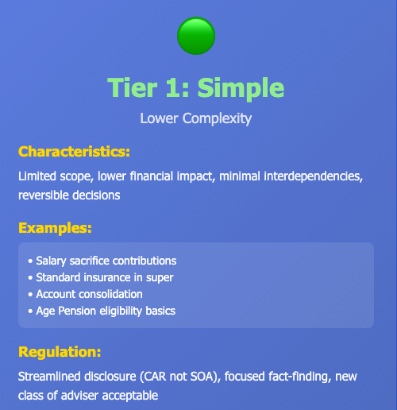
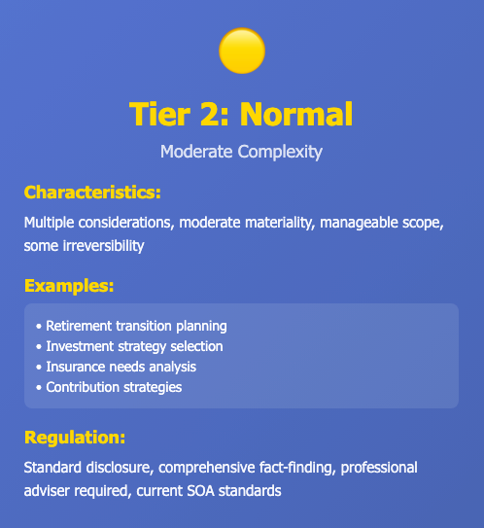
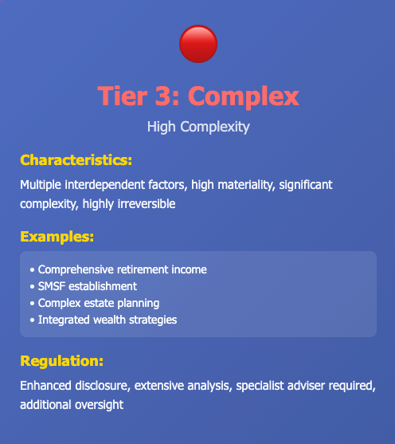
Tiering of Advice
Regulation Proportionate to Complexity and Risk
INCREASING COMPLEXITY→INCREASING REGULATION
Notes:
The law does not differentiate between types of advice. There is a good argument for tiering advice according to the potential risk of harm to a consumer. If the rules were simplified for cases such as those shown in Tier 1, it would allow accountants and superannuation funds to help their clients, as well as cutting the costs for a financial adviser advising in these areas.
Tier 3 is where the main risks lie. New structures are developed continuously in the market, and this opens opportunities for fraud or misconduct. It is right to regulate heavily in this area, but efforts to date have simply made the other Tiers of Advice too expensive for the average consumer.

Slide 9

Discussion/Questions
Scan the QR code or
go to slido.com and
enter code 1357689

Slide 10


Defining Help, Guidance and Advice
HELP
GUIDANCE
ADVICE
How do I do something?
What should I consider?
Recommended actions
The central proposal is a tiered approach to support, categorised as:
Help: Basic assistance with processes and (factual) information, not considering personal circumstances.
Guidance: Suggestions or pathways based on general circumstances, without specific recommendations.
Advice: Personalised recommendations based on a detailed analysis of individual financial circumstances, goals and risk tolerance.
Notes:
The Core Concept
The framework creates clear categories with proportionate regulation
Each tier serves different needs, has appropriate safeguards
Creates natural progression and referral pathways
HELP: "How do I do something?"
Basic factual information, tools, calculators
No personalisation, minimal regulation
GUIDANCE: "What should I consider?"
Suggestions/nudges based on general circumstances
Stops short of personal recommendations
Defined boundaries but not full advice regulation
ADVICE: "What should I do?"
Personalised recommendations based on full situation analysis
Only provided by qualified financial advisers
Three complexity levels: Simple (low risk), Normal (medium risk), Complex (high risk)
Full professional standards and protections
How They Work Together
Natural progression: Help → Guidance → Advice
Each tier has appropriate regulation matched to risk
Creates referral pathway to advisers as complexity increases
Guidance in the grey zone
Help is straightforward - already well-understood by industry and regulators. Low risk, no personalisation, focused on factual accuracy. Existing practices largely work here
Advice remains the domain of qualified financial advisers. Framework actually strengthens this by clearer differentiation.
Guidance is the critical missing piece - where most Australians need support. Guidance provides direction without making personal recommendations. Think of it as 'here are factors to consider' not 'you should do this.
For APRA: This is what would enable RIC compliance without the advice regulatory burden
Needs legislative recognition with principles-based, light-touch regulation

Slide 11
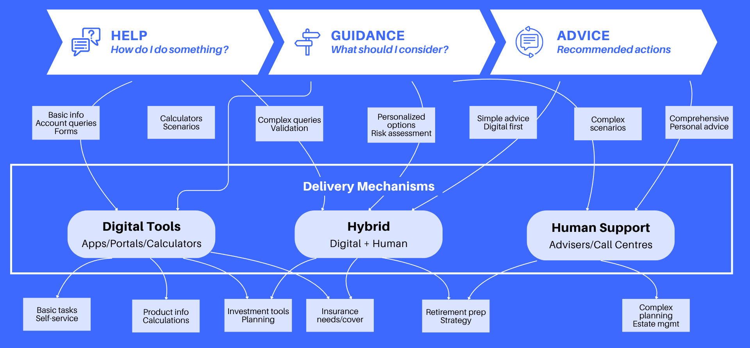
The HGA Framework
Notes:
Almost all consumers are financially illiterate when it comes to making important decisions. They are confused by:
the complexity of our industry,
the jargon which is foreign to most people, and
the heavy documentation supporting a decision to implement their strategy.
We can provide HELP by explaining concepts and showing people where to learn more about the subject – for example, ASIC’s MoneySmart site. For some young people, we will have to explain that they should be wary of things they see on Social Media as this is not always helpful.
The HELP phase will include matters such as budgeting, so you generate savings which can then invested. It could show how you calculate how much life insurance you need. It can help you decide how to prioritise your financial goals. If you are renting and want to buy a house, saving the deposit will usually be your immediate goal.
Guidance is essentially the steps to build a personal strategic plan. It covers personal or family financial requirements for life insurance, superannuation and personal investments.
Advice will provide a plan to implement the strategies, allowing for the client’s capacity to purchase everything needed.

Slide 12


What Does Guidance Look Like in Practice?
Targeted Prompts/Nudges
Cohorting
Age-based, balance-based, life-event triggers
Example: "Approaching 67 - consider Age Pension eligibility factors"
Grouping members with similar characteristics
Tailored pathways for different cohorts
Example: "Members 55-60 with $200-400k - retirement timing pathway”
Soft Defaults
Risk Assessment Tools
Presumed choices based on best practice (can opt out)
Example: "Insurance set to recommended level for your age/balance"
Interactive tools assessing situation, flag when complexity requires advice
Example: "Retirement readiness tool showing factors relevant to YOUR situation"
What All Guidance Has in Common:
DOES use member data to tailor
DOES provide relevant factors
Does NOT make recommendations
Notes:
Discussion Prompt: "Which of these do you see as highest priority? Where's the biggest regulatory uncertainty for superannuation funds?“
Superannuation fund members will take comfort in knowing that people in similar circumstances are using the same strategy.

Slide 13
DBFO Tranche 2A
What it does well (with a couple of caveats):
Advice through Superannuation
Targeted Superannuation Prompts
Client Advice Records
What's Still Missing:
DBFO 2b
Guidance Recognition
Trustee Certainty
Data Access
Implementation Details
Notes:
Overall Assessment - Significant Progress
The DBFO reforms represent potentially the most significant advice reforms since FSR and FOFA. As a package, they are very good proposals that should enable significant expansion of advice availability and affordability.
Some caveats:
Advice through super - concerned that despite the intent of the legislation to provide flexibility for trustees to identify additional circumstances where advice would meet the requirements for collective charging, even if not prescribed by the regulations, this may continue the so-called 'Trustee Dilemma' where trustees are caught between the desire to provide advice to members, and the need to comply with and navigate the legislative requirements, especially advice obligations. – need ASIC General Relief arrangements
Targeted prompts – stop short of hard recommendations or statements of opinion (because haven’t considered member’s personal circumstances)
What Still Needs Work
DBFO 2b (NCA and principles based Best Interest Duty)
Guidance Recognition
DBFO relatively silent on Guidance as its own category
Needs fuller legislative recognition
Would provide certainty for funds and clarity for advisers
Trustee Certainty
Some uncertainties remain about permissible advice circumstances
Need clear pathways for guidance vs advice
Data Access
Trustees need broader member information access
Currently constrained by privacy and advice regulation concerns
Will It Be Effective?
Yes, if:
Implementation maintains clarity
ASIC/APRA provide helpful guidance
Industry embraces spirit, not just minimum compliance
Continued refinement based on real-world experience
Risks:
Overly cautious implementation despite clearer rules
Insufficient Guidance recognition
Industry resistance to change

Slide 14
Member Outcomes - The Test
Current State:
With HGA Framework
Most members get nothing beyond basic info
Critical retirement decisions made without support
$100k-$500k members: too small for advice economics, too large for poor decisions not to matter
Disengaged members default into suboptimal outcomes
Help: Basic questions answered
Guidance: Direction at critical moments (pension eligibility, timing, contributions)
Advice: Complex situations get professional support
Better informed members, improved financial wellbeing
Focus on Retirement Cohort:
710,000 retirees in next 5 years (first wave of demographic shift)
Need scalable solutions, not just more advisers
Framework enables RIC compliance with member support at scale
Connection to APRA Framework:
SPS 515:
Direct improvement in retirement outcomes assessment
RIC Compliance:
Framework enables trustees to identify needs and assist members
Best Financial Interests
Graduated support IS in members' interests
Notes:
Discussion Prompt: "How would you measure success? What outcomes data would you want to see? Is this framework better for member outcomes or does it create more risk?"

Slide 15
Retirement Journey - Detailed Member Outcomes
Pre-Retirement
5 years out
At Retirement
The Critical Moment
In Retirement
Ongoing Years
Without HGA
Member unaware of options, no planning, reactive approach. Misses contribution opportunities and Age Pension optimization
Without HGA
Default decisions, suboptimal pension setup. Takes minimum drawdown without considering tax, Age Pension, or longevity risk.
Without HGA
Set-and-forget approach, no adjustments. Potentially running out of money or underspending and missing quality of life.
With HGA
Targeted prompts about Age Pension eligibility
Guidance on contribution strategies
Early planning for retirement date
Outcome: Better prepared, maximised benefits
With HGA
Guidance on account-based pension considerations
Understanding of drawdown options
Referral to adviser if complex situation
Outcome: Appropriate retirement income structure
With HGA
Ongoing monitoring and prompts
Guidance on Age Pension changes
Advice when circumstances change
Outcome: Sustainable income, better quality of life
Notes:
Connection to APRA's Prudential Framework
Sole Purpose Test
HGA supports sole purpose (retirement benefits) by improving outcomes
Best Financial Interests
Graduated support IS in members' best financial interests
RIC Compliance
Framework enables trustees to identify needs and assist members
SPS 515 Outcomes Assessment: Direct improvement in retirement cohort outcomes - members better prepared, better supported, better

Slide 16
Discussion/Questions
Scan the QR code or
go to slido.com and
enter code 1357689

Slide 17
Roadmap for implementation
Timeframe | Focus | Key Actions
Short-term (0-12 months) | DBFO Implementation | Pass legislation, provide regulatory guidance, establish trustee certainty
Medium-term (1-3 years) | Framework Refinement | Recognise Guidance, enable data access, implement tiered approach, monitor effectiveness
Longer-term (3-5+ years) | Structural Reform | Simplify legislation, principles-based regulation, cross-system integration
Notes:
CRITICAL PATH
The recommendations build on each other:
First: DBFO creates foundation for expanded advice provision
Then: Guidance recognition fills the critical gap between Help and Advice
Next: Risk-based tiering makes the whole system economically sustainable
Finally: Fundamental legislative reform creates enduring, coherent framework
Without short-term action, medium-term improvements are impossible. Without medium-term refinement, long-term reform lacks practical foundation.

Slide 18




Implementation success factors
Clear Regulation
Industry Commitment
Consumer Understanding
Collaborative Oversight
Notes:
CLEAR REGULATION
Clear regulation doesn't mean prescriptive regulation. It means trustees understand the boundaries - where Help ends, where Guidance begins,- Right now, those boundaries are fuzzy, which creates paralysis.
Regulatory guidance post-DBFO will be critical. Not just 'what the law says' but 'what this looks like in practice.'
Trustees need safe harbours - scenarios where they know they're clearly in Help or Guidance territory.
2. INDUSTRY COMMITMENT
Industry commitment looks like: funds building hybrid digital/human models, training member service teams on Guidance boundaries, developing cohort strategies, investing in data infrastructure. Real clarity on member outcomes, and assessing impact. Not just ticking boxes.
As an example, for the retirement segment, the 2025 APRA-ASIC Retirement Pulse Check, released just last week, highlights key issues for industry to address.
3. CONSUMER UNDERSTANDING
Members need to understand what they're getting - and what they're NOT getting. If someone receives Guidance and thinks it's personal advice, that's a problem. If they don't understand they should see an adviser for complex situations, that's a problem.
There's also a broader financial literacy piece. Members who understand the difference between information, guidance, and advice are better equipped to navigate the system. Industry bodies, funds, consumer groups all have roles here.
4. COLLABORATIVE OVERSIGHT
Collaborative oversight means: joint guidance on RIC/advice intersection, aligned enforcement approach, coordinated messaging. When a trustee asks 'can I do this?', APRA and ASIC should give consistent answers.
Your joint RIC review was good - but it identified problems without fully resolving them. Trustees are still reluctant to collect data, still cautious about member engagement. The findings need to translate into clearer guardrails."

Slide 19
The framework's success depends on coordinated action across multiple stakeholders
Government and regulators
Superannuation funds and other financial institutions
Financial advisers
Technology providers
Industry bodies
Notes:
Government and regulators: Finalise DBFO legislation with clearer Guidance recognition and streamlined advice definitions.
Superannuation funds and other financial institutions: Develop comprehensive HGA strategies utilising the expanded regulatory permissions.
Financial advisers: Embrace tiered service models that leverage Help and Guidance to extend their reach.
Technology providers: Invest in digital tools that enable scalable, hybrid delivery models.
Industry bodies: Support member education and promote best-practice HGA implementation.
The HGA framework offers a pathway to addressing Australia's advice gap by creating a graduated, consumer-centric model of support. By better matching service levels to consumer needs, it balances accessibility, affordability and protection. The framework has the potential to reshape financial engagement in Australia, enabling millions more Australians to receive timely, appropriate support.

Slide 20
What can the profession do?
Key question: to what extent are further progressive HGA developments dependent on public policy and regulatory reforms, or can the FS sector still make major positive strides in the absence of further reforms post DBFO?
  Individual Actuaries?
  The Actuaries Institute?
Notes:
Discussion Prompt: to what extent are further progressive HGA developments dependent on public policy and regulatory reforms, or can the FS sector still make major positive strides in the absence of further reforms post DBFO?
Enable, don't constrain - guidance that empowers trustees
Coordinate on RIC and advice intersection
Balanced messaging: consumer protection AND access
2. Guidance on Guidance
Publish clear examples of permissible Guidance
Principles-based approach, not prescriptive rules
Safe space for trustees to experiment within boundaries
3. Medium-Term Priority: Establish Advice Guidance Boundary Review
Joint APRA/ASIC/Treasury sponsorship
Formal review modeled on UK FCA approach
Australian-specific framework building on UK learnings
Timeline: Commence 2026, 12-18 month process
4. Support Data Access & Monitor Outcomes
Enable broader member information access with safeguards
SPS 515 outcomes should include retirement transition success
Be willing to refine based on real-world experience

Slide 21
What can the profession do?
To what extent are progressive HGA developments dependent on regulatory reforms, or can the FS sector make major strides in the absence of further reforms post-DBFO?
Individual Actuaries
In current roles:
Champion HGA thinking in your organisations
Implement what's possible now: Help frameworks, pilot Guidance, build cohort strategies
Use actuarial skills: Model outcomes, quantify value, develop risk frameworks
Document/share: Case studies, barriers, evidence of improvement
As Advisers to Trustees:
Advocate for investment in HGA capabilities (not just compliance)
Educate boards on trustee dilemma and HGA solutions
Design graduated support models within current boundaries
In Policy Roles:
Provide technical input on advice guidance boundary
Share actuarial evidence on outcomes and risks
Actuaries Institute
Immediate (0-12 months):
Advocate for DBFO completion and trustee certainty
Build evidence base: Commission research, gather case studies
Education: CPD sessions, insights forums, media engagement
Coalition building: e.g. with FAAA, super funds, consumer groups
Medium-term (1-3 years):
Champion Advice Guidance Boundary Review (joint ASIC/APRA/Treasury)
Develop professional standards for Guidance delivery
Support new class of adviser education and pathways
Longer-term (3-5+ years):
Support legislative simplification (ALRC recommendations)
Evolve professional standards: Retirement income as core actuarial domain
Build actuarial role as HGA design experts
Notes:
Discussion Prompt: to what extent are further progressive HGA developments dependent on public policy and regulatory reforms, or can the FS sector still make major positive strides in the absence of further reforms post DBFO?
AND access
2. Guidance on Guidance
Publish clear examples of permissible Guidance
Principles-based approach, not prescriptive rules
Safe space for trustees to experiment within boundaries
3. Medium-Term Priority: Establish Advice Guidance Boundary Review
Joint APRA/ASIC/Treasury sponsorship
Formal review modeled on UK FCA approach
Australian-specific framework building on UK learnings
Timeline: Commence 2026, 12-18 month process
4. Support Data Access & Monitor Outcomes
Enable broader member information access with safeguards
SPS 515 outcomes should include retirement transition success
Be willing to refine based on real-world experience

Slide 22
Discussion/Questions
Scan the QR code or
go to slido.com and
enter code 1357689

Slide 23
Feedback Survey
Scan the QR code or
go to slido.com and
enter code 1357689

Slide 24
Thank you
Actuaries Institute
actuaries.asn.au
Notes:
KEY MESSAGES
The HGA framework creates clear tiers of financial support - Help, Guidance, and Advice - with regulation proportionate to complexity, so millions more Australians can access appropriate support while maintaining quality and positioning advisers as the expert tier for complex work.
Framework creates opportunity, not threat - Clearer boundaries, tiered services, expert positioning
Multiple pathways needed - 710,000 retirees, not everyone needs or can afford comprehensive advice
Regulation proportionate to complexity - Simple stuff shouldn't carry comprehensive burden
DBFO is progress but needs refinement - Client Advice Records are wins, Guidance needs recognition
It's an ecosystem - Help, Guidance, Advice serve different needs and complement each other

