Slide 1
Guidance for AI Adoption
Actuaries Institute
3 Feb 2026

Slide 2
Important notice for all participants
This Insights Session is being conducted in accordance with Institute’s Code of Conduct and attended by members in their professional capacity.
It is acknowledged that professional members in their employed capacity, may be active market participants in their respective industries who may compete with each other as defined by competition law.
Participants are, therefore, reminded that in accordance with their competition law compliance obligations they should not:
discuss any matter that may be perceived as being cooperation by competitors in a market to influence that market;
discuss any matters that could be regarded as fixing, maintaining or controlling prices, allocation of customers or territories, coordinating bids and/or restricting output or acquisitions in any circumstances;
share commercially sensitive information relating to their employer; or
share information for an anti-competitive purpose.

Slide 3

Q&A
Join at slido.com #3584469

Slide 4
National AI Centre (NAIC)
OUR VISION:
A prosperous and productive AI-powered future that improves the lives of Australians.
OUR MISSION:
Unlock the positive potential of AI by supporting industry to secure AI opportunities and grow economic productivity.
Confidence | Clarity | Capability

Slide 5
Transition from the Voluntary AI Safety Standard to Guidance from AI Adoption
NAIC received extensive feedback throughout 2024–25, as part of consultation extending VAISS practices to developers, including:
  Industry professionals more advanced in AI adoption, and technical experts from a wide range of organisations, valued the VAISS as a useful framework to compare and guide practices and procedures.
  Most industry stakeholders were seeking more accessible, actionable and streamlined guidance which can be tailored to both technical and non‑technical audiences, particularly SMEs.
  Specific additional guidance was requested on procuring AI systems as well as transparency mechanisms for AI‑generated content, such as watermarking.
Notes:
In this update, we have:
condensed 10 guardrails into 6 essential practices
removed redundant language
expanded our audience to developers as well as deployers.

Slide 6
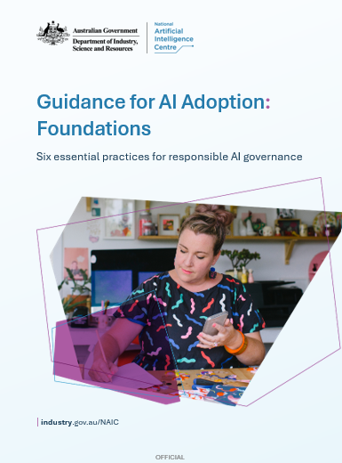
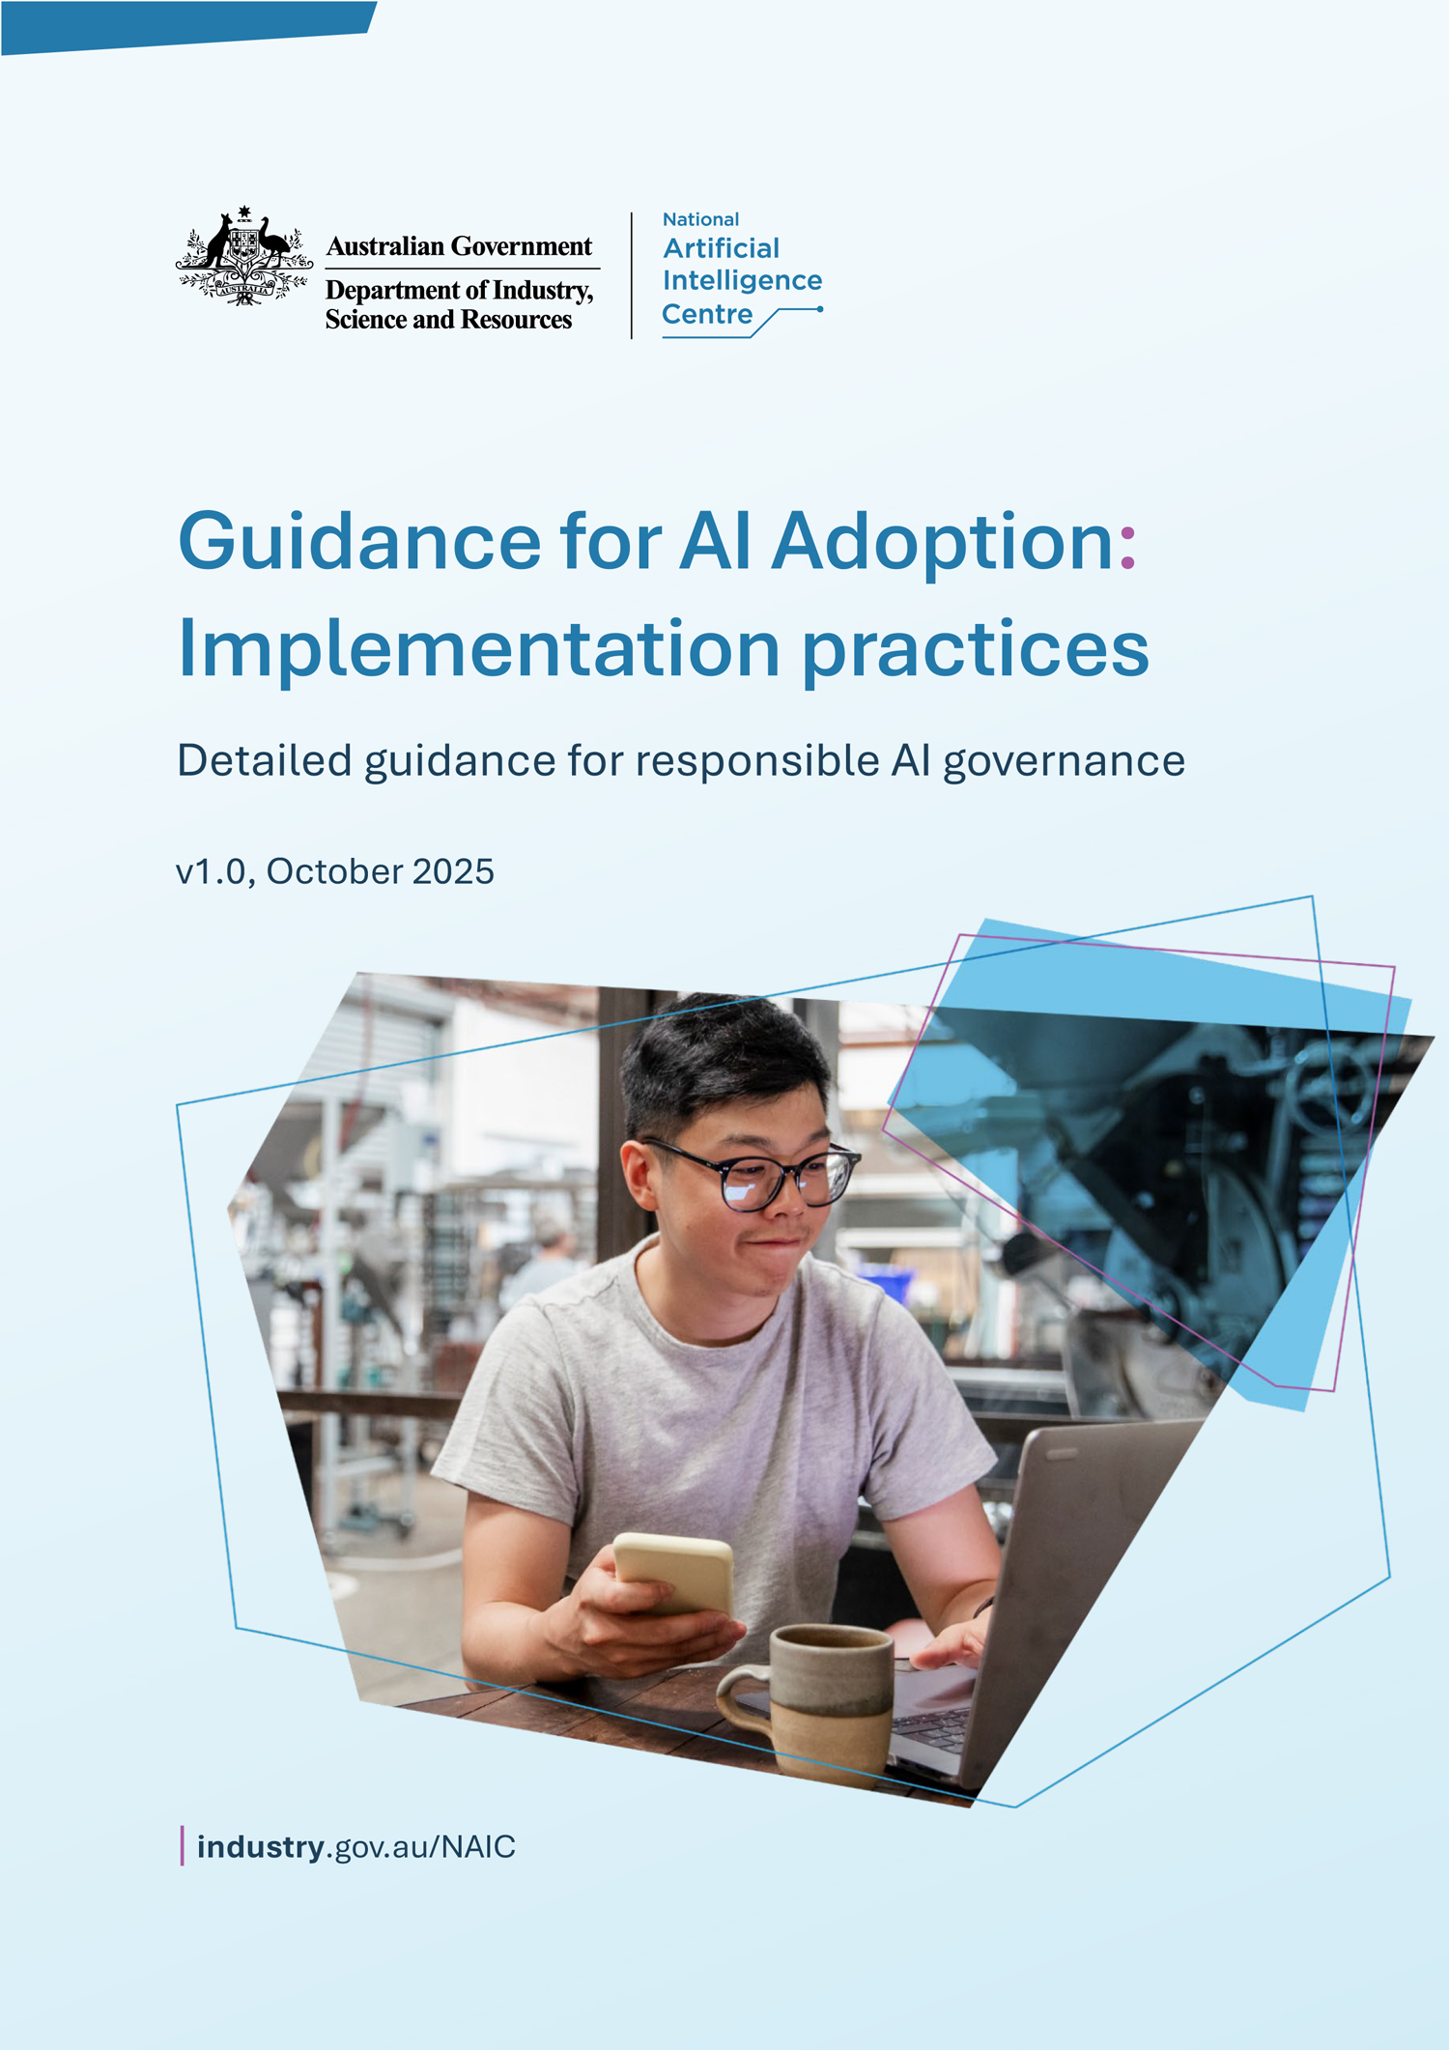
Guidance for AI Adoption
Notes:
Two versions meeting people where they are at.
Overall approach has been human-centred with a focus on:
Protecting people
Upholding diversity, inclusion and fairness
Prioritising people with human-centred design
Developing trustworthy AI systems to build social licence – this focus on the actions of developers was an extension from the VAISS

Slide 7
AI6 – 6 essential practices
Decide who is accountable
Understand impacts, and plan accordingly
Measure and manage risk
Share essential information
Test and monitor
Maintain human control

Slide 8


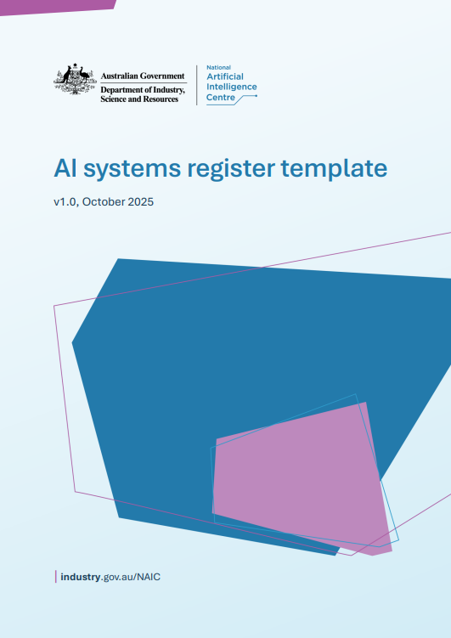
Additional Resources – Editable Templates

Slide 9




Decide who is accountable
1.1 Accountable people Safe and responsible practices & procedures Development and deployment of every AI system Oversight of third-party systems Testing Oversight of challenges, concerns and redress Performance and continual improvement | 1.3 AI literacy and training Deliver training to establish broad understanding of AI and culture of accountability. Deliver targeted training for people responsible for: legal and regulatory obligations; personally identifiable information; operation, control, intervention or termination of each system; oversight and monitoring; procurement of third-party systems; safe and responsible development of AI systems (DEV).
1.2 Supply chain accountabilities Ensure shared responsibility across supply chain for: monitoring system performance; human oversight & intervention; processes to raise problems. Document accountabilities to downstream organisations. Includes transparency of model and system risks, expected behaviours and contractual obligations (DEV). | 1.4 AI governance framework Policies, processes and overall management system which covers: Strategic AI intent Relevant regulations Safe and responsible use of AI Identification of problems or system noncompliance

Slide 10
Experiences and lessons: Accountability
What steps are organisations taking to assign and embed accountability for AI across the business?
What are some of the main challenges people are having with this aspect of AI governance?

Slide 11



Understand impacts and plan accordingly
2.1 Understand and engage stakeholders Identify and document key types of stakeholders that might be impacted by your AI use For each AI system – identify benefits and harms to: vulnerable groups; unwanted bias & discrimination; use of personal info; where decisions are made about people. Where risks are identified, conduct stakeholder impact assessment with ongoing monitoring and feedback. | 2.3 Monitor for systemic issues Monitor contestability and redress processes to identify systemic risks and improve their effectiveness. Review and evaluate stakeholder contests of AI system use regularly.
2.2 Establish feedback and redress processes Ensure stakeholders are able to raise concerns, request remediation or receive responses. Communicate inclusively and meet accessibility requirements. Implement mechanisms to enable contestability of each AI system as well as ways to share information about end user contests with deployers (DEV). Ensure those that can review stakeholder feedback can trigger redress and recourse where required.

Slide 12
Experiences and lessons: Stakeholder impact
Biggest hurdles to stakeholder engagement and impact assessment?
What additional resources might assist?

Slide 13



Measure and manage risks
3.1 Establish fit-for-purpose risk management framework Implement a risk management framework that deals to risks of AI systems, including third party and supply chain risks. Establish org risk tolerance and criteria to determine unacceptable risks of AI system development or use. Implement AI impact assessment, risk assessment and risk treatment processes. Explicitly document use cases outside organisational tolerance. | 3.3 Implement controls for AI systems Research and implement leading practices in safety measures as safeguards (DEV) Implement and clearly communicate risk treatment plan including controls to mitigate defined risks Implement deployment plan including response, recovery and communication for realization of residual risks.
3.2 Assess AI system risks Establish a triage system to determine which systems pose an unacceptable risk Conduct risk assessment for each AI system which includes: potential severity and likelihood of harms to stakeholders; legal commercial and reputational risks; data governance risks; systemic analysis using risk models to identify risk sources; | 3.4 Monitor and report incidents Track and report series incidents and corrective measures to stakeholders (regulators & public) having regard to privacy and cyber risks Fulfil reporting and disclosure obligations such as those under the Online Safety Act and data breach reporting requirements and liabilities, e.g. OAIC. Maintain developer – deployer communication. Regularly monitor & evaluate risk assessment, plans and the risk management system.

Slide 14
Experiences and lessons: Measuring and managing risk
How confident are you in your organisation’s risk management system to identify and address AI risks? 1-10
Why? What are the biggest roadblocks?

Slide 15



Share essential information
4.1 Maintain an AI register Create and maintain an inventory of each AI model and system with key info such as: accountable people; purpose and goals; capabilities and limitations; origin; acceptance criteria and test results; impact and risk assessments and risk treatment plans; audit requirements & outcomes; review dates. | 4.3 Supply chain transparency Document & request upstream AI system technical details required to meet organisational or stakeholder needs. Includ Developers should share as much info as possible with deployers about: technical details, data, components and characteristics; test methods, use cases and testing results; known limitations, risks and mitigations…cont Deployers should share with developers issues, faults, failures, incidents, risks and unwanted bias.
4.2 AI system transparency and explainability Transparently communicate when and how AI will be developed, deployed and used – including capabilities and limitations of relevant AI systems. Have regard to accessibility needs of stakeholders. Choose interpretable & explainable systems. Provide reasonably interpretable & explainable systems to ensure downstream providers can meet obligations (DEV). | 4.4 AI-generated content transparency Implement fit-for-purpose transparency mechanisms as per Being Clear About AI Generated content guidance.

Slide 16
Experiences and lessons: Sharing essential info
What transparency measures is your organisation progressing as priority?
Internal – org level
Internal – system level
External – customer facing
External – supply chain

Slide 17
Test and monitor
5.1 Pre-deployment testing Review, approve and document testing methodologies and results. Monitor performance, user feedback and operational impacts post-deployment. Define clear test criteria & methodologies that reflect intended use and potential risks. Ensure testing and results conducted upstream meet your acceptance criteria. Secure authorisation to deploy from accountable person in line with test results. | 5.3 Conduct additional testing proportionate to risk Conduct safety evaluations that scale with model risk (e.g for GPAI - cyber, prompt manipulation, jailbreaking) For systems with high risks (e.g. GPAI) conduct independent and thorough reviews of testing methodologies and results. Determine which systems require auditing based on the risks they pose. Conduct audits.
5.2 Establish feedback and redress processes Establish monitoring systems for each AI system to track KPIs Map business targets to AI system performance metrics Document the response processes to address foreseeable harms Establish regular performance review cycles including stakeholders | 5.4 Implement robust data and cybersecurity measures Implement and evaluate the effectiveness of policies and procedures which address data governance, privacy and cyber security having regard to key regulations. For each AI use case: determine data quality, provenance and preparation required; document and manage key data sources for operation and training including personal or sensitive info; establish processes to protect against cyber and privacy risks; document data usage rights; monitor for data leakage.

Slide 18
Experiences and lessons: Test and monitor
What resources would support effective system testing?
What are the greatest data governance challenges right now?

Slide 19
Maintain human control
6.1 Maintain human oversight and control Maintain operational accountability, capability and human oversight over the AI lifecycle. Enable human control and intervention during the operation of the AI system - especially mechanisms to address systemic risks such as capability evaluation; training; pause; independent oversight; dynamic guardrails and system access controls (DEV). Ensure those overseeing AI systems are trained to understand system capabilities, limitations and failure modes and when intervention is required. | 6.2 Decommission when appropriate Establish the criteria for when a system should be decommissioned. Appoint the appropriate person to oversee the decommissioning process. Determine if the system is essential to critical infrastructure or service delivery. Assess the risks of shutdown, develop a treatment plan to address known risks, determine how to extract data for the return or deletion of assets. Determine the process to communicate to stakeholders the decommissioning, open channels for feedback or support. Determine and maintain alternate pathways to support critical functions where required, if the AI system is taken offline.

Slide 20
Experiences and lessons: Maintain human control
Greatest challenges for ongoing human oversight?
Experiences with decommissioning to share?

Slide 21
Q&A
Join at slido.com #3584469

Slide 22



Follow NAIC on LinkedIn
https://www.linkedin.com/company/national-ai-centre/
Subscribe to our newsletter
https://www.industry.gov.au/naic
Sign up to our AI Directory
https://aidirectory.industry.gov.au/directory
Join the AI conversation
#AIAustralia
  Thank you!
  National AI Centre
  NAIC@industry.gov.au
  www.industry.gov.au/naic
#
Notes:
Follow NAIC on LinkedIn
https://www.linkedin.com/company/national-ai-centre/
Join Responsible AI Network
https://www.industry.gov.au/naic
Connect with Australia’s AI Industry
Join the AI conversation
#AIAustralia

Slide 23
Feedback Poll
Join at slido.com #3584469

