Slide 1
IFRS-17 Post Implementation 2025 Survey Report February 2026

Slide 2
Important notice for all participants
This Insights Session is being conducted in accordance with Institute’s Code of Conduct and attended by members in their professional capacity.
It is acknowledged that professional members in their employed capacity, may be active market participants in their respective industries who may compete with each other as defined by competition law.
Participants are, therefore, reminded that in accordance with their competition law compliance obligations they should not:
discuss any matter that may be perceived as being cooperation by competitors in a market to influence that market;
discuss any matters that could be regarded as fixing, maintaining or controlling prices, allocation of customers or territories, coordinating bids and/or restricting output or acquisitions in any circumstances;
share commercially sensitive information relating to their employer; or
share information for an anti-competitive purpose.

Slide 3
Contents
Introduction | 3
Participation | 4
Glossary and Abbreviations | 5
Executive Summary | 6
Section 1: Technical IFRS 17 Interpretations and Policy Choices | 7
Section 2: System & Operations | 27
Section 3: Business Impact & Lessons Learned | 33
Section 4: Reflections on Industry & Institute Support | 41

Slide 4
Introduction
Purpose of this pack
The purpose of this pack is to:
Present the key insights from the Actuaries Institute’s IFRS 17 Post-Implementation Survey, capturing insights from the post-implementation application of IFRS 17 by life insurers and life reinsurers across Australia and New Zealand.
Present the survey results in a factual and balanced manner, while highlighting clear patterns, areas of variation, and other notable observations emerging from the data.
Context and approach
This survey is an initiative of the Actuaries Institute’s Life Insurance Practice Committee (LIPC) and was delivered with the support of Dataly Actuarial and Deloitte Actuaries & Consultants.
The objective of the survey is to conduct a post-implementation review of the impacts of the international accounting standard IFRS 17 Insurance Contracts (IFRS 17) across life insurers and life reinsurers operating in Australia and or New Zealand.
The survey is intended to inform actuaries, accountants, other professionals, professional bodies, standard setting organisations, and regulators who are responsible for, involved in, or have an interest in the ongoing application of IFRS 17 within Australia and New Zealand, particularly in relation to life insurance.
The survey was designed and delivered by Dataly Actuarial and Deloitte under the oversight of the Actuaries Institute. The AALC reviewed the survey objective and questions as part of the development process. The NZSA was kept informed of the approach and delivery of the survey. Neither the AALC nor the NZSA has reviewed this pack.
Analysis presented in this pack integrates survey responses with working group observations to highlight industry-wide themes. The analysis does not assess or evaluate individual companies, nor does it seek to draw technical conclusions or compliance interpretations.
The survey questions are limited to historical considerations in setting assumptions and approaches. No information relating to participants’ future intentions, planned actions, or expected future behaviour is presented within this pack.
All results are anonymised and presented at an aggregate level. The purpose of the survey and this pack is to consolidate industry experience rather than to provide prescriptive guidance.
Responses were collected in both quantitative and free-text form across four areas:
Section 1: Technical interpretations and policy choices
Section 2: Systems and operational processes
Section 3: Business impacts and reporting outcomes
Section 4: Lessons learned from the first year of IFRS 17

Slide 5
Participation
All life insurers and life reinsurers operating in Australia and/or New Zealand (29 organisations at the time the survey was conducted) were invited to participate in the survey. The survey was conducted over the period September 2025 to December 2025.
A total of 22 organisations participated in the survey, comprising 15 direct insurers and 7 reinsurers.
Direct insurers were further categorised into Small or Medium and Large insurers where appropriate to support additional insights. This categorisation reflects both the size and complexity of the business. For example, a medium-sized insurer with a highly complex product set may be classified as Large for the purposes of this survey.
Seventeen participating organisations were based in Australia, with the remaining five based in New Zealand. All New Zealand participants were direct insurers. Most reinsurer participants provide coverage across both the Australian and New Zealand markets.
Follow-up discussions were held with 21 of the 22 participating organisations to clarify survey responses and provide additional context. Insights from these discussions were used to validate interpretations and highlight key themes and are reflected in this pack on an anonymised basis.
Participating Organisations
The Actuaries Institute acknowledges and thanks the participating organisations for their time, insights, and contribution to this survey. The participating organisations are listed below.
Australia
New Zealand
AIA Australia
Allianz Retire+
ART Life
Gen Re
Hannover Re
HCF Life
MetLife
Acenda
Munich Re
NobleOak
Pacific Life Re
Resolution Life
RGA
SCOR
St Andrew’s Life
Swiss Re
Zurich Australia
Medical Assurance Society
Nib New Zealand
PPS Mutual
Partners Life
Fidelity New Zealand

Slide 6
Glossary and Abbreviations
This page provides a glossary of abbreviations and technical terms used throughout this pack. It is intended to support readability and ensure a common understanding of terminology across the sections that follow:
AALC: Actuaries Advisory and Liaison Committee
AASB 17: Australian Accounting Standards Board 17 Insurance Contracts
AoP: Analysis of Profit
bps: Basis points
CCI: Consumer Credit Insurance
CDS: Credit Default Swap
CICP: Claims In Course of Payment
Coverage Units: Units used to determine the pattern of CSM release, reflecting the quantity of benefits provided under a group of insurance contracts (IFRS 17.B119-B124)
CSM: Contractual Service Margin (IFRS 17.38-44)
Current Rates: Discount rates determined at the measurement date and updated at subsequent reporting periods (IFRS 17.36 and B72-B74)
DLR: Disabled Life Reserve
EIOPA: European Insurance and Occupational Pensions Authority
EV: Embedded Value
FCF: Fulfilment Cash Flows (IFRS 17.32-35)
GIC: Group of Insurance Contracts (IFRS 17.14-24)
GMM: General Measurement Model (IFRS 17.30-52)
IACF: Insurance Acquisition Cash Flows (IFRS 17.27-28 and B65-B67)
IFRS: International Financial Reporting Standards
IFRS 17: International Financial Reporting Standard: Insurance Contracts
Illiquidity Premium: An adjustment to the discount rate to reflect the illiquid nature of insurance liabilities (IFRS 17.36 and B72)
IP: Income Protection
KPI: Key Performance Indicator
LC: Loss Component (IFRS 17.48-50)
LIC: Liability for Incurred Claims
Locked-in Rates: Discount rates determined at initial recognition and applied consistently in subsequent measurement (IFRS 17.36 and B72-B75)
LRC: Liability for Remaining Coverage (IFRS 17 Appendix A)
NB: New Business
NDIC: Non-Distinct Investment Component (IFRS 17.11 and B31-B32)
NSPBO: No Significant Possibility of Becoming Onerous (IFRS 17.47-49)
Onerous Contracts: Groups of insurance contracts for which fulfilment cash flows exceed premiums, resulting in immediate loss recognition (IFRS 17.47–49)
P&L: Profit and Loss
PAA: Premium Allocation Approach (IFRS 17.53–59)
PV: Present Value
RA: Risk Adjustment for non-financial risk (IFRS 17.37 and B86–B92)
RCH: Reinsurance Contracts Held (IFRS 17.60-70)
RLRC: Reinsurance Loss Recovery Component (IFRS 17.66-70)
ROE: Return on Equity
VaR: Value at Risk
VFA: Variable Fee Approach (IFRS 17.B101-B118)
VNB: Value of New Business
WD: Working Day

Slide 7
Executive Summary
IFRS 17 Interpretation and Policy Choices
The Top 4 most challenging IFRS 17 topics for interpretation (at least 7 out of 22 participants rating them as significant or most challenging):
Contractual Service Margin (CSM)
Treatment of reinsurance contracts held
Contract Boundaries
Disclosures
A diverse range of accounting policy choices have been observed, particularly in relation to the contract boundary and measurement model for retail stepped premium underlying contracts. For example:
Both long and short contract boundaries were observed for retail stepped premium underlying contracts, with 80% classified as short contract boundary
Both General Measurement Model (GMM) and Premium Allocation Approach (PAA) were adopted for short bounded retail stepped premium underlying contracts, with 67% of these contracts measured under PAA
Accounting policy choices for contract boundary/measurement model were more consistent for retail level premium underlying contracts, group risk contracts and reinsurance contracts:
Nearly 100% of participants adopted long boundary with GMM for retail level premium underlying contracts
Nearly 100% of group risk contracts were classified short contract boundary with the majority measured under PAA
87% of retail reinsurance contracts held and 100% of retail reinsurance contracts issued were long bounded, measured under GMM
Variations in policy interpretations and the differing mix of product offerings have led to a wide range in the number of insurance portfolios adopted e.g. 50% of Direct Insurers have between 5 and 24 insurance portfolios for underlying contracts with the maximum being 46.
There is no single methodology emerging as the standard practice for illiquidity premium calculation. However, the resulting assumptions adopted largely range between 0 and 60bps.
Cost and Capital and Confidence Interval approaches were the most common Risk Adjustment methodologies, with an approximately even split between the two.
Systems and Operations
The following were identified as the Top 3 system and operational challenges experienced since IFRS 17 go live:
Accounting interpretation / methodology
Automation compared to manual process
Data transformation and GIC tagging
The majority of participants had strategic solution in place for IFRS 17 reporting – however fewer than 10% of participants indicated a fully automated IFRS 17 solution, with nearly 50% indicating significant manual intervention is still required within their processes.
For most areas, the majority of participants indicated that they have not made, nor are they planning to make, further changes to their IFRS 17 policies or methodologies post implementation.
Business Impacts and Lessons Learned
A mixed response was observed for whether IFRS 17 has led to changes to KPIs. Some participants indicated a shift from the old IFRS 4 statutory profit or other KPIs to IFRS 17 based KPIs while others indicated existing non-IFRS 17 metrics (EV, USGAAP) continue to be used.
More Direct Insurers have observed significant increased to earnings volatility relative to Reinsurers. The main drivers of volatility for Direct Insurers were contract boundary mismatch and onerous contracts.
A majority of participants indicated that IFRS 17 has not met their company’s expectations, particularly in relation to reporting comparability and consistency across the industry.
Reflections on Industry and Institute Support
A large majority of participants found the Institute Information Note helpful, however, some indicated that the guidance was not sufficiently tailored to reinsurance and would have liked to see more illustrative/worked examples.
Support for Institute involvement was exceptionally strong across all participants, with the majority expecting the Institute to continue playing both a technical and an advocacy role in future reforms of similar scale.
Survey results highlight two related observations: limited understanding of IFRS 17 reporting outcomes beyond Actuarial and Finance teams, and mixed views on whether IFRS 17 has delivered improvements in transparency, comparability, and consistency.

Slide 8
Section 1: Technical IFRS 17 Interpretations and Policy Choices

Slide 9
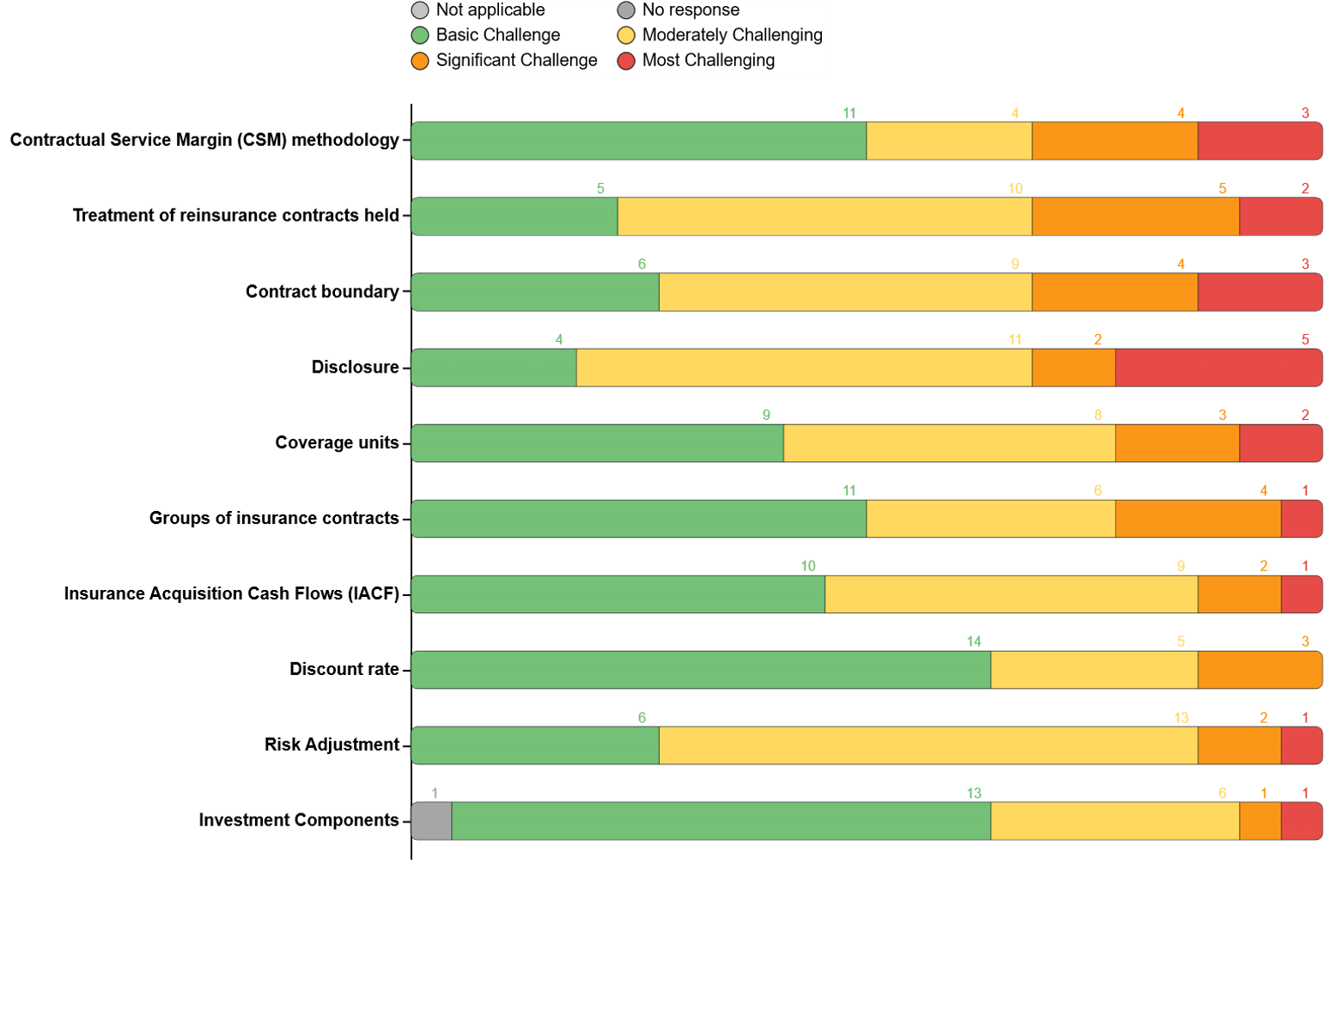
Section 1: Technical IFRS 17 Interpretations and Policy Choices
Which aspects of IFRS 17 were the most challenging to interpret, requiring significant judgment as well as consultation with auditors or advisors?
The following has been the top 4 most challenging IFRS 17 topics for interpretation (i.e. at least 7 out of 22 participants have rated these as significant challenge or most challenging):
Contractual Service Margin
Determining CSM at transition rules
CSM roll-forward methodology including determining when FCF changes adjust CSM versus flow to profit or loss, new business recognition, understanding nuances of CSM release etc.
Treatment of reinsurance contracts held
Determining reinsurance loss recovery component
Misalignment of contract boundary with underlying contracts
Contract boundary
For Direct Insurers - A lot of (wasted) effort spent to ensure UC vs RCH interpretation was meeting the accounting requirements but still give sensible business results as far as possible
For Reinsurers - Treaties with different termination / recapture / repricing rights required additional effort for contract boundary assessment
Disclosures
Volume of disclosure tables increased significantly vs IFRS 4 /MoS
Complexities of the liability roll forward tables
In addition, Risk Adjustment was generally viewed as moderately challenging (13 out of 22 participants). Key challenges include the judgement/subjectivity for determining key parameters (e.g. cost of capital rate, probability of sufficiency) method for deriving gross vs net etc.
Several respondents noted ongoing difficulty aligning technical interpretations (especially for RA, discount rates and coverage units) with external audit expectations.

Slide 10
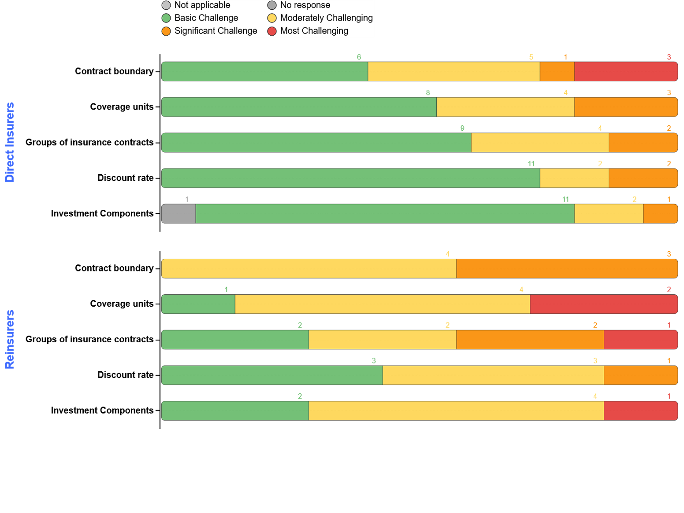
Section 1: Technical IFRS 17 Interpretations and Policy Choices
Which aspects of IFRS 17 were the most challenging to interpret, requiring significant judgment as well as consultation with auditors or advisors?
Reinsurers found the following IFRS 17 topics generally more challenging than Direct Insurers (i.e. rated at least moderately challenging):
Contract Boundary (100% of reinsurers vs 60% of direct insurers)
No reinsurers rated contract boundary as “basic challenge”.
Some direct insurers (6 out of 15) rated this as “basic challenge’, in particular for the smaller/medium sized insurers where contract boundary interpretation is generally well accepted for their core business (e.g. group risk writers).
2. Discount Rate (57% of reinsurers vs 27% of direct insurers)
Most reinsurers rely on methodology prescribed by their overseas parent (e.g. based on EIOPA method), which may be difficult to justify for local audit requirements.
Coverage Units (86% of reinsurers vs 47% of direct insurers)
Determining coverage unit for DI business is particularly challenging for reinsurers, especially when this is often in the same treaty/contract as lump sum.
Groups of insurance contracts (71% of reinsurers vs 40% of direct insurers)
Unlike direct insurers, reinsurers need to consider the complications/implications of whether to combine certain reinsurance treaties and/or to separate out treaties by underwiring year and different classes of business
Investment Components (71% of reinsurers vs 27% of direct insurers)
Identification and determination of profit share as NDIC has been challenging for most reinsurers

Slide 11
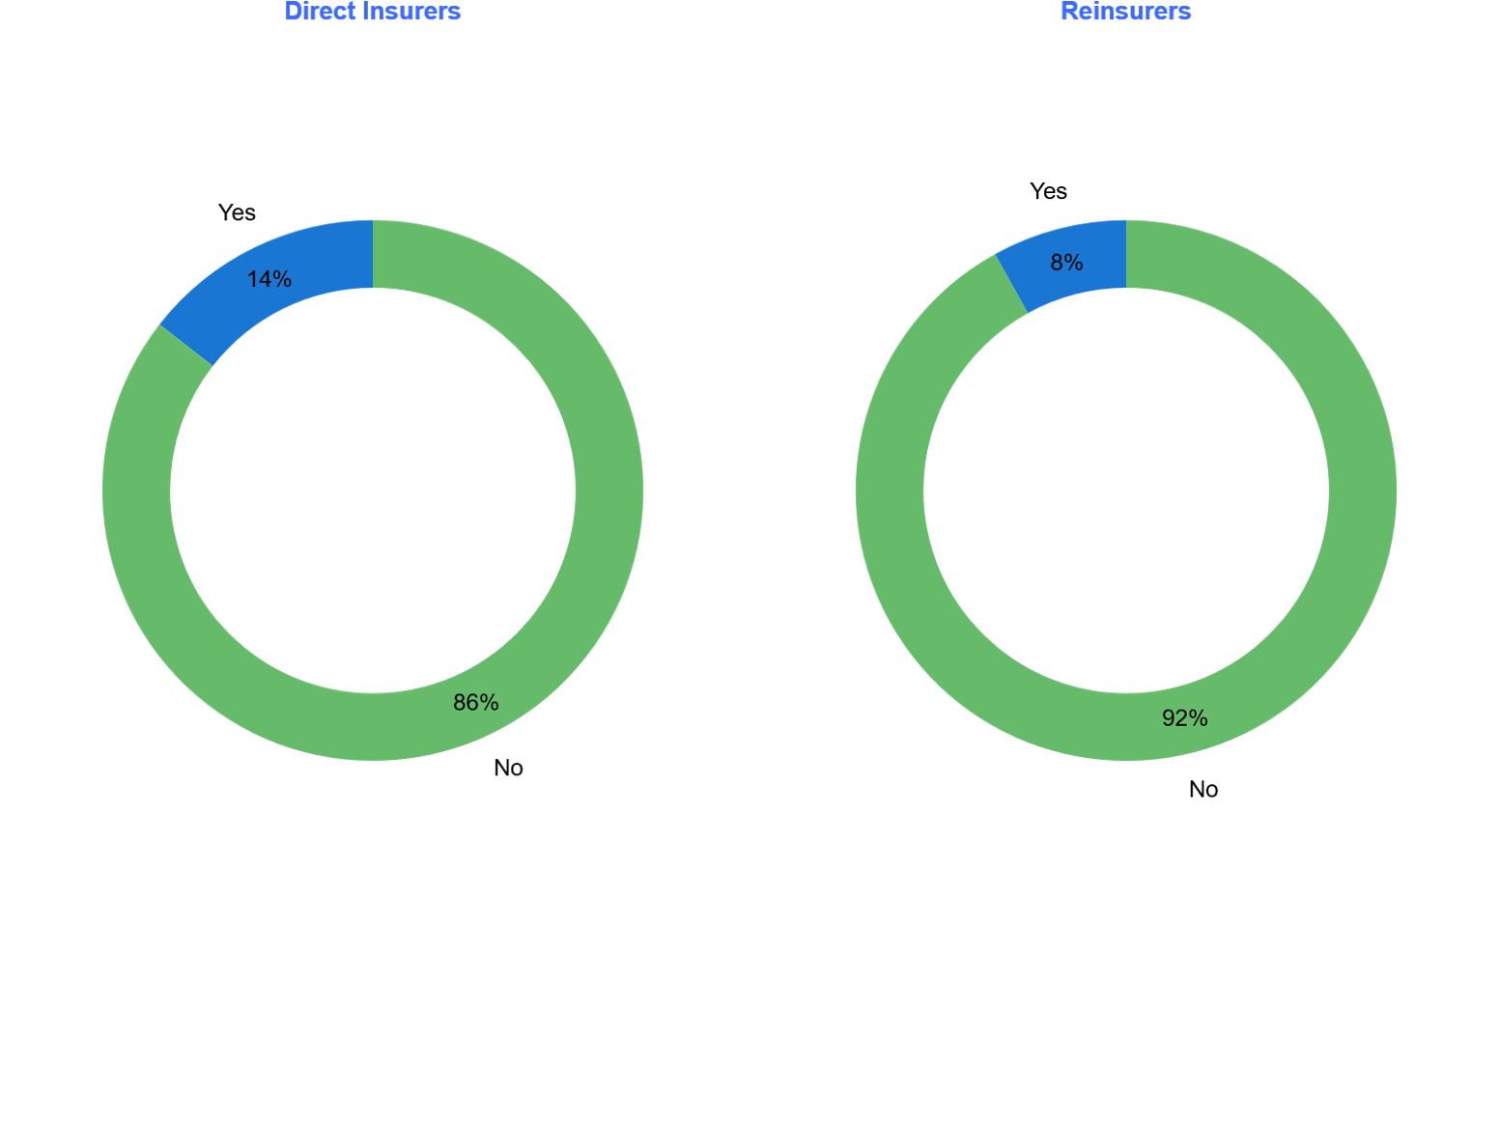
Section 1: Technical IFRS 17 Interpretations and Policy Choices
For each topic, have there been any changes or planned changes in the approach or accounting policies post-implementation?
For most areas, the majority of Direct Insurers and Reinsurers (at least 85%) have not made or planned further changes to their IFRS 17 policy/methodology post go-live.
A minority (14% of the topics were answered "Yes" by Direct Insurers and 8% of the topics were answered "Yes" by Reinsurers) indicated planned or in-flight changes to the following topics, For example:
CSM methodology
3 Direct Insurers are refining/enhancing their CSM roll forward methodology. 1 Direct Insurer has decided to move from GMM to PAA for some products.
Discount Rates
3 Reinsurers are refining discount rate methodology in line with their Group Office direction.
3. Grouping of Insurance Contracts
3 Direct Insurers have decided to enhance/simplify methodology for their immaterial/legacy business (potentially reducing the number of GICs).
4. Disclosure
4 Direct Insurers have decided to refine their disclosures following auditors feedback and improving automation of producing disclosure tables.

Slide 12
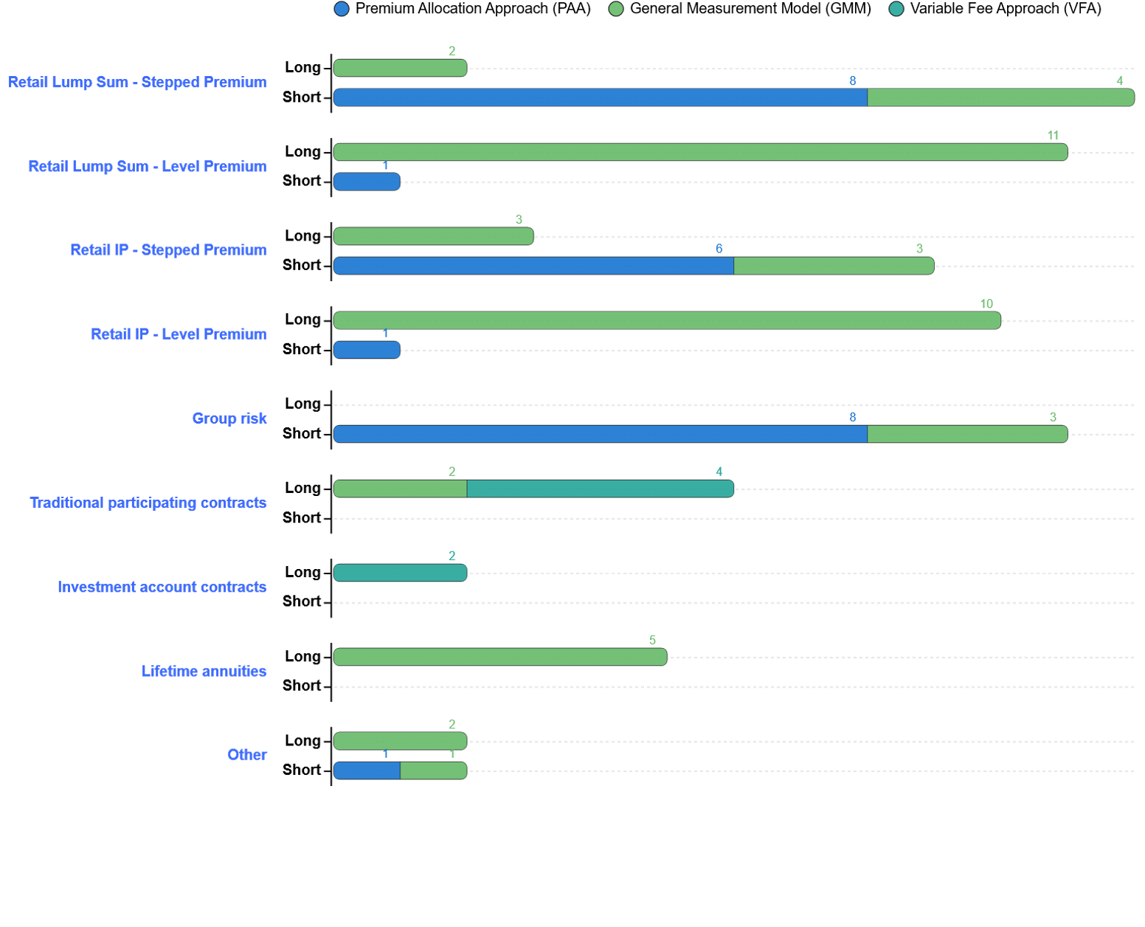
Section 1: Technical IFRS 17 Interpretations and Policy Choices
Please specify the following IFRS 17 methodology/policy choice for underlying contracts: Measurement Model and Contract boundary
Retail risk:
Retail Lump Sum Stepped premium
All but 2 respondents indicated short boundary, of which 8 adopted PAA and 4 adopted GMM.
Long boundary related to products distributed by third parties.
Retail Lump Sum Level premium – All but 1 respondent indicated long boundary and adopted GMM.
Retail IP Stepped Premium
3 respondents justified long boundary. One argument observed is a change in insurable definition to consider risks past 1 year.
Of the 9 on short boundary 6 used PAA.
Retail IP Level premium was similar observations per Retail Level Lump Sum with 10 of the 11 respondents on long boundary and GMM.
Group risk:
All respondents indicated short boundary of which 8 adopted PAA and 3 adopted GMM.
Traditional, Investment Account and Lifetime Annuities:
All respondents indicated long boundary.
6 out of 8 respondents who have traditional and investment account contracts adopted VFA.
Other mainly relates to CCI and Direct business, with the majority adopting GMM with long boundary.
Coverage Units
Where GMM is adopted, Sum insured (or analogous measures) is by far the most common coverage units adopted across Retail lump sum and IP.
For Group Risk, 3 out of 4 respondents used premium as the proxy for sum assured.

Slide 13
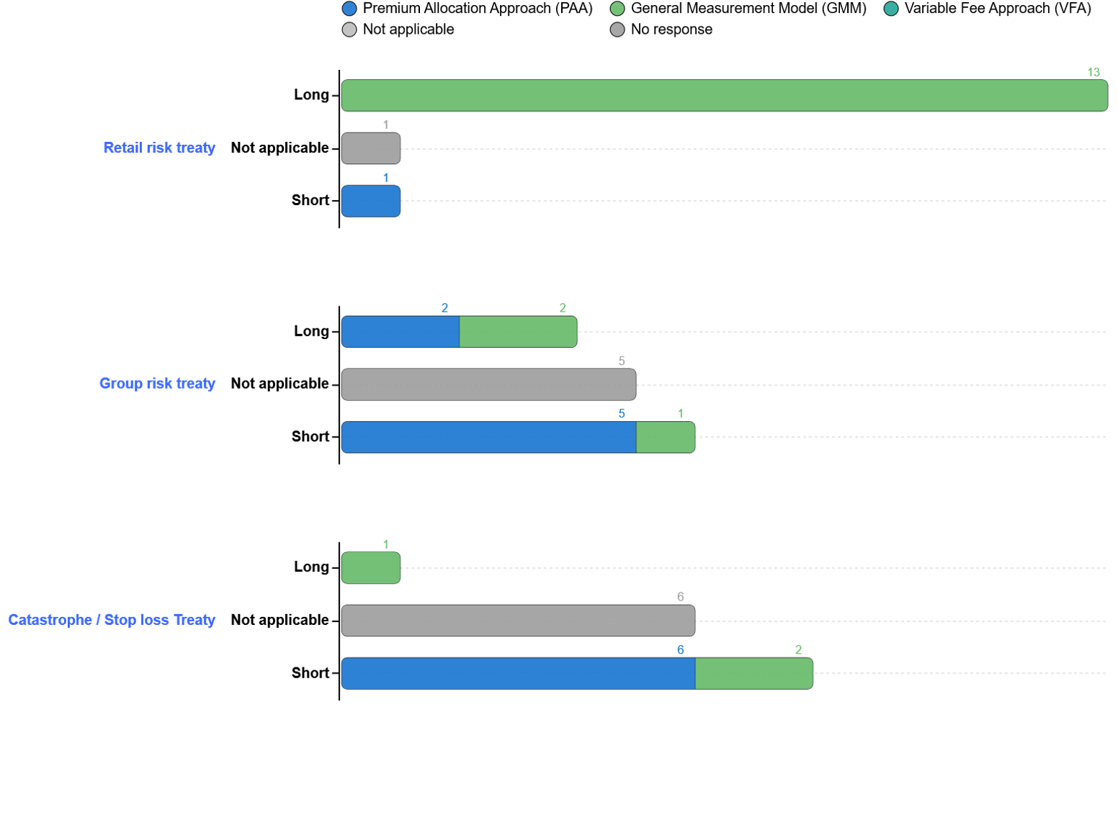
Section 1: Technical IFRS 17 Interpretations and Policy Choices
Please specify the following IFRS 17 methodology/policy choice for reinsurance contracts held: Measurement Model and Contract boundary
Retail Risk Treaties
13 of 15 respondents adopted a long boundary with GMM for retail reinsurance contracts held. 1 respondent had no retail treaty, and another used short-boundary PAA on materiality grounds.
Group Risk Treaties
Not all respondents have group treaties. Among those that do, approaches are more varied:
4 apply long boundaries (2 PAA, 2 GMM)
6 apply short boundaries, with 5 using PAA
In responses to the contract boundary question for Group Risk Treaties, it was observed that the definitions of “long” and “short” contract boundaries were not applied consistently across participants. The responses have been plotted as provided in the survey data. However, based on follow-up discussions, it is understood that, regardless of whether a long or short boundary was selected, the contract boundary was applied consistently to all business covered under the group policy and extended to the legal expiry of the underlying contracts.
Catastrophe & Stop-Loss Treaties
Where present, these treaties are predominantly short-boundary PAA, consistent with short-duration characteristics.
Future New Business
Future new business is excluded from GMM projections for all direct insurers.
1 direct insurer aligned treaty cancellation with quarterly reporting, preventing future NB from flowing into projections.
All remaining direct insurers exclude future NB on materiality grounds.
Coverage Units
Coverage units typically mirror the underlying basis (e.g., share of sum insured).
For direct insurers’ group business, 3 out of 4 use premium as a proxy for sum assured.

Slide 14
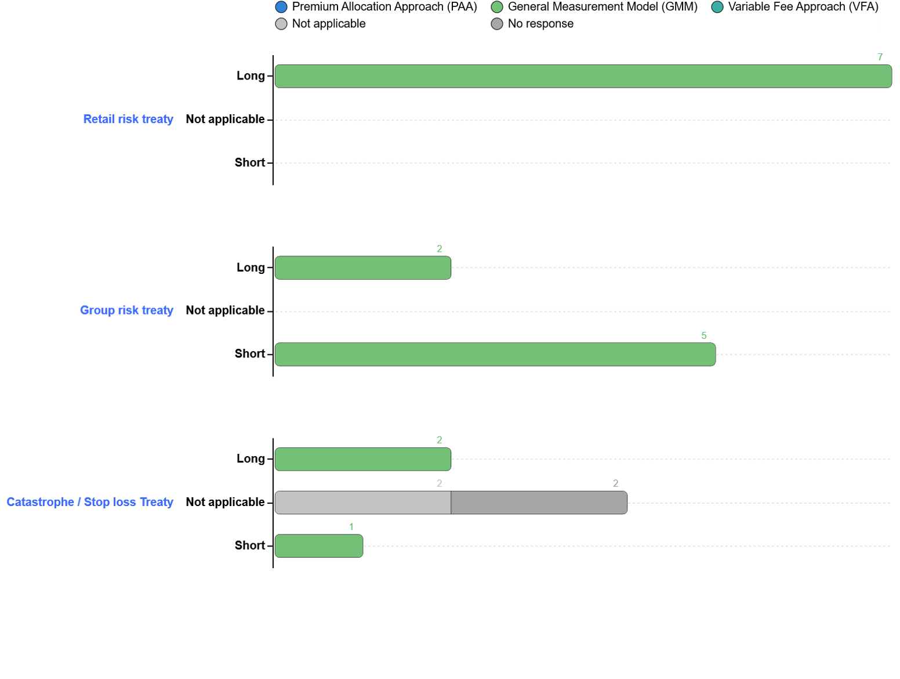
Section 1: Technical IFRS 17 Interpretations and Policy Choices
Please specify the following IFRS 17 methodology/policy choice for reinsurance contracts issued: Measurement Model and Contract boundary
Measurement Models
GMM is the dominant model used for all retail risk treaties, group risk treaties and catastrophe/stop loss treaties for reinsurance contracts issued.
Contract Boundary
Contract boundaries are generally long for retail risk treaties (83%) and for group risk treaties match the rate guarantee period. Although within responses this was misleading with some respondents answering this as ‘long’ and others as ‘short’.
4 reinsurers include future NB consistent with the cancellation clauses on new business.
Coverage Units
Coverage units usually follow the sum insured.
3 reinsurers use projected claims cost where sum-at-risk measures are unreliable.

Slide 15
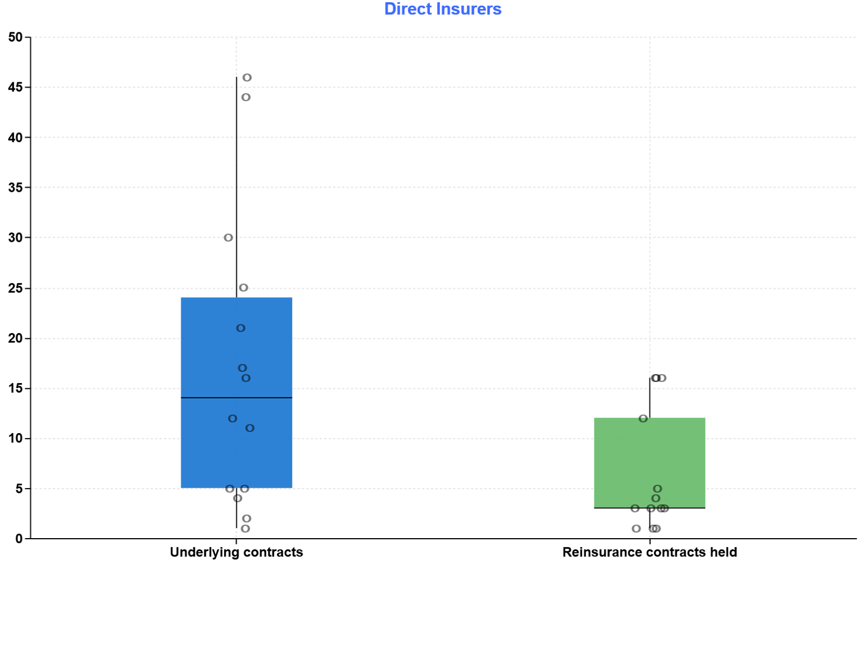
Section 1: Technical IFRS 17 Interpretations and Policy Choices
How many insurance portfolios does your company define for measurement purposes?
For Direct Insurers, variations in policy interpretation and the differing mix of product offerings across respondents have led to a wide range in the number of portfolios adopted.
50% of Direct Insurers have between 5 and 24 insurance portfolios for underlying contracts with the max being 46.
For reinsurance contracts held, 50% of Direct Insurers have between 3 and 12 portfolios.
Even when underlying product features are similar, variations in the number of portfolios can still exist, which reflect how each organisation manages risk and reports its business
Most respondents group all retail lump-sum benefits into a single portfolio, although a few choose to separate lump-sum disability benefits into a separate portfolio where these products have distinct risk profiles or are managed independently (or seen to have different risks).
Reinsurance portfolios for direct insurers tend to be fewer, often consisting of a single treaty portfolio spanning multiple underlying groups of insurance contracts.
All respondents split portfolios by premium structure (e.g., stepped vs. level).

Slide 16
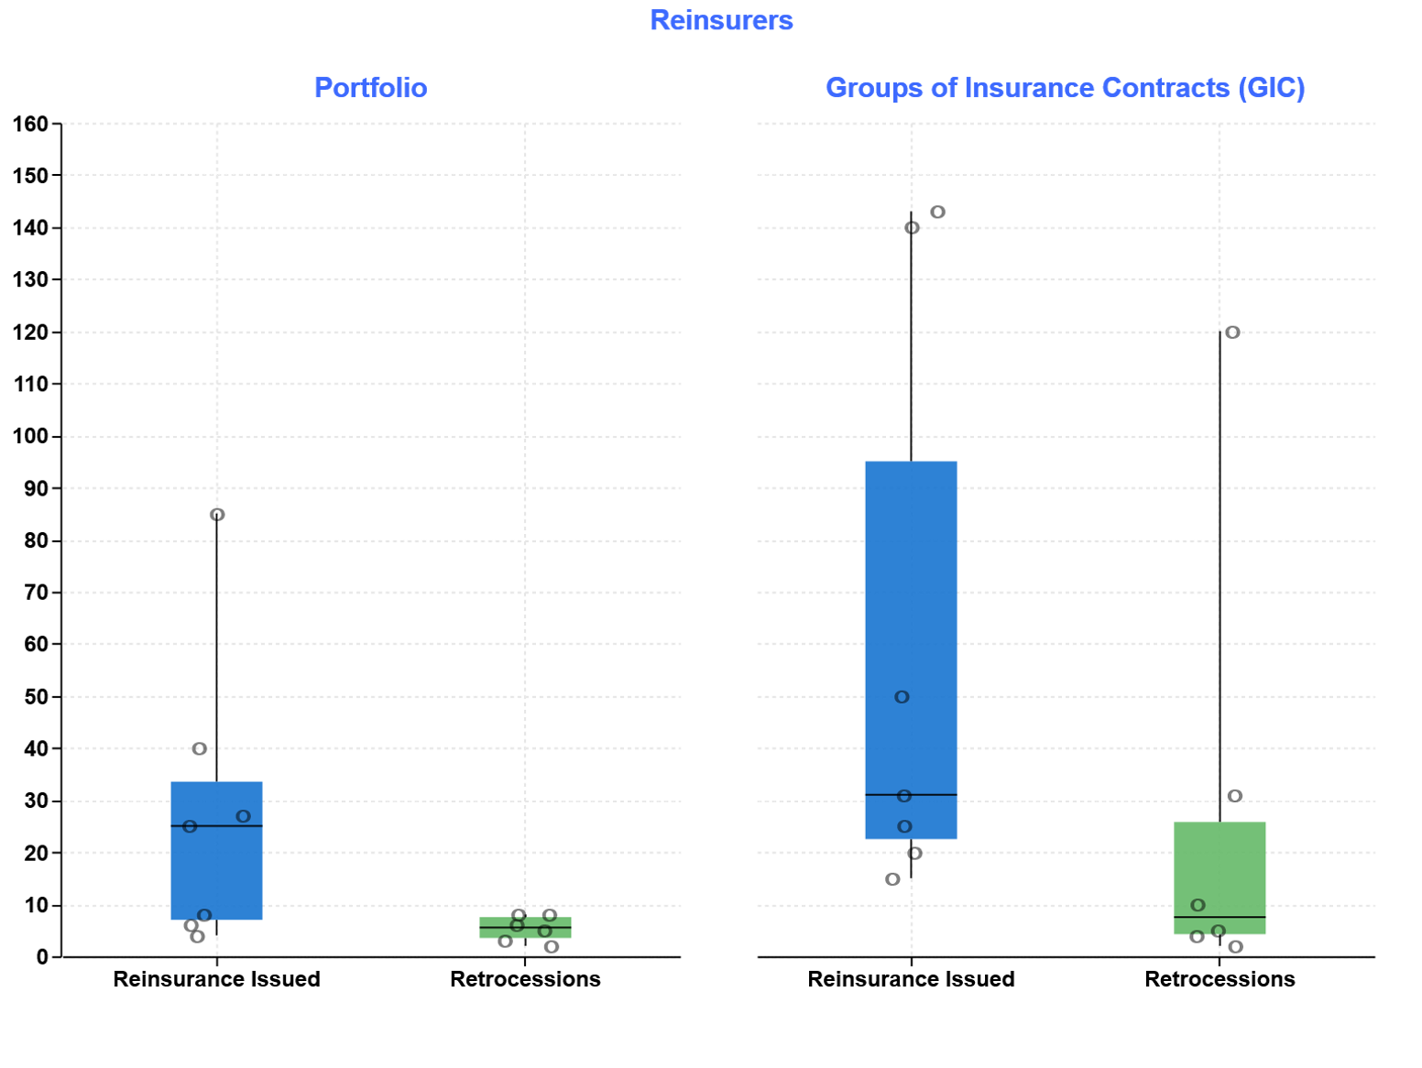
Section 1: Technical IFRS 17 Interpretations and Policy Choices
How many portfolio and Groups of Insurance Contracts (GIC) does your company define for measurement purposes?
The graph on the left shows the number of portfolios held by reinsurers, where portfolios group contracts with similar risks that are managed together.
The graph on the right shows the number of Groups of Insurance Contracts, reflecting the application of portfolio, cohort, and profitability requirements.
Level of aggregation approaches vary more for reinsurers than for direct insurers:
The most common approach aligns portfolios or Groups of Insurance Contracts to individual treaties, with smaller or legacy treaties sometimes combined into a single portfolio or group.
Some reinsurers apply separation principles within each treaty and then group business by line of business, placing multiple treaties with similar product characteristics into a single portfolio or group.
At the more aggregated end of practice, a small number of reinsurers adopt a managed together approach, grouping multiple treaties that are operationally managed as a single block.
There are differing interpretations of the cohorting requirements, contributing to variation in market practice.

Slide 17
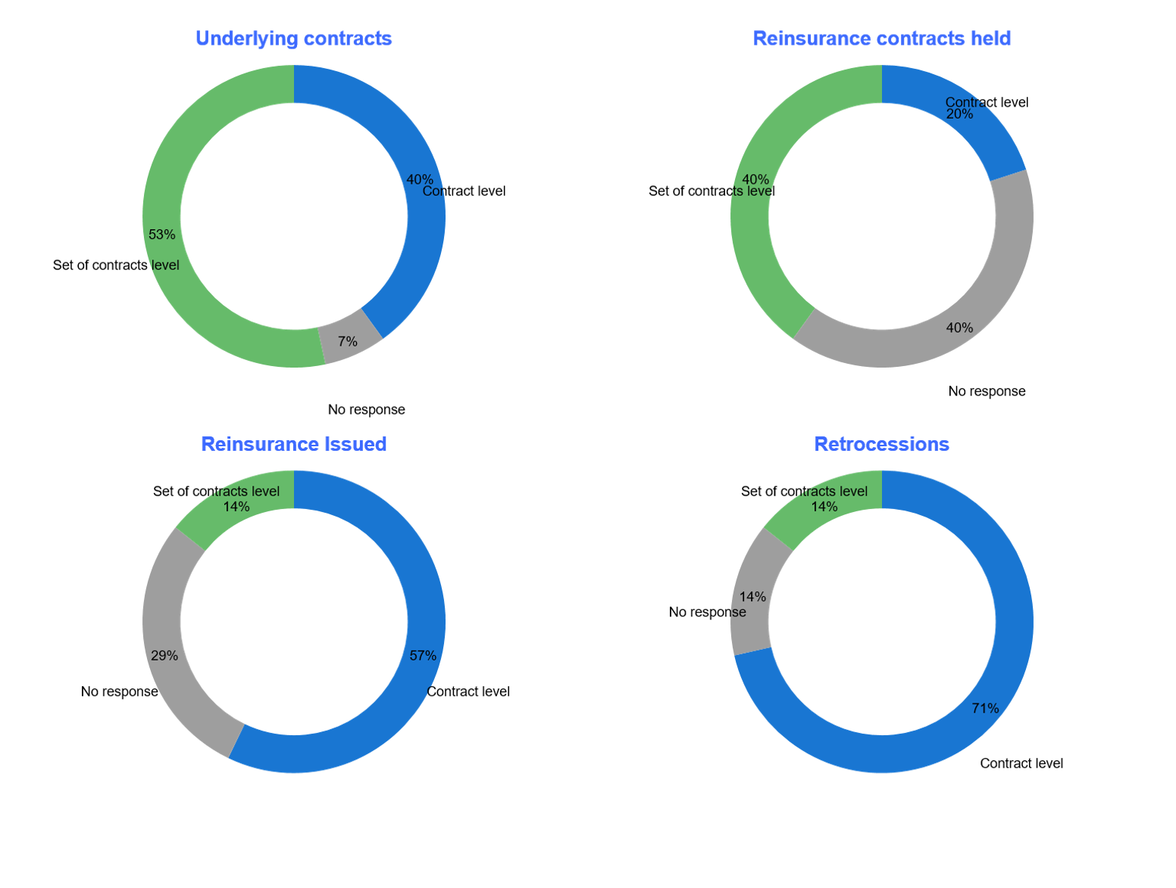
Section 1: Technical IFRS 17 Interpretations and Policy Choices
Does your company test profitability at a set of contracts or at a contract level?
GMM: Level of Profitability Testing
Respondents reported that their chosen level of testing provides adequate early identification of onerous groups under the GMM.
Direct insurers
A mixed approach observed, with 40% testing at a contract level and 53% at a set-of-contracts level.
Those applying set-of-contracts testing typically rely on qualitative indicators, such as pricing metrics and portfolio-level profitability assessments.
For reinsurance contracts held 40% of those that responded test at a set of contract level.
Reinsurers
Tend to use contract-level testing more frequently than direct insurers (57% compared with 40%), as contract level is often at the treaty level.
71% of respondents tested retrocessions at a contract level.
Qualitative assessment is the most common method when testing at a set-of-contracts level.
PAA: Facts and Circumstances for Identifying Onerous Contracts
Qualitative indicators are the primary filter for identifying onerous PAA groups.
Explicit GMM-style measurement is performed only when facts and circumstances indicate onerosity.
For direct insurers, “facts and circumstances” triggering onerous assessment are typically driven by qualitative and quantitative indicators such as past losses, deteriorating claims or persistency experience, material changes in assumptions or expenses, aggressive pricing or repricing activity, and adverse movements in forecast cash flows. Some respondents apply simple ratio checks to trigger further analysis, while others rely on routine profitability reporting rather than formal periodic onerous testing.

Slide 18
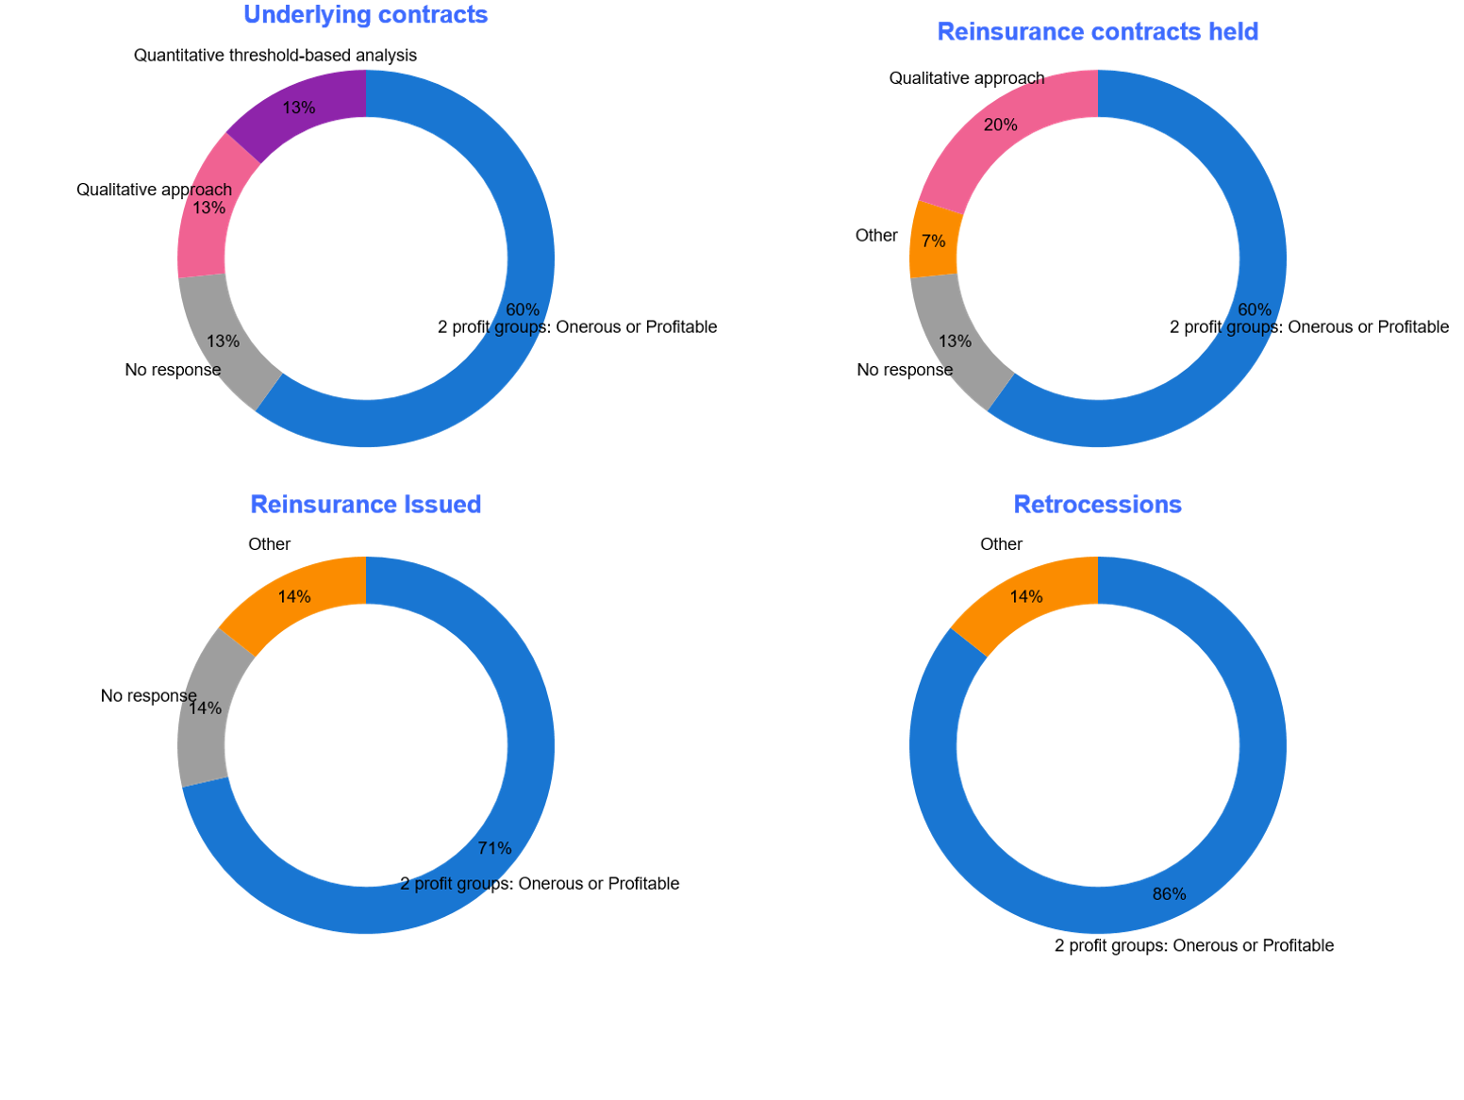
Section 1: Technical IFRS 17 Interpretations and Policy Choices
How does your company test for ‘No Significant Possibility of becoming onerous/net gain’?
There is broad industry alignment that the NSPBO group adds limited practical value and does not reflect how business is priced or managed in either direct insurance or reinsurance.
60% of Direct Insurers only have two profit groups (Onerous or profitable):
Some have formally decided not to use the NSPBO group based on a technical argument that no business will ever fall in this bucket.
Others note that while the group is permitted, they have not written business that would fall into this category.
A small minority (13%) apply a quantitative check, typically comparing CSM at initial recognition against a multiple of the risk adjustment.
Reinsurers tend to not use the NSPBO group in practice with 71% only have two profit groups.
The most common reason is repricing flexibility, which means treaties rarely meet the criteria for “significant possibility” of net gain.
Several reinsurers indicated that the decision aligns with their Group Office policy, which explicitly avoids use of this category.

Slide 19
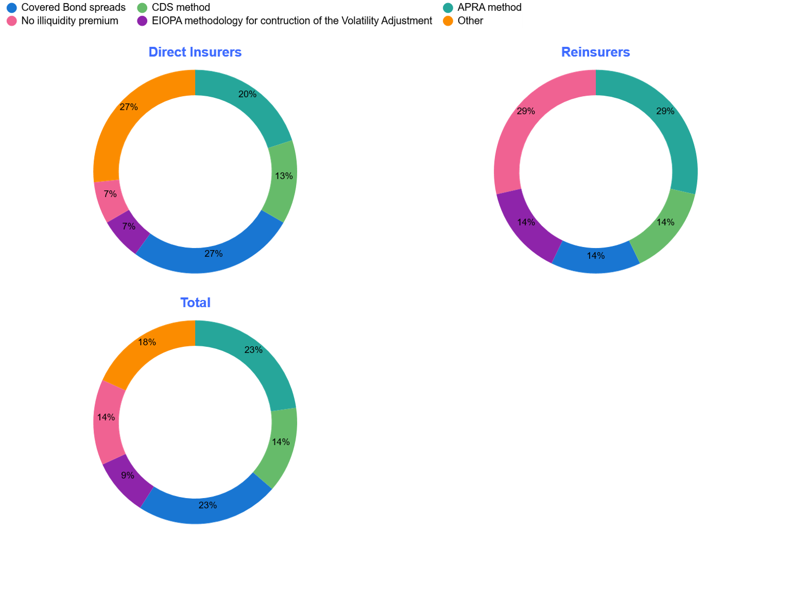
Section 1: Technical IFRS 17 Interpretations and Policy Choices
What illiquidity premium methodology does your company use?
There is no single methodology emerging as the standard practice for calculating the illiquidity premium across Direct Insurers and Reinsurers.
A variety of Illiquidity premium methodologies were observed including the APRA LPS 112 method, Credit Default Swap (CDS) method and covered bond spreads method.
A popular methodology for both Direct Insurers and Reinsurers (5 out of 22) is using APRA’s method for determining illiquidity premium under LPS 112.
The application of a zero illiquidity premium is more prevalent among Reinsurers than among Direct Insurers, with 2 out of 7 applying no illiquidity premium
“Other” methods observed are either a modification to the listed known methodologies, bespoke method determined by overseas parent or a simplified “rule of thumb” approach entirely reliant on judgement.

Slide 20
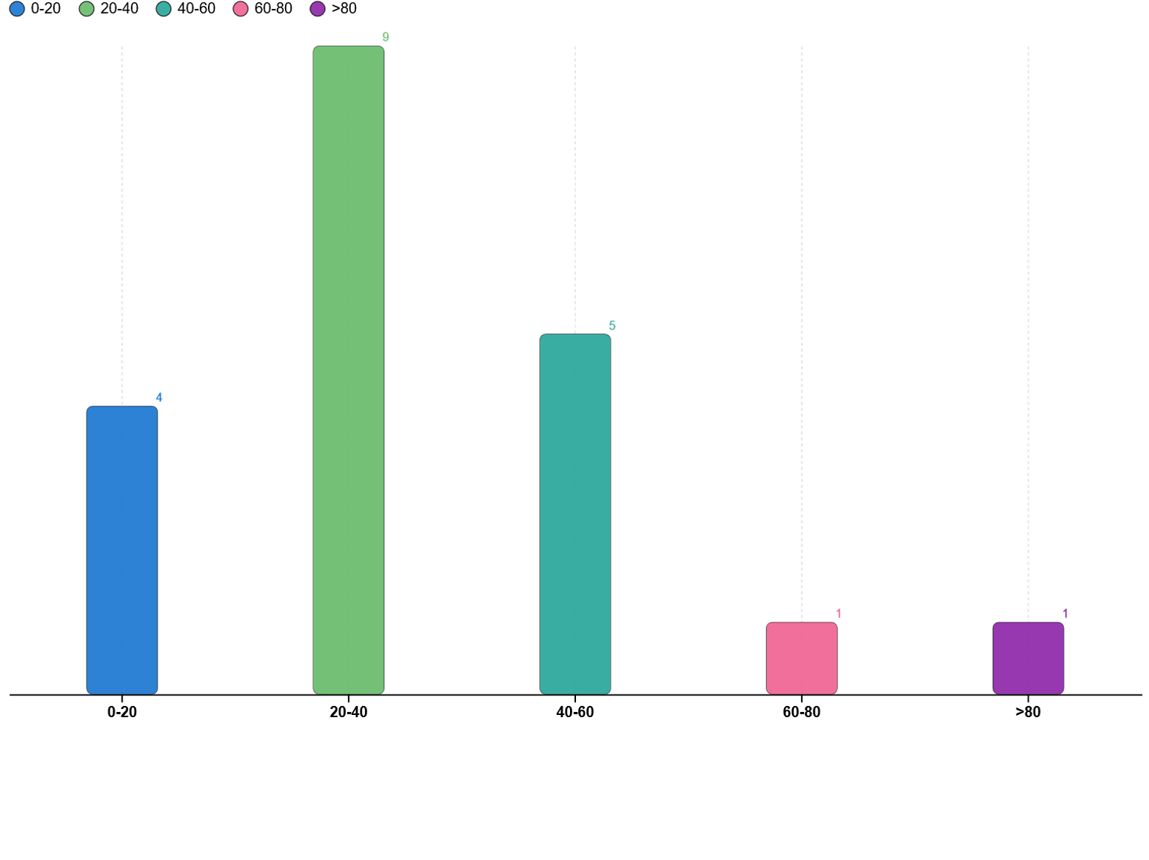
Section 1: Technical IFRS 17 Interpretations and Policy Choices
What is the resulting average range of the illiquidity premium (bps) applied to the discount rate assumptions at your last year-end?
Across Direct Insurers and Reinsurers:
Illiquidity premium assumptions largely range between 0 to 60 bps, with very few applying an assumption greater than 60bps.
The wide range of assumptions adopted is consistent with the variation of illiquidity premium methodologies observed from the previous page.
The most prevalent (45% of respondents) average range of illiquidity premium applied to the discount rate assumption is 20-40 bps, with over half of the Direct Insurers (8 of 15) applying this range.
The next most applied (25% of respondents) was 40-60 bps.
3 out of the 4 respondents applying no illiquidity premium to their discount rate assumption as observed on the previous page.

Slide 21
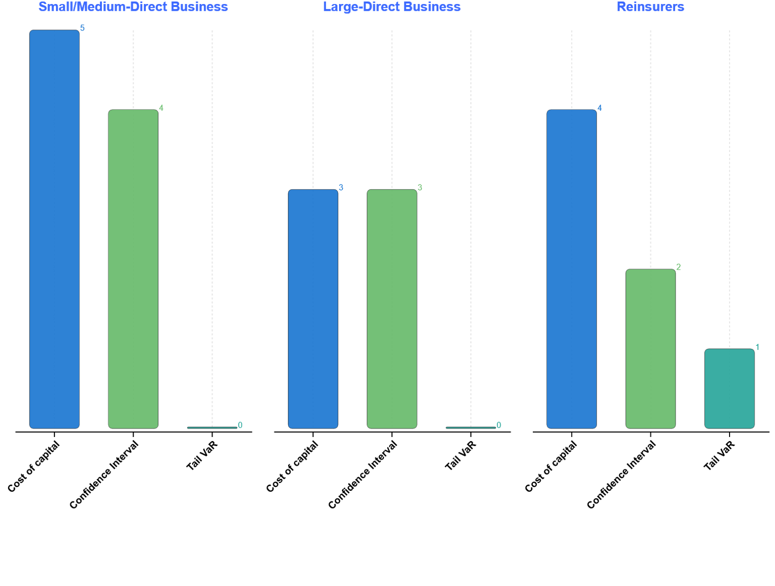
Section 1: Technical IFRS 17 Interpretations and Policy Choices
What risk adjustment methodology does your company use?
Cost of capital is the most widely used method (55% of respondents) across both Direct Insurers and Reinsurers for calculating the Risk Adjustment (Small/medium direct insurers: 5, Large direct insurers: 3 and Reinsurers: 4)
Confidence interval approaches are the next most common method (41% respondents) adopted (Small direct insurers: 4, Large direct insurers: 3 and Reinsurers: 2)
Tail VaR is used only by one reinsurer and none of the direct insurers.
Other methods are also limited to reinsurers, with one reinsurer reporting an alternative approach using pricing margins

Slide 22
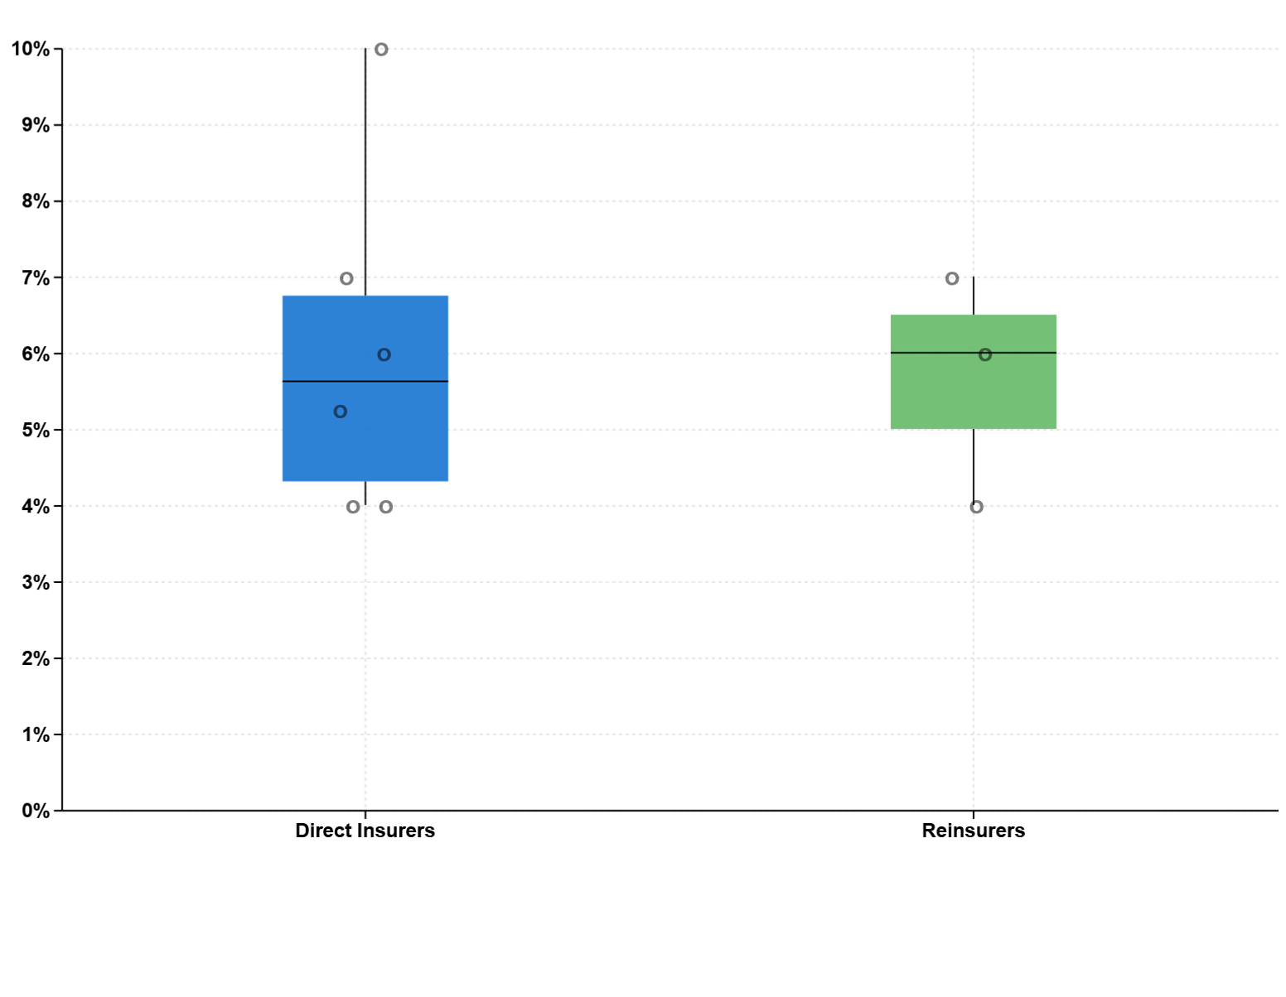
Section 1: Technical IFRS 17 Interpretations and Policy Choices
If the Cost of Capital method is used, what is the cost of capital rate assumed in the risk adjustment calculation at your last year-end?
This graph reflects only the respondents who use a cost of capital methodology, comprising 8 Direct Insurers and 3 Reinsurers.
Direct Insurers
Direct insurers show a wider range of cost of capital rate assumptions, from 4.3% to 6.8%.
The median rate is approximately 5.6%.
Most respondent (4) sit between 4% and 6%, with isolated high outlier (at 10%). Note that 2 respondents using Cost of capital approach preferred not to disclose the rate used.
Reinsurers
Reinsurers apply consistently higher rates relative to direct insurers.
Reported responses using this approach where 4%, 6% and 7%.

Slide 23
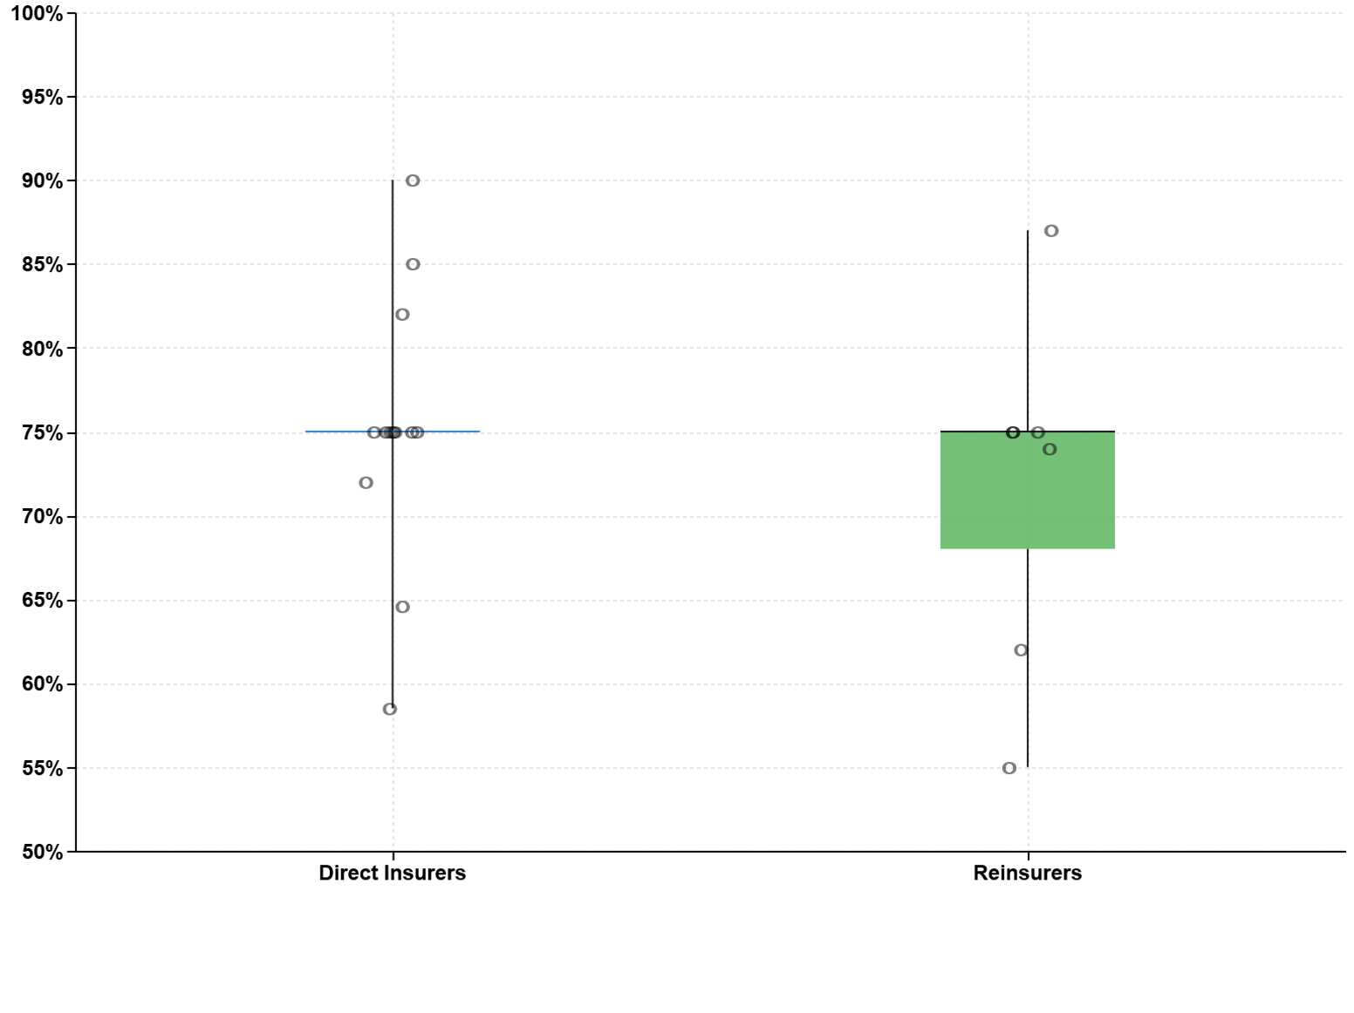
Section 1: Technical IFRS 17 Interpretations and Policy Choices
What is the resulting risk adjustment confidence level applied/implied at your last year-end?
These results reflect the explicit confidence level for respondents using a confidence interval approach and the implied confidence level for those using alternative methodologies for financial statement disclosure.
Overall, both Direct Insurers and Reinsurers typically anchor around a 75% confidence level, although reinsurers exhibit greater dispersion due to more varied methodologies and global group influence.
Direct Insurers
Direct insurers show a tight clustering around 75%, with 50% of responses falling between 74.3% and 75%, and the median also at 75%.
A small number of outliers are present, including one direct insurer below 60% and three above 80%.
The distribution indicates a strong convergence of practice, with limited variation in the implied confidence level.
Reinsurers
Reinsurers display wider variation than direct insurers, with responses ranging from 55% to the mid 80s.
Despite this spread, the median remains close to 75%, with four of the seven reinsurers reporting a confidence level at either 74% or 75%.

Slide 24
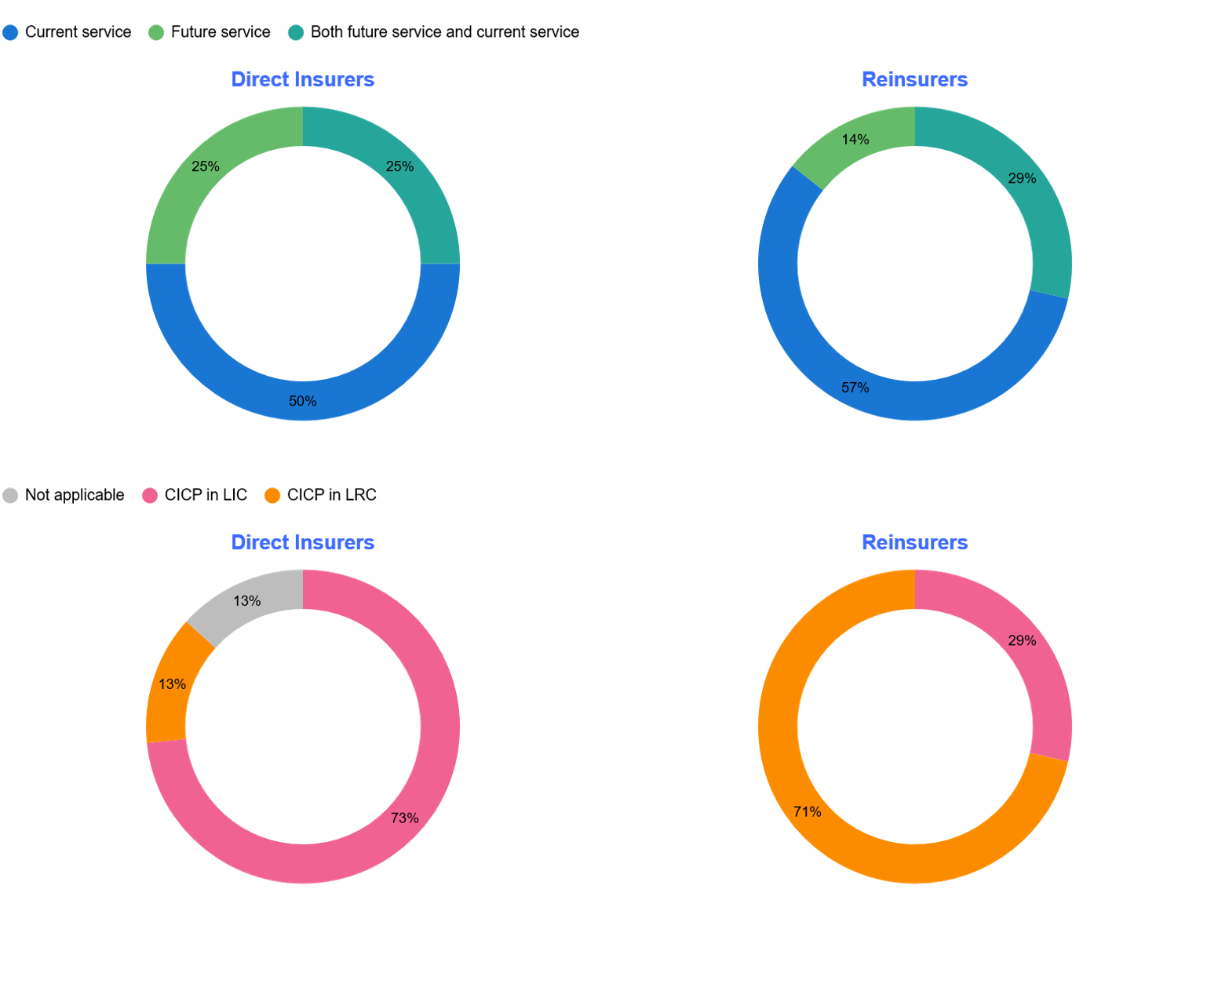
Section 1: Technical IFRS 17 Interpretations and Policy Choices
Where GMM or VFA applies, how has your company treated subsequent measurement of premium experience variance?
Premium Experience Variance
Current service is the most widely adopted treatment (50% Direct Insurers; 57% Reinsurers) for subsequent treatment of premium experience variance.
5 out of 22 respondents indicated that both current and future service is adopted depending on the reason of the premium experience variance.
Some reinsurers indicated that the premium experience treatment was determined centrally by their group office.
Treatment of CICP (Claims in Course of Payment, also known as DLR, Disabled Life Reserve)
Only 2 Direct Insurers treat CICP within the LRC (Liability for Remaining Coverage), with all other direct insurers treat CICP within the LIC. Of the insurers who treat CICP within the LRC, one allocates premium experience entirely to current service and one uses a split approach.
Relative to Direct Insurers, a larger proportion of Reinsurers (5 out of 7) treat CICP within the LRC. Three of these allocate premium experience entirely to current service. One uses a split approach.
Conclusion: In the context of smoothing experience variance:
No consistent link is observed between premium experience variance treatment and treatment of CICP.
A mild tendency for reinsurers with CICP in the LRC to favour current service allocation for premium, but practice still varies.
Has your company treated CICP for disability income business within LRC or LIC?

Slide 25
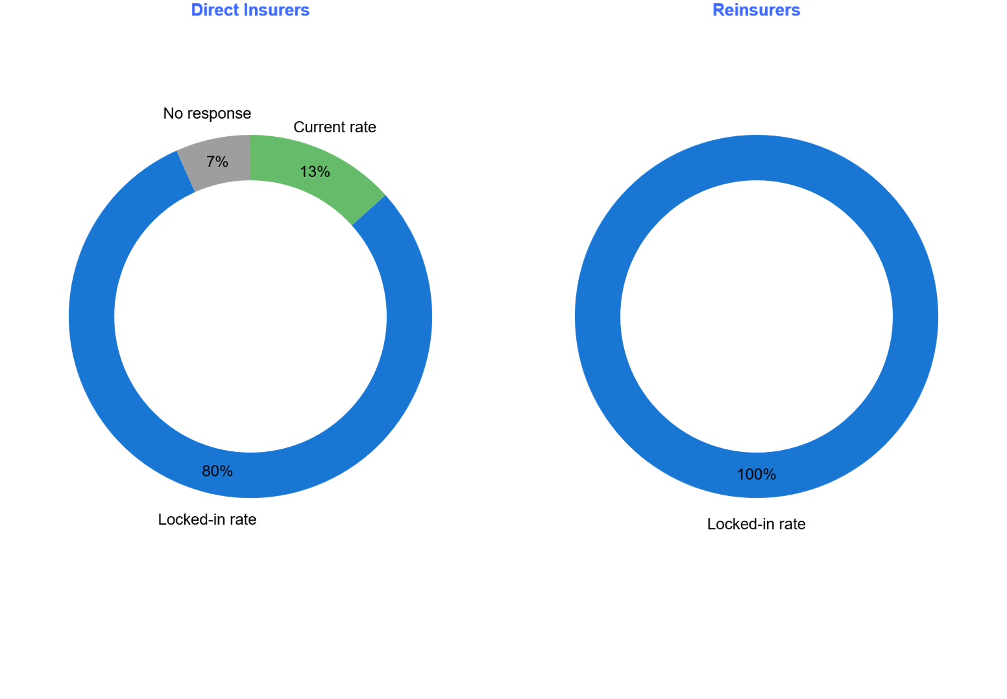
Section 1: Technical IFRS 17 Interpretations and Policy Choices
Does your company use current rates or the locked-in rates for the measurement of the loss component?
Across Direct insurers and Reinsurers, the majority of respondents apply locked-in rates for the measurement of the loss component (80% Direct Insurers; 100% Reinsurers).
For Direct Insurers, a small proportion (13%) use current rates, while 7% did not provide a response.
Three commonly cited reasons for selecting locked-in rates are:
Group office directives, where local implementation followed global policy decisions.
Alignment with the CSM methodology, to maintain consistency between the liability for remaining coverage and the loss component.
Reduction in operational complexity, particularly avoiding additional movements between the CSM and the loss component that arise under a current-rate approach.

Slide 26
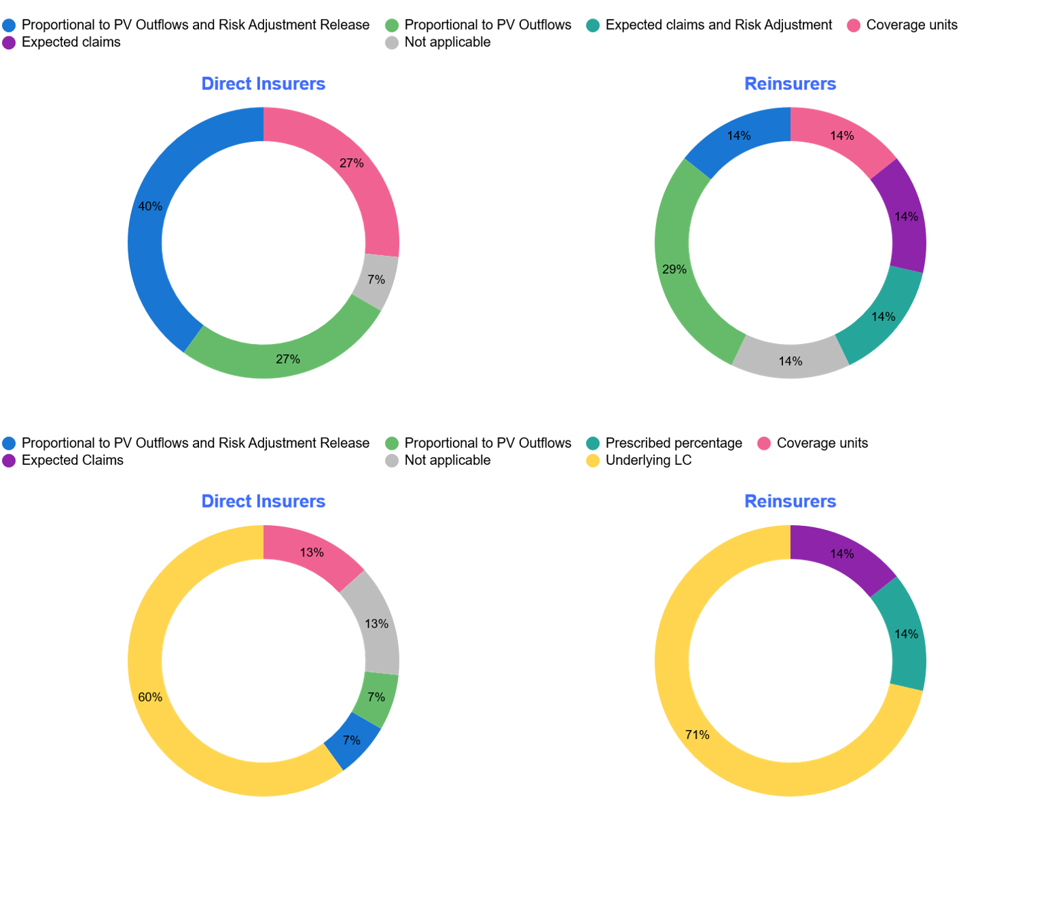
Section 1: Technical IFRS 17 Interpretations and Policy Choices
What is the method used for releasing Loss Component at subsequent measurement?
Loss Component (LC) release methods are varied across respondents:
Direct insurers are generally less varied than Reinsurers, with the majority of respondents (67%) applying proportional PV outflows with or without RA release.
Reinsurers are generally more varied than Direct Insurers. In addition to using proportional to PV outflows (45%), nearly 30% of Reinsurers also apply expected outflows (with or without risk adjustment).
Coverage units are used by 4 Direct Insurers and 1 Reinsurer, generally where LC is treated as a negative CSM for simplicity.
Reinsurance Loss Recovery Component (RLRC) release methods show far less variation than LC methods.
Majority of respondents (67% Direct insurers; 71%Reinsurers) release the RLRC in proportion to the underlying loss component. Where applied, RLRC calculations generally mirror the LC approach, either through applying reinsurance percentages, or reflecting underlying FCF movements.
Some respondents have not yet experienced an RLRC in practice, as they do not currently have onerous underlying contracts. The RLRC mechanism is therefore conceptually understood but has been seldom operationally tested for some.
What is the method used for releasing Reinsurance Loss Recovery Component at subsequent measurement?

Slide 27
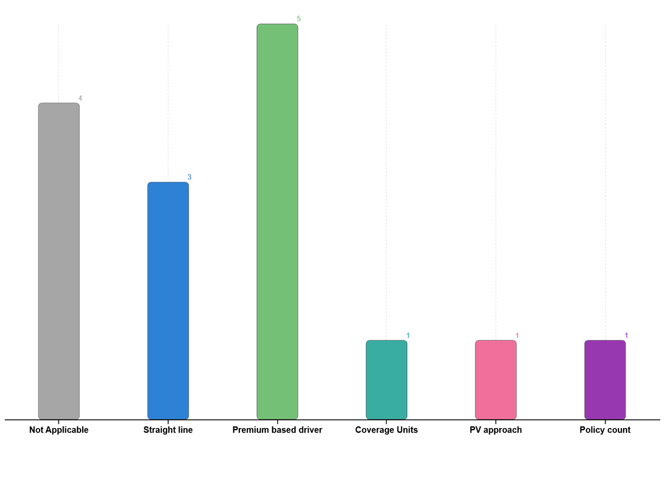
Section 1: Allocation of Insurance Acquisition Cash Flows (IACF)
What drivers have you used for allocating IACF to future renewal groups?
The observations on this page only apply to Direct Insurers as IACF is typically irrelevant or not material for Reinsurers.
Allocation of IACF to Future Renewal Groups
Premium is the most widely adopted driver (33%), either in the form of expected premium or PV of premium.
The next most adopted driver (20% was a simple uniform method such as straight line.
4 respondents stated that IACF are not applicable or that the acquisition expenses are expensed to the current group.
1 respondents adopt “unit of cover” to allocate IACF to future renewal groups.
Only 1 Direct Insurer uses PV of Cash Flow as the allocation driver.
Level 1 Impairment Testing
Across the Direct Insurers with IACF balances:
Only 50% consider genuine new business within future groups of insurance contracts
71% apply discounting and 100% consider the risk adjustment
Level 2 Impairment Testing
Similar response to level 1 impairment testing was observed with limited further insight on approach.

Slide 28
Section 2: System & Operations

Slide 29
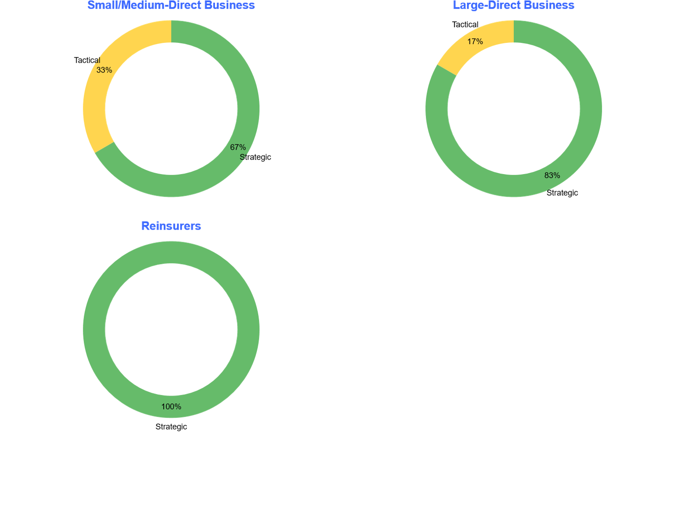
Section 2: System & Operations
Are you currently using your long term planned strategic solution or are you still on an interim tactical solution?
Strategic Solution:
All reinsures have their strategic solution in place for IFRS 17 reporting, largely driven by their Group Office requirement to use the central IFRS 17 subledger/ledger solution.
The larger Direct insurers are more likely (83% or 5 out of 6) to be on a ‘strategic solution’ for IFRS 17 reporting.
60% of Strategic Solutions are vendor based (e.g. FIS, SAS, SAP FPSL etc.) while 40% are built in-house
Tactical Solution:
Some of the smaller/medium sized Direct insurers (3 out of 9) are still on a ‘tactical solution’
These are largely Excel based.

Slide 30
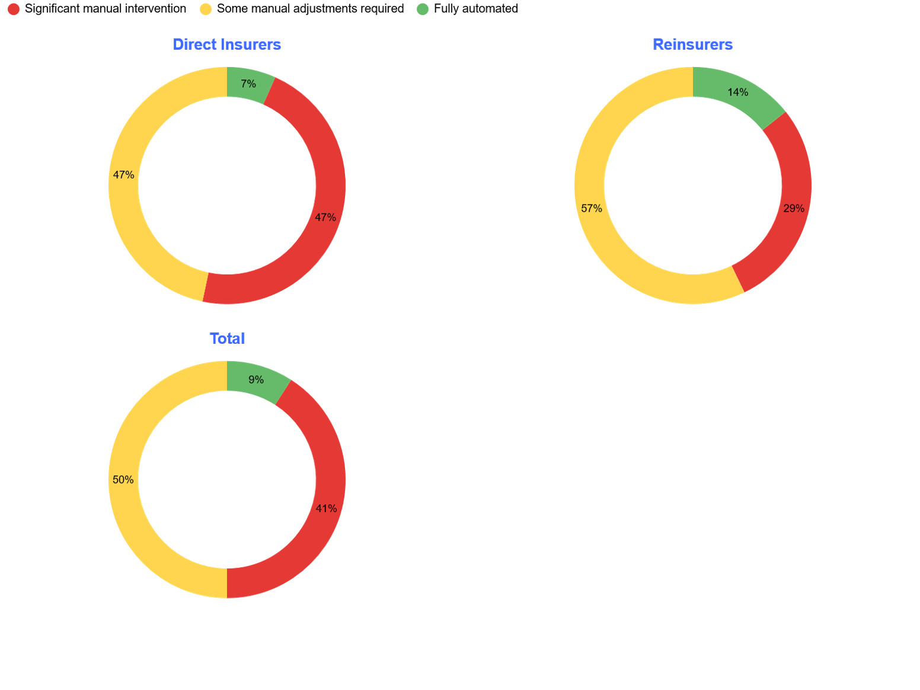
Section 2: System & Operations
What level of automation has been implemented in your IFRS 17 reporting process?
Manual Intervention
Only 3 out of 22 respondents (< 10%) have indicated a fully automated IFRS 17 solution
Direct insurers appear to require more significant manual intervention (47%) relative to reinsurers (29%).
Respondents who indicated significant manual intervention required are largely due to manual adjustments to data inputs or results output for their IFRS 17 solution.
Some other examples of manual adjustments in the IFRS 17 reporting process are:
Manual intervention required for certain disclosures
Bespoke calculations where IFRS 17 solution is not catered for (e.g. NDIC, profit share, actuarial manual reserves etc.)

Slide 31
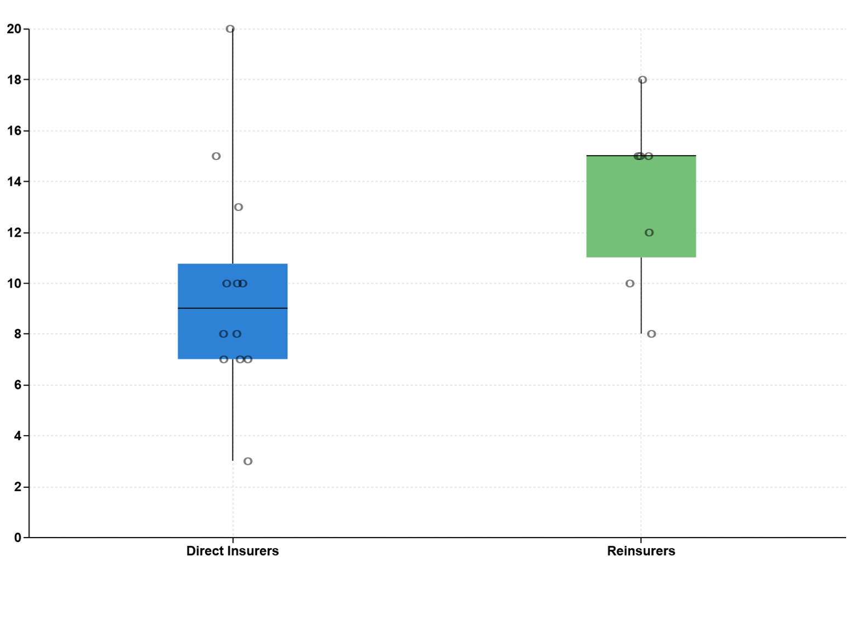
Section 2: System & Operations
What is your ledger close target/expectation for reporting IFRS 17 balances?
In terms of Working Day (WD), Reinsurers tend to have a longer target ledger close date (11WD to 15WD) relative to Direct Insurers (7 to 11 WD)
Ability to meet the target close timetable has been a challenge across the industry.
Direct Insurers appeared to have encountered greater challenges:
Nearly 70% indicated that that they did not achieve their target ledger close date in their first implementation year.
Whilst there has been improvement since then, most respondents indicated that actual close is still short of expectations – mirroring extent of those requiring manual intervention in their IFRS 17 solution.
Reinsurers appeared to have fared better:
c. 40% indicated that that they did not achieve their target ledger close date
It is customary for reinsurers to commence work on year-end using data from the previous quarter with updates to discount rate assumptions etc. from WD 1 onwards.
Approximately 30% (6 out of 22) respondents have indicated that simplifications have been made in order to help meet the reporting timelines – these largely relate to using prior month data with a roll forward approach (per the point with Reinsurers above).

Slide 32
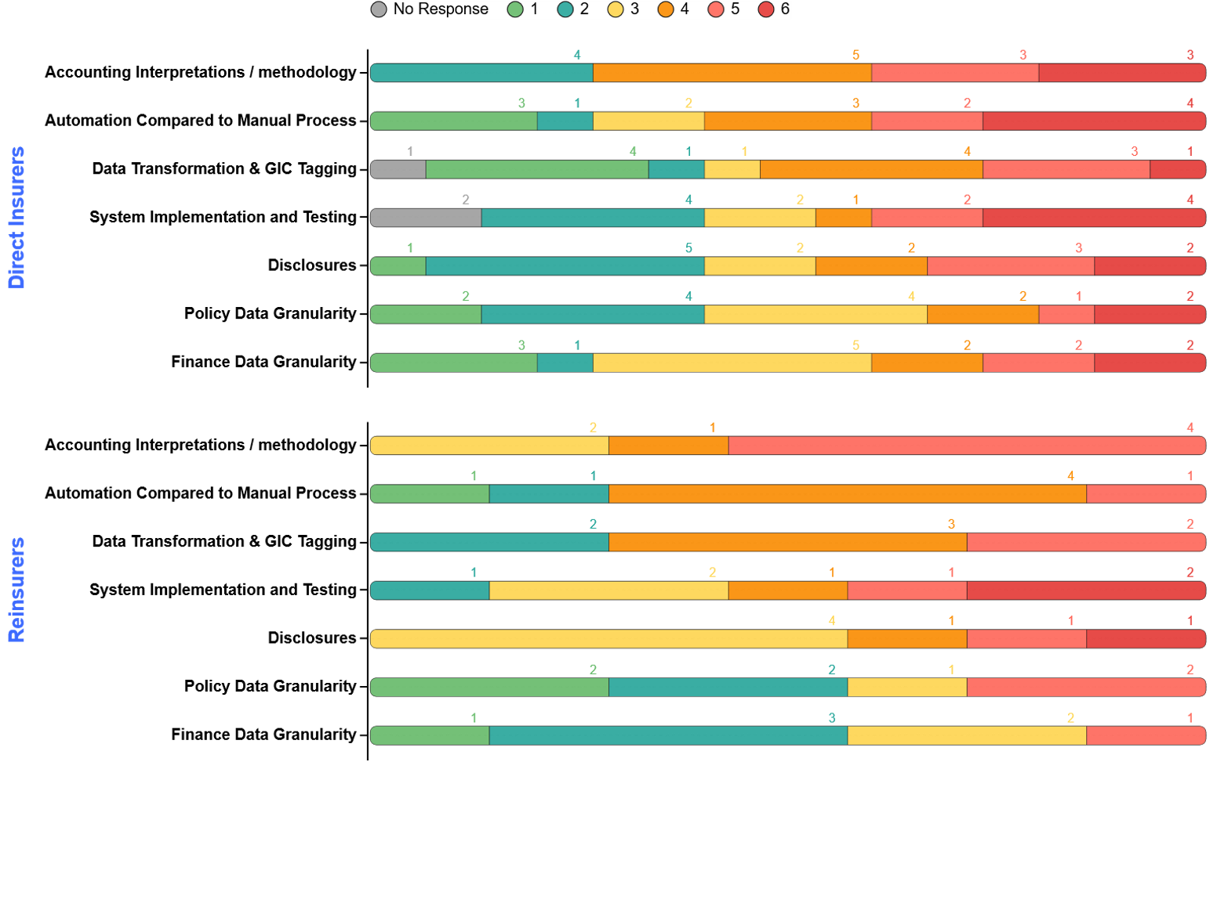
Section 2: System & Operations
Rank the following areas in terms of challenges as a result of IFRS 17 implementation (1 being straightforward and 6 being most challenging)
The Top 3 challenges (ranked 4 and above) experienced since go-live has been:
Accounting interpretations / methodology (73% of respondents ranked 4 and above)
Automation compared to manual process (64% of respondents ranked 4 and above)
Data transformation and GIC tagging (59% of respondents ranked 4 and above)
The ranking appears consistent for both Direct Insurers and Reinsurers.
Data transformation and GIC tagging
Appears to be more challenging for Reinsurers (71% ranked 4 and above), relative to Direct Insurers (53%).
This was expected given the wide range of GIC variations observed for reinsurers per our findings from Section 1

Slide 33
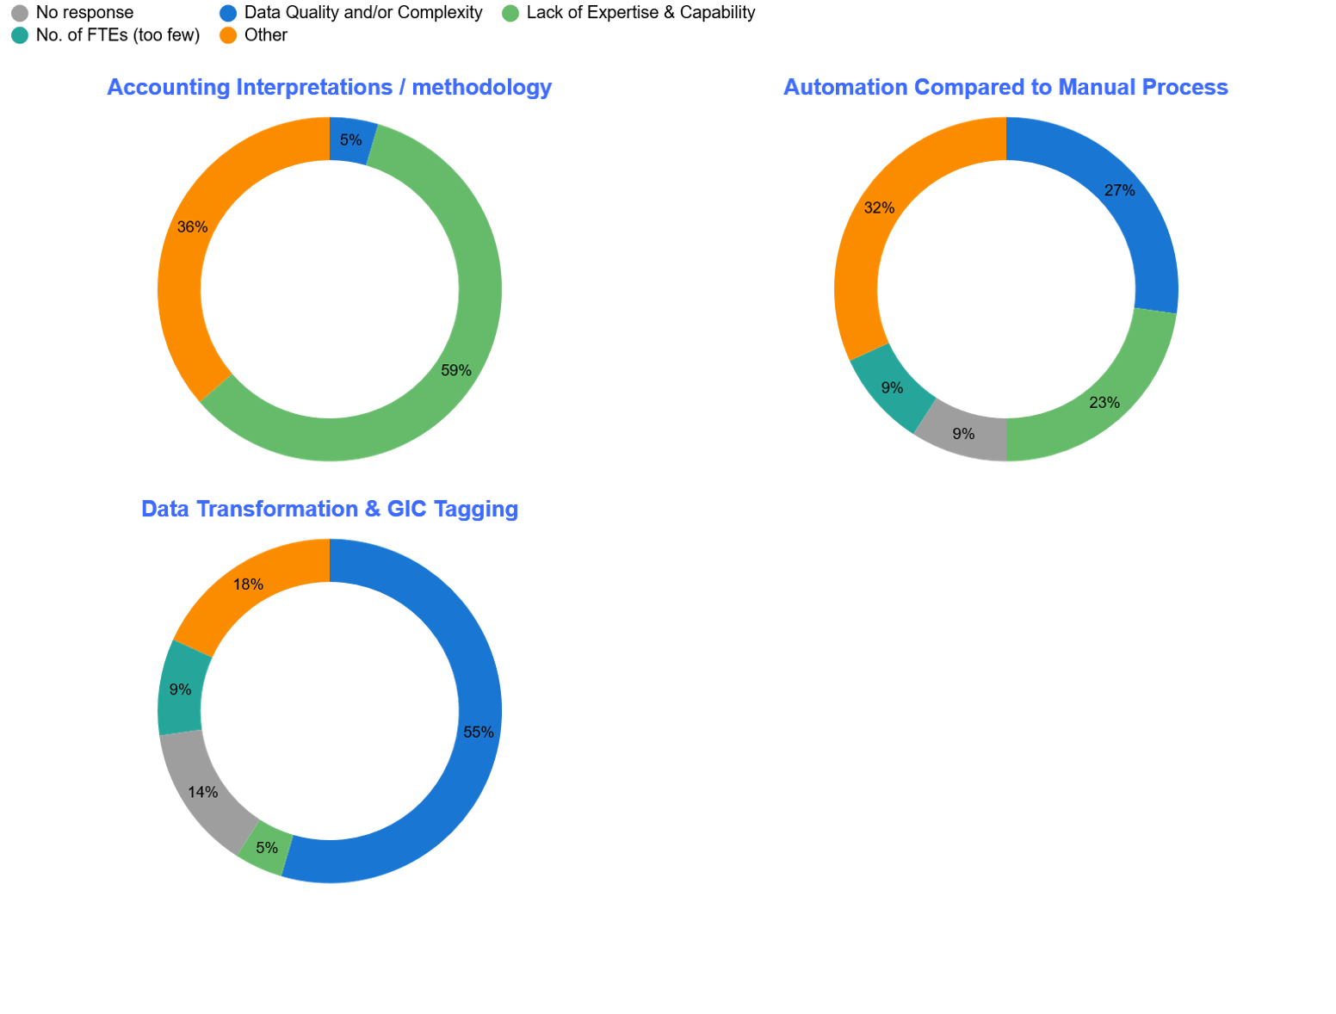
Section 2: System & Operations
Rank the following areas in terms of Driver for Challenge as a result of IFRS 17 implementation
For the Top 3 most challenging areas, the key drivers for each challenge selected by respondents are as follows:
Accounting interpretations / methodology:
Lack of expertise & capability (59% of respondents) and
Other reasons (36% of respondents) such as complexity of the pure accounting interpretation vs business implications and differences in interpretation between Group Office vs local.
Automation compared to manual process:
Data qualify and complexity (27% of respondents)
Lack of expertise & capability (23% of respondents) and
Other reasons (32% of respondents) largely due to the overly complex, detailed and time consuming processes.
Data transformation and GIC tagging:
Data qualify and complexity (55% of respondents) and
Other reasons (18% of respondents) such as additional processing of valuation output required despite having a strategic solution and time consuming/costly exercise.

Slide 34
Section 3: Business Impact & Lessons Learned

Slide 35
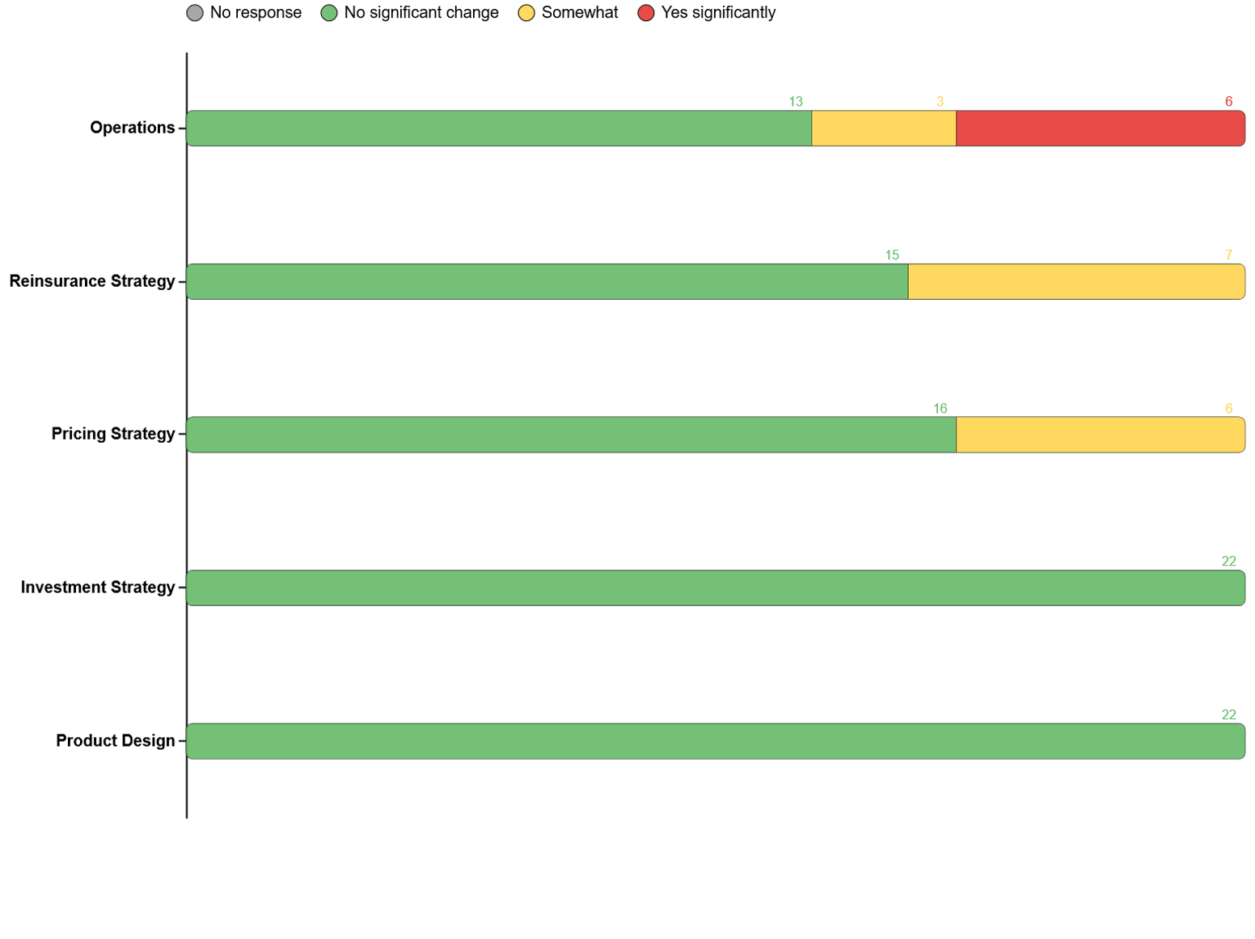
Section 3: Business Impact & Lessons Learned
Has IFRS 17 impacted the following areas?
Operations was identified as the area most significantly impacted by IFRS 17, with 6 of the 22 respondents selecting this option. The key drivers cited were additional data requirements and changes to processes and systems, particularly within Actuarial and Finance teams.
It should be noted that responses to this question may be influenced by differing interpretations of the term “Operations”. Many respondents appeared to consider operations as encompassing Actuarial and Finance reporting and related processes. However, it is possible that other respondents interpreted operations more narrowly, for example as referring only to back-office underwriting, claims, or similar operational activities. As a result, the responses should be interpreted with this context in mind.
Both Direct Insurers and Reinsurers responded no significant impact to product design and investment strategy areas.
40% (6 out of 15) of Direct Insurers noted a somewhat impact to both:
Pricing strategy: driven by profitability assessment under the new IFRS 17 basis and impact of onerous contracts
Reinsurance strategy: driven by alignment of contract boundary in treaties with underlying contracts and onerous contracts considerations during treaty negotiations

Slide 36
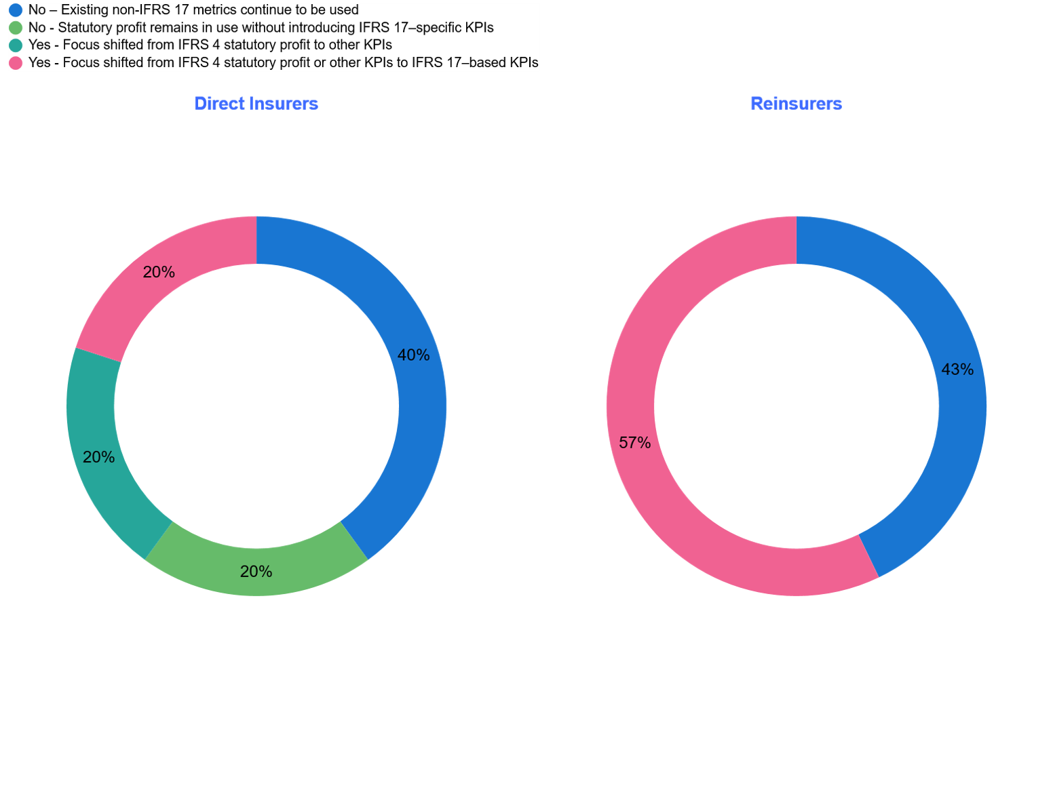
Section 3: Business Impact & Lessons Learned
Has IFRS 17 led to changes in your company's key financial metrics or KPIs for management reporting?
Direct Insurers
6 out of 15 Direct Insurers (40%) responded that IFRS 17 had led to changes to their KPI's:
3 responded that this change was due to shifting the focus from statutory profit previously under IFRS 4 or other KPIs (e.g. EV, VNB etc) to KPIs based on IFRS 17 (e.g. IFRS 17 profit, CSM ratios etc)
3 responded that IFRS 17 had led to a shift in focus away from using the previous IFRS 4 statutory profit to now using other KPI’s (e.g. EV, VNB, ROE etc)
60% of Direct Insurers responded that IFRS 17 had not led to any changes:
6 responded that the existing non-IFRS 17 metrics continue to be used (e.g. USGAAP, EV)
3 responded that statutory profit remains in use but no additional IFRS 17–specific KPIs have been introduced (e.g. CSM ratios)
Reinsurers
4 reinsurers (57%) responded that their KPI’s had changed due to shifting focus to KPI’s based on IFRS 17
3 reinsurers (43%) responded no change to KPI’s due to existing non-IFRS 17 metrics continue to be used (e.g. US GAAP.)

Slide 37
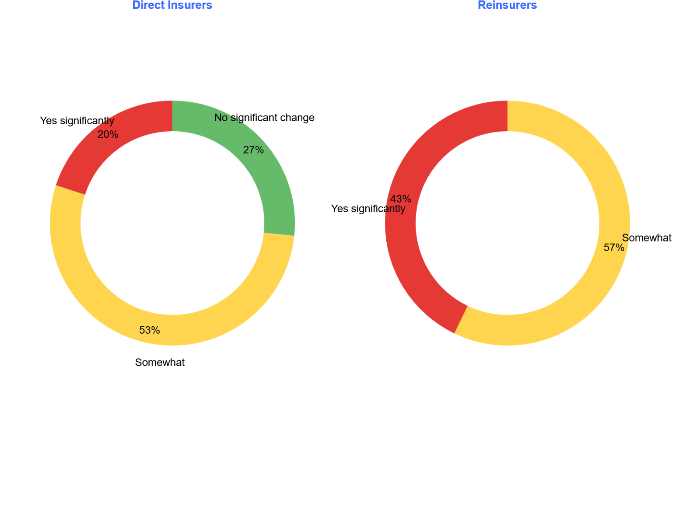
Section 3: Business Impact & Lessons Learned
Has IFRS 17 impacted or changed how the company results are communicated to the Board or to external reporting narratives?
10 out of 13 Direct insurers responded that IFRS 17 had at least somewhat impacted how the results are communicated.
Direct Insurers who responded a significant impact also responded a shift in focus from IFRS 4 statutory profit to other KPIs, which included introducing EV and other management reporting with “normalised profit” to avoid misleading outcomes under IFRS 17
Direct Insurers who responded a somewhat impact also responded that existing non-IFRS 17 metrics continue to be used, but with additional commentary required to explain the results in relation to other metrics (e.g. EV) and the volatility arising from IFRS 17
Direct Insurers who responded no significant change also responded that existing non-IFRS 17 metrics have largely been maintained (with minor formatting changes), or that statutory profit remains in use with no additional IFRS 17-specific metrics introduced.
All Reinsurers responded that IFRS 17 had at least somewhat impacted how the results are communicated:
For reinsurers who continue to use existing non-IFRS 17 metrics, additional commentary is required to explain how IFRS 17 outcomes differ from other reported metrics, e.g. USGAAP results.
Significant change to the presentation of the results and supporting commentary are required for the reinsurers who shifted focus from other reporting bases or metrics to IFRS 17 based KPIs.

Slide 38
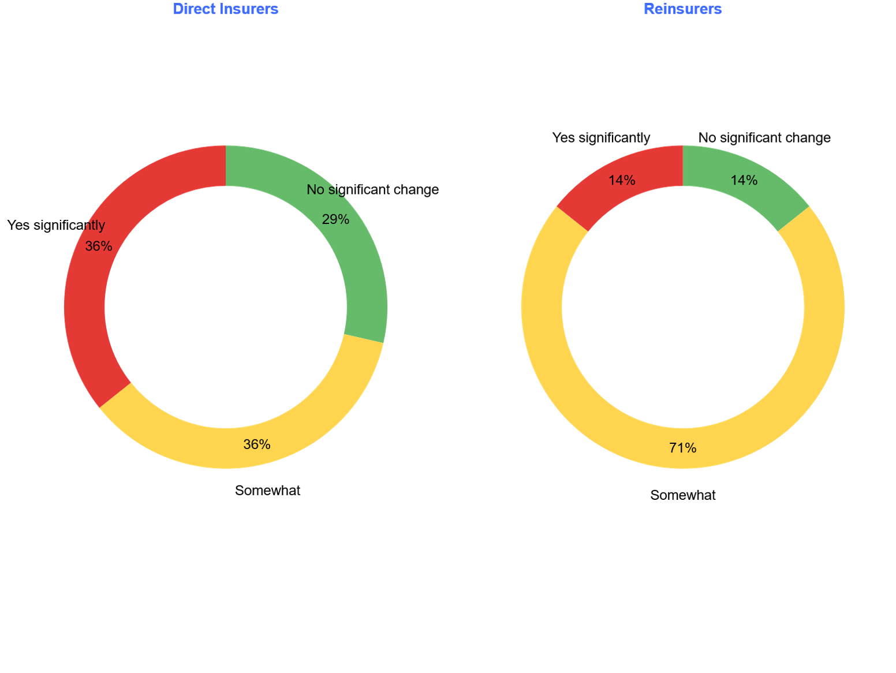
Section 3: Business Impact & Lessons Learned
Have you observed increased earnings volatility due to IFRS 17?
More Direct Insurers (36% or 5 out of 14) have observed significantly increased earnings volatility relative to Reinsurers (14% or 1 out of 6).
71% of Direct Insurers and 85% of Reinsurers noted at least some change to earnings volatility due to IFRS 17.
The main drivers of volatility for Direct Insurers:
Accounting mismatches: Contract boundary differences between underlying contracts and reinsurance contracts held
Onerous contracts: Recognised at a more granular level and the increased likelihood due to the introduction of the risk adjustment
Reinsurers appear to be less impacted as:
Contract boundaries between reinsurance contracts issued and retrocessions are more aligned.
CICP treatment as LRC vs LIC (Liability for Incurred Claims) – Impact of disability income experience and assumption change smoothed through CSM adjustment (if not in loss recognition as observed in page 23)
Some volatility for reinsurers remain due to the impact of the locked-in discount rate, which cannot be smoothed.

Slide 39
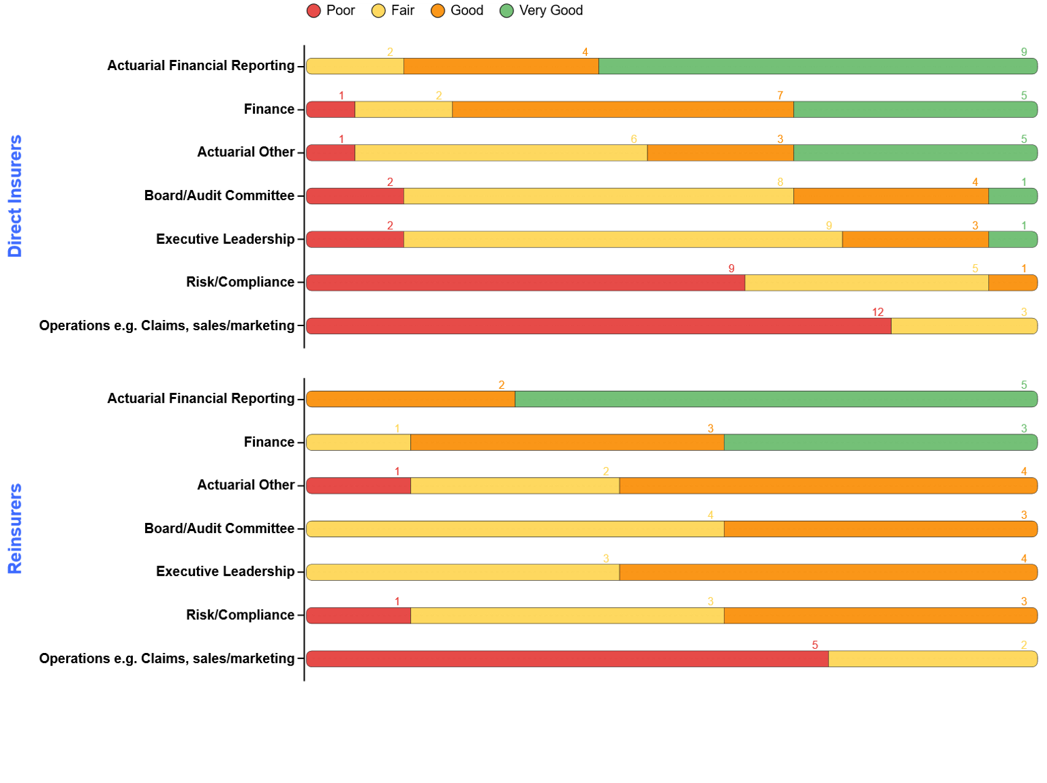
Section 3: Business Impact & Lessons Learned
How would you assess the understanding of IFRS 17 reporting outcomes across the following groups?
The Top 3 groups rated with the best understanding (good and very good) of IFRS 17 reporting outcomes are:
Actuarial Financial Reporting (91% of respondents indicated good or very good)
Finance (82% of respondents indicated good or very good)
Actuarial Other (55% of respondents indicated good or very good)
The ranking appears consistent for both Direct Insurers and Reinsurers.
The group rated with the least understanding of IFRS 17 across both direct insurers and reinsurers was Operations, largely because of limited involvement/exposure and relevance to their day-to-day functions.
87% of Direct Insurers and all Reinsurers indicated that Board/Audit Committee and Executive Leadership have at least a fair knowledge of IFRS 17 reporting outcomes, attributable to IFRS 17 Board education sessions provided.

Slide 40
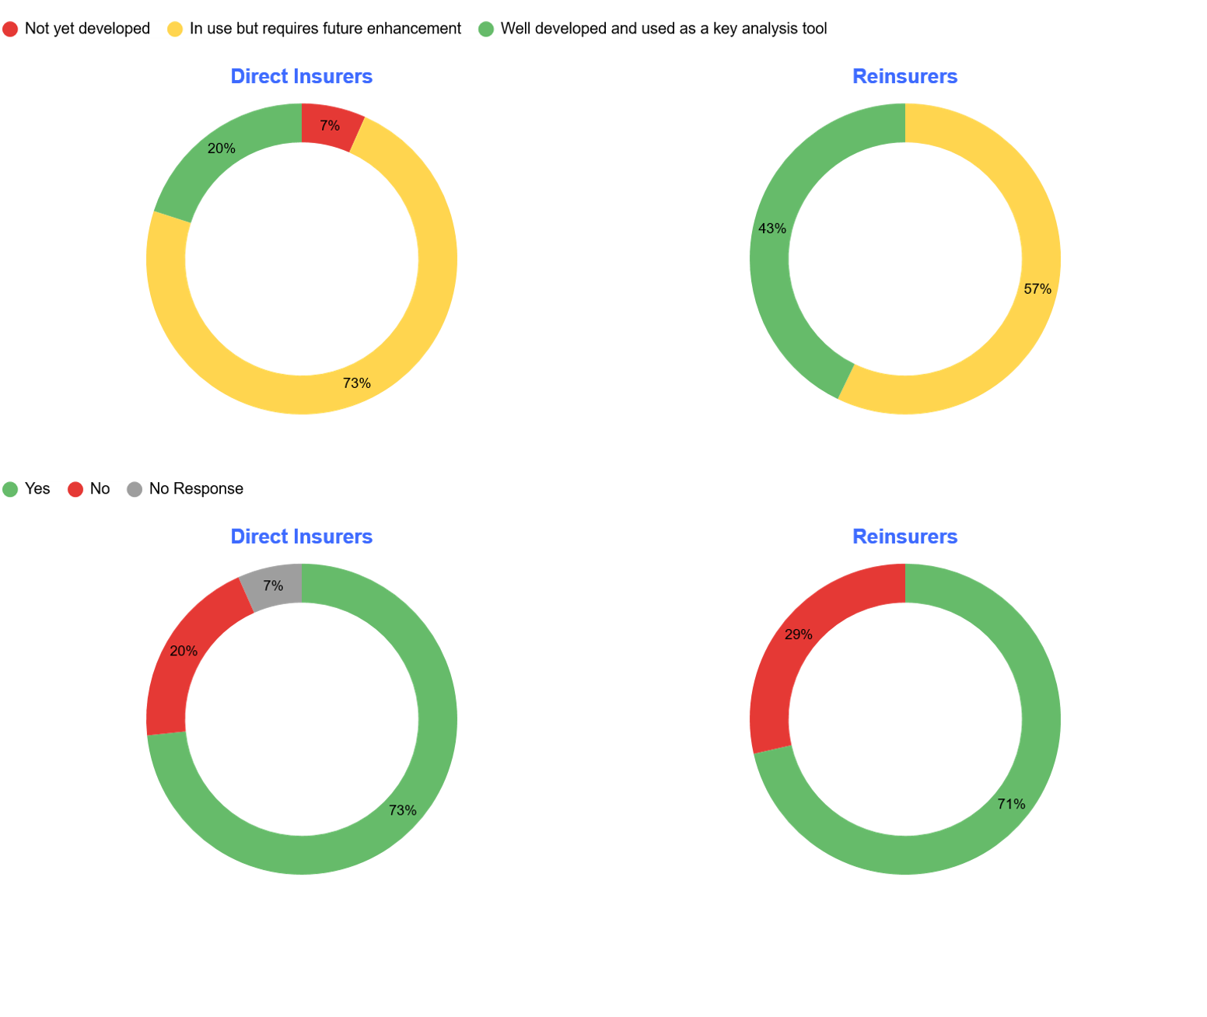
Section 3: Business Impact & Lessons Learned
In regards to the Analysis of Profit developed under IFRS 17: a) Could you rate the level of maturity in terms of its development?
The majority of Direct Insurers (80%) responded that their AoP under IFRS 17 is underdeveloped and requires future enhancements, with specific improvements for:
Granularity: To analyse at a more granular level using improved data
Profit components: To analyse components of the IFRS 17 insurance service revenue e.g. premiums and claims variance drivers, lapse experience and CSM movements
Integration with other metrics: E.g. Embedded value
Automation: Minimising manual intervention
Reinsurers appear to have:
Better developed AoP compared to Direct Insurers, as 43% responded that their AoP under IFRS 17 was well developed.
57% of Reinsurers responded further refinement is required, the main drivers of which were for automation and process improvement.
Despite the challenges with IFRS 17 reporting outcome, the majority of Direct Insurers and Reinsurers (>70%) believe the AoP is still useful under IFRS 17.
b) Is the analysis still useful in providing insights and/or used as a key control relative to the previous AoP under IFRS4/MoS?

Slide 41
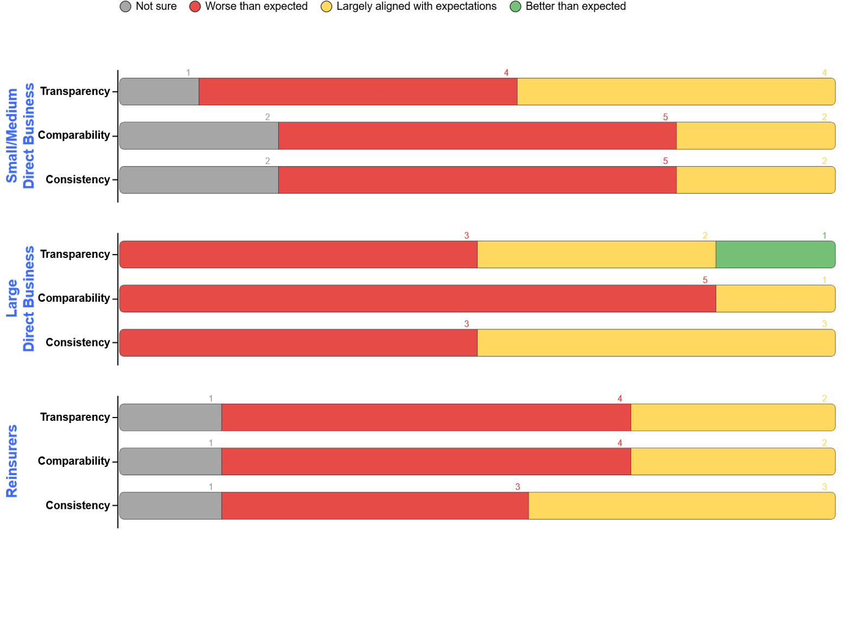
Section 3: Business Impact & Lessons Learned
Has IFRS 17 met your company's expectations in terms of reporting transparency comparability and consistency?
Based on further feedback and discussion of responses, expectations for the outcome of IFRS 17 were generally low. Therefore, the interpretation of ‘Largely aligned with expectations’ should be understood in this context.
Transparency
Both Small and Large Direct Insurers (47%) found transparency was at least largely aligned with their expectations. These insurers found that the granularity required for group of contracts have helped identify onerous contracts and reduce cross subsidy
Reinsurers appear to be less positive of transparency achieved by IFRS 17 as only 29% found that it aligned with their expectations, noting that there has been a variety of interpretation depending on the company’s expectations.
Comparability and Consistency
Reinsurers and Smaller/Medium Direct Insurers tend to find that IFRS 17 reporting is more comparable and consistent compared to Direct Insurers.
83% of Large Direct Insurers responded that comparability is worse than expected, mainly due to different accounting policy choices creating significant variability across insurers.
43% of Reinsurers responded consistency is largely aligned with expectations, as IFRS 17 implementation resulted in development/implementation of calculation engines which improved consistency in how the Standard is applied.
A key theme was that although industry results now follow a more consistent structural format, meaningful comparability remains limited.

Slide 42
Section 4: Reflections on Industry & Institute Support

Slide 43
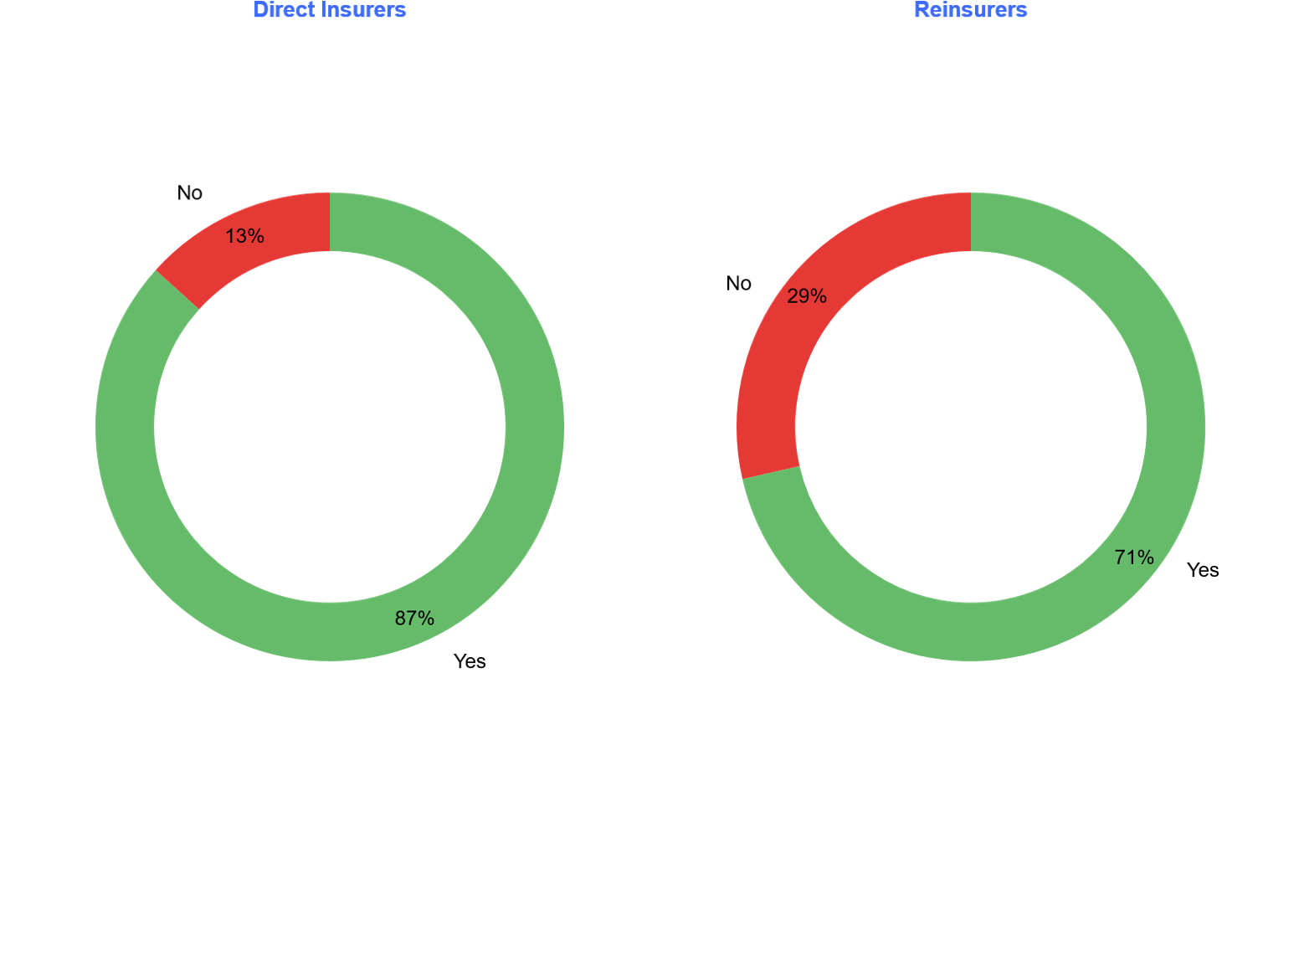
Section 4: Reflections on Industry & Institute Support
Did you find the Actuaries Institute information note on AASB 17 useful in helping you to interpret the IFRS 17 standard?
Usefulness of the Actuaries Institute Information Note**
A strong majority found the Information Note helpful, with 87% of direct insurers and 71% of reinsurers responding “Yes”.
Feedback from those who did not find it useful (5 respondents)
2 felt the guidance was not sufficiently tailored to reinsurance.
1 considered the document too long or difficult to apply in practice.
1 relied primarily on accounting-firm interpretations instead.
1 raised concerns about paraphrasing and lack of precision in areas requiring judgment.
What additional support would have been most helpful?
Technical or illustrative guidance (e.g. worked examples, disclosures, CSM/LC/RLRC/IACF topics) – 7 respondents.
Worked examples tailored to the AU/NZ market – 6 respondents.
More industry forums or discussion circles – 5 respondents (including 3 reinsurers).
Greater clarity or alignment in interpretation – 4 respondents.
No additional support needed – 3 respondents.
Differences in emphasis
Direct insurers (15) commonly sought worked examples and clearer disclosure guidance.
Reinsurers (7) placed more weight on peer forums and reinsurance-specific interpretation challenges.
** The paper was originally published as an Information Note in 2018. In February 2023 it was updated to a Technical Paper. The paper can be found here: TP AASB 17 Insurance Contracts Technical Paper Version 3.2 (February 2021)

Slide 44
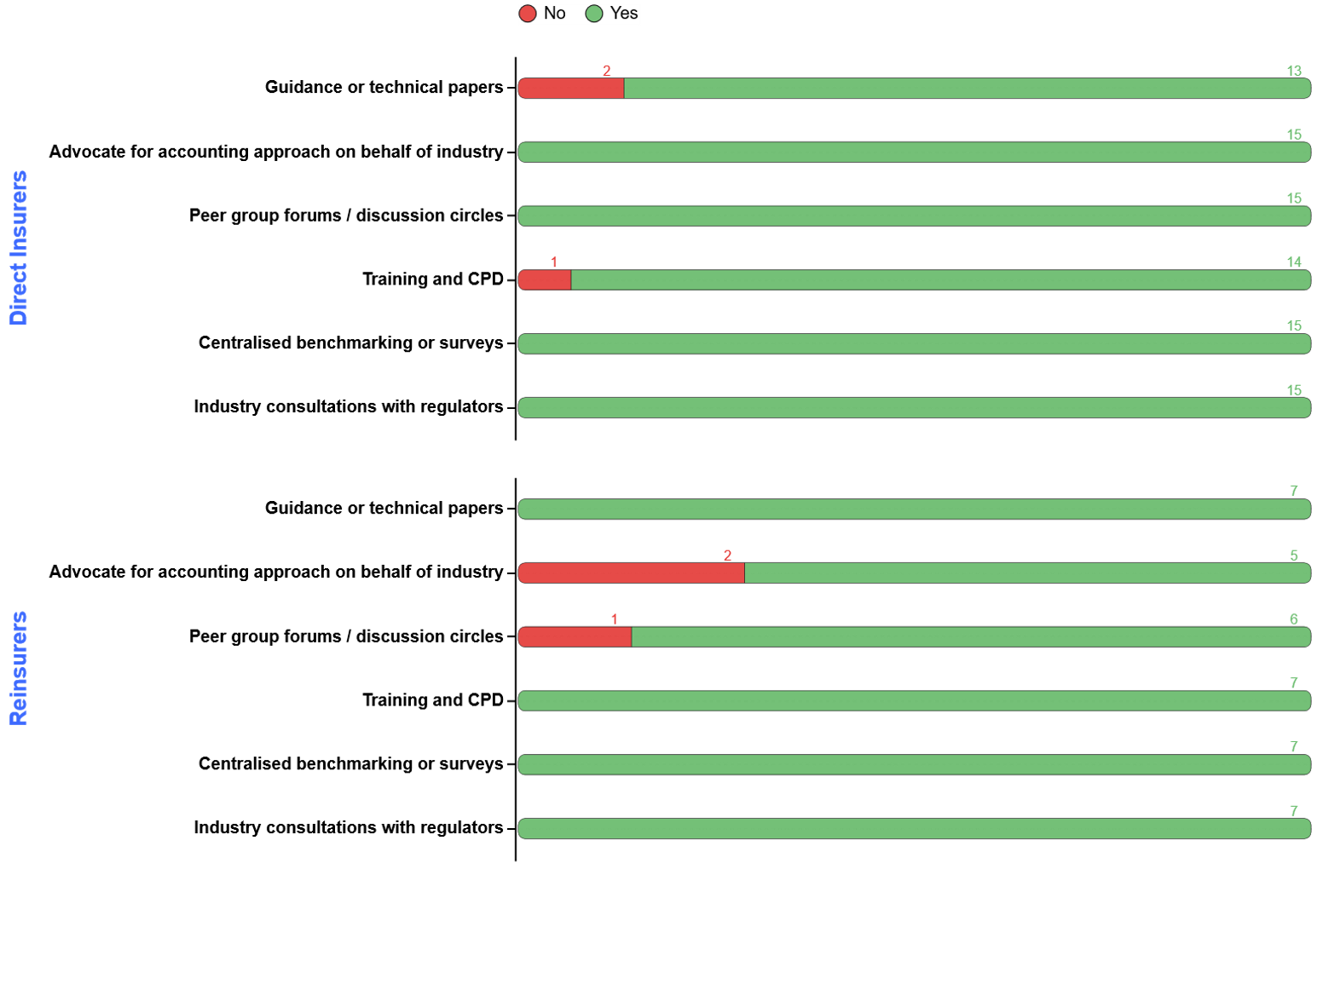
Section 4: Reflections on Industry & Institute Support
What role should the Actuaries Institute play in supporting future reforms of similar scale?
Institute’s Role
Support for Institute involvement was exceptionally strong across all 22 respondents, with almost all selecting every available support option shown in the graph.
Respondents expect the Institute to continue playing both a technical and an advocacy role in future reforms of similar scale.
From discussions, one respondent emphasised the importance of the Institute advocating for more “sensible” outcomes for IFRS 17 reporting, while others approached the question more reflectively, expressing more modest expectations of future involvement.
Post-IFRS 17 Focus Areas
Respondents highlighted four clear areas of immediate focus:
Operational enhancements (10 respondents / 45%): Reducing manual work, strengthening controls, streamlining calculations, and scaling cohort processing.
Improved analysis and communication (7 respondents / 32%): Enhancing AoP insights, understanding volatility drivers, improving interpretation of P&L and balance sheet movements, and strengthening stakeholder communication.
Data quality and system alignment (5 respondents / 23%): Cleaning transition data, aligning actuarial and finance systems, and integrating IFRS 17 projections with planning and capital processes.
Strategic and business improvements (5 respondents / 23%): Refining coverage units, managing onerous losses, developing EV and cashflow-profit metrics, and aligning with global reporting frameworks.
Reinsurers also noted specific priorities, including strengthening controls, improving outward reinsurance processes, reducing volatility, and ensuring stronger alignment between local and group reporting.

Slide 45

Q&A
Join at slido.com #3793188

Slide 46
Feedback Poll
Join at slido.com #3793188

