Slide 1
Evaluation of the effectiveness of claims farming reforms in the QLD CTP scheme
David Vincent, Peter Mulquiney, Danielle Ling
November 2025

Slide 2
Contents
Claims farming reforms in QLD 01
Evaluation Study 02
Claims farming reforms across Australia 03

Slide 3
Claims farming reforms in QLD
01

Slide 4

Claim Farming prevention Why?

Slide 5
Intent of Legislation
Does not prevent lawyers from informing people about their rights and entitlements, nor does it prevent them from advertising or promoting their services.
What it aims to do is stop the harassing calls and intimidating behaviour, particularly toward vulnerable people and protect the affordability and stability of the scheme.

Slide 6
Legislative Provisions
Applies to referrals of claims and contact to solicit or induce claims.
Two new offences:
• Section 74 - Giving or receiving consideration for claim referrals
• Section 75 – Approach or contact for the purpose of making a claim
Applies both within and outside Queensland.

Slide 7
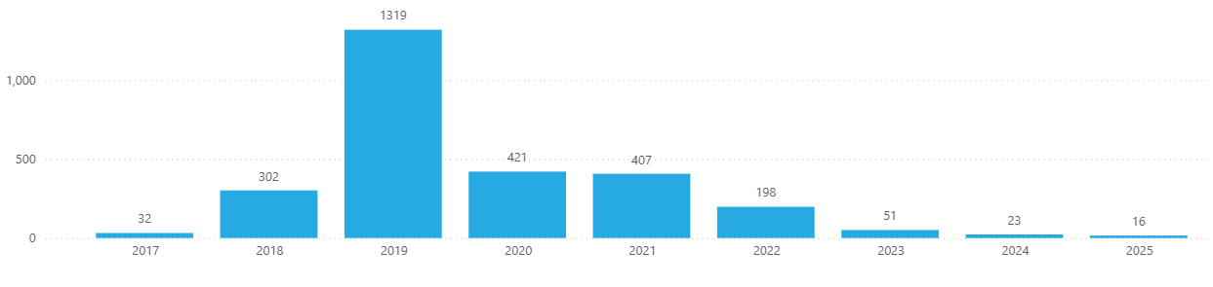
Car crash scammer reporting from the public

Slide 8
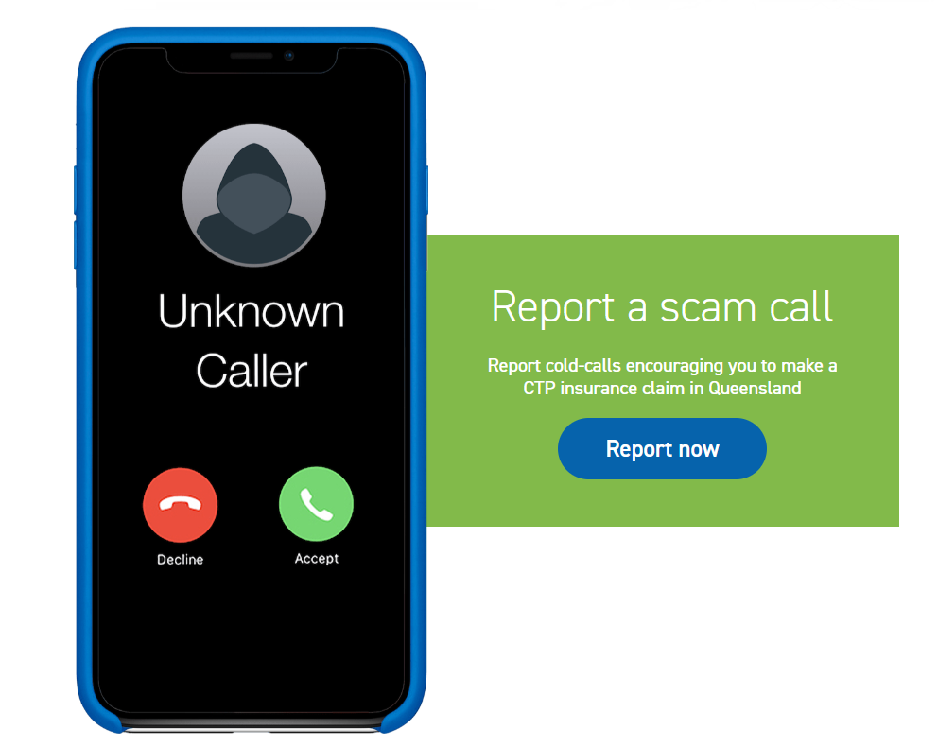
Support for claim farming reforms
Market research – 800 Queenslanders >18yo surveyed on-line
93% support action being taken against claim farmers
37% had been contacted by a claim farmer in prior 12 months
People very concerned about how their privacy was breached
Complaints made to MAIC and to ACCC
Concerned that claim farmers have targeted children and elderly people
Claim farmer techniques include impersonation and high-pressure tactics

Slide 9

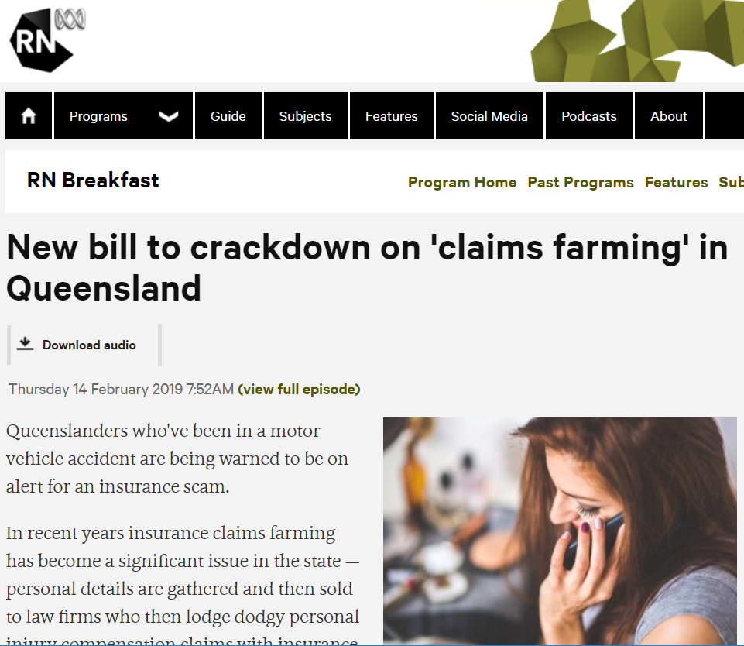
Public awareness initiatives
Key message: Car Crash scamming is a crime/ Hang up and report. Visit maic.qld.gov.au/hangup or call 1800 CTP QLD (1800 287 753)
Phase 2 advertising campaign delivered February 2020, and ongoing communication continues to keep the issue top-of-mind
Channels:
Emails
Newspaper ads
Radio ads and coverage (ABC Radio, 4EB Community Radio)
Social media
MAIC website
QLS update
Flyers in 1.5 million rego renewals (Feb-July)
Message included in our rego renewal notice

Slide 10
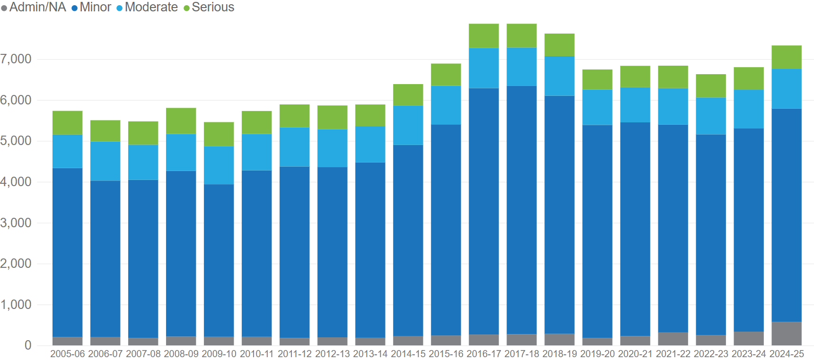
New claims
Legislative changes introduced December 2019
COVID-19 restrictions commenced March 2020

Slide 11
Tracing Reform and Impact
Research
Reform
Amendments
Richard Douglas QC advice on the practice of claims-farming in the Qld CTP scheme.
The Motor Accident Insurance and Other Legislation Amendment Act 2019
The Personal Injuries Proceedings and Other Legislation Amendment Act 2022
2017
2019
2022
Covid
2016

Slide 12
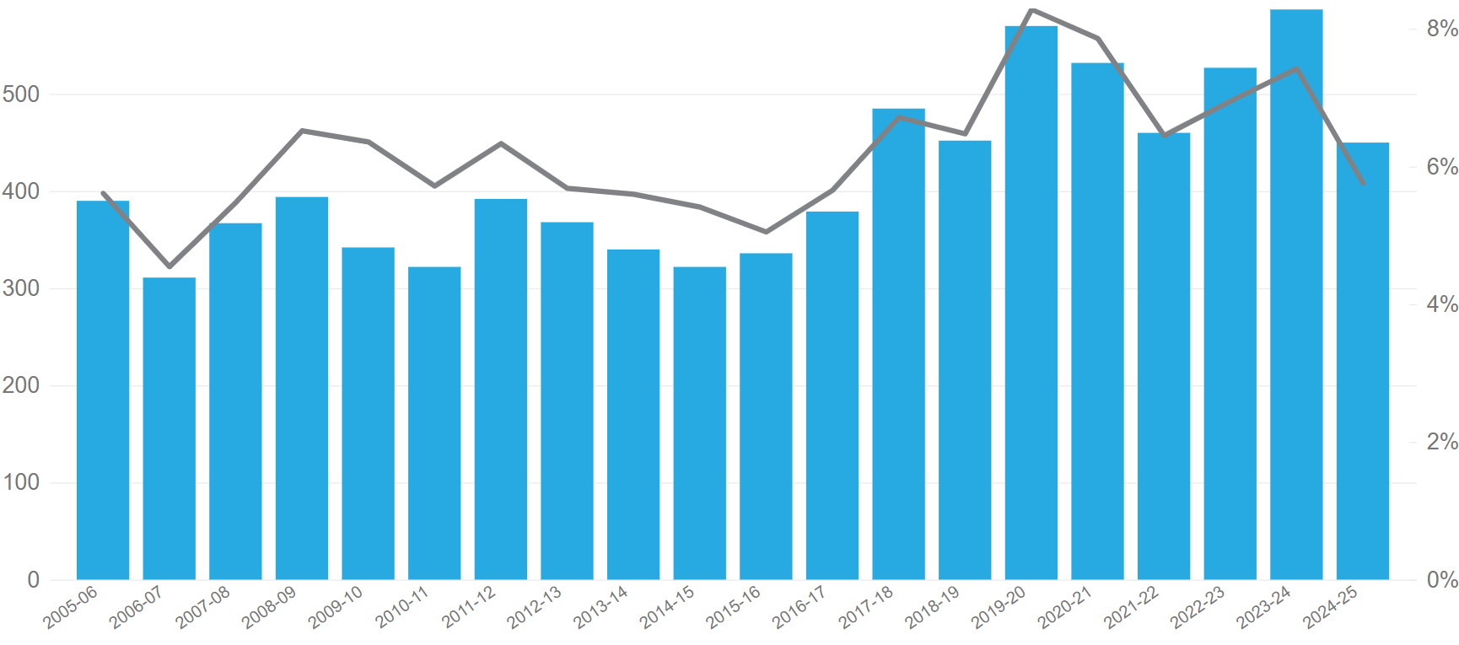
Discontinued & lapsed claims
The number of discontinued (withdrawn) or lapsed (closed due to inactivity) claims has trended upwards post-reform.
Legislative changes introduced December 2019
COVID-19 restrictions commenced March 2020

Slide 13

Since implementation
1 successful prosecution
94 Claim farming offences and $1M in fines
Proceedings served on other matters
Supreme Court Application
Investigations ongoing

Slide 14
Evaluation study
02

Slide 15

Purpose of the Study
To evaluate the effectiveness of the 2019 Queensland CTP claims-farming reforms by:
identifying the claim segments most affected by the reforms, and
estimating the cost impact associated with the reduction of those claims.

Slide 16
Methodology
Data
Queensland CTP claim information for accident years 2017–2021, drawn from the Personal Injury Register (PIR), including:
Claimant information: age, earnings, prior claim history, occupation, legal firm, etc
Accident/injury information: accident circumstance, severity, hospitalisation, shared representation, etc
Signals of change
Examined shifts in claim frequency across year and quarter of accident, and assessed distributional changes in key explanatory variables
Methods
Classification (GBM): Identified variables exhibiting the largest distributional shifts between accident years 2017 and 2021
Interpretable decision tree: Grouped claims into distinct segments, each representing meaningful combinations of characteristics associated with the most significant changes

Slide 17
Challenges and limitations
Data and definitions
Missing or measurement error: Some variables show incomplete or inconsistent recording across years.
Definition drift: Changes in coding or reporting practices over time may cause apparent trends that do not reflect true behavioural changes.
Approach and segment identification
Causality limits: Observed signals cannot fully isolate the reform impact from other concurrent influences such as COVID-19, macroeconomic factors, or exposure mix changes.
Collinearity: Many variables are correlated to varying extent, making it difficult to interpret isolated effects and form distinct segments.
Segment leakage: There is an inherent trade-off between clear, interpretable segmentation and complete capture of claims-farming activity. Some farmed claims may remain outside the identified shrinking segments (false negatives), while some non-farmed claims may be included within them (false positives).

Slide 18
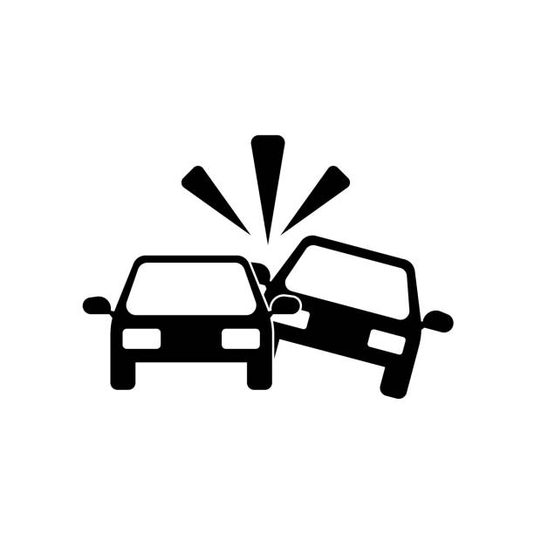

Variables exhibiting the largest distributional shifts
Claimant characteristics
Accident outcome
Shared
representation
Earnings
Age
Hospital visit
Prior claim
history
Treatment type

Slide 19
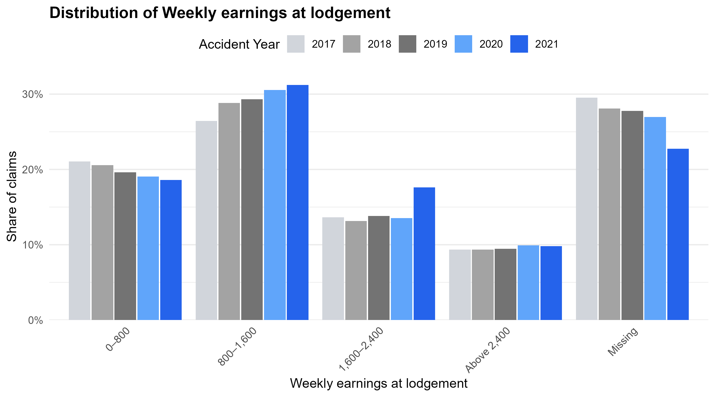
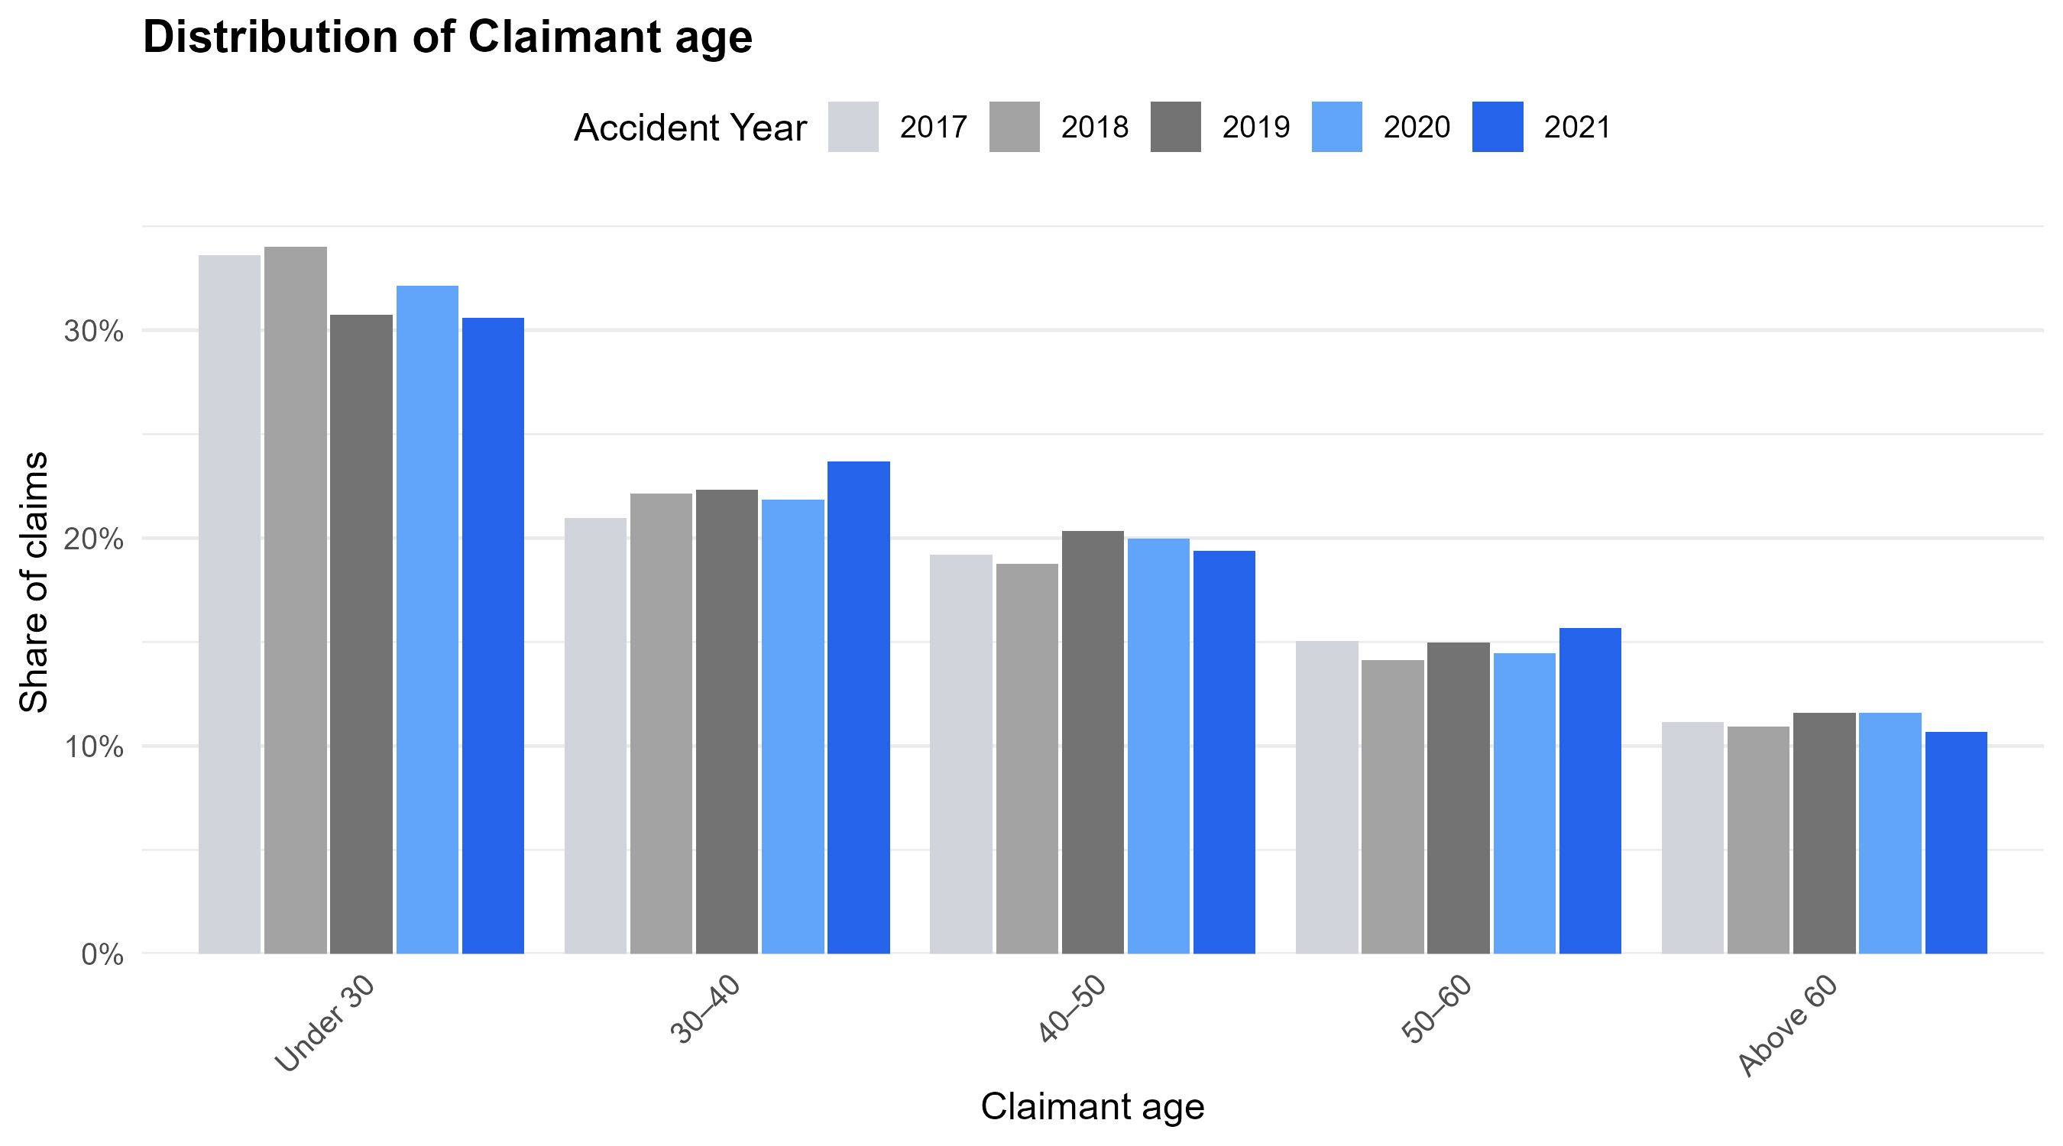
Variables exhibiting the largest distributional shifts
Claimant weekly earning
Claim mix shifted away from missing or low-income earners toward mid-to high-income claimants.
Claimant age
Claim mix shifted from younger claimants (≤30 years) toward older age groups (>30 years).
Note: Earnings are inflation-adjusted to September 2024 values.

Slide 20
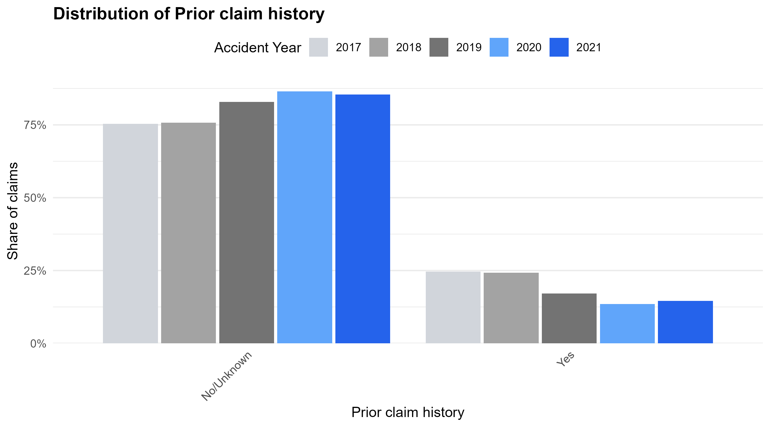
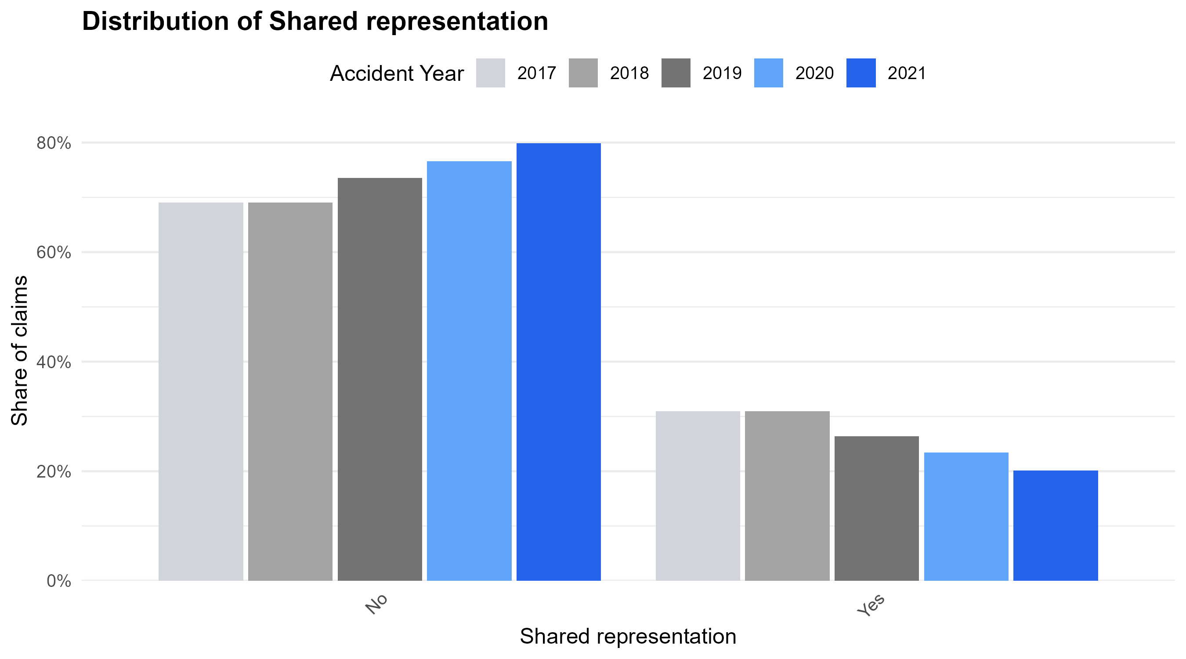
Variables exhibiting the largest distributional shifts
Prior claim history
Claim mix shifted away from claimants with a prior personal-injury claims history toward those making their first claim.
Shared representation
Claim mix shifted away from claims jointly handled by multiple insurers toward those managed by a single insurer.

Slide 21
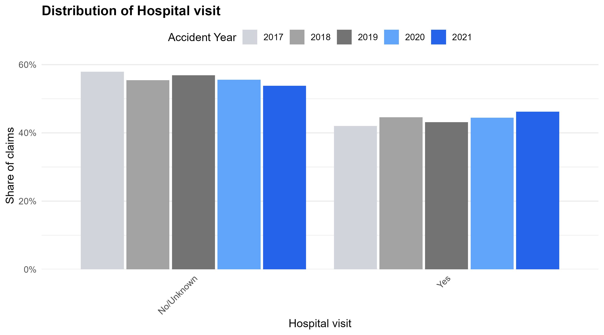
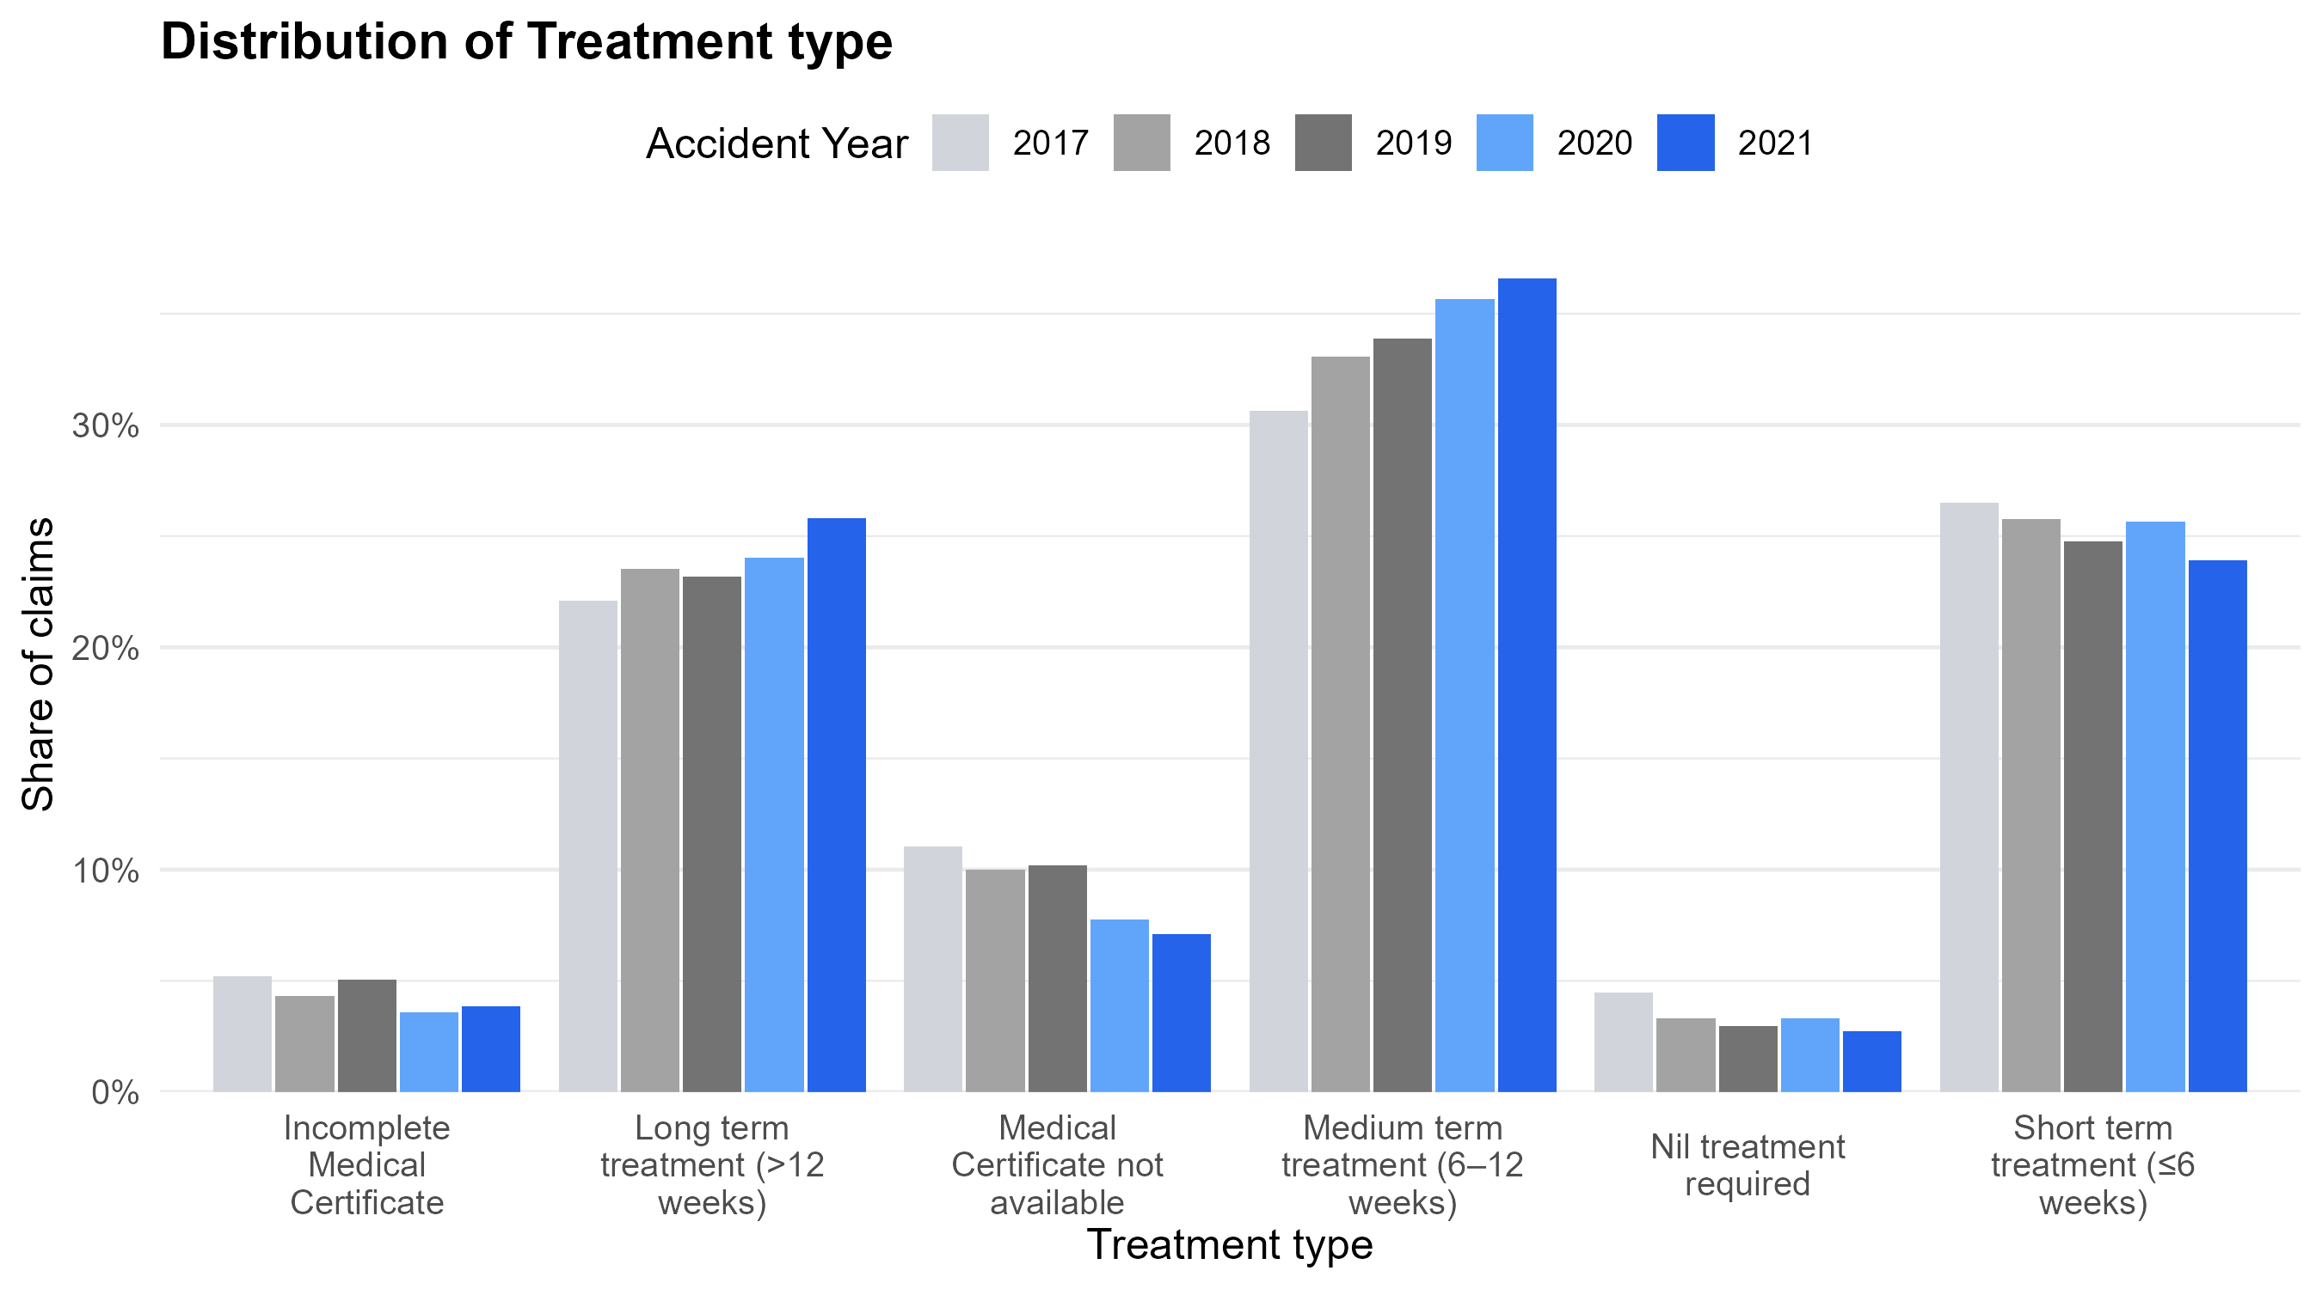
Variables exhibiting the largest distributional shifts
Hospital visit
Claim mix shifted away from claimants without hospital visits toward those who attended hospital.
Treatment type
Claim mix shifted toward claimants receiving longer treatment durations (medium- to long-term treatment).

Slide 22
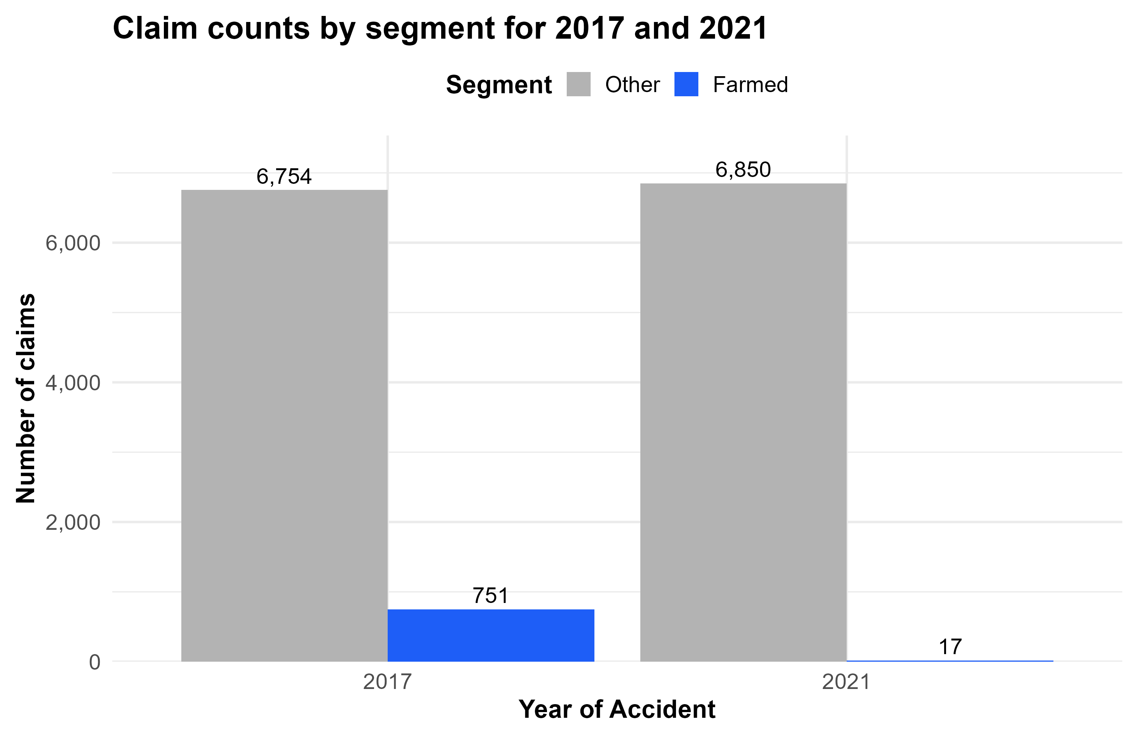
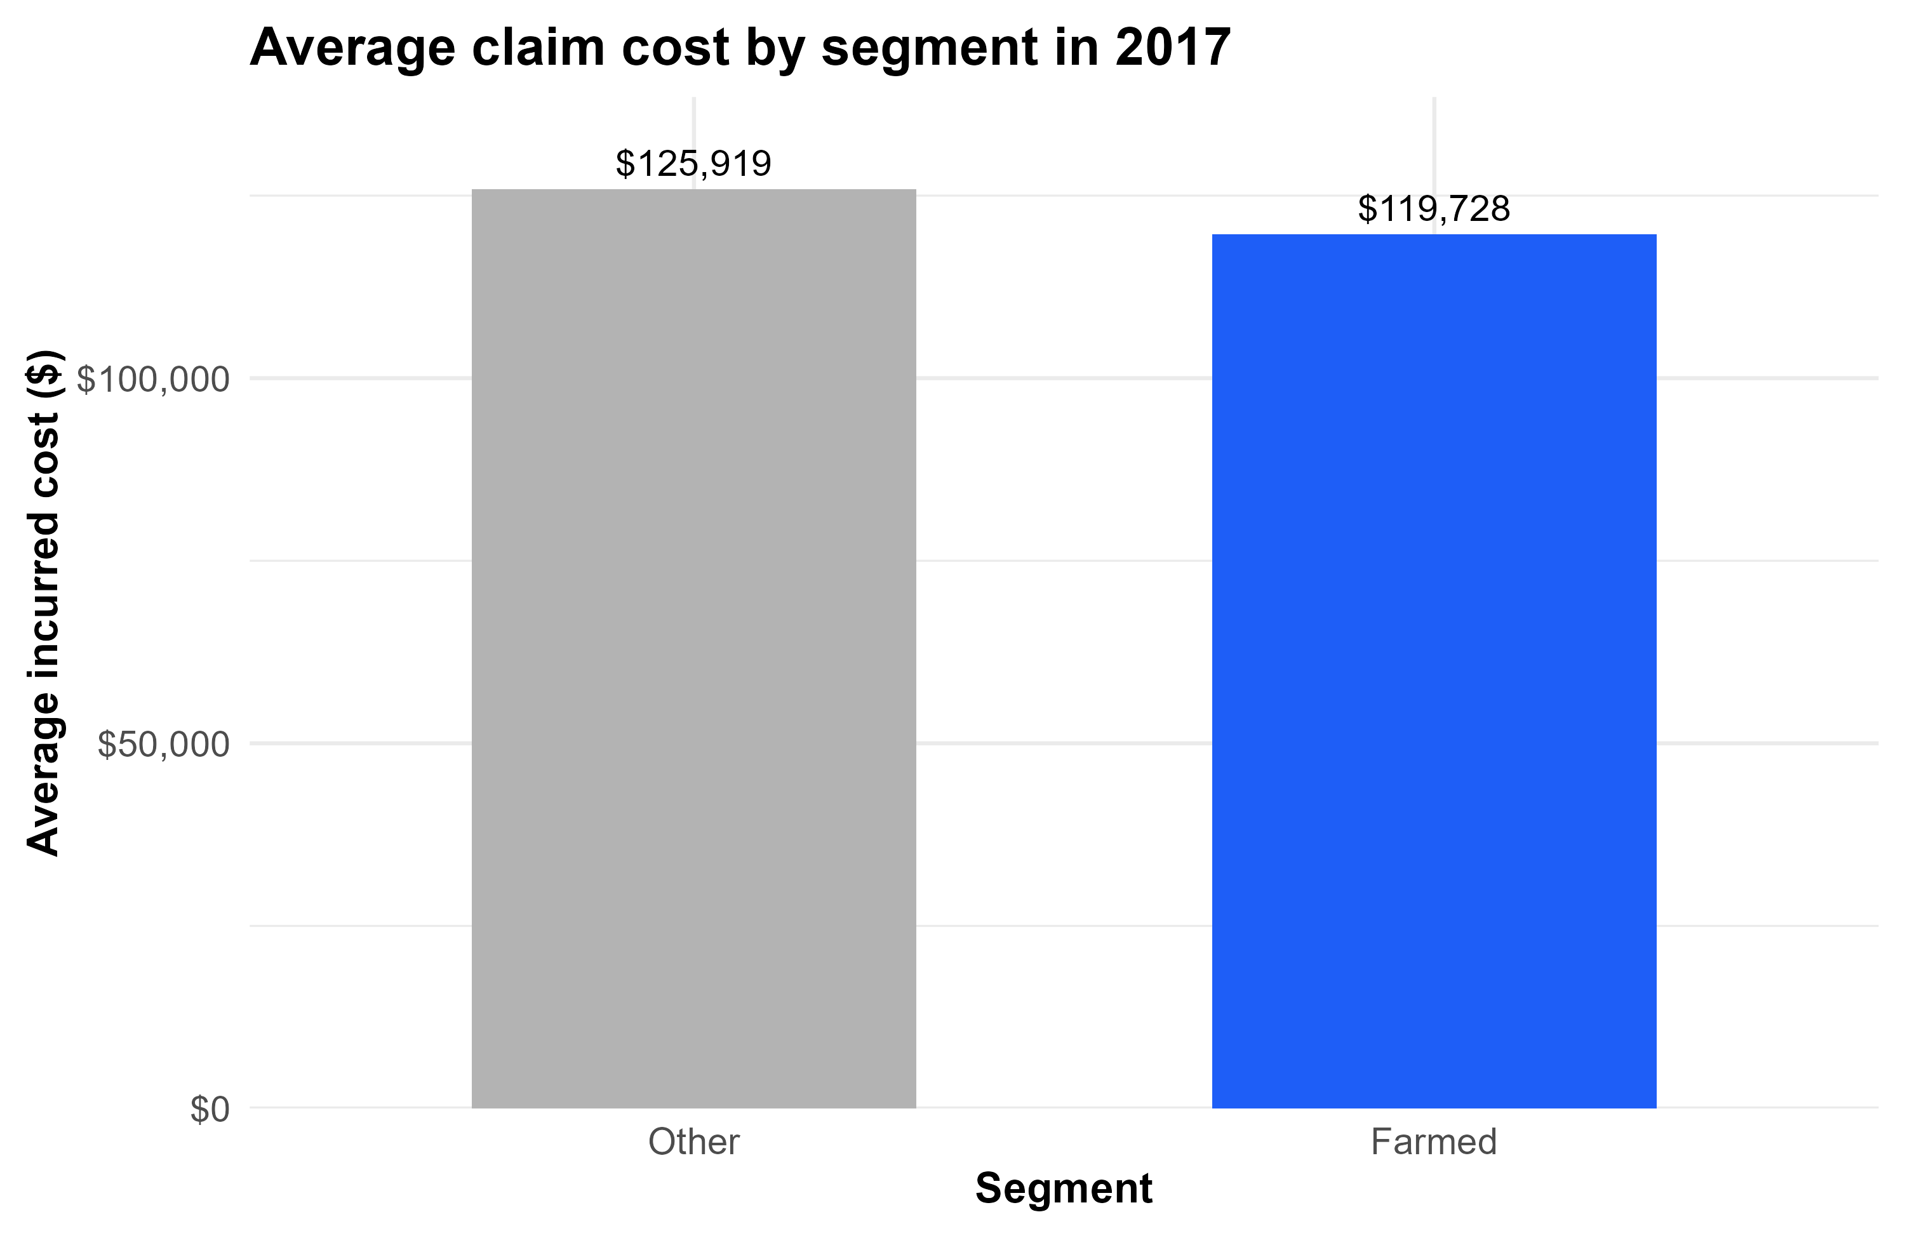
The six variables were used to identify a claims farming segment
The claims farming segment
Claims with patterns of claim characteristics – young, low income, prior claims, shared, no hospital visit, and short-term treatment – that had a high probability (> 92.5%) of disappearing by 2021 were assumed to be “farmed”
This segment was about 10% of claims in 2017 and dropped to just 17 claims by 2021 – a drop of 734 claims
The farmed segment had slightly lower average claim cost ($120K vs $126K)
This gives an upper bound to the estimated savings of about:
~$90M annual saving or
~ 9% reduction in premium

Slide 23
Summary – Benefits of Claims Farming
Reduction in premium rates for QLD CTP
Estimate from this analysis should be considered an upper bound
Based on lots of strong and uncertain assumptions – in particular, that reductions in claim farming are sole cause of changes in the distribution of claim characteristics
Mid range estimate of 4.5% premium reduction seems most reasonable
Less harassment of vulnerable Queenslanders
Significant drop in the number of complaints made to MAIC
Claim farming notifications from Queenslanders continued to trend down from more than 1,300 complaints in 2019 to 16 reported in 2024–25

Slide 24
Claims farming reforms across Australia
03

Slide 25
Australia’s Claims Farming Reform Timeline
QLD Reform
NSW Reform
The Motor Accident Insurance and Other Legislation Amendment Act 2019
Claims Farming Practices
Prohibition Act 2025
2019
QLD Amendments
2025
The Personal Injuries Proceedings and Other Legislation Amendment Act 2022
SA Bill (in progress)
2022
Statutes Amendment (Claim Farming)
Act 2024
WA Bill (lapsed)
2024
Insurance Legislation Amendment (Motor
Vehicle Claims Harvesting) Bill 2023
QLD Research
2023
Richard Douglas QC advice provides guidance on a way forward.
2016
2017
2016
2019
2022
2025
Presented at the 2025 IDSS

Slide 26
Jurisdiction Comparison
Coverage
 | QLD | NSW | SA (in progress) | WA (lapsed)
CTP | ✓ |  | ✓ | ✓
Workers Compensation | ✓ |  | ✓
Other Personal Injury | ✓ | ✓ | ✓
Penalty | 300 penalty units | 500 penalty units | $50,000 | $10,000
Penalty
Presented at the 2025 IDSS

Slide 27
Jurisdiction Comparison
Prohibitions
 | QLD | NSW | SA (in progress) | WA (lapsed)
Contacting another person to solicit or induce them to make a claim | ✓ | ✓ | ✓ | ✓
Providing or receiving consideration for the referral of a potential claimant | ✓ | ✓ | ✓ | ✓
Breach may constitute professional misconduct | ✓ | ✓ | ✓ | ✓
Legal costs can not be recovered and amounts received must be repaid | ✓ | ✓ | ✓ | ✓
Law Practice Certificates are required throughout every claim | ✓ |  |  | ✓
Regulators can apply for injunctions | ✓ |  |  | ✓
Process Control
Presented at the 2025 IDSS

Slide 28
The Actuaries Institute acknowledges the traditional custodians of the lands and waters where we live and work, travel, and trade. We pay our respect to the members of those communities, Elders past and present, and recognise and celebrate their continuing custodianship and culture.

Slide 29
About the Actuaries Institute
The Actuaries Institute is the peak professional body for Actuaries in Australia. The Institute provides expert comment on public policy issues where there is uncertainty of future financial outcomes.
Actuaries have a reputation for a high level of technical financial expertise and integrity. They apply their analytical and risk management expertise to allocate resources efficiently, identify and mitigate emerging risks and to help maintain system integrity across multiple segments of the financial and other sectors. This unrivalled expertise enables the profession to comment on a wide range of issues including life, general and health insurance, climate change, superannuation and retirement income policy, enterprise risk management and prudential regulation, the digital economy, finance and investment and wider health issues.
© Institute of Actuaries of Australia 2023.​ All rights reserved.

Slide 30
Thank you
Actuaries Institute
actuaries.asn.au

