Slide 1
Orchestrating Scheme Impact with AI
Aaron Cutter and Minh Phan
November 2025
Notes:
Thank you for attending our session -

Slide 2



What are different kinds of AI?
Language Models
AI that reads and writes like a person.
Speech and Vision Models
AI that understands audio, images and video.
Predictive AI
AI that spots patterns in
structured data
Notes:
It can summarise claim notes, classify injury types, detect sentiment in emails, and draft correspondence.
Used to transcribe calls, read scanned forms, recognise injury photos.
e.g. predicting claim frequency, duration, cost, or likelihood of fraud

Slide 3
Composing an AI Symphony
Theory
Conductor
Learn concepts
Obey rules
Symphonies
Solve problems
Inspiration
Instruments
Identify opportunities
Deploy tools
Notes:
I see this process occurring in 5 stages;
Firstly, finding inspiration by identifying opportunities in your business where AI can provide value
And to take action on these opportunities, you need to understand theory on how to build AI systems.
Next comes the instruments (tools) – and you’ll want to know what’s out there and how to deploy them.
Fourth is to follow the conductor, who will set the rules for you to get access.
And finally, the most exciting stage – composing AI symphonies to solve real business problems.

Slide 4
Finding Inspiration
Inspiration
Identify opportunities

Slide 5
Finding Inspiration
External
Internal
Cross-industry
Desktop research
Conferences / Networking
Underused unstructured data
High volume manual processes

Slide 6



Cross-industry Use Cases
Analytics
Assistants
Automation
Data Enrichment
Improve decisions with cleaner data
Centralised Knowledge Agents
Summaries and Q&A on your own data
Document Ingestion
Structure data from any file
Clustering
Identify “like” claims using richer data
Direct to Customer Chatbots
Enhanced AI powered chatbots
Process Automation
Interact with non-API platforms
Predictive Analytics
Predictions of outcomes or quantities
Notes:
Data Enrichment – data labels, or creating new risk attributes
Clustering – grouping similar claims based on their meaning; compare
Predictive – likelihood to claim, or severity of claim, detect fraud
Chat Agents – can help staff internally by finding things faster, or if you’re brave, you can go direct to customer; something that has been done in personal lines
Automation – document ingestion and process automation

Slide 7
External Inspiration
Perform a deep research on all the Generative AI use cases that occur within Workers Compensation and Accident Compensation Schemes.
Return your answer as a table with columns:
Region: Australia, Europe, USA, other
Company
Short Description (1 sentence)
Moderate Description (1 paragraph)
Rules
Try to focus on Australia if you can
Focus on specifically Generative AI use cases; not generic ML or AI
Find contemporary cases from 2024 onwards
Notes:
There might be times you want to comprehensively search the web to find out as much as you can about a particular topic. And here’s where Deep Research really shines.
And the current hottest question right now is – what are the best, practical use cases in AI… but you specifically want to know it for the niche you work in.
Here I specify the output format and giving it guiding rules to make sure it returns what we want

Slide 8
External Inspiration
Hexaware
Medical summaries for AU insurer – 45% reduction in claim resolution
DXC Assure
WC platform – streamlining intake, document generation and case workflows
QBE AU
AI call summaries – reduce call time from 7 minutes to 2.5 minutes
QLD NIISQ
Invoice processing – up to 90% reduction in manual effort
USA Allstate
Customer communication drafting for ~50,000 comms daily

Slide 9
Internal Inspiration – Claims Lifecycle
Unstructured Data
A – Injury Notification and Initial Contact
Emails, scanned claim forms, certificates of capacity and incident reports, phone calls, police reports
B – Collecting Information for PIAWE / RTW Plan
Wage data, further reports, certificate of capacity
C – Liability Determination and Entitlements
Determination report
Payment schedule
Further certificates of capacity
Policies, procedures, protocols
D – Investigations and Disputes
Reports from investigations, case conferences and IMEs
E – Ongoing Management and Closure
Email correspondence, phone correspondence with claim notes. specialist impairment reports
Notes:
A – Notification
1.Notification/Lodgment 2. Employer Incident Report 3. Initial Contact made with injured worker, employer and treating doctor 4. Initial Certificate of Capacity from treating Doctor
C
9. Liability determination 10. Entitlements begin: Weekly payments – need to be 11. Ongoing certificates of capacity required for weekly payments

Slide 10
Composing an AI Symphony
Theory
Learn concepts
Inspiration
Identify opportunities

Slide 11









What are language models good at?
Extracting Data
Comparing Documents
Summarising Documents
Reasoning
Writing
LLMs unlock the value of unstructured data.
Notes:
But before learning theory, if you haven’t already… your first step is to actually USE the tools daily to understand how great it is.
[EXTRACT] Narrative Parsing – “Return the name, email, address, injury details … in a structured format” → “From this employer incident narrative, extract body part (back), mechanism (lifting), location (warehouse), and cause (‘fell from ladder’)
[SUMMARISE] Summarization – “Summarise the medical report, with the following bullet points: diagnosis, prognosis, causation opinion”
[COMPARE] Document comparison “Compare the GP report summary with the IME report — highlight differences in diagnosis, causation opinion, and work capacity.”
[WRITE] Writing – “Draft an acceptance letter referencing injury details, evidence considered, legislative section (s9A), and next steps.”
[REASON] Classification “classify this as a simple physical, complex physical or psychological claim based on content”

Slide 12



5 Concepts to Build AI Systems
Access
Vendor API
Open Weights
Types
Embeddings
Foundation
Reasoning
Knowledge
Prompt Stuffing
RAG
Fine-tuning
Tools
MCP Tool Calling
Pure Code
Agentic Patterns
Parallelisation Routing Chaining Evaluation
Notes:
5 concepts you should know to help build AI systems.
Many LLMs, Access in two ways.
Big 3 allow you to access their models per per use API
Open Weights – host on own infrastructure – Llama, Deepseek
Types of LLMs
Embedding – convert text to a high dimensional point which allows you to do similarity searches based on meaning.
Foundation – default models that power apps like ChatGPT
Reasoning – extend Foundation models by adding a planning step, before executing multiple actions
Attaching Knowledge
Prompt Stuffing
RAG – where the system cleverly uses embedding LLMs to retrieve the relevant information from a larger body of documents , open book exam
Fine-tuning – model actually learns the concepts based on a large number of existing example pair. Computationally expensive, I haven’t had any use case that needs this yet.
Accessing Tools – database or network, web browsing, API. Tool Calling available in native API for big 3, MCP standarised method for tool integration.
Agentic Patterns – Coding patterns to combine knowledge, tools and models into workflows.

Slide 13
AI Agents
Agent
Multiple Agents
Instructions
Retrieve Email
Knowledge
Tools
Extract fields
Enter into system
Notes:
Lots of people talk about “AI agents” and it’s worthwhile understanding components
Instruction – are contained in the prompt you provide as the task at hand.
Knowledge – extra information you supply; could be a mapping file,
Tools – things you provide your agent so that it can take actions on your behalf. Searching the web, reading emails or writing to your policy admin system.
While AI is capable of doing multiple steps – to improve the reliability of your AI systems you should aim to decompose your tasks into their component steps and

Slide 14
AI Agents
Agent
Multiple Agents
Instructions
Pure Code
Retrieve Email
Knowledge
Tools
Extract fields
Pure Code
Enter into system
Notes:
Lots of people talk about “AI agents” and it’s worthwhile understanding components
Instruction – are contained in the prompt you provide as the task at hand.
Knowledge – extra information you supply; could be a mapping file,
Tools – things you provide your agent so that it can take actions on your behalf. Searching the web, reading emails or writing to your policy admin system.
While AI is capable of doing multiple steps – to improve the reliability of your AI systems you should aim to decompose your tasks into their component steps – and if it doesn’t make sense to use AI, then don’t use it.

Slide 15
Composing an AI Symphony
Theory
Learn concepts
Inspiration
Instruments
Identify opportunities
Deploy tools
Notes:
Next is choosing and deploying your instruments.

Slide 16




Choosing Your Instruments
01 – Chatbot
Human staff manually ingest their documents and type in their prompts each time
02 – Agents
Re-usable chatbot agents which have pre-defined instructions, knowledge and tools
03 – External Applications
Standalone application which allows for more complex workflows and direct system integration
04 – Integrated AI
Vendor or self-built integration of AI into the tool
Notes:
Technology choices around how to integrate AI into your workflows.
Simplest integration is using the human bridge.
Start off with Chatbot – Extract, summarise, write, compare, reason – can the AI even complete the task if you give it exactly what it needs inside its context window?
Phrase better? Too much information? Too little information? Break down task further?
If there’s a task that is repeated often, you can then store the prompts, knowledge and tools and create re-usable agents – there are a few alternatives, but Copilot Studio is capable of this.
Key benefit here is re-usability.
If you have a multi-step problem you can try your luck by stuffing your instructions – or even using the “Flows” functionality to map out entire workflows.
But you may find that you tap out at certain levels of complexity.
It’s better to use code to build a dedicated code. At this point, the world is your oyster – you can build solutions with several steps involving hundreds of fields and documents and directly connect to multiple bespoke systems using API – for example [email, PAS]
And you can choose to use AI only for the parts you need to, and use traditional code and logic to capture
The last layer is having the AI directly built into the system you’re using – while this is elegant, because you’ll be using mostly third party vendors, you’ll need to rely on them to either build the workflow out that you’re after – which depending on the vendor, may not give you what you’re after
Sweet spot is a combination of 2 and 3.

Slide 17
Composing an AI Symphony
Theory
Conductor
Learn concepts
Obey rules
Inspiration
Instruments
Identify opportunities
Deploy tools
Notes:
Obeying the conductor so that you can get access to LLM

Slide 18
Governance Considerations
Balance oversight with innovation
Data Sensitivity
Policies & Principles
Review & Enablement
Governance in Practice
Public vs confidential vs PII vs Sensitive PII
Medical records and IP require strict controls
Consider data residency, third party and training risks
AI Use Policy for organisational clarity
Principles-based approach for flexibility
Reference frameworks: ISO 42001, EU AI Act, Australian Guardrails
Third-party onboarding review
Tool approval and cyber risk assessments
Risk & Compliance Committee
Security reviews of GenAI tools
Notes:
Let’s now turn to governance, which is arguably the most critical enabler of AI success—especially in workers compensation, where we deal with highly sensitive data like medical records, personal identifiers, and employer information.
At Finity we think of governance in terms in a few four key pillars:
The first pillar is data sensitivity. Public data might be fine to use with general-purpose tools like ChatGPT, but once you’re dealing with internal documents, intellectual property, or personally identifiable information (PII), you need stricter controls. For example, medical records or detailed claims notes must be handled with care, and you need to assess whether the tool you're using stores or processes the data offshore or uses it for model training.
The second pillar is policy and principles. A well-defined AI Policy helps understanding what’s allowed and what’s not. At Finity we align with frameworks like ISO 42001 and the Australian Government’s AI Guardrails which have comprehensive controls for safe and secure use of AI – but ultimately the guardrails and controls you put through should be specific to the individual use case – and considering whether there is a direct negative impact to customers if AI is inaccurate or biased.
Third is the review and enablement process.
Third party vendors likely won’t be self-hosting their AI solutions – so they will be outsourcing too.
Before introducing a new tool, we go through a structured onboarding checklist – looking at data residency, security, and whether the tool aligns with our internal risk appetite.
And finally, we’ve set up dedicated forums like our Risk & Compliance Committee, Information Security Management Forum, and AI Governance Forum. These groups assess risks, make decisions, and ensure our AI used safely and is aligned with both ethical standards and business goals. They also stay on top of emerging developments and regularly review policies to keep them current.

Slide 19
Composing an AI Symphony
Theory
Conductor
Learn concepts
Obey rules
Symphonies
Solve problems
Inspiration
Instruments
Identify opportunities
Deploy tools

Slide 20
Internal Inspiration – Claims Lifecycle
Unstructured Data
AI Use
A – Injury Notification
Emails, scanned claim forms, certificates of capacity and incident reports
EXTRACT handwritten or scanned data and auto-populate claims system fields.
SUMMARISE key claim facts for case managers to review before first contact with stakeholders incident reports
B – Collecting Information and
Draft RTW Plan
Wage data, further certificates of capacity
EXTRACT earnings information from payslip, compute preliminary PIAWE.
CLASSIFY claims based on medical and incident characteristics.
DRAFT preliminary RTW plan summaries aligned to existing restrictions or employer duty libraries.
C – Liability Determination
Determination report
GENERATE liability rationale summaries to support decision-making.
SYNCHRONISE payments to incapacity periods, explicitly noted in certificates of capacity.
D – Investigations and Disputes
Reports from investigations, case conferences and IMEs
EXTRACT and SUMMARISE information from IME and treating-doctor reports and investigation findings
E – Ongoing Management and Closure
Email correspondence, phone correspondence with claim notes. specialist impairment reports
SUMMARISE claim history and outstanding actions
DRAFT closure report
CLOSURE QA: flag gaps (missing certificates, unpaid provider invoices, open recoveries/subrogation, date misalignments) and produce a final checklist.
Notes:
All these are designed to streamline the process of managing claims to reduce administrative burden – so case managers have more time to concentrate on guiding claimants through their rehab and supporting their return to work.

Slide 21
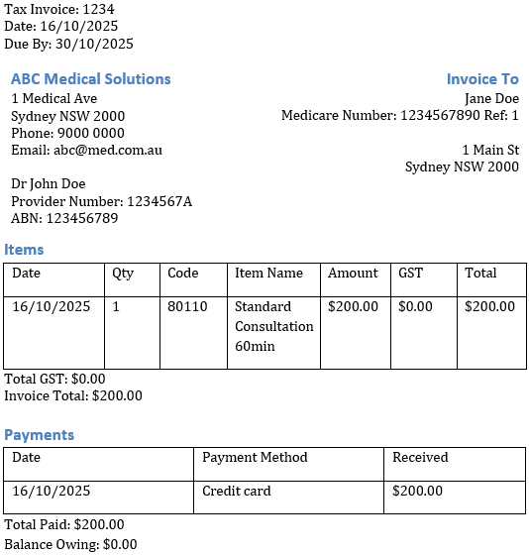
A – Ingest and summarise claims data
Ingest claims data and auto-populate claims system fields
Provider Details
Patient Details
Provider Name
John Doe
Patient Name
Jane Doe
Provider Number
1234567A
Medicare Number
1234567890
ABN
123456789
Medicare Reference #
1
Clinic Name
ABC Medical Solutions
Street Number
1
Service Details
Street Name
Medical Ave
Service Date
16/10/2025
City
Sydney
Medicare Code
80110
Postcode
2000
Amount ex GST
$200
GST
$0
Total
$200
Paid Date
16/10/2025

Slide 22
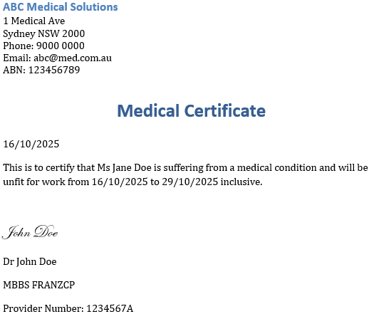

A – Document ingestion – claim data
Transform documents (PDFs, scans) and Excel files into structured information
Provider Details
Provider Name
John Doe
Patient Details
Provider Number
1234567A
Patient Name
Jane Doe
ABN
123456789
Start of Incapacity
16/10/2025
Clinic Name
ABC Medical Solutions
End of Incapacity
29/10/2025
Street Number
1
Service Details
Street Name
Medical Ave
Service Date
16/10/2025
City
Sydney
Service Type
Medical Certificate
Postcode
2000
Notes:
For small forms, you should be able to do this quite reliably in Copilot.
However, if you need to do this at scale – where you are extracting hundreds of fields needing to be returned with a specified format with confidence measures attached – then we’ve developed a product called Identifi that helps achieve this.

Slide 23
A – Ingest and summarise claims data
Summary of key claim facts for case managers to review before first contact with stakeholders
Worker Injury Claim Form
Name: Jane Doe
DOB: 11/11/00
Gender: Female
Address: 10 Sunny Drive, Sydney, NSW, 2000
Phone number:
Role: Facilities Manager
Date of incident: 3/1/25
Ordinary activities in current role: Co-ordinating cleaning and maintenance
What happened and how were you injured? walking downstairs while carrying a box and missed the last step and twisted my ankle
Did you require an ambulance? Yes
Do you consent to ABC Co. to deal with and release relevant medical information relevant to your claim:
Quick Claim Snapshot (for first call)
Worker: Jane Doe
DOB/Age: 11 Nov 2000 — 24 (turns 25 on 11 Nov 2025)
Address: 10 Sunny Drive, Sydney NSW 2000
Role & start date: Facilities Manager, Incident (brief): Missed last stair while carrying a box; twisted ankle. Ambulance: Yes. Date/time of incident: Not stated — confirm.
Language: Form completed in English → likely English-speaking. Consent reminder (signature missing from claim form):
Obtain and record explicit consent to collect/use/share health and personal information, and to contact employer and treating providers.
Explain what information will be shared, with whom, and why; note any limitations or preferences stated by the worker.
Confirm on first call: incident date/time/location, treating provider/hospital, diagnosis & current treatment, work capacity and any certificates, immediate support needs (transport, duties), and contact details for treating doctor.
Notes:
In the Notification stage, we can also use AI to summarise the information from the claim form, as well as things for the

Slide 24
B – Classifying Claims
Automatically classify claims to help with triaging
Description
Classification
Slipped on wet floor and fractured wrist while carrying stock
Physical claim
Reports workplace bullying by supervisor; difficulty sleeping; GP certificate for stress
Psychological claim
Hand laceration from slicer; since experiences flashbacks and panic attacks near machine
Secondary psychological claim (primary physical)
24
Notes:
Classification of claims –

Slide 25

C – Weekly Payment Synchronisation to Cert of Capacity
Ensure payments are compliant and capacity evidence is on file
Patient Details
Patient Name
Jane Doe
Certificate of Capacity
Start of Incapacity
16/10/2025
End of Incapacity
29/10/2025
Service Details
Service Date
16/10/2025
Service Type
Medical Certificate
Weekly Payment Schedule
For the period: 20/10/25 – 26/10/25
Processed
For the period: 27/10/25 – 2/11/25
Issue Reminder to update CoC
Notes:
From our audit reviews, we’ve seen cases of payments made

Slide 26
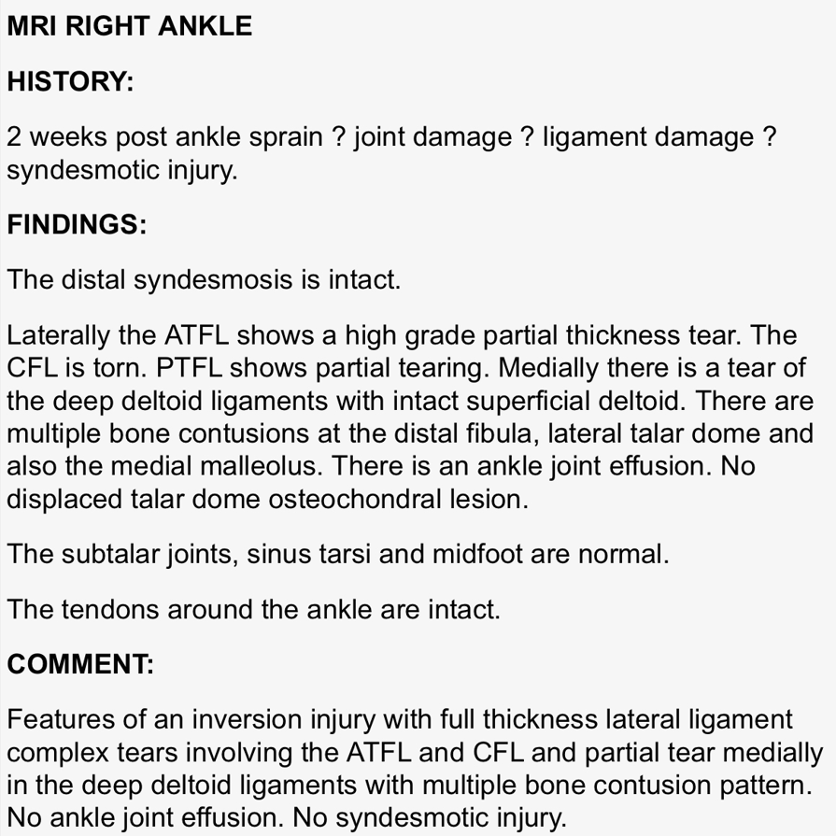
D – Extraction and summarisation of complex IME reports
Summary and Plain English Explanation
Findings
ATFL: high-grade partial tear
CFL: complete tear
PTFL: partial tear
Deep deltoid: partial tear; superficial deltoid intact
Bone bruising: distal fibula, talar dome, medial malleolus
No syndesmotic injury or fracture
Tendons and midfoot normal
Plain English Severe ankle sprain with multiple torn ligaments and bone bruising, but no fracture or high-ankle injury.

Slide 27
E – Claim Closure Quality Assurance Check
1) Core admin & liability
✅ Claim number, worker/employer details match across all docs
✅ Mechanism of injury consistent across notification, IME, provider notes
✅ Liability decision issued (date + reasons recorded)
❓ Consent not on file for medical info-sharing ❓ Employer incident report not uploaded – referred to in claims notes.
2) Capacity & certification
✅ Most recent Certificate of Capacity covers last 4 weeks of claim activity
❓ Gap in CoC: 03–17 Sep not covered by a certificate.
✅ Work capacity decisions documented where capacity changed
✅ IME report on file; findings communicated to worker & employer
3) Treatment & providers
✅ GP and physio treatment plans on file
✅ Discharge/closure summary from physio confirms goals met
✅ No outstanding investigations or referrals
4) Payments & financials
✅ PIAWE calculated, audit trail stored; adjustments logged
❓ Weekly benefits not paid for 3-17 September
❓ Two provider invoices unpaid (Physio 22/10, Imaging 03/11)
✅ Travel reimbursements processed where claimed
✅ Overpayments check completed; none detected
5) RTW & duties
✅ RTW plan versions 1–3 on file; final plan marked completed
✅ Suitable duties offered; worker confirmed acceptance via email
❓ Final RTW outcome note (fit for pre-injury duties) not explicitly recorded; implied in physio discharge
6) Recoveries & subrogation
❓ Potential recovery flagged (wet stairwell—third-party contractor)
❓ No letter of demand or liability inquiry to contractor on file
✅ Medicare/NDIS queries: not applicable
7) Disputes & governance
✅ No open disputes/reviews at SIRA or Commission
✅ Complaints register checked; none open
✅ File notes meet governance standard (dated, author, substance)
8) Data integrity & dates
✅ Date of injury, first medical consult, first incapacity, first payment all recorded
✅ Closure date proposed; rationale documented
Notes:
Big Administrative task – audit

Slide 28
Composing an AI Symphony
Theory
Conductor
Learn concepts
Obey rules
Symphonies
Solve problems
Inspiration
Instruments
Identify opportunities
Deploy tools
Notes:
Recap on your music lesson for today.
Inspiration – look both externally and internally for inspiration on where AI can help your organisation
Theory – use the tools and understand what are the unit actions the AI is capable of solving, and which ones it isn’t.
Instruments –
Conductor – thinking about data sensitivity, policies, enablement and governance
And finally the composing symphonies to actually solve problems.

Slide 29




Minh Phan
Head of AI Innovation
Aaron Cutter
Director
Notes:
Finally, thank you so much for tuning into our “Making AI” webinar series. it’s been an absolute pleasure for Dylan and I to host these webinars and we hope that we’ve deepened your knowledge on AI just that bit further.
We’re really passionate about building AI solutions that add value – and so please feel free to reach out to us if you’d like us to be part of your AI journey.

Slide 30
About the Actuaries Institute
The Actuaries Institute is the peak professional body for Actuaries in Australia. The Institute provides expert comment on public policy issues where there is uncertainty of future financial outcomes.
Actuaries have a reputation for a high level of technical financial expertise and integrity. They apply their analytical and risk management expertise to allocate resources efficiently, identify and mitigate emerging risks and to help maintain system integrity across multiple segments of the financial and other sectors. This unrivalled expertise enables the profession to comment on a wide range of issues including life, general and health insurance, climate change, superannuation and retirement income policy, enterprise risk management and prudential regulation, the digital economy, finance and investment and wider health issues.
© Institute of Actuaries of Australia 2025​ All rights reserved.

Slide 31
Thank you
Actuaries Institute
actuaries.asn.au

