Slide 1
Navigating PTSD in Accident Compensation
Hansi Weerasooriya, Ash Evans
Taylor Fry
November 2025

Slide 2
And a bit more motivation
All injuries
Psychological injury
PTSD
Claims per 1,000 employees in 2022/23
11.2
+20%
1.2
+100%
0.2
+140%
Growth in incidence over 8 years
8
35
77
weeks
weeks
weeks
The average claimant
is off work for
Source: SafeWork Australia, special request

Slide 3
Introducing PTSD
What is PTSD?
PTSD is a mental health condition
“… caused by an extremely stressful or terrifying event – either being part of it or witnessing it”
Mayo Clinic, 2025
May start within three months of traumatic event but also can be delayed to years afterwards.
Who experiences PTSD?
Not everybody who suffers trauma suffers PTSD – individual vulnerability and resilience play a role
How is PTSD diagnosed?
11%
Lifetime prevalence of PTSD
Traumatic event
… that is specific and external
14% for women
Trauma
7% for men
… including intrusion, avoidance, cognitions and arousal
Symptomatic
National Study of Mental Health and Wellbeing 2020-2022
Enduring
… for duration longer than 1 month
Chronic course is common, with
40%
of sufferers exhibit symptoms ten years after onset
Impairment
Kessler et. al ‘Posttraumatic stress disorder in the National Comorbidity Survey’ , 2013
PTSD diagnosis
Diagnostic and Statistical Manual of Mental
Disorders, 5th Edition (DSM-5)
3

Slide 4
Prevalence of PTSD in accident compensation
All industries
Public admin and safety
Police and fire
0.17
2.4×
claims per 1,000 employees in 2022/23
1.42
3.9x
claims per 1,000 employees in 2022/23
5.93
4.2x
claims per 1,000 employees in 2022/23
growth in incidence in 8 years
growth in incidence in 8 years
growth in incidence in 8 years
PTSD claims as a proportion of psychological injuries
Source: SafeWork Australia, special request
4

Slide 5
Cost of PTSD in accident compensation
All injuries
Psychological injury
PTSD
8
35
77
weeks
median time lost
weeks
median time lost
weeks
median time lost
$16k
$65k
$150k
paid on average
paid on average
paid on average
Source: SafeWork Australia, special request
“It is rarely helpful to remove the person from work situations altogether”
“The person should not be given sick leave, but rather, kept in a meaningful role in the organisation…”
Australian Guidelines for the Presentation and Treatment of Acute Stress Disorder, Posttraumatic stress disorder and Complex PTSD
Phoenix Australia
5

Slide 6
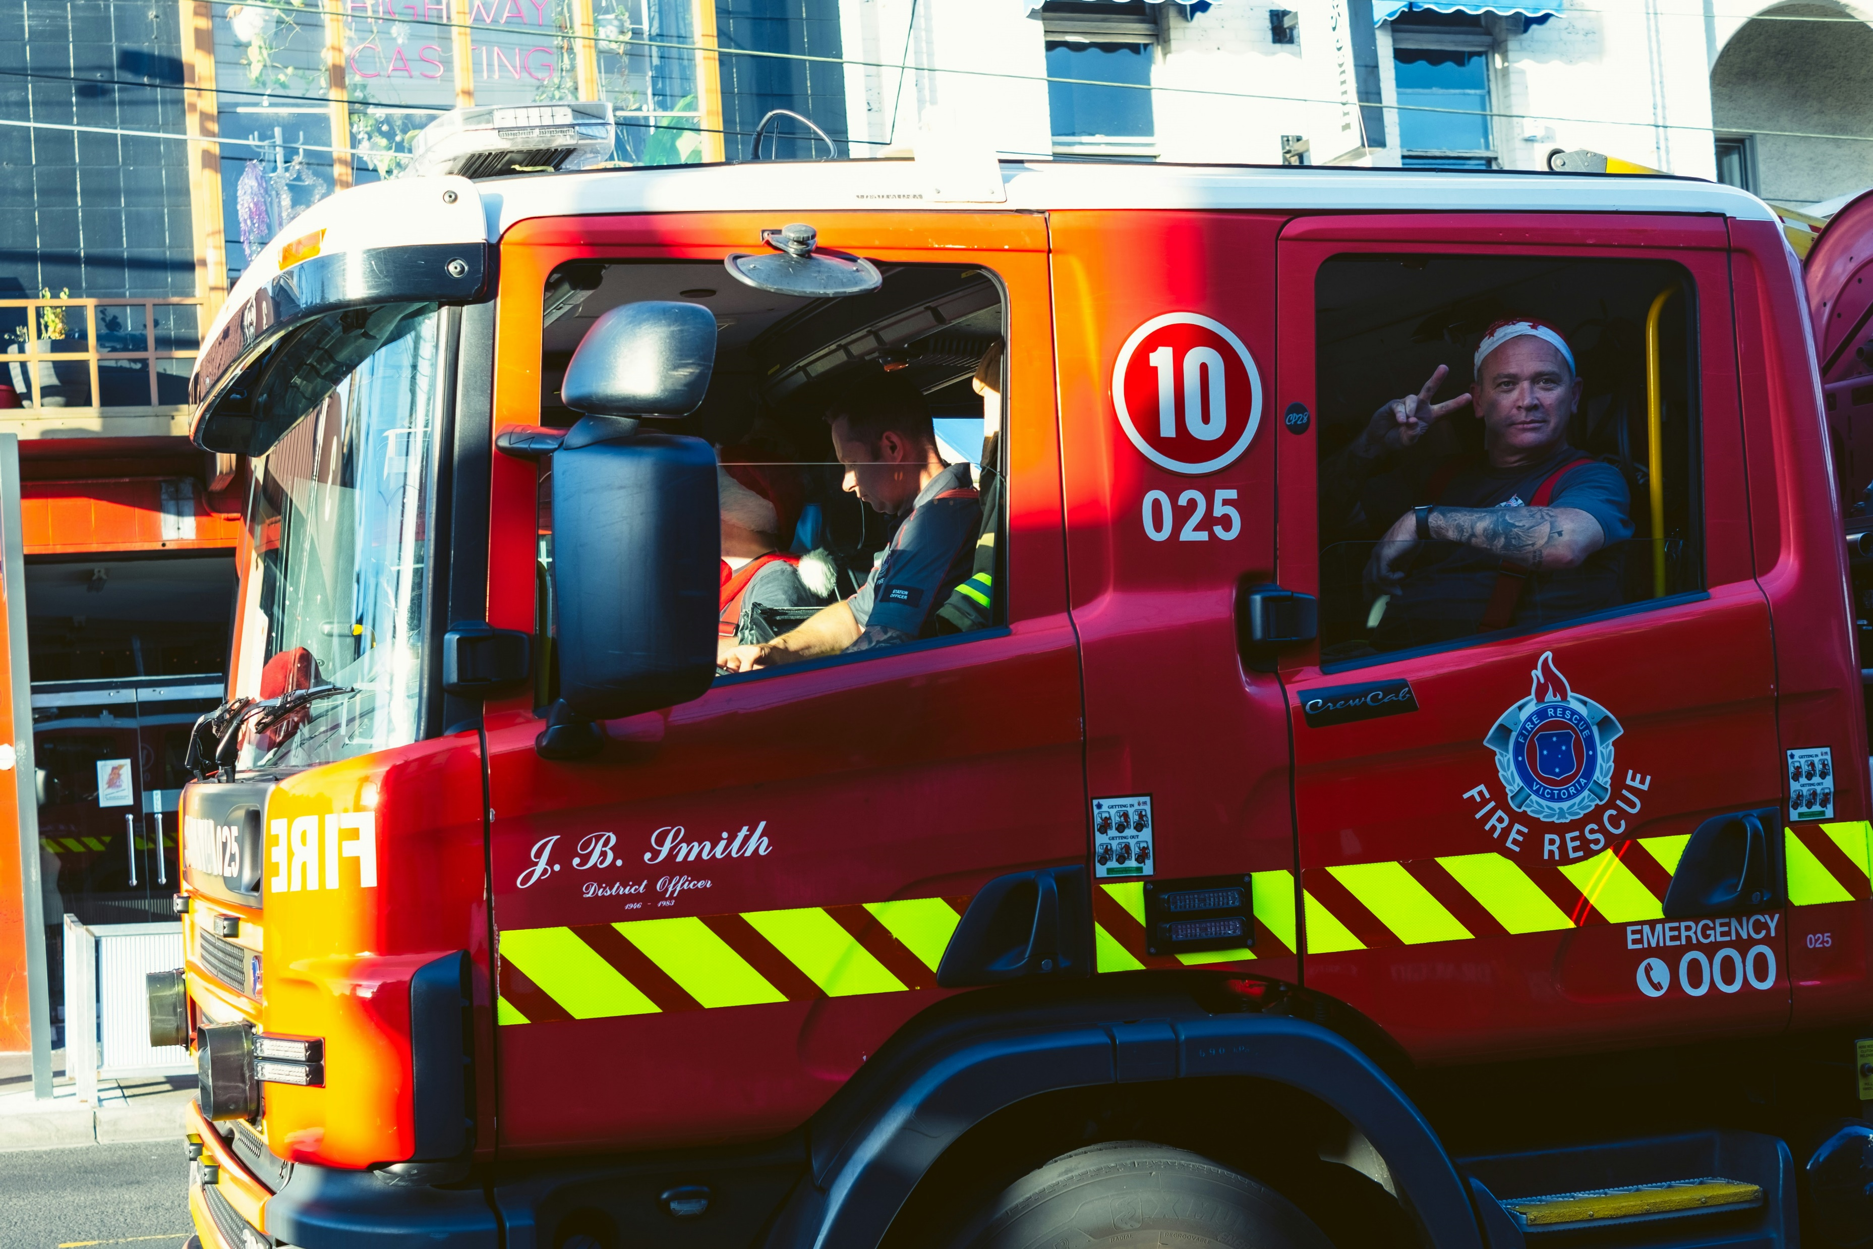
Presumptive PTSD
Employee engagement programs and legislative changes are easing access to compensation
Our evidence shows people in the public sector – particularly first responders – respond to employee engagement programs and PTSD presumption
Experience –
WorkCover Queensland and WorkSafe Tasmania’s initiatives expanded access to PTSD for first responders
WorkCover Queensland
Police vs Non-first responders
WorkSafe Tasmania
Police vs private sector
+200% PTSD
+100% PTSD
6

Slide 7

The New Zealand experience
Exclusivity for PTSD
means heightened advocacy from practitioners
The NZ experience may provide a lesson
in the unintended consequences of preferential treatment for PTSD
General population test
to control for heightened vulnerability
The general population test provides an additional test over diagnosis
Exclusions for vicarious trauma
if witnessed remotely
The client must have experienced the
trauma first-hand
Complex mental health panel
assess difficult cases
A panel meets on all contentious cases, erring towards the client when in doubt
7

Slide 8



Emerging risks
Increased vulnerability
Cumulative trauma
Complex PTSD
      Vulnerability may no longer be mostly confined to blue-light roles:
      Pre-existing neurological or psychological vulnerabilities
      Historical trauma
Sensitisation of emergency services workers can provoke increasingly severe reactions.
      Complex PTSD (CPTSD), while not defined in DSM-5, is introduced in ICD-11 as a distinguishable construct.
      CPTSD has additional symptoms:
      Dysregulation
      Entrenched avoidance
      meaning more pervasive impairment and poorer return to work.
8

Slide 9


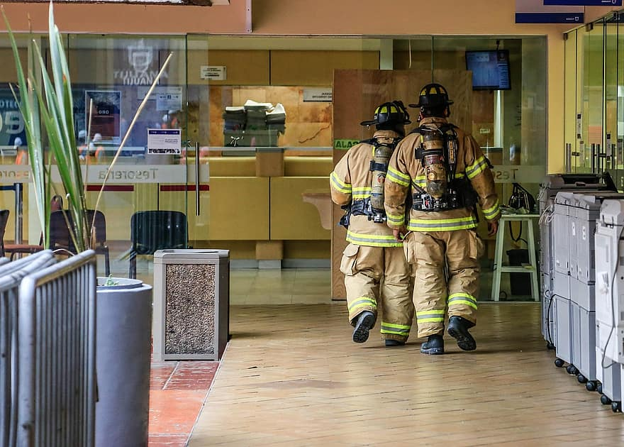
Levers
Mentally safe(r) workplace
Early intervention
Return to work
      Strategies include:
      Supportive, trauma-informed workplace
      Screening
      Early claims resolution
      Within hours, proactive outreach
      Within days, psychological first aid
      Within weeks, early clinical engagement
      Ongoing workplace connection
      Work is therapeutic when it is:
      Safe
      Supported
      Flexible
Phoenix Australia’s Guidelines for the Treatment of Acute Stress Disorder, PTSD and Complex PTSD, 2023
National Mental Health Commission
National Workplace Initiative, 2024
9

Slide 10
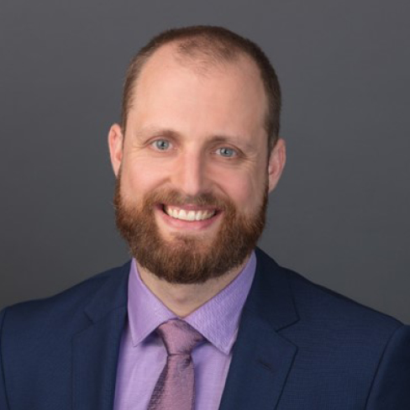

Ash Evans
  Principal
    P: 0412 277 588
    E: ash.evans@taylorfry.com.au
Hansi Weerasooriya
  Consultant
    P: 0406 936 554
    E: Hansi.weerasooriya@taylorfry.com.au
Sydney
Melbourne
Canberra
Wellington

Slide 11
About the Actuaries Institute
The Actuaries Institute is the peak professional body for Actuaries in Australia. The Institute provides expert comment on public policy issues where there is uncertainty of future financial outcomes.
Actuaries have a reputation for a high level of technical financial expertise and integrity. They apply their analytical and risk management expertise to allocate resources efficiently, identify and mitigate emerging risks and to help maintain system integrity across multiple segments of the financial and other sectors. This unrivalled expertise enables the profession to comment on a wide range of issues including life, general and health insurance, climate change, superannuation and retirement income policy, enterprise risk management and prudential regulation, the digital economy, finance and investment and wider health issues.
© Institute of Actuaries of Australia 2023.​ All rights reserved.

Slide 12
Thank you
Actuaries Institute
actuaries.asn.au

