Slide 1
WorkCover WA Scheme Update
Chris White
November 2025
Notes:
Good morning. I’m Chris White, from WorkCover WA. Today I’ll share a concise update on the Western Australian workers compensation scheme—where we are, what’s changed with the 2023 Act, and what we’re seeing in disputes, compliance, and psychological injuries.

Slide 2
Contents
Western Australian Workers Compensation Scheme 03
Workers Compensation and Injury Management Act 2023 10
Disputes and Settlements 15
Compliance and Regulation 18
Psychological Injury Claims 21
Notes:
We’ll move through five sections: the scheme overview, legislative changes under the Workers Compensation and Injury Management Act 2023, disputes and settlements, compliance and regulation, and the outlook for psychological injury claims.

Slide 3
Western Australia’s Workers Compensation Scheme
01
Notes:
First, the scheme landscape—size, underwriting model, and how WA compares nationally.

Slide 4



Overview of the WA Scheme | 2024/25
$1.65 billion
in claim payments
7
licensed
insurers
23
self-insurers
58
workplace
rehabilitation
providers
112K policies
underwritten
299
permanent
impairment
assessors
208
noise
practitioners
4
independent
registered
agents
1.4 million
workers covered
Notes:
WA is:
the fourth largest scheme overall across Australia
largest privately underwritten scheme.
Has over $1.65 billion in claim payments
Underwriting 112 thousand policies
Covering 1.4 million workers.
WA consists of:
7 licensed insurers, including specialised insurer, ICWA
23 self-insurers
58 workplace rehab providers
299 approved PI assessors – previously known as AMS
208 noise practitioners – new Act abolished audiometric officers in support of a simplified and streamlined NIHL claim process
4 independent registered agents and participation as a service provider will cease.

Slide 5
Workers compensation claims | Number of claims
Notes:
Claim volumes fell ~30% since 2005–06, but have risen ~13% over the past five years off the 2019–20 low. We’re watching drivers closely—mix shifts and claim severity can matter more than headline counts.
Income claims have also decreased nominally but grown in proportion, up from 46% to 56% of all claims.

Slide 6

Recommended premium rates
Notes:
RPRs have been stable for four years. We continue to monitor average claim sizes, case estimates, and macro factors—our focus is predictable, sustainable pricing for employers.

Slide 7
Standardised premium rates
WA is slightly above the national average (1.38%)
WA
$1.5b
Notes:
WA sits at 1.52%, slightly above the national average (1.38%), and comparable to other jurisdictions. That’s an acceptable range given our underwriting model and risk mix.

Slide 8
WA’s scorecard
Worst
Jurisdictional performance
Best
STANDARDISED AVERAGE PREMIUM RATES
INCIDENCE RATE (serious injury)
CURRENT RETURN TO WORK RATE
SCHEME EXPENDITURE (% direct to workers)
DISPUTATION RATE
DISPUTE RESOLUTION (resolved in 9 months)
WA
Aust
WA
Aust
WA
Aust
WA
Aust
WA
Aust
WA
Aust
Notes:
Against national performance, WA shows lower serious-injury incidence (9.2 vs 10.7) and strong RTW (90% vs 83%). Our disputation rate is a touch higher (4.7% vs 4.2%), but resolution within nine months is better (88% vs 82%). Scheme expenditure paid directly to workers sits at 54.1%—close to national.

Slide 9
Workers compensation claims | Costs
Notes:
Total real payments have trended up—2024/25 growth concentrated in income compensation (+25%; ~$146m) and allied health (+21%; ~$16m). That composition matters for premium adequacy and reserving.

Slide 10
Workers Compensation and Injury Management Act 2023
02
Notes:
Now, the Workers Compensation and Injury Management Act 2023—what’s changed and how it’s tracking.

Slide 11
Legislative impact and issues
IMPACT
ISSUES
Scale of change | seamless transition
Scheme performance | stable
Pressure points | largely resolved
Effectiveness and efficiency | liability decision making and provisional payments
Definition of worker | status of contractors
Settlement | processes and practices
Tax status | settlements
Notes:
Scale of change: a seamless transition, with stable scheme performance and pressure points largely resolved. Efficiency gains are visible in liability decision-making and provisional payments. Focus areas include the definition of worker (contractor status), settlement processes, and the tax status of settlements.

Slide 12
Key area snapshot
Coverage & claims | Compensation | Medical assessment & injury management | Scheme administration & service providers
Definition of worker & contractors | Doubling of medical cap | Treating medical practitioners & certificates of capacity | Insurance
Injury from employment | Income compensation step down extension to 26 weeks | Permanent impairment assessment | Licensed insurers & self-insurers
Presumptive diseases | Dust disease and NIHL clarified and streamlined | Independent medical examination | Insurance brokers
Presumptive firefighter cancers | Settlements & PI compensation | Employer attendance at medical consultations prohibited | Workplace rehabilitation providers
Reasonable administrative action exclusion | Stopping or reducing compensation | RTW case conferences | Approved permanent impairment assessors
Claim process & consent authority | Catastrophic injuries support scheme & workplace fatality | Workplace rehabilitation & return to work | Conciliation & arbitration services
Liability decision timeframes & provisional payments | Common law damages | Protection of pre-injury position or suitable position | Administration and regulation of scheme by WorkCover WA
Notes:
These were some of the areas of focus with the new Act.

Slide 13
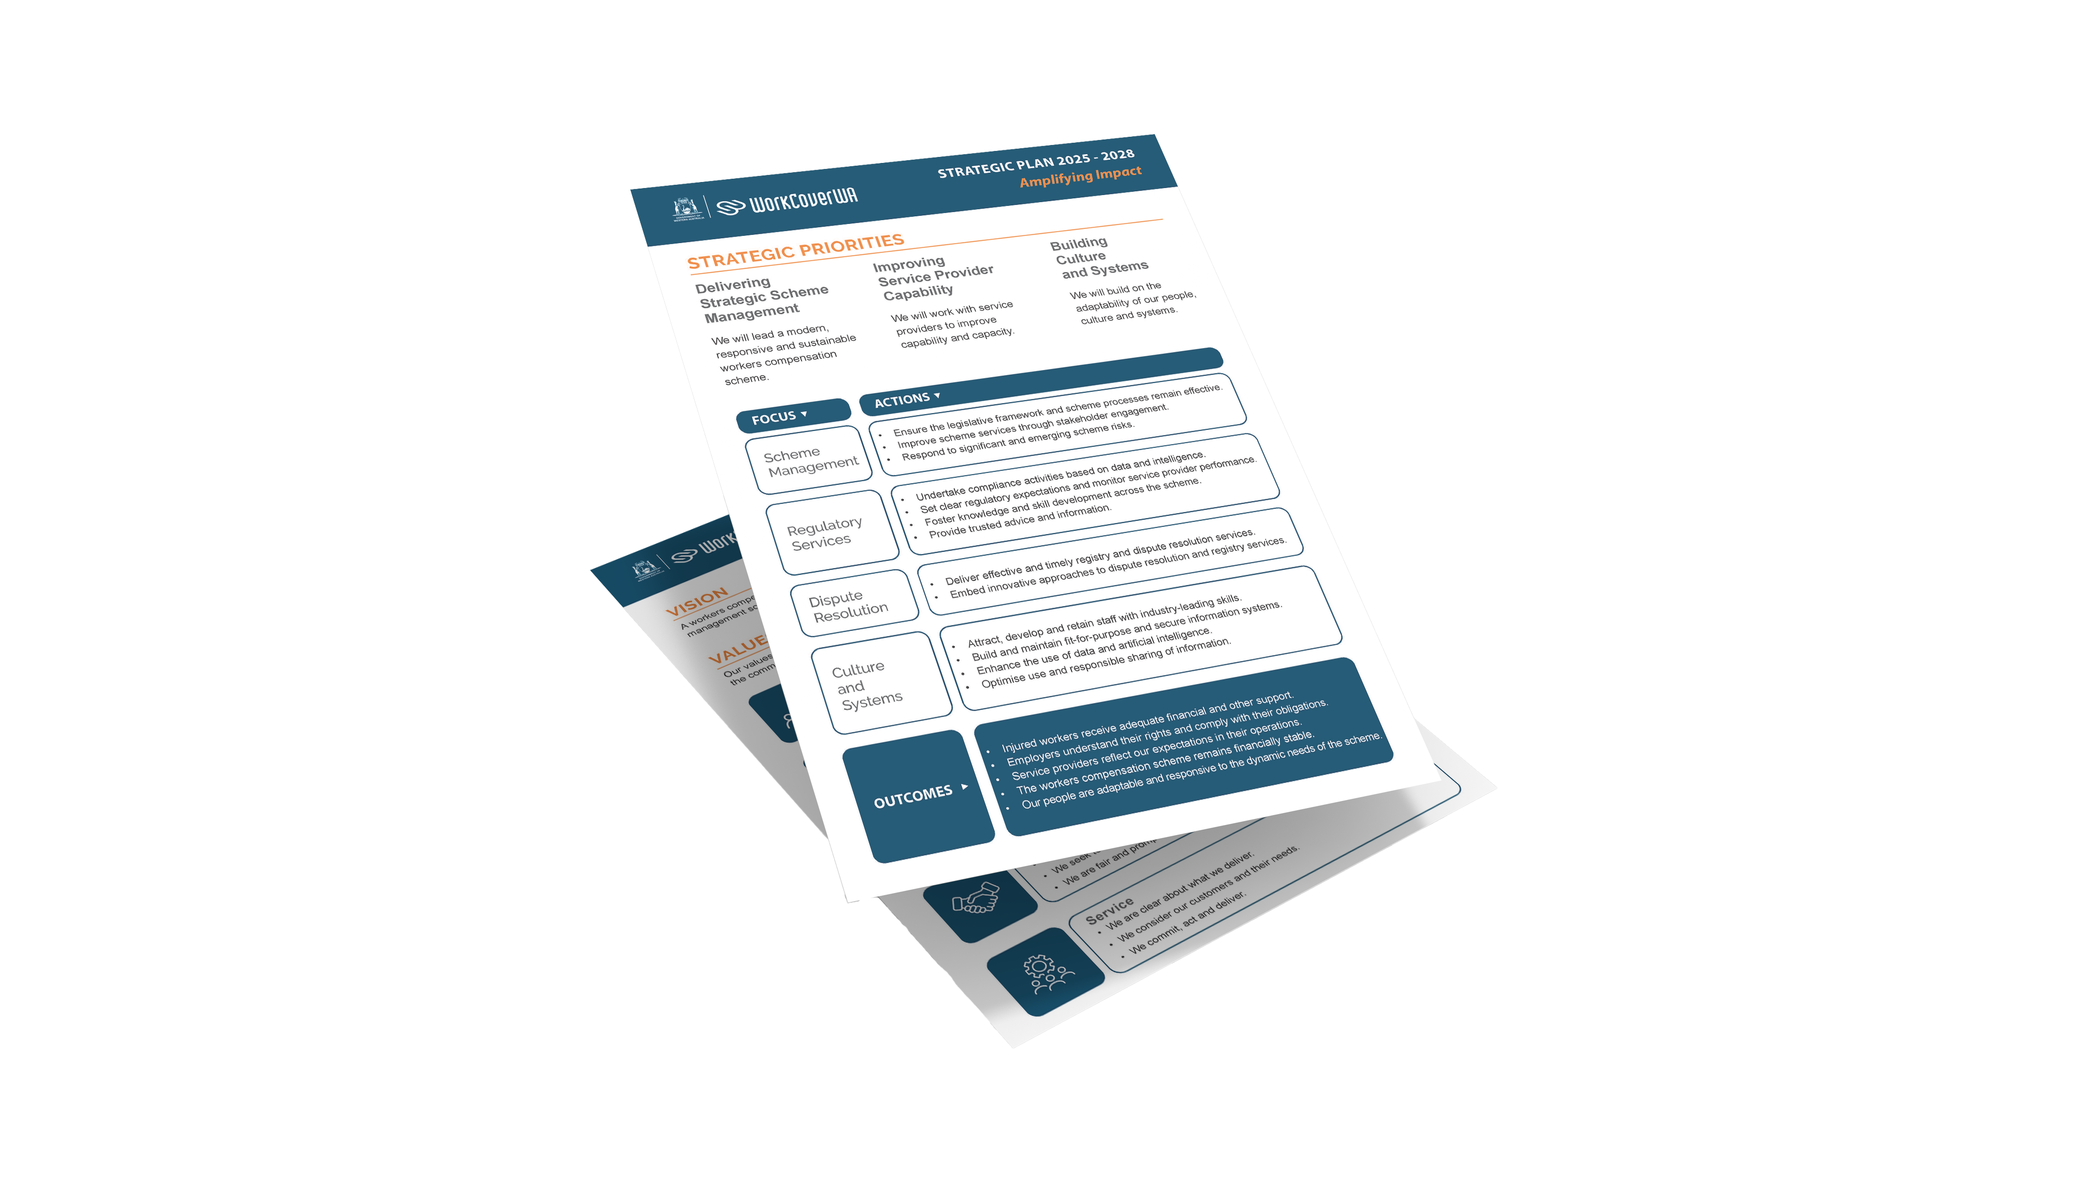
WorkCover WA’s focus
Strategic Plan 2025 – 2028
Amplifying Impact
Notes:
Our Strategic Plan 2025–2028 is about Amplifying Impact—better outcomes for injured workers, data-driven regulation, and partnering across the system to lift capability and performance.

Slide 14
Disputes and Settlements
03
Notes:
Next, the disputes picture—volumes, timeliness, and settlement metrics.

Slide 15
Number of disputes accepted
New Act
implementation →
Notes:
After rising to 2,595 in 2023/24, disputes fell to 2,123 in 2024/25. The new Act appears to be supporting earlier clarity and fewer escalations.

Slide 16
Dispute resolution timeframes
1 month
3 months
6 months
9 months
Western
Australia
31%
74%
82%
88%
National
average
13%
48%
72%
82%
Notes:
Our focus is timely resolution. The quarterly charts indicate continuing improvement across decision bands, with more matters resolved earlier in the pathway.

Slide 17
Settlements registered
Notes:
Settlement activity varies month to month, reflecting claim maturity and operational cycles. The series through 2024–25 shows typical seasonality—with spikes and troughs around implementation windows.

Slide 18
Compliance and Regulation
04
Notes:
Turning to compliance—activity, outcomes, and our regulatory priorities.

Slide 19




Compliance outcomes in 2024/25
20,571 investigations completed | 5,667 new workers compensation policies
109 prosecutions completed | $4.64 million in fines and penalties
Notes:
We completed 20,571 investigations; established 5,667 new workers compensation policies covering 27,841 workers; completed 109 prosecutions; and returned $4.64 million in fines and penalties into the scheme.

Slide 20
Regulatory focus
Compliance | Employers
Engaging | Treating Medical Practitioners
Developing | Principles and Standards
Monitoring | Service Provider Performance
Building | Service Provider Capability
Notes:
Our priorities:
Compliance (employers): ATO data matching, onboarding new policies, and premium integrity.
Engaging treating medical practitioners: targeted GP engagement and APIA principles & standards.
Consent & PRIS: modernising data and consent flows.
Monitoring provider performance & capability: quarterly snapshots and uplift programs.

Slide 21
Psychological Injury Claims
05
Notes:
Finally, psychological injury claims—the counts, costs, causes, and WA’s outlook.

Slide 22
Psychological injury claims | Number of claims
Notes:
Psychological injury claims have been relatively stable over five years, representing ~3.4–4.0% of total accepted claims in recent periods.

Slide 23
Psychological injury claims | Public vs Private sector
Notes:
More than half of psych claims arise in the public sector—reflecting frontline roles with elevated exposure to stress and trauma, such as prison officers, nurses, and teachers.

Slide 24

Psychological Injury Claims | WA outlook
Western Australia | Comparatively Stable
Primary Focus | Prevention
Injury Management Effectiveness
Claim Settlement Role
Active Monitoring and Assessment
Notes:
WA’s psych claim levels are relatively low and stable, but this is a potential growth area. Our primary focus is prevention—partnering across jurisdictions and bodies to learn, share, and act—while actively monitoring trends in our scheme.

Slide 25
Thank you
WorkCover WA
workcover.wa.gov.au
Notes:
Thank you. For more details, visit workcover.wa.gov.au. I look forward to your questions.

