Slide 1
Legislative changes and the NSW CTP Scheme:
A Post-Amendment Perspective
Bronwyn Martin & Danny Rouel
November 2025

Slide 2





Introduction
The NSW CTP Scheme commenced for crashes on and from 1 December 2017.
SIRA’s role as the regulator is to provide oversight and stewardship of the CTP Scheme, ensuring its ongoing sustainability, so that it continues to provide fair and timely support for a person with an injury while remaining affordable for motorists and stable for all parties
The 2017 Scheme has delivered significant reductions in CTP insurance premiums while providing broader coverage and benefits for people injured.
The scheme provides fast access to statutory benefits, including weekly income support and treatment and care, with a strong focus on rehabilitation, recovery and return to work.
The CTP Scheme enables payments and support for people who lose a loved one on the road.

Slide 3








Statutory Objectives
The scheme’s objectives outline the guiding principles of the scheme. They inform policy and operational objectives and outcomes.
Early and appropriate treatment and care to achieve optimum recovery
Provide early and ongoing financial support
CTP insurance should be compulsory
Keep premiums affordable and constrain insurer profits
Promote competition and innovation in the setting of premiums
Encourage the early resolution of claims and the quick, cost effective and just resolution of disputes
Ensure the collection and use of data to facilitate the effective management of the scheme
Deter fraud

Slide 4


Pre-amendment environment – Legislative and policy
While the CTP Scheme is broadly operating as intended and in line with its statutory objectives, it does so within a dynamic and evolving environment.
Since scheme inception, the scheme has had to adapt to the COVID-19 pandemic, inflationary and cost of living pressures, ongoing policy and regulatory reforms, as well as the impact of emerging technology.
Covid-19
2017
2020
2021
2022
2023
NSW 2017 CTP scheme commenced
Standing Committee on Law and Justice
Personal Injury Commission and the Independent Review Office commenced operation
2021 Statutory Review of the Motor Accident Injuries Act 2017 completed
Standing Committee on Law and Justice
Motor Accident Injuries Amendment Bill 2022 passed
- Amendments commenced on Assent
CTP Care launched on 1 December
Motor Accident Injuries (Claim for Statutory Benefits) Regulation 2023 commenced
Motor Accident Injuries Amendment Bill 2022
- Amendments commenced April 2023

Slide 5
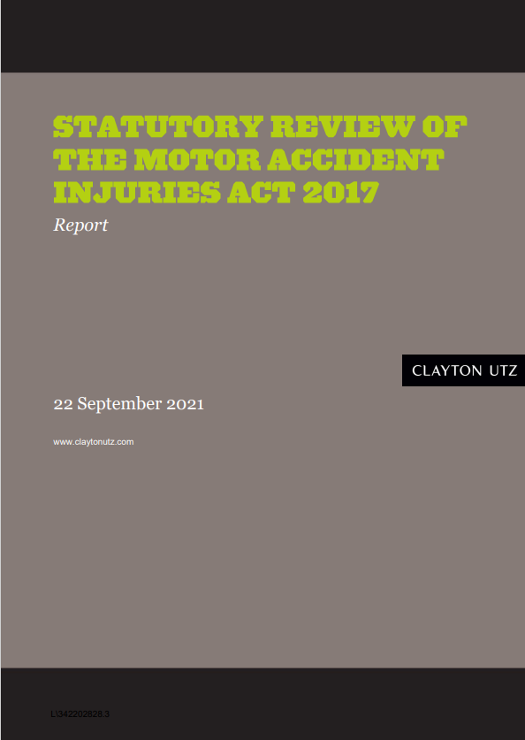

2021 Statutory Review of the Motor Accidents Injuries Act 2017
The three-year statutory review of the MAI Act, undertaken by Clayton Utz and Deloitte from July 2021, considered all aspects of the scheme.
The purpose was to determine whether the policy objectives of the Act remain valid, and whether the terms of the Act, Regulation and Guidelines remain appropriate in securing those objectives.
Clayton Utz and Deloitte were commissioned to undertake the Review. Clayton Utz focused on whether the design and terms of the Act, Regulations and Guidelines meet the policy objectives of the Scheme. Deloitte reviewed the implementation of the Act with reference to specific KPIs.
The final report was tabled in Parliament in November 2021 and made 73 recommendations and 20 suggestions.

Slide 6

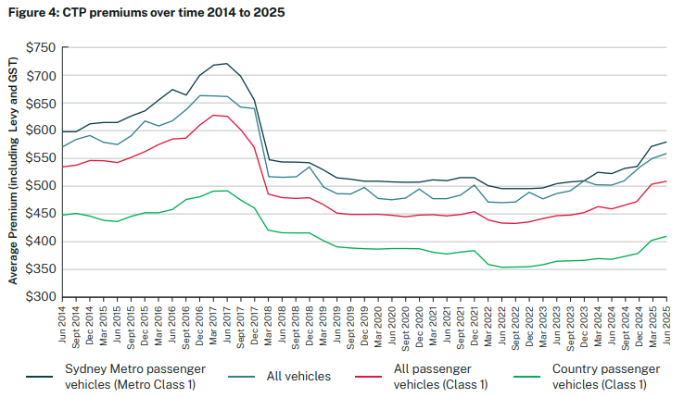
Pre-amendment environment – premium experience
The 2017 Scheme reforms led to significant premium savings
In the years to 2022, premiums continued to slightly reduce.
At the time of the amendments, premium affordability was not an issue.

Slide 7

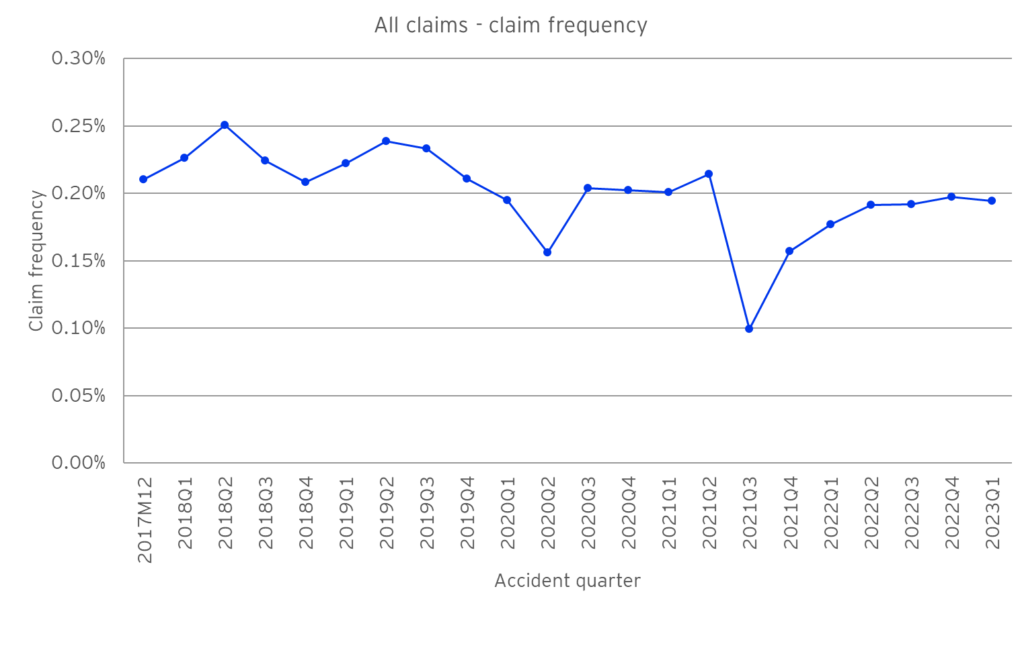
Pre-amendment environment – claims frequency experience
Since scheme commencement, claims frequency reduced and included periods impacted by COVID-19 related lockdowns.

Slide 8

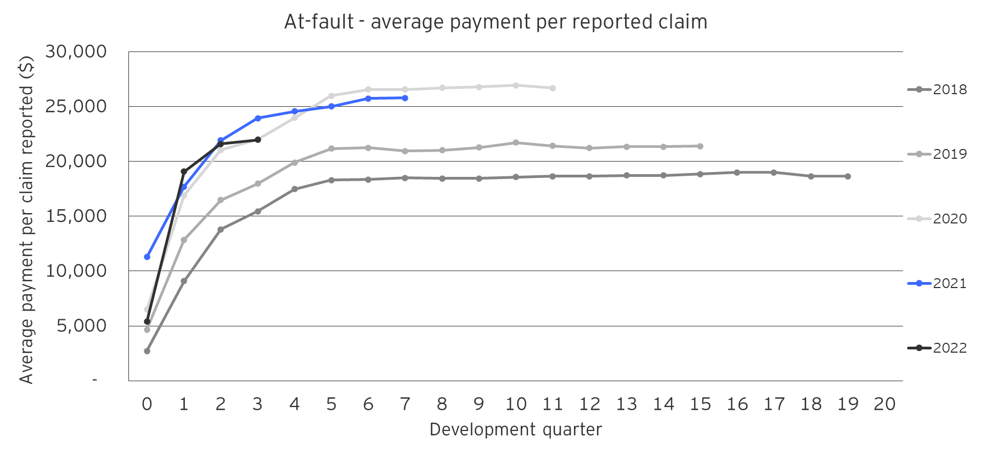

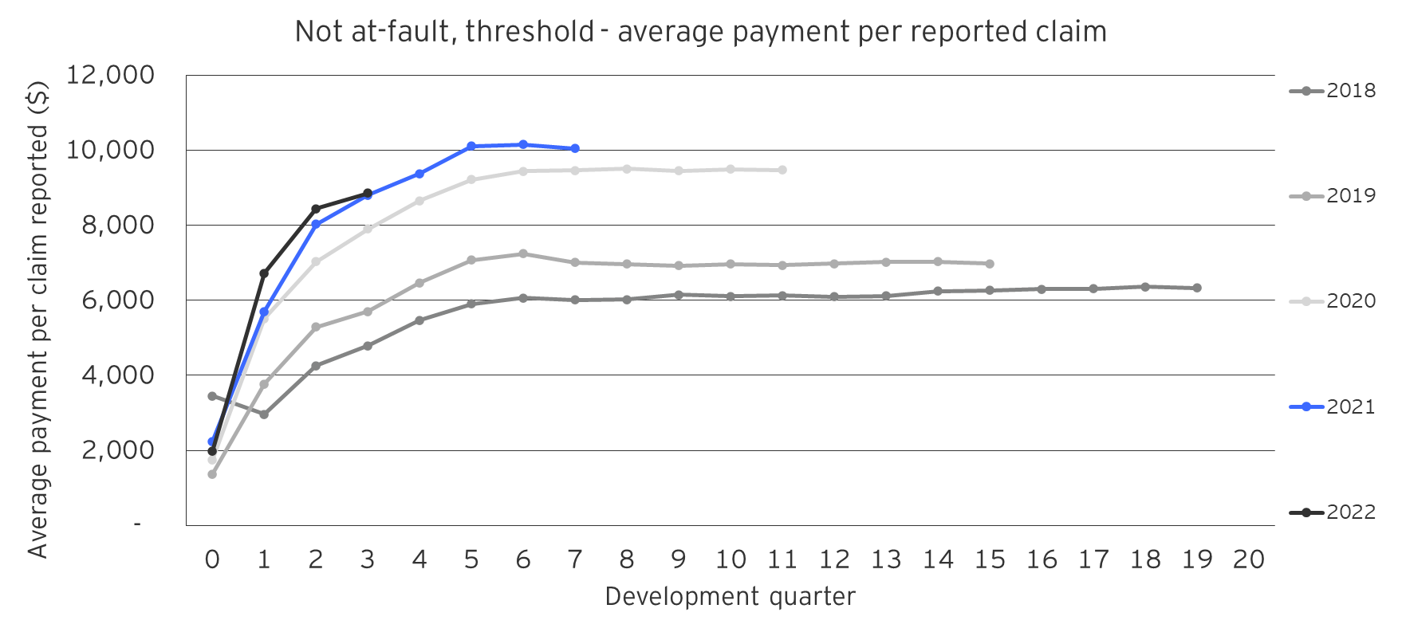

Pre-amendment environment – claims cost experience
At-fault claims received up to 26 weeks of benefits for Treatment and Care as well as Loss of Income
Not at-fault Threshold (i.e. soft-tissue injuries and/or non-diagnosed psychological injuries) claims received up to 26 weeks of benefits for Treatment and Care as well as Loss of Income

Slide 9

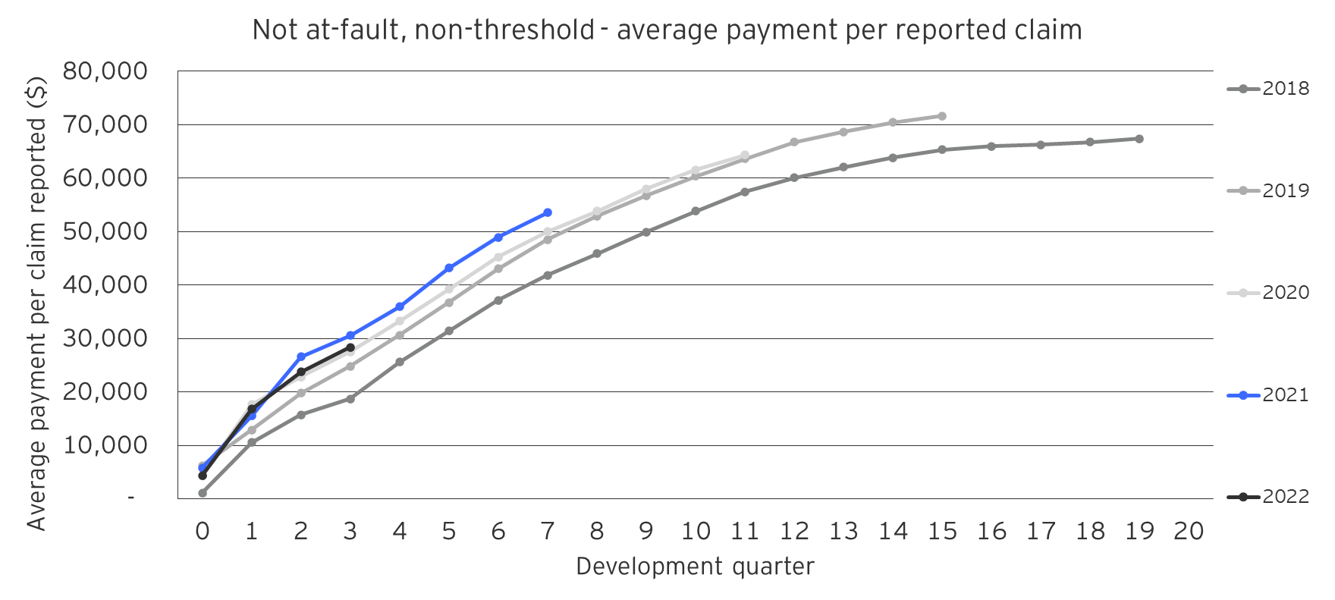

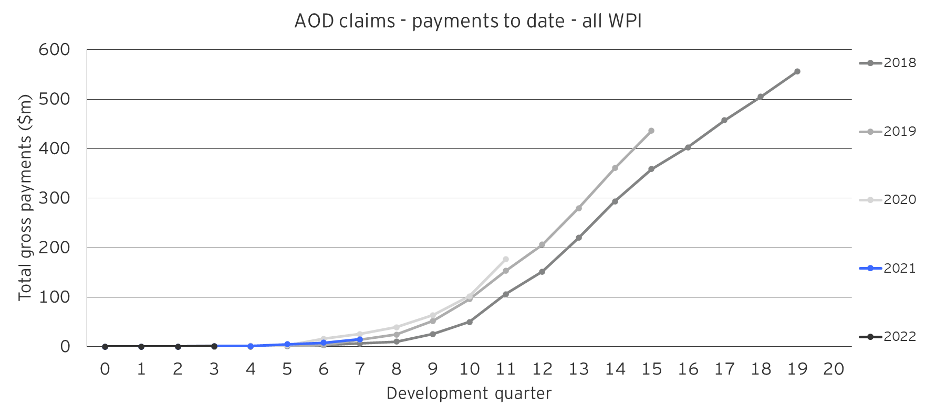
Pre-amendment environment – claims cost experience
Not at-fault Non-Threshold claims receive up to 5 years of benefits for Treatment and Care, Loss of Income as well as access to Damages claims
Damages claims can receive lump sum settlements for Past and Future Economic Loss and Non-Economic Loss

Slide 10

What were the main amendments or changes?
The Government responded to 15 recommendations through the Motor Accident Injuries Amendment Act 2022.
These changes extended statutory benefits for people with a claim, enabled earlier access to damages claims and increased access and availability of rehabilitation and trauma supports.
Amending timeframe requirements to lodge a statutory benefits claim
Power for SIRA to establish a Trauma Support Service
Changing ‘minor’ injury terminology to ‘threshold injury’
Commenced Nov 2022
Remove requirement to seek internal review for PI dispute at Commission
Removal of the 20-month timeframe to lodge a damages claim
Extending statutory benefits from 26 to 52 weeks
Commenced April 2023

Slide 11
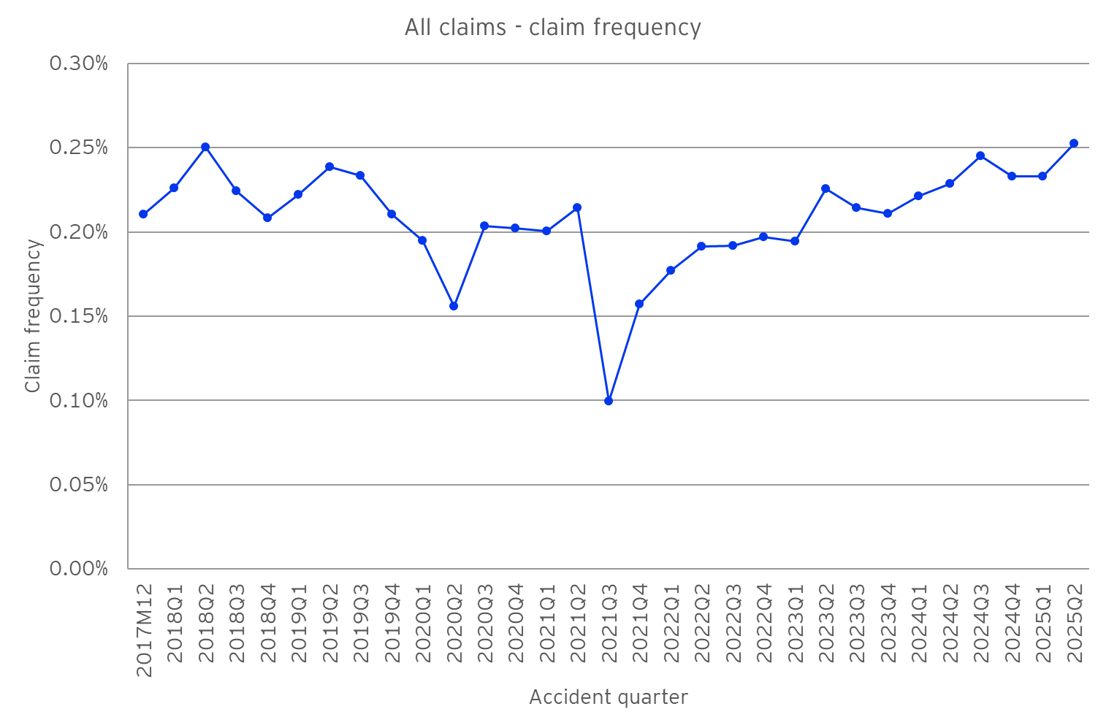
Post-amendment environment – claims frequency experience
Since the amendments, the claims frequency has increased. To pre-COVID levels or beyond?

Slide 12
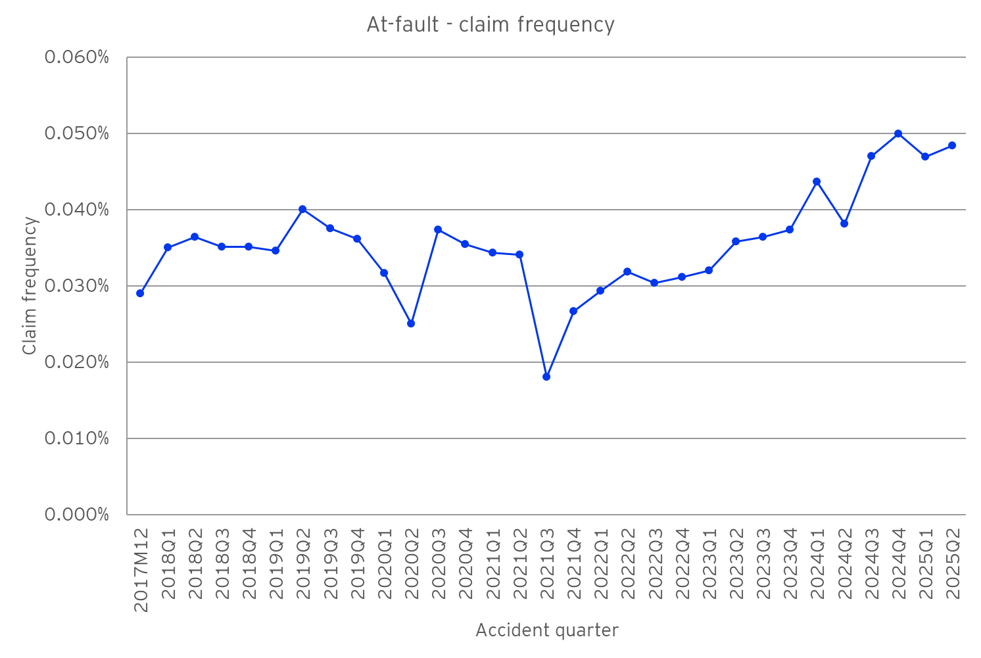
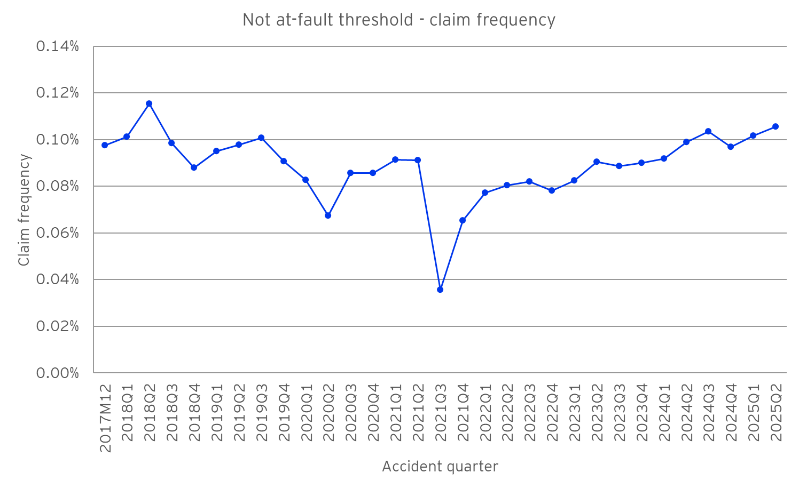
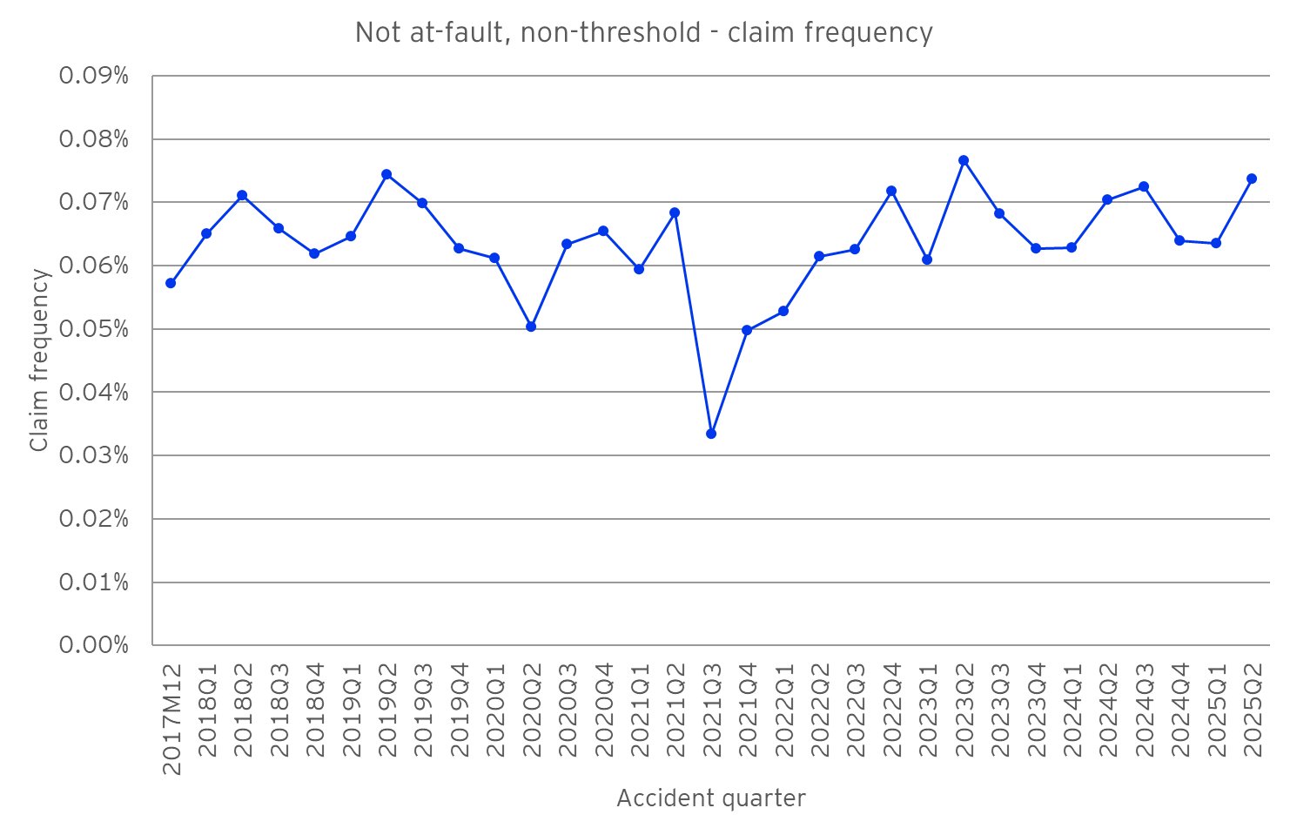
Post-amendment environment – claims frequency experience
At-fault claims frequency has exceeded pre-COVID levels
Not at-fault threshold claims frequency likely to exceed pre-COVID levels
Not at-fault non-threshold claims frequency relatively stable at pre-COVID levels for now.

Slide 13
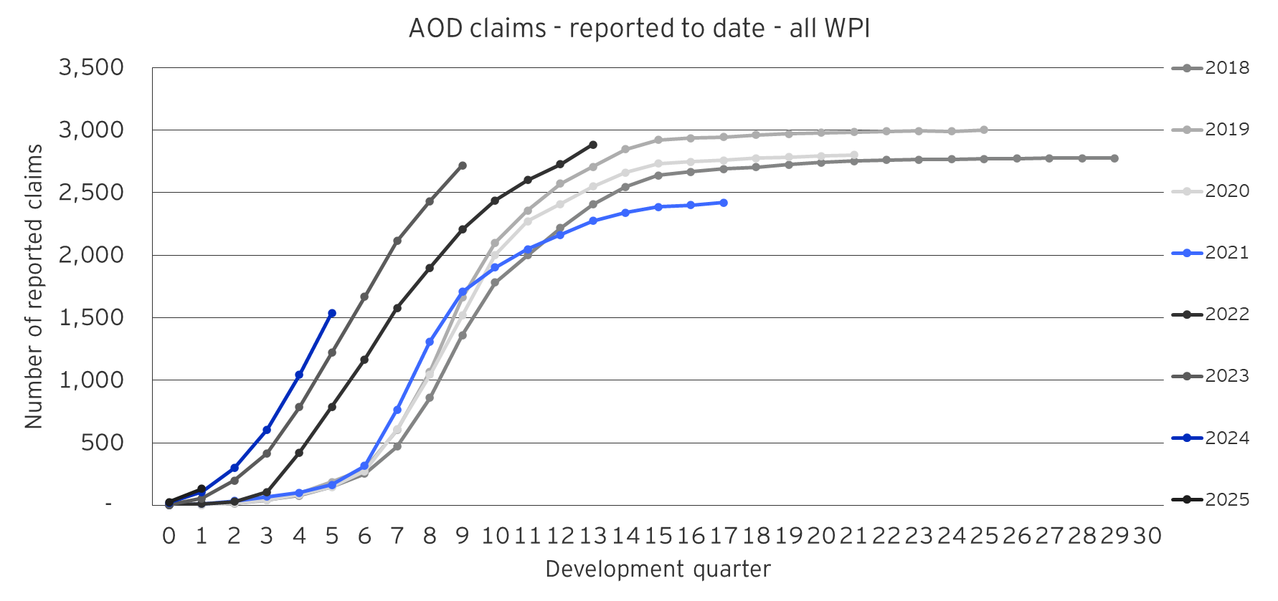
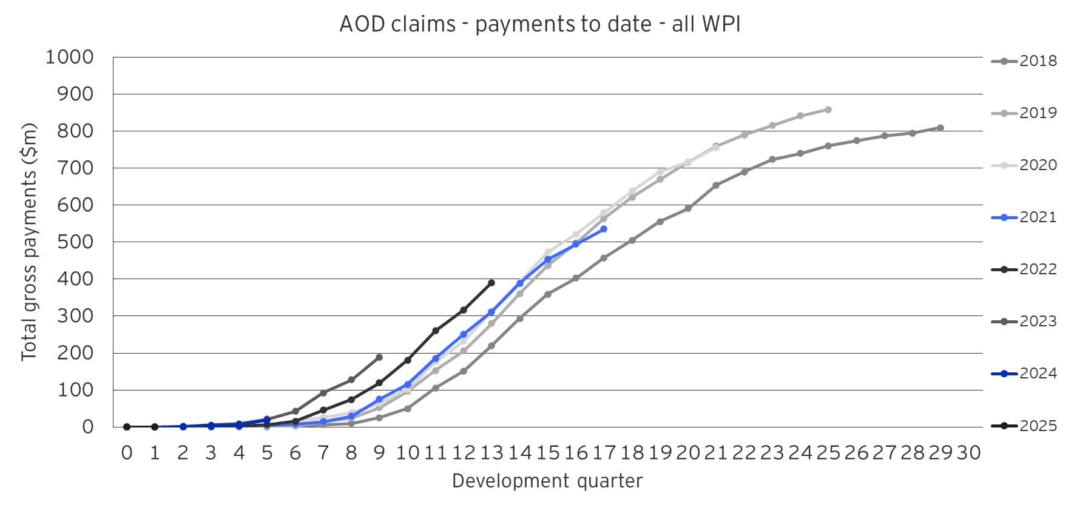
Post-amendment environment – damages claims experience
Damages claims are lodging and settling earlier.
Is this just a timing effect or will there be more ultimate claims?

Slide 14

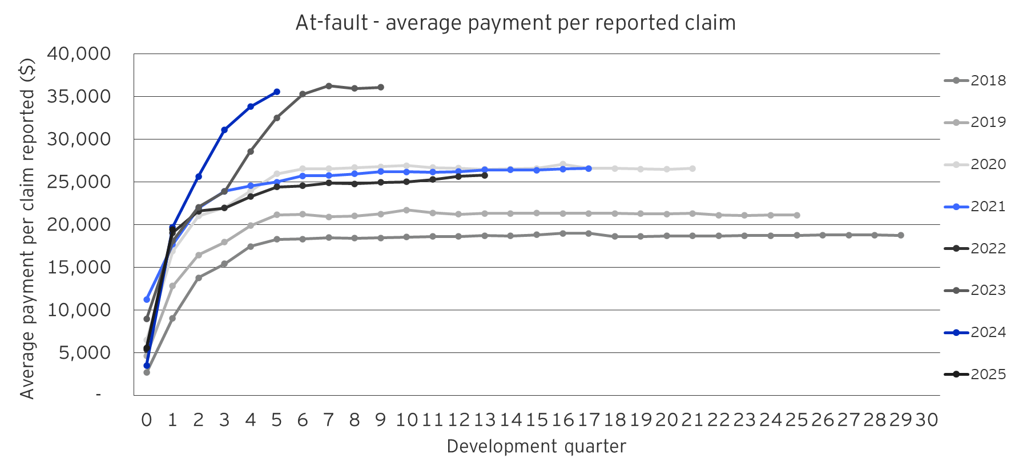
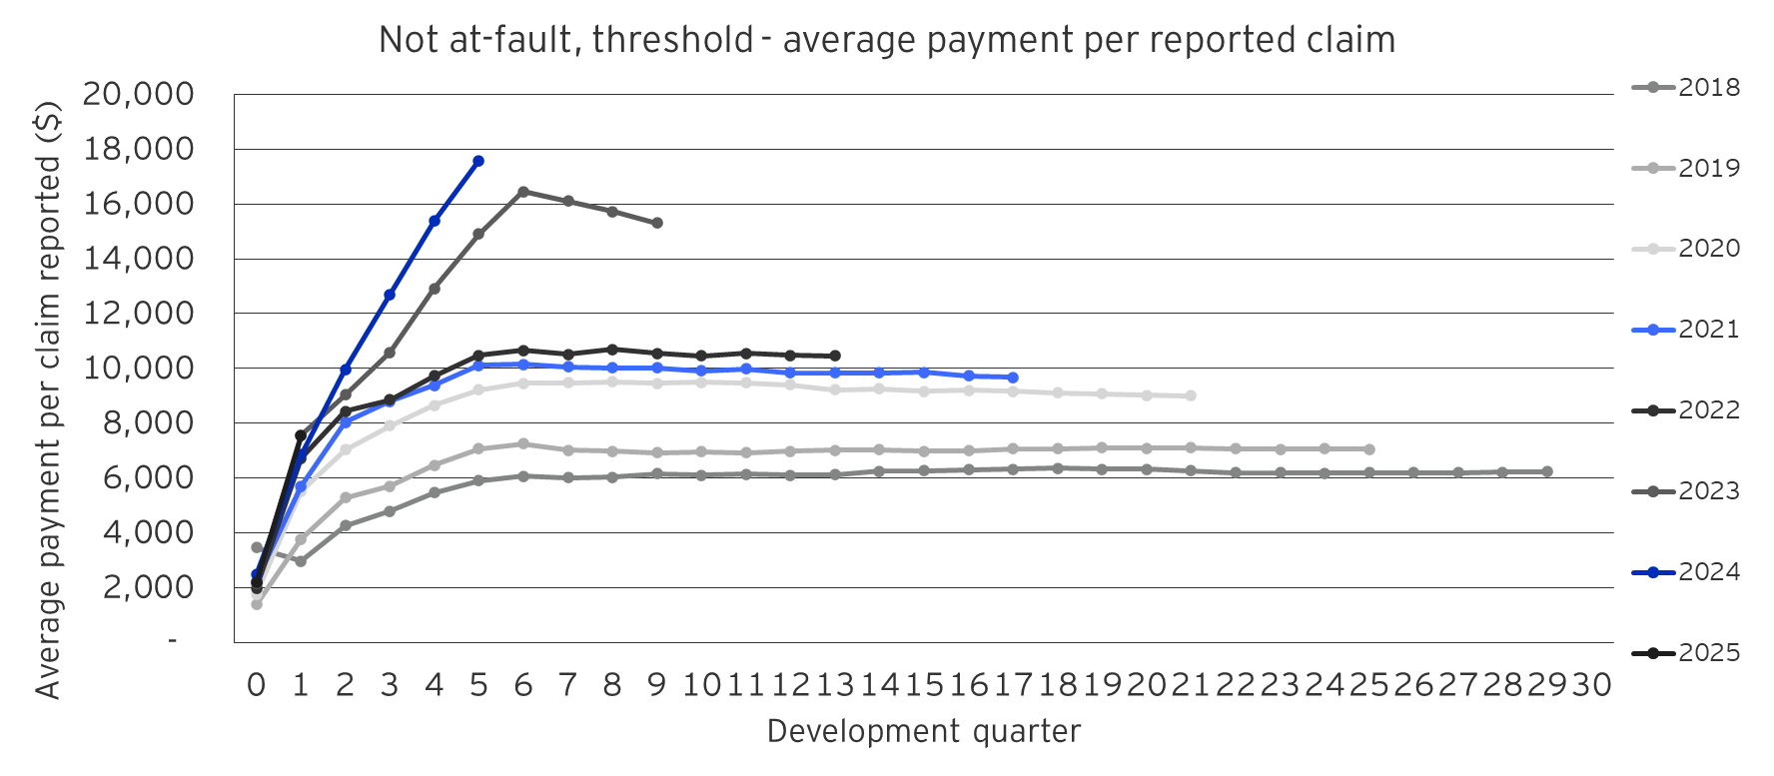
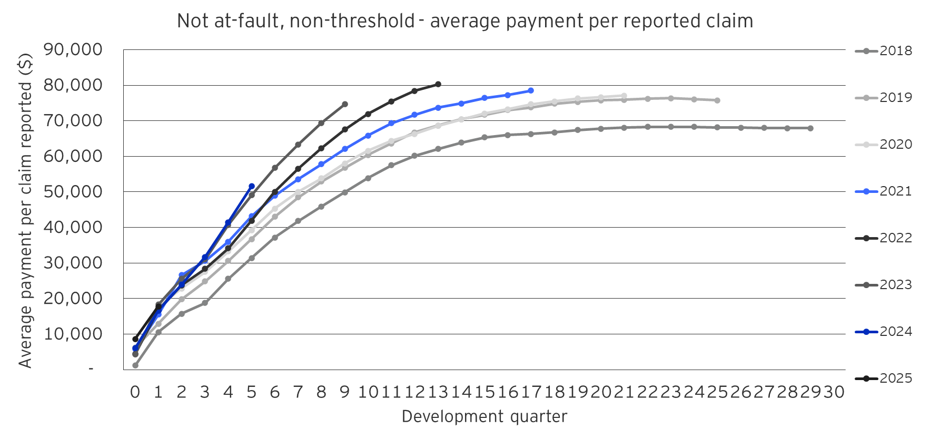
Post-amendment environment – claims cost experience
All claim types are experiencing escalation in average claims costs.
Some of this is driven by direct effects of the amendments
Some of this may be driven by indirect behavioural effects or unrelated underlying scheme inflation

Slide 15

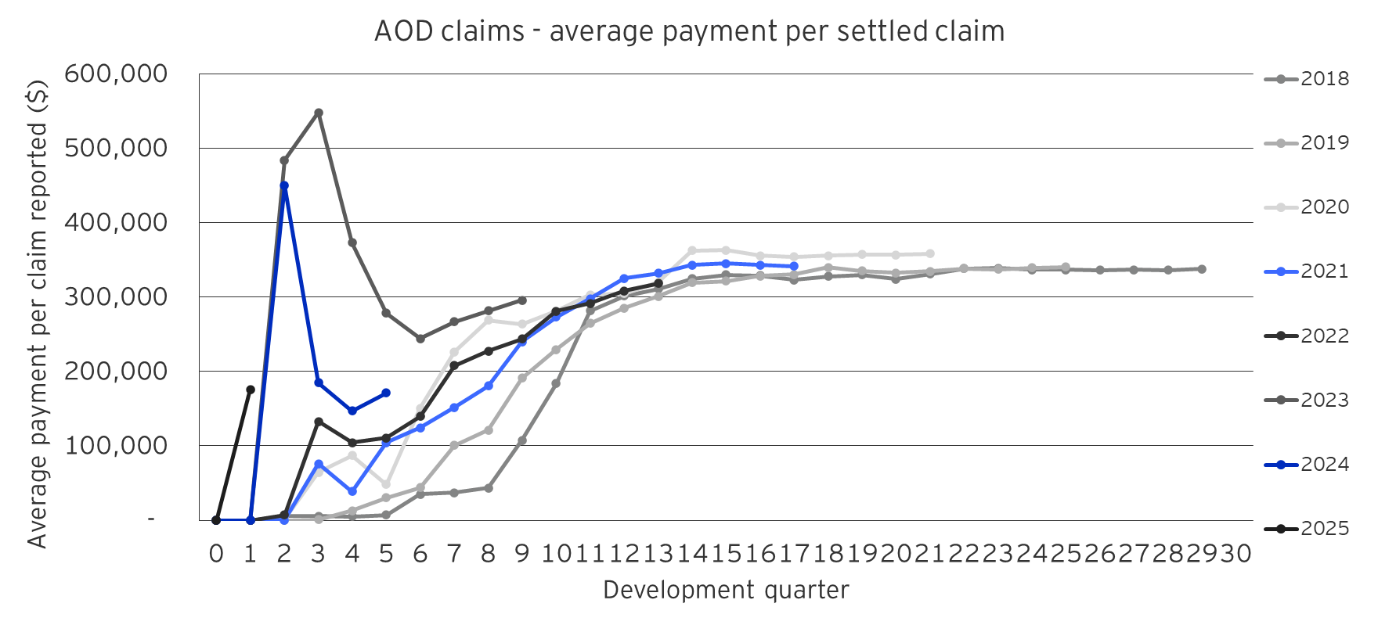
Post-amendment environment – claims cost experience
Damages claims are the costliest, making up close to 70% of total scheme costs
Some early levels of superimposed inflation however this appears to be stabilising
High uncertainty remains as the effects of the amendments are still developing

Slide 16
Post-amendment environment – premium experience
O the past 2.5 years since the amendments, premiums have increased in the order of 18% or ~$85.
Some of this a response to the expanded benefits but there are other effects from underlying claims inflation and changes in levies.

Slide 17


Post-amendment policy environment
The Current Landscape
The 2022 legislative reforms improved access and expanded statutory benefits and enabled the establishment of a new trauma support service.
While these changes have enhanced benefits and supports for people with an injury, they have also contributed to higher claim volumes, longer benefits durations, and increased scheme costs.
These cost pressures are further exacerbated by medical cost inflation, extended recovery periods, and more complex disputes.
The Current Challenges
Steady increase in claims and claims costs.
Continuing uncertainty in claims experience.
Claim farming.
Increasing complexity of fraud.
Legal challenges, disputes and scheme stability.

Slide 18

What’s next?
2025 Standing Committee on Law and Justice Review of the CTP scheme
Second Statutory Review of the Motor Accidents Injuries Act 2017
Strategic Review of Health Provider Regulation
Road Transport and Other Legislation Amendment (Micromobility Vehicles and Smartcards) Bill 2025
Advancements in vehicle technology and Automated Vehicles
2025
The transport and motor vehicle landscape continues to evolve with the emergence of e-micromobility devices such as e-scooters and e-bikes. Alongside this are advancements in vehicle technology, including driver-assist systems and the ongoing progress toward the introduction of automated vehicles.
These developments may influence scheme user behaviour, crash and injury patterns, and lead to new trends in claims, treatment, and care needs.

Slide 19
About the Actuaries Institute
The Actuaries Institute is the peak professional body for Actuaries in Australia. The Institute provides expert comment on public policy issues where there is uncertainty of future financial outcomes.
Actuaries have a reputation for a high level of technical financial expertise and integrity. They apply their analytical and risk management expertise to allocate resources efficiently, identify and mitigate emerging risks and to help maintain system integrity across multiple segments of the financial and other sectors. This unrivalled expertise enables the profession to comment on a wide range of issues including life, general and health insurance, climate change, superannuation and retirement income policy, enterprise risk management and prudential regulation, the digital economy, finance and investment and wider health issues.
© Institute of Actuaries of Australia 2025.​ All rights reserved.

Slide 20
Thank you
Actuaries Institute
actuaries.asn.au

