Slide 1
WorkSafe Victoria – Scheme Update
Mark Arnott
November 2025

Slide 2

Contents
Our Strategy 03
Reducing Workplace Harm 04
Improving Outcomes for Injured Workers 05
Financial Sustainability 06
Scheme Reform 09

Slide 3
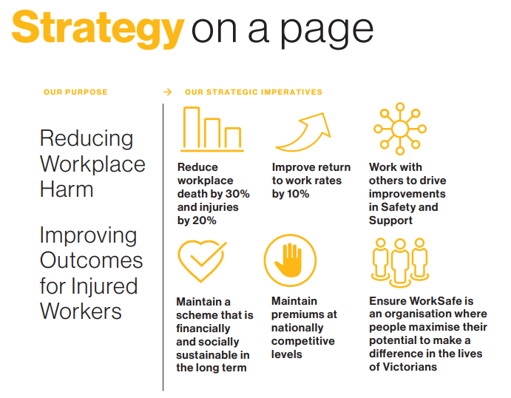
Our Strategy
Source: https://content-v2.api.worksafe.vic.gov.au/sites/default/files/2025-02/Worksafe-victoria-strategy-2025-02.pdf

Slide 4
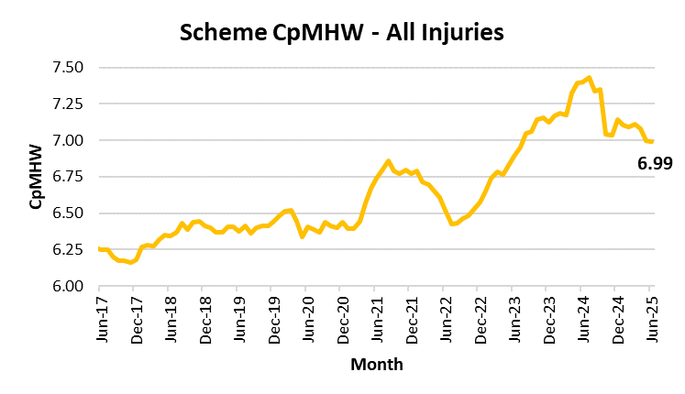
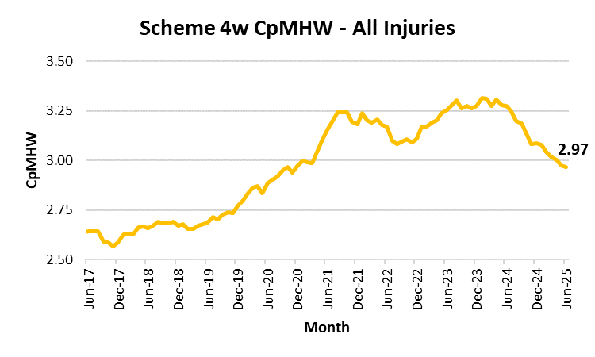
Reducing Workplace Harm
Scheme numbers: All injuries
Reduction in Claims per Million Hours Worked (“CpMHW”) after an increase from July 2022 to July 2024
Reduction in 4 week CpMHW after an increase from August 2022 to June 2024

Slide 5
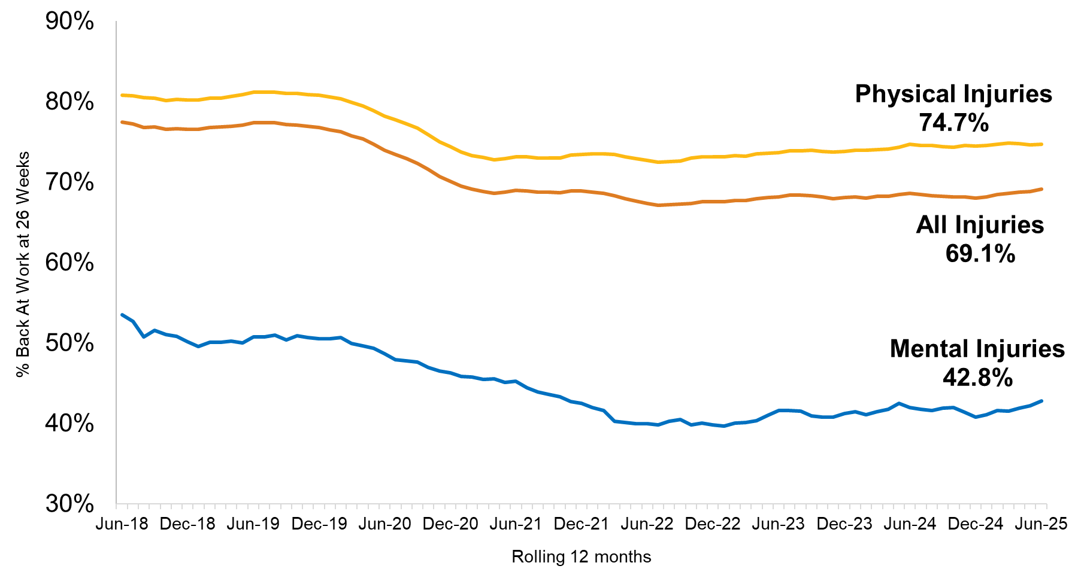
Improving Outcomes for Injured Workers
Back At Work
Our measure is % Back at Work: The percentage of claims with 10 days of time loss reported in a 12 month period, that are back at work six months after claim lodgement.
Significant reduction in RTW rates during the Covid-19 period, small increase over the last three years but still significantly lower than pre-Covid experience.

Slide 6
Financial Sustainability
Key Figures
  Actuarial Change: -$663m (release)
  Break-Even Premium: 1.723%
  Net Result: $797m
  Insurance Funding Ratio: 112.7%
Key Challenges and Uncertainties
  Effectiveness of the scheme Reforms:
    Mental Injury Eligibility
    Second Entitlement Review
    Flow on to Common Law
  Slow-down in dispute resolution leading to an increase in the number of open conciliation matters
  Increase in durations and costs for Medical & Like benefits
  Impact of Psychological Health Regulations

Slide 7
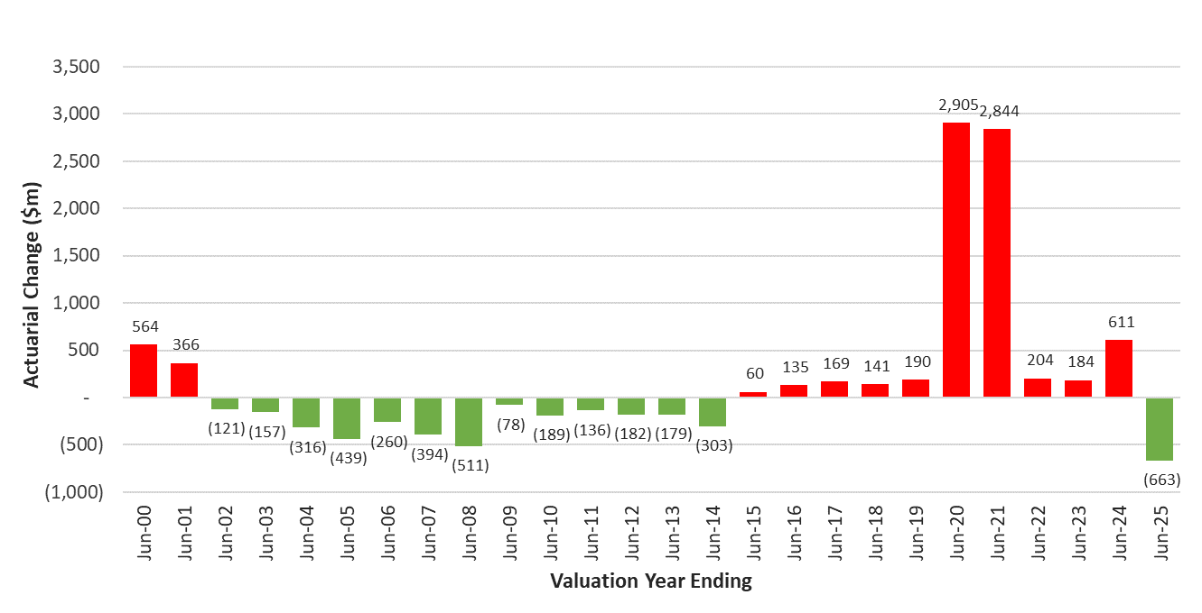

Financial Sustainability
Historical Actuarial Change by Financial Year
Actual scheme costs below projections
Actual scheme costs above projections

Slide 8
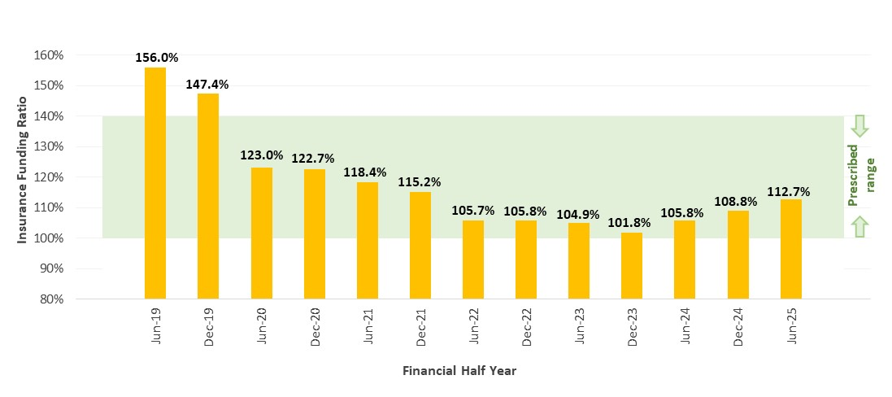
Financial Sustainability
Historical Insurance Funding Ratio (“IFR”)
  Key drivers of IFR improvement of 6.9% between June 2024 and June 2025:
  3.7% from investment earnings
  1.9% from claims movements
  1.1% from BEP buffer

Slide 9
Scheme Reform
WorkCover Scheme Modernisation
  The average premium rate was increased to 1.8% (42% increase) for the 2023/24 policy year
  .
Key Change | What Do We Know? | What Don’t We Know?
New eligibility requirements for mental injury claims | The initial rejection rate is stabilizing, with the initial acceptance rate reducing by almost 50% Slow-down in dispute resolution leading to an increase in the pool of open conciliation matters This has slowed the emergence of Weekly paid claims | Ultimate outcomes from conciliations and statutory dispute activity Potential behavioural changes from workers / their advisors Key legal precedent
An additional whole person impairment (WPI) requirement for workers to continue to receive weekly payments after the 130 week second entitlement period | Termination notices (notices issued to workers ceasing Weekly benefits) have increased since scheme reform This implies higher Weekly discontinuances, although it is unclear what the sustainable level will be | Proportion of termination notices challenged and overturned via dispute Proportion of ultimate claims with WPI 21+ Bracket creep in WPI assessments Common Law flow on from additional terminations

Slide 10
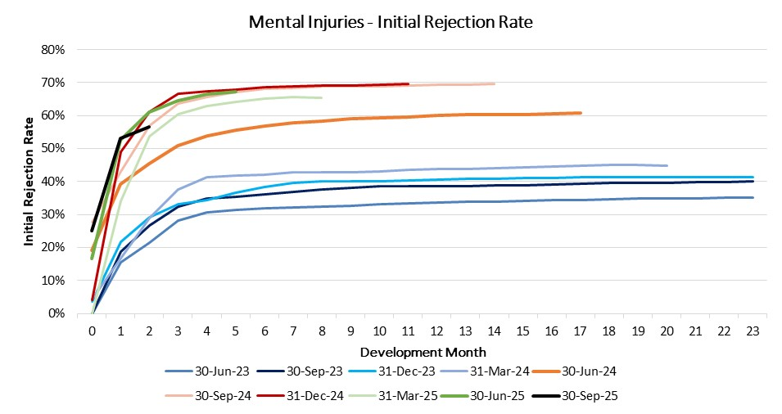
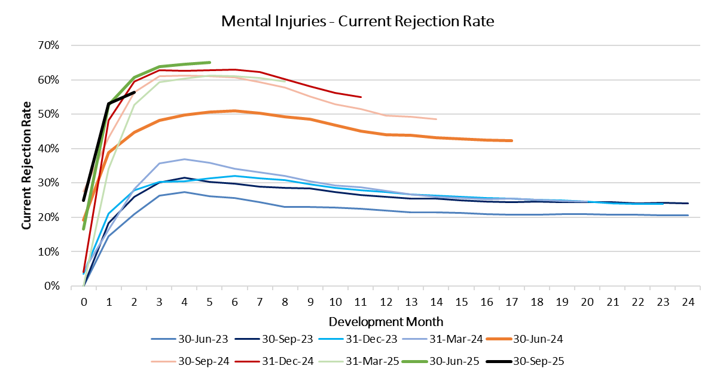
Scheme Reform
Rejection Rate for Mental Injuries Has Increased
Post-reform
Post-reform
Pre-reform
Pre-reform

Slide 11
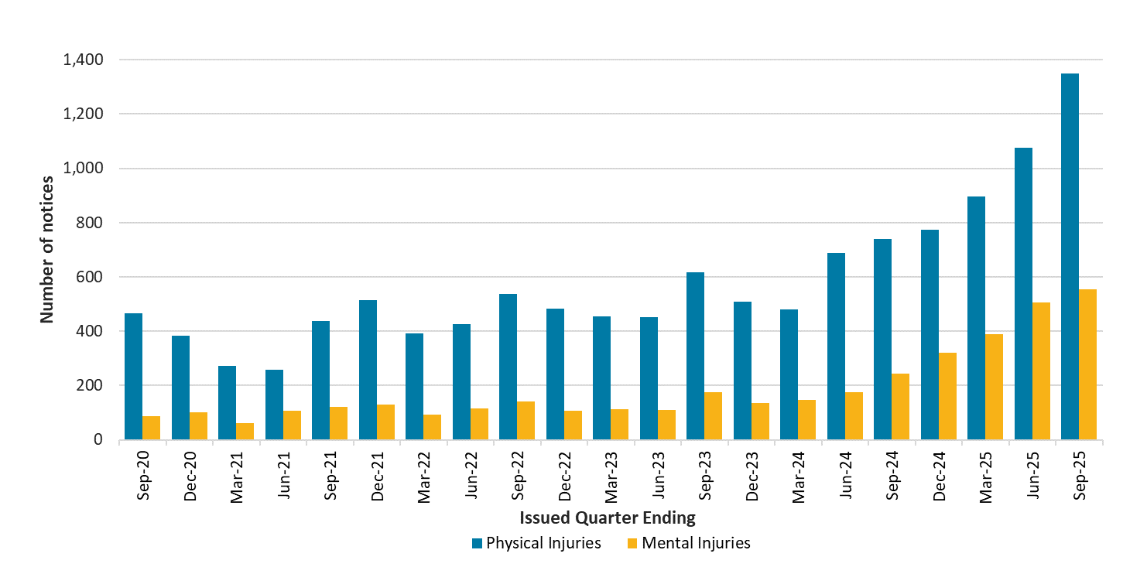
Scheme Reform
Increase in Notices Issued to Workers Ceasing Weekly Benefits (78 Weeks+)
Reform

Slide 12
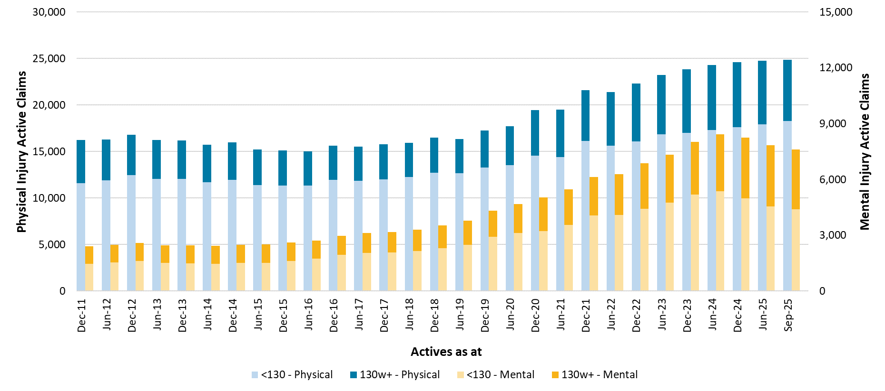
Active Weekly Claims
Reduction in Mental Injury Active Claims Since Reforms
Reform

Slide 13
Thank you
Actuaries Institute
actuaries.asn.au

