Slide 1


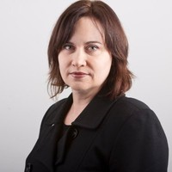
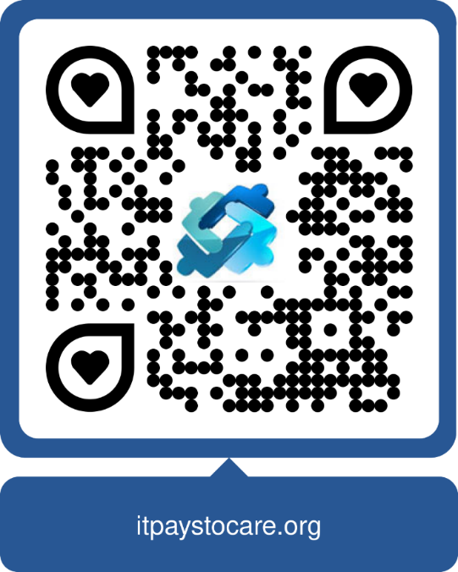
Care and
collaboration
COUNT
Sharon Stratford, Advocacy Lead, IPTC
Actuaries Institute IDSS
17 November 2025
1

Slide 2


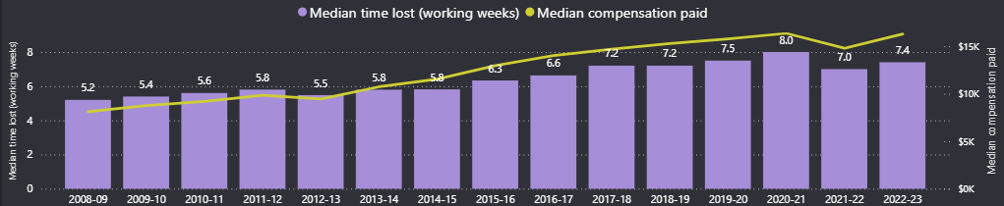
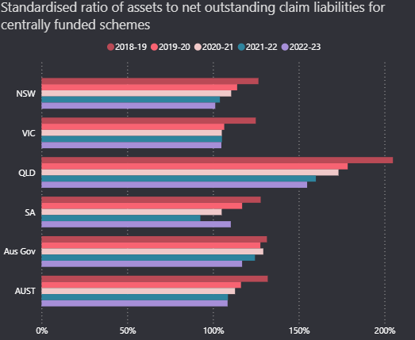

Why does it Pay to Care?
Safe Work Australia national data
2

Slide 3





About the policy and advocacy
The Royal Australasian College of Physicians through the Faculty of Occupational and Environmental Medicine has produced an evidence-based policy: It Pays To Care promoting a national discussion about fair and efficient work injury systems to improve outcomes. Evidence shows that caring systems that are respectful, engaging, transparent and collaborative help both workers and their employers.
The subsequent advocacy work receives philanthropic funding through the Orford foundation and co-funding through the Heads of Workers’ Compensation.

Slide 4

Why should we care?
“Work absence and long-term disability rates
are higher in compensable settings”

Slide 5
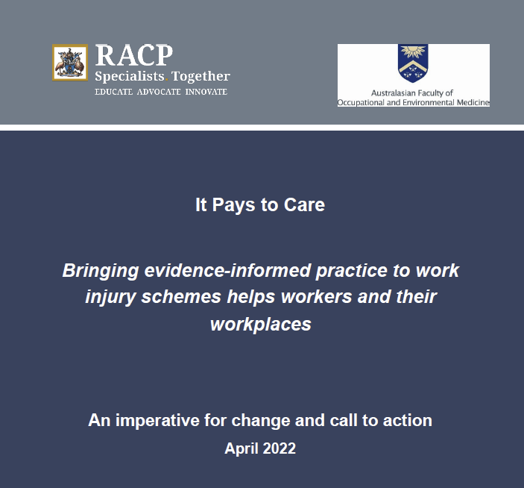
Evidence-informed policy paper
DOMAINS of INFLUENCE
Strong focus on available evidence (364 references)
Narrative review, non-systematic
Strong evidence early good quality care helps people and saves money
Seek to increase the focus on science and evidence in work injury schemes
Scheme regulation/leadership
Insurers and case management
EMPLOYERS
Health care providers
Psychosocial factors!
Call for long term thinking
https://www.racp.edu.au/policy-and-advocacy/division-faculty-and-chapter-priorities/faculty-of-occupational-environmental-medicine/it-pays-to-care
Notes:
Trade off in sustainability and workers – false view

Slide 6
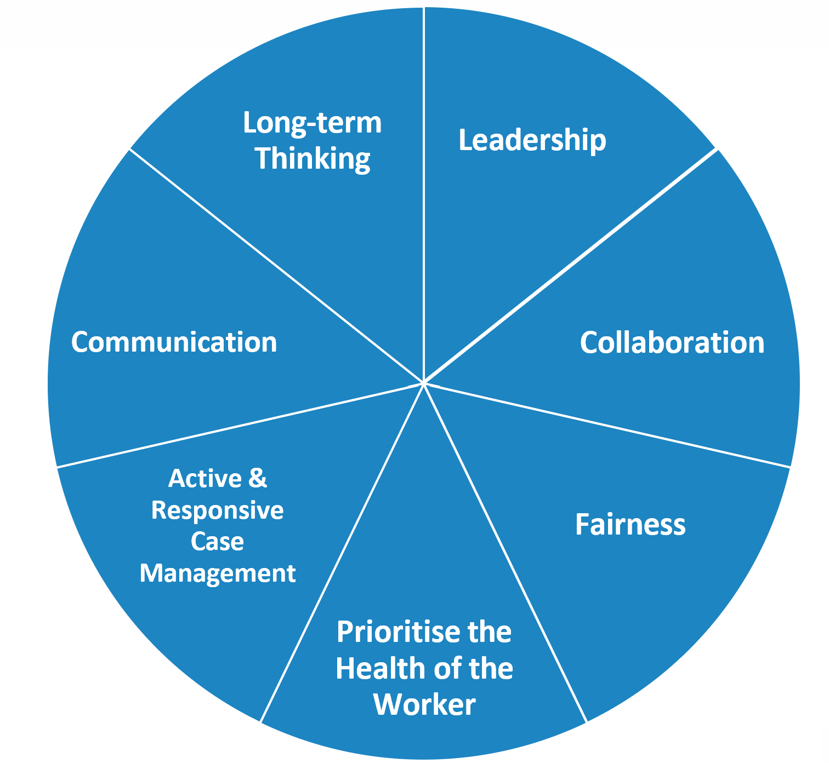
Values and principles papers
The evidence shows that values matter
Injury insurance systems that are fair, respectful, engaging, transparent and collaborative support recovery and return to work.
Key elements for collaboration
Trust: More sharing and willingness to commit
Reciprocity: Give and take, responsiveness
Mutuality: Collective over self-interest
Governance: Not too loose, not too tight
Systems: Explicit focus, arrangements to facilitate collaboration
https://www.racp.edu.au/policy-and-advocacy/division-faculty-and-chapter-priorities/faculty-of-occupational-environmental-medicine/it-pays-to-care
6

Slide 7
Psychosocial factors are common and modifiable

Slide 8
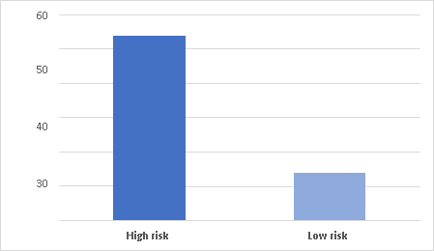



Psychosocial factors
Psychosocial factors
account for up to
85% of prolonged work disability
Average days paid by psychosocial risk
Every 1-point in the ÖMPSQ-SF score - chance of RTW 4%
Stratil, R. S. M. (2012). Work-related back pain study: measuring biopsychosocial risk factors, Discussion paper. Adelaide, WorkCover SA.
Nicholas, M. K., et al. (2019). "Predicting Return to Work in a Heterogeneous Sample of Recently Injured Workers Using the Brief OMPSQ-SF." Journal of Occupational Rehabilitation 29(2): 295-302.
8

Slide 9
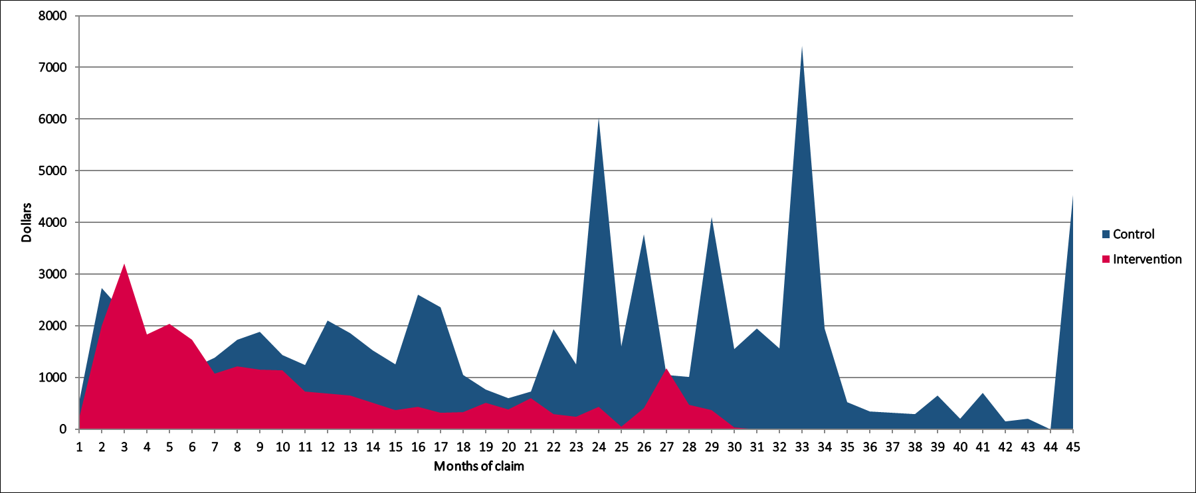
Psychosocial factors are MODIFIABLE
All claimants with common musculoskeletal claims screened using the SF-Orebro
Those at risk of prolonged work disability Mean costs incurred by month
Given extra support – at workplace, IMC, psychologist
50% reduction in lost time, 30% reduction in claims costs for those at risk of prolonged work disability
Importantly, a reduction
in long term cases
Study replicated at AusPost
Nicholas MK, Costa DSJ, Linton SJ, Main CJ, Shaw WS, Pearce G, Gleeson M, Pinto RZ, Blyth FM, McAuley JH, Smeets RJEM, McGarity A. Implementation of Early Intervention Protocol in Australia for 'High Risk' Injured Workers is Associated with Fewer Lost Work Days Over 2 Years Than Usual (Stepped) Care. J Occup Rehabil. 2020 Mar;30(1):93-104. Erratum in: J Occup Rehabil. 2019 Dec;29(4):671.
9
Notes:
Other studies included in paper, others on the way – Recovery Blueprint,

Slide 10
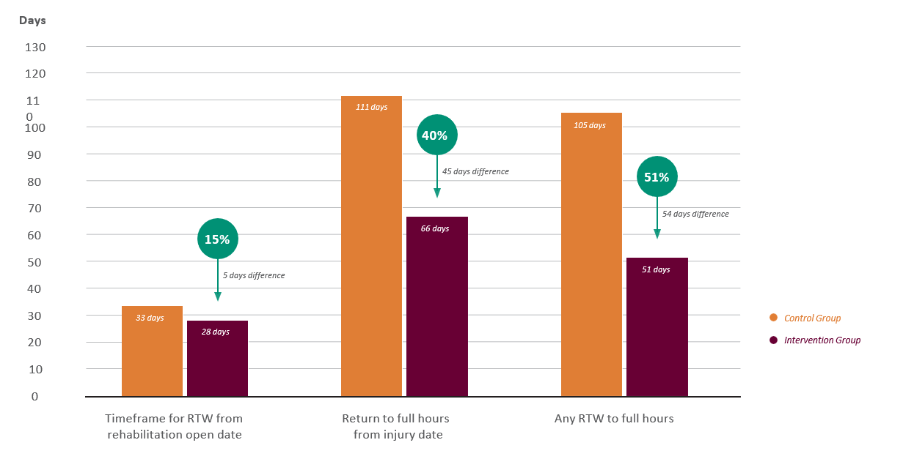





Australia Post EMPCAP study - RTW improvements
Courtesy of Melanie Ianssen of Australia Post - https://www.anzsom.org.au/iptc/video-resources-melanie-ianssen
10

Slide 11





Reduction in costs
Incapacity
Cost
(average)
$8,500
$8,000 |  |  | $8,267.18
$7,500
$7,000
$6,500
$6,000
$5,500
 |  |  |  |  | $5,403.43
$5,000
$4,500
$4,000
34%
$2,863.75
Control Group
Intervention Group
Medical
Cost
(average)
$5,500
$5,184.18
$5,000
$4,500
17%
$884.29
$4,000
$4,299.89
Control Group
Intervention Group
11

Slide 12
Key role of the workplace

Slide 13
Employer response the greatest influence on RTW
RTW by Employer response to injury
Positive response from employer, RTW:
43% higher in physical claims (87% versus 61%)
52% higher in psychological claims (79% versus 52% )
100%
90%
80%
70%
60%
50%
40%
30%
20%
10%
0%
Physical Psychological
At work at time of survey
Return to work: A comparison of psychological and physical injury claims: Analysis of the Return to Work Survey results. Dr Mary Wyatt, Dr Tyler Lane. Report for Safe Work Australia, published 2017. www.safeworkaustralia.gov.au/doc/return-work-comparison-psychological-and-physical-injury-claims
Positive
Negative

Slide 14
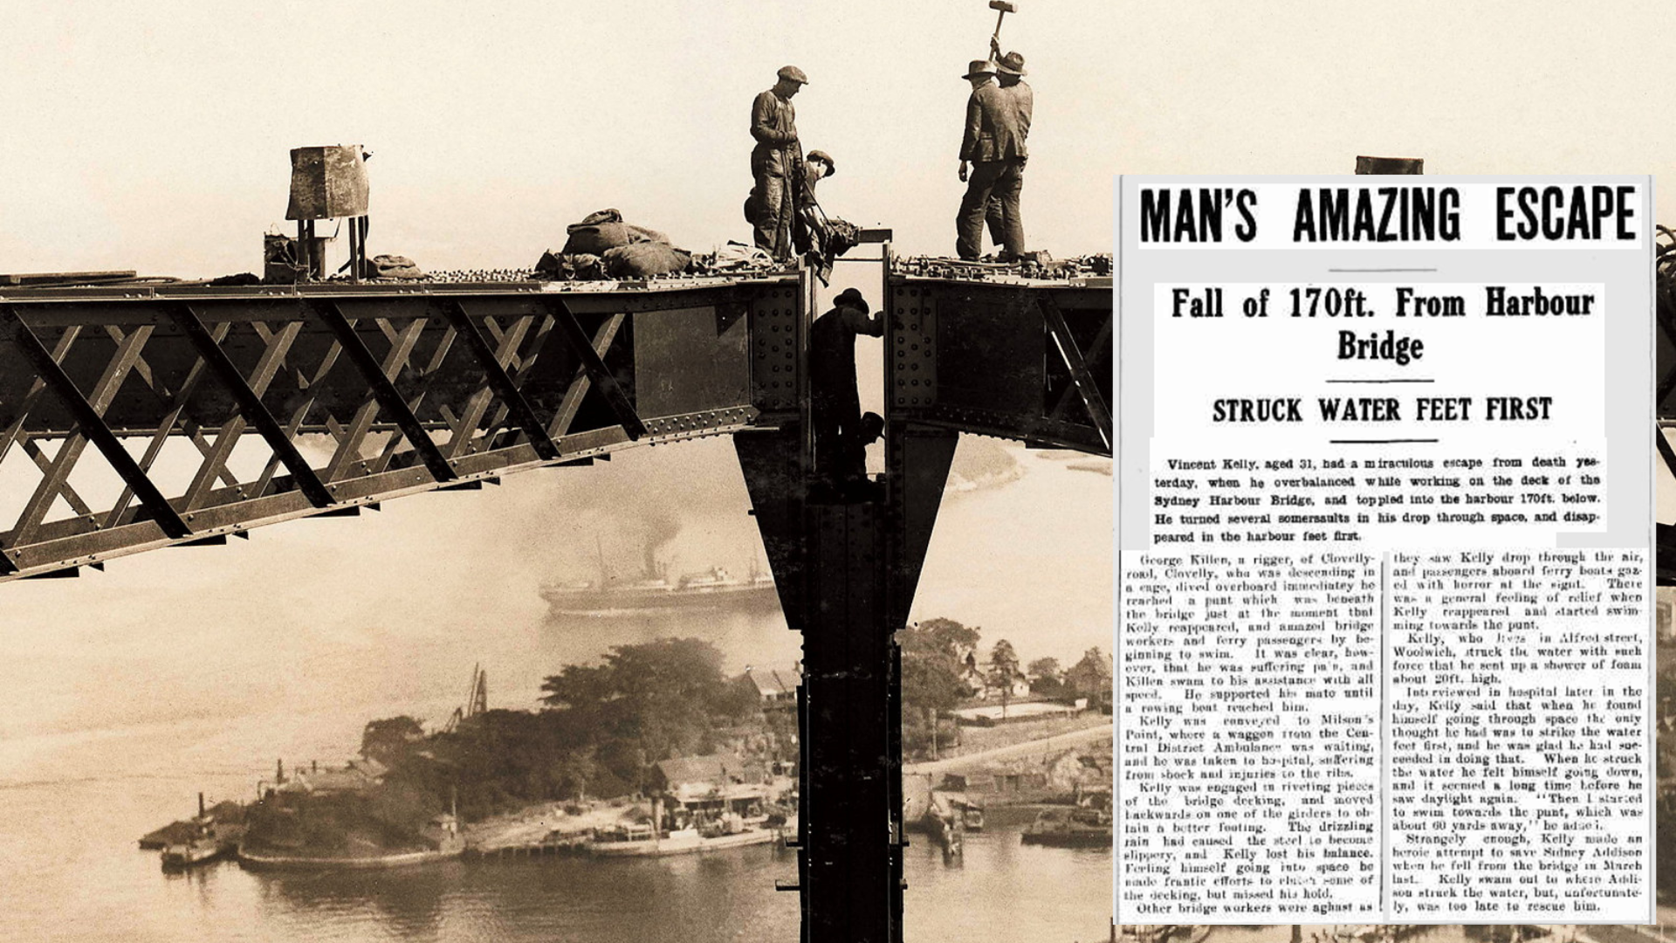
Coz I’m Free Fallin…
Notes:
In Oct 1930 Vincent Kelly was working on the Sydney Harbour Bridge when he fell 170ft from the bridge deck into the water. Being a diver and swimmer, he survived the fall by landing feet first and covering his ears with his hands. Suffering from shock, Vincent lost consciousness, cracked a few ribs, and despite covering his ears, busted one ear drum.
Although his surviving the fall was amazing, what was truly extraordinary was that he returned to work just 15 days after the fall. This wasn’t because his ribs had healed, nor that this eardrum had un-busted, it was because of the camaraderie he had, and the support he received from his workmates.
You see, it was Vincent’s workmates who visited him at hospital, raised money to support his wife and children whilst he couldn’t work, and it was his workmates who couldn’t wait to have him back. Nearly a century later, the research explains Vincent’s speedy return to work.
***And what does that research show?- The workplace is the single greatest influence on RTW outcomes.

Slide 15
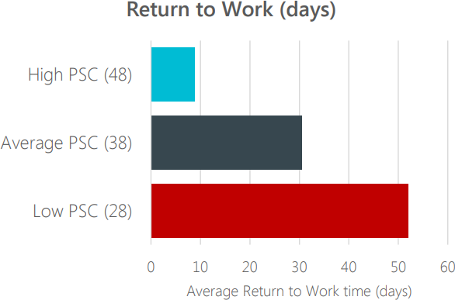
Prevention psychosocial hazards
Psychosocial Safety Climate (PSC) -organisational climate for employee psychological health, wellbeing, and safety
The PSC survey explores employee perceptions
  management commitment
  the priority of mental health within the org
  communication
  employee participation and involvement.
It can predict
    Future work conditions, psychological health and engagement with other workers
    Injury likelihood and under-reporting of work injuries.
    Sickness absence
    Prosocial procedures (job design, social relations) that prevent bullying
    Productivity loss.
Organisations with a low or moderate PSC have significantly more average days lost per workers’ compensation claim than those with high PSC scores,

Slide 16
Case management

Slide 17
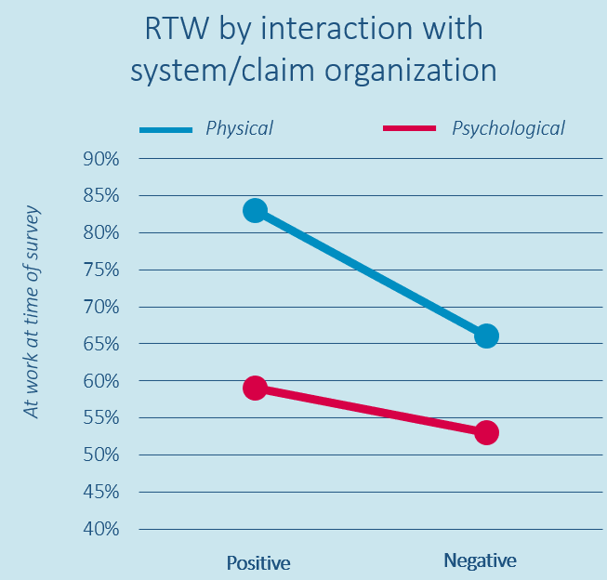
Insurance case management
Workers who describe positive interactions with their case manager have higher rates of RTW, report less pain, greater perceived health, quicker recovery from traumatic injury and improved quality of life
Positive case management interactions with the injured worker
▶ 25% more likely to RTW from a physical injury
▶ 13% more likely for a psychological claim.
Wyatt, M. and T. Lane (2017). Return to Work: A comparison of psychological and physical injury claims: Analysis of the Return to Work Survey Results, Safe Work Australia.

Slide 18
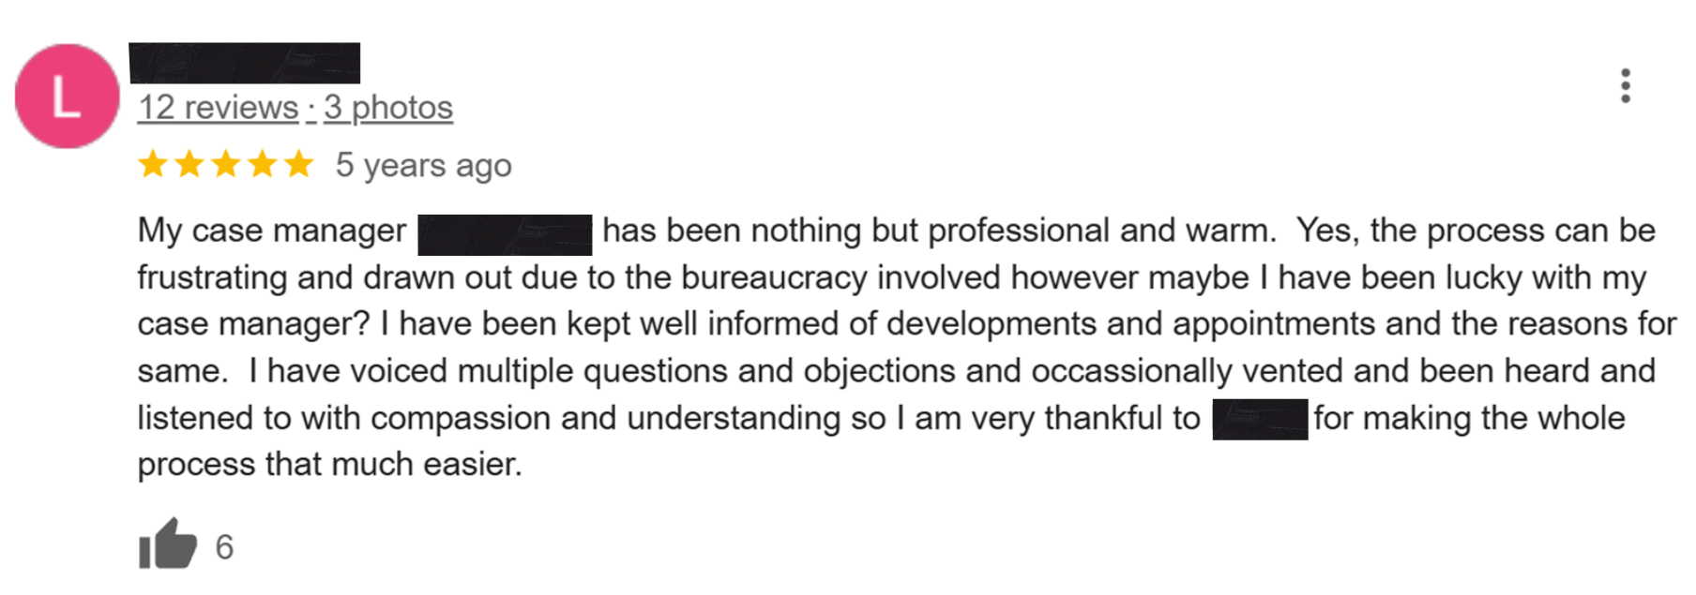
Best practice case management
Notes:
From a claims management perspective, studies show a multi-faceted approach in which the case managers address psychosocial barriers, effectively communicate, and are collaborative problem-solvers could reduce claims costs by 30% and improve return to work outcomes.
Employers can make a difference too. Training supervisors in communication and problem-solving skills has been seen to reduce work absence due to pain by 50%.
Let’s run through some other things you can do in the workplace….
***Effective systems facilitate timely and comprehensive

Slide 19
Evidence in short:

Slide 20
What to influence – positive factors increase RTW
Key influencing factors in RTW Survey | Physical | Psychological
Positive employer response to injury | 42% | 65%
Early contact from workplace versus no workplace contact | 26% | 63%
Employer pre-claim assistance provided | 18% | 33%
Absence of disagreement / dispute | 22% | 31%
Lack of concern about lodging a claim | 24% | 29%
Positive interaction with system / claims organisation | 25% | 11%
Positive workplace culture prior to injury | 25% | 2%
Higher personal resilience | 10% | 12%
Medical care focused on RTW | 8% | *
13

Slide 21
What have we been doing to influence domains?

Slide 22




What IPTC has been doing:
Sharing strategies/ results
Advocacy
Collaboration
Symposiums on key topics bringing people together to share/network
Using many opportunities to present on and advocate for IPTC
Presentations for employers, brokers, self-insurers, unions, providers etc
Articles in journals, resources developed and made available
Collaborations with others e.g. PIEF, regulators, insurers

Slide 23



Practical domain solutions:
Resources
Tools
Presentations
Psychosocial factors: guidelines for risk identification and management
Scheme: regular at HWCA, CTP symposium, national premium forum
Insurers/CM: IECCC, PIEF super SME national cm standards, workshops
Employers: government, unions, national IM standards, generic preso’s
Providers: GP CPD module, presentations/articles with APA, ESSA, ARPA

Slide 24
Psychosocial resources
Best practice guide
ANZSOM hosted videos on psychosocial triage, assessment and intervention
24

Slide 25
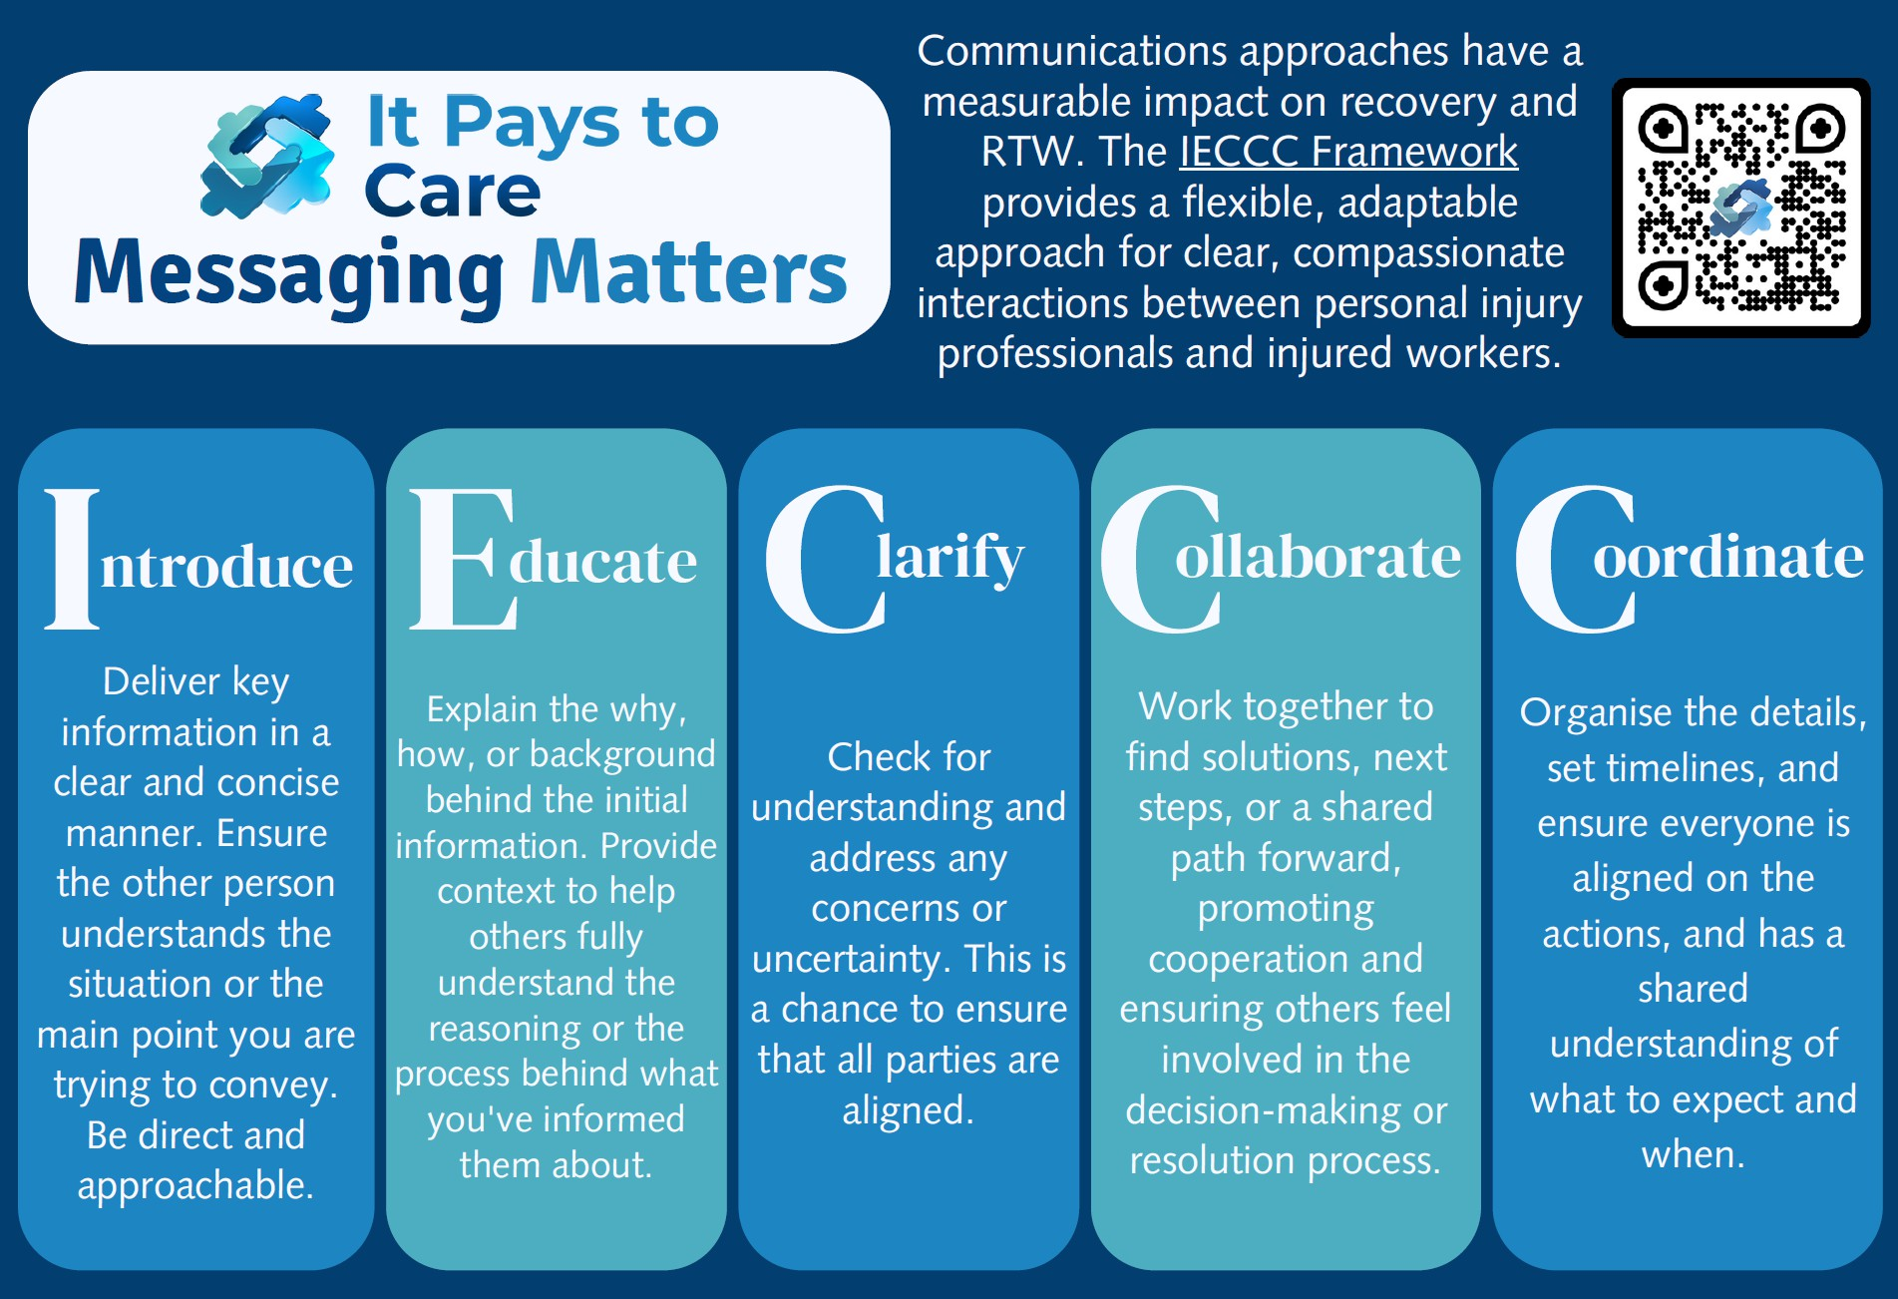

Slide 26

2025-2028 Strategic Plan
As an independent not for profit organisation, we’re working to support the transformation of compensation systems: connecting people and policy to create a future where it truly Pays to Care.
Our Vision: To deliver best evidence-based care for the whole worker, improving outcomes in the personal injury industry.
Our Purpose: to help drive change in the personal injury industry by embedding the It Pays to Care policy and fostering collaboration to improve outcomes for all.
STRATEGIC FOCUS
PLANS
INITIATIVES
Collaboration, Projects and Partnerships
To strengthen purpose-driven partnerships by collaborating to identify, implement and share best practice, and support research and communication that drive system-wide improvement.
Work as a trusted partner, providing advice and assistance to the industry
Run collaborative symposiums
Collaborate on projects with key industry organisations and contacts
Starting Points:
Collaborate on PIEF training, insurer claim approaches, provider practices, regulator communication campaigns.
Work with Government entities to improve injury management practices.
Thought Leadership
To shape national thinking across schemes by influencing policy, promoting evidence-based culture change, and embedding It Pays to Care as a priority for improving care outcomes while reducing system costs and increasing efficiency.
Influence/educate large employers, insurers, government departments, self-insurers, regulators, healthcare providers and policy makers to move towards evidence-based best practice.
Starting Points:
Present widely to H&S groups, conferences, symposiums
Engage with key gov’t stakeholders
Work with insurers to reach employers
Invite key stakeholders to events, or host an industry forum with VIP guests
Leverage regulator’s relationships
Supporting Capability
We use our expertise to contribute to building knowledge and confidence in the personal injury sector through evidence-based resources that enable professionals to aid worker recovery and return to work.
Develop a best practice guide for case management
Deploy the RTW Matters AI tool for use by practitioners
Ensure the IPTC policy is accessible in different formats
Create resources for use with employers
Starting Points:
Expand use of already created resources e.g. GP CPD modules, IECCC messaging matters, PS triage guidelines
Leverage stakeholder’s communication channels to expand reach
Continue to engage guest experts who can reinforce benefits of implementing the policy
26

Slide 27

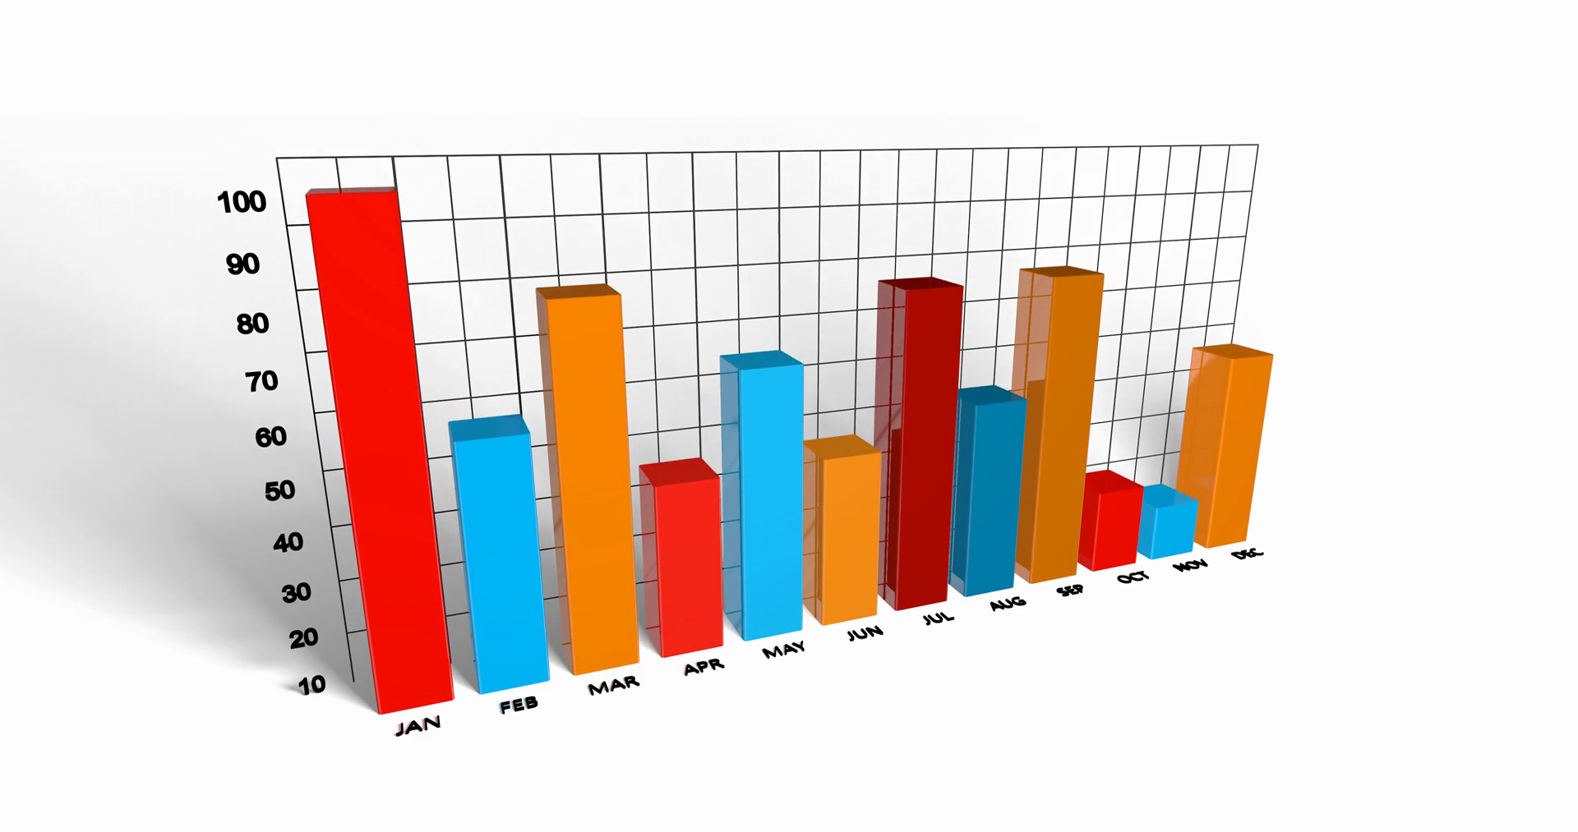

What can you do?
27

Slide 28



28

