Slide 1
The emerging challenges around Silicosis
Tim Rao & Dai Liu
November 2025

Slide 2
Contents
Overview of Silicosis 03
Future Disease Incidence 07
Ultimate Claim Numbers 09
Timing of awards 17
Manufactured Stone and Tunnelling 21

Slide 3
Overview of Silicosis
01

Slide 4
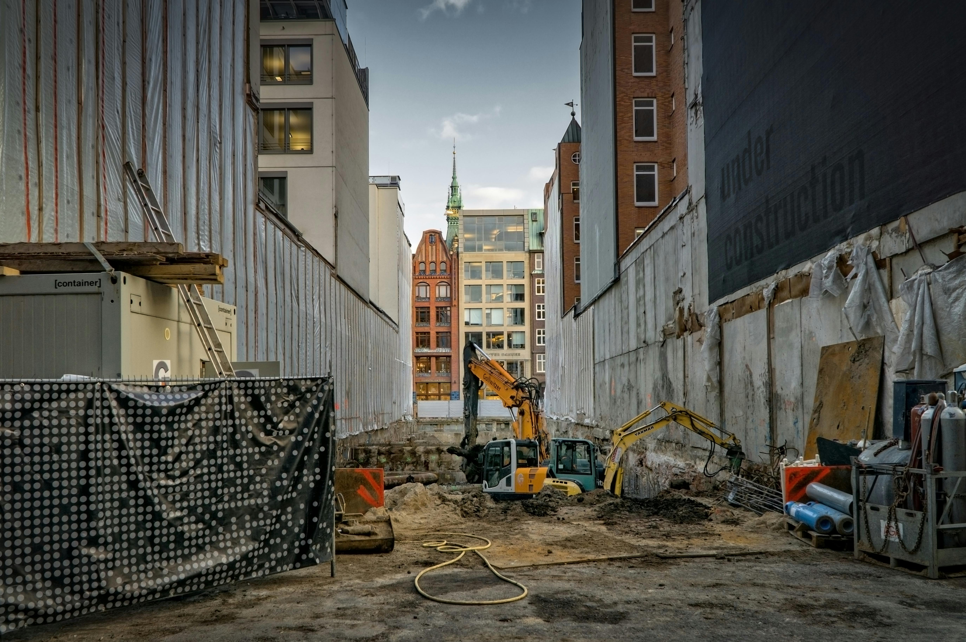


Silicosis as a disease – background
Nature of the disease
  Occurs after continuous exposure to respirable crystalline silica (RCS)
  Results in inflammation and fibrosis (scarring) of lungs
  Can generally be categorised into Chronic, Acute, or Accelerated silicosis
  Typical latencies of 10-30 years from exposure, but may be shorter for acute or accelerated cases
Sources of Respirable Crystalline Silica
  RCS generated from cutting, grinding or polishing crystalline silica (e.g. quartz)
  Common materials include sandstone, concrete, and brick.
  Most represented industry in NSW are construction (incl. tunnelling) and manufactured stone benchtop installation, representing >60% of all cases since 2010.
  Other jurisdictions may be exposed via mining and manufacturing.

Slide 5


Silicosis as a disease – emerging trends and impacts
Resurgence of Silicosis
  Asbestos related diseases in decline following phasing out and eventual ban
  New silicosis exposures, primarily from tunnelling and construction resulting in younger workers being diagnosed
  Infrastructure and housing needs continue to drive demand
Recent Developments in the industry
  Lowering the recommended exposure limit (REL) from 0.10 mg/m³ to 0.05 mg/m³ (over 8 hrs)
  Requirements for protective equipment, such as fitted dust masks
  Dust suppression equipment, including wet cutting, ventilation, and water curtains
  Manufactured stone processing ban for materials with >1% crystalline silica
  Medical advancements, including improved screening (CT scans) and early detection of the disease
  Launch of the National Silica Worker Register (1st October)
  Review of the Code of Practice for Tunnels Under Construction

Slide 6
Silicosis as a disease – emerging trends and impacts
NSW Dust Diseases Scheme
  The NSW Dust Diseases Care scheme (DDC) provides support to workers in the form of:
  Fortnightly benefits payments to workers who are incapacitated for work (for life)
  Medical payments to workers for reasonably necessary treatment and care
  Funeral benefits
  Lump sum and fortnightly benefit payments to dependants after the worker passes away
  The costs of providing life-long care and support to workers is estimated to range from $400k to $700k (inflated and discounted to present value) per claim, not accounting for lost productivity.
Other Considerations
  Non-financial cost of providing care and support to permanently disabled workers, including impact on social life, family, and friends
  Higher mortality for workers affected by silicosis
  Lost productivity from workers who are no longer able to perform at their previous capacity due to their disability
  Changes to age distributions, as newly exposed workers tend to be younger, and may have different needs to older workers near retirement.
  Disproportionate impacts on CALD communities due to the demographic of exposed workers

Slide 7
Future Disease Incidence
02

Slide 8
Model Overview
Key Model Components
  Appropriate proxy for the number of workers potentially exposed to RCS
  Risk weighting to estimate the number of future claimants
  Disease latency distributions to predict when workers will start receiving benefit payments
  Age distribution to predict the age of a claimant
  Allocation of future claimants to appropriate cohorts
Future 1% Awards

Slide 9
Ultimate Claim Numbers
03

Slide 10
New Workers Exposed to Risk
Rationale
  Workers exposed to RCS have a risk of becoming a claim
  The new workers exposed to risk will be used to estimate ultimate claim numbers
  Different activities will result in varying levels of exposure to RCS
Industries at risk
  In NSW, the construction industry represents more than half of all silicosis related claims since 2010.
  A US study of RCS exposures (Doney et al., 2020) found 79% of workers exposed above the regulatory exposure limit (REL) were from the construction industry.
Data Source
  The occupational data used for this purpose was sourced from the Australian Bureau of Statistics
Projection methodology
  ABS Industry Job Mobility (Feb 2024) implies approximately 9% annual replacement rate
  Total new workers exposed is annual net change + replacement
  Future workers can be projected with industry growth rate
Risk Stratification
  Apply an occupation-specific risk weighting based on typical tasks under the unit group
  This reflects the likelihood of a worker performing an RCS generating activity, the regularity of such tasks, and the quantity of dust which may be generated.
  Examples:
    8212 Concreters – High risk
    3411 Electricians – Low risk
Notes:
(ABS April 2025 release, 6291.0.55.001 - EQ08 - Employed persons by Occupation unit group of main job (ANZSCO), Sex, State and Territory, August 1986 onwards).
The occupations and industries most at risk of RCS exposure may vary across jurisdictions.

Slide 11
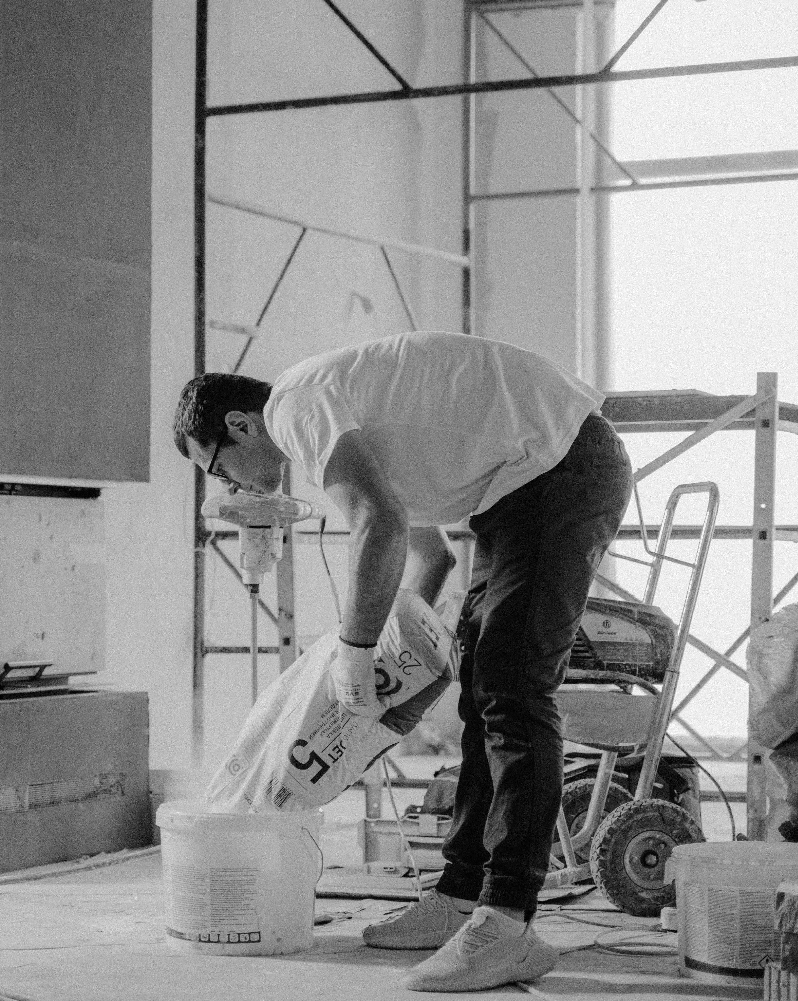
Estimating future worker awards
Key Considerations affecting risk level
  A proportion of workers exposed to RCS may develop silicosis and be awarded as a workers’ compensation claim
  The risk of a worker becoming a claim should consider scheme experience, academic studies and external benchmarks
  The probability that a newly exposed worker develops silicosis and becomes awarded may reflect the following:
    Over half of workplaces will have exposure above the REL
    Between 4% and 21% of exposures may result in silicosis (crude incidence rate).
    More than half of all workers with silicosis have historically not made Workers’ Compensation claims (likelihood of making a claim).
Exposure above the REL
  New Zealand - 56% of workplace samples exceeded 0.025 mg m⁻³ (McLean et al, 2017, n = 39).
  United States - more than half exceeded 0.075 mg m⁻³ (Tjoe et al, 2003, n = 61).
Notes:
Noteworthy considerations
Time-dependant factors are allowed for as “safety improvements” over time.
Some degree of uniformity is assumed across aggregated data for the purposes of producing a central estimate.
Claims must satisfy more strict criteria, including occupational exposure and loss of lung function. Other interested parties may have broader requirements.
Exposures below the REL is not risk-free, however the level of risk increases significantly with dose.

Slide 12
Crude Incidence Rate
Author | Silicosis/Sample Size | Crude Rate
Hnizdo and Sluis-Cremer | 313 / 2,235 | 14%
Steenland and Brown | 170 / 3,330 | 5%
Hughes et al. | 81 / 1,809 | 4.5%
Chen et al. | 2,816 / 14,427 855 / 4,028 785 / 4,547 | 20% 21% 17%
Liu et al. | 5,297 / 34,018 | 16%
Kreiss and Zhen | 32 / 100 | 32%
Miller et al. | 47 / 547 | 9%
Rosenman et al. | 36 / 936 | 4%
Key Points
  China – Cohort study of 34,018 workers, stratified based on cumulative exposure (Liu et al, 2013).
    Between 0.01 mg m⁻³ years and 1.12 mg m⁻³ years of exposure, the incidence rate was 3.1%.
    Between 1.12 mg m⁻³ years and 2.91 mg m⁻³ years of exposure, the incidence rate was 12.2%.
  Assume a typical Australian exposure is between 1.1 mg m⁻³ years and 2.75 mg m⁻³ years, based on the previous REL over a period of 11 years.
  Other cohort studies from different countries reported comparable incidence rates.
Notes:
Notes and Commentary
Consideration should be made for the following points:
Limited protective equipment (such as masks) were used by workers in the study (<5%).
A greater proportion of workers in the study were smokers compared to the Australian population average
Properly fitted masks and ventilation, such as in outdoor cutting environments, can reduce the level of risk
Workers in the construction industry may take on multiple tasks at different phases of a project, with varying levels of RCS exposure.

Slide 13
Crude Incidence Rate

Slide 14

Likelihood of making a claim
Key Points
  In 2018, Deslauriers and Redlich reported that 65% of workers with silicosis in the US had not applied for Workers’ Compensation.
  Within Australia, it is reasonable to expect a higher proportion of workers will make a claim.
    Heightened media attention
    Regulatory focus
    Mandatory health monitoring obligations for employers
    In NSW, active screening program provided by icare (Lung Bus and Kent St Clinic)

Slide 15
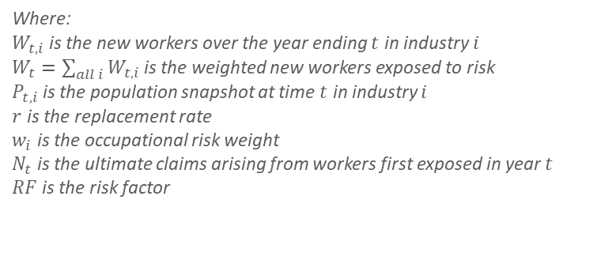



Proxies for Silica Exposure
Ultimate claims from entry year $t$:
$$N_{t}=W_{t}×RF$$
New workers entering an occupation:
$$W_{t,i}=\left(P_{t−1, i}×r+ΔP_{t,i}\right)×w_{i}$$
Where:
$W_{t,i}$ is the new workers over the year ending $t$ in industry $i$
$W_{t}=\sum_{all i}{W_{t,i}}$ is the weighted new workers exposed to risk
$P_{t, i}$ is the population snapshot at time $t$ in industry $i$
$r$ is the replacement rate
$w_{i}$ is the occupational risk weight
$N_{t}$ is the ultimate claims arising from workers first exposed in year $t$
$RF$ is the risk factor

Slide 16
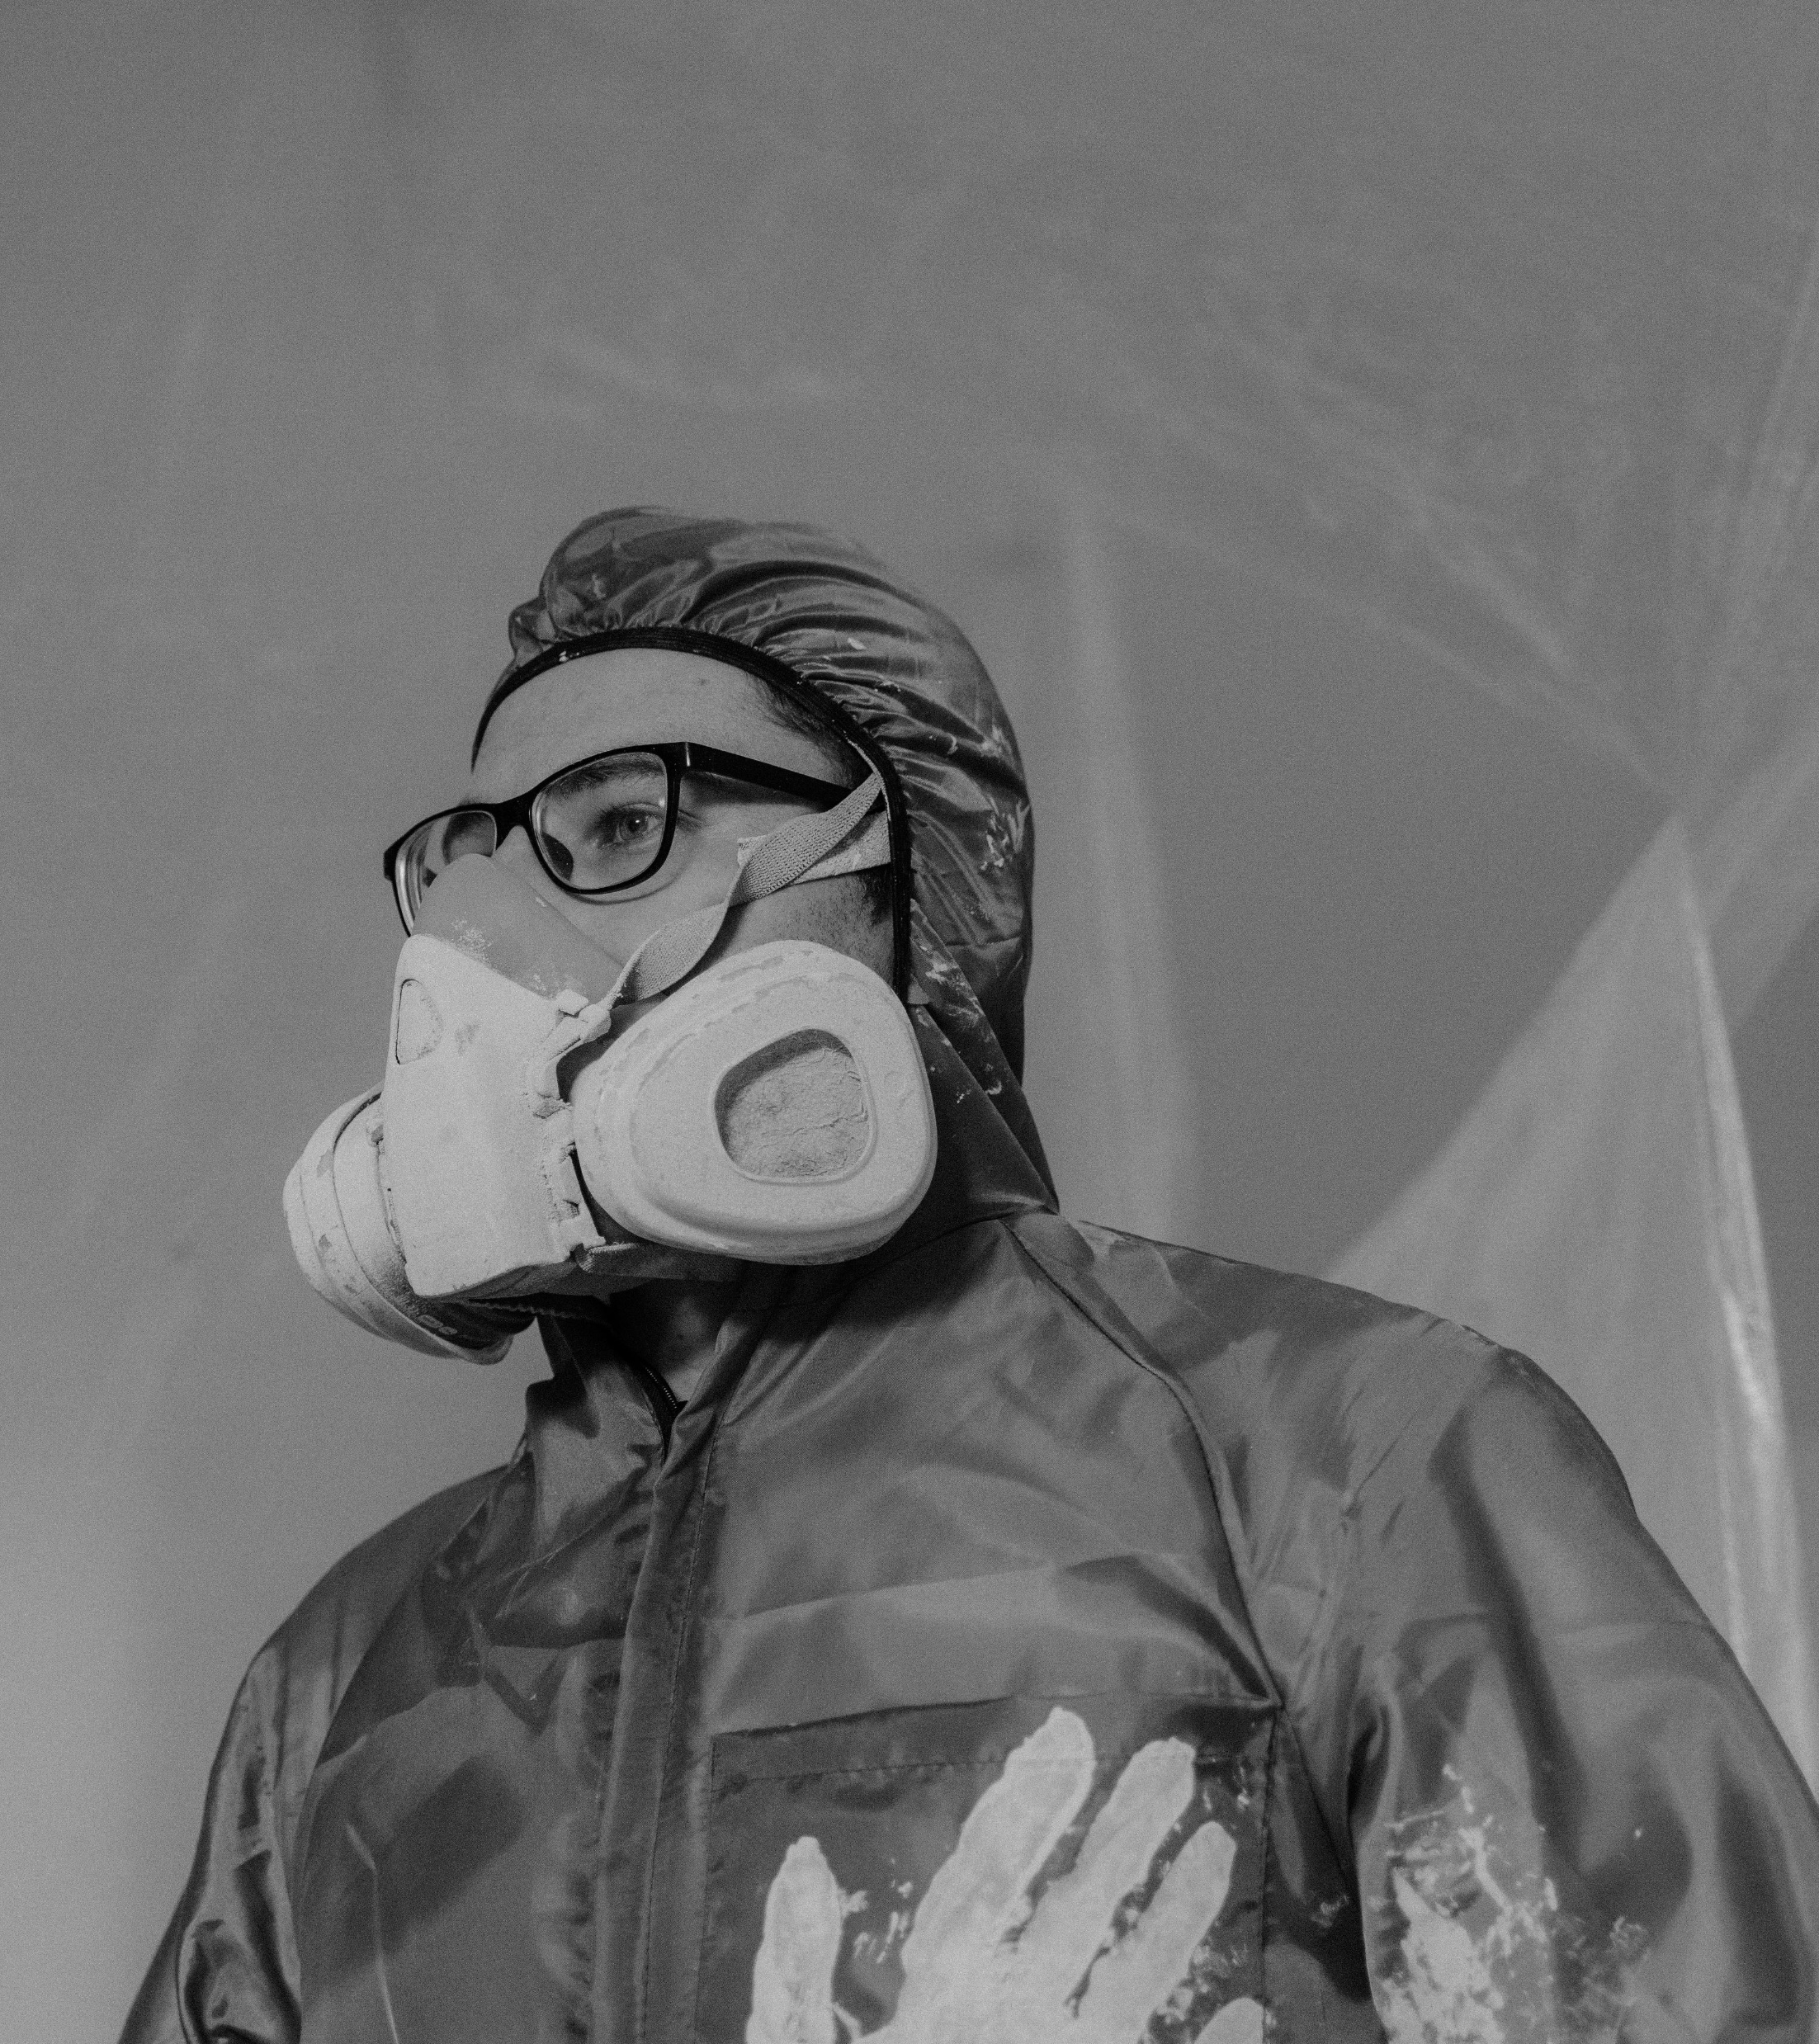
Safety improvement
Key Points
  The level of RCS exposure to workers can be reduced if appropriate safety controls are used.
  Since 2017:
    Increased media attention and industry awareness
    Reductions to the exposure limit in NSW
    Requirements for wet cutting
    Ban on manufactured stone installation
  Industries with regulatory focus may have gradual improvements over several years
Notes:
Some level of reduction can assumed annually, eventually reaching a minimum level to allow for accidental exposure.

Slide 17
Timing of Awards
04

Slide 18
Disease Latency and Award Timing
Key Points
  Allocate ultimate claims from an exposure year to future award years based on an assumed latency distribution
    Used for estimating the number of future claimants and allocating resources efficiently.
  Considerations include:
    Historical scheme experience
    Proportions of chronic, accelerated, and acute silicosis based on the level of exposure
    Reported latency periods and standard deviations in academic studies
    The shape of the distribution
  Most reported claims are chronic (10 to 30 years after their first exposure). However, those exposed to high concentrations of RCS may develop accelerated or acute silicosis, latency of under 10 years (Baum and Arnold, 2023)
Sample Latency distribution
Notes:
Note that a second delay distribution is assumed for claims processing time.

Slide 19
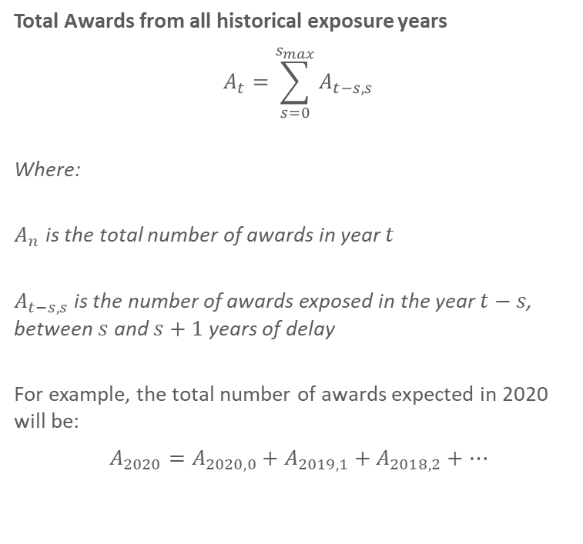
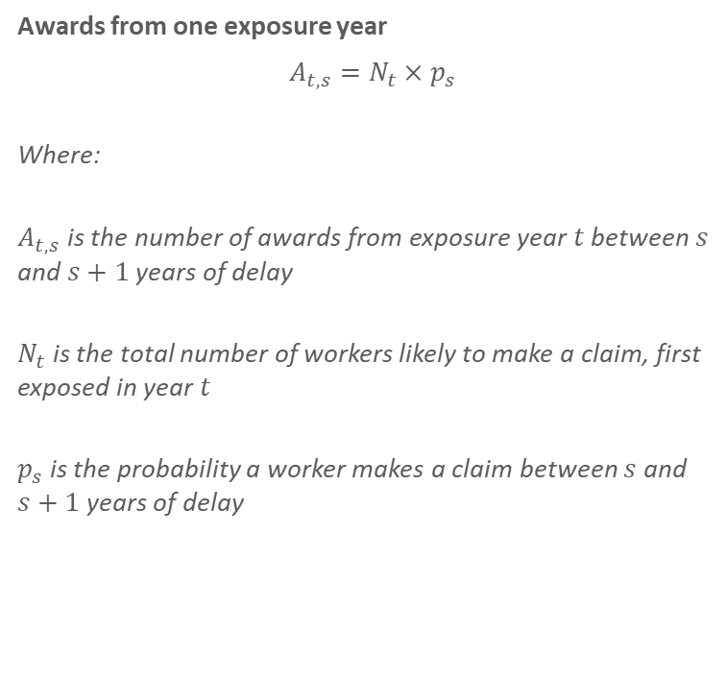
Estimate of future awards
Awards from one exposure year
$$A_{t, s}=N_{t}×p_{s}$$
Where:
$A_{t, s}$ is the number of awards from exposure year $t$ between $s$ and $s+1$ years of delay
$N_{t}$ is the total number of workers likely to make a claim, first exposed in year $t$
$p_{s}$ is the probability a worker makes a claim between $s$ and $s+1$ years of delay
Total Awards from all historical exposure years
$$A_{t}=\sum_{s=0}^{s_{max}}{A_{t−s, s}}$$
Where:
$A_{n}$ is the total number of awards in year $t$
$A_{t−s, s}$ is the number of awards exposed in the year $t−s$, between $s$ and $s+1$ years of delay
For example, the total number of awards expected in 2020 will be:
$$A_{2020}=A_{2020, 0}+A_{2019,1}+A_{2018,2}+…$$

Slide 20
Estimate of future awards - NSW
Projected NSW claims
By applying the previously mentioned principles to workers in NSW, it is possible to project a plausible scenario for future silicosis claims from exposures up to June 2025.
Furthermore, future exposures are expected to result in additional claims, shown in a different colour. These are projected using an assumed industry growth rate and continued safety improvements over time.
Projected silicosis claims in NSW

Slide 21
Manufactured Stone and Tunnelling
05

Slide 22
Special considerations for high-risk workplaces
Tunnelling
  Enclosed environment with poor ventilation
  Higher concentrations of RCS
  Greater risk to workers
Manufactured Stone
  Enclosed environment with poor ventilation
  Artificial stone contains more crystalline silica than natural stone
  Higher concentrations of RCS
  Greater regulatory attention over the last decade, and eventual ban of the material

Slide 23
Thank you
Actuaries Institute
actuaries.asn.au

