Slide 1
The rise of e-micromobility
Implications for the NSW CTP Scheme
Belinda Ernst and Ning An

Slide 2
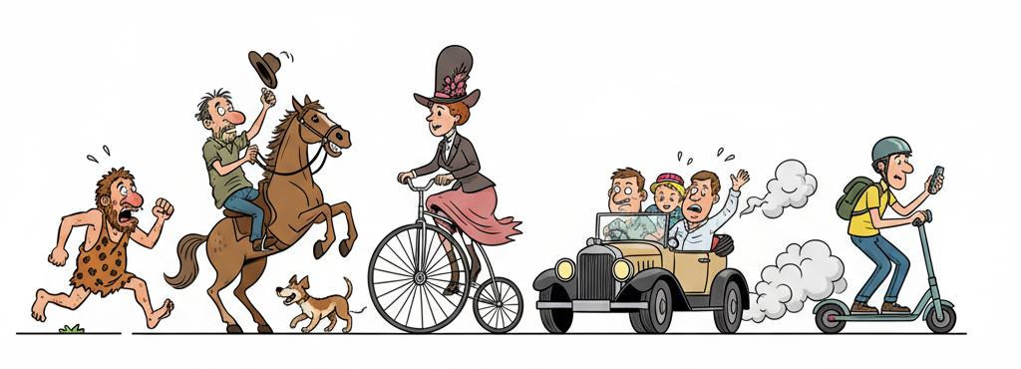
The evolution of e-micromobility

Slide 3


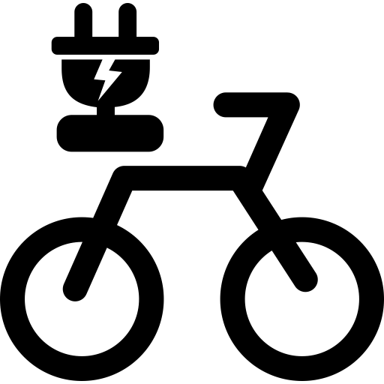
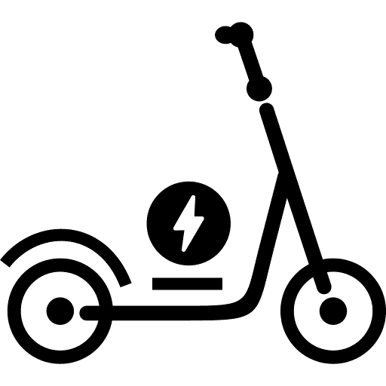





Global snapshot
E-bikes
Consistent approach internationally
Generally, e-bikes meeting EPAC or pedelec definition do not require registration, licensing or insurance
Higher speed e-bikes, and those that can be fully electric, generally require registration, licensing and insurance
E-scooters
More disparate arrangements
Ongoing responses to safety concerns
Some countries have requirements for registration, license plates and third-party liability insurance

Slide 4



E-micromobility in NSW
Share scheme trials commenced in December 2022
Privately owned e-scooters illegal on public roads
Plans to legalise private e-scooters on public roads
E-bikes legal on public roads when they meet required specifications
E-micromobility devices do not require registration and are therefore ineligible for CTP insurance
Legal e-scooter use | NSW | ACT | VIC | TAS | SA | WA | NT | QLD
Shared scheme
Privately owned
Trial only
Excluding Melbourne
Temporary ban in Perth

Slide 5






The policy problem
Key policy issues
Key policy gaps
Rapid uptake of e-micromobility devices
Uptake outpacing regulation ad insurance frameworks
Emerging evidence of different injury profiles
Potential cost implications to the NSW CTP Scheme
Need for robust evidence to inform government decisions
CTP coverage
Equity

Slide 6


How things have progressed
Parliamentary inquiry into e-micromobility established 6 June 2024
Committee did not consider that the Compulsory Third Party Scheme could or should be extended, especially in the absence of licensing and registration
NSW Government committed to exploring options for e-micromobility insurance
Road Transport and Other Legislation Amendment (Micromobility Vehicles and Smartcards) Bill 2025
Introduced to NSW Parliament October 2025
Includes proposed amendments to the Motor Accidents Injuries Act 2017 to clarify that crashes involving only e-micromobility devices are not covered by the Act

Slide 7



Approach and Data
Model segments
Data
Model structure
E-bikes
E-scooters
1
2
3
Private
use
Private
use
Number of MMD Injuries
Propensity to claim
(likelihood to claim benefits)
Average claims size
Shared scheme
Shared scheme
Published reports, news articles and organisation websites
CTP cost
Non-CTP cost
Other
Costs due to a higher volume of MMDs on public roads resulting in more accidents involving a registered motor vehicle
Costs due to claims arising from MMDs but not involving a registered motor vehicle;
Bodily injury or other liabilities arising from manufacturing or battery failures
Mixture Australian and overseas data was considered.

Slide 8




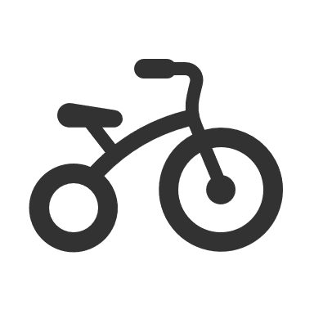







Current state and usage of MMDs
Current number of e-bikes and e-scooters in NSW
Average distance and frequency of use
Estimated exposure
The two largest component of e-bike and e-scooter ownership is either private use or Shared Scheme, while e-bike share scheme is more mature
Annual km travelled by e-bikes and e-scooters:
E-bikes
E-scooters
Shared scheme:
0.7 – 2.3 times / day
1.5 – 3.5 km/ trip
Private
Shared
970k
5k
~520km/year
E-bikes
0.7 – 2.3 times / day
3 – 15 km / trip
480k
1k
Note: survey respondents can choose more than one option.
E-scooters
~500km/year
35%
Conversion to private use
Visit family & friends
Difficult to source private use statistics
Frequency of usage:
45%
By comparison:
Go shopping
2 ~ 3 : 1
What do people use e-scooters for?
50%
1,000 km/year
For recreation
Leading operators/distributors
Average distance travelled:
1,900 km/year
53%
0.8 ~ 1.5 : 1
Get to public transport
11,200 km/year
46%
Go to work

Slide 9



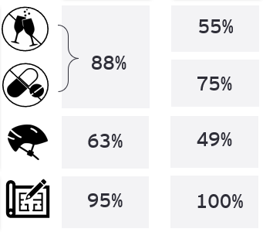
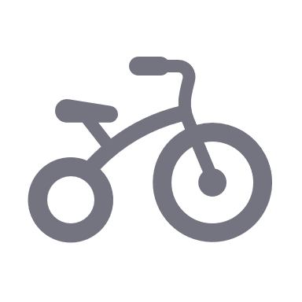


Injury rate and claims rate
Injury and claim frequency per MMD
E-scooter usage¹
Male
60%
Gender
Female
40%
Demographics
Age
band
Estimated injuries and claims
MMDs used in a legal manner
Annual number of injuries:
E-bikes
E-scooters
Annual number of claims:
E-bikes
E-scooters
Wear helmet
Legal design
No alcohol
No drug
2,950 injuries/year
1,930 claims/year
88%
63%
95%
4,800 injuries/year
2,860 claims/year
55%
75%
49%
100%

Slide 10






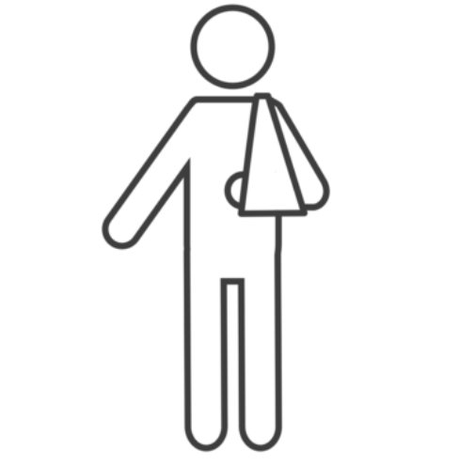

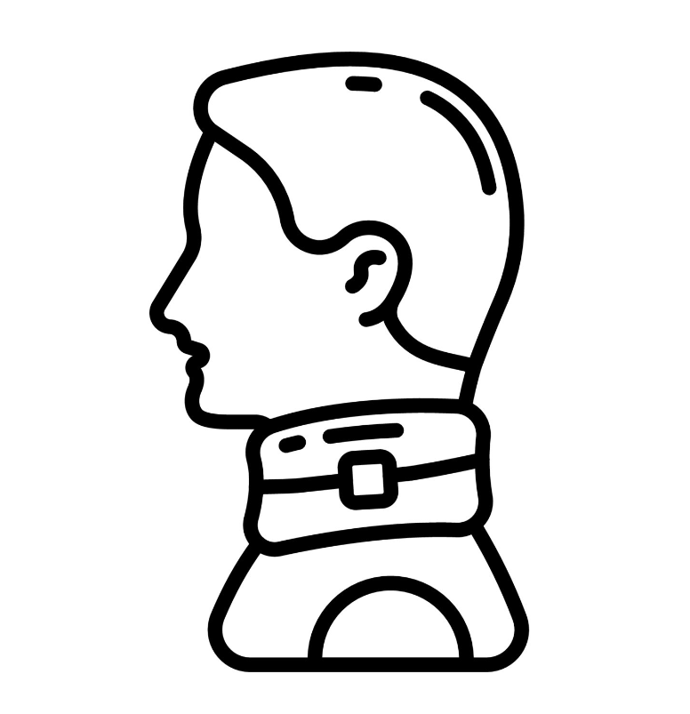




MMD injuries are of lower severity than motorcycle accidents where we have observed 20% threshold, 78% non-threshold and 2% fatality claims.
E-scooters are assumed to have a higher proportion of threshold claims due to lower speed and power output of devices.
¹ Inclusive of all parties injured in an accident.
MMD injury profile, claim profile and average claim size
MMD injury profiles
Claim profile
Conversion to NSW CTP claim type
By injury locations
By injury types
8%
22%
Legend
Brain and traumatic injury
43%
5%
Threshold
Head, face, and neck
10%
17%
Estimated cost using published NSW CTP Schedule 1E
Non-threshold
32%
7%
E-scooter
Fatality
54%
38%
E-bike
Fracture and dislocation
Thorax, chest, pelvis, spine and abdomen
27%
24%
31%
14%
8%
64%
Sprain and Laceration
12%
11%
29%
72%
26%
15%
Extremities
48%
30%
26%
29%
Soft tissue
33%
55%
Average claim size (MAGs)
^{Legend}
^{E-bike}
^{E-scooter}
^{Motorcycle}
^{Car}
64%
of e-bike injured persons are at-fault
threshold
¹ Inclusive of all parties injured in an accident.
non-threshold
78%
of e-scooter injured persons are at-fault
fatality
7% and 4% of injuries are assumed to be pedestrians for e-bike and e-scooters respectively.
2.3% and 2% of injuries are assumed to be pillions for e-bikes and e-scooters respectively.
For both e-bikes and e-scooters, the proportions of injuries relating to pedestrians, pillions and riders are assumed to be the same across privately owned and rental scheme MMDs.

Slide 11
Direct cost attribution
MMD collision types
NSW CTP cost
1
Number of MMD Injuries
2
4
Propensity to claim
(likelihood to claim benefits)
Proportion of collision with CTP registered vehicles
3
Average claims size

Slide 12
Future outlook and usage of MMDs
Our conclusion
SIRA plans to closely monitor the financial impact to the scheme
Behavioural: As greater uptake of MMD, will we start to see a shift in the transport mode? Impact on public transport? Offset vehicle volume?
Continuous monitoring of other potential disruptors that might threaten sustainability of the scheme
Legalisation of e-scooters will be a government decision
Options and viability of insurance cover for collision with other non-registered vehicles is currently being considered by NSW Treasury

