Slide 1
Attendant Care and Support: Insights on sustainability from LSA and NIISQ
Lifetime Support Authority| Kylie Smith, Director - Services
NIISQ Agency | Genevieve Lee, Director - Scheme Specialist Services
Finity Consulting| Claire White, Actuary
November 2025

Slide 2
We pay our deepest respect to Aboriginal and Torres Strait Islander peoples as the traditional custodians of what we know as Australia, and recognise their continuing connection to land, water and culture. We pay respect to Elders past and present.
We acknowledge the long history of knowledge exchange, through stories and traditions and commit to fostering a culture of learning from and working with Aboriginal and Torres Strait Islander people in the spirit of reconciliation.

Slide 3
Agenda
Experience from the Australia’s NIIS schemes
Industry challenges and opportunities
2. NIISQ’s perspective
Rethinking our approach to keep up with today’s challenges

Slide 4



Context
Attendant Care
Care Needs
Scheme environment
Attendant care is the support an individual needs to assist them with their activities of daily living, accessing the community or support to ensure safety for the individual and others.
Examples include support to transfer in and out of a bed, assistance to prepare and eat a meal or supervision for someone with challenging behaviours while they access community.
Across Australia, each state has CTP coverage that funds attendant care services for catastrophically injured individuals for life.
Broadly speaking 70-80% of the cost of services funded by these schemes will relate to attendant care services.
The sustainability of care expenditure is therefore critical for scheme sustainability.
The disability landscape is changing. The NDIS and NIIS schemes have changed what is possible for people with disability – individualized funding and a growth in service providers means more choice and control.
With the funding definition of ‘reasonable and necessary’ schemes must set clear processes for consistent decision making and manage participant and provider stakeholders

Slide 5

Changing disability care environment
The aim is to identify if care planning has changed, any key factors driving this and areas schemes can monitoring for risks and opportunities

Slide 6







Thank You!

Slide 7
Changing disability landscape
2000s
Need for change
2011
Productivity commission inquiry
2013
NDIS Act & trial sites
2014–2017
CTP & NIIS Schemes
2019
NDIS full roll out
2023
Disability Royal Commission

Slide 8

Rehabilitation Pathway
Acute Hospital stay
Rehabilitation Hospital
Home

Slide 9

What the Schemes said
Insight 1: Hospital
Hospital stay
is shorter
Rehabilitation in community
Less independent on discharge
Discharge planning
risk averse
Cost implications

Slide 10


What the Schemes said
Insight 2: Market Changes
Providers influenced by NDIS rules
Providers with specific injury are rare.
Quality care requires stable workforce
Challenging behaviours add complexity .
Cost implications
“People with challenging behaviours sometimes have requests for 2:1 care, which essentially puts 2 people at risk and can be aggravating for a client. These programs are hard to work through to find a best solution for independence and safety of care workers. “

Slide 11

What the Schemes said
Insight 3: Social changes
NDIS influences perspective/expectation
Family care impacts funded care
Cost implications
Focus on maximizing packages rather than functional attainment

Slide 12
What the Schemes said
Insight 4: Assessment of need, consistency and ‘reasonableness’
Care and Needs Scale (CANS) to assess need.
Bespoke tools identify vulnerabilities that influence care.
Consistent decision-making tools
High court case guidance on ‘reasonableness’. Consideration to choice, not just cost of service.
Cost implications

Slide 13

What today’s care planning looks like in practice
Understand the person and create a plan that is meaningful to them
Understand injury and access to funding
What’s Important…
Service planner relationship with participant.
Scheme relationship with providers
Measuring outcomes and supporting consistent decision making
Service planner’s skills, tools.

Slide 14
Implications for schemes
A small number of highly complex participants are now living in the community and require specialist support. This has never happened before.
What tools do you have to support your team measure outcomes?
In an underdeveloped market price does not always develop skill.
1 hour of care per day is $1m for that participant over their lifetime
Does more care reduce risk to a participant and others or a new strategies required?

Slide 15
Implications for actuaries
When and how much care is funded is evolving – could see a noticeable difference in care across the last 10 years as a direct result of what is considered best practice. E.g. managing challenging behaviors or availability of care in different living arrangements.
Schemes need help to:
Identify drivers of change and quantify net impact for funded care
Measure outcomes – each participant’s trajectory is unique and portfolio monitoring is volatile
Communicate risk and opportunity in ‘their language’
Valuation tools: actuaries in this space generally use CANS or FIM type measures. Are these operational measures capturing the changing environment?

Slide 16
Data-driven innovations in Attendant Care and Support
Ensuring sustainability and productivity
NIISQ Agency | Genevieve Lee
November 2025

Slide 17
Funded care decisions
At NIISQ attendant care funding decisions have two components.
How many hours of care
Care plans completed by Agency approved care advisers (normally an OT), reviewed by NIISQ Support Planners
Consider individual circumstances and rehabilitation goals including maximising independence
Cost per hour of care
NIISQ requests quotes from providers to deliver care. Providers are not bound to a care rate schedule.

Slide 18
Challenges identified
By our 8-year anniversary we had grown out of our existing processes. Our actuary had identified risks that we couldn’t easily monitor.
How many hours of care
Comparing funded care between participants was challenging:
Individual circumstances differ – who to benchmark the proposed hours with? There is a (relatively) small number of participants with a wide range of funded supports.
Data and information was not structured for analysis. Some key information was not being captured in a structured format. Some key information was not accessible for reporting or monitoring purposes.
Cost per hour of care
Commercial negotiations occurring on every contract
Data and information systems not supporting benchmarking of contract rates

Slide 19

So, we rethought our approach

Slide 20
RISK Cost of care (care rate) RISK MITIGATION Price benchmark
01

Slide 21
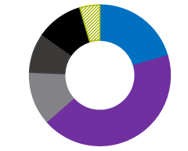
Scheme Care Review – data analysis
Initial analysis focused on comparing NIISQ care rates with NDIS and other comparable industry care rates
at both scheme and provider levels
Who are our providers and what circumstances impact the hourly rate of care?
Developed dashboards to monitor each provider:
Total value of approved plans p.a.
Number of plans and services p.a.
Rates being charged relative to NDIS equivalent service
We had 160 registered care providers across all our participants and eleven providers with more than $1million per annum in approved care.
Notes:
What we did

Slide 22
Scheme AC&S review – identified challenges
Who are our providers and what circumstances impact the hourly rate of care?
1. Our data wasn’t clean. Step one was to improve system processes to fix data quality.
Fee negotiations were happening on each individual care plan. This means each Support Planner was negotiating with our service providers for each participant contract.
We were adding to workload of our Support Planners
We were getting inconsistent contract rates
There was a lack of consistency and transparency in how the Agency determined cost effectiveness for care services
We needed to improve our processes to reduce administration burden and achieve consistency
Notes:
What we found

Slide 23
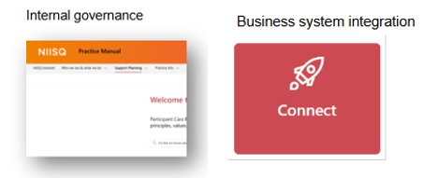
Scheme AC&S review – risk mitigation
Expected return / outcome
More guidance for Support Planners to improve consistency of decision making and quality of outcomes for participants
Reduce administrative burden by centralising the information in easy to use dashboards
Provider dashboards help us identify and monitor our key provider partnerships for targeting activity if needed.

Slide 24
RISK Care hours RISK MITIGATION Innovative data capture and automation
02

Slide 25
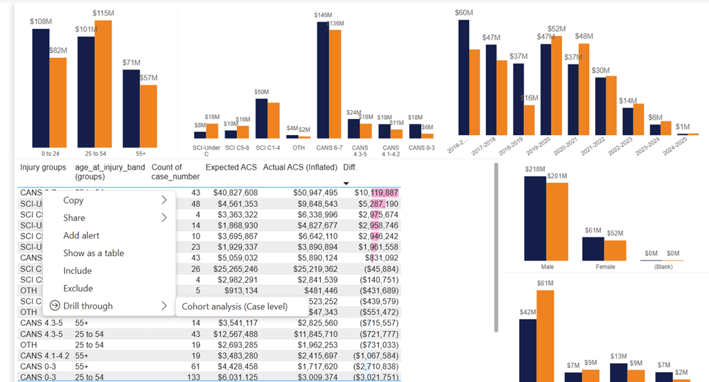
Scheme Care review – data analysis
Initial analysis focused on comparing NIISQ care hours to valuation projections and between like participants.
How many hours of care?
Developed dashboards to monitor each participant:
Total value of approved plans p.a.
Number of plans and care services p.a.
Hospital discharge care plan hours
Vulnerability/risk factors
Worked with our actuary to:
Compare our expenditure to the actuarial valuation to benchmark experience against projection and provide insights on sustainability
Consider if there were changes in funded care supports over time or between cohorts that required further consideration.

Slide 26
Scheme Care review – identified challenges
How many hours of care?
Our data wasn’t clean. Step one was to improve system processes to fix data quality.
We didn’t have all the data we needed in a structured format.
Our Support Planners relied on their own knowledge to assess proposed care plans. They are skilled but only know what they’ve seen. Specialist skills in assessing care need was limited and not delivered in a coordinated manner. It isn’t easy to find ‘like’ participants for benchmarking.
4. Our management team didn’t have the tools or data to confidently speak to our schemes experience regarding care hours at a participant level or cohort level
We needed more tools and improved processes to assist our support planners understand if the requested care hours were reasonable and consistent with like cases.

Slide 27
Scheme Care review – risk mitigation
How many hours of care?
Data and analytics:
Redesigned what information is captured in structured format to support monitoring of key risks
Built more detailed care monitoring dashboards for our management team. These are linked to actuarial projections and NIISQ participant benchmark and projections.
Operational activities:
Co-designed and piloted a Digital platform – Care Adviser Portal.
My Care and Support Advice report uplifted
Creation of an internal Specialist AC&S role
Developed a digital vulnerability assessment tool
Rethinking early stakeholder engagement
Expected return / outcome
Access to specialist care advice for our Support Planners to improve consistency of decision making and quality of outcomes for participants
Reduced administrative burden and improved data accuracy by automating processes
Care monitoring dashboard helping us identify and monitor our participant care hours/rates and care providers for targeting activity if needed.

Slide 28
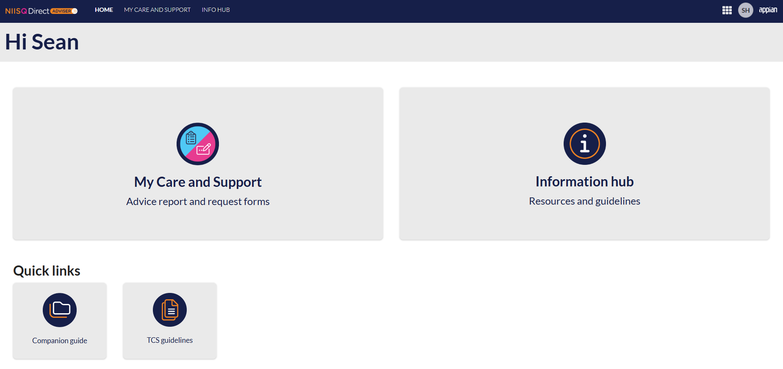
Data driven and automated – Care data
Example information only

Slide 29
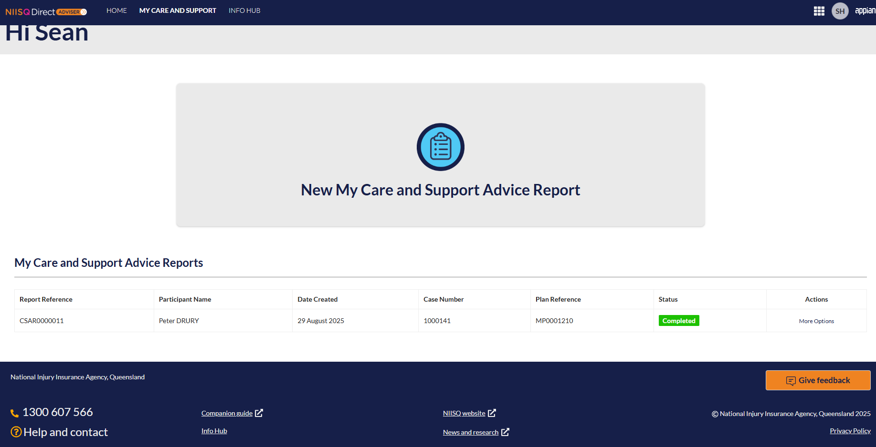
Example information only

Slide 30
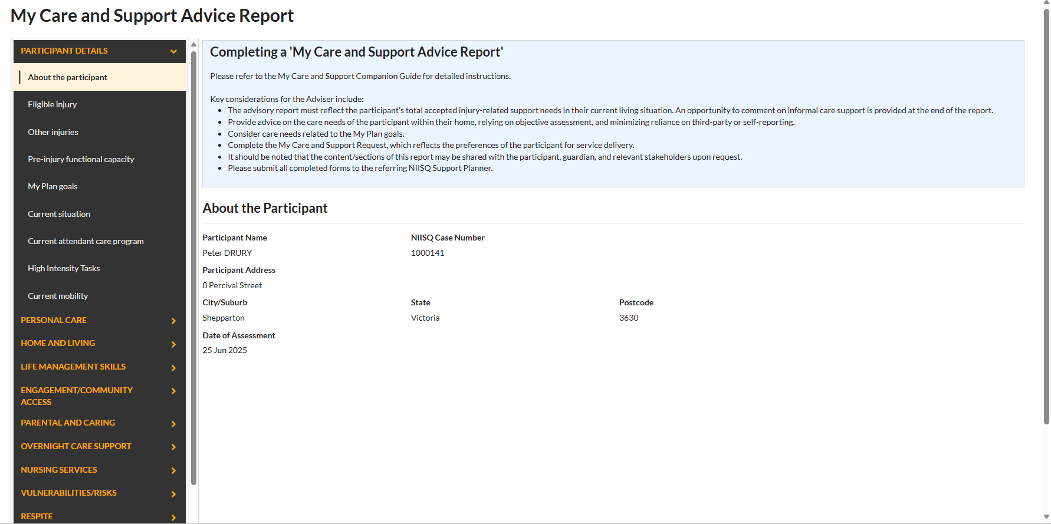
Data driven and automated – AC&S needs
Example information only

Slide 31
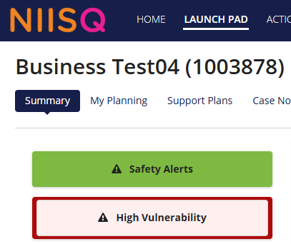
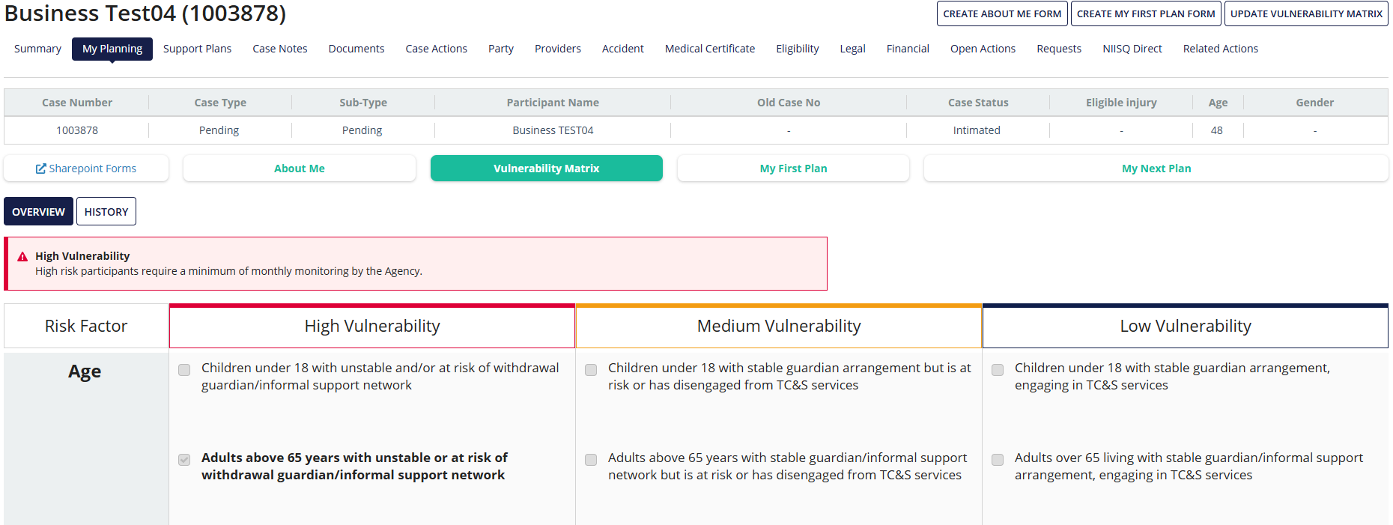
Data driven and automated – vulnerability and risk factors
Example information only

Slide 32
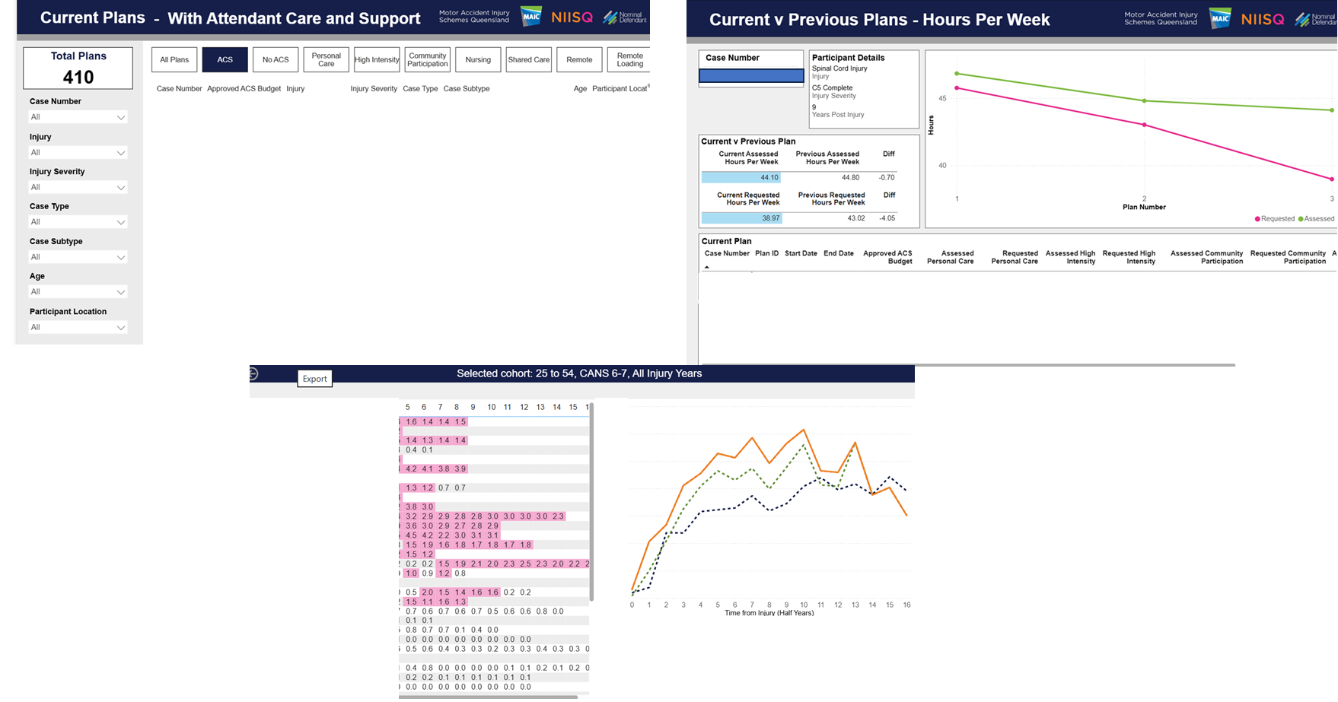
Scheme Care Monitoring Framework
Example information only

Slide 33
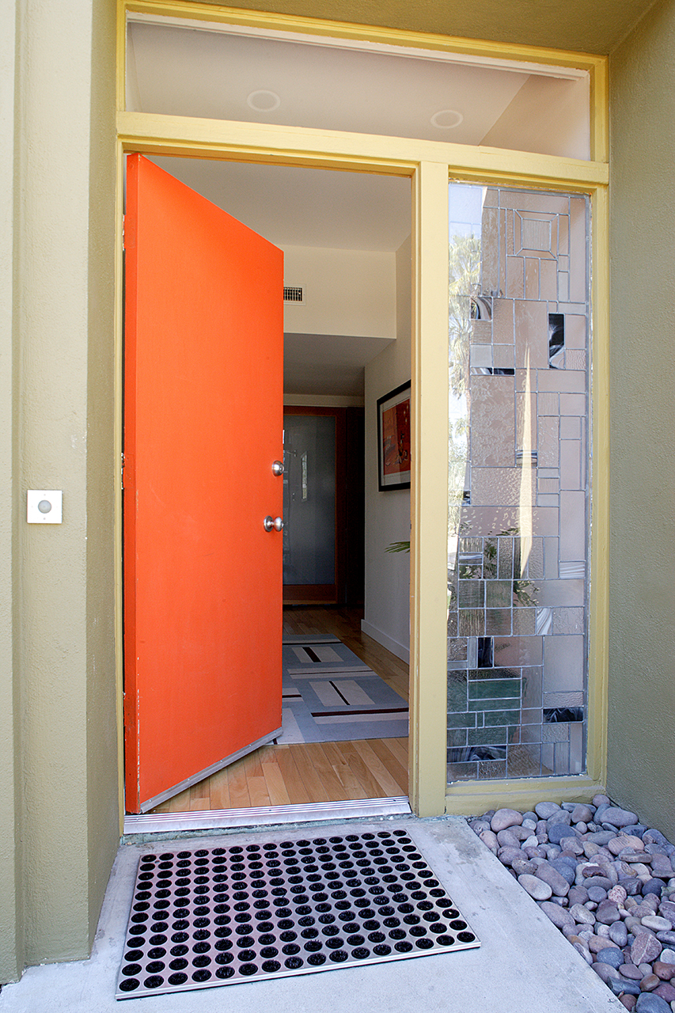
Redesigning early stakeholder engagement
Discharge AC&S: working collaboratively with the Qld Brain Injury Service
Getting care right at the front door?

Slide 34

Thank you

Slide 35
Questions?

