Slide 1
Generative AI and Injury Schemes
IDS WG and YDAWG

Slide 2
Important notice for all participants
This Insights Session is being conducted in accordance with Institute’s Code of Conduct and attended by members in their professional capacity.
It is acknowledged that professional members in their employed capacity, may be active market participants in their respective industries who may compete with each other as defined by competition law.
Participants are, therefore, reminded that in accordance with their competition law compliance obligations they should not:
discuss any matter that may be perceived as being cooperation by competitors in a market to influence that market;
discuss any matters that could be regarded as fixing, maintaining or controlling prices, allocation of customers or territories, coordinating bids and/or restricting output or acquisitions in any circumstances;
share commercially sensitive information relating to their employer; or
share information for an anti-competitive purpose.

Slide 3
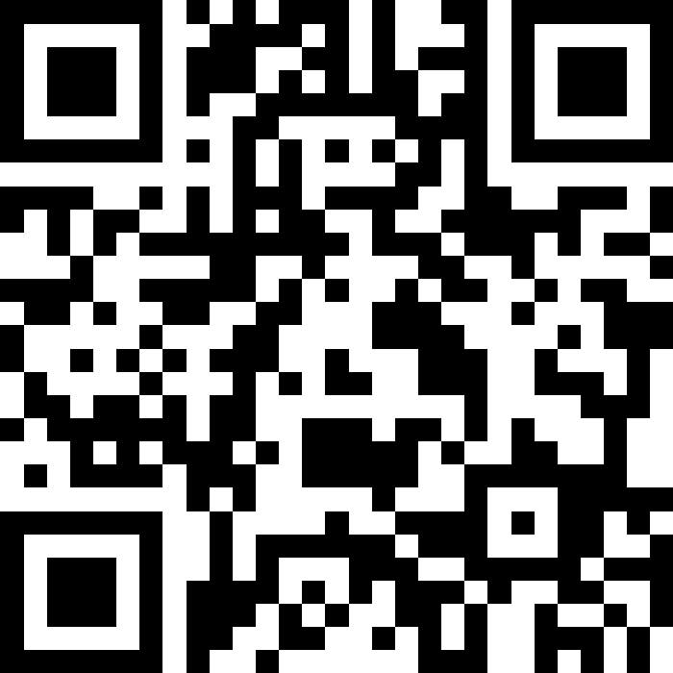
Q&A
Join at slido.com #4208495

Slide 4
Agenda
 | Section | pg
1 | Overview | 3
2 | Current state of Schemes | 8
3 | Potential | 14
4 | Challenges | 21
5 | Next Steps | 29

Slide 5
1. Overview
2. Current State
3. Potential
4. Challenges
5. Next steps

Slide 6
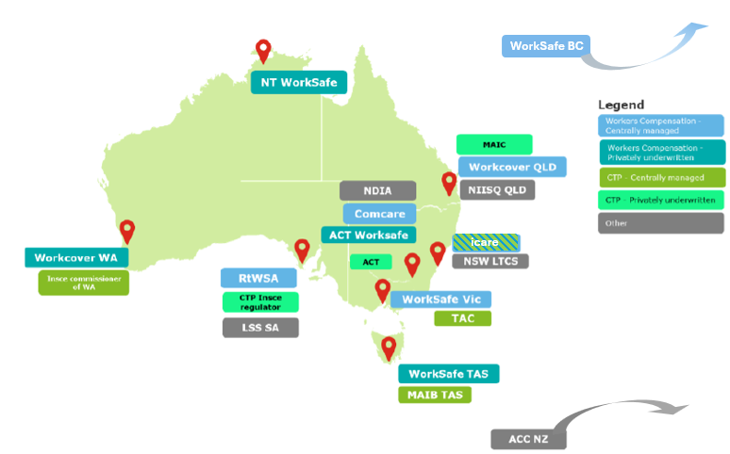
Injury Schemes

Slide 7
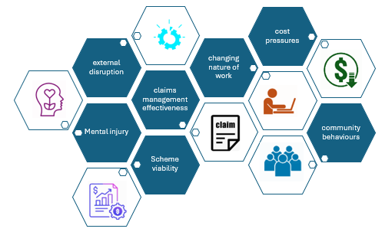
Injury Schemes – current business issues

Slide 8

Current AI landscape
AI in Australia
Financial Services & Insurance
Health
Government
Retail & Customer Service
Professional Services
Workforce & Capability
AI is already embedded across the Australian economy
Adoption is widespread, but uneven
People and capability are the main constraints
AI is primarily used as an assistive tool
Emerging agent tools are becoming a disruptive force

Slide 9
So, What ….
Explosion of AI
Schemes focus on challenges

Slide 10
1. Overview
2. Current State
3. Potential
4. Challenges
5. Next Steps

Slide 11
Current State of Schemes – where used
Admin staff fns
Claims staff - processing
IT or Tech support teams
Safety
Strategic functions
Actuarial
Medical & Health Professional engagement teams
Regulatory staff
Claims staff - assistive
claim staff: routine fns
Claims staff - training
Premium – routine tasks
Scheme Perf
Finance

Slide 12

Current State of Schemes – Gen AI tools (approved & used)
ChatGPT (licensed)
GitHub CoPilot
Genesis
Daisee
AWS

Slide 13
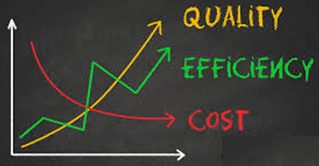
Current State of Schemes – case studies: Gen AI

Slide 14
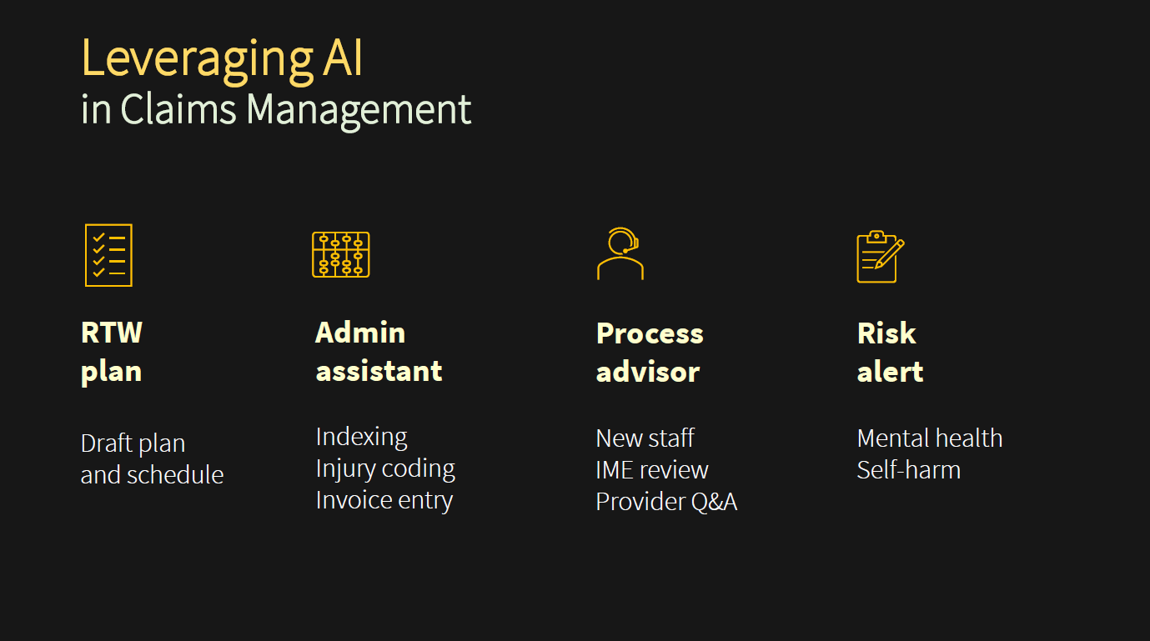
Case Study: Workcover Qld
Notes:
Dannie Zarate to speak to this slide

Slide 15
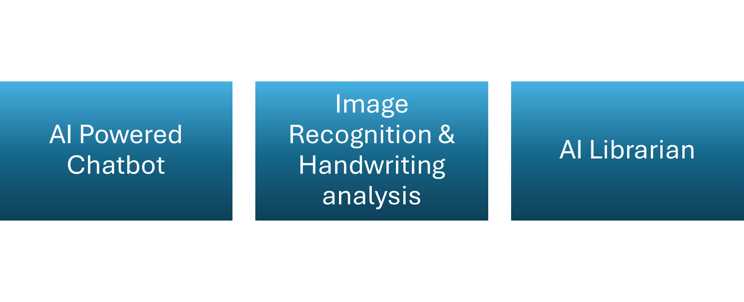
Case Study: TAC
Notes:
Cathal Laffan (TAC) to speak to this

Slide 16
1. Overview
2. Current State
3. Potential
4. Challenges
5. Next steps

Slide 17
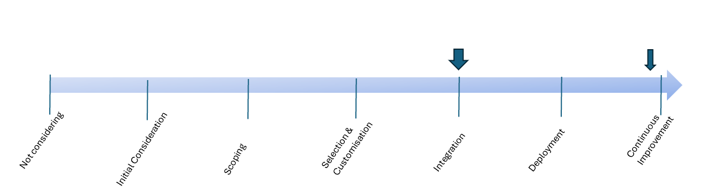
Gen AI adoption pathway
Injury schemes
Private insurers
Government agencies
Healthcare providers
Other Financial services
Professional services

Slide 18
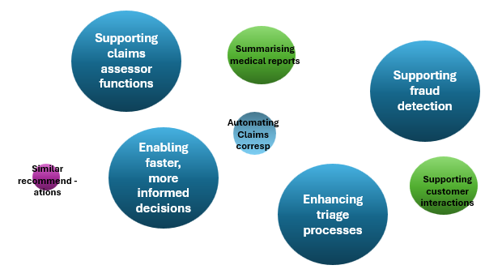
Schemes: future uses of Gen AI

Slide 19








Typical Gen AI use case focus areas in Insurance
Actuarial, Claim, Risk & Underwriting
Technology
Customer & Growth
Distribution & Servicing
Finance & Accounting
HR & People Mgmt.

Slide 20
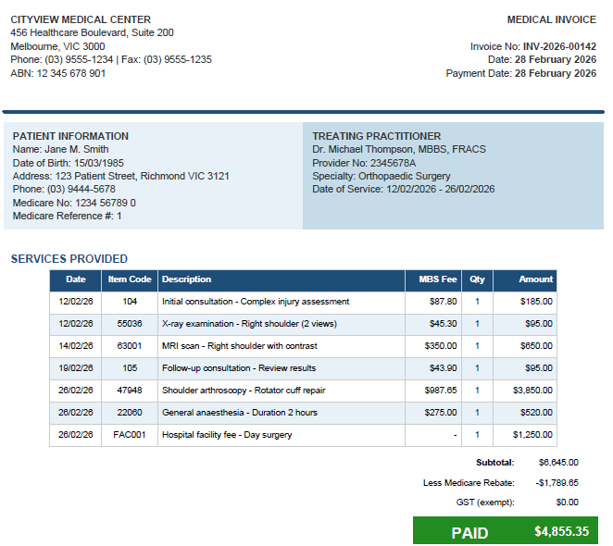
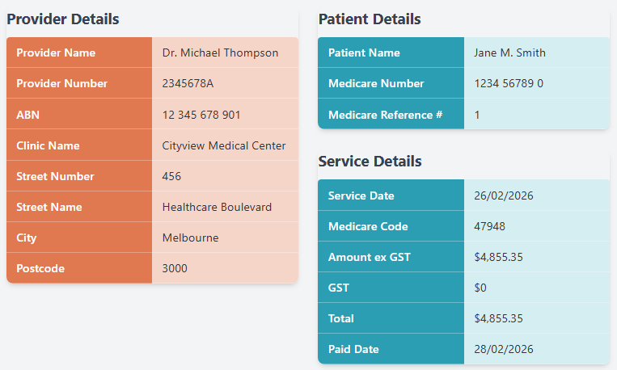
Document Auto-Ingestion
Structured Data

Slide 21
Claim assessment
Step 1: from claim description to classification
Slipped on wet floor and fractured wrist while carrying stock
Physical claim
Reports workplace bullying by supervisor; difficulty sleeping; GP certificate for stress
Psychological claim
Step 2: claim clustering & case estimate
Small claims
Large claims
Claim A – 1 of 6 neighbours was a large claim
Claim B – 4 of 6 neighbours were large claims
Claim | Case Estimate
A | $15,000
B | $400,000

Slide 22
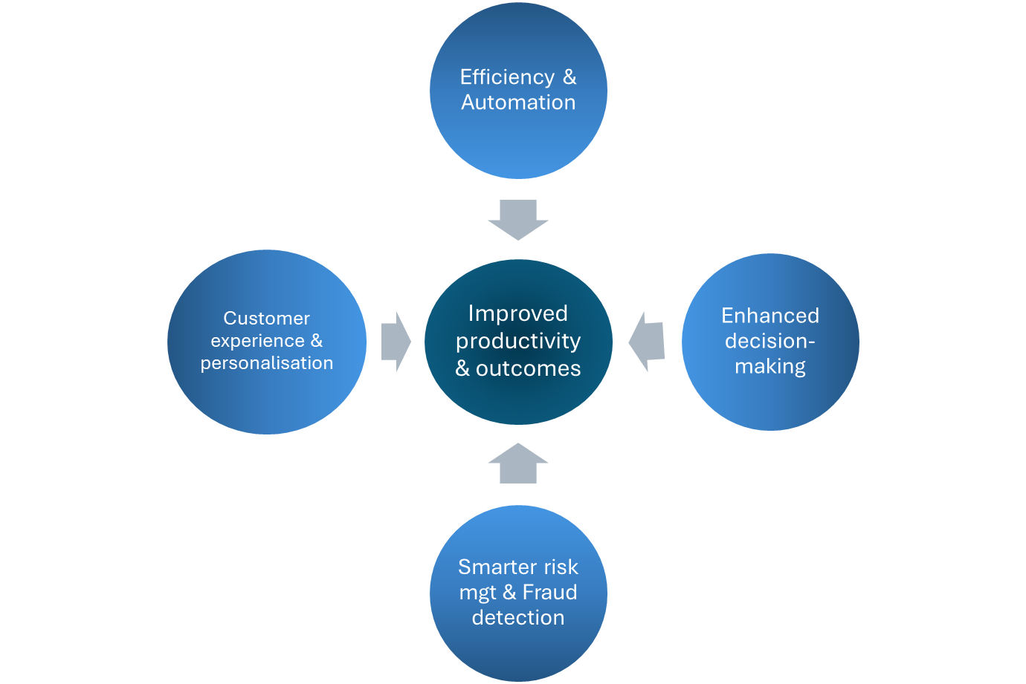
Benefits of AI

Slide 23
1. Overview
2. Current State
3. Potential
4. Challenges
5.Next Steps

Slide 24
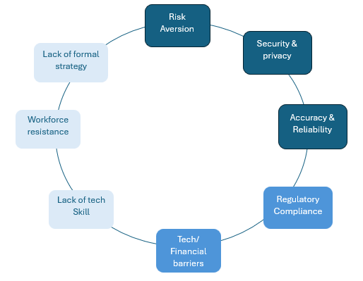
Challenges for Injury Schemes

Slide 25
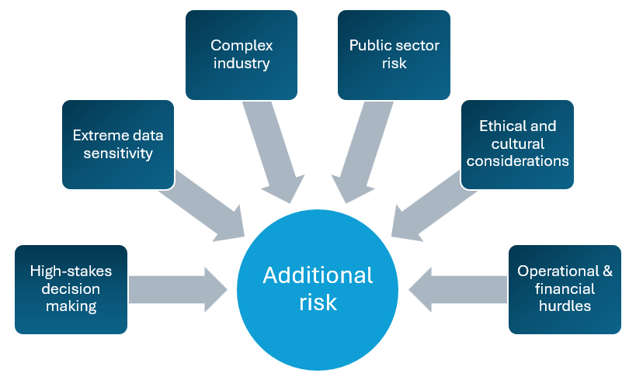
Current State of Schemes – nuances

Slide 26
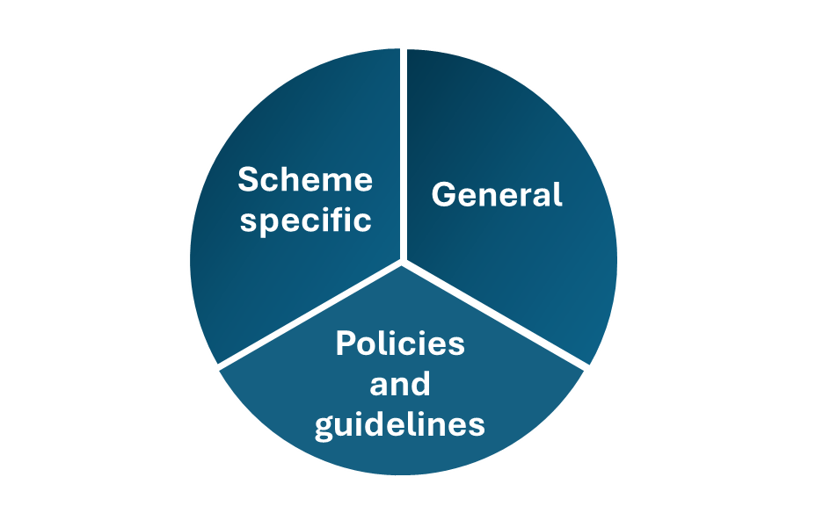
Mitigation considerations

Slide 27
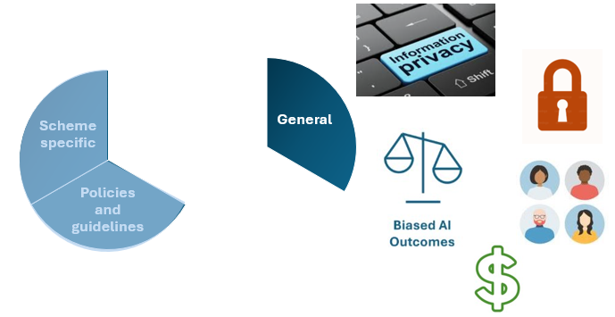
General

Slide 28
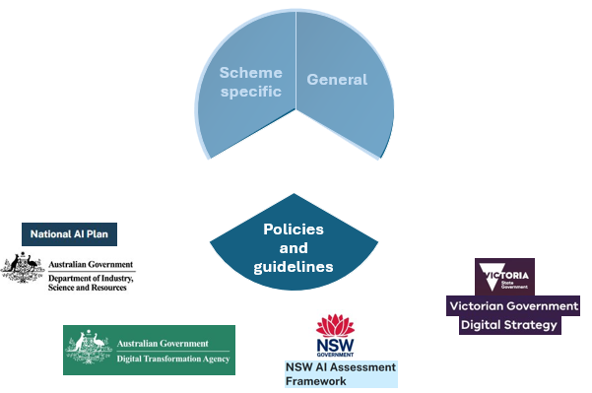
Policies and Guidelines

Slide 29
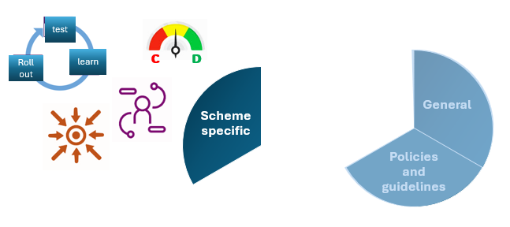
Scheme specific

Slide 30


Another Challenge … “Shadow usage”
Unseen Risk
Visibility & Control

Slide 31
1. Overview
2. Current State
3. Potential
4. Challenges
5. Next Steps

Slide 32
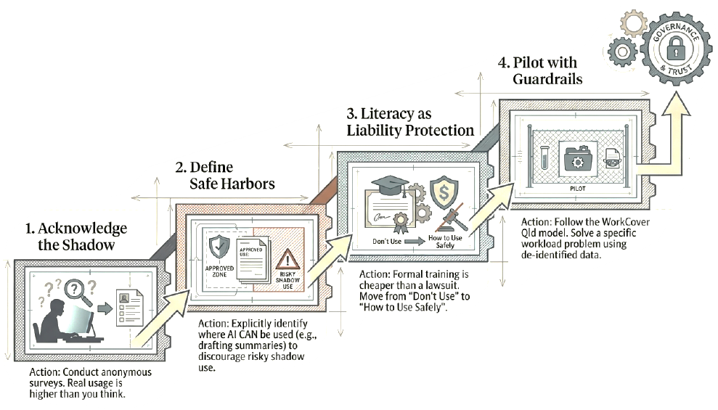
How to get there – organisational pathway

Slide 33


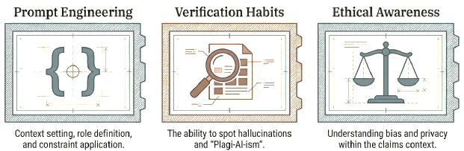

How to get there – individual readiness
Establish a verification workflow for all AI outputs
Complete formal AI literacy training covering:
Verify no sensitive data is public

Slide 34

The Vision

Slide 35
Q&A
Join at slido.com #4208495

Slide 36
Feedback Poll
Join at slido.com #4208495

