Slide 1
Long term social and economic consequences of workplace injury:
Insights from HILDA data
Michael McLean
November 2025
This presentation uses unit record data from Household, Income and Labour Dynamics in Australia Survey [HILDA] conducted by the Australian Government Department of Social Services (DSS). The findings and views reported in this presentation, however, are those of the author[s] and should not be attributed to the Australian Government, DSS, or any of DSS’ contractors or partners. DOI: 10.26193/NBTNMV

Slide 2
Contents
Introduction 01
Costs of workplace injury 02
HILDA data 03
Predictors or workplace injury 04
Estimated Causal effects 05
Conclusions 06

Slide 3
Introduction
01

Slide 4
Economic and Social costs of workplace injury
How does risk of workplace injury vary by risk factors?
What are the causal effects of workplace injury on labour force, income, wealth, health and wellbeing measures?

Slide 5
Costs of workplace injury
02

Slide 6
Economic and Social Costs of workplace injury
  Direct costs can be measures by schemes and insurers
  Indirect costs are often hidden and accumulate to injured workers, their families, to firms and broader society
Direct Costs: Treatment and rehabilitation services, Wage replacement, lump sum payments, damages, administration
Indirect Costs:
Workers + Families
Firms
Society
Lost earnings
Lost promotions, skills atrophy
Health and wellbeing
Lost productivity, replacement worker hire
Health system utilization
Social welfare system

Slide 7


Causal Identification:
What is the causal effect of workplace injury?
Observed outcomes: Income, employment, health and wellbeing
Counterfactual scenario is never observed
Causal effect can not be observed directly.
Risk factors which influence injury can also influence outcomes

Slide 8
What’s known about causal effects of workplace injury?
Consistent finding across US, Canada, Europe: workplace injuries cause substantial losses in employment and earnings
Earnings losses: in USA - ranging from $8,000 per injury (Boden & Galizzi, 1999) to 15% of earnings over 10 years (Seabury et al., 2014)
Employment impacts: unemployment rates increase 14% (Parro & Pohl, 2021) and (Crichton et al., 2011); lower employment rates persist long-term (Mazzolini, 2020)
Broader consequences: increased mortality (Boden et al., 2016), family breakdown (Senthanar et al., 2020), social welfare service utilization (Brown et al., 2007), sick leave (Galizzi et al., 2023)
In Australia: social security use increased after benefits ceased (Griffiths et al., 2023)
Research gap: no population-level causal studies. impacts beyond employment/income (e.g., wellbeing, out-of-pocket expenses) not well understood

Slide 9
Difference-in-Differences Estimator
Difference between actual and expected is the causal effect
Difference-in-Differences (DID) approach enables estimation of a causal effect.
Long history and theoretical foundation
Surge of recent methodological advances for extending beyond canonical 2-by-2 framework. For example:
    Conditional parallel trends
    Double robustness
    Multiple time periods
Trend in the control group enables calculation of an expected outcome for test group

Slide 10
HILDA data
03

Slide 11
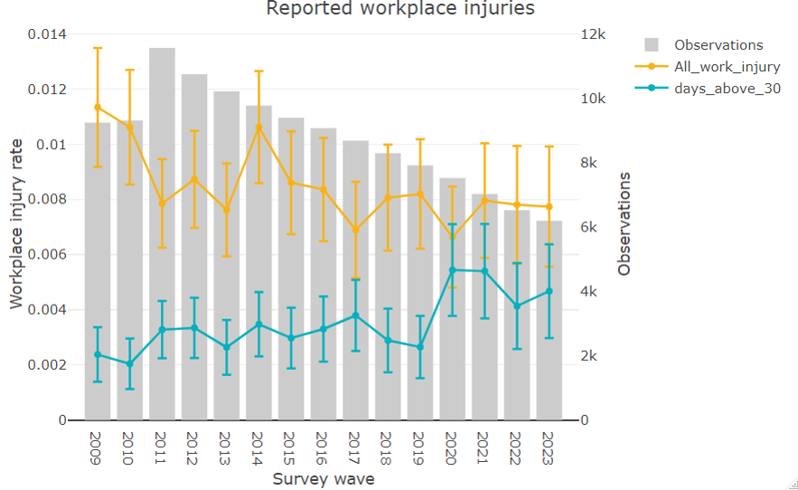
Household, Income and Labour Dynamics in Australia Survey (HILDA)
Annual survey of Australian Households from 2001. Latest release 2023

Slide 12
Predictors of workplace injury
04

Slide 13
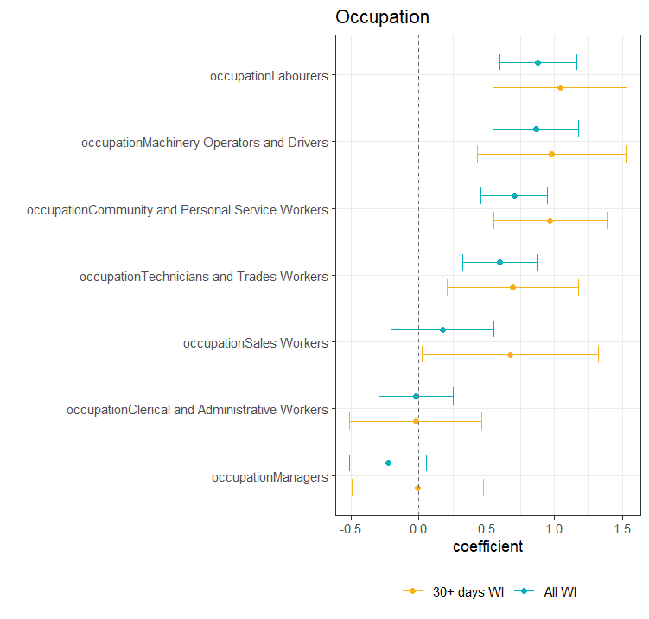
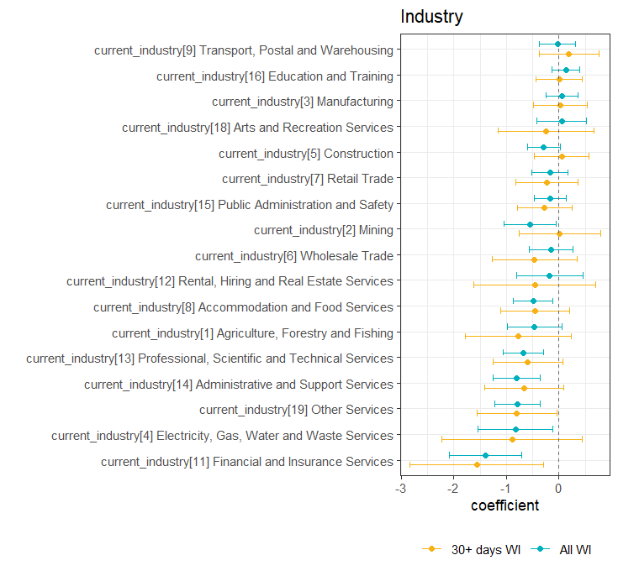
Predictors of workplace injury
Sub-heading here
  z

Slide 14
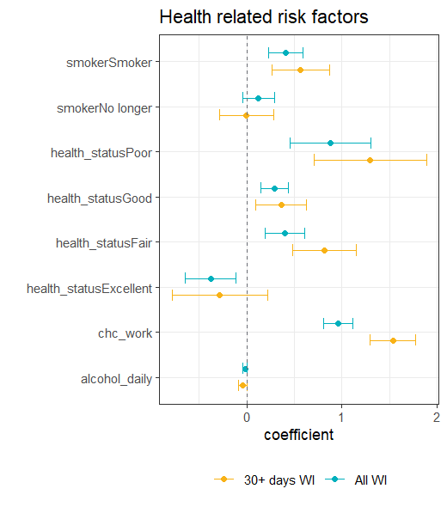
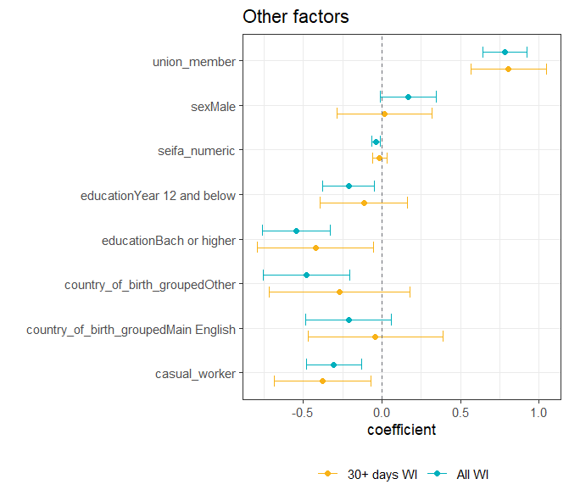
Predictors of workplace injury
Sub-heading here
  z

Slide 15
Estimated Causal effects
05

Slide 16
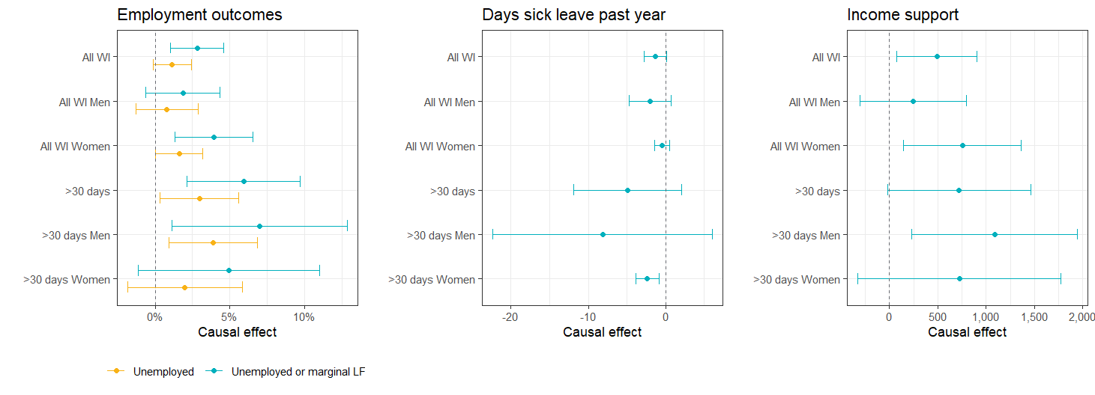
Unemployment and marginal labour force participation
Increased unemployment and marginal participation in labour force and increased reliance on income support

Slide 17
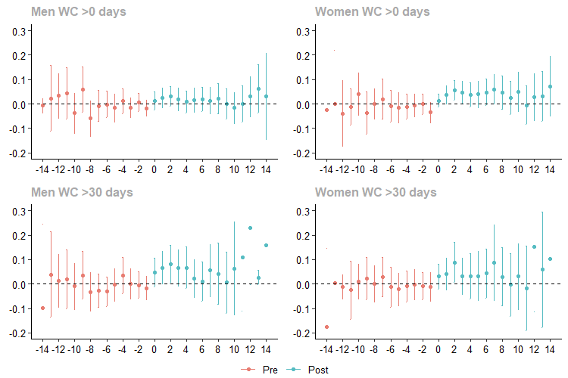
Unemployment or marginal labour force attachment
Pre-exposure trends are essential diagnostic to check for violations of the parallel trend assumption in the pre-treatment time periods.
Dynamic treatment effects seen by examining trend among post treatment time periods. Effects are moderate in magnitude but persist over time

Slide 18
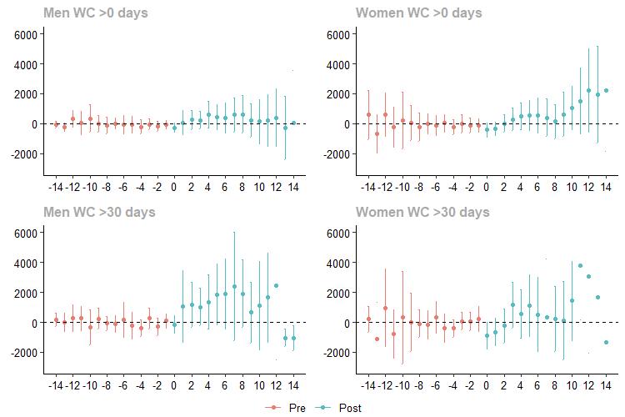
Income support payments
Trends for income support are more pronounced for women for all injuries and men for 30 days+ injuries

Slide 19
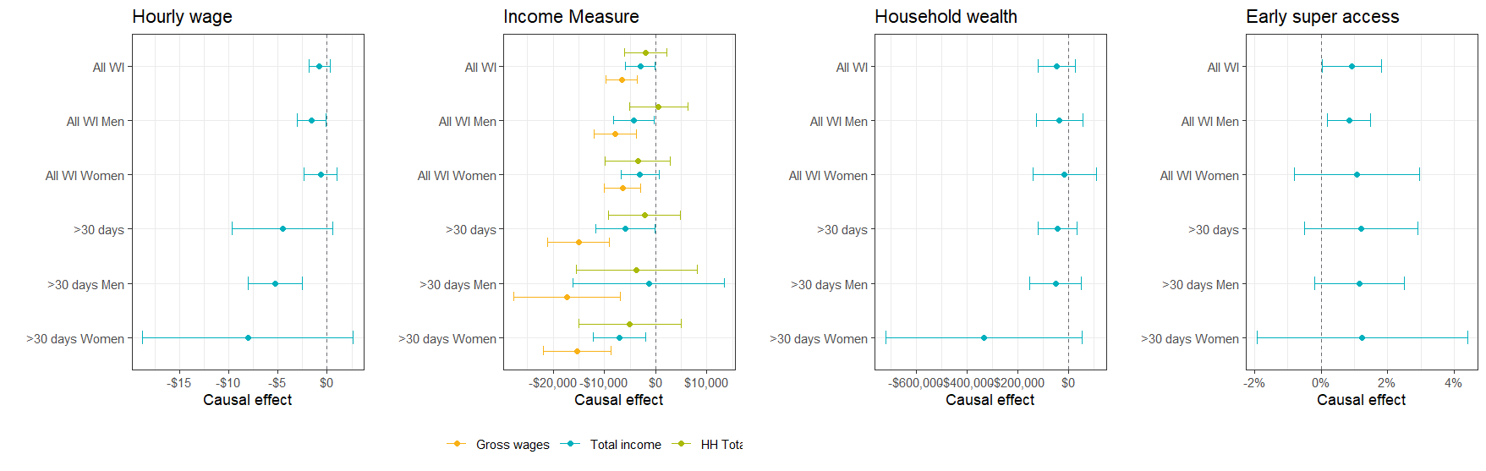
Wages and total income effects

Slide 20
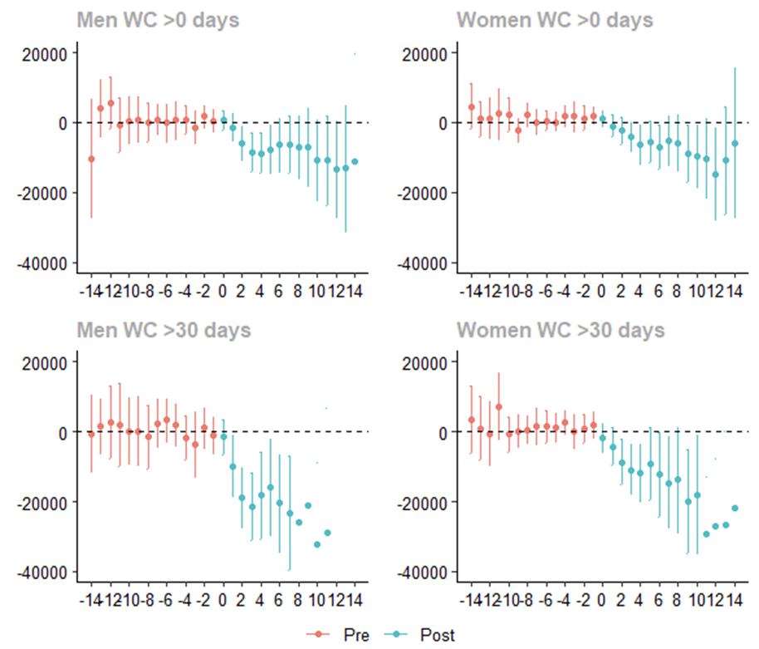
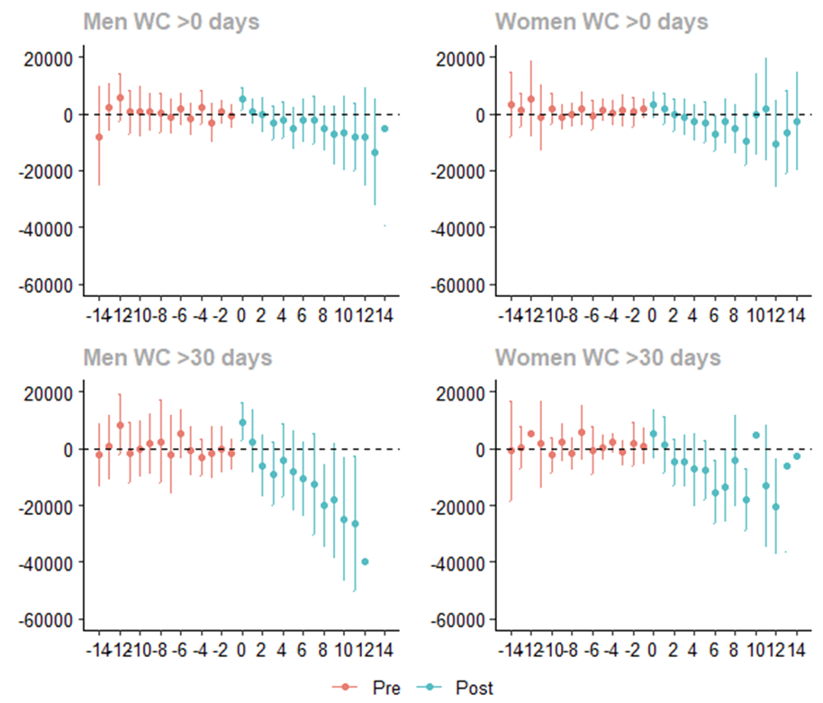
Wages and total income
Wages
Total income

Slide 21
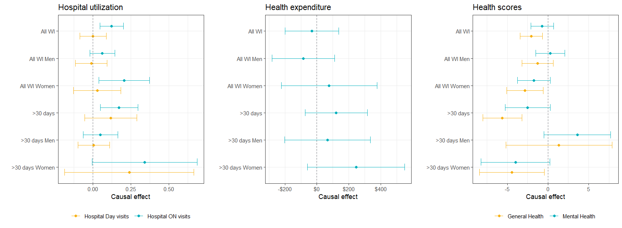
Health and wellbeing effects
Workplace injuries lead to lower self assessed health scores and increased health system utilization among women. No impact is seen on household health expenditure

Slide 22
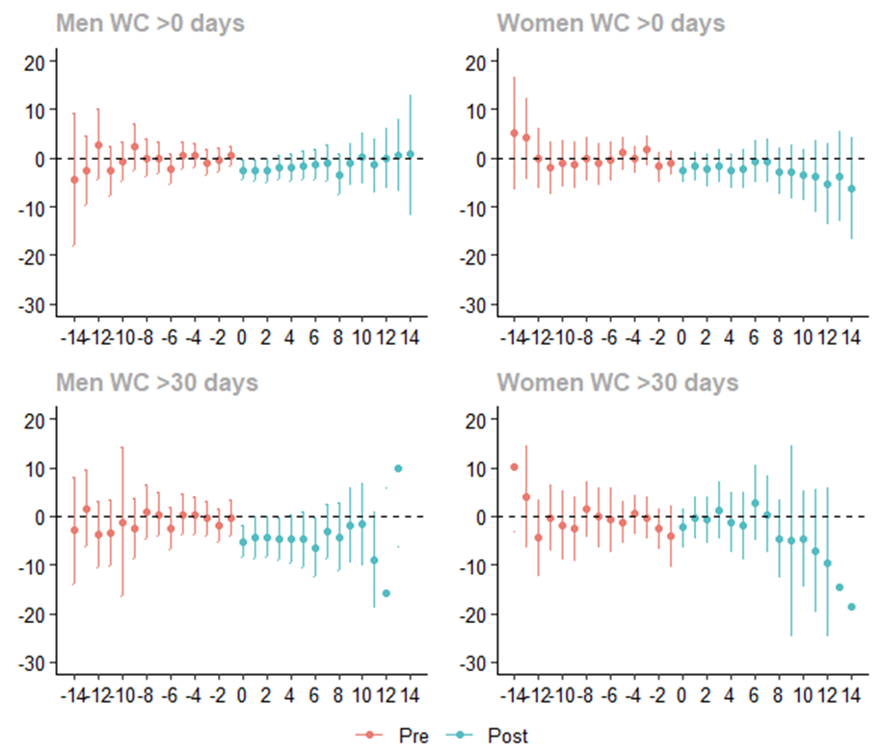
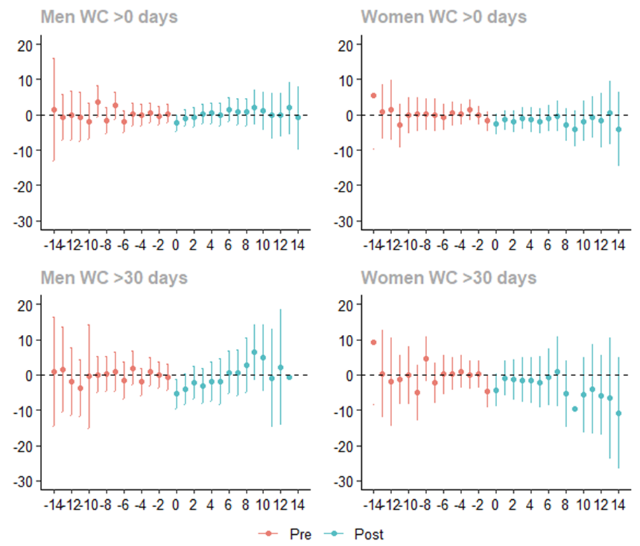
General and Mental health scores
General and Mental health scores are impacted by workplace injury. Men and women have distinct post injury
General Health score
Mental Health score

Slide 23
Conclusions
06

Slide 24
Conclusions
Workplace injuries cause substantial hidden costs
Whole-of-System Perspective
Long-Term Support Needs
Gender-Specific Responses
Prevention Focus
Future research

Slide 25
This presentation uses unit record data from Household, Income and Labour Dynamics in Australia Survey [HILDA] conducted by the Australian Government Department of Social Services (DSS). The findings and views reported in this presentation, however, are those of the author[s] and should not be attributed to the Australian Government, DSS, or any of DSS’ contractors or partners. DOI: 10.26193/NBTNMV

Slide 26
Thank you
Actuaries Institute
actuaries.asn.au

