Slide 1
Good Practice Principles for Retirement Modelling
Checklist
Richard Starkey
Ruvinda Nanayakkara
March 2026

Slide 2
Important notice for all participants
This Insights Session is being conducted in accordance with Institute’s Code of Conduct and attended by members in their professional capacity.
It is acknowledged that professional members in their employed capacity, may be active market participants in their respective industries who may compete with each other as defined by competition law.
Participants are, therefore, reminded that in accordance with their competition law compliance obligations they should not:
discuss any matter that may be perceived as being cooperation by competitors in a market to influence that market;
discuss any matters that could be regarded as fixing, maintaining or controlling prices, allocation of customers or territories, coordinating bids and/or restricting output or acquisitions in any circumstances;
share commercially sensitive information relating to their employer; or
share information for an anti-competitive purpose.

Slide 3
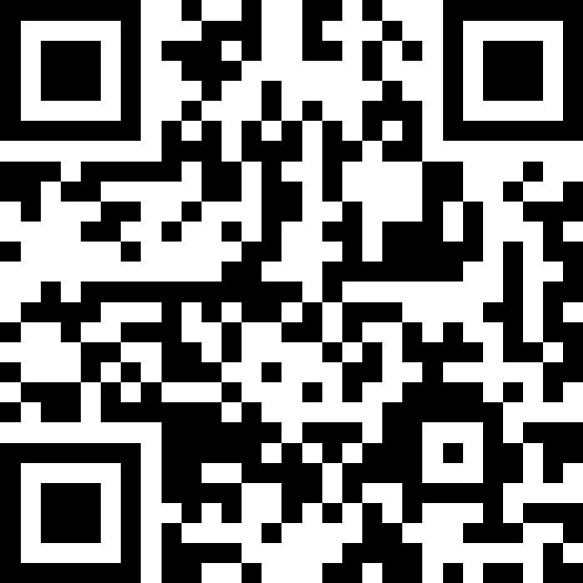
Q&A
Join at slido.com #1766129

Slide 4
Overview of GPP paper
First Edition 10 years ago
Now includes a “Checklist”
Consumers will need more help than ever
Most will not access personal financial advice
Actuaries increasingly involved in models
GPP has been designed to assist actuaries

Slide 5
Overview of GPP paper
11 Principles for Retirement models
7 Key elements in Checklist
Be goal-based
Illustrate and quantify risk
Include all resources
Incorporate all income drivers
Model accumulation phase drivers
Allow for year-by-year inputs
Set defaults as central estimates
Consider uncertain mortality
Facilitate annual reviews
List standard scope and assumptions
Be easily updated
Goals
People
Resources
Presentation
Risks
Assumptions
Methodology
11

Slide 6


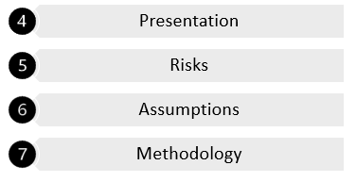
Three questions for model builders
What are you trying to help the user achieve?
What input do you need to capture from the user?
What do you need to inform the user?

Slide 7
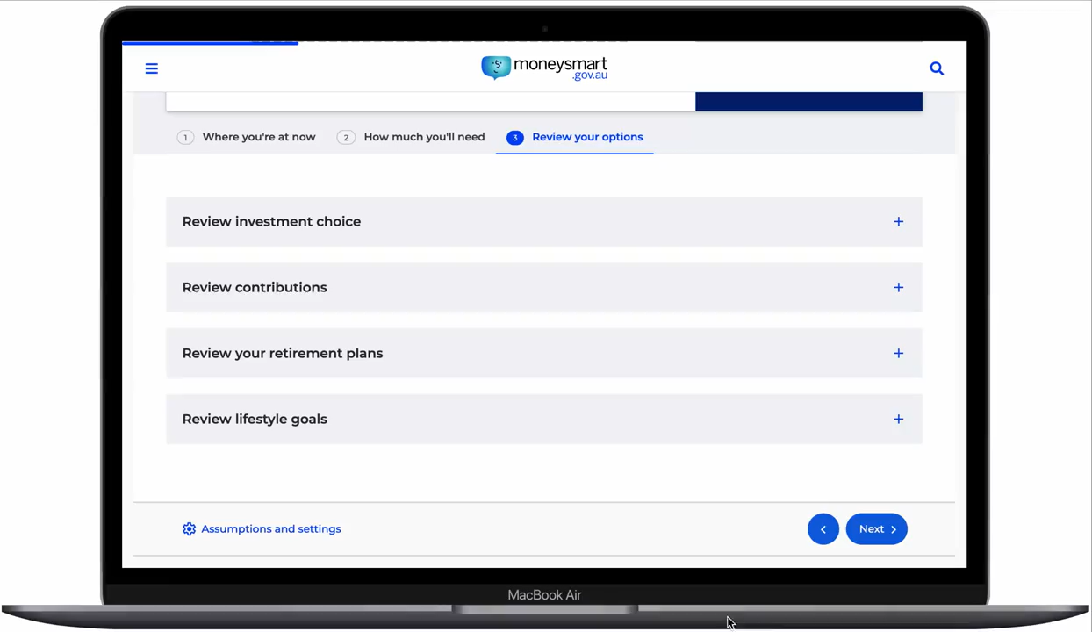
What are you trying to help the user achieve?
Goals | People | Resources | Presentation | Risks | Assumptions | Methodology
User questions/needs > purpose > goals > scope > metrics
Retirement goals
Prioritising goals
Income and expenses
Lump sums
Retirement period
Bequest/contingency
Home ownership

Slide 8

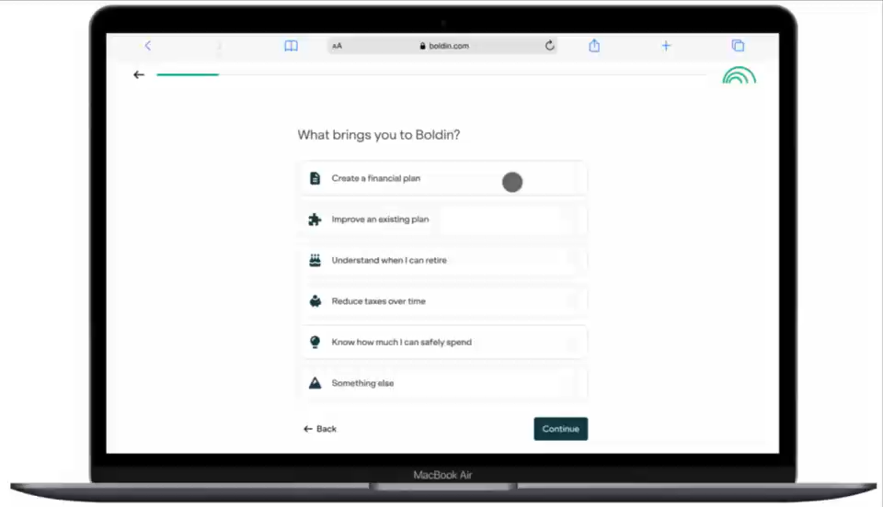


What input do you need to capture from the user?
Goals | People | Resources | Presentation | Risks | Assumptions | Methodology
Single
People
Couple
Household

Slide 9
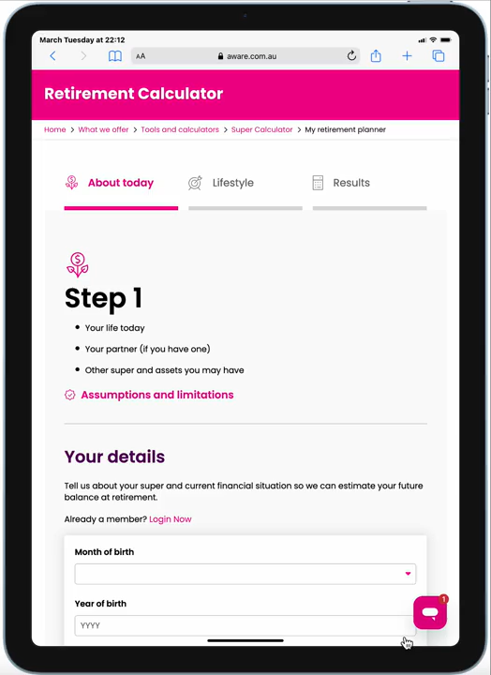




What input do you need to capture from the user?
Goals | People | Resources | Presentation | Risks | Assumptions | Methodology
Income
Resources
Savings
Assets
Debts

Slide 10

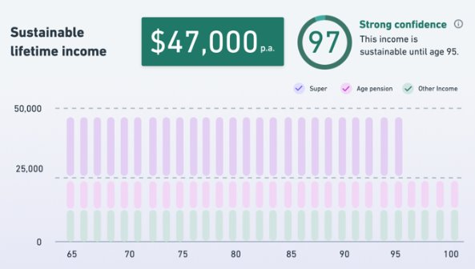
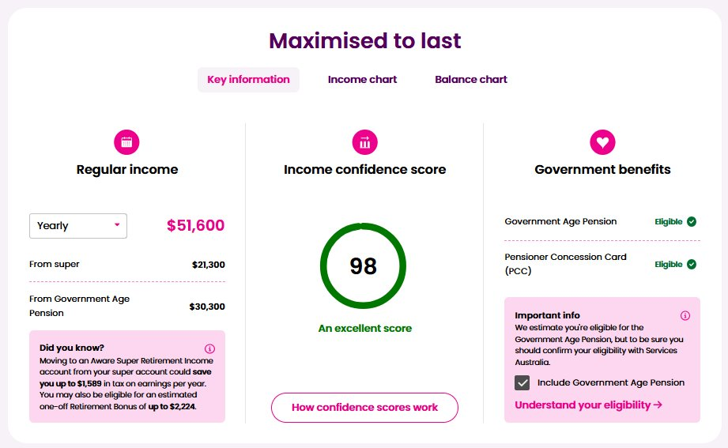
What do you need to inform the user?
Goals | People | Resources | Presentation | Risks | Assumptions | Methodology
Presentation
We might think charts are king…
But members prefer simplicity!

Slide 11


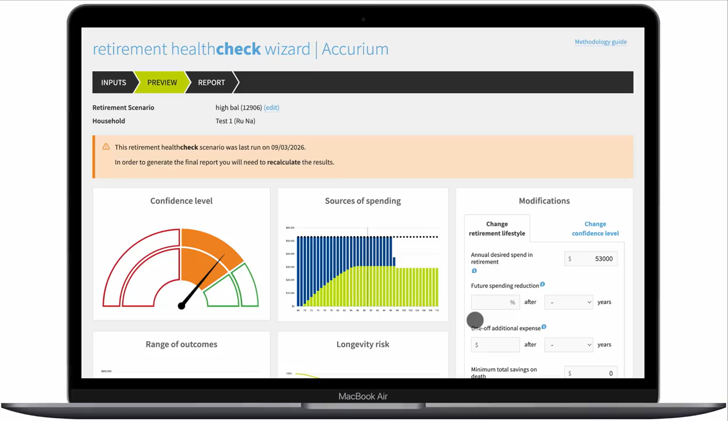

What do you need to inform the user?
Goals | People | Resources | Presentation | Risks | Assumptions | Methodology
Longevity
Investments
Risks
Inflation

Slide 12
What do you need to inform the user?
Goals | People | Resources | Presentation | Risks | Assumptions | Methodology
Logical
Reasonable
Methodology
Defaults
Consistent
Assumptions
Fees
Products

Slide 13
Conclusion
What input do you need to capture from the user?
What do you need to inform the user?
What are you trying to help the user achieve?

Slide 14
Special thank you to the members of the working group
Ruvinda Nanayakkara (Chair)​
Richard Starkey​
Anthony Asher ​
Jim Hennington​
Aidan Nguyen​
Estelle Liu​
Anita Woon​
Miing Pin Low​
Hailey Cai​
Desmond Muzorewa
Actuaries Institute
actuaries.asn.au

Slide 15
Feedback Poll
Join at slido.com #1766129

