Slide 1
The National Efficient Price
An Introduction for Private Health Insurers
March 2026

Slide 2
Important notice for all participants
This meeting is being conducted in accordance with Institute’s Code of Conduct and attended by members in their professional capacity.
It is acknowledged that professional members in their employed capacity, may be active market participants in their respective industries who may compete with each other as defined by competition law.
Participants are, therefore, reminded that in accordance with their competition law compliance obligations they should not:
  discuss any matter that may be perceived as being cooperation by competitors in a market to influence that market;
  discuss any matters that could be regarded as fixing, maintaining or controlling prices, allocation of customers or territories, coordinating bids and/or restricting output or acquisitions in any circumstances;
  share commercially sensitive information relating to their employer; or
  share information for an anti-competitive purpose.

Slide 3

Q&A
Join at slido.com #3976982

Slide 4
01 Introduction | 02 NEP | 03 Private NEP

Slide 5
01
Introduction

Slide 6

On private hospitals
“… the funding arrangements underpinning Australia’s private hospitals [sic] are increasingly under strain.”
Pricing Framework for Australian Private Hospital Services, DRAFT for Comment, DHDA
https://www.croakey.org/wp-content/uploads/2025/12/251210-Pricing-Framework-for-Private-Hospital-Services-October-2025.pdf
41%
of Australian hospitalisations are in private hospitals
Private hospital profit margins
31%
of Australian hospital days are in private hospitals
+3% p.a.
increase in same day separations
+0% p.a.
increase overnight separations
Source: Australian Bureau of Statistics, Australian Industry, catalogue 8155.0

Slide 7
On a Private National Efficient Price
In November 2025, the Department of Health, Disability and Ageing (DHDA) shared a discussion paper on a Pricing Framework for Australian Private Hospital Services.
Objective
The framework aims to support a private hospital sector that is:
Efficient
Sustainable
Able to deliver high-quality care to the community.
Proposal for comment
The centrepiece of the framework was a Private National Efficient Price (PNEP) mechanism to:
Provide a robust reference point for pricing and benchmarking
Reduce administrative burden by replacing the current default benefit regime
Address systemic cross subsidisation of services by aligning funding with the actual cost and complexity of care
Preserve the private sector’s strengths – patient choice, clinical independence, and innovation.

Slide 8
02
The NEP

Slide 9

Who develops the NEP?
The Independent Health and Aged Care Pricing Authority (IHACPA) was established under the National Health Reform Act 2011 to promote improved efficiency in, and access to, public hospital services through the provision of independently determined pricing advice to all Australian governments.
IHACPA’s activities include:
  Specifying data requirements
  Establishing standards for costing, i.e. how to allocate hospital costs to individual episodes of care
  Developing classification systems to categorise healthcare activity
  Determining the National Efficient Price (NEP) and National Efficient Cost (NEC), the foundation of activity-based funding
IHACPA key principles are independence, consultation, and transparency

Slide 10
Role of everyone involved
IHACPA
Delivers the price (NEP)
States and Territories
National Health Funding Body (NHFB)
Determine volume and distribution of services, and provide data
Calculates and distributes funding, based on change in price and volume of activity

Slide 11
Developing the National Efficient Price
Combine data, remove out-of-scope costs and poor quality data
Understanding legitimate/unavoidable variations in costs (e.g. remote areas)
Determine the final NEP, including scaling to ensure total cost is covered by the model, and indexing to the pricing year
Activity Data
Cost Data
Cost Profile
Price Profile
NEP, price weights and adjustments
Classifications
Consultation and Independent Quality Assurance

Slide 12





Hospital care types
Acute admitted | Sub-acute and non-acute | Mental health Admitted / Community | Emergency Department | Non-admitted
priced at episode level
Admitted: priced by phase
Community: by service contact
priced by presentation
priced by instance of service

Slide 13
Bundling for pricing
Example of a private hospital stay billing record for a pulmonary valve replacement hospitalisation
Equivalent single Commonwealth price
MBS code | Description | MBS fee | Gap
38474 | Repair of pulmonary artery | $1,897.90 | $632.60
38718 | Repair of main pulmonary artery with cardio-pulmonary bypass for congenital heart disease | $1,888.35 | $629.40
38603 | Peripheral cannulation for cardiopulmonary bypass | $838.55 | $279.50
XXXXX | XXX | $30.56 | $6.70
XXXXX | XXX | $18.65 | $8.90
…
Cardiac Valve Interventions with CPB Pump without Invasive Cardiac Investigation, Minor Complexity (F04C)
Length of stay from 2 to 22 days attracts ~$52,000
(assuming zero adjustments)
vs
Hundreds of items

Slide 14
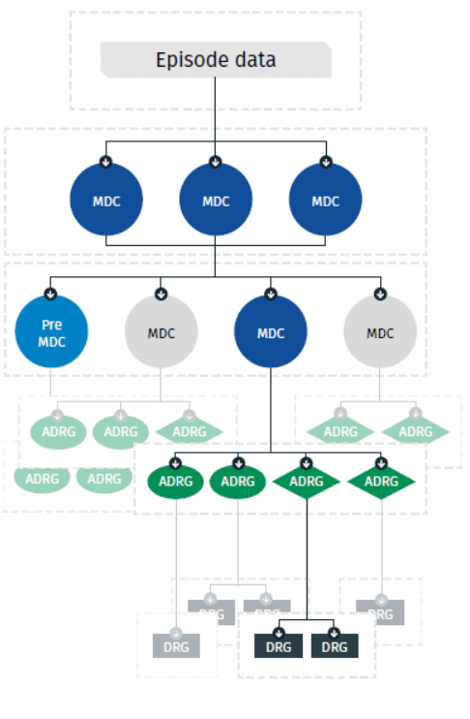
Classifying care for pricing
Admitted Acute patient care
E.g. knee replacement, gastro-intestinal surgery, childbirth
The activity is classified using Australian Refined Diagnosis-Related Groups (AR-DRG):
I04A - Knee Replacement, Major Complexity
I04B - Knee Replacement, Minor Complexity
04
relates to the Adjacent Diagnosis-Related Group:
Knee replacement
I
relates to Major Diagnostic Category 08:
Conditions related to bones, joints, muscles, and connective tissue.
A/B/C/D/Z
relates to complexity within the group
A = major complexity
B/C/D = lower complexity

Slide 15
Costing care for pricing
National Hospital Costs Data Collection collects costs data from over 700 public hospitals
Cost centres
~240 Departmental cost centres - each maps to a hospital function
E.g. Medical/Surgical Wards, ie inpatient care areas.
Operating theatres, allied health specialties, ICU / HDU
ED, Pharmacy, Imaging, Pathology, Patient transport
Line items
19 Line items - types of cost recorded within each cost centre account
E.g. Salaries and wages, oncosts, imaging, pathology, pharmacy, as well as corporate, lease, hotel, and depreciation costs.
Example of a costs record for a single episode
Cost centre | Line item | Direct cost | Indirect cost
Cardiology | S&W Nursing | $ 707.59 | $ 19.73
Cardiology | S&W Medical | $ 402.32 | $ 45.14
OR | S&W Nursing | $ 596.69 | $ 69.86
OR | S&W Medical | $ 213.55 | $ 64.35
Adult ICU | S&W Nursing | $ 469.79 | $ 1.90
Adult ICU | S&W Medical | $ 888.27 | $ 82.49
Anaesthesia | Medical Supplies | $ 223.88 | $ 68.77
Anaesthesia | Pharmacy | $ 838.09 | $ 12.08
Anaesthesia | S&W Medical | $ 940.11 | $ 35.82
This is an example with random numbers for costs and does not represent real data

Slide 16
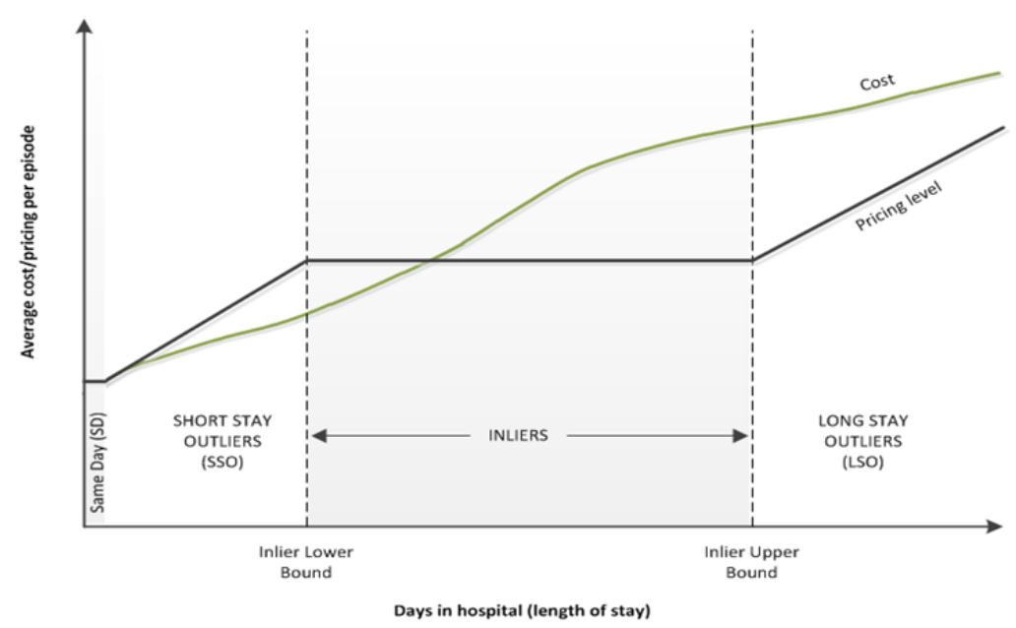
Admitted care inlier-outlier model
Pricing of admitted care is fundamentally based on an ‘inlier-outlier’ model:
  Inliers have length of stay close to the average (for that particular diagnosis category)
  Outliers have very low or very high length of stay
All inliers are assigned the same initial cost weight parameters
Short stay and long stay outliers have additional parameters that vary by length of stay
Pricing level is designed to overfund shorter stay episodes and underfund longer stay episodes, to incentivise efficiency
Source: IHACPA – NEP 2025-26 Technical Specifications | ihacpa.gov.au

Slide 17
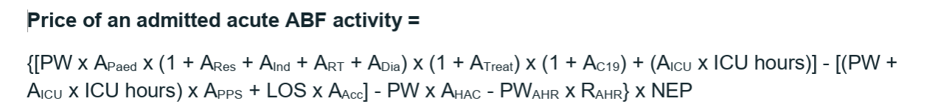
Acute admitted care – full price weight formula

Slide 18
National Weighted Activity Unit (NWAU)
The National Weighted Activity Unit (NWAU) is a measure of hospital activity expressed as a common unit, against which the NEP is paid. Roughly speaking:
  An ‘average’ hospital service: 1 NWAU
  More complex / expensive activities: >1 NWAU
Simple example of NWAUs and the NEP:
Calculating the NWAUs in the NEP
Average cost of hip replacement in 2022-23 | $24,609
Reference cost of acute admitted activity in 2022-23 | $6,114
Hip replacement NWAU | 4.0251 =24,609/6,114
Applying the NWAUs in the NEP
NEP25 (for pricing the 2025-26 year) | $7,258
Hip replacement NWAU | 4.0251
Hip replacement base price 2025-26 | $29,214 =7,258×4.0251
Adjustments (e.g. indigenous patient) | x1.03
Hip replacement final price 2025-26 | $30,090 (=29,214×1.03)
Source: IHACPA National Efficient Price Determination 2025-26 and IHACPA National Pricing Model Technical Specifications 2025-26 | ihacpa.gov.au
Source: IHACPA National Efficient Price Determination 2025-26 | ihacpa.gov.au

Slide 19
NEP over time
The NEP has grown 3.9% p.a. over the past 10 years
  acceleration in recent years (e.g. 7.2% in 2024/25 and 12.3% in 2025/26)
Growth over time captures:
  A range of inflationary pressures in healthcare (e.g. wages, award rates, medical treatment technology)
  But not changes in case-mix, i.e. the growth has normalised for changes in activity profile.
Source: IHACPA National Efficient Price Determinations 2012-13 to 2025-26
Source: IHACPA – NEP Determinations

Slide 20
Adjustments
Adjustments to the NEP reflect legitimate and unavoidable variations in the costs of delivering health care services, and include:
  Paediatric (children treated in specialist children’s hospitals)
  Remoteness (patient residence and/or location of treatment)
  Indigenous patients
  Radiotherapy
  Dialysis
  Intensive care unit (ICU)
  Multidisciplinary clinics
  Private patient service and accommodation (for eligible admitted private patients in public hospitals).
Additional adjustments also penalise (reduce funding) for hospital acquired complications, to encourage safety and quality standards are met
  These adjustments consider the complexity of the patients and their relative risk of acquiring complications.

Slide 21
Hospital acquired complications
Hospital Acquired Complication (HAC)
1
HAC Identified
A complication occurring during a hospital stay for which clinical risk mitigation strategies may reduce (but not eliminate) the risk.
Episode coded with an ICD-10-AM diagnosis flagging a HAC.
Risk factors assessed: age, gender, emergency status, AR-DRG type, MDC & Charlson comorbidity score.
16 HAC Categories (v3.1)
2
Complexity Score Assigned
HAC 1 Pressure injury
HAC 2 Falls resulting in fracture
HAC 3 Healthcare-assoc. infections
HAC 4 Surgical complications
HAC 5 Respiratory complications
HAC 6 Venous thromboembolism
HAC 7 Renal failure
HAC 8 Gastrointestinal bleeding
HAC 9 Medication complications
HAC 10 Delirium
HAC 11 Persistent incontinence
HAC 12 Malnutrition
HAC 13 Cardiac complications
HAC 14 Third/fourth degree tears
HAC 15 Neonatal birth trauma
HAC 16 Unplanned ICU admission*
Episode scored across relevant risk factors and grouped into LOW, MODERATE or HIGH complexity — reflecting pre-existing patient risk, not hospital performance.
3
NWAU Funding Reduced
Incremental cost of the HAC is subtracted from the episode NWAU. Dampening factors protect high-risk patients:
E.g., for HAC 10 Low = 10% reduction, Moderate = 5%, High = 2%
Negative NWAU values are not permitted — episode is held at zero if adjustment exceeds base NWAU.
Source: IHACPA National Efficient Price Determination 2024–25 & Risk Adjustments for HACs Technical Specifications | ihacpa.gov.au

Slide 22

Hospital acquired complications
Example: Delirium
The incremental cost of a patient having delirium is 10% of the patient’s NWAU.
Person A
Person B
HAC 10: Delirium
HAC 10: Delirium
20 years old
84 years old
No severe illness or cognitive impairment: none
Dementia and hearing loss present
Complexity:
LOW
Complexity:
HIGH
NWAU reduction:
10%
NWAU reduction:
2%

Slide 23
Avoidable Hospital Readmissions
Avoidable Hospital Readmission (AHR)
1
AHR Identified
When a patient is readmitted within a condition-specific time interval, where the readmission was potentially preventable through better clinical management or discharge planning.
Readmission flagged using ICD-10-AM codes, condition-specific intervals (up to 90 days) & exclusion criteria (e.g. emergency, childbirth). Identified at jurisdictional level for broadest coverage.
2
Risk Score Calculated
AHR Conditions (v2.0) & Readmission Intervals
Gradient-boosted decision tree model assigns a complexity score per episode based on risk factors: age, sex, AR-DRG, MDC, LOS, ICU admission, Charlson comorbidities & chronic conditions.
Infections – 30 days
Heart failure – 30 days
COPD/asthma – 30 days
Diabetes – 30 days
Renal disease – 30 days
Cellulitis – 30 days
Bowel obstruction – 30 days
Knee replacement – 90 days
Hip replacement – 90 days
Hysterectomy – 90 days
Surgical complications – 30 days
Haematological – 30 days
GI conditions – 30 days
3
Complexity Group Assigned
Score percentiles split into 3 equal terciles: Low, Moderate, High risk of readmission. Higher complexity = higher dampening factor = smaller NWAU reduction from index episode.
4
Index Episode NWAU Reduced
The readmission episode is funded in full. Only the index admission NWAU is reduced — capped at the index episode value; cannot go below zero.
Readmission NWAU x risk adjustment factor is subtracted from the index admission NWAU (capped at the index episode value). Readmission episode itself is funded in full.
Source: IHACPA National Efficient Price Determination 2024-25 & Risk Adjustments for AHRs Technical Specifications | ihacpa.gov.au

Slide 24
03
A Private NEP conversation

Slide 25
The role of benchmarking – public sector
In our context here, benchmarking refers to a comparison of key metrics on a (as much as possible) like-for-like basis. For example:
  How do costs differ across the various states and territories in Australia, for similar diagnoses / patient profiles?
IHACPA have a National Benchmarking Portal that contains information on:
  Cost per national weighted activity unit (NWAU)
  Hospital acquired complications (HACs)
  Avoidable hospital readmissions (AHRs).
Benchmarking helps identify opportunities for improvement, for example:
  By understanding how costs vary for similar activity, we can begin to understand opportunities for efficiency
  Similarly, benchmarking can also help identify opportunities for improving safety and quality.

Slide 26






Private Sector NHCDC
Private Health insurer perspective and use cases
⚠ No Dollar Costs Published
Relative Cost of Procedures
Activity Volume & Case Mix
Cost Weight Trends Over Time
Relative resource intensity of each AR-DRG. Insurers can identify which procedures are disproportionately expensive compared to the national averages.
Separation volumes by AR-DRG and MDC reveal which procedures are growing in the private sector. Year-on-year shifts in cost-weighted activity can inform projected claims exposure.
Year-on-year cost weight movements by AR-DRG signal changing resource intensity or clinical complexity.
High-Relativity DRG Identification
Cost Bucket Composition
Public vs. Private Relativities
Top 10 tables by highest cost weight flag the AR-DRGs with the greatest relative cost. These are where benefit shortfalls and gap payments are most likely.
The report identifies which AR-DRGs drive costs in the operating room / SPS and critical care cost buckets. Insurers can use this to understand what is driving high-relativity claims without seeing dollar amounts.
Comparing private NHCDC cost weights against public NHCDC cost weights for the same AR-DRG reveals relative efficiency differences — useful for regulatory submissions and benchmarking benefit adequacy.
Source: IHACPA NHCDC Private Sector Report 2022–23 | ihacpa.gov.au

Slide 27
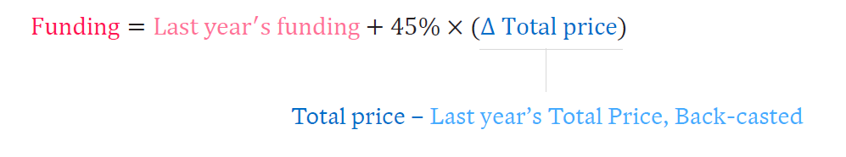
Pricing ≠ Funding
A price is a building block of a funding model:
  E.g. to date, Commonwealth funding is based on the change to the total price (NEP x NWAU), rather than is a fixed proportion of the total price:
  Specific funding models may have additional adjustments to drive incentives
  Prices can be set up as “floors”, “benchmarks” or “caps”

Slide 28
Q&A
Join at slido.com #3976982
&Conversation

Slide 29


Ash Evans
  Principal
    P: +61 2 9249 2923
    E: Ash.Evans@taylorfry.com.au
Anna Cohen
  Principal
    P: +61 2 9249 2985
    E: Anna.Cohen@taylorfry.com.au
Sydney
  Level 22
  45 Clarence Street
  Sydney NSW 2000

Slide 30
Feedback Poll
Join at slido.com #3976982

Slide 31
About the Actuaries Institute
The Actuaries Institute is the peak professional body for Actuaries in Australia. The Institute provides expert comment on public policy issues where there is uncertainty of future financial outcomes.
Actuaries have a reputation for a high level of technical financial expertise and integrity. They apply their analytical and risk management expertise to allocate resources efficiently, identify and mitigate emerging risks and to help maintain system integrity across multiple segments of the financial and other sectors. This unrivalled expertise enables the profession to comment on a wide range of issues including life, general and health insurance, climate change, superannuation and retirement income policy, enterprise risk management and prudential regulation, the digital economy, finance and investment and wider health issues.
© Institute of Actuaries of Australia 2023.​ All rights reserved.

