Slide 1
Modelling the impacts of deglobalisation on the non-life insurance industry
Joseph Hoang-Luu
April 2026
Notes:
Thank ASM, CAS, Actuaries Institute
Anita – passionate about global trade
No AI – instead, I used a traditional junior consultant
Joseph – articulate your contribution to society and do your best to execute it

Slide 2
Important notice for all participants
This Insights Session is being conducted in accordance with Institute’s Code of Conduct and attended by members in their professional capacity.
It is acknowledged that professional members in their employed capacity, may be active market participants in their respective industries who may compete with each other as defined by competition law.
Participants are, therefore, reminded that in accordance with their competition law compliance obligations they should not:
discuss any matter that may be perceived as being cooperation by competitors in a market to influence that market;
discuss any matters that could be regarded as fixing, maintaining or controlling prices, allocation of customers or territories, coordinating bids and/or restricting output or acquisitions in any circumstances;
share commercially sensitive information relating to their employer; or
share information for an anti-competitive purpose.

Slide 3
Definition: for this presentation, we have defined globalisation as the measure of imports and exports between countries / regions / geopolitical blocks as a proportion of total gross domestic product. This is commonly called trade-openness or trade-to-GDP-ratio
Limitations: this measure ignores other globalisation dimensions, such as capital inflows, foreign direct investment, migration, technology transfer, regulatory harmonisation, etc.
Notes:
Why did I choose to focus on this metric? Availability of data, ultra simple to understand,
Limitations are important – yesterday we touched on the importance of understanding the limitations of our analysis / methods. This is just one dimension

Slide 4

Q&A
Join at slido.com #2360601

Slide 5
01
Global trade: Global Export + Import
The measure of global export + import on a country-by-country basis, aggregated across all countries
Bretton Woods Collapse
WTO &
Uruguay Round
2008 Global Financial Crisis
Source: International Monetary Fund and World Bank
Notes:
This is a graph of trade openness for the globe from 1960,
What can we observe: a) trade-openness experienced a step change in the 70s, which coincided with the Bretton Woods Collapse. It was a monetary system that fixed currency exchange with the USD, which could be converted to Gold Bullion. On the face value, it was a rigid system. With its collapse, we witnessed the rise of floating exchange rates.
The establishment of the World Trade Organisation and what is known as the Uruguay round of the General Agreement on Tariffs and Trade. Its goal was to liberalize trade by reducing tariffs and establishing multilateral trade rules.
The 2008 global financial crisis, made the world wake up. Since then, trade openness has hovered between 40 and 50% of global GDP

Slide 6
02
Global trade: 2024 Export + Import Ranking
The largest 9 countries by 2024 GDP and their associated ratio of 2024 export + import as a % of 2024 GDP
Source: International Monetary Fund and World Bank
Notes:
Importantly, trade openness varies by country. There are a few narratives to note on this graph.
US has the largest annual GDP, but a very low trade openness metric. This indicates that the US can provide most of the goods and services it needs domestically.
China has a much higher trade openness, which is reflective of its significant export capacity
Germany is an outlier with a very high trade openness due to its significant vehicle exports, which may be under pressure with the advent of EV vehicles
Lastly, we observe a general upward trend in trade openness as a countries GDP decreases. This is reflective of the dependence of smaller economies on international trade.

Slide 7
03
Global trade: US & China Contribution to Imports + Exports
The proportion of global imports + exports related to the US and China
Source: International Monetary Fund and World Bank
Notes:
We note that the US and China are the largest economies by GDP and by total imports and exports
Interestingly, the US has become less reliant on international trade relative to its GDP over time, whilst China has become more reliant

Slide 8
04
Global trade: US Counter Parties
Top 4 US counter parties plus emerging markets combined (Bangladesh, India, Indonesia, Malaysia, Singapore, Thailand, Vietnam)
Source: International Monetary Fund and World Bank
Notes:
Let’s look at who are the US’s top 4 trading partners today
Mexico and Canada are the main trading partners, with significant trade in vehicles, vehicle parts and machinery
The top 3 trading partners made up roughly 30% of the US total exports and imports in 1960 and now its above 40%

Slide 9
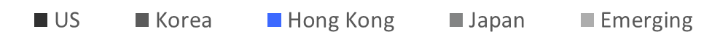
05
Global trade: China Counter Parties
Top 4 China counter parties plus emerging markets combined (Bangladesh, India, Indonesia, Malaysia, Singapore, Thailand, Vietnam)
Source: International Monetary Fund and World Bank
Notes:
Let’s look at who are China’s top 4 trading partners today
The US is the main trading partner, with no other country remotely close
The top 4 trading partners peaked at over 60% of China’s total exports and imports in the 90s but has now diversified significantly. That number is below 30%.
In the 90s, we observe Britain handover rule of Hong Kong and a reshaping of its economy such as movement of manufacturing to China

Slide 10
06
Framework: Hypothesis testing – Does volume of imports impact the cost of those goods domestically?
Example: Comparing the value of vehicles imported into Australia against the price of vehicles sold in Australia
-95% correlation
Source: Australian Bureau of Statistics and Observatory of Economic Complexity
Notes:
We have set the foundation of measurement for how we plan to interpret deglobalization
Now, we need to test our hypothesis on how different trade phenomena will impact an insurer
Our hypothesis is quite intuitive: an increase in imports will increase supply of goods domestically, therefor reduce the price of those goods domestically
This is evidenced for motor vehicle imports, but only between 1996 and 2020
After COVID, there appears to be a paradigm shift, where the domestic supply of vehicles has not caught up to the demand gap caused by COVID. Therefore, prices continue to rise.

Slide 11
07
Framework: Hypothesis testing – Does country to country trade balance impact foreign exchange rates?
A model of trade-weighted-index for Australia and US, respectively. The ratio of trade-weighted-indexes explains FX movement
Source: Australian Bureau of Statistics
Notes:
Has anyone heard of a trade-weighted-index?
It is the value of a currency compared to a basket of all the currencies that a country trades with based on the share of trade
It is a snapshot representation of the economy, which we can use to sensitivity test how much and in which direction trade balance impacts foreign exchange rates

Slide 12
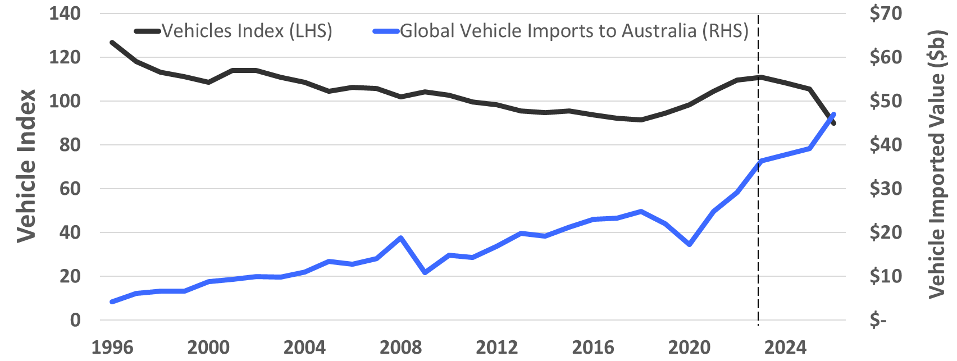
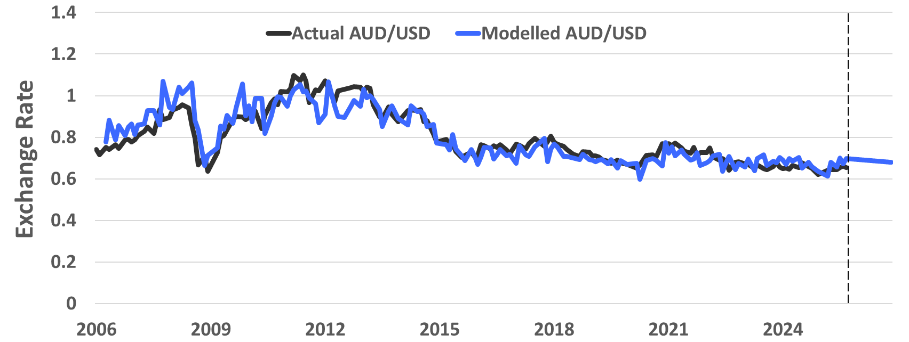
08
Framework: Application example on a motor portfolio
Scenario: What is the impact on the expected cost for motor total losses for an insurer in Australia, when import volume of US cars increases by 100%
Scenario Observations:
Trade balance between Australia and US increases by 16% in 2026
An increase in imported vehicles will place a material downward pressure on domestic vehicle prices
An increase in trade balance will apply a minor downward pressure of AUD against the USD
Important to note the step-change in relationship between the value of vehicles imported and the domestic cost of vehicles since 2020
Notes:
Let’s perform a scenario analysis if Australia doubles its import of US vehicles, for an insurer which has roughly 20% of its total vehicle's losses related to US vehicles
We assume that the relationship between import volume and domestic vehicle prices corrects in the next year and prices reduce with the increase in imports
We assume that the AUD weakens very minorly against the USD

Slide 13
09
Events: Lumber inflation (not related to de-globalisation)
Trade balance should be considered in the context of global demand and supply
Source: United Nations Economic Commission for Europe (UNECE)
Notes:
Here is a real-life example where supply and demand of a commodity rapidly shifted
Post-COVID, there was a sharp increase in demand for lumber due to demand for home construction and renovation
There was a very minor disruption to supply due to COVID, which was not material

Slide 14
10
Events: Russia Conflict
Energy price index for countries reliant on energy imports from Russia
Source: Internation Monetary Fund
Notes:
Another example of a sharp change in supply
The Russia conflict meant that electricity was no longer imported from Russia post 2022
Countries that relied on Russian electricity like UK and Germany experience a sharp increase in electricity costs
Countries like US and Canada also experienced the impact on energy prices, even though the US is a major energy producer. Interestingly China did not experience this phenomena, which was due to Government intervention and trade with Russia.

Slide 15
11
Events: US Tariffs
Number of announcements made related to the trade of commodities by the US in 2025. This can be a signal for trade risk.
Source: Peterson Institute for International Economics
Notes:
Another tool to consider when assessing the impact of global trade is the trade announcements made by Government.
Here we track announcements by the White House and Government departments for specific commodities
Some of these commodities directly related to motor, which could be a signal for trade risk and hence financial risk for motor after April 2025.
It may have been a trigger to run some scenarios.

Slide 16
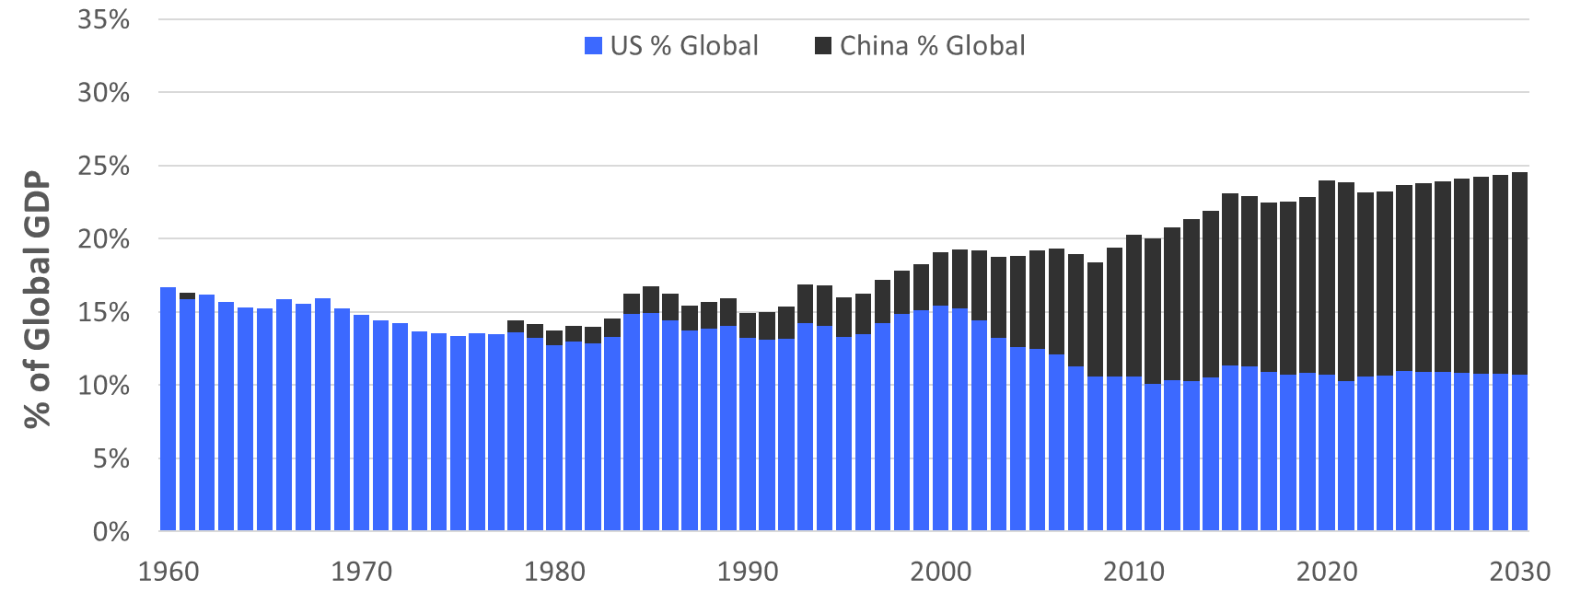
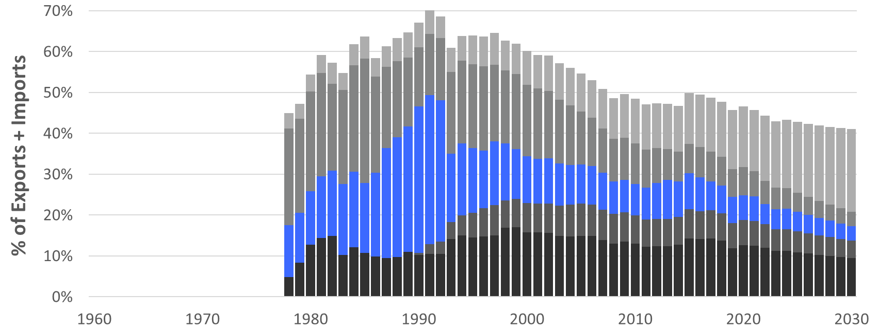
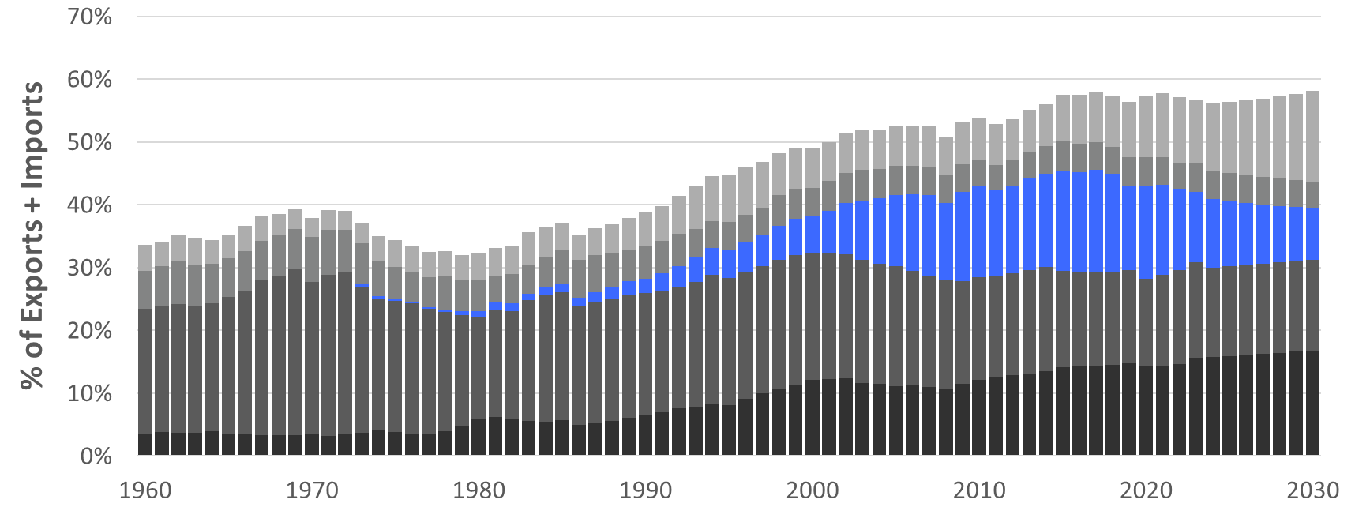

12
Future Scenarios: Escalation
Scenario: a continuation of current trends
Scenario Observations:
A continuation of current trade trends
US trade plateaus relative to global GDP, whilst China increases
Trade between US and China declines
US will strengthen trade with Mexico and Canada, particularly on automotive, machinery, and electronics
Emerging markets will play a greater role with both US and China
Notes:
Now we move onto possible future scenarios.
Read box

Slide 17
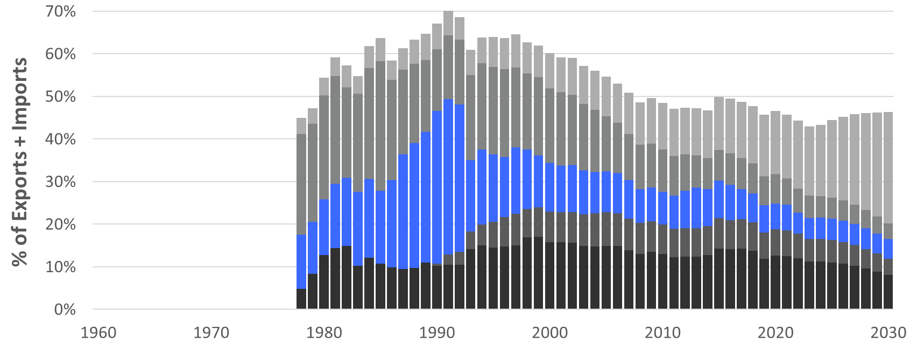

13
Future Scenarios: Regionalisation
Scenario: an increase in trade activity within regional blocks
Scenario Observations:
Some similarities with the escalation scenario
Accelerated strengthening on US trade with Mexico and Canada, particularly with the US-Mexico-Canada Agreement (‘USMCS 2020’)
Accelerated strengthening on China with Emerging markets through Regional Comprehensive Economic Partnership (‘RCEP’) and the Association of Southeast Asian Nations (‘ASEAN’)-China Free Trade Area (‘ACFTA’)
Deceleration of US with Emerging markets
17
Notes:
Now we move onto possible future scenarios.
Read box

Slide 18
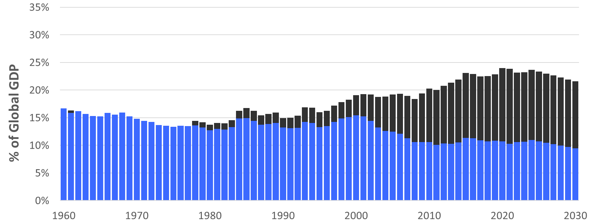
14
Future Scenarios: Bifurcation
Scenario: a direct move to focus on trade activity within a global split
Scenario Observations:
An extreme scenario
Global GDP declines
Global trade openness declines. I.e. trade + imports decline at a greater rate than the decline in GDP
Both China and the US (along with most major economies) will rapidly shift trading activity towards their respective global split
Notes:
Now we move onto possible future scenarios.
Read box

Slide 19
Q&A
Join at slido.com #2360601

Slide 20
About the Actuaries Institute
The Actuaries Institute is the peak professional body for Actuaries in Australia. The Institute provides expert comment on public policy issues where there is uncertainty of future financial outcomes.
Actuaries have a reputation for a high level of technical financial expertise and integrity. They apply their analytical and risk management expertise to allocate resources efficiently, identify and mitigate emerging risks and to help maintain system integrity across multiple segments of the financial and other sectors. This unrivalled expertise enables the profession to comment on a wide range of issues including life, general and health insurance, climate change, superannuation and retirement income policy, enterprise risk management and prudential regulation, the digital economy, finance and investment and wider health issues.
© Institute of Actuaries of Australia 2025.​ All rights reserved.

Slide 21
Feedback Poll
Join at slido.com #2360601

Slide 22
Thank you
Actuaries Institute
actuaries.asn.au

