Slide 1
Portability for lifetime income streams
Adam Butt, Associate Professor of Actuarial Studies,
Australian National University (presenter)
Jim Hennington, CEO, Apricot Actuaries
7 July 2026

Slide 2
The Actuaries Institute acknowledges the traditional custodians of the lands and waters where we live and work, travel, and trade.
We pay our respect to the members of those communities, Elders past and present, and recognise and celebrate their continuing custodianship and culture.
2

Slide 3
Important notice for all participants
This meeting is being conducted in accordance with Institute’s Code of Conduct and attended by members in their professional capacity.
It is acknowledged that professional members in their employed capacity, may be active market participants in their respective industries who may compete with each other as defined by competition law.
Participants are, therefore, reminded that in accordance with their competition law compliance obligations they should not:
discuss any matter that may be perceived as being cooperation by competitors in a market to influence that
market;
discuss any matters that could be regarded as fixing, maintaining or controlling prices, allocation of customers or territories, coordinating bids and/or restricting output or acquisitions in any circumstances;
share commercially sensitive information relating to their employer; or share information for an anti-competitive purpose.

Slide 4
Contents
Background Motivation
Principles – calculation of transfer value (TV) Other Principles
Key Risks Identified
05
09
11
17
20
4

Slide 5

Q&A
Join at slido.com #2752529

Slide 6
Background

Slide 7
Background
Choice of fund and portability already exists in the accumulation phase and (effectively)
for account-based pensions in the retirement phase
Requirement(s) of the Retirement Income Covenant “managing expected risks to the sustainability and stability of their expected retirement income”
Still relatively low take up of traditional annuities and “innovative retirement income streams” (IRISs)

Slide 8
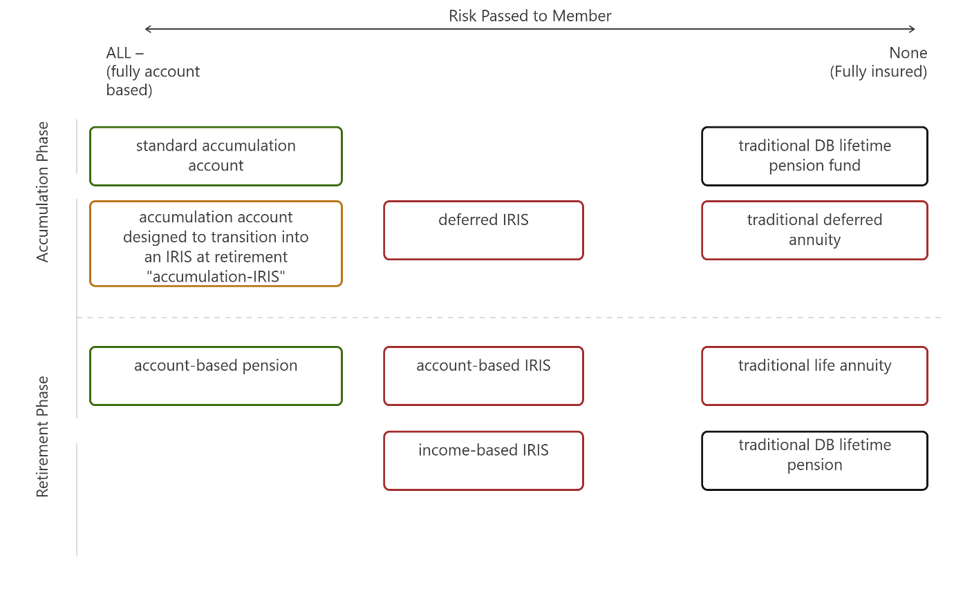
The product landscape
Green border
Fully account-based and portable under current rules
Orange border
Fully account-based and portable but requiring a simple law change
Red border
Some form of lifetime income protection by the provider. These products are the focus of this blueprint.
Black border
Defined benefit pensions that are not publicly available. We do not
consider these in this blueprint.

Slide 9
The product landscape – IRISs in payment
Some framed around income and periodic (annual) adjustments; e.g. ART, Challenger
Some framed around account balance and transactions (including living benefits), with income determined based on annuitisation of account balance; e.g. AMP, MLC
For both, income is dependent on an underlying “assumed interest rate” used to
calculate income

Slide 10
Motivation

Slide 11
Motivation
Portability can only be applied from one income stream to another income stream
Benefits of income streams for some cohorts in retirement
Increase in offering of “investment-linked” IRISs, meaning that customer income is
dependent on investment performance of the provider
Improving competition in the IRIS market
Reducing regret risk and hence improving confidence for customers to purchase IRIS
Improving incentives for recommendation by financial planners due to improved customer confidence and potential for ongoing advice
10

Slide 12
Principles – Calculation of transfer value (TV)

Slide 13
Calculation of transfer values (TVs)
Pre-retirement and no guarantees have yet accrued; TV – account value
For other cases, TV is based on actuarial present value (APV) of future payments, including guarantees, reversionary benefits, death benefits, etc.
Assumption basis
  Mortality - current pricing basis; any age-period selection effects for new business may be applied based on the age and timing of original product purchase
  Discount rate – current pricing basis or assumed interest rate equivalent to current income level
  Expenses – current pricing basis

Slide 14
Calculation of transfer values (TVs)
If current pricing basis does not exist then use liability valuation assumptions
Exit fees limited to the actual cost of unwinding guarantees and/or sale of illiquid assets are allowed

Slide 15
Additional principles in calculation of TVs
If all financial risks shared by members (e.g. ART), TV must represent the member’s
interest in the pool when fully allocating all assets of the pool
There should be no opportunity for arbitrage; i.e. a policyholder should not be able to take a TV and immediately reinvest it in the same product with the same provider to obtain a higher income payment.
Where a product is framed around an account balance, the TV should not be larger than the account balance
Where a product is framed around an adjustable income level, the TV should not be larger than the calculation of TV using the pricing basis from the initial purchase instead of the current pricing basis.

Slide 16
Numerical example and explanation
Imagine a customer owns an account-based product with a balance of $200,000 at the time of transfer. This product was initially priced on initial purchase price assumption basis A (mortality rates, discount rates); the $200,000 would also be the TV under this basis.
Imagine now that the current pricing basis B gave a TV of $250,000. This might be because B incorporated lower mortality rates and/or lower discount rates than A. The additional $50,000 represents the difference in value to the customer of the income stream under assumption basis B compared to A. A customer who chooses to transfer their income stream is choosing to give up the guarantees implicit in A. Under this blueprint, the customer would not be compensated for doing so, nor should the provider be required to fund the higher TV. Therefore, the TV would be equal to
$200,000.

Slide 17
Numerical example and explanation
Imagine instead that the current pricing basis B gave a TV of $150,000. This might be because B incorporated higher mortality rates and/or higher discount rates than A. Were the TV calculated as the ongoing balance of $200,000, the customer would have an arbitrage opportunity to immediately increase their income stream by transferring
$200,000 to the same product under B. Therefore, the TV in this case should be equal to $150,000 to remove this arbitrage opportunity.
What this effectively means is that the TV is calculated as the minimum of:
  (for account-based IRIS products) the ongoing account balance,
  (where an ongoing account balance is not available) the calculation of the TV using
initial purchase assumption basis A, and
  the valuation under the current pricing basis B.

Slide 18
Other Principles

Slide 19
Other principles (see paper for more details)
Governance involves an Appointed Product Actuary, Trustees, APRA
Capital access schedule position transfers to new provider
Communication to customers includes appropriate disclosures; this should include the development of consistent product descriptions between all IRISs
Should some form of financial advice be mandatory if TV above a certain threshold (say
$200,000)?
Should portability be mandatory for providers? If not, providers may offer a portable and non-portable version of the same product – with different pricing to reflect liquidity implications.

Slide 20
Anti-selection safeguards
New providers may not offer more generous death/withdrawal benefits
Limit assumed interest rates that can be applied; as high rates might be used to market an increase in short-term income level to customers in poor health
Reversionary benefits cannot be added or removed on transfer
Underwriting (“Enhanced” annuities) can only occur on first purchase of an income stream. New providers can choose to maintain previous underwriting on transfer if they wish.

Slide 21
Key Risks Identified

Slide 22
Risks
Cost of implementation
Pricing challenges as TV could rapidly affect risk characteristics of customers
Erosion of fixed cost sharing and/or mortality pooling for some providers; i.e. small pool risks
Poor and/or systematic bad advice around transfers
21

Slide 23
Q&A
Join at slido.com #2752529

Slide 24

Thank you
Actuaries Institute actuaries.asn.au

Slide 25
Feedback Poll
Join at slido.com #2752529

