Slide 1


Executive Presence -
Being visible where it counts
Sydney · Melbourne · Brisbane · Canberra · Adelaide · Virtual
Melbourne Venue
Hosted by Monash Business School

Slide 2
In the spirit of reconciliation, the Actuaries Institute acknowledges the Traditional Custodians of lands on which we meet today, and their connections to country, sea and community. We pay our respect to their elders past and present and extend that respect to all Aboriginal and Torres Strait Islander peoples today.​

Slide 3
Welcome to Executive Presence
Most of us were taught to do the work well and trust that people would notice. Tonight we explore what happens next
Thank you to our Melbourne Venue Partner – Monash Business School
Thank you to our Sydney Venue Partner – Bluefin Resources
Thank you to our Watch Party hosts for your time and effort in supporting tonight’s event
Sydney
Canberra
Adelaide
Queensland
The Institute Team,
Bluefin Resources
Chetana, Khubaib, Pramo and ANU
Mason and
Brett & Watson
Kuan and
Heritage Lanes

Slide 4
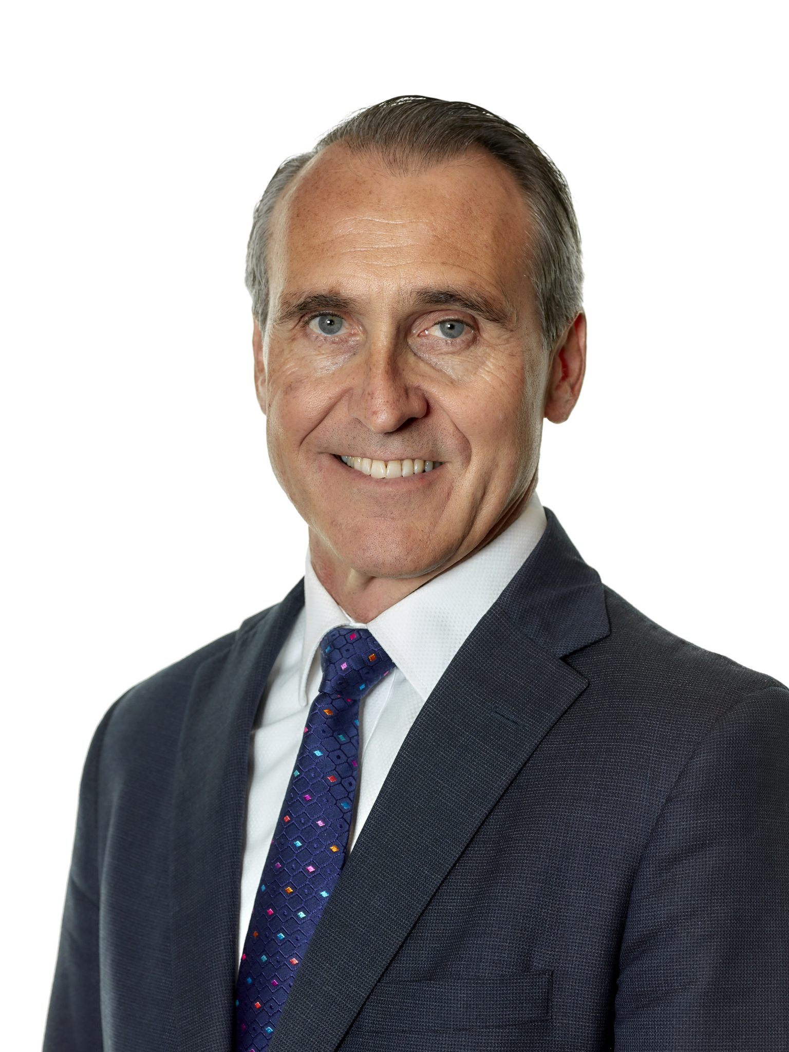
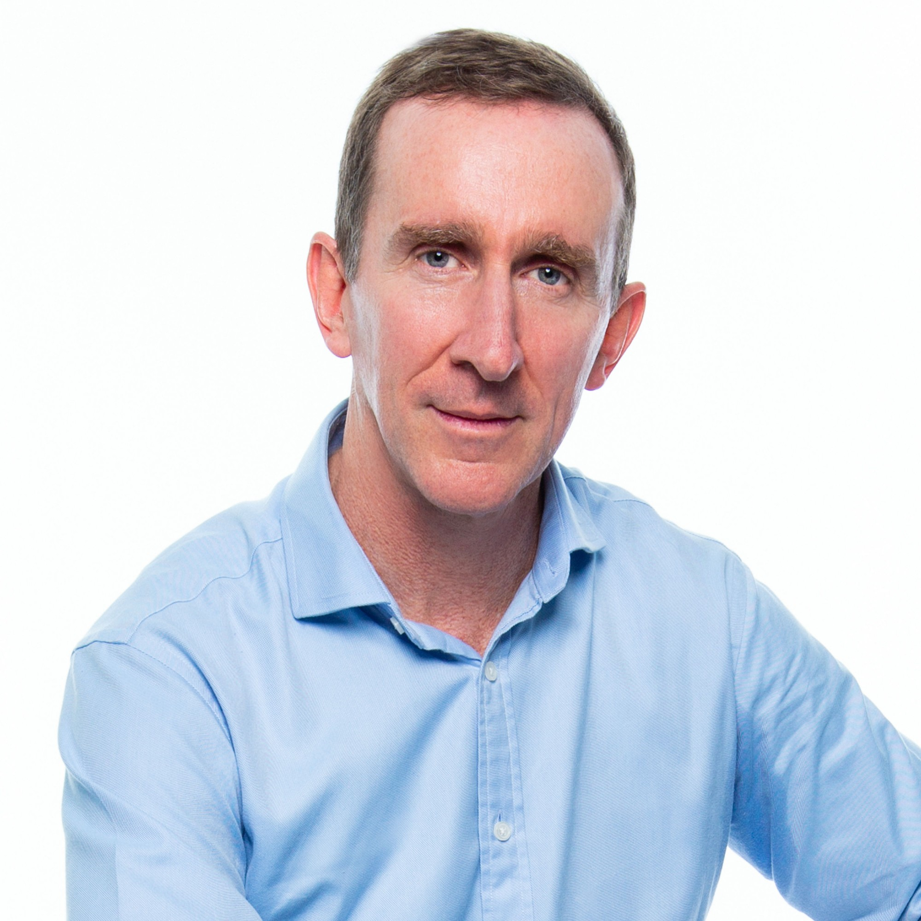

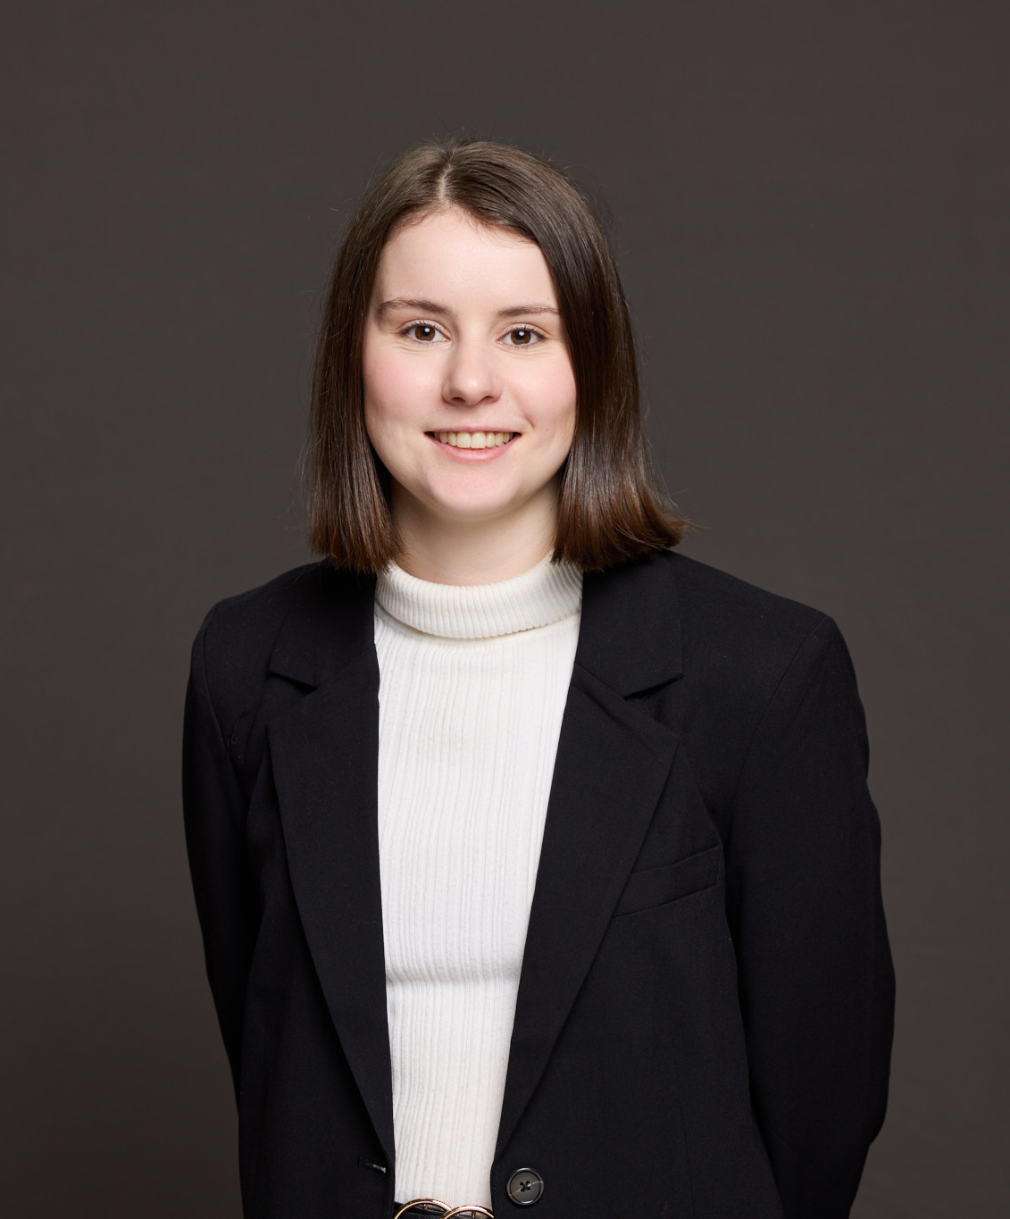
Tonight’s Presenters
Thank you to our presenters for generously giving your time to this Career Series session
Andrew Boal, FIAA
Partner, Deloitte & Member of Council, Actuaries Institute
Andrew Matthews, FIAA
Principal and Actuary, Finity and Associate Professor at Monash Business School
Justin McGee Odger
Managing Consultant, Hybrid DNA & Committee Member, DSAIPC
Shea McNaughton, FIAA
Acting Assistant Director, Data and Actuarial Analytics, Dept. Veterans Affairs

Slide 5
Learning Outcomes
Tonight you will:
You’ll leave with:
Explore what it takes to ensure your work reaches the right people
Identify what's getting in your way and how to move past it
Discover how contribution beyond your day job drives career growth
Clarity on where your contribution lands today
Practical strategies that work with who you are
Your Executive Presence Toolkit, which will land in your inbox within the week

Slide 6
Do not edit
How to change the design
What's the one thing that's stopped you from making your contribution more visible?
The Slido app must be installed on every computer you’re presenting from

Slide 7
Three actuaries. Three honest perspectives. Here's what they learned.
Lightning Talks with Andrew Boal, Andrew Matthews and Justin McGee Odger

Slide 8
The Three C’s.
Andrew Boal, FIAA

Slide 9
Do not edit
How to change the design
When you think of someone with strong executive presence, what is the first word that comes to mind?
The Slido app must be installed on every computer you’re presenting from

Slide 10
Do not edit
How to change the design
Which of the three has had the biggest impact on your career so far?
The Slido app must be installed on every computer you’re presenting from

Slide 11
Creating the Conditions.
Andrew Matthews, FIAA

Slide 12
Do not edit
How to change the design
What gift do people consistently seek you out for?
The Slido app must be installed on every computer you’re presenting from

Slide 13
You can’t outsource your voice.
Justin McGee Odger

Slide 14
1
It
gets
easier.

Slide 15
Do not edit
How to change the design
How often do you post to LinkedIn?
The Slido app must be installed on every computer you’re presenting from

Slide 16


Slide 17


Slide 18


Slide 19


Slide 20


Slide 21
2
You
might be
surprised.

Slide 22
Do not edit
How to change the design
Which emotion do you think works best for engagement?
The Slido app must be installed on every computer you’re presenting from

Slide 23


Slide 24


Slide 25


Slide 26
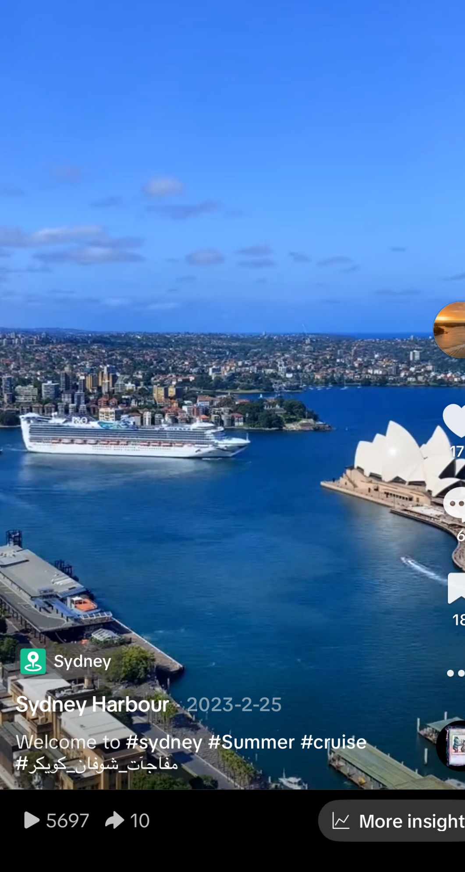
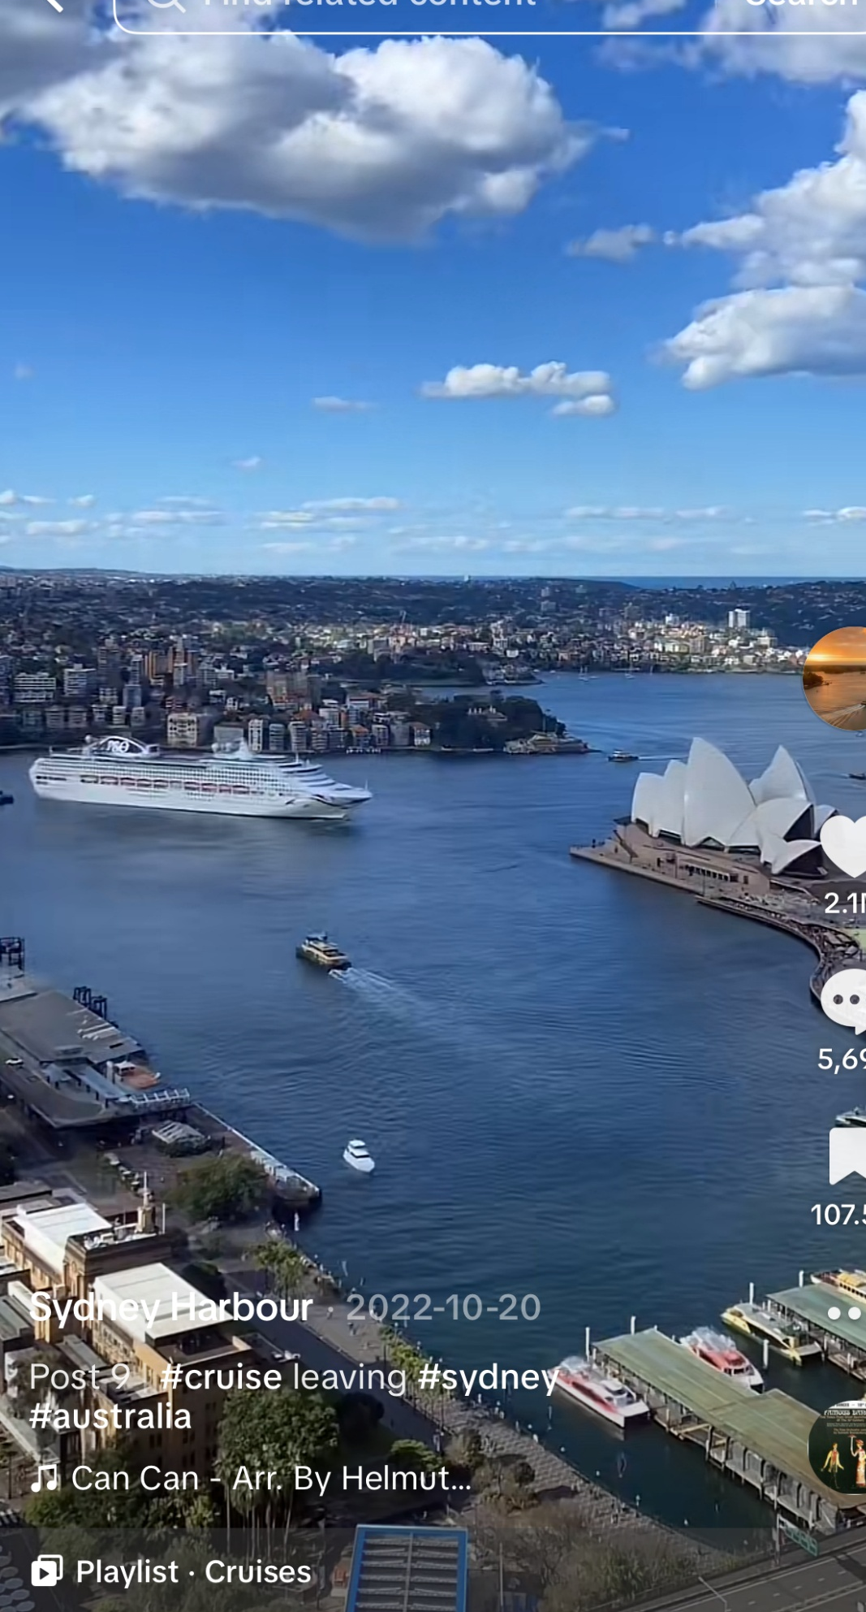



Slide 27
3
Your voice
has
value.

Slide 28
Do not edit
How to change the design
How often do you go on LinkedIn?
The Slido app must be installed on every computer you’re presenting from

Slide 29


Slide 30


Slide 31


Slide 32


Slide 33
4
You can’t outsource your voice.

Slide 34
Do not edit
How to change the design
How often can you spot when a post is written by AI?
The Slido app must be installed on every computer you’re presenting from

Slide 35


Slide 36


Slide 37
3x
5x

Slide 38


Slide 39
1. It gets easier.
2. You might be surprised.
3. Your voice has value.
4. You can’t outsource your voice.

Slide 40
Don’t await opportunity…
Create it.

Slide 41
Do not edit
How to change the design
If you could only get better at one of these things over the next 6 months, what would it be?
The Slido app must be installed on every computer you’re presenting from

Slide 42
Do not edit
How to change the design
Audience Q&A
The Slido app must be installed on every computer you’re presenting from

Slide 43

Future Events
Save the Date
Join us at our upcoming events to build your career and network with fellow members
Young Actuaries Conference
Tuesday 1 December 2026
Sydney – Museum of Sydney, Warrane Theatre
Melbourne – Monash Conference Centre
Virtual
Career Series 2026
29 October (In-Person in Sydney + Watch Parties)
Your Career Roadmap in the World of AI
Women Actuaries Connect +
Early Bird Registrations
Open Mid Sept 2026
29 July: Sydney
20 August: Melbourne
18 November: Sydney
What's On

Slide 44
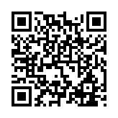
Thank you
We’d love your feedback so that we can make future events even better.
Provide feedback here:

