Slide 1
Lights, Camera, Algorithm:
AI Takes the Stage
Ean Chan, Lachlan Clark, Meg Yang, Rohan John, Yige Wang
June 2026

Slide 2
Disclaimer
All data used in this presentation are either dummy data or publicly available data for demonstration purposes only.
All scenarios are fictious and not based on a true story.
For the purpose of this presentation, it is the process that matters, not the results. Critically evaluate the technical aspects are you own discretion.
Enjoy the play!

Slide 3
Sentiment Analysis in Investment
01

Slide 4
7:04AM

Slide 5
The CIO’s inbox
7:04am. Ten fires. One question.
Chair of Investment Committee
6:47am
Brent hit $109 on Friday — up 8% for the week. Strait of Hormuz still closed. IEA says undersupplied until October. Do we increase energy exposure? Need answer before ASX opens.
Risk and Audit Committee
6:52am
WTI swung ±4% three times this week on ceasefire headlines. 52-week range $58–$126. Extreme volatility. What's our exposure ceiling under the mandate?
Investment Manager
7:01am
Running Bloomberg BSV and AlphaSense now. Signals not clean — bullish on supply disruption, volatile on ceasefire. Woodside +1.8%, Santos +2.1% Friday. Give us 2 hours.
Investment Manager
7:03am
One more thing — the LLM flagged an article that looks credible but reads ambiguously. Will show you in the debrief.

Slide 6
ACT 1 · THE REAL-WORLD CONTEXT
"The greatest threat to global energy security in history."
— Fatih Birol, IEA Executive Director, March 2026
Strait of Hormuz — closed since early March
Brent $109/bbl · Peak $138 on 7 April · +67% YoY
US-Israel air war against Iran began 28 February. IRGC blockaded the strait. Normal flow ~20 mb/d — now below 10% of capacity. The IEA calls it the largest supply disruption in oil market history by volume removed.
April 2026 average: $117/bbl — highest since post-Ukraine 2022. 52-week range: $58.72–$126.41. Extreme intraweek volatility; WTI moved ±4% multiple times in May on ceasefire headlines.
14+ mb/d shut in · IEA emergency release of 400 million barrels
Ceasefire — on/off/on/off
More than 14 mb/d of Gulf oil production now shut in. UAE left OPEC in late April. IEA's 32 member countries agreed the largest emergency stock release in history on 11 March.
8 April ceasefire → oil fell. Iran reimposed restrictions → prices recovered. 4 May: Operation Project Freedom (US escort). Paused 6 May. As of 17 May: Iran FM says talks 'making progress' — strait still restricted.
Notes:
The Strait of Hormuz has been effectively closed since early March. Normal flow is around 20 million barrels a day. Right now flows have collapsed by more than 90%. The IEA has called this the largest supply disruption in the history of the global oil market.
Brent peaked above $125 in late April. It's now around $109, still up 67% year on year. The 52-week range is $58 to $126. WTI has moved plus or minus 4% multiple times in a single week on ceasefire headlines alone.
More than 14 million barrels a day of oil production is now shut in across the Gulf. The UAE left OPEC in late April. The IEA coordinated the largest emergency stock release in its history, 400 million barrels from 32 member countries.
And the ceasefire has been on, then off, then on, then off again. As of last week, Iran says talks are making progress, but the strait is still restricted.

Slide 7
AI-powered Analysis – Bloomberg BSV + Alphasense
The real tools being used right now — this is not fictional
Bloomberg Terminal
AlphaSense
FactSet Transcript Assistant
BloombergGPT / BQuant
"This would take us two days. We have two hours."

Slide 8
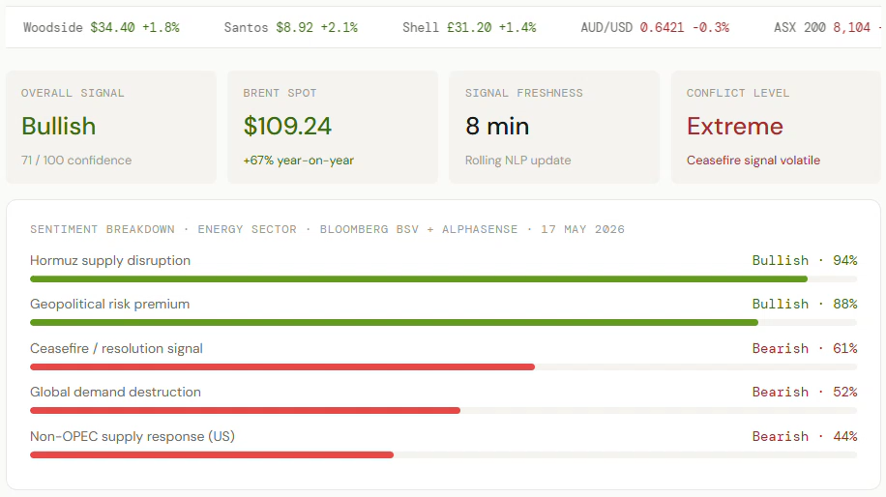
ACT 2 · AI-powered Analysis
90 seconds. Bullish but ‘Conflict Level: Extreme’
IEA Oil Market Report · 14 May 2026
Global oil market remains in deficit until Q4 2026 — supply losses exceed 1 billion barrels, inventories drawing at record pace
EIA Short-Term Outlook · 12 May 2026
Shut-ins peak at 10.8 mb/d in May (10.5 mb/d in April) — Strait assumed closed through late May, gradual resumption June, pre-conflict levels not until late 2026
Barchart · 13 May 2026
WTI falls 3.9% as ceasefire in Middle East appears to be holding — Iran FM says talks "making progress"
WION / Iranian Parliament · 16 May 2026
Iran announces "professional mechanism to manage traffic" in Hormuz "soon" — fees for cooperating vessels, strait remains closed to US and Israeli ships

Slide 9
ACT 2 · AI-powered Analysis
From $73 to $138 to $110 — in 11 weeks.
$140
$138
$120
$118
$116
$113
$109
$108
Today $110
$100
$91
$80
$73
25 Feb
Pre-conflict
4 Mar
Hormuz closed
11 Mar
IEA release
7 Apr
Peak
8 Apr
Ceasefire
17 Apr
Re-restricted
1 May
UAE exits OPEC
17 May

Slide 10
ACT 2 · AI-powered Analysis
What should we do?
Increase energy exposure to mandate ceiling (12%)
Hold at 8.4% - wait for ceasefire resolution
Reduce – too much tail risk at these prices

Slide 11
The Tension – The investment manager pushes back
The model says bullish 71/100. But this is the most uncertain oil market in history.
Four questions that must be answered before acting:
Was any model trained on a Strait of Hormuz closure at this scale?
Ceasefire headlines are moving WTI ±4% in hours. Can the model keep up?
If every fund gets the same ceasefire signal simultaneously, what happens?
The hallucination with ambiguous information. Can you always trust it?
"who is accountable if this call is wrong?"
Notes:
* The 2026 closure is the largest supply shock in oil history. FinBERT, BloombergGPT, AlphaSense — trained on data with no analogue for 14 mb/d simultaneous shut-ins. Ask your vendor: what's the training cutoff?
* Bloomberg NLP updates every 14 minutes. Ceasefire tweet to price move: under 60 seconds. For event-driven geopolitical crises, even near-real-time signals may be structurally stale.
* WTI's 3.9% move Tuesday may have been amplified by AI-assisted herding. The ECB's 'monoculture' warning is not theoretical — it appears to be happening in real time. FSOC flagged this in Dec 2024.
* LLM scored Iran's 'transit fee mechanism' article as bearish (supply returning). A human analyst read it as institutionalising the blockade as revenue — not reopening. Correct governance: lower the weight, flag for the board.
* Trustees must demonstrate a documented, defensible investment process. Crisis-period decisions face higher scrutiny. APRA has signalled it will review AI tool usage during the Hormuz crisis.

Slide 12
The Decision Framework
How to use AI responsibly when the market is outside the model’s training distribution?

Slide 13
ACT 4 · The Decision Framework
The AI gets us to the question faster.
It doesn't answer the question for us.
30%
40%
30%
AI Sentiment
Fundamentals Model
Risk Limit Checks
External + customized models
Supply, demand, forward curve
Mandate, concentration, liquidity, risk profile
Human sign-off: 100% — no exceptions, especially in a crisis
Three-line AI governance framework
1st line · Operations
2nd line · Risk
3rd line · Audit
Team owns the recommendation. AI output documented. Human sign-off required.
Regular model validation (Flags model training cutoff vs crisis date). Monitors drift, data quality, herding risk.
Annual audit of AI-influenced decisions. Board paper includes AI governance section for any crisis-period allocation

Slide 14
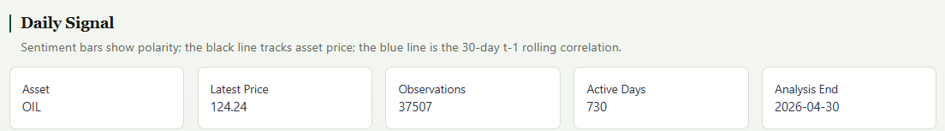
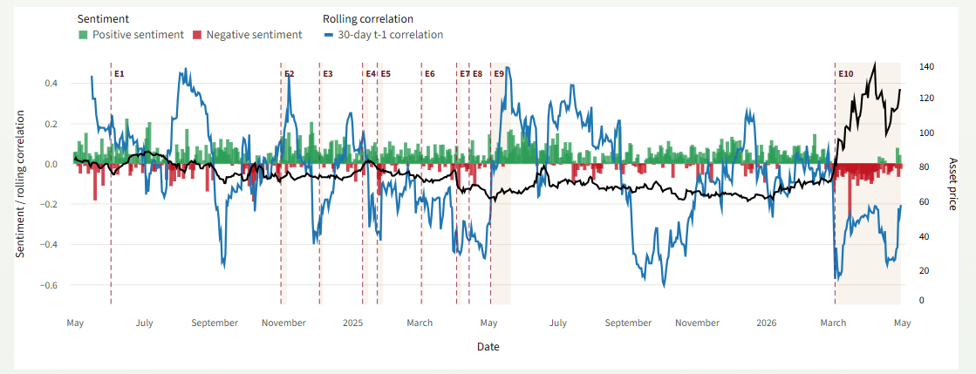
ACT 4 · The Decision Framework
Built our own sentiment analysis to best align with our strategy

Slide 15
Resolution
The CIO gets her answer…

Slide 16
ACT 5 · Resolution
8:54am. Markets open in 6 minutes.
RECOMMENDATION
Hold at 8.4%. Trigger increase to 10% only if: Bloomberg sentiment signal sustains above 70/100 for 48hrs AND fundamentals confirm disruption without imminent ceasefire AND IEA's June resumption assumption is formally revised outward.
Traditional (pre-LLM/AI)
AI-assisted
2 days
1h 50m
AI models have training cutoffs — in an unprecedented market, high confidence scores may be misleading
APRA will review crisis-period AI usage — the governance documentation you produce now is what protects the fund
Herding risk is systemic when AI tools are industry-wide
Speed is still the value — but the 48-hour confirmation window is a feature, not a delay

Slide 17
"The AI didn't make the call.
My team did — with better information, faster.
That's the deal."
— CIO· 8:54am
When AI adds value
When human judgement is critical
· Scanning large volumes of unstructured data
· Accountability for the final decision
· Identifying sentiment patterns at speed
· Assessing model fitness and recency
· Flagging anomalies and conflicting signals
· Contextual judgement on data quality
· Reducing time to insight from days to hours
· Governance disclosure and mandate compliance

Slide 18
Workers Compensation Claims Analysis
02

Slide 19
9:00AM

Slide 20
The CEO’s inbox
Board of Directors
8:55am
We received the Q2 financial results — why is the workers compensation claims favourable last quarter but now in red zone?
Notes:
CEO stops the Product Owner to raise concerns.
CEO: Hey can I talk to you for a minute?
Product Owner: …
CEO: The workers compensation portfolio reserves are fluctuating significantly quarter to quarter, do you know what’s going on? The Board is asking questions I can’t answer, it’s starting to affect their confidence in our numbers.
Product Owner: Yes, I’m aware of that. I’ll talk to the actuarial team today. See what’s possible.
CEO: Ok let me know as soon as you’ve got something. I need an answer by end of day.
Product Owner: Understood.
Product Owner approaches the Actuary's desk, looking stressed.
Product Owner: Hey, got a minute? I just got pulled into a conversation with the CEO. It wasn't fun.
Actuary: Oh, what's going on?
Product Owner: Reserves. Again. The Board is asking why our incurred claims keep moving around so much quarter to quarter. We put up a number, then three months later it's completely different. It's making us look like we don't know what we're doing.
Actuary: Yeah, I've noticed that. The problem is we're reserving off the initial estimate the claims team puts in when a claim is first lodged. And honestly... those numbers are pretty rough. They don't have much to go on at that point - just whatever the claimant tells them and maybe some early medical reports.
Product Owner: Exactly. The CEO wants a better approach. Something more predictive. Is that something you could build?
Actuary: You mean like a model that predicts ultimate claim cost based on early information?
Product Owner: Yes. How long would it take to put something together?
Actuary: Give me a couple of hours, let me see what I can do with AI.
Product Owner: Perfect. The CEO wants to see something by end of day. Let me know when you've got something to show.
Actuary: Will do.

Slide 21
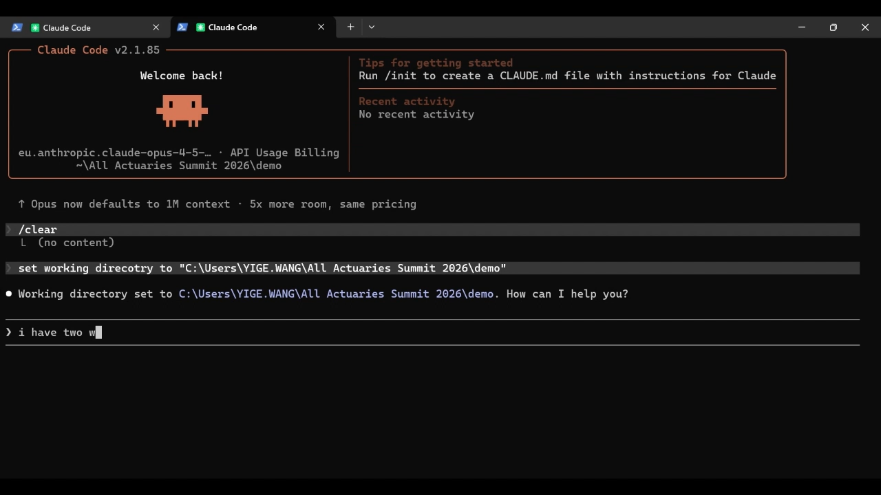
The Problem (Scene 1)
Needs a model… tight on time
Outputs don’t always make sense
Hard to explain
Low confidence from Board
What’s driving claims
Reporting delay → major impact on cost
Injury type / body part matters (e.g. back, strains, fractures)
Common causes: lifting, falls, repetitive strain
Combination of factors drives severity
Fewer hours = higher cost?
That CAN’T BE RIGHT!
Notes:
“First I need to

Slide 22
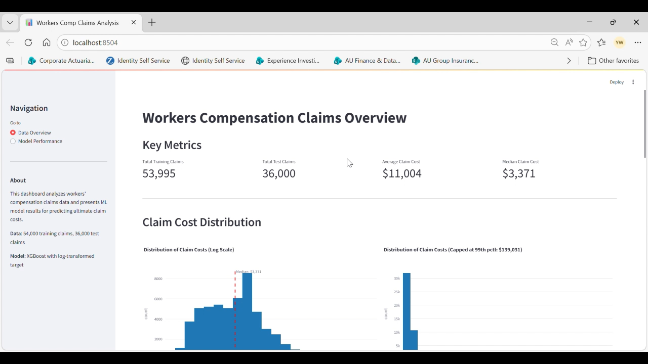

Slide 23
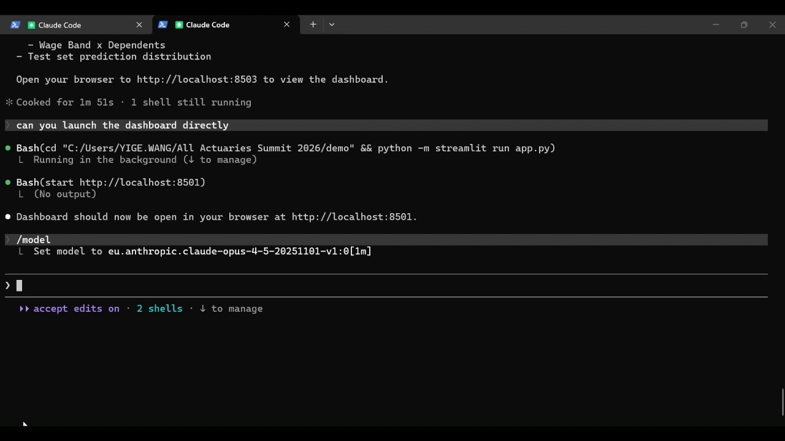
The Shift (Scene 2)
From model → usable product
Simple what-if views (clear relationships)
Plain-English explanations for every prediction
Business control (rules, overrides, caps)
Now I can explain this!
We maintain control

Slide 24
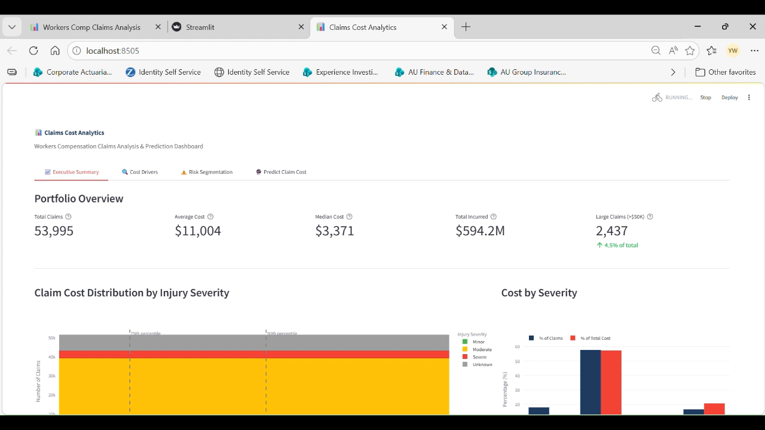

Slide 25
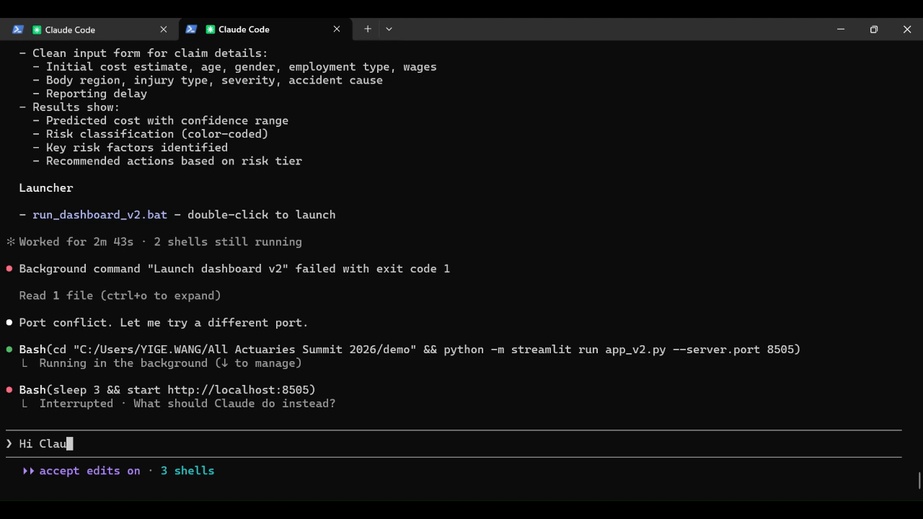
Outcome
From insight → action
Explainable and defensible analysis
Data-driven decisions
Higher confidence across business

Slide 26
Computer Vision in Motor Portfolios
03

Slide 27
2:00PM

Slide 28
CEO’s Calendar
Meeting Reminder
2:00 PM Tuesday, 26 May 2026
15 minutes
Innovative Motor Insurance Pricing with AI
Notes:
Over confidence
Train model on different things
Otherwise same signals and all doing the same thing – all about who gets in first – particularly if you are only using things that are publicly available
Model
Better
Faster
More aligned with your strategy

Slide 29

Computer Vision
Computer vision is a field of artificial intelligence (AI) that trains machines to interpret and understand the visual world.
It uses deep learning and neural networks to recognize objects, people and patterns.
Can capture information that can:
    Identify distracted drivers (phone usage, head movements)
    Identify tired drivers (yawning, eyes closed)
Discounts can be offered based on how safe a driver is

Slide 30
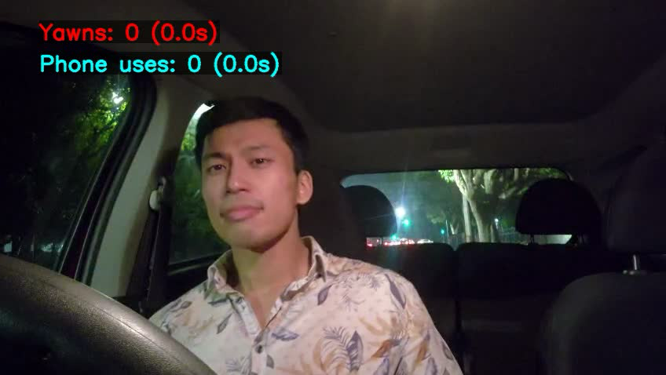
Example

Slide 31

Safety Measures
An estimated 10 – 30% of all road accidents are caused by distracted drivers.
Advanced driver distraction warning (ADDW) systems are becoming mandatory for newly registered vehicles in the EU as of July 2026.
Monitor driver fatigue and distraction.
Systems must operate on a closed loop system.
Edge-processing architecture can mean that raw video stream never leaves the car.
Systems are not permitted to use biometric data
It is estimated that 93% of Australian vehicles will have embedded telematics by 2031.

Slide 32

Privacy Concerns
The Privacy Act was drafted in 1988 before internet connected devices became prominent.
Consent model in Australia means that manufacturers may be free to use consumer data as long as they are given notice in their privacy polices.
If data is stored overseas other countries may not be obligated to uphold Australian privacy standards.
Car telematics have sold data to AI software training companies
General Motors will pay a $12.75 million (USD) civil penalty to California for selling driver data to third party brokers
Privacy laws generally cover the driver but not the passengers of vehicles.

Slide 33

Other Limitations
ADDW systems are expensive: can add approximately $500 - $2000 to the cost of a car.
The features detected by the system may be better at helping with safety rather than predicting insurance risk.
Harsh breaking, acceleration, speeding and cornering forces may be a better determinant compared to tired drivers.
Mobile phone usage can be detected through app-based methods without the need of a ADDW system.

