Slide 1

Climate Change
Assessing and Preparing for the Impacts on
Life Insurance
Henk Meintjes
Head of Client Solutions, Munich Re Australia
Jonathan Blunden
Client Manager, Munich Re Australia
May 2026
Presented at the 2026 All Actuaries Summit
Notes:
Good morning and thank you for joining us.
My name is Henk and I’m head of client solutions at Munich Re. Ordinarily I’d ask our CMO, Dr Matt or Natalie our head of claims to join me when talking about matters like mental health. Today however I’m excited to have Jonathan Blunden join me. Jonathan will be known to many of you as an active member of the Actuaries institute and enthusiastic client manager.
The presentation should take about 40 minutes with opportunity for questions at the end but please stop me if there is anything I fail to explain properly.
Part of the reason for doing these sessions is to encourage industry dialogue and, selfishly, for me to learn from yourselves.
I suspect many in the audience have already started grappling with the financial reporting requirements mandating climate disclosures – so possibly more advanced than what we are in our thinking and I’d appreciate learning from you too.

Slide 2
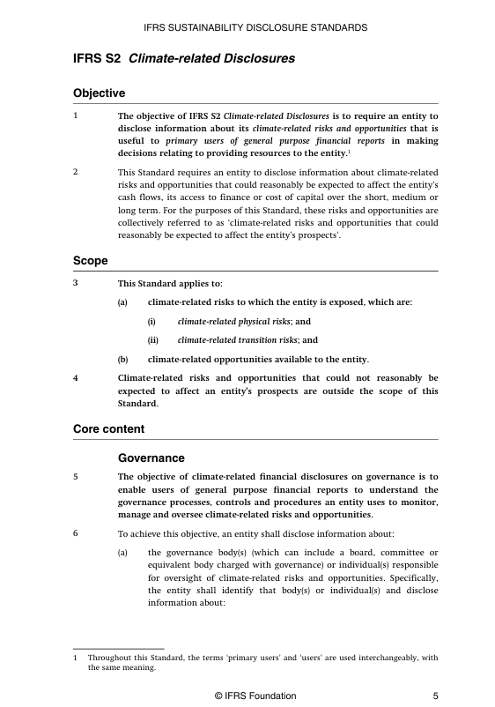

Sustainability Reporting Standards increasingly require mandatory Climate Reporting from Insurers
Four pillars:
Governance - board oversight, management roles, remuneration links
Strategy - climate risks/opportunities, scenario analysis, transition planning
Risk Management - processes for identifying and managing climate risks
Metrics & Targets - greenhouse gas emissions including emissions that occur up or down an organisation’s supply chain and emissions associated with their financing or investment activities
Presented at the 2026 All Actuaries Summit
Notes:
Reporting content hasn’t changed since the second consultation paper. Climate-related financial disclosures will include information about an entity’s climate-related risks and opportunities, as required by Australian climate disclosure standards, including:
Governance - board oversight, management roles, remuneration links
Strategy - climate risks/opportunities, scenario analysis, transition planning
Risk Management - processes for identifying and managing climate risks
Metrics & Targets - greenhouse gas emissions including emissions that occur up or down an organisation’s supply chain and emissions associated with their financing or investment activities (including Scope 1* and Scope 2* greenhouse gas emissions). These will be required from the first year of reporting.
Full assurance requirements will phase in by 2030, giving insurers time to build capability.

Slide 3
Agenda
Agenda
01 The growing significance and impact of climate change
02 A framework for assessing the impact on mental health in disability
03 Broader impacts and opportunities
Obesity: background
Obesity: treatments
Potential impacts: general population
Potential impacts: life insurers
Opportunities for insurers
Presented at the 2026 All Actuaries Summit
Notes:
For our agenda today, we’ll stick to a formula which we’ve really found works well. That is to share insights, how these will likely impact our industry, and then to leave you with some imperatives or tangible actions to consider and take away with you. Hopefully leading to a more sustainable, competitive and innovative market for all.
I’ll kick us off now with a quick recap of where we stand with climate change and some of the high-level impacts we are already seeing.

Slide 4
Hopefully, we can all agree that global temperatures are rising, even if policy is challenging
Projected warming based on pledges and current policies
Warming projected by 2100
+2.9°C High ¹
Scientific consensus → 1.5ºC looks almost impossible to achieve.
Policies & Action
+2.5°C Low ¹
2030 & 2035 targets only
+2.6°C ¹
Pledges & targets
+2.2°C ¹
Last 3 years have been the 3 warmest years on record!
Optimistic scenario
+1.9°C ¹
2023 +1.3°C
1.5°C compatible
Historical
1 Temperatures will continue to increase past the year 2100
Source: Cimate Action Tracker – Warming Projections Global Update Nov 2025 (https://climateactiontracker.org/documents/1348/CAT_2025-11-13_GlobalUpdate_COP30.pdf)
Presented at the 2026 All Actuaries Summit
Notes:
The Last 3 years have been the 3 warmest years on record, so Hopefully we can all agree that global warming is happening - even if we can’t necessarily agree on the right political responses.
The Paris Agreement, now ten years old, was designed to hold global warming below 1.5°C relative to pre-industrial levels.
The world stands at a critical juncture, with little to no measurable progress to reducing emissions or slowing rising global temperature.
Major emitters China and the EU have failed to propose emissions targets that change their course significantly.
Worse, the US rolled back climate policies, at times undermined global climate action, and is withdrawing from the Paris Agreement.
We can see from the graph
The proposed 1.5’C is now very unlikely
Scientific consensus is for a 2 to 3’C increase by 2100.

Slide 5
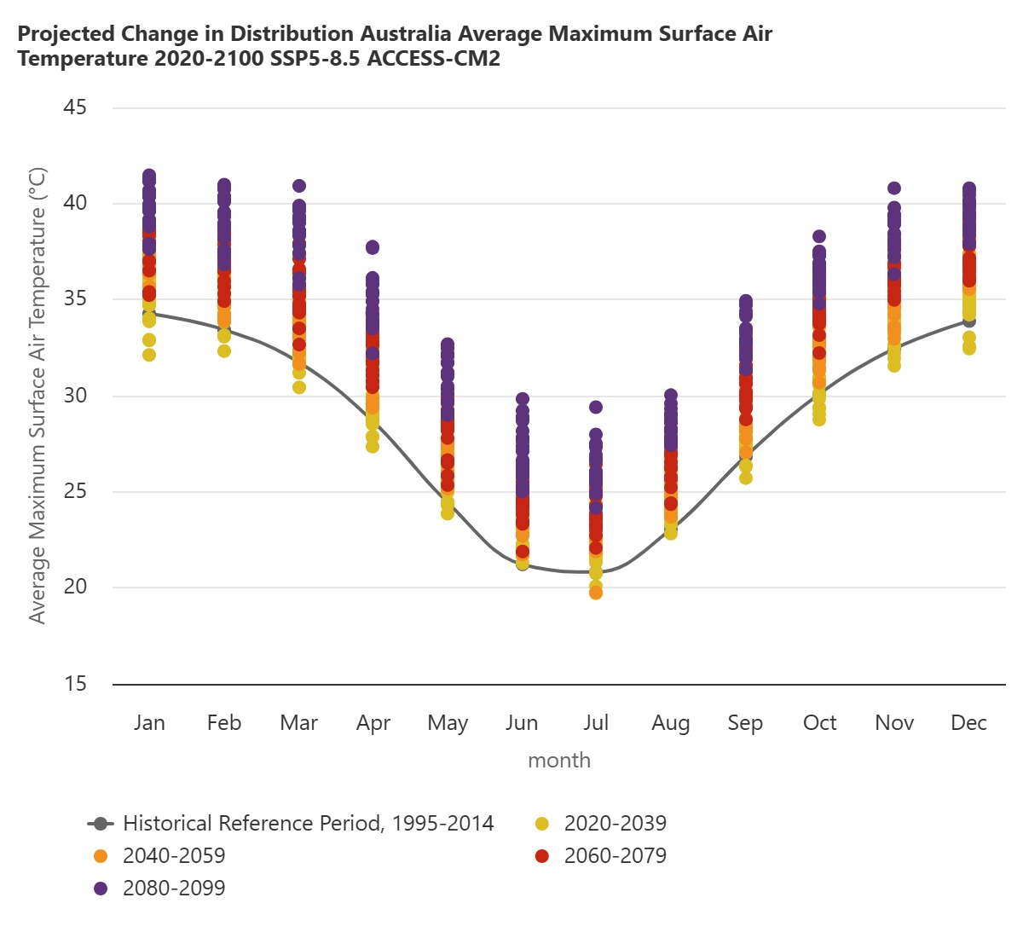
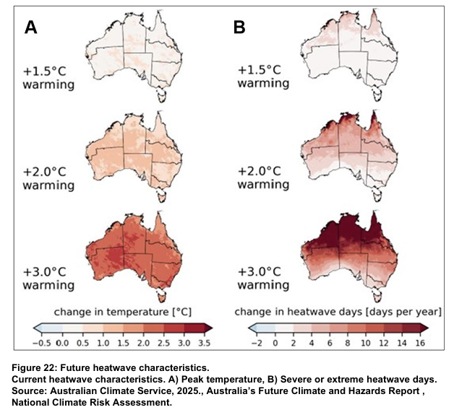
Australia is similarly expected to continue warming and to have more/longer heatwaves
Projected increase in average daily maximum temperature and heatwave days per year
Sources: WBG Climate Change Knowledge Portal (CCKP 2026). Australia Projected Future Climate.
URL: Australia - Mean Projections (CMIP6) | Climate Change Knowledge Portal
* Australian Climate Service, 2025, Health and Wellbeing Technical Report
Presented at the 2026 All Actuaries Summit
Notes:
As for the rest of the world, Australia’s temperatures are expected to continue increasing…. Warming impacts are widespread with only the most optimistic scenarios showing any flattening of average temperature
The graph shows how the average daily max temperatures are likely to increase over future decades
A heatwave is defined as a period of three or more consecutive days during which both maximum and minimum temperatures are unusually high for a given location, relative to its historical climate.
As temperatures rise, so do the number of days per year with heatwaves. The frequency, intensity, and length of heatwaves are projected to increase as the Australian climate changes.
In Northern Australia, including parts of Queensland and the Northern Territory, heatwaves are already frequent and intense.
These regions also experience high humidity levels which can exacerbate the effects of heat

Slide 6
Australia is similarly expected to continue warming and to have more/longer heatwaves
Projected increase in average daily maximum temperature and heatwave days per year
Extreme heat currently leads to more deaths and hospital admissions than any other hazard*
During heatwaves, health service demands increase:
  3-3.5% increase in Emergency Dept. presentations
  4% increase in GP consultations
  5-8% increase in ambulance callouts (Adelaide only)
Heatwaves caused 2% more deaths during the 2007-17 warm season (Oct-Mar). Excess deaths in major cities:
  Adelaide – 8%
  Hobart – 6%
  Melbourne/Sydney – 3%
Heatwaves linked to higher rates of suicide and mental health-related hospital admissions
Sources: WBG Climate Change Knowledge Portal (CCKP 2026). Australia Projected Future Climate.
URL: Australia - Mean Projections (CMIP6) | Climate Change Knowledge Portal
* Australian Climate Service, 2025, Health and Wellbeing Technical Report
Presented at the 2026 All Actuaries Summit
Notes:
Heatwaves cause a range of illnesses, including dehydration, heat cramps, heat exhaustion, and heatstroke (Bhatta et al. 2023). These conditions can quickly become life-threatening if not treated promptly.
Chronic conditions such as heart disease, diabetes, and respiratory illnesses can also worsen during heatwaves. This puts increased pressure on health services
Over the decade 2007 – 2017 it was estimated that heatwaves accounted for 2% more death.
Larger cities are of particular concern for heat-health risk due to their population size and the variation in heat exposure, social vulnerability, and ability to respond to temperature extremes.
These impacts are however mostly among old and vulnerable in society and insured pools is expected to be more resilient
Extreme heat can negatively affect mental health, leading to increased irritability, impaired judgment, and exacerbation of psychiatric presentations like bipolar disorder and depression (Bhatta et al. 2023). Heatwaves have been linked to higher rates of suicide and mental health-related hospital admissions, citing heightened stress, anxiety, and aggravation of psychiatric conditions (Thompson et al. 2018) - I’ll come back to this later.

Slide 7
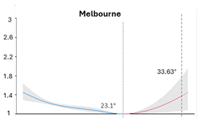
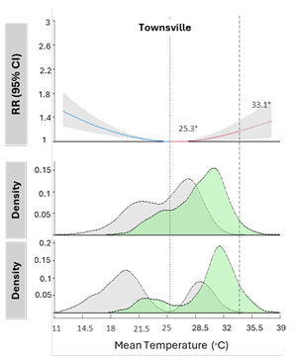
Fortunately, populations acclimatise to local temps and there are options to manage heatwaves
Relative risk (RR) of mortality by temperature
Insights
Current mean temp seldom exceeds 33.6°C
Minimum mortality temperature for Melbourne is 23.1°C
At 34°C there is a RR of 1.4 or 40% increase in risk of death
Similar RR for 7°C
Temp Distrib
Mean Temperature °C
* Australian Climate Service, 2025, Health and Wellbeing Technical Report
Presented at the 2026 All Actuaries Summit
Notes:
This graph shows Melbourne’s current Mean temperature distribution in the blue shaded area. We can see daily mean temp seldom reaches 27, 28’ and almost never 33.6’C
The blue and red lines provide the exposure–response curve or relative mortality risk (RR) across the temperature (°C) range, with a 95% confidence interval in grey
Based on this:
Minimum mortality temperature for Melbourne is 23.1°C
At 34°C there is a RR of 1.4 or 40% increase in risk of death
Similar RR for 7°C,

Slide 8
Fortunately, populations acclimatise to local temps and there are options to manage heatwaves
Relative risk (RR) of mortality by temperature
Insights
Current mean temp seldom exceeds 33.6°C
Minimum mortality temperature for Melbourne is 23.1°C
At 34°C there is a RR of 1.4 or 40% increase in risk of death
Similar RR for 7°C
Similar maximum mean temp but distribution is shifted to the right
Minimum mortality temperature for Townsville is 25.3°C
At 37°C there is a RR of 1.4 or 40% increase in risk of death
Similar RR for 13°C
Brisbane, Cairns, Sunshine Coast etc currently experience a higher mortality burden during cold days.
With projected temperature increases these areas are projected to face greater mortality risks attributable to heat days.
The current model does not include humidity, or other concurrent weather events/non-climatic factors.
Temp Distrib
Temp Distrib
Temp Distrib
* Australian Climate Service, 2025, Health and Wellbeing Technical Report
Presented at the 2026 All Actuaries Summit
Notes:
If we now contrast this to Townsville, we see Similar maximum mean temp but distribution is shifted to the right with daily mean temp regularly reaching 27, 28’C. Shifting the graph aids in interpretation. Hopefully I haven’t given anyone vertigo ☺
From this we see that due to aclimitisation, Townsville’s. Minimum mortality temperature is 25.3°C and only at 37°C is there a 40% increase in risk of death
Notably, for Townsville, they suffer a similar 1.4 RR @ 13°C. As a result, warmer cities like Brisbane, Cairns, Sunshine Coast etc currently experience a higher mortality burden during cold days.
With projected temperature increases these areas are projected to face greater mortality risks attributable to heat days.
The current model does not include humidity, or other concurrent weather events/non-climatic factors.

Slide 9
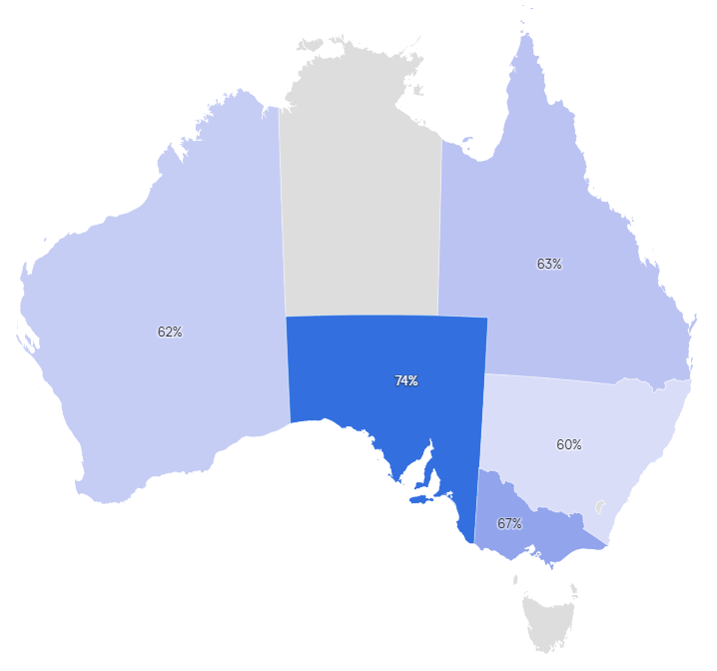
Fortunately, populations acclimatise to local temps and there are options to manage heatwaves
Relative risk (RR) of mortality by temperature
Short term adaptation can be achieved in several different ways
Adjusting behaviors: increasing water intake and seeking refuge
Technology: Remote control of air conditioning systems will receive increased Artificial Intelligence and automation updates to work more efficiently:
63% of AU households
use AC
AC reduces heat-related
deaths by 75%*
Temp Distrib
Proportion of people using AC by state
(Source: finder)
Temp Distrib
ND-GAIN Index ranks Aus 11th out of 181 countries with high adaptive capacity in terms of climate change vulnerabilities
* Australian Climate Service, 2025, Health and Wellbeing Technical Report
Presented at the 2026 All Actuaries Summit
Notes:
Adaptation can be achieved in several different ways:
• Acclimatisation: Through repeated exposure to heat, individuals develop a more efficient and effective cooling response, leading to improved thermal comfort.
• Adjusting behaviours: The impact of periods of extreme heat can be mitigated by reducing physical activity, increasing water intake and seeking refuge in cool places.
• Technology: External cooling can be achieved through the use of air conditioning or electric fans.
Some papers suggest AC reduces heat-related deaths by around 75%. The UK only has about 3% of households with an aircon… Hotter places, like Australia will have much higher penetration those on higher incomes will see greater protection from heat-related deaths through AC ownership than those on lower incomes.
ND-GAIN Index ranks Aus 11th out of 181 countries with high adaptive capacity in terms of climate change vulnerabilities
It is not surprising then that Actuaries and industry bodies like CALI have not called for drastic action with regards to insurance products. Believing a wait and see approach may be most appropriate with sufficient time and ability to respond as consequences become clear.

Slide 10
But climate systems are non-linear and increasing temperatures are only part of the challenge
Higher temperatures
Temperatures have already increased by 1.5°C since 1910
Warmest year on record was 2019 and 8 of 9 warmest years have occurred since 2013.
Frequent floods
Northern Australia has been wetter than average over the last 30 years across all seasons. Seven of the 10 wettest northern Australia wet seasons have occurred since 1998
Longer, harsher fire seasons
There has been an increase in extreme fire weather, and in the length of the fire season, driven by hot windy conditions but also fuel availability and thunderstorms
Longer droughts
Australia has had far fewer (if more intense rain days), and patterns are changing.
Winter rains in southern Australia in particular have reduced.
1 Source: Australia’s changing climate, CSIRO. https://www.csiro.au/en/research/environmental-impacts/climate-change/state-of-the-climate/australias-changing-climate
Presented at the 2026 All Actuaries Summit
Notes:
An increase of 1.5 °C is a threshold that is widely referenced in global climate change assessments, and it is important to understand how Australian conditions have changed.
I think it is easy to understand how high temperatures can increase bushfire risks.
But it is also affecting rainfall
Cool season rainfall is particularly important for southern Australia, as it is the main growing season for many crops. It is when peak streamflow occurs in most catchments in the region, as cool season rainfall is generally more effective than warm‑season rainfall in generating runoff, and is also when groundwater recharge is most likely to occur.
Warmer air can hold more water vapour than cooler air, and moisture in the atmosphere can increase by 7% per degree of warming, all other things being equal. This can cause an increased likelihood of heavy rainfall events, even in areas where average rainfall is likely to decrease such as some regions of southern Australia.

Slide 11
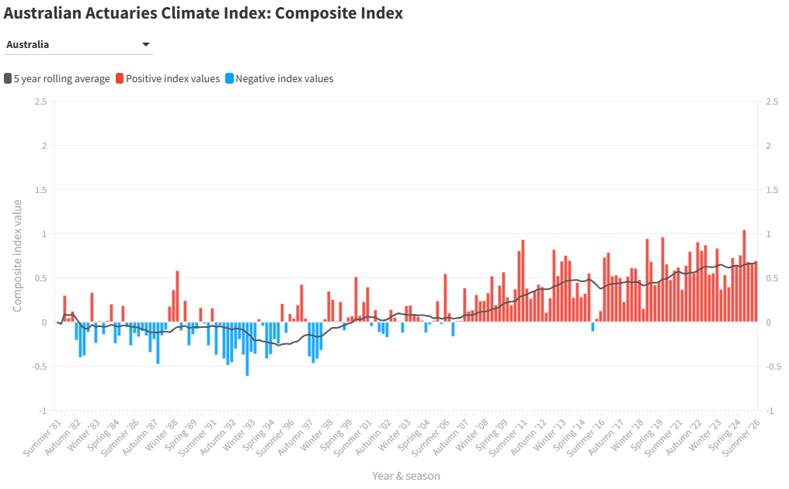
Frequency and severity of extreme weather is set to continue increasing
Australian Actuaries Climate Index combines high temperature, rainfall, wind and sea level
Reference period 1981 - 2010
Autum 2025
Source: https://www.actuaries.asn.au/climate-index
Presented at the 2026 All Actuaries Summit
Notes:
Give credit to Actuaries and institute for work they are doing
The Australian Actuaries Climate Index (AACI) covers extreme high and low temperatures, extreme rainfall, consecutive dry days, extreme wind and sea level. Unlike many other measures, the Index focuses on changes in the extremes. This is a more relevant metric for the insurance industry than averages, as it correlates more closely with damage. This is done by measuring how often we observe exceedances of an extreme threshold, usually the 99th percentile, set during the reference period of 1981-2010.
The Index is intended to provide a useful measure of how the extremes of weather are changing in order to support assessment of the change in risk.
Concerningly, it has recorded its 42nd consecutive positive value in the summer of 2025/26, indicating that the frequency of extreme weather across Australia continued to remain above the 1981–2010 reference period average.
Autumn 2025 Sees Highest-Ever Climate Index. A key contributor to these elevated levels was ex-Tropical Cyclone Alfred, which made landfall off the Queensland coast in early March. The system caused large sea level anomalies (SLA) of up to 0.6 metres above normal, especially along the northern New South Wales and southern Queensland coastlines, These anomalies are partly due to the cyclone's low atmospheric pressure, which creates a “bulge” in sea level. Lower pressure reduces the weight of the air pressing down on the ocean, allowing water to rise. Cyclones also influence wave energy. As they pass over the ocean, strong winds transfer energy to the surface, generating waves. In this case, waves up to 8 metres high were observed

Slide 12
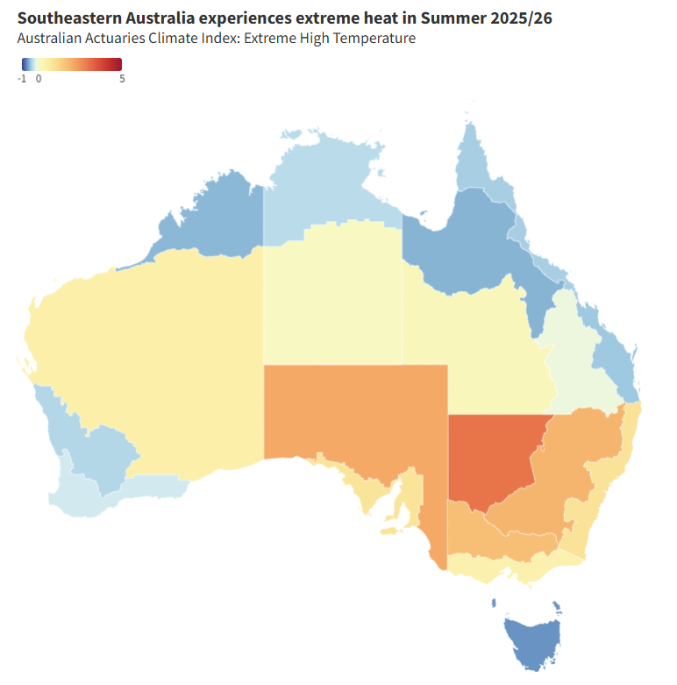
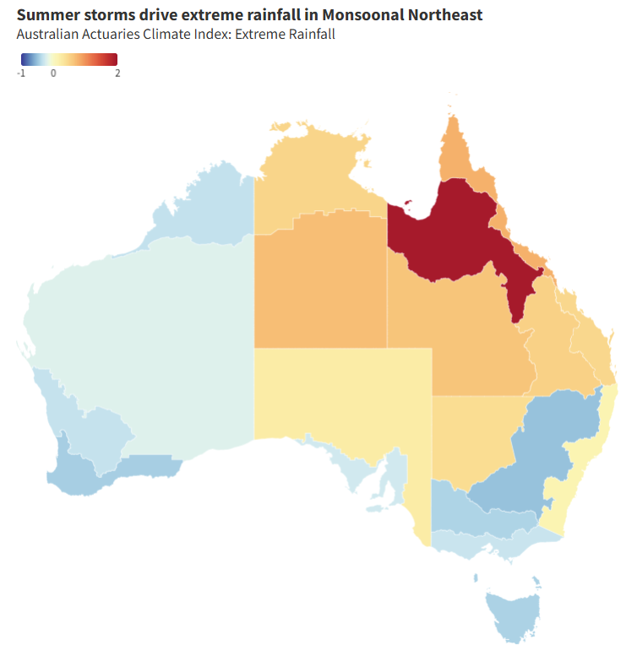
Frequency and severity of extreme weather is set to continue increasing
Australian Actuaries Climate Index combines high temperature, rainfall, wind and sea level
Summer 2025/26 is marked by heatwaves in the south and storms in the north
Reference period 1981 - 2010
Source: https://www.actuaries.asn.au/climate-index
Presented at the 2026 All Actuaries Summit
Notes:
Maps show the areas most likely to be affected by changes in summer weather patterns.
There are effectively 19 climatologically consistent regions of Australia
On left we can see that southern Aus will suffer more extreme heat and drought
While in the north summer storms will drive extreme rainfall with flooding and storm damage.
Brisbane now in cyclone path?

Slide 13
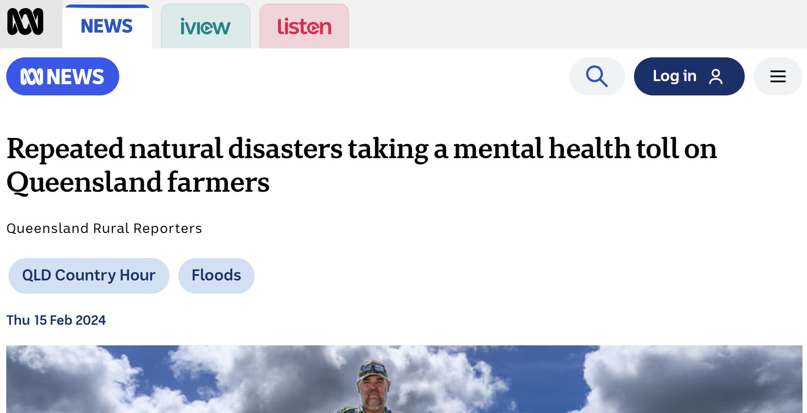
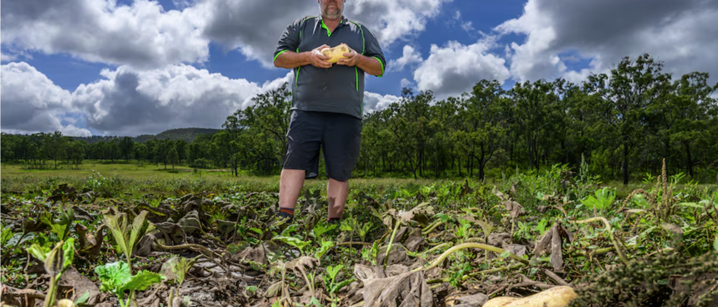
Areas prone to climate events (fires, flooding, cyclone) likely to experience greater burden of mental disease
The aftermath of draught/flood can be devastating, testing the resilience of entire communities
https://www.abc.net.au/news/2024-02-15/farmers-psychological-impact-of-natural-disasters/103449710
Drought pushes farmers' mental health to the brink across southern Australia - ABC News
Understanding the social impacts of drought | CSI
Presented at the 2026 All Actuaries Summit
Notes:
Experiencing a natural disaster can be a deeply traumatic event. Affects entire communities
But how do survivors cope when their homes and businesses are repeatedly battered by cyclones, floods or fires, with little relief in between?
The impact of these acute weather systems are compounding and putting even greater pressure on Life and Health insurers faced with mounting Mental health burden

Slide 14
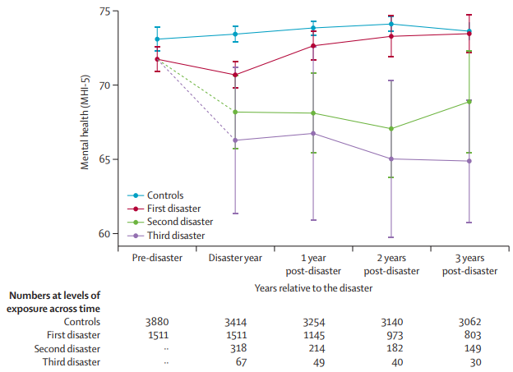
Areas prone to climate events (fires, flooding, cyclone) likely to experience greater burden of mental disease
The aftermath of draught/flood can be devastating, testing the resilience of entire communities
Mental health and recovery deteriorates with each natural disaster
https://www.abc.net.au/news/2024-02-15/farmers-psychological-impact-of-natural-disasters/103449710
Drought pushes farmers' mental health to the brink across southern Australia - ABC News
Understanding the social impacts of drought | CSI
Basis: national HILDA data, 2009-2019
Presented at the 2026 All Actuaries Summit
Notes:
Analysis
Basis: national HILDA data, 2009-2019
Extreme event (fires, flooding, cyclone) exposure self reported
Each climate event associated with deterioration in mental health, with recovery
Repeated climate events worsened mental health, and prolonged recovery.
Varied impact on socio economic classes (more events in lower classes, more impact on MH in higher classes).

Slide 15
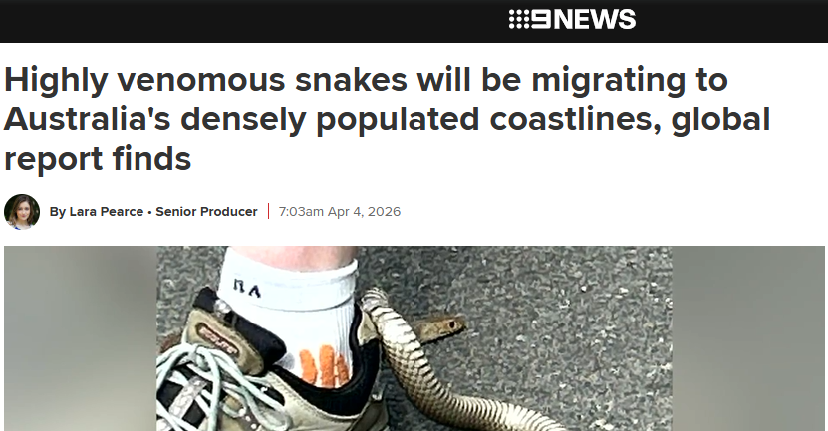

And if that wasn’t enough…
Imagine the mental distress of having a
snake caught in your shoe…
Eastern brown snake becomes stuck in heel loop of woman's shoe
Presented at the 2026 All Actuaries Summit
Notes:
This is a story that I heard on the radio during the easter school holidays… Poor lady went for a walk in Western Sydney when she was bitten by a highly venomous, eastern brown snake.
It had became stuck in the loop of her shoe. She amazingly remained still and called paramedics. It took 45mins for the snake catcher to reach her..
The women was said to be at home recovering but tbh I haven’t heard more and truly hope she is ok.
Snake catcher: He said the situation was unlike anything he'd ever dealt with before.
"﻿It hit me heavy," he said. "I thought, if she dies, that's on me."﻿
As for the snake.. It officially died of heat exposure.﻿ “having been trapped on the hot bitumen on a 36-degree day for more than half an hour.﻿”
PLOS is a nonprofit based in California, US, actually has some interesting reading on the topic.
Climate change will drive venomous snakes away from arid interiors and towards densely populated coastlines, increasing the risk of deadly encounters for millions of people, a new global study says.
It notes that snake populations will broadly move towards higher latitudes and more heavily populated areas as rising temperatures make their current habitats less suitable.
The eastern brown snake — the world's second most venomous and responsible for most local fatalities — is expected to expand its range south along the populous east coast by 2050.
Coastal taipans are also likely to move closer to urban areas as inland ranges contract.
While snakebite deaths in Australia are rare, the increased proximity to humans could heighten the need for vigilance and preparedness in cities and regional centres.

Slide 16
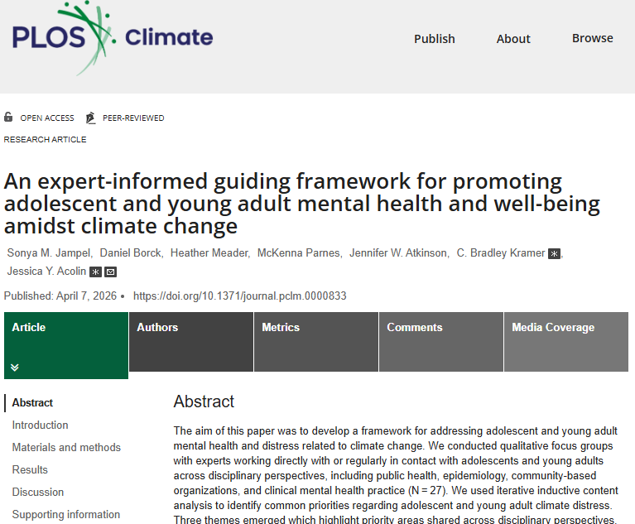
And if that wasn’t enough…
Imagine the mental distress of having a
snake caught in your shoe…
Over 60% of youth worldwide experience climate distress
Eastern brown snake becomes stuck in heel loop of woman's shoe
https://journals.plos.org/climate/
Presented at the 2026 All Actuaries Summit
Notes:
Rising temperatures, extreme weather, and ecosystem disruptions due to global warming have major impacts on human physical and mental health.
Negative emotions about climate change (i.e., “climate distress”) are common and linked to experiencing acute weather events (e.g., hurricane, flood, heatwave, which increase in frequency and severity due to global warming), chronic climate change effects (e.g., biodiversity loss, changing landscapes) or climate change awareness
Over 60% of youth worldwide experience climate distress, and between 5–27% of individuals with climate distress experience adverse psychiatric symptoms such as impaired sleep or intrusive thoughts
While substantial research examines mental health impacts of acute weather events, relatively little addresses distress associated with chronic climate change effects and climate change awareness
PLOS, actually has some interesting reading on the topic.
Recent work has documented links between negative climate emotions and poor mental health, such as clinical depression and anxiety. Some research has begun identifying protective mechanisms, contributors to psychological resilience, and opportunities for screening and intervention. Scientific interest in climate distress is growing rapidly.
A PubMed search performed by the authors retrieved 2596 manuscripts addressing “climate anxiety” or “climate distress” published between 1959–2024, with over 50% published after 2020.

Slide 17
Agenda
Agenda
01 The growing significance and impact of climate change
02 A framework for assessing the impact on mental health in disability
03 Broader impacts and opportunities
Obesity: background
Obesity: treatments
Potential impacts: general population
Potential impacts: life insurers
Opportunities for insurers
Presented at the 2026 All Actuaries Summit
Notes:
I’ll hand over to Jonathan now to talk to some of the impacts this may have on L&H insurance and what actions we might be able to take to manage risks.

Slide 18
Mental health makes up ~30% of disability claims and is widely acknowledged as a leading concern
Income protection
Sources: KPMG-CALI Cause of Claim Reports
KPMG-CALI “Australia’s Mental Health Check-up”, 2024
Presented at the 2026 All Actuaries Summit
Notes:
MH is a major driver of claims cost for disability claims, particularly TPD.
It’s a large and growing problem for group schemes.
Let’s consider a bit of a framework to quantify the impact.

Slide 19
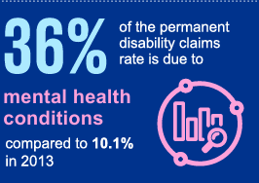
Mental health makes up ~30% of disability claims and is widely acknowledged as a leading concern
Income protection
Total and permanent disability
Sources: KPMG-CALI Cause of Claim Reports
KPMG-CALI “Australia’s Mental Health Check-up”, 2024
Presented at the 2026 All Actuaries Summit
Notes:
MH is a major driver of claims cost for disability claims, particularly TPD.
It’s a large and growing problem for group schemes.
Let’s consider a bit of a framework to quantify the impact.

Slide 20
Estimating the impact of climate change on mental health claims
Population visualisation
Key Assumption
 | General Population | 100
Notes:
AND, for the increasing number who are exposed, the impact is getting more frequent, more severe and more prolonged.
The ICA released a report on this, and you may have seen similar numbers before – Australia’s economic losses to natural hazards in the past decade (per capita) was well over double that of the 2000s.
So if we assume that the hazard exposed portion are now twice as likely to be severely impacted, it perhaps follows that they’re twice as likely to have a mental health episode associated.
Now these numbers are only loosely grounded in data, and we know there’s geographic variation and age variation. A lot more research effort is needed to refine this and make it applicable to real portfolios.

Slide 21
Estimating the impact of climate change on mental health claims
Population visualisation
Key Assumption
 | General Population | 100
 | Mental Health | 20%
22% of Australians experienced a mental disorder in the past 12 months.
Source: AIHW, 2025
Total mental health burden
20%
Notes:
AND, for the increasing number who are exposed, the impact is getting more frequent, more severe and more prolonged.
The ICA released a report on this, and you may have seen similar numbers before – Australia’s economic losses to natural hazards in the past decade (per capita) was well over double that of the 2000s.
So if we assume that the hazard exposed portion are now twice as likely to be severely impacted, it perhaps follows that they’re twice as likely to have a mental health episode associated.
Now these numbers are only loosely grounded in data, and we know there’s geographic variation and age variation. A lot more research effort is needed to refine this and make it applicable to real portfolios.

Slide 22
Estimating the impact of climate change on mental health claims
Population visualisation
Key Assumption
 | General Population | 100
 | Mental Health | 20%
 | High Loss Exposure | 20%
84% of Aus affected since 2019
23% >1 flood
19% >1 bushfire
More likely in rural areas
Source: Climate Council, 2024
Total mental health burden
20%
Notes:
AND, for the increasing number who are exposed, the impact is getting more frequent, more severe and more prolonged.
The ICA released a report on this, and you may have seen similar numbers before – Australia’s economic losses to natural hazards in the past decade (per capita) was well over double that of the 2000s.
So if we assume that the hazard exposed portion are now twice as likely to be severely impacted, it perhaps follows that they’re twice as likely to have a mental health episode associated.
Now these numbers are only loosely grounded in data, and we know there’s geographic variation and age variation. A lot more research effort is needed to refine this and make it applicable to real portfolios.

Slide 23
Estimating the impact of climate change on mental health claims
Population visualisation
Key Assumption
 | General Population | 100
 | Mental Health | 20%
 | High Loss Exposure | 20%
 | Natural Hazard MH | 20%
50% of recently impacted Australians report some mental health impact
19% report moderate or major impact
Source: Climate Council, 2024
Total mental health burden
22%
Notes:
AND, for the increasing number who are exposed, the impact is getting more frequent, more severe and more prolonged.
The ICA released a report on this, and you may have seen similar numbers before – Australia’s economic losses to natural hazards in the past decade (per capita) was well over double that of the 2000s.
So if we assume that the hazard exposed portion are now twice as likely to be severely impacted, it perhaps follows that they’re twice as likely to have a mental health episode associated.
Now these numbers are only loosely grounded in data, and we know there’s geographic variation and age variation. A lot more research effort is needed to refine this and make it applicable to real portfolios.

Slide 24
Estimating the impact of climate change on mental health claims
Population visualisation
Key Assumption
 | General Population | 100
 | Mental Health | 20%
 | High Loss Exposure | 20%
 | Natural Hazard MH | 20%
 | Solastalgia / Climate Anxiety | 2%
78% worried about climate
49% fairly or very worried
Source: Climate Council, 2024
Total mental health burden
24%
Notes:
AND, for the increasing number who are exposed, the impact is getting more frequent, more severe and more prolonged.
The ICA released a report on this, and you may have seen similar numbers before – Australia’s economic losses to natural hazards in the past decade (per capita) was well over double that of the 2000s.
So if we assume that the hazard exposed portion are now twice as likely to be severely impacted, it perhaps follows that they’re twice as likely to have a mental health episode associated.
Now these numbers are only loosely grounded in data, and we know there’s geographic variation and age variation. A lot more research effort is needed to refine this and make it applicable to real portfolios.

Slide 25
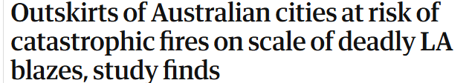
Estimating the impact of climate change on mental health claims
Population visualisation
Key Assumption
 | General Population | 100
 | Mental Health | 20%
 | High Loss Exposure | 20%
 | Natural Hazard MH | 20%
 | Solastalgia / Climate Anxiety | 2%
 | New High Loss Exposure | 10%
Total mental health burden
25%
Notes:
AND, for the increasing number who are exposed, the impact is getting more frequent, more severe and more prolonged.
The ICA released a report on this, and you may have seen similar numbers before – Australia’s economic losses to natural hazards in the past decade (per capita) was well over double that of the 2000s.
So if we assume that the hazard exposed portion are now twice as likely to be severely impacted, it perhaps follows that they’re twice as likely to have a mental health episode associated.
Now these numbers are only loosely grounded in data, and we know there’s geographic variation and age variation. A lot more research effort is needed to refine this and make it applicable to real portfolios.

Slide 26
Estimating the impact of climate change on mental health claims
Population visualisation
Key Assumption
 | General Population | 100
 | Mental Health | 20%
 | High Loss Exposure | 20%
 | Natural Hazard MH | 20%
 | Solastalgia / Climate Anxiety | 2%
 | New High Loss Exposure | 10%
 | New Natural Hazard MH | 50%
>100% increase in economic losses since 2000s
Source: ICA Resilience Report, 2024-25, p7
Total mental health burden
28%
Notes:
AND, for the increasing number who are exposed, the impact is getting more frequent, more severe and more prolonged.
The ICA released a report on this, and you may have seen similar numbers before – Australia’s economic losses to natural hazards in the past decade (per capita) was well over double that of the 2000s.
So if we assume that the hazard exposed portion are now twice as likely to be severely impacted, it perhaps follows that they’re twice as likely to have a mental health episode associated.
Now these numbers are only loosely grounded in data, and we know there’s geographic variation and age variation. A lot more research effort is needed to refine this and make it applicable to real portfolios.

Slide 27
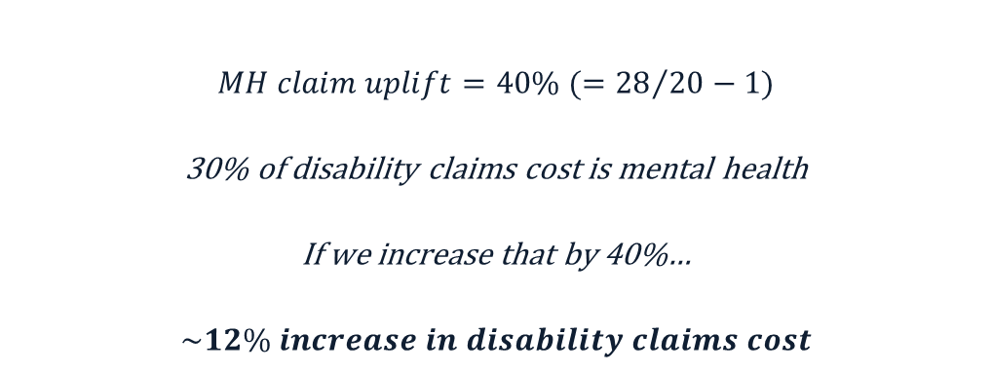
Estimating the impact of climate change on mental health claims
$$MH claim uplift=40\% (={28}/{20}−1)$$
30% of disability claims cost is mental health
If we increase that by 40%…
$$\sim 12\% increase in disability claims cost$$
Notes:
If you accept all of this, this is a potential increase in disability claims cost based on:
General population mental health impacts
Specific exposure and eventuation of losses
This is heavily geographically dependent and also by age.
You’ll need to consider your own exposure and combine this with geospatial scenario projections. We already have these projections, and we’re looking for partners who can provide geospatial data (postcode level).

Slide 28

Combining non-life expertise in climate risk modelling & geospatial data with Life & Health data
Munich Re is looking to further research to understand empirical evidence for climate change in global L & H portfolios in collaboration with partners
What we need
High frequency claim
data
Spatial reference –
location of the claim
Cause of claim –
ideal, but unlikely
Spatial reference is needed to identify climate parameters (‘heat-wave’ days, pollution etc)
Use the above to identify relationship between mortality/morbidity rates and climate parameters
Extrapolate this to identify future impacts of climate change and mortality/morbidity rates
Image: Prostock-studio / stock.adobe.com
Presented at the 2026 All Actuaries Summit
Notes:
Munich Re are looking to build up more empirical evidence. We’ve got great natural hazard / climate data and are looking for partners with life insurance portfolios (who have geospatial data at postcode level we can use to enrich and link).
But what can you be doing now?

Slide 29
Agenda
Agenda
01 The growing significance and impact of climate change
02 A framework for assessing the impact on mental health in disability
03 Broader impacts and opportunities
Obesity: background
Obesity: treatments
Potential impacts: general population
Potential impacts: life insurers
Opportunities for insurers
Presented at the 2026 All Actuaries Summit

Slide 30
Life insurers should consider action across the life insurance value chain
Product
Design
Pricing
Underwriting
Portfolio
Management
Claims
Consider infectious diseases as prevalence increases
Consider mental health impacts in price-setting
Cardiovascular and respiratory conditions are susceptible to climate
Climate reporting requirements will increase
Anticipate spikes in claims due to climate events
Consider ability to return to work post disaster
Evaluate geographic risk and consider rating geographically
Consider occupational exposure to extreme heat & events
Monitor exposure to high-risk groups: geography, elderly, lower socio-economic.
Plan for disruption and strain on healthcare provision
Provisions for disaster relief including premium waiver
Higher climate risks may necessitate higher margins
Interactions between mental health and geography
Services to help policyholders manage exposure and impact of climate events
Carefully consider rate guarantees
Consider mortality improvements and morbidity trends
Increased demand from regions with disrupted healthcare and advisor access
Allocate marketing spend and distribution efforts where risks are managed
Presented at the 2026 All Actuaries Summit
Notes:
Product design
How do we have a fair assessment of what is preventing you from working? Flooded office etc
Eg with COVID, ability to work vs opportunity to work. What about requirements to be in active employment, and your work has been disrupted by climate events
Pricing
Rating on geography (eg urban/rural)
Ethics of doing so
Underwriting
Occupational exposure: Should we be underwriting on ability to adapt to risk?
Aircon for heat (and particulate matter)
Mobility (migration)
If someone can’t get home insurance, should we be offering them TPD insurance?
Portfolio management:
Group super is more interesting because they might capture concentrated higher-risk groups
There’s opportunity for value-add here with wellness programs to help manage exposure
Do you know what the climate exposure is of your portfolio?
Claims:
Expect disruption in general
Particularly could be an issue for claims after natural disasters with less access to recovery services
Also applies to underwriting (medical tests) and distribution (advisors)
Bigger picture - marketing spend:
Given that people will be more interested in life insurance, there might be opportunities to market to those groups. At the same time, we should consider whether we want to target the groups that are being impacted by natural disasters…?
Do we really want to be selling TPD to people who are so exposed to flood risk that they can’t get home-building insurance any more?
We’re in the business of helping society to manage risk. So let’s make sure we’re prepared for this. Thinking not just reactively and protecting our existing business model, but how we can adapt and what opportunities this gives us to support society.

Slide 31
Life insurers should consider action across the life insurance value chain
Product
Design
Pricing
Underwriting
Portfolio
Management
Claims
Consider ability to return to work post disaster
Presented at the 2026 All Actuaries Summit
Notes:
Product design
How do we have a fair assessment of what is preventing you from working? Flooded office etc
Eg with COVID, ability to work vs opportunity to work. What about requirements to be in active employment, and your work has been disrupted by climate events
Pricing
Rating on geography (eg urban/rural)
Ethics of doing so
Underwriting
Occupational exposure: Should we be underwriting on ability to adapt to risk?
Aircon for heat (and particulate matter)
Mobility (migration)
If someone can’t get home insurance, should we be offering them TPD insurance?
Portfolio management:
Group super is more interesting because they might capture concentrated higher-risk groups
There’s opportunity for value-add here with wellness programs to help manage exposure
Do you know what the climate exposure is of your portfolio?
Claims:
Expect disruption in general
Particularly could be an issue for claims after natural disasters with less access to recovery services
Also applies to underwriting (medical tests) and distribution (advisors)
Bigger picture - marketing spend:
Given that people will be more interested in life insurance, there might be opportunities to market to those groups. At the same time, we should consider whether we want to target the groups that are being impacted by natural disasters…?
Do we really want to be selling TPD to people who are so exposed to flood risk that they can’t get home-building insurance any more?
We’re in the business of helping society to manage risk. So let’s make sure we’re prepared for this. Thinking not just reactively and protecting our existing business model, but how we can adapt and what opportunities this gives us to support society.

Slide 32
Life insurers should consider action across the life insurance value chain
Product
Design
Pricing
Underwriting
Portfolio
Management
Claims
Consider ability to return to work post disaster
Evaluate geographic risk and consider rating geographically
Presented at the 2026 All Actuaries Summit
Notes:
Product design
How do we have a fair assessment of what is preventing you from working? Flooded office etc
Eg with COVID, ability to work vs opportunity to work. What about requirements to be in active employment, and your work has been disrupted by climate events
Pricing
Rating on geography (eg urban/rural)
Ethics of doing so
Underwriting
Occupational exposure: Should we be underwriting on ability to adapt to risk?
Aircon for heat (and particulate matter)
Mobility (migration)
If someone can’t get home insurance, should we be offering them TPD insurance?
Portfolio management:
Group super is more interesting because they might capture concentrated higher-risk groups
There’s opportunity for value-add here with wellness programs to help manage exposure
Do you know what the climate exposure is of your portfolio?
Claims:
Expect disruption in general
Particularly could be an issue for claims after natural disasters with less access to recovery services
Also applies to underwriting (medical tests) and distribution (advisors)
Bigger picture - marketing spend:
Given that people will be more interested in life insurance, there might be opportunities to market to those groups. At the same time, we should consider whether we want to target the groups that are being impacted by natural disasters…?
Do we really want to be selling TPD to people who are so exposed to flood risk that they can’t get home-building insurance any more?
We’re in the business of helping society to manage risk. So let’s make sure we’re prepared for this. Thinking not just reactively and protecting our existing business model, but how we can adapt and what opportunities this gives us to support society.

Slide 33
Life insurers should consider action across the life insurance value chain
Product
Design
Pricing
Underwriting
Portfolio
Management
Claims
Consider ability to return to work post disaster
Evaluate geographic risk and consider rating geographically
Consider occupational exposure to extreme heat & events
Presented at the 2026 All Actuaries Summit
Notes:
Product design
How do we have a fair assessment of what is preventing you from working? Flooded office etc
Eg with COVID, ability to work vs opportunity to work. What about requirements to be in active employment, and your work has been disrupted by climate events
Pricing
Rating on geography (eg urban/rural)
Ethics of doing so
Underwriting
Occupational exposure: Should we be underwriting on ability to adapt to risk?
Aircon for heat (and particulate matter)
Mobility (migration)
If someone can’t get home insurance, should we be offering them TPD insurance?
Portfolio management:
Group super is more interesting because they might capture concentrated higher-risk groups
There’s opportunity for value-add here with wellness programs to help manage exposure
Do you know what the climate exposure is of your portfolio?
Claims:
Expect disruption in general
Particularly could be an issue for claims after natural disasters with less access to recovery services
Also applies to underwriting (medical tests) and distribution (advisors)
Bigger picture - marketing spend:
Given that people will be more interested in life insurance, there might be opportunities to market to those groups. At the same time, we should consider whether we want to target the groups that are being impacted by natural disasters…?
Do we really want to be selling TPD to people who are so exposed to flood risk that they can’t get home-building insurance any more?
We’re in the business of helping society to manage risk. So let’s make sure we’re prepared for this. Thinking not just reactively and protecting our existing business model, but how we can adapt and what opportunities this gives us to support society.

Slide 34
Life insurers should consider action across the life insurance value chain
Product
Design
Pricing
Underwriting
Portfolio
Management
Claims
Consider ability to return to work post disaster
Evaluate geographic risk and consider rating geographically
Consider occupational exposure to extreme heat & events
Monitor exposure to high-risk groups: geography, elderly, lower socio-economic.
Services to help policyholders manage exposure and impact of climate events
Presented at the 2026 All Actuaries Summit
Notes:
Product design
How do we have a fair assessment of what is preventing you from working? Flooded office etc
Eg with COVID, ability to work vs opportunity to work. What about requirements to be in active employment, and your work has been disrupted by climate events
Pricing
Rating on geography (eg urban/rural)
Ethics of doing so
Underwriting
Occupational exposure: Should we be underwriting on ability to adapt to risk?
Aircon for heat (and particulate matter)
Mobility (migration)
If someone can’t get home insurance, should we be offering them TPD insurance?
Portfolio management:
Group super is more interesting because they might capture concentrated higher-risk groups
There’s opportunity for value-add here with wellness programs to help manage exposure
Do you know what the climate exposure is of your portfolio?
Claims:
Expect disruption in general
Particularly could be an issue for claims after natural disasters with less access to recovery services
Also applies to underwriting (medical tests) and distribution (advisors)
Bigger picture - marketing spend:
Given that people will be more interested in life insurance, there might be opportunities to market to those groups. At the same time, we should consider whether we want to target the groups that are being impacted by natural disasters…?
Do we really want to be selling TPD to people who are so exposed to flood risk that they can’t get home-building insurance any more?
We’re in the business of helping society to manage risk. So let’s make sure we’re prepared for this. Thinking not just reactively and protecting our existing business model, but how we can adapt and what opportunities this gives us to support society.

Slide 35
Life insurers should consider action across the life insurance value chain
Product
Design
Pricing
Underwriting
Portfolio
Management
Claims
Climate reporting requirements will increase
Consider ability to return to work post disaster
Evaluate geographic risk and consider rating geographically
Consider occupational exposure to extreme heat & events
Monitor exposure to high-risk groups: geography, elderly, lower socio-economic.
Services to help policyholders manage exposure and impact of climate events
Presented at the 2026 All Actuaries Summit
Notes:
Product design
How do we have a fair assessment of what is preventing you from working? Flooded office etc
Eg with COVID, ability to work vs opportunity to work. What about requirements to be in active employment, and your work has been disrupted by climate events
Pricing
Rating on geography (eg urban/rural)
Ethics of doing so
Underwriting
Occupational exposure: Should we be underwriting on ability to adapt to risk?
Aircon for heat (and particulate matter)
Mobility (migration)
If someone can’t get home insurance, should we be offering them TPD insurance?
Portfolio management:
Group super is more interesting because they might capture concentrated higher-risk groups
There’s opportunity for value-add here with wellness programs to help manage exposure
Do you know what the climate exposure is of your portfolio?
Claims:
Expect disruption in general
Particularly could be an issue for claims after natural disasters with less access to recovery services
Also applies to underwriting (medical tests) and distribution (advisors)
Bigger picture - marketing spend:
Given that people will be more interested in life insurance, there might be opportunities to market to those groups. At the same time, we should consider whether we want to target the groups that are being impacted by natural disasters…?
Do we really want to be selling TPD to people who are so exposed to flood risk that they can’t get home-building insurance any more?
We’re in the business of helping society to manage risk. So let’s make sure we’re prepared for this. Thinking not just reactively and protecting our existing business model, but how we can adapt and what opportunities this gives us to support society.

Slide 36
Life insurers should consider action across the life insurance value chain
Product
Design
Pricing
Underwriting
Portfolio
Management
Claims
Climate reporting requirements will increase
Consider ability to return to work post disaster
Evaluate geographic risk and consider rating geographically
Consider occupational exposure to extreme heat & events
Monitor exposure to high-risk groups: geography, elderly, lower socio-economic.
Plan for disruption and strain on healthcare provision
Services to help policyholders manage exposure and impact of climate events
Presented at the 2026 All Actuaries Summit
Notes:
Product design
How do we have a fair assessment of what is preventing you from working? Flooded office etc
Eg with COVID, ability to work vs opportunity to work. What about requirements to be in active employment, and your work has been disrupted by climate events
Pricing
Rating on geography (eg urban/rural)
Ethics of doing so
Underwriting
Occupational exposure: Should we be underwriting on ability to adapt to risk?
Aircon for heat (and particulate matter)
Mobility (migration)
If someone can’t get home insurance, should we be offering them TPD insurance?
Portfolio management:
Group super is more interesting because they might capture concentrated higher-risk groups
There’s opportunity for value-add here with wellness programs to help manage exposure
Do you know what the climate exposure is of your portfolio?
Claims:
Expect disruption in general
Particularly could be an issue for claims after natural disasters with less access to recovery services
Also applies to underwriting (medical tests) and distribution (advisors)
Bigger picture - marketing spend:
Given that people will be more interested in life insurance, there might be opportunities to market to those groups. At the same time, we should consider whether we want to target the groups that are being impacted by natural disasters…?
Do we really want to be selling TPD to people who are so exposed to flood risk that they can’t get home-building insurance any more?
We’re in the business of helping society to manage risk. So let’s make sure we’re prepared for this. Thinking not just reactively and protecting our existing business model, but how we can adapt and what opportunities this gives us to support society.

Slide 37
Life insurers should consider action across the life insurance value chain
Product
Design
Pricing
Underwriting
Portfolio
Management
Claims
Climate reporting requirements will increase
Consider ability to return to work post disaster
Evaluate geographic risk and consider rating geographically
Consider occupational exposure to extreme heat & events
Monitor exposure to high-risk groups: geography, elderly, lower socio-economic.
Plan for disruption and strain on healthcare provision
Services to help policyholders manage exposure and impact of climate events
Allocate marketing spend and distribution efforts where risks are managed
Presented at the 2026 All Actuaries Summit
Notes:
Product design
How do we have a fair assessment of what is preventing you from working? Flooded office etc
Eg with COVID, ability to work vs opportunity to work. What about requirements to be in active employment, and your work has been disrupted by climate events
Pricing
Rating on geography (eg urban/rural)
Ethics of doing so
Underwriting
Occupational exposure: Should we be underwriting on ability to adapt to risk?
Aircon for heat (and particulate matter)
Mobility (migration)
If someone can’t get home insurance, should we be offering them TPD insurance?
Portfolio management:
Group super is more interesting because they might capture concentrated higher-risk groups
There’s opportunity for value-add here with wellness programs to help manage exposure
Do you know what the climate exposure is of your portfolio?
Claims:
Expect disruption in general
Particularly could be an issue for claims after natural disasters with less access to recovery services
Also applies to underwriting (medical tests) and distribution (advisors)
Bigger picture - marketing spend:
Given that people will be more interested in life insurance, there might be opportunities to market to those groups. At the same time, we should consider whether we want to target the groups that are being impacted by natural disasters…?
Do we really want to be selling TPD to people who are so exposed to flood risk that they can’t get home-building insurance any more?
We’re in the business of helping society to manage risk. So let’s make sure we’re prepared for this. Thinking not just reactively and protecting our existing business model, but how we can adapt and what opportunities this gives us to support society.

Slide 38
Life insurers should consider action across the life insurance value chain
Product
Design
Pricing
Underwriting
Portfolio
Management
Claims
Consider infectious diseases as prevalence increases
Consider mental health impacts in price-setting
Cardiovascular and respiratory conditions are susceptible to climate
Climate reporting requirements will increase
Anticipate spikes in claims due to climate events
Consider ability to return to work post disaster
Evaluate geographic risk and consider rating geographically
Consider occupational exposure to extreme heat & events
Monitor exposure to high-risk groups: geography, elderly, lower socio-economic.
Plan for disruption and strain on healthcare provision
Provisions for disaster relief including premium waiver
Higher climate risks may necessitate higher margins
Interactions between mental health and geography
Services to help policyholders manage exposure and impact of climate events
Carefully consider rate guarantees
Consider mortality improvements and morbidity trends
Increased demand from regions with disrupted healthcare and advisor access
Allocate marketing spend and distribution efforts where risks are managed
Presented at the 2026 All Actuaries Summit
Notes:
We’re in the business of helping society to manage risk. So let’s make sure we’re prepared for this. Thinking not just reactively and protecting our existing business model, but how we can adapt and what opportunities this gives us to support society.

Slide 39
Thank you
The biggest risk a person can take is to do nothing
- Robert T. Kiyosaki
© 2026 Münchener Rückversicherungs-Gesellschaft Aktiengesellschaft in Munich ("Munich Re"). All rights reserved.
Munich Re has used its discretion, best judgement and every reasonable effort in compiling the information and components contained in this presentation. It may not be held liable, however, for the completeness, correctness, topicality and technical accuracy of any information contained herein. Munich Re assumes no liability with regard to updating the information or other content provided in this presentation or to adapting this to conform with future events or developments.
Actuaries Institute
actuaries.asn.au

