Slide 1
The Dynamic Future of Catastrophe Management
The Impact of Temporal Intelligence on General Insurance Markets
Dr Joanna Aldridge and Dmitry Gorelik
May 2026

Slide 2
The Actuaries Institute acknowledges the traditional custodians of the lands and waters where we live and work, travel, and trade.
We pay our respect to the members of those communities, Elders past and present, and recognise and celebrate their continuing custodianship and culture.

Slide 3

Temporal intelligence is a forecast-driven, time‑varying view of risk.
And our temporal capabilities have improved dramatically
Imagine a general insurance market where:
What does this mean for:
In the coming season, the chance of a major cat event and subsequent events, is well known…
Our customers?
Portfolios and risk appetites can be shaped on-the-fly in response to regular forecast updates…
For the stability of our insurance market?
The price of insurance varies week to month like airline tickets…
For reinsurance?

Slide 4
The Science
01

Slide 5
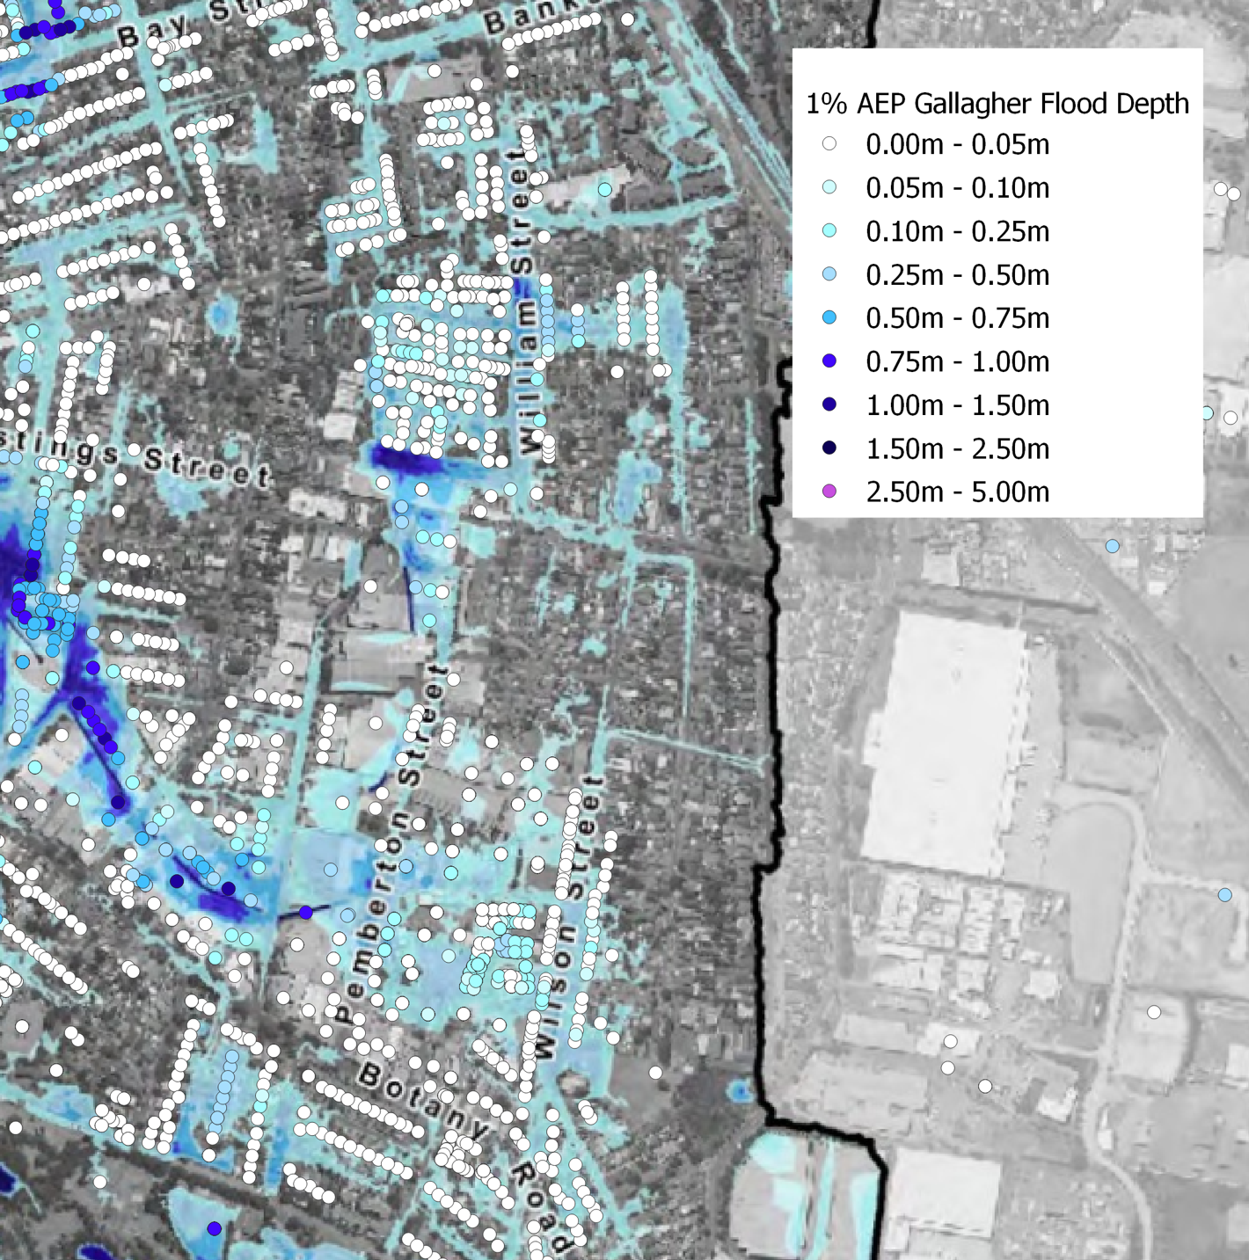
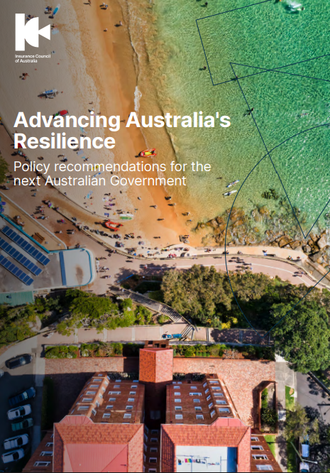

Spatial Precision Redefined the Market
How will improving temporal intelligence affect general insurance?
  Over the past 15 years, granular spatial perils data has emerged
  Fundamentally reshaped risk-based pricing for perils such as flood and bushfire.
  → Significant shifts in affordability and regulatory scrutiny

Slide 6
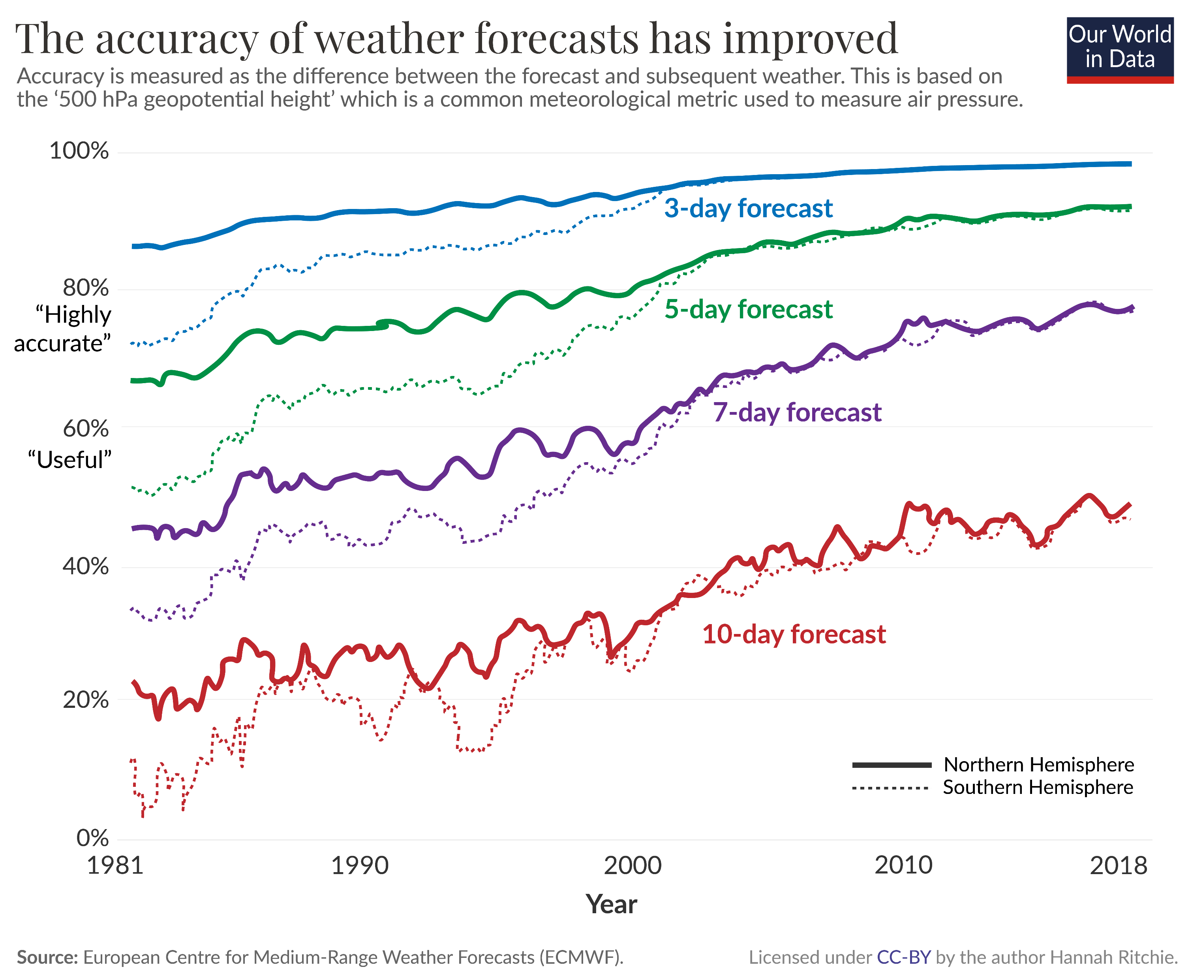
Weather Forecasts are Getting Sharper
The weather is a highly chaotic system with historically poor predictability.
Drivers of Forecast Accuracy
Advancements in:
Observations and Satellite coverage
Computer power, ensemble size and model resolution
Assimilation and error statistics
1 – 10 days: Weather
10 – 90 days: Subseasonal scale
3 – 12 months: Seasonal scale
12 – 36 months: Interannual scale

Slide 7
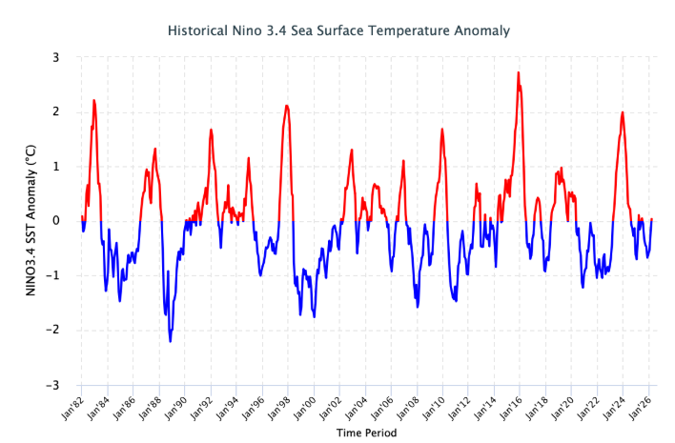
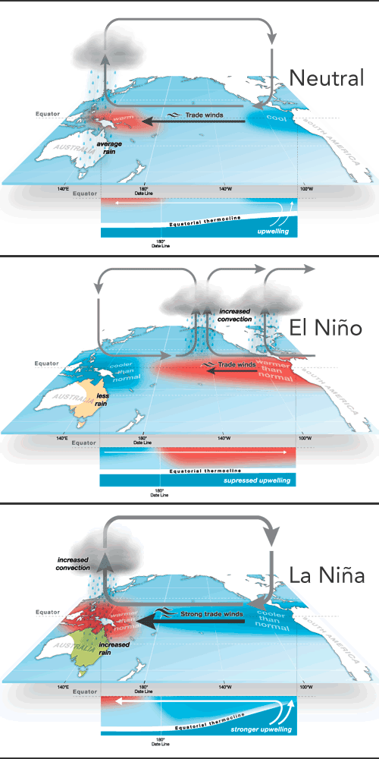
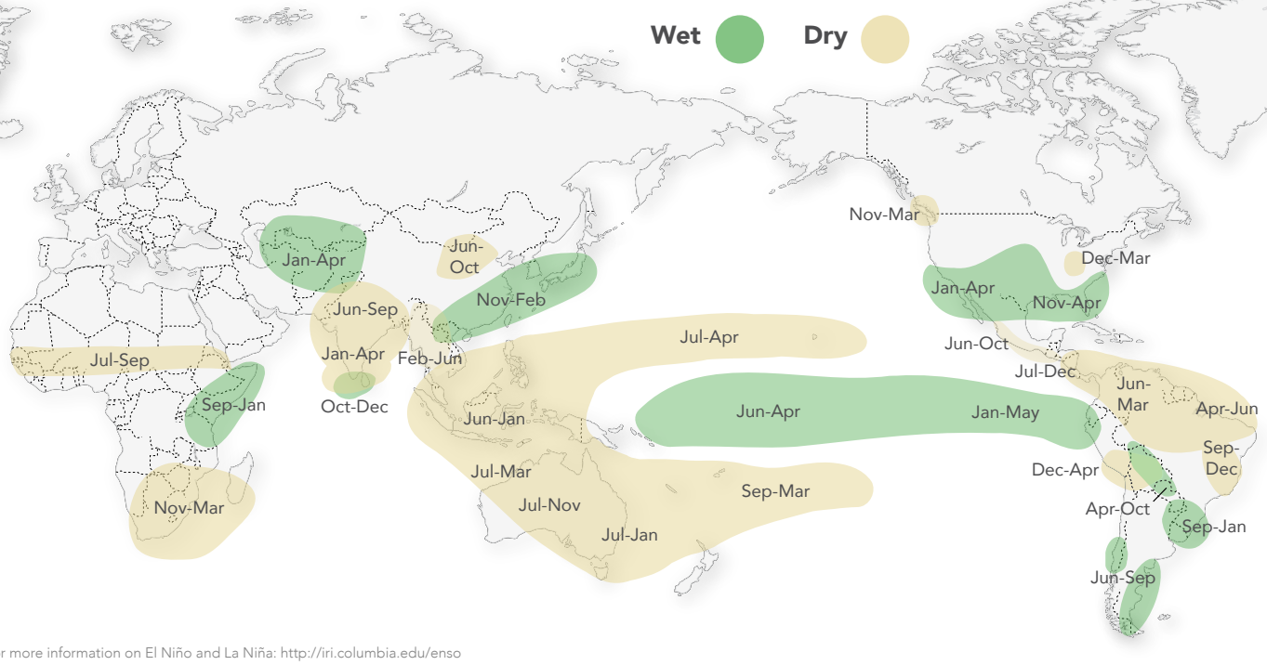
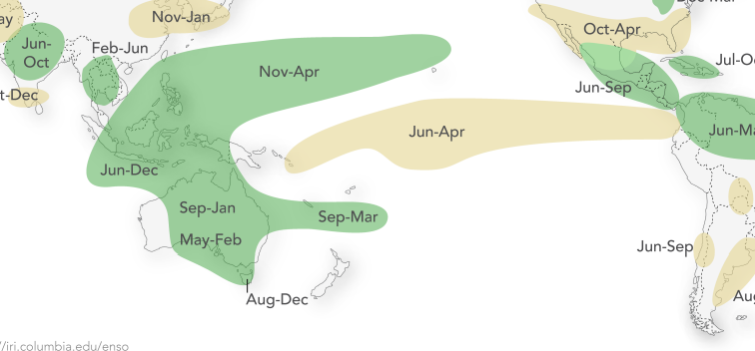
ENSO: The Dominant Driver of Climate and Loss Variability
Warm water + onshore winds = rain
BOM
El Nino
La Nina
IRI
Notes:
What is ENSO?
El Nino Southern Oscillation results from coupled ocean-atmosphere interactions in the tropical Pacific.

Slide 8
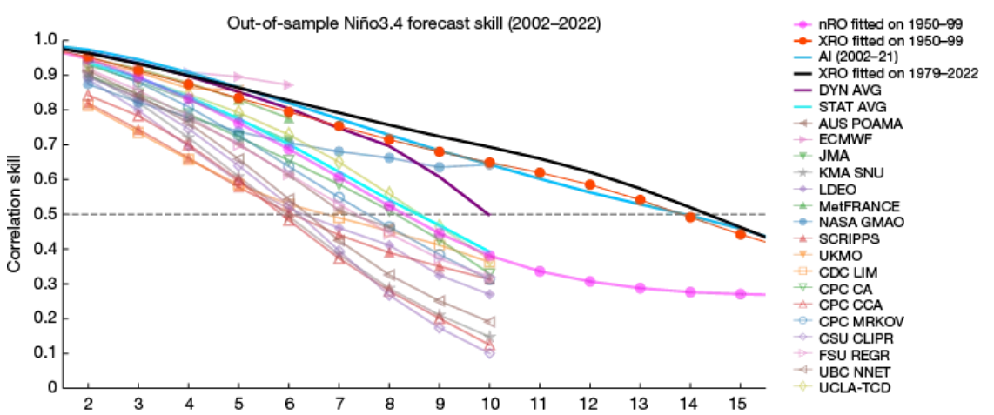
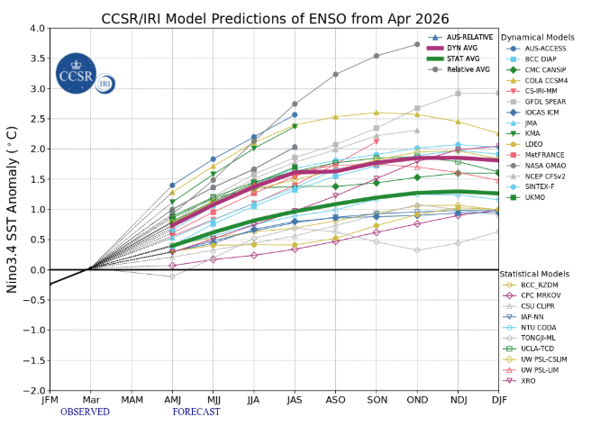
Seasonal Forecast Skill is Rising
Forecast skill peaks in spring and degrades in autumn
Historically limited skill beyond the ‘autumn predictability barrier’ (Levine et al. 2025)
Overconfident forecasts even in multi-model ensembles
Recent advances
Skill now extends to ~16‑month lead time
New XRO model blends AI with deep-ocean physics (Zhao et al. 2024)
Reinsurance decisions currently require ~18 months lead time → how could insurance decisions use this information?

Slide 9
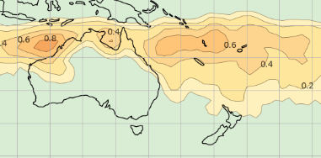
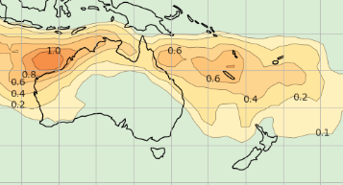
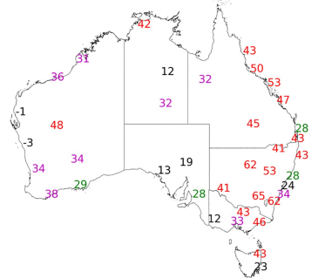
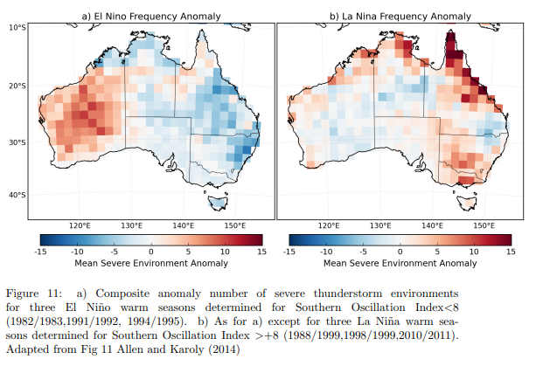
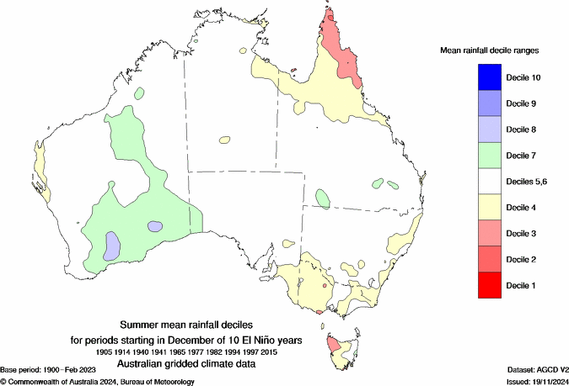
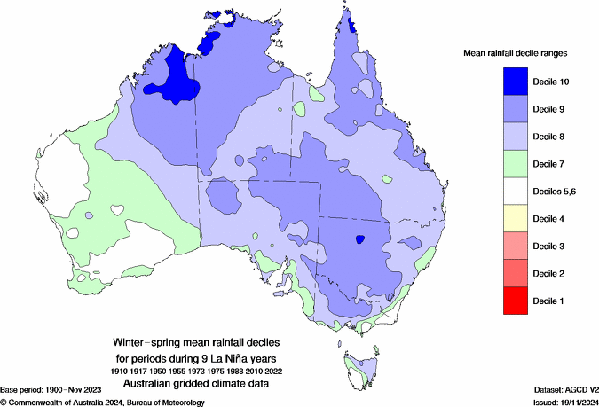
ENSO: The Dominant Driver of Climate and Loss Variability
El Nino
La Nina
More Tropical Cyclones(BOM)
BOM
More Bushfire Weather Harris and Lucas 2019)
More Hail Environments (Allen & Karoly2014)
More Extreme rainfall and floods (Kiem; Power and Callaghan)
Notes:
What is ENSO?
El Nino Southern Oscillation results from coupled ocean-atmosphere interactions in the tropical Pacific.

Slide 10
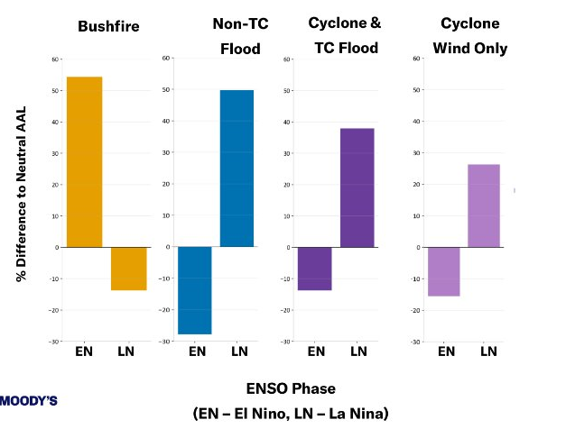
When ENSO Shifts, Risk Shifts
Source: Moody’s STF (Apr 2026) – AU Climate HD Models: Cross Peril Coherence.
Bushfire risk anticorrelated to east coast storm and flood risk
11.0
10.0
Industry Losses (AUDBn)
9.0
8.0
7.0
6.0
5.0
4.0
3.0
2.0
1.0
0.0
2006 El Niño
2007 La Niña
2008 La Niña
2009 El Niño
2010 Strong La Niña
2011 Strong La Niña
2012 Weak La Niña / Neutral
2013 Neutral
2014 Neutral / weak El Niño tendency
2015 Strong El Niño
2016 El Niño → Neutral
2017 Neutral / weak La Niña late
2018 Weak La Niña → warm neutral
2019 Neutral / weak El Niño
2020 La Niña
2021 La Niña
2022 Persistent La Niña
2023 Strong El Niño
2024 El Niño → Neutral
2025 Neutral / weak La Niña tendency
Data Source: Insurance Council of Australia
Hail
Bushfire
Cyclone
Storm
Flood
Notes:
ENSO creates opposing risk profiles:
Bushfire and water perils respond in exactly opposite directions to ENSO, creating a natural portfolio offset [
Bushfire is the most ENSO-sensitive peril under El Niño, and non‑TC flood under La Niña, each driving earnings volatility [
Tropical cyclones tend to be wetter during La Niña phases [
La Niña creates simultaneous elevated losses across all water perils, amplifying accumulation risk [
]
Regional impacts can be more or less significant

Slide 11
Catastrophe Models
02

Slide 12


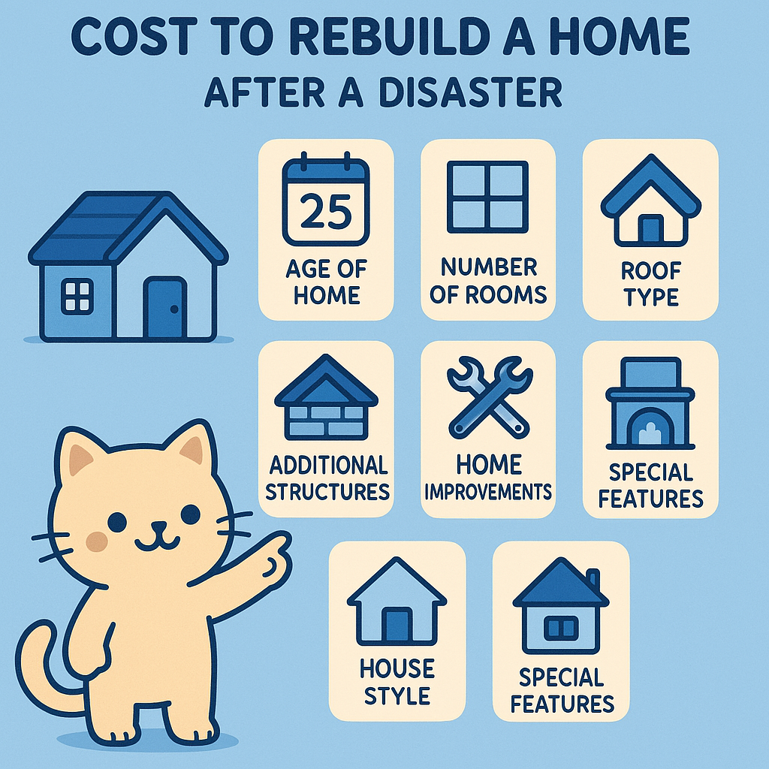

Next Generation Catastrophe Model Advances
Australia Gets Fully Functional Secondary Peril Models
Ultra High-Resolution Hazard
Secondary Perils: Storm/hail
Flood
Bushfire
Dynamic Seasonality
Temporal clustering
Antecedent conditions
Multidimensional Rating Factors
Customisable Vulnerability Functions
Financial Sophistication

Slide 13
New Generation Cat Models Add Temporal Capability
Status Quo - Current Model
Isolated Peril models
New Models
Larger stochastic sets
Event based or year based with no difference between years
Seasonal climate driver flags
Continuous simulation from underlying weather
Peril correlations applied posthoc (if at all)
Stationarity assumption
Hazard reflects present climate state
Hours clause depends on inflexible event definition
New Management Actions
More confidence in present day hazard
Joint distributions across perils captured
Better estimates of combined seasonal losses
Seasonally adjusted risk view possible
Enables more realistic hours clause & reinstatement pricing
More realistic sequencing, duration and clustering
Impractical perils definitions are breaking down, enabling better risk management

Slide 14
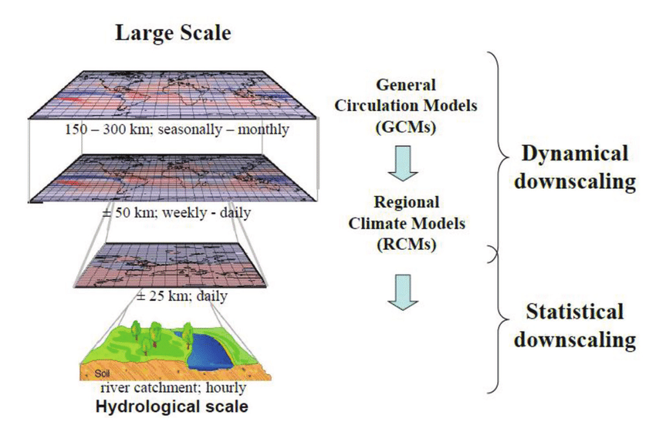
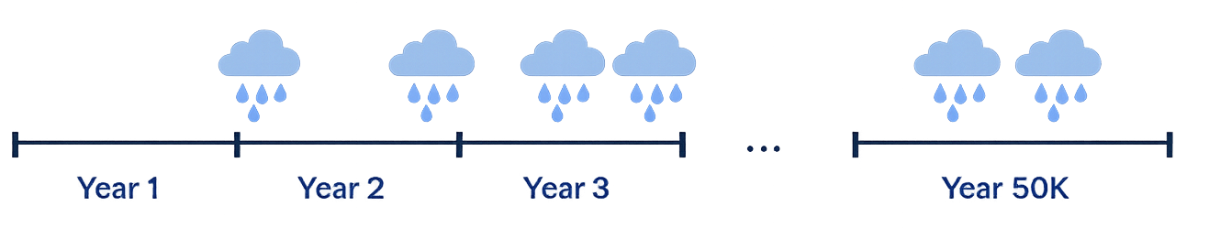
Continuous simulation of the weather enables more realistic losses
More realistic sequencing, duration and clustering
Sample Year Loss Table
Year | Event | Loss | Event Date | ENSO Phase
1 | 1 5 | $1m $1.1m | 4 Jan 2020 19 Feb 2020 | Weak La Nina
2 | 3 | $2.2m | 15 Dec 2020 28 Dec 2020 | Strong La Nina
3 | - | - |  | Strong El Nino
4 | 7 6 | $6.1m $0.3m | 1 Mar 2020 16 Mar 2020 | Neutral
5 | 4 8 5 | $2.1m $0.1m $4.2m | 4 Jun 2020 30 Nov 2020 13 Dec 2020 | Neutral
………
50 000 | 9 | $4.3m | 5 Mar 2020 | Weak La Nina

Slide 15
Example: OEP curves El Nino vs La Nina
ENSO phase can shift 10 yr estimation by say +/-30%
Example Only! Normalised Numbers!

Slide 16
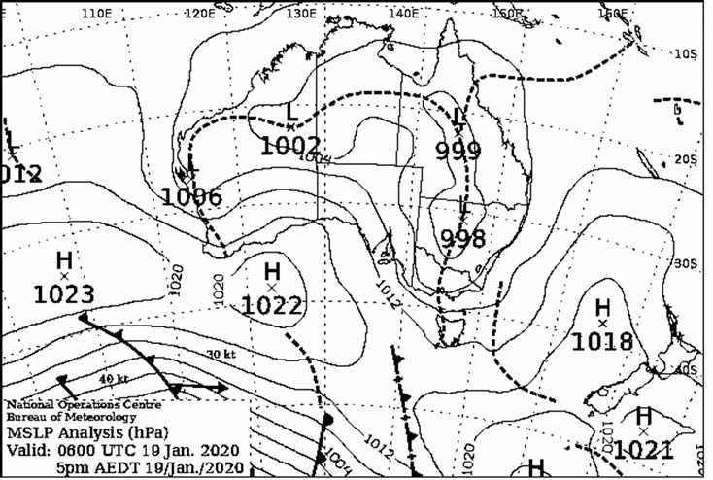
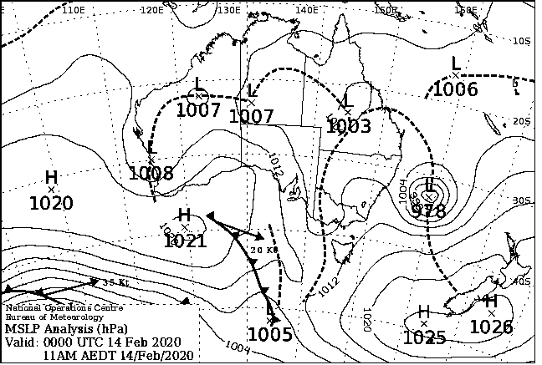
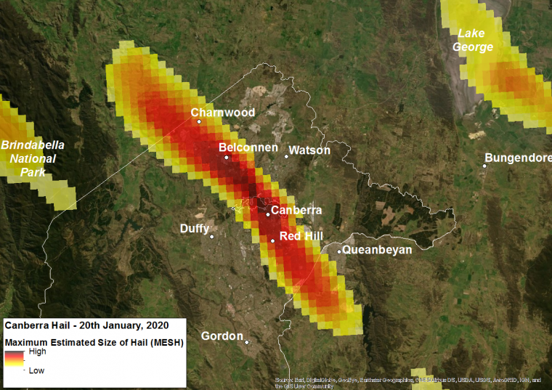
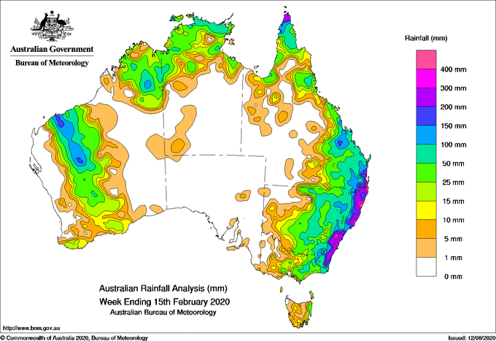
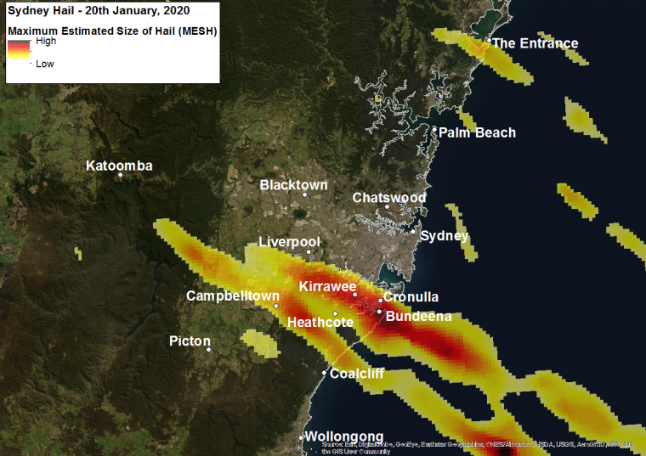
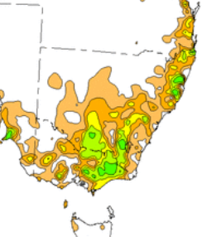
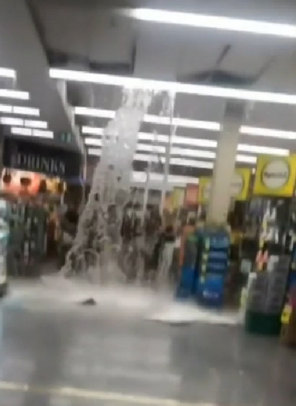
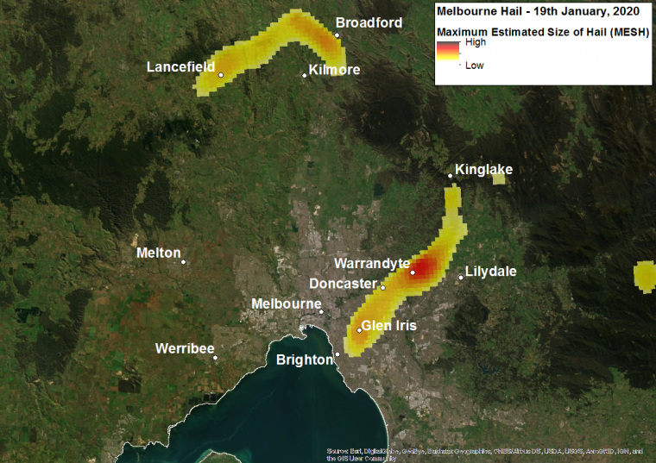
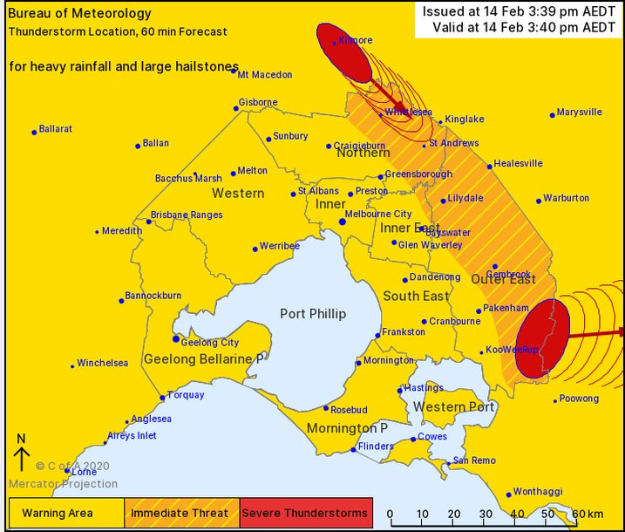
Yes a Storm can be a Flood
Working towards Unified Event Definitions
Hail event with flash flooding: Tri City Hail Jan 2020
Flood event with storm damage: Feb 2020
Extensive East Coast Rain
Hail in
Canberra
Sydney
Ex TC Uesi
BOM
BOM
Hail in
Melbourne
Melbourne
Guy Carp
Reality
Impact
Work arounds to correlate/load model losses for other peril losses in the same event.
The Future?
Status Quo
Separate storm and flood models due to impractical peril definitions.
A single weather system can cause property damage via heavy rain and water ingress, wind, flash and riverine flood.
Leads to underestimated event modelled losses.
All encompassing ‘weather’ model gives continuous loss simulation
Tailored to suit policy wordings and reinsurance clauses.
Reinsurance treaties are written on an event basis.
EG. Storm models typically do not consider rainfall. Flood models do not consider wind.

Slide 17
Implications for the Australian Market
Equals the playing field for granular pricing capability
Ability to construct bespoke technical rates from climate phase classification and forecast
More model settings mean less relevance of reference View of Risk
Competitive focus shifts to temporal View of Risk
Better estimate of aggregate losses across all modelled perils
Next‑Gen Models Shift the Edge to Temporal Risk Views
Limitations:
Uncertainty: Signal to noise ratio can be limiting
Stationarity: ENSO Predictability breakdown with climate change?
Agility: Operational and governance latency can exceed forecast update cadence

Slide 18
Risk Management
03

Slide 19
Action Matrix: Bad Year
if signals indicate an unfavourable season, responses are faster, more defensive, and more costly
Accept Risk Status Quo Rely on reinsurance budget Rely on Diversification Maintain/grow market share if competitors raise prices
Transfer Risk Timing decision: Before or after forecast deteriorates?
Reduce Risk Stop writing Impose sub limits and deductibles Resilience: Encourage policyholders to prepare
Retain Risk Charge more to everyone Charge more to selected risks Marginal pricing for those impinging on reinsurance limits

Slide 20
Action Matrix: Bad Year
Action Matrix: Good Year
If signals indicate an unfavourable season, responses are faster, more defensive, and more costly:
If an insurer knows the coming season will be favourable in a given region, it could:
Accept Risk Status Quo Rely on reinsurance budget Rely on Diversification Maintain/grow market share if competitors raise prices
Transfer Risk Timing decision: Before or after forecast deteriorates?
Reduce Risk Stop writing Impose sub limits and deductibles Resilience: Encourage policyholders to prepare
Retain Risk Charge more to everyone Charge more to selected risks Marginal pricing for those impinging on reinsurance limits
Wear Risk Status Quo Maintain pricing and possibly lose market share to competitors
Transfer Risk Buy less reinsurance or hold less capital Transfer excess reinsurance on a secondary market?
Increase Risk Portfolio growth, risk appetite expansion Write more by lowering pricing or increasing advertising spend Reduces sub limits and deductibles
Retain Risk Charge less to everyone Charge less to selected risks Give discounts or rebates?

Slide 21
Temporal intelligence in practice
04

Slide 22
Catastrophe risk is no longer a quarterly number
Traditional “snapshot” catastrophe modelling
Temporal “continuous” intelligence
Data​
Cat model outputs updated monthly/quarterly (AAL, EP, PML)​
Live inputs: forecasts + exposure change + portfolio mix​
Cadence​
​Exposure reviews quarterly / annually (risk committees, renewals)​
Dashboards update continuously (hotspots, footprints, loss views)​
Decision question​
“What is our risk?” — often recognised after the fact
“What is our expected loss today — and how is it drifting?”
Catastrophe risk is transitioning from a static exposure measurement problem to a dynamic temporal decision problem

Slide 23

Decision Making Journey:
Using early signals to stay within risk appetite
Australian insurer writing home and motor across NSW, VIC, QLD, with concentrations in hail and bushfire‑exposed postcodes
Signals
- Growth above plan
Results of Monitoring
- Accumulation rising in hail / bushfire postcodes
Actions (prepositioned)
- Seasonal top‑up layer (reduce “two events” risk)
Outcome
- Keep earnings volatility within tolerance
- Seasonal outlook worsens
- Early storm claims trend up
- Lower layer exhaustion probability increasing
- Short‑dated aggregate (cap repeated mid‑sized losses)
- Increase quota share for new business (slow capital use)
- Align actions to ICAAP / board risk appetite
Dynamic Reinsurance

Slide 24
Dynamic Reinsurance: Good Idea, Hard Reality
Reinsurance is not just about buying protection – it is about when, how much, at what price and under what governance
REINSURANCE
Protection is dynamic, markets are not
2. GOVERNANCE
Control and agility must evolve together
3. COMPETETIVE ADVANTAGE
Edge today, but not for long
NOT ALWAYS AVAILABLE WHEN NEEDED
When risk peaks, capacity tightens, terms deteriorate and pricing spikes. By the time you most want it, the window may be closed.
CAN BECOME EXPENSIVE
Repeated purchases of more cover can erode value. May be overpaying to smooth outcomes shareholders already accept.
GOVERNANCE CAN BE SLOWER THAN THE MODEL
APRA (GPS 230) requires a board- approved framework, clear accountability and documentation. Hard to execute quickly unless pre-positioned.
CAPITAL BENEFIT MAY BE LIMITED
Dynamic cover is often sold as capital solution, but GPS 116 governs capital outcomes, not deal economics. May require APRA’s consultation with every “deal”.
CAPITAL RELIEF IS NOT GUARANTEED
Even when reinsurance makes clear economic sense, capital recognition may be constrained.
DATA QUALITY IS A CONSTRAINT
Timely, decision-grade exposure, claims and near-term hazard signals are hard to obtain. Weak data can trigger the wrong actions — too early, too late, or too aggressively.
ADVANTAGE MAY BE TEMPORARY
Once dynamic reinsurance becomes common, reinsurers and ILS markets will price for it.
STRUCTURAL EDGE CAN COMPRESS
What looks like a structural edge today may quickly compress into a tactical capability as others catch up.
EARLY SIGNALS ARE NOT UNIQUE
When everyone sees the same signals and hears the same broker advice, they all try to buy protection at once.
IMPLICATION: Temporal intelligence may tell us when to hedge — but market capacity may already have closed.
IMPLICATION: Dynamic reinsurance needs dynamic governance. Governance latency can exceed risk velocity.
IMPLICATION: The real differentiator is not foresight, but who can act first.

Slide 25
Dynamic pricing: Good Idea (?) but even Harder (?) Reality
Pricing is not just about the models – it is about timing, governance and market realities
PRICING
Responsive in theory, complex in practice
2. GOVERNANCE
Control and agility must evolve together
3. COMPETETIVE ADVANTAGE
Edge today, not guaranteed tomorrow
CUSTOMERS EXPECT STABILITY
Frequent repricing can damage retention and broker relationships
COMPETITORS MAY DELAY RESPONDING
Some will lag risk signals, creating short-term pressure to hold the line.
REGULATORY AND CONDUCT CONSTRAINTS
Regulators and conduct expectations limit the speed and manner of price adjustments.
SIGNALS ARE PROBABALISTIC
Climate and hazard signals are uncertain, not deterministic.
RISK OF WRONG MOVES
Incorrect pricing only creates value when responsiveness is balanced against customer, market and regulatory realities
PERIODIC REVIEW CYCLES
Pricing governance is often built around quarterly or annual review processes.
APPROVALS & DOCUMENTATION
Rate changes require approvals, documentation and robust audit trails.
MULTIPLE STAKEHOLDERS INVOLVED
Product, compliance, actuarial, underwriting and distribution frameworks can slow execution.
DATA DEPENDENCY
Dynamic pricing depends on timely, high-quality exposure, claims and hazard data.
RISK OF POOR GOVERNANCE
Weak governance can lead to inconsistent pricing, volatility and reputational risk.
EARLY RECOGNITION CAN HELP
Being first to detect risk changes can improve pricing precision.
MARKET WILL CATCH UP
Over time, competitors will incorporate similar signals and analytics. PRICING CONVERGENCE After major events, market pricing converges rapidly.
EXECUTION SPEED MATTERS MOST
The advantage shifts from modelling sophistication to speed of execution.
BETTER PORTFOLIO OUTCOMES
Dynamic pricing can improve portfolio quality before market hardening becomes widespread.
IMPLICATION: Dynamic pricing only creates value when responsiveness is balanced against customer, market, and regulatory realities.
IMPLICATION: Governance frameworks must evolve from periodic approval processes toward controlled adaptive pricing oversight.
IMPLICATION: The real competitive advantage is not seeing risk first, but adapting pricing and portfolio strategy before competitors react.

Slide 26
The Dynamic Future of Catastrophe Management
Temporal intelligence is shifting catastrophe management from reporting to real-time decisioning
The risk profile is no longer a quarterly snapshot — it evolves continuously with climate signals and portfolio change.
Next‑generation catastrophe models and climate phase conditioning (e.g., ENSO) make those shifts observable and quantifiable.
Value is created only when insight is paired with execution: decision triggers, data quality, governance agility, and market access.
Dynamic reinsurance and pricing are feasible in parts — but constrained by capacity, regulation, conduct expectations, and customer fairness.
The next step is an industry conversation: what variability is acceptable, what guardrails are needed, and how we keep trust while adapting.

Slide 27
Thank you
Actuaries Institute
actuaries.asn.au

