Slide 1
From Seed to Safety: Phenology Driven Weather Index Insurance.
Sachini Wijesena FIAA
Distinguished Professor Biswajeet Pradhan
May 2026
Notes:
1. Good morning everyone, and it’s a pleasure to be here today.
2. My name is Sachini Wijesena, and I am currently working as an actuary in the general insurance industry for over a decade.
3. Today’s presentation comes from my PhD research at the University of Technology Sydney.
4. This work was conducted in collaboration with my PhD supervisor, Biswajeet Pradhan, and focuses on how we can design next-generation weather index insurance.
5. I hope you enjoy the presentation.

Slide 2
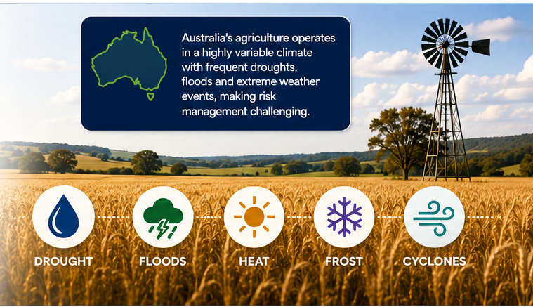
Notes:
1. Australia provides one of the clearest examples of the growing challenge of agricultural climate risk.
2. It is the driest inhabited continent on Earth,
while also experiencing some of the highest rainfall variability globally,
which is heavily influenced by ENSO climate cycles.
3. We have already witnessed the long-term consequences of this volatility.
4. The Millennium Drought lasted more than a decade and severely disrupted agricultural productivity.
5. More recently, studies estimate that changing rainfall and temperature patterns have reduced average broadacre farm profits by approximately 22% over the past two decades.
6. So Risk management is critical for the viability of the agricultural industry

Slide 3
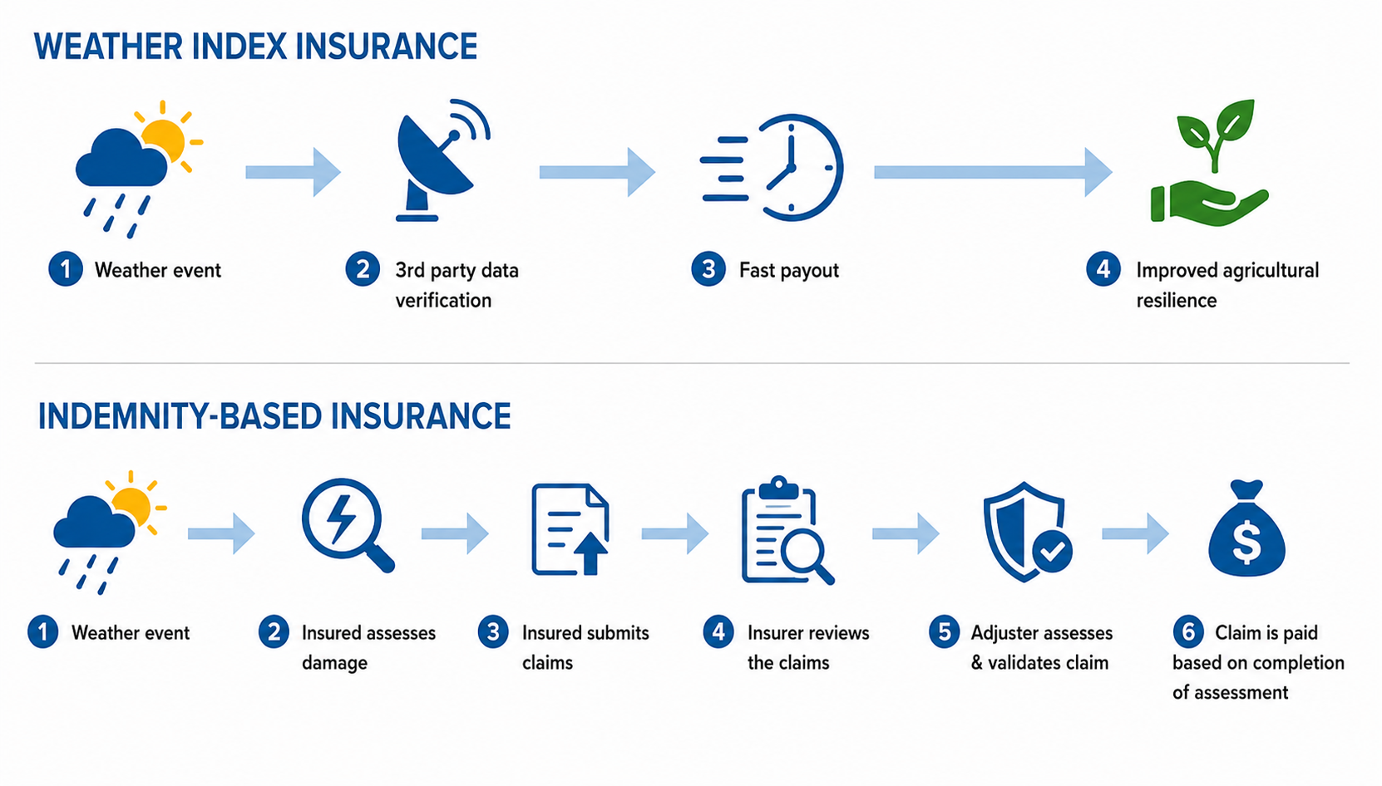
Indemnity Based Crop Insurance vs Weather Index Insurance
Notes:
Traditional indemnity based crop insurance is widely adopted globally however has certain challenges due to:
Lengthy claims assessment process
Moral hazard
Delayed payouts
2. Alternatively WII is a new innovative risk management tool that has emerged globally especially in recent years
3. Indemnity insurance pays based on the farmer’s actual loss after damage is assessed in the field, while WII pays automatically when a weather trigger is reached.
4. If indemnity insurance can be compared to repairing a car after an accident, then WII is like an umbrella that opens the moment it starts raining.
5. measures actual damage, while WII measures weather conditions.

Slide 4
Indemnity Based Crop Insurance vs Weather Index Insurance
Notes:
2. Alternatively WII is a new innovative risk management tool that has emerged globally especially in recent years
3. Indemnity insurance pays based on the farmer’s actual loss after damage is assessed in the field, while WII pays automatically when a weather trigger is reached.
4. If indemnity insurance can be compared to repairing a car after an accident, then WII is like an umbrella that opens the moment it starts raining.
5. measures actual damage, while WII measures weather conditions.

Slide 5
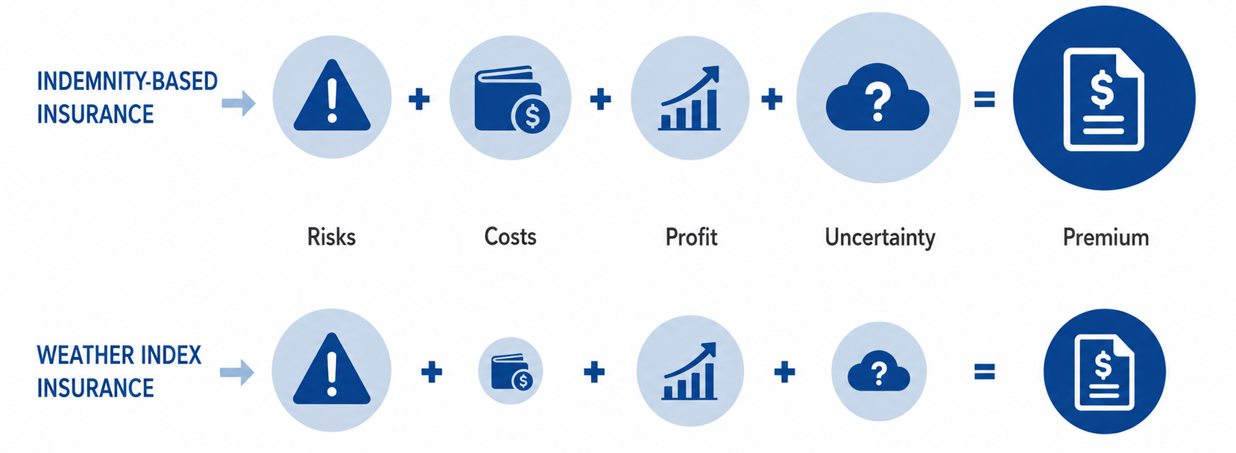
Indemnity Based Crop Insurance vs Weather Index Insurance
Notes:
1. In both products Premium is the sum of risks, costs, profit and uncertainty
2. Traditional indemnity insurance in Australia has historically faced challenges will limited uptake due to expensive premiums.
3. The insurer has high operating costs and uncertainty due to sending loss adjusters, assessment of individual farm damage, and management of lengthy administration processes.
4. WII reduces both operating cost and uncertainty because payouts are triggered automatically using independently verified weather data.
5. Consequently WII offers a more affordable and accessible form of protection for smallholder farmers.

Slide 6
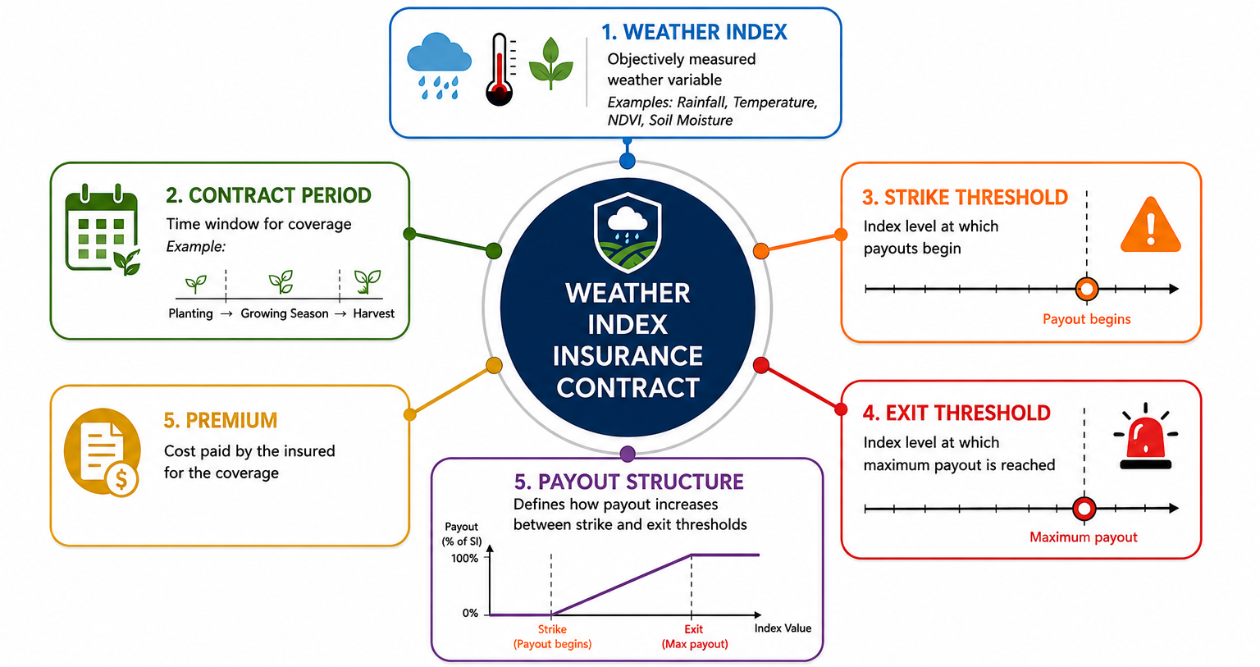
Weather Index Insurance Contract
Notes:
Now might be good point to talk about some key terminology and parameters of a WII contract, which I will refer to throughout this presentation
There are 6 key parameters of a WII product.

Slide 7
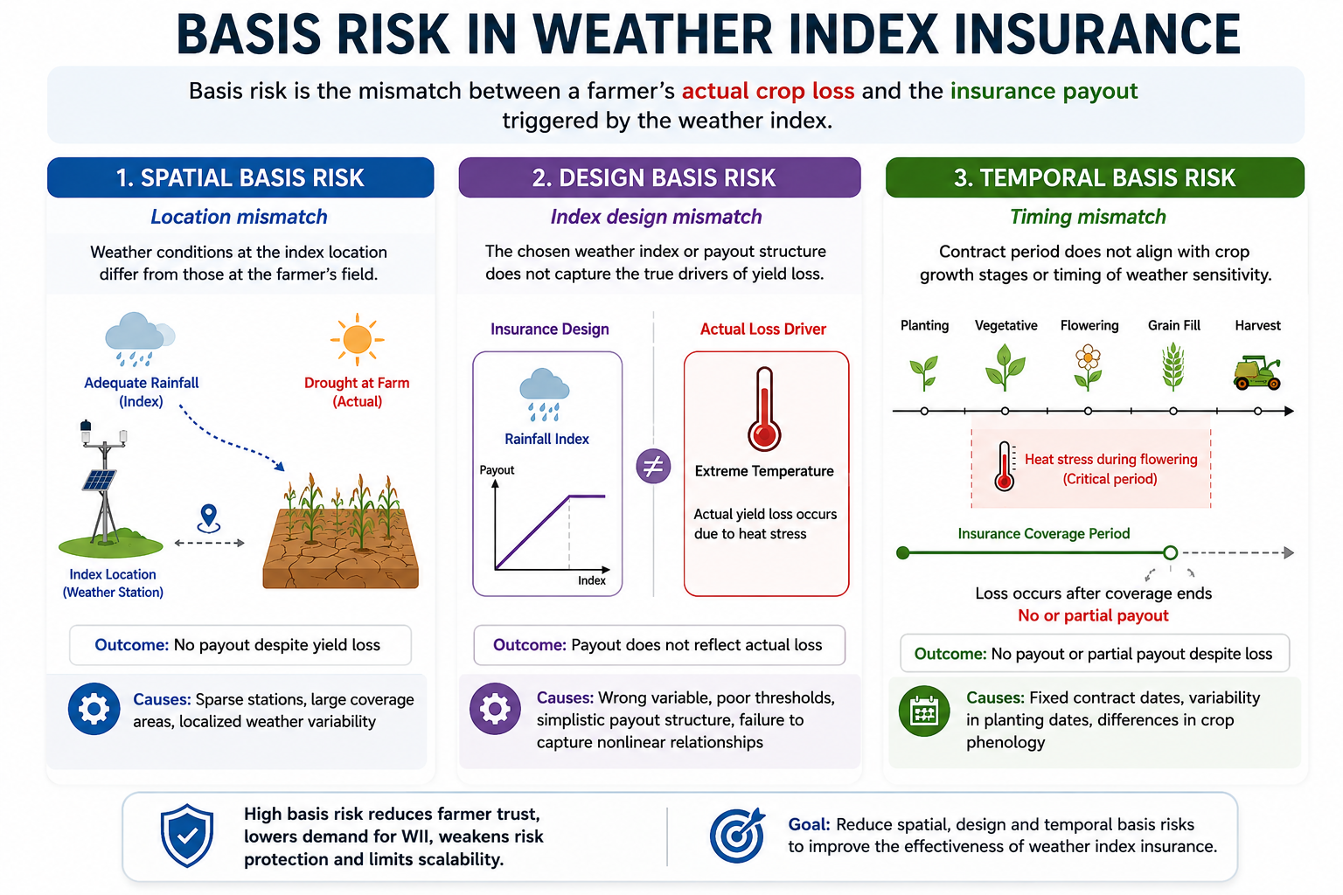
The Problem: Basis Risk
Notes:
One of the greatest challenges in WII is something called basis risk — this is the difference between the farmer’s actual crop yield loss and the payout from the WII contract.
There are three major forms of basis risk.
1) First, spatial basis risk occurs when the weather recorded by the weather station or remote sensing index does not reflect the actual conditions at the farm.

Slide 8
The Problem: Basis Risk
Notes:
2) Second, design basis risk occurs when the insurance index itself does not fully capture the true drivers of crop loss.
For example, a rainfall index may be used in a drought region which is better suited to a temperature index.

Slide 9
The Problem: Basis Risk
Notes:
3) Lastly Temporal basis risk occurs when the timing of the insurance contract does not align with the crop’s actual growth stages and periods of weather sensitivity.
This is the least investigated in the literature and research. And actually the core focus of this research.

Slide 10
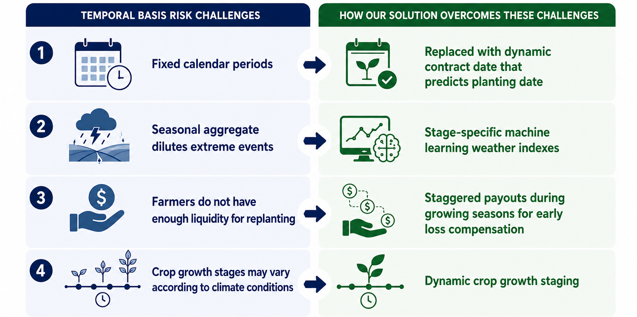
Can insurance be redesigned around crop phenology?
Notes:
The problem statement we will answer is: Can insurance be redesigned around crop phenology?
We will develop a hybrid WII to resolve these challenges.
3. The first challenge is fixed calendar periods. Farmers don’t plant on the same date every year, yet traditional insurance assumes they do.
Our solution replaces fixed contract dates with dynamic planting-dates predicted by machine learning, aligning coverage with the actual growing season.
4 Second, seasonal aggregate indexes can hide short but catastrophic extreme events.
A single heatwave during flowering can destroy yield, even if the overall season looks ‘normal’.
To overcome this, we introduce stage-specific machine learning weather indexes that capture climate sensisitvities related to each crop growth stage.
5. Third, farmers often receive payouts too late. End-of-season compensation may not provide enough liquidity for replanting or recovery during the season. Our framework introduces staggered in-season payouts, delivering earlier financial support when it is needed most.
6. And finally, crop growth stages themselves vary depending on weather and climate conditions.
Fixed-stage insurance windows therefore create major temporal mismatches.
To address this, we dynamically model crop growth stages using planting date, maturity group, and growing degree days.
6. Together, these innovations fundamentally redesign weather index insurance to better
align with real crop development, real climate variability, and real farmer needs.

Slide 11
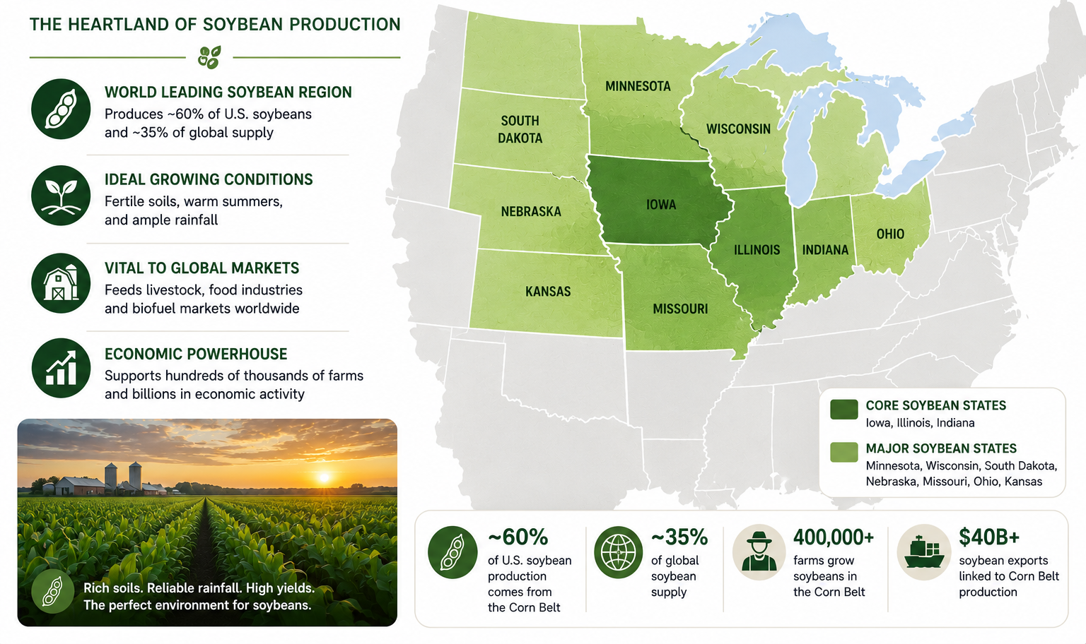
USA Corn Belt Region
Notes:
1. The United States Corn Belt was selected as the study region because it is often considered one of the most fertile regions in the world
2. The region provides an ideal environment to study weather index insurance due to its
strong climate sensitivity,
synchronized growing seasons, and
exceptionally rich and granular datasets.
4. This level of data availability is critical for developing and rigorously testing advanced machine learning models.
5. In contrast, Australia has far greater geographic and climatic heterogeneity, with more dispersed cropping regions and less consistent large-scale yield and weather datasets.
6. Therefore, the US Corn Belt provides a stronger environment for methodological testing before adapting these frameworks to regions such as Australia.

Slide 12
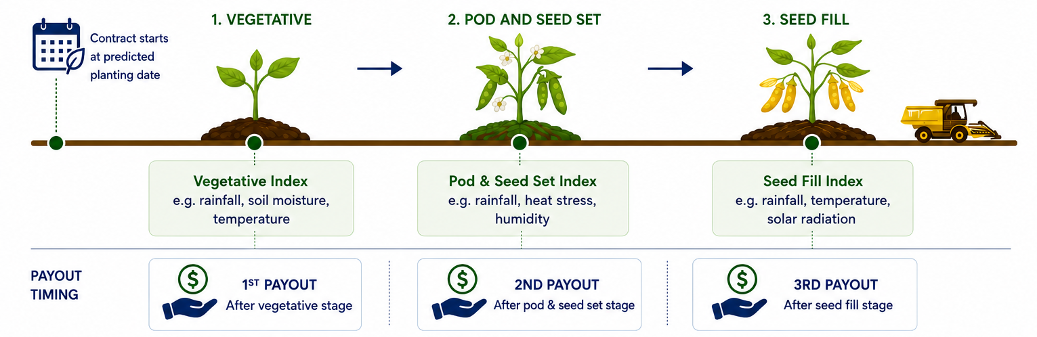
Proposed Hybrid Weather Index Insurance
Notes:
This is a visual representation of our proposed hybrid WII design for soybeans in the corn belt region.
The soybean growing season is divided into three phenological stages: vegetative (VE to V6), pod & seed set (R1 to R4), and seed fill (R5 to R6).
The planting date is predicted by a machine learning model using preseason climate indicators
Crop stage duration are also dynamically determined (using a combination of soybean maturity group classification, predicted planting dates, and GDD
Rather than an aggregate index: Weather indexes are developed for each crop growth stage to align with the specific physiological factors most sensitive during that stage.
Optimal strike and exit thresholds are defined for each stage, and a staggered payout structure is designed.

Slide 13
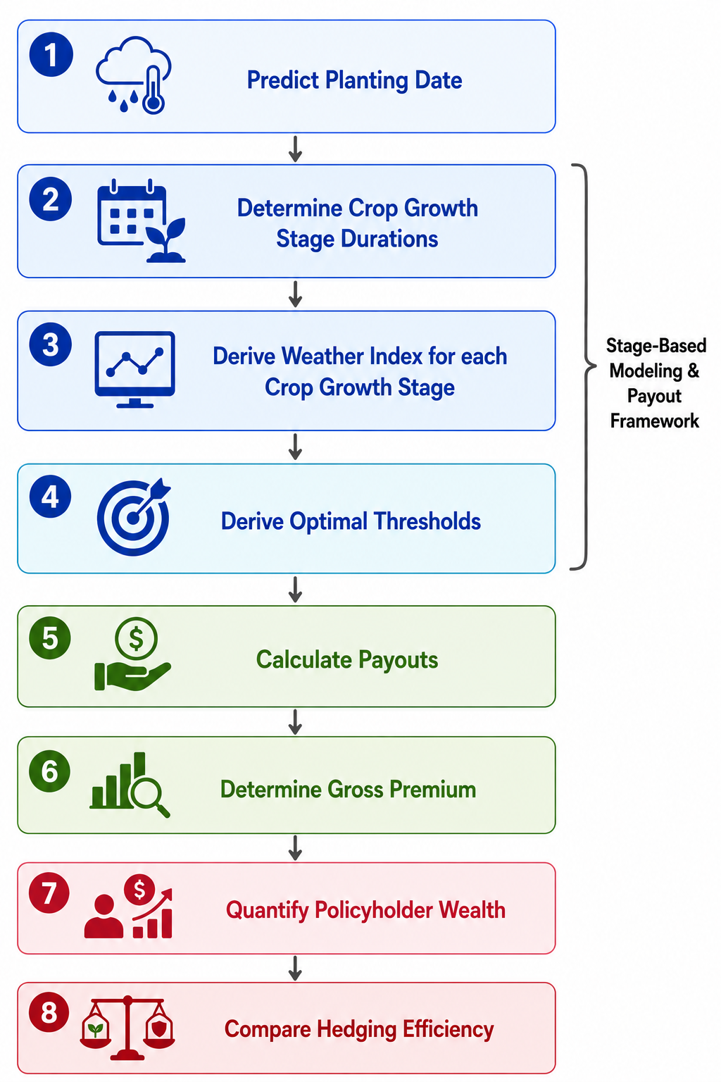
Methodology Framework
Notes:
Our methodology develops a stage-based WII model designed specifically around soybean crop phenology.
First 2 steps focus on aligning WII contract parameters for Soybean biology and crop phenology
Next 2 stages develop key parameters
Once we have key parameters we then determine premium
Lastly evaluate the model

Slide 14
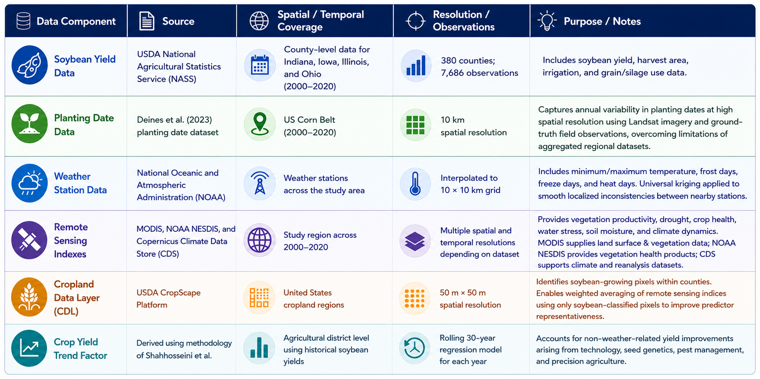
Data
Notes:
Here is a summary of the Data used for this research. In the interest of time I won’t be going through this in detail.
1. This slide summarises the multi-source dataset used to develop the proposed phenology-based weather index insurance framework.
2. It combines soybean yield data (county), planting date information (10km), weather station observations, remote sensing products, and cropland mapping across the U.S. Corn Belt to capture both the spatial and temporal dynamics of crop growth and climate risk.
A linear regression model was fitted using the previous 30 years of yield data, and the predicted value for each year was used as the crop yield trend factor.

Slide 15
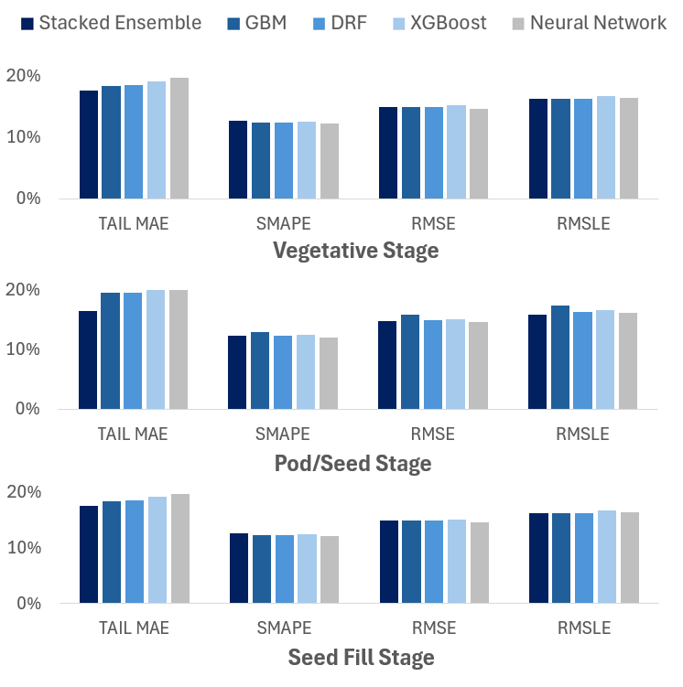
Machine Learning Framework
      Goal: Predict yield separately for each stage.
      Separate machine learning models developed for each crop growth stage.
      • GBM
      • Random Forest
      • Neural Networks
      • Stacked Ensemble
      Stage-specific modelling captures the unique climate sensitivities occurring throughout crop development
Notes:
First we will have a look at the creation of the weather index
1. “For each crop growth stage — vegetative, pod and seed set, and seed fill — separate machine learning models were developed using only the data available within that specific stage. This allowed the models to capture the unique climate sensitivities that occur throughout crop development.
2. Multiple machine learning approaches were tested.
3. The stacked ensemble model delivered the strongest overall performance by combining the strengths of different algorithms.
4. Importantly, the focus was not just average prediction accuracy. Since insurance payouts occur during bad years, a specialised Tail MAE metric was developed to specifically evaluate performance in the lower-yield tail.
5. From an insurance perspective, accurately predicting extreme losses matters far more than performing well in average seasons.”

Slide 16
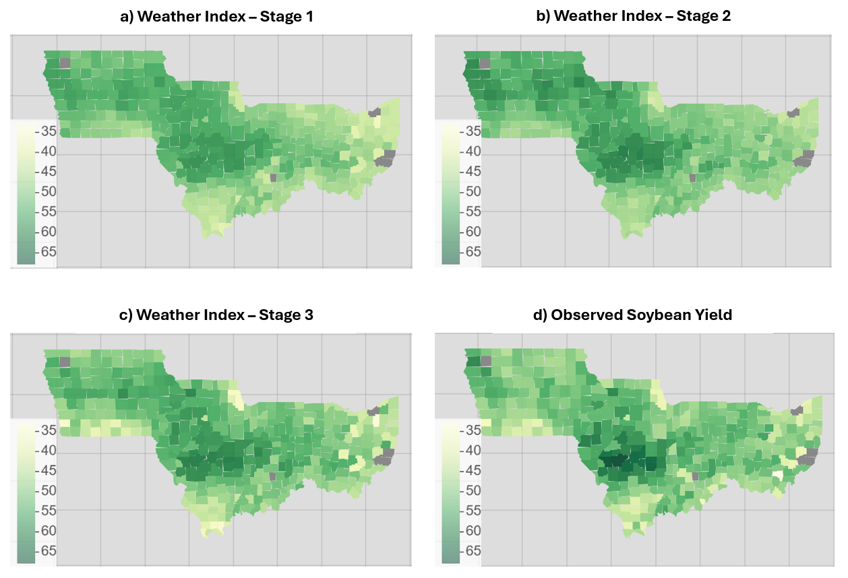
How Early Can We Predict Crop Loss?
Weather Index – Stage 1
Weather Index – Stage 2
Weather Index – Stage 3
Observed Soybean Yield
Notes:
1. “This figure shows how the stage-based weather index models track soybean yield throughout the growing season.
2. Figures on the top panel represent predictions of crop yield from stages 1, 2, and 3, while Figure on the bottom panel shows the actual harvested yield.
3. These results use unseen holdout data, demonstrating how well the models generalise to real-world conditions.
4. We can clearly see higher yields in central Illinois and lower yields across southern Illinois, southern Iowa, and eastern Ohio.
5. As expected, the stage 3 model — closest to harvest — provides the strongest alignment with final crop yield.
6. But importantly, even the early-stage model is already able to identify regions likely to experience poor yields.
7. This demonstrates the value of stage-specific forecasting and highlights how early-season weather signals can support earlier and more targeted insurance payouts.”

Slide 17
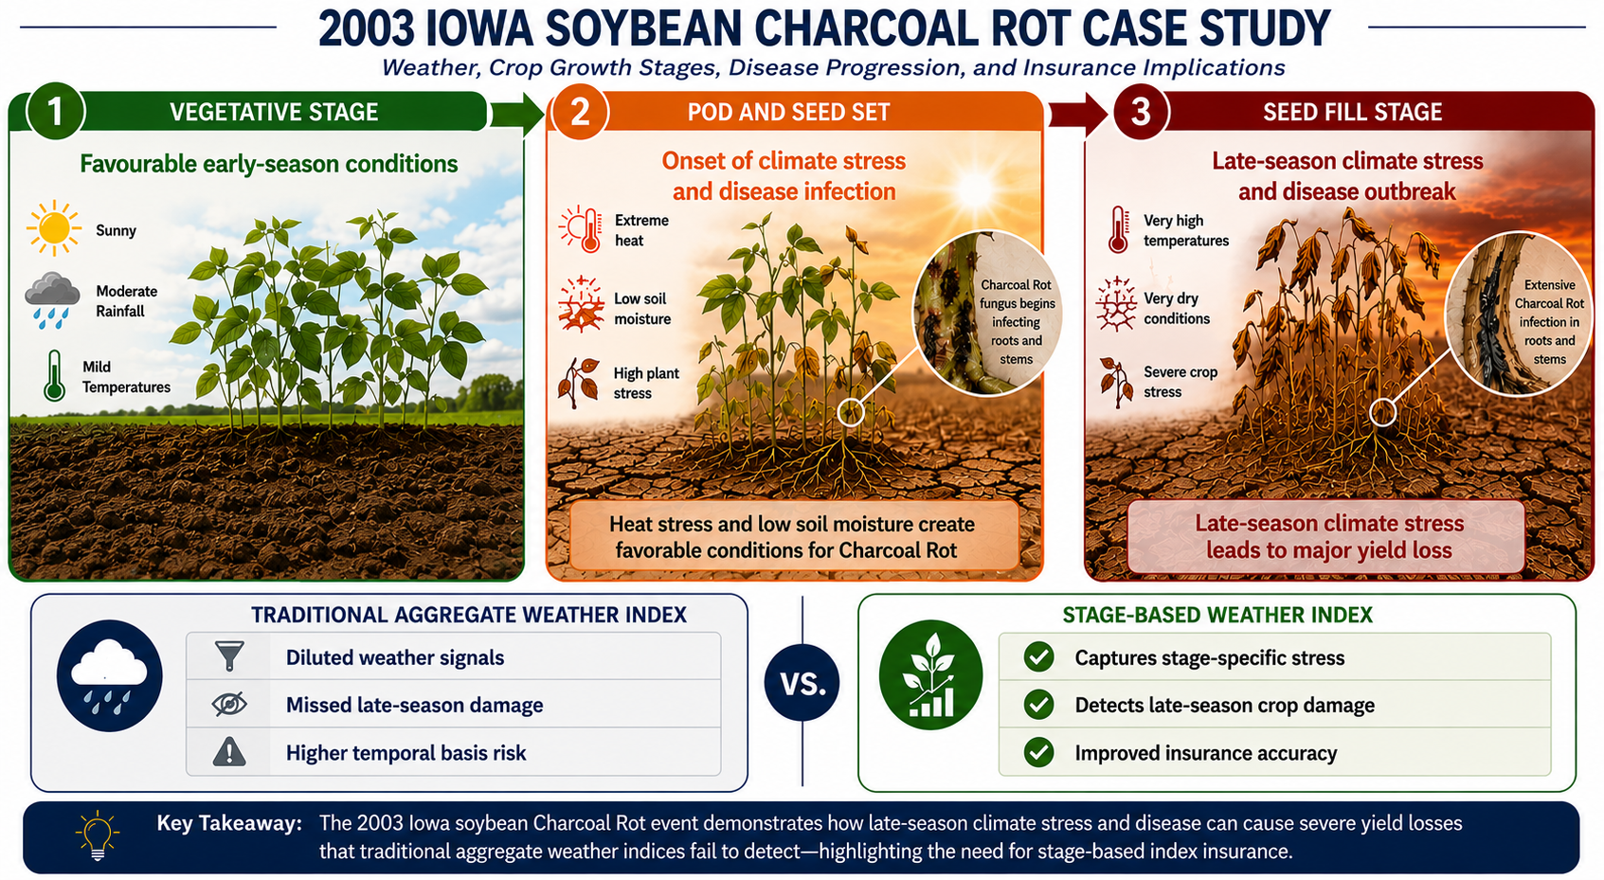
Case Study: Charcoal Rot Disease Outbreak (Iowa)
Notes:
1. When looking at our crop yield predictions over 20 years from 2000 to 2020 an interesting case study was during the 2003 growing season in Iowa
2. The beginning of the growing season was very promising with favourable rainfall and temperature.
3. However during the next reproductive stage of crop growth, where where pods and seeds are forming, extreme heat emerged.
4. Those conditions triggered widespread plant stress and created an ideal environment for Charcoal Rot disease development in the roots and stems.
5. By the seed fill stage, up to 80% of fields reported the disease with many soybean plants experiencing premature death before full seed development.
6. For farmers, this meant substantial financial stress. Many producers entered the season expecting strong yields, only to experience severe late-season losses.
7. Traditional aggregate indexes diluted weather conditions across the entire season. The favourable early-season conditions offseted the catastrophic late-season stress.
8. In contrast, our proposed stage-based model was able to isolate the climate sensitivity of each crop growth stage separately.
9. By aligning the weather index to crop phenology - It captured when the stress occurs, not just how much stress occurs.
10. This enabled improving payout accuracy and significantly reducing temporal basis risk.

Slide 18
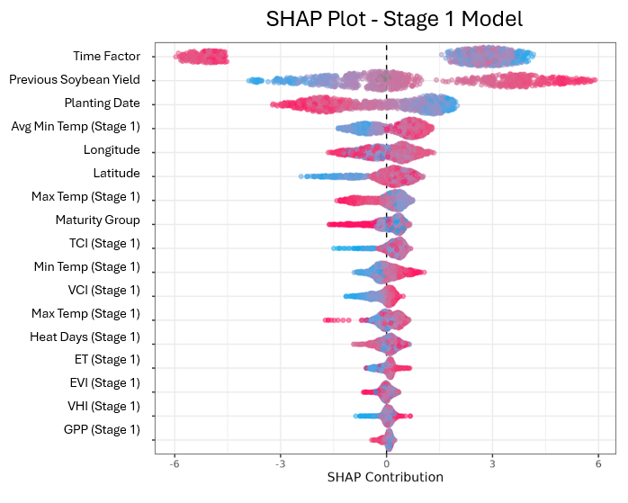
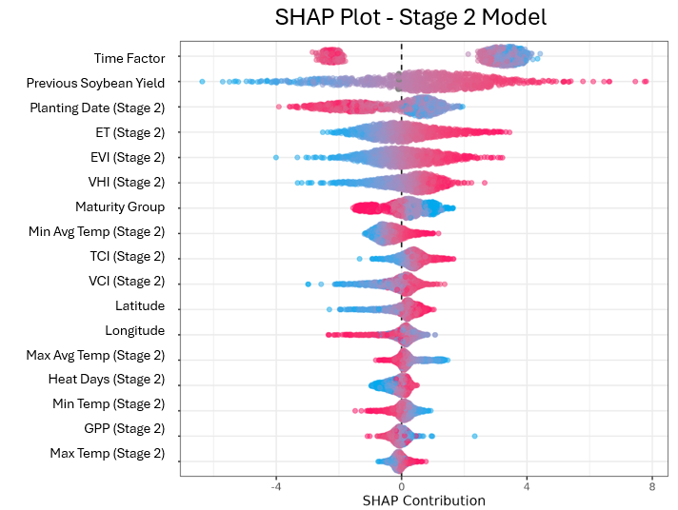
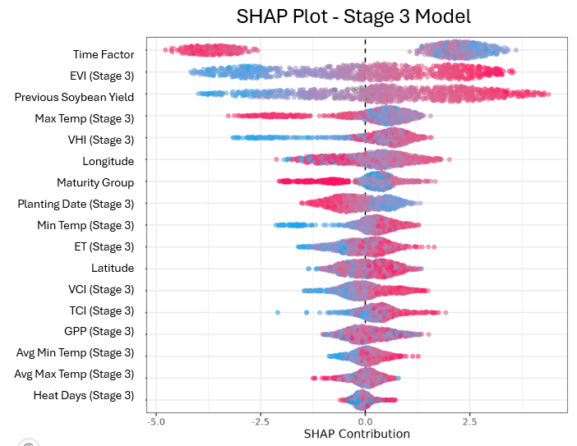
SHAP validates biologically meaningful predictors
Stage 1: Minimum temperature dominates due to its importance for germination and early crop establishment. Vegetation indices remain weak due to sparse canopy and soil background.
Stage 2: Evapotranspiration becomes most important as crop water demand peaks during reproductive growth.
Stage 3: Enhanced Vegetation Index (EVI) is the strongest predictor, capturing canopy vigour and biomass during seed fill.
Notes:
We used explainability tool like SHAP to determine if the three machine learning models produced biologically meaningful predictors, that are consistent with the climate sensitivity of each crop growth stage.
1) In Stage 1, minimum temperature dominated because early germination and crop establishment are highly sensitive to cooler conditions.
At this stage, vegetation indexes remain relatively weak because the crop canopy is still sparse and much of the satellite signal is influenced by bare soil.
2) In Stage 2, evapotranspiration became the most important predictor as crop water demand peaks during reproductive growth and pod formation.
3) And by Stage 3, Enhanced Vegetation Index — or EVI — emerged as the strongest predictor, reflecting canopy vigour, biomass accumulation, and crop health during seed fill.
So these insights strongly align with established biological understanding of soybean development.

Slide 19
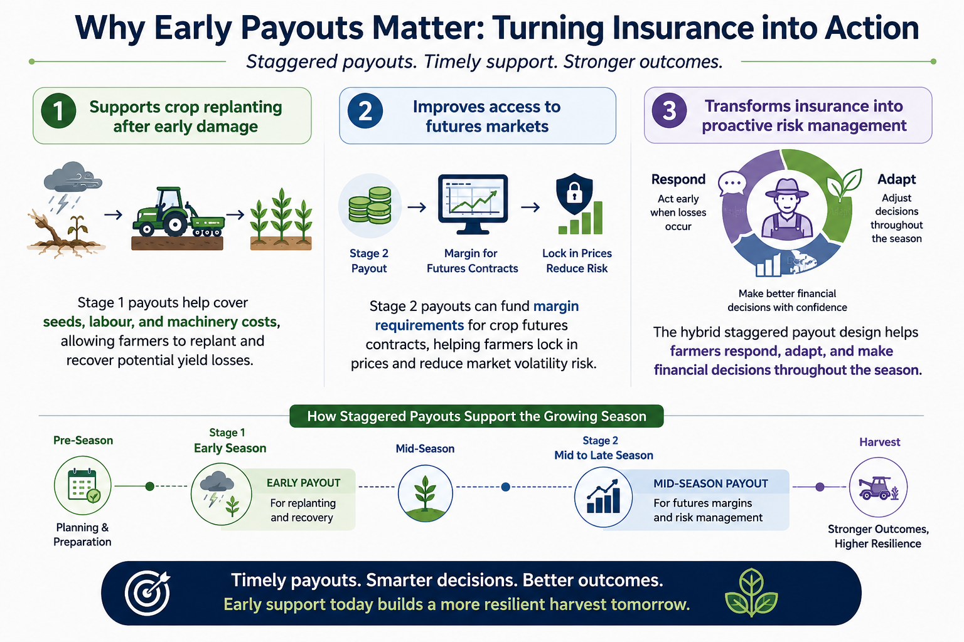
Why Early Payouts Matter: Turning Insurance into Action
Notes:
Now that we have looked at the weather index, we will move onto the payout.
1. Unlike traditional insurance that only pays after harvest, our hybrid WII product provides staggered early payouts.
2. This design provides farmers with liquidity during the growing season, when financial support is needed most.
3. The first major benefit is the replanting benefit.
- If severe weather occurs during the early vegetative stage, farmers can receive an immediate payout for replanting.
- This helps overcome liquidity constraints associated with seeds, labour, and machinery costs, giving farmers an opportunity to recover part of the lost yield if later-season conditions improve.
4. The second benefit is the futures benefit.
- Mid-season payouts can help farmers access crop futures markets by covering the upfront margin requirements needed to enter futures contracts.
- This enables farmers to lock in crop prices earlier and reduce exposure to price volatility, particularly during seasons with high climate uncertainty.
5. Overall, these early payouts transform Weather Index Insurance from a passive compensation tool into an active risk management strategy.
6. This helps farmers respond, recover, and make better financial decisions throughout the growing season rather than at harvest.

Slide 20
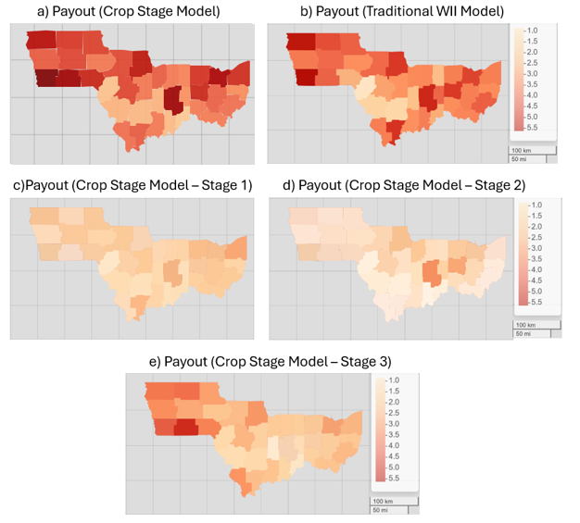
Why Early Payouts Matter: Turning Insurance into Action
The proposed WII product with staggered payouts delivered greater financial benefits to policyholders overall
The staggered payout mechanism improved both the responsiveness and the adequacy of compensation
Payouts in stages 1 and stage 2 are smaller, given that the strike thresholds have intentionally been chosen to be lower.
Notes:
1. Now we compare payout from traditional WII model with the proposed hybrid WII model on hold out data
2. The hybrid WI has delivered greater financial benefits overall.
3. The payout from the hybrid model is based on payouts at each stage
4. It’s evident that most of payouts are from stage 3, however payouts are also provided for early replanting and investment in futures.
5. The strike and exit threshold for stage 1 and stage 2 were on purpose selected to lower
> to reflect the fact that replanting would only happen if there was widespread crop mortality.

Slide 21
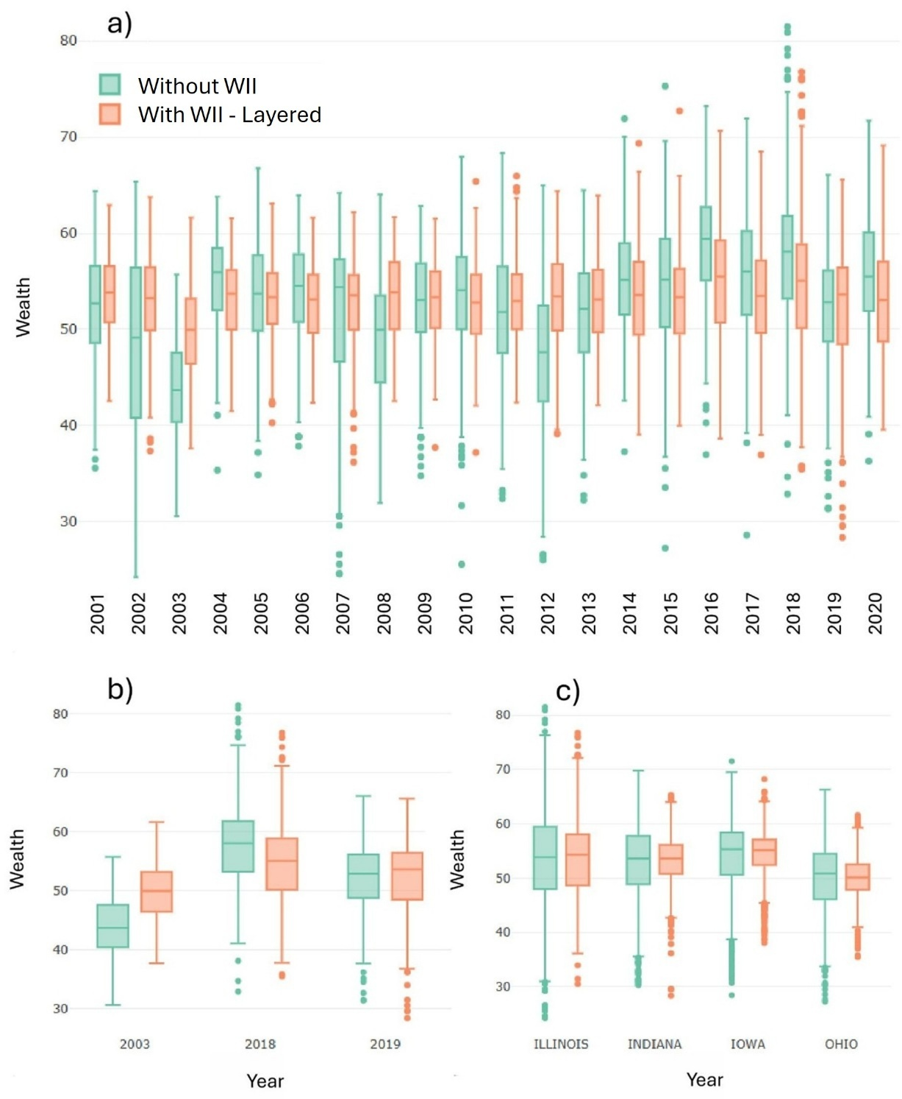
Wealth Over Time
Notes:
Now we will evaluate the model.
1. The final wealth of the policyholder is determined as the sum of WII payouts, insurance premium deductions, and any additional benefits from replanting or investment in futures.
2. The green boxplots show farmer wealth without insurance, and we can clearly see large swings in financial outcomes over time.
3. During severe climate years like 2002, 2003, and 2012, some farmers experienced extremely large losses.
3. But when we introduce the staged Weather Index Insurance product — shown in orange — the story changes dramatically. The wealth distribution becomes far more stable, extreme losses are reduced, and farmers experience much more consistent financial outcomes across the years.
4. What’s especially important is that this stability is achieved without significantly reducing average wealth.
5. In strong agricultural years, farmers only see a very small reduction due to the insurance premium, but in poor climate years, the protection becomes extremely valuable.
5. This figure shows that the staged WII product acts like a financial safety net — smoothing wealth volatility, reducing downside risk, and improving farmer resilience to climate shocks.

Slide 22
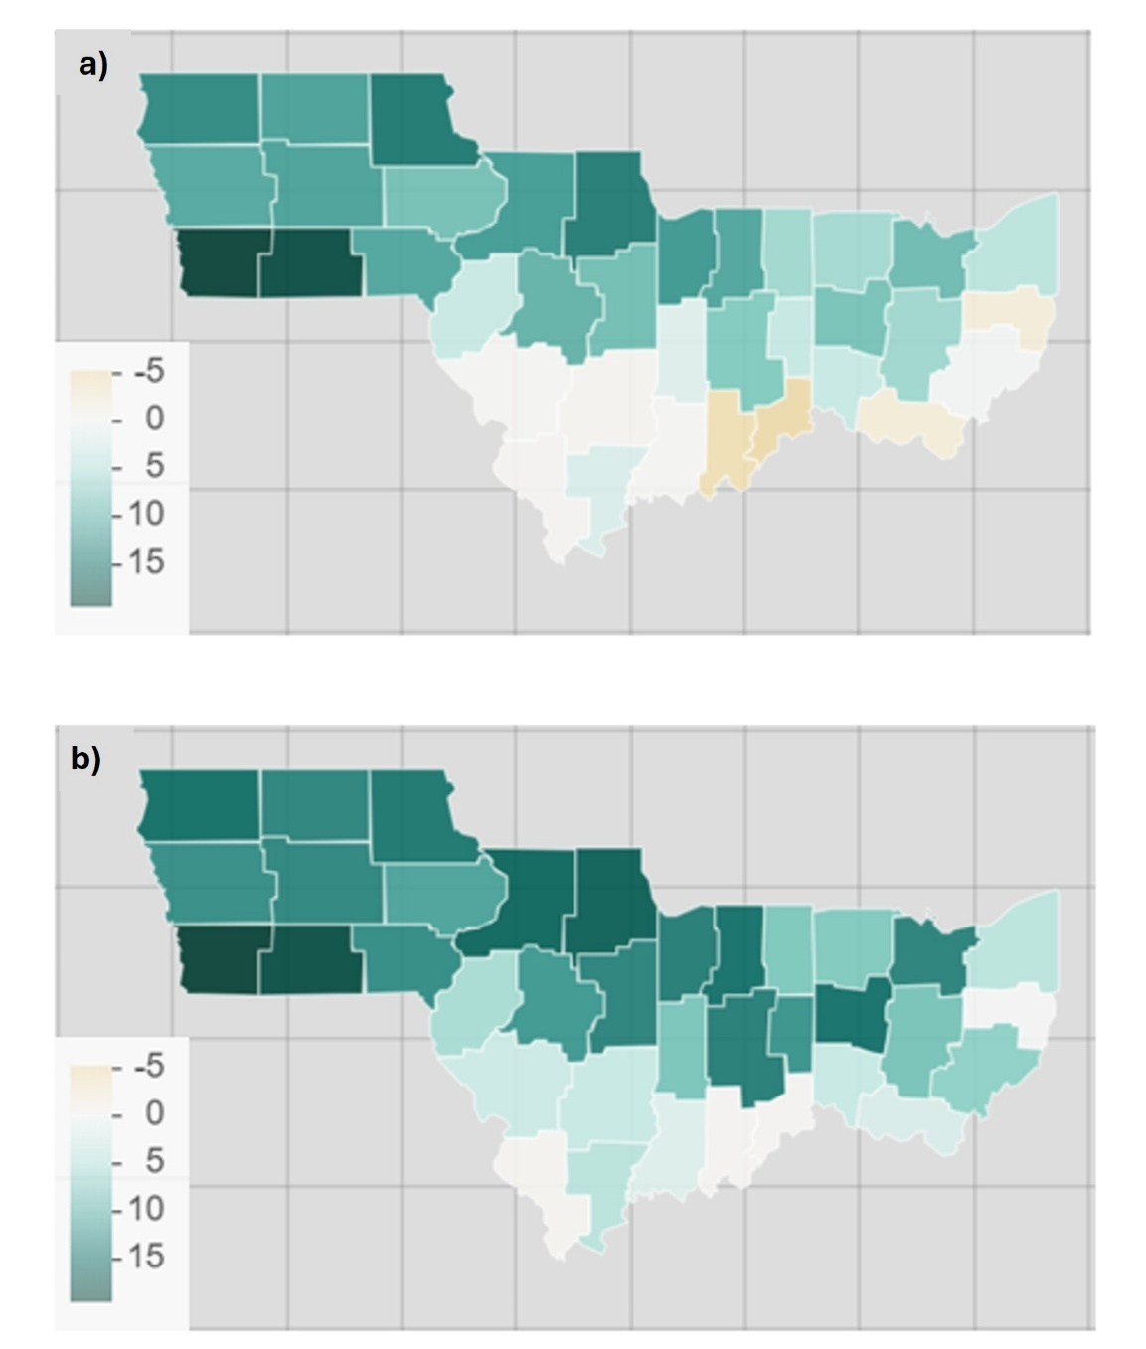
Improved Hedging Efficiency Through Crop-Stage Alignment
Heatmap of risk reduction for a farmer
with Traditional WII
Heatmap of risk reduction for a farmer
with Stage Based WII
Hedging Efficiency is measured by Spectral Risk measure, which considers not only the size and likelihood of losses, but also farmer risk aversion
Notes:
We will continue to evaluate by looking at the hedging efficiency.
1. This figure shows how effectively the proposed stage-based Weather Index Insurance product reduces farmer risk compared to a traditional single-payout insurance model.
2. The analysis uses a spectral risk measure, which considers not only the size and likelihood of losses, but also farmer risk aversion — meaning it focuses on the losses farmers care about most.
3. What stands out is that the stage-based model delivers stronger risk reduction across key soybean regions, particularly in Indiana, Ohio, and Illinois.
4. In fact, while the traditional WII product actually increased risk in nine districts due to temporal basis risk, the stage-based model reduced risk in every district.
5. Perhaps these regions had early plant mortality, but due to later favourable conditions had no compensation
6. This highlights the advantage of aligning insurance payouts with crop growth stages, allowing the model to better capture stage-specific weather stress and provide more reliable financial protection for farmers.

Slide 23
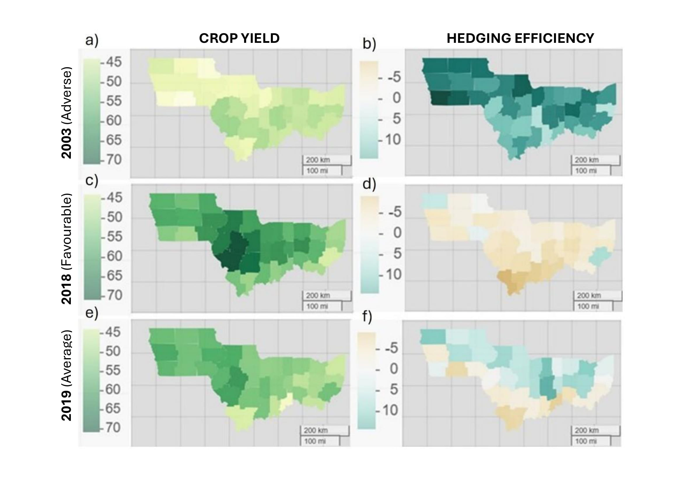
From Drought to Flooding: How the WII Product Performs
2003
(Severe drought)
2018
(Favourable conditions)
2019
(Delayed planting due to flooding)
Notes:
We will do a deeper dive into the hedging efficiency by looking at each hold out years.
1. This figure presents how the stage-based Weather Index Insurance product performs under very different climate conditions across the holdout years.
2. In 2003, severe drought caused major soybean yield losses across the study region. The insurance product responded strongly, triggering payouts across all districts and delivering substantial risk reduction — reaching up to 20% in Iowa.
3. In contrast, 2018 was a very favourable growing season with high yields, especially in central Illinois. Because farmers experienced minimal losses, the WII product made very few payouts, which is exactly what we would expect from a well-designed insurance system.
4. The most interesting case is 2019, when excessive rainfall and flooding delayed planting across the region.
- However, later-season weather improved, so yield impacts varied between districts.
The stage-based model successfully captured these regional differences
— triggering payouts mainly in the northern districts where yields remained below average, while avoiding unnecessary payouts in areas that recovered later in the season.
5. Overall, this figure demonstrates that the staged WII product can adapt to very different climate scenarios and provide targeted financial protection when and where farmers actually need it most.”

Slide 24
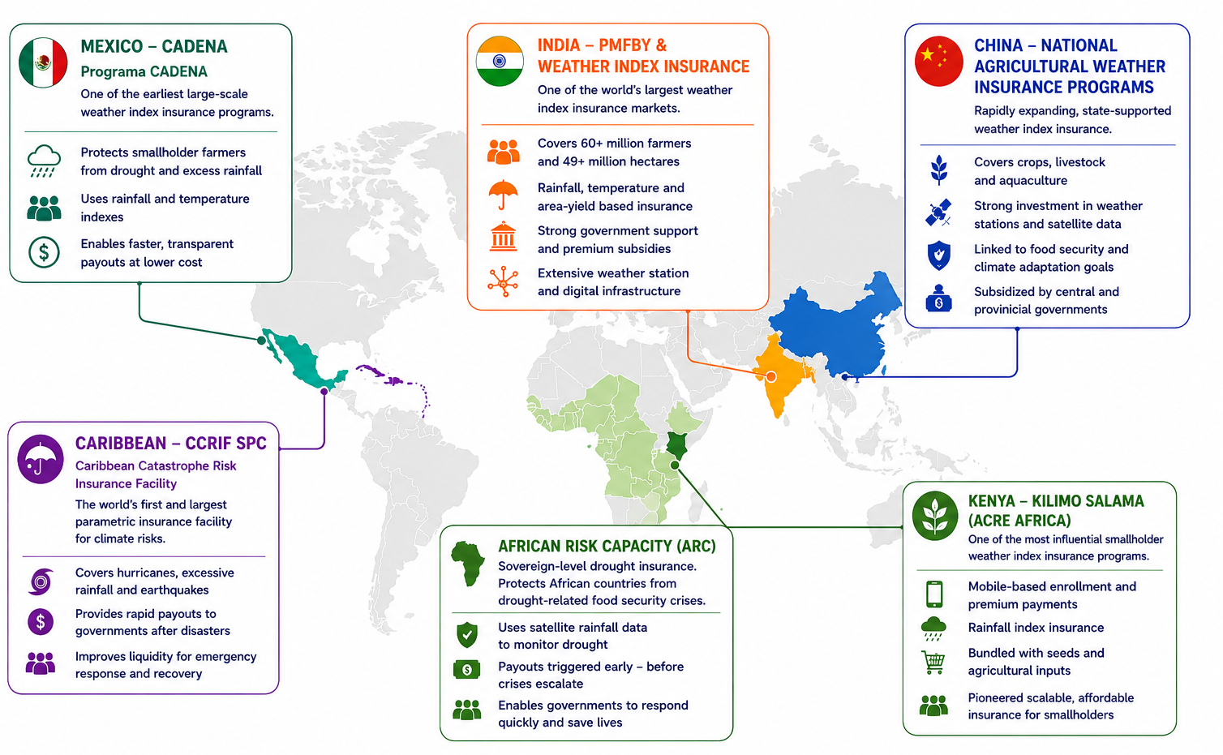
Global Weather Index Insurance Programs
Notes:
This map shows that WII has evolved very differently around the world depending on climate risk, government policy, and agricultural systems.
The largest and most innovative WII programs often emerged not in the richest agricultural markets — but in regions where traditional insurance simply struggled to work.
1. Let’s start with India.
India is now considered one of the world’s largest WII markets, insuring millions of farmers against drought and monsoon, backed by strong government support and integrated into national agricultural policy.
2. In China rather than focusing only on drought, China expanded weather insurance across crops, livestock, and even aquaculture.
3. Now if we move to Africa, the story becomes even more fascinating.
- African Risk Capacity — or ARC — is not really farmer insurance at all.
- It is sovereign-level weather index insurance.
- Governments themselves are insured against drought.
- If severe drought conditions emerge, payouts are triggered early so governments can respond before food crises escalate.
4. At the farmer level, one of the most influential programs globally was Kilimo Salama in Kenya.
- This program transformed how weather index insurance could be distributed.
- Farmers could enrol using mobile phones, insurance was bundled with seeds and fertiliser purchases, and payouts were triggered automatically from rainfall data.
- It showed that weather index insurance could scale among smallholder farmers using digital technology.
- There are still challenges of low farmer trust and financial literacy
5. Other programs includes Mexico and Carribean.
6. Now what’s particularly interesting is that WII actually developed more slowly in some mature agricultural markets.
Lets take the United States.
The US already has an enormous federally subsidised multi-peril crop insurance system through the USDA. However adoption of WII has potential to reduce these extensive government subsidies.
Australia is also another interesting example where AIIis still in emergence.

Slide 25
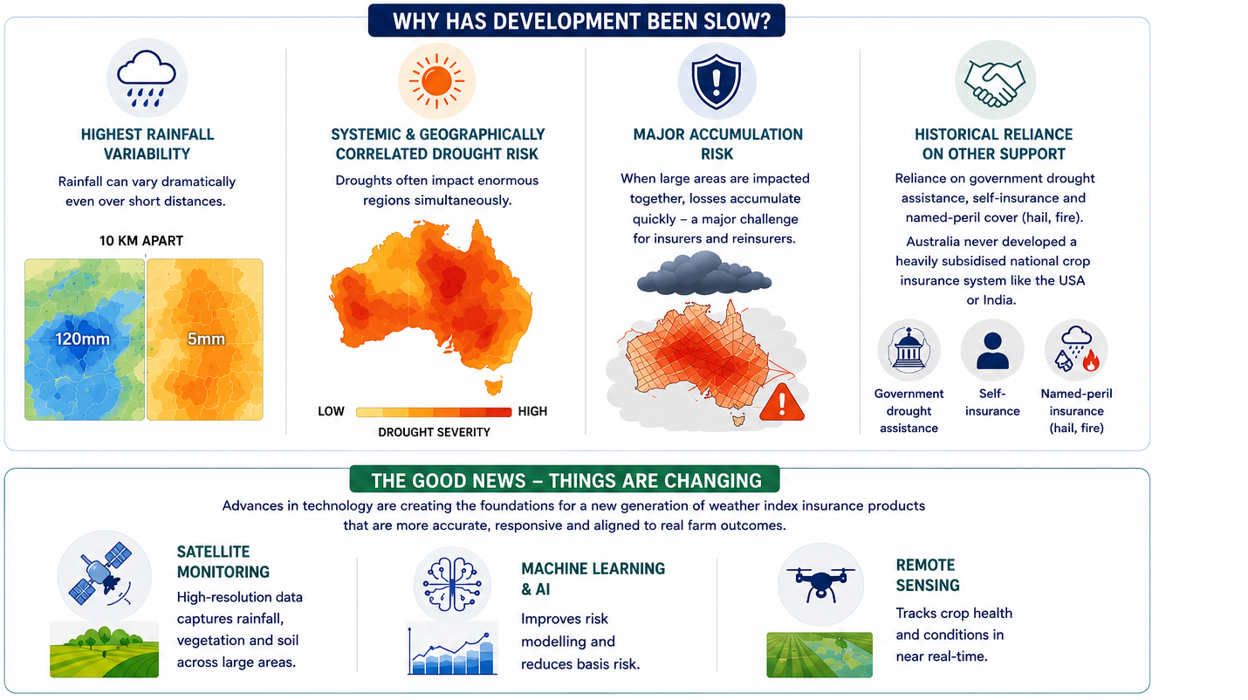
Agricultural Insurance in Australia
Notes:
Agriculture remains a cornerstone of the Australian economy, contributing more than 80 billion dollars annually. Yet commercial development of WII in Australia has historically been slow.
So why is this?
Australia some of the hardest agricultural insurance challenges globally.
1) First, Australia experiences some of the world’s highest rainfall variability.
Rainfall can differ dramatically even across short distances.
For example, in Central West New South Wales, one farming area may receive more than 100 millimetres of rainfall from a storm system, while another property just 10 or 20 kilometres away receives almost nothing.
2) The third challenge is that drought risk in Australia is highly systemic and geographically correlated. We saw this during the millennium drought.
3) For insurers and reinsurers, this creates major accumulation risk because very large losses can occur across huge geographic areas at the same time.
4) Historically, Australia also relied heavily on:
- self-insurance,
- and named-peril products such as hail and fire insurance.
- government drought assistance,
- Programs such as the Farm Household Allowance and Drought Communities Program became major support mechanisms during severe drought periods.
> But today, things are beginning to change due to advances in:
satellite monitoring, remote sensing,
machine learning,
and AI-driven climate analytics

Slide 26
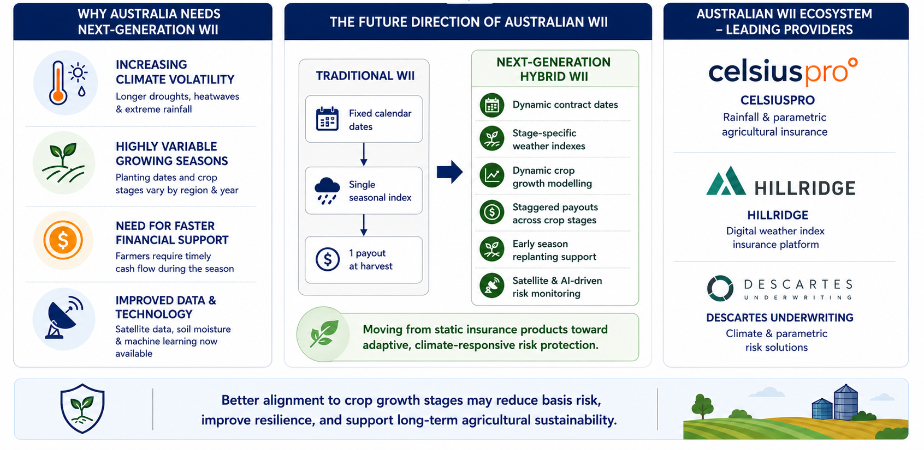
Future of Weather Index Insurance in Australia
Notes:
1. From Seed to Safety is more than a research concept — it is a vision for making agricultural insurance more adaptive, more timely, and ultimately more meaningful for farmers.
2. As we look to the future, WII in Australia is entering a major turning point.
3. For decades, traditional agricultural insurance struggled in Australia because our climate is simply too variable, too geographically diverse, and too exposed to systemic drought risk.
4. But what’s changing now is the data, the technology, and the design philosophy behind insurance itself.
5. There are also other key forces driving change — (4)
6. Agriculture doesn’t work in one single block of time. Crops are biologically dynamic. Risk changes across growth stages. Farmer cash flow needs also change during the season.
7. We’re moving away from these static, one-size-fits-all products… toward dynamic, climate-responsive protection systems.
8. That is why the future lies in next-generation hybrid WII — with dynamic contract dates aligned to planting, stage-specific weather indexes, dynamic crop growth modelling, and staggered payouts across the season.
9. Importantly, early-season payouts can provide immediate support for replanting and resilience.
10. On the right, we can already see the foundations of an emerging Australian WII industry, with organisations such as CelsiusPro, Hillridge, and Descartes actively developing parametric and climate-risk solutions for agriculture.
11. And if designed well, these systems have the potential to reduce basis risk, improve resilience, strengthen rural communities, and help agriculture adapt to an increasingly uncertain climate future.
Thank you for your time today.

Slide 27
Thank you
Actuaries Institute
actuaries.asn.au

